Slide 1


Scalably Scheduling Processes with Arbitrary Speedup Curves
(Better Scheduling in the Dark)
Jeff Edmonds
York University
Kirk Pruhs
University of Pittsburgh
MAPSP 2009

Slide 2
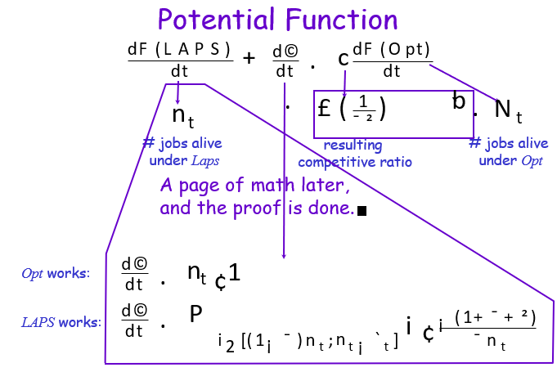
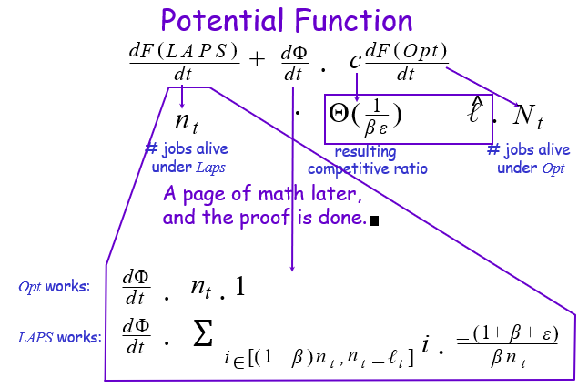

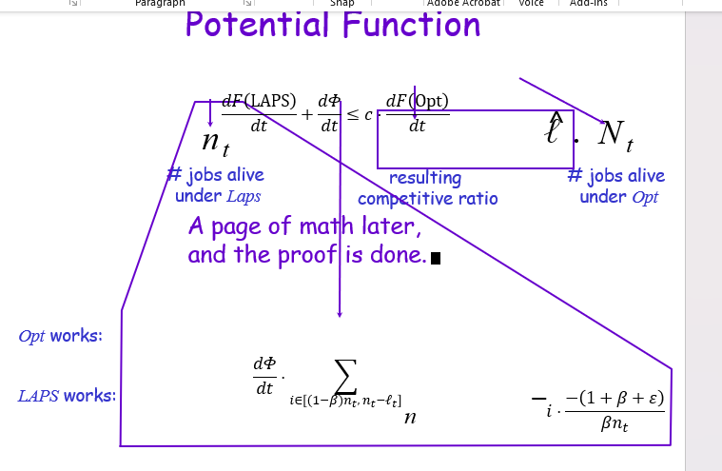
AI Miricle
(TeX4PPT needed for equations in ppt)

Slide 3
Prove Lower Bounds
∀ A_{known} ∃ input I_{known} Time(A_{known},I_{known}) ≥ bad
For each known algorithm A_{known}:
find a bad/counter input I
on which it does badly.
∀ A_{unknown} ∃ input I_{unknown} Time(A_{unknown},I_{unknown}) ≥ bad
Assume the adversary gives you
an arbitrary algorithm A_{unknown}
(you don’t even really know what it is)
What is the range of things A_{unknown} could do?
Hopefully: ∀ A_{unknown} = ∑ A_{known}
Find a bad/counter input I_{unknown}
on which it does badly.
Hopefully: I_{unknown} = ∑ I_{known}

Slide 4
Design New Algorithm
∃ A_{new} ∀ input I_{known} Time(A_{new},I_{known}) ≤ good
First get an algorithm that works for
- all the known bad/counter input examples.
∃ A_{new} ∀ input I_{adv} Time(A_{new},I_{adv}) ≤ good
Assume the adversary gives you
an arbitrary input I_{adv}
(you don’t even really know what it is)
What is the range of things I_{adv} could be?
Hopefully: ∀ I_{adv} = ∑ I_{known}
➔ your algorithm works for all input.
Prove that it does.

Slide 5
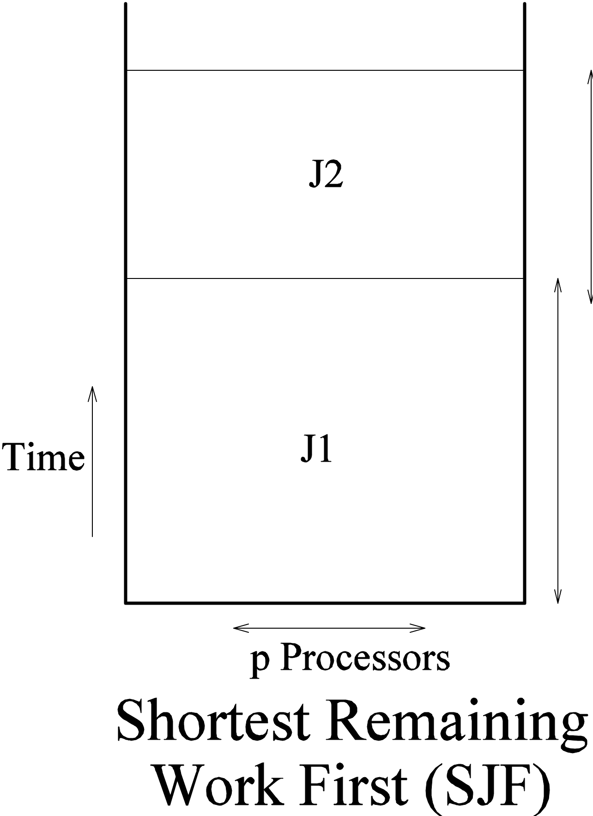
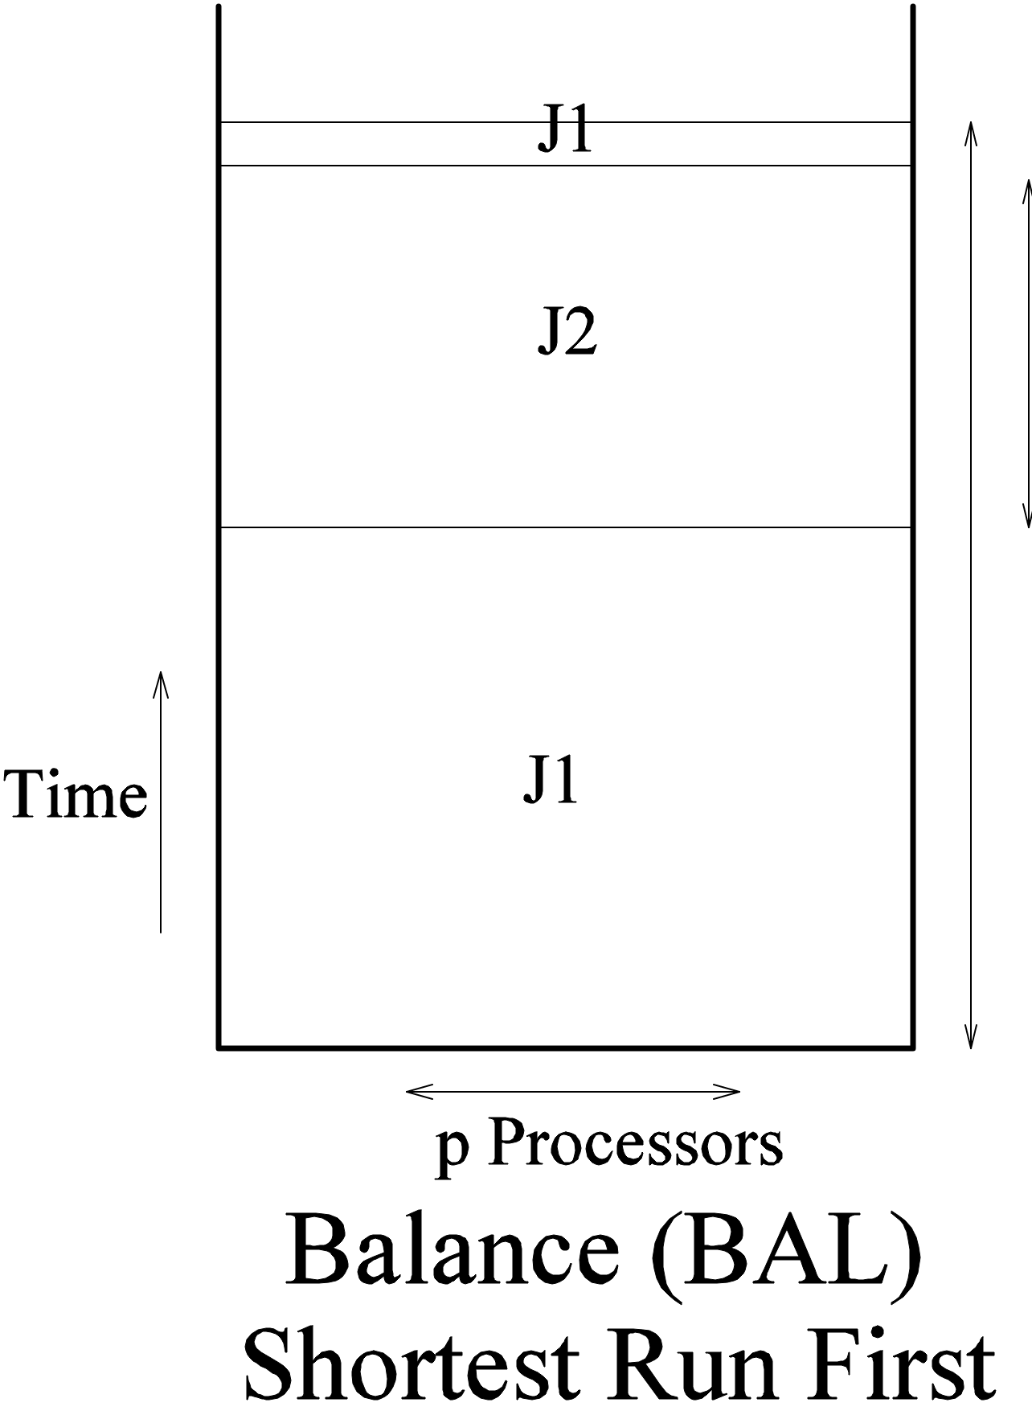
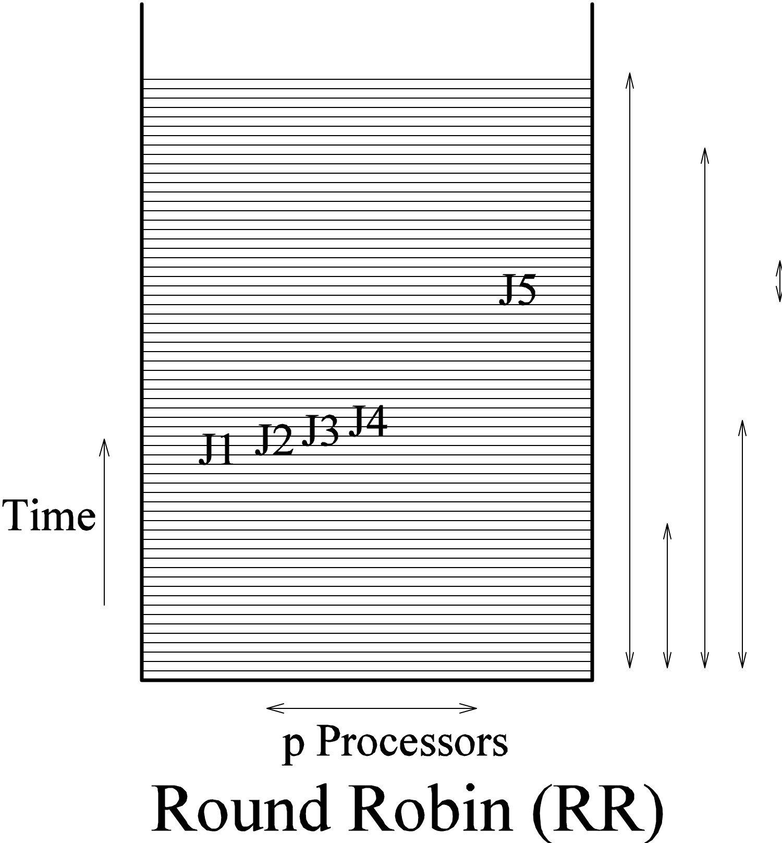
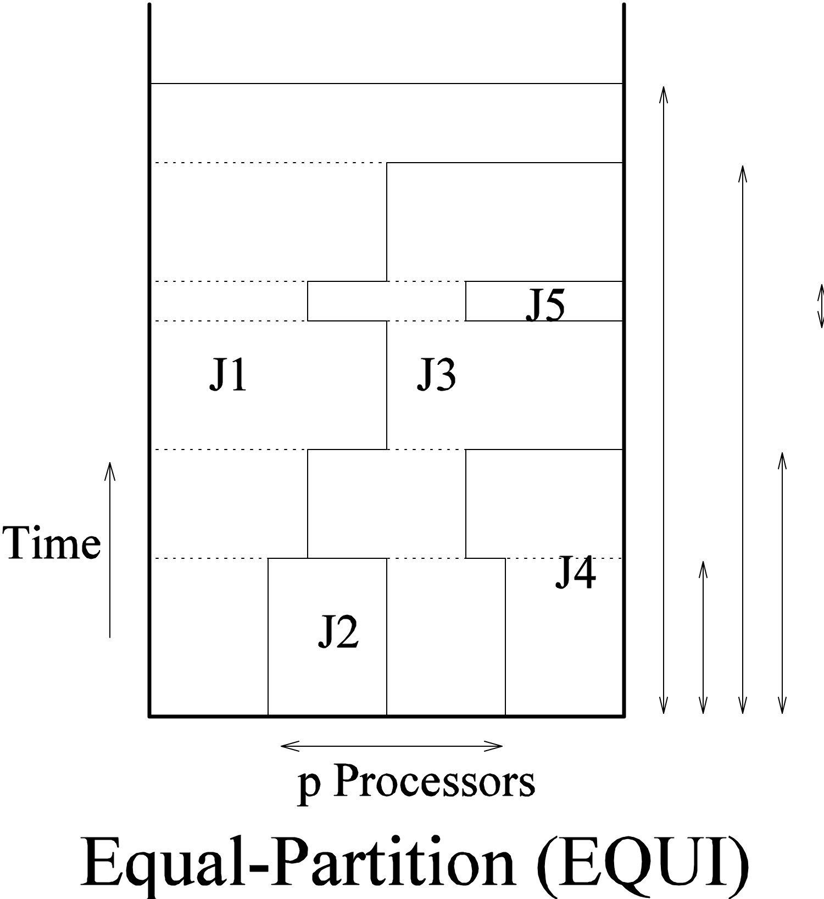
The Scheduling Problem
Allocate p processors to a stream of n jobs:
Shortest Remaining
Processing Time (SRPT)
Shortest Elapsed
Time First (SETF)

Slide 6
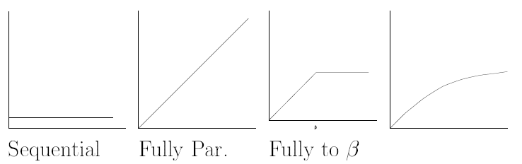
Sublinear Nondecreasing
Speedup Functions
A set of jobs:
Each job has phases:
Each phase:
  Work:
  Speedup function:
    Nondecreasing
    Sublinear
Examples:
J= {J₁,…, J_{n}}
J_{i} = {J_{i}¹,…, J_{i}^{qi}}
J_{i}^{q} = {W_{i}^{q},S_{i}^{q}}
W_{i}^{q}
S_{i}^{q}

Slide 7
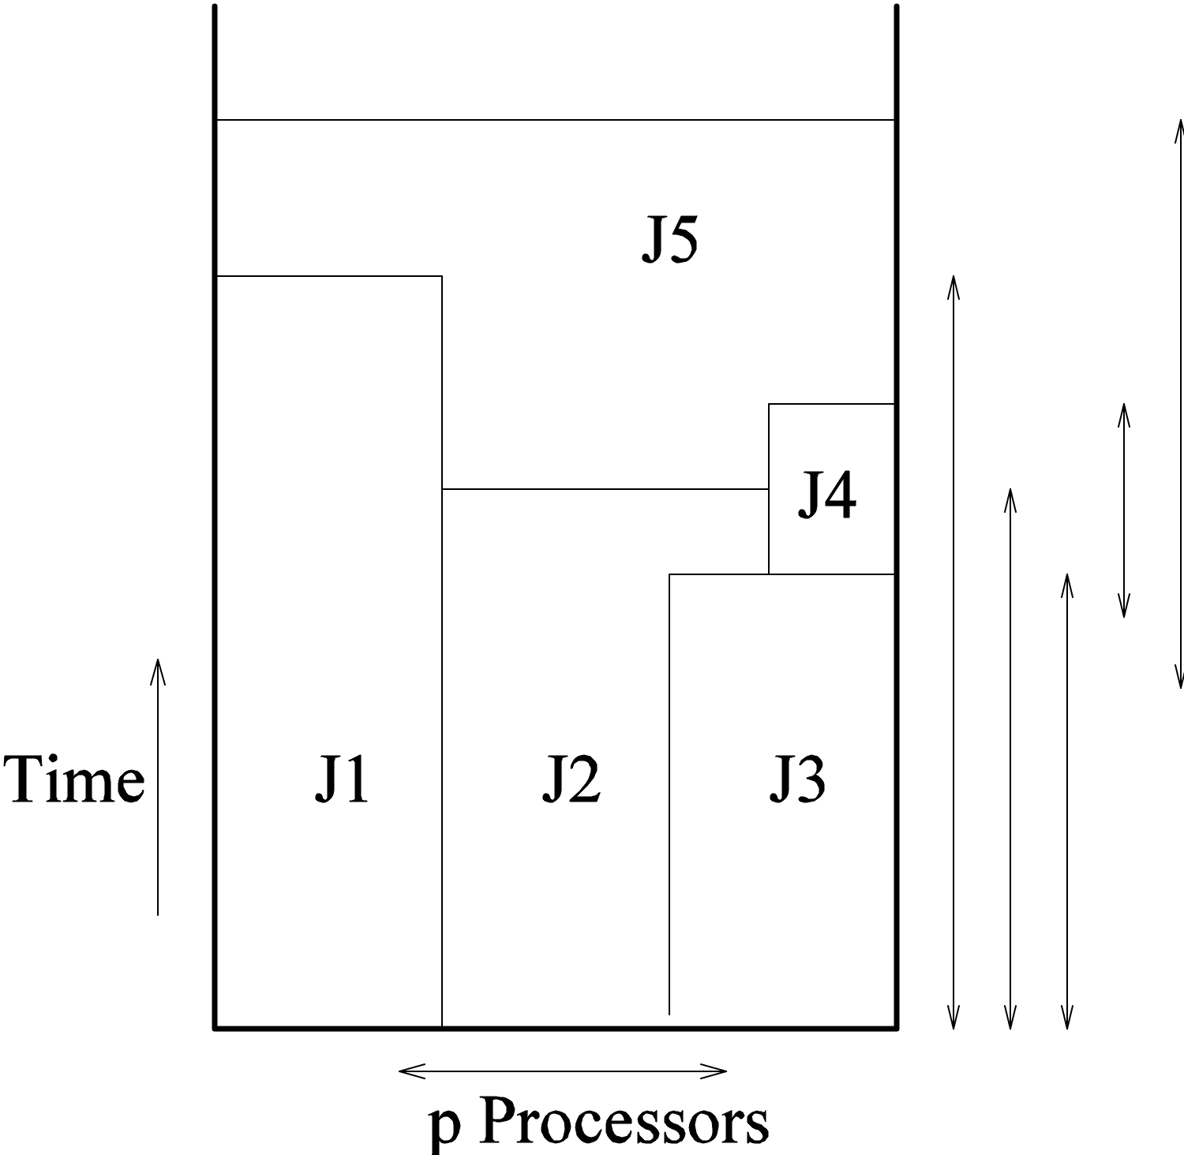

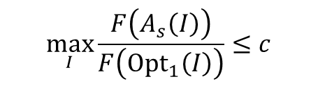
The Scheduling Problem
Allocate p processors to a stream of n jobs:
Measure of Quality:
Competitive Ratio:
$$F\left(A\left(I\right)\right)$$
$$\max_{I}\frac{F\left(A_{s}\left(I\right)\right)}{F\left({Opt}_{1}\left(I\right)\right)}≤c$$

Slide 8



Sublinear Nondecreasing
Speedup Functions
Online
Nonclairvoyant:
Future
?
Optimal:
All Knowing
All Powerful
Not Competitive:

Slide 9
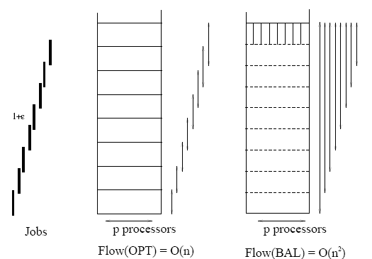
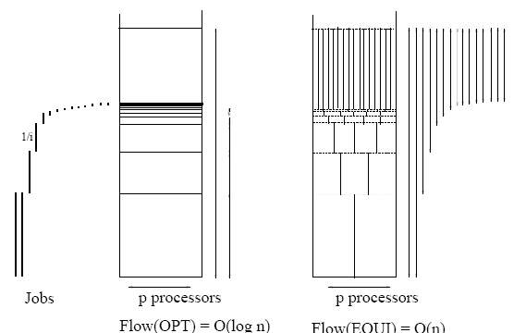
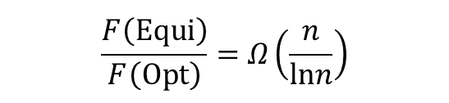




Nonclairvoyant
I
O
$$SETF$$
I
O
t
$$Equi$$
n
p
u
t
p
t
n
p
u
t
p
$$\frac{F\left(SETF\right)}{F\left(Opt\right)}=Ω\left(n\right)$$
$$\frac{F\left(Equi\right)}{F\left(Opt\right)}=Ω​\left(\frac{n}{lnn}\right)$$
$$\frac{F\left(Nonclairvoyant\right)}{F\left(Opt\right)}=Ω\left(\sqrt{n}\right)$$
[MPT]

Slide 10


Performance vs Load
Average
Performance
$$F\left(A\left(I\right)\right)$$
F
(
O
t
(
I
)
)
p
Load
I
$$\max_{I}\frac{F\left(A_{s}\left(I\right)\right)}{F\left({Opt}_{1}\left(I\right)\right)}≤c$$

Slide 11

Performance vs Load
Average
Performance
$$F\left(A\left(I\right)\right)$$
F
(
O
t
(
I
)
)
p
c
Load
I
$$\max_{I}\frac{F\left(A_{s}\left(I\right)\right)}{F\left({Opt}_{1}\left(I\right)\right)}≤c$$

Slide 12


Performance vs Load
Average
Performance
$$F\left(A_{s}\left(I\right)\right)$$
F
(
O
t
(
I
)
)
p
c
Load
Load
I
$$\max_{I}\frac{F\left(A_{s}\left(I\right)\right)}{F\left({Opt}_{1}\left(I\right)\right)}≤c$$

Slide 13


Resource Augmentation
Nonclairvoyant:
Future
?
Extra Speed
Optimal:
All Knowing
All Powerful
Competitive:

Slide 14
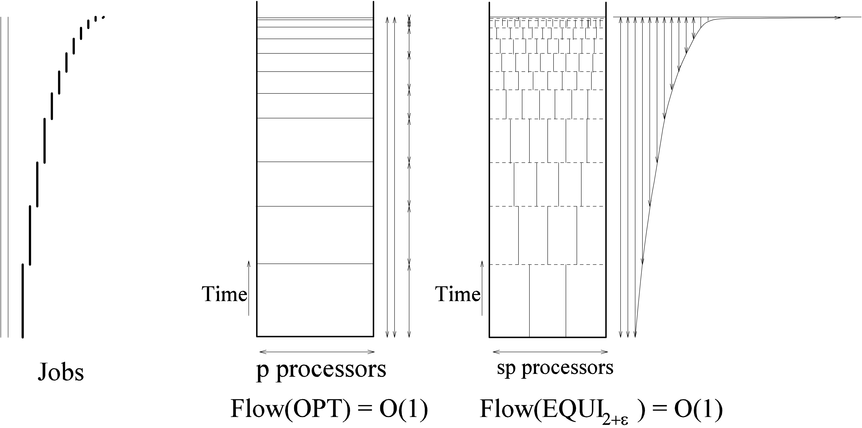



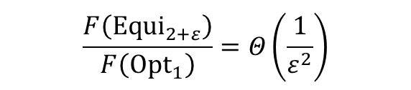
Resource Augmentation
$${Alg}_{1+ε}$$
I
t
O
t
$$SETF$$
I
n
p
u
t
O
p
t
E
q
u
i
2
+
ε
n
p
u
p
$$\frac{F\left({SETF}_{1+ε}\right)}{F\left({Opt}_{1}\right)}=Θ​\left(\frac{1}{ε^{2}}\right)$$
$$\frac{F\left({Equi}_{2+ε}\right)}{F\left({Opt}_{1}\right)}=Θ​\left(\frac{1}{ε^{2}}\right)$$
Required
Fully Parallelizable Jobs
[KP]
[E]

Slide 15
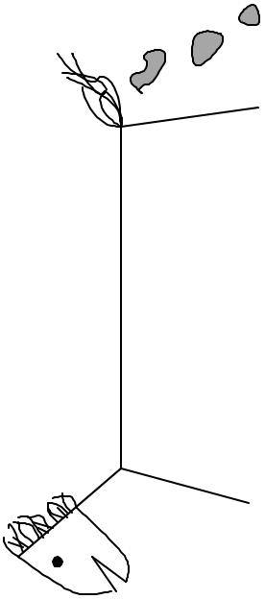
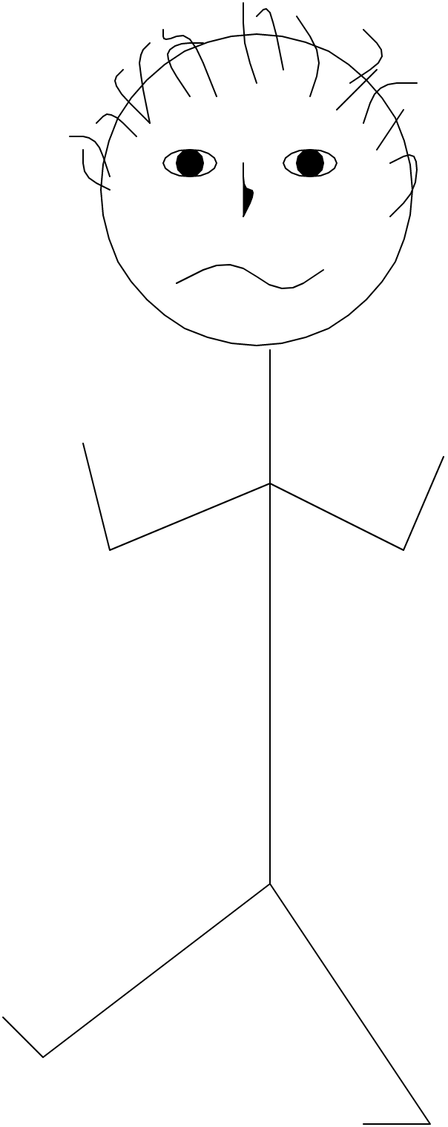
Sublinear Nondecreasing
Speedup Functions
Arrives
over time
Currently
Alive
Opt gives all its resources to the
parallelizable job and hence
competes them as they arrive.
The sequential jobs complete
with no resources.
O
p
t

Slide 16
Sublinear Nondecreasing
Speedup Functions
Arrives
over time
Currently
Alive
Opt gives all its resources to the
parallelizable job and hence
competes them as they arrive.
The sequential jobs complete
with no resources.
O
p
t

Slide 17

Sublinear Nondecreasing
Speedup Functions
Arrives
over time
Currently
Alive
Shortest Elapsed Time First (SETF)
gives all its resources to a sequential
job, wasting it.
The parallelizable jobs, getting no
resources never complete.
S
E
T
F
s
$$\frac{F\left({SETF}_{s}\right)}{F\left({Opt}_{1}\right)}=Ω\left(n\right)$$

Slide 18
Sublinear Nondecreasing
Speedup Functions
Arrives
over time
Currently
Alive
ℓ
jobs
ℓ
jobs
1 vs ε
EQUI wastes є resources,
but has є extra.
ε
Equi spreads its resources fairly.
Most are wasted on the sequential jobs.
The parallelizable jobs don’t get enough
and fall behind.
E
q
u
i
1
+
ε
F
(
E
q
u
i
1
+
)
ℓ
=
ε
+
ℓ
1
ε
=
=
F
(
O
p
t
1
)
ℓ
ε

Slide 19

S
E
T
F
<
L
A
P
S
<
E
i
q
u
n_{t} jobs currently alive
sorted by arrival time.
Latest Arrival Processor Sharing
O
p
t
S
E
T
F
1 job
But may be sequential.
β
jobs
Compromise
L
A
P
S
n
t
Too thin
& needs speed
E
i
n
jobs
q
u
t
2
+
ε
New result
[EP]
$$\frac{F\left(LAPS⟨β, 1+β+ε⟩\right)}{F\left({Opt}_{1}\right)}=Θ​\left(\frac{1}{βε}\right)$$
Speed

Slide 20
S
E
T
F
<
L
A
P
S
<
E
i
q
u
n_{t} jobs currently alive
sorted by arrival time.
Latest Arrival Processor Sharing
O
p
t
S
E
T
F
1 job
β
0
≈
β
jobs
Compromise
L
A
P
S
n
t
E
i
n
jobs
β
1
q
u
t
=
F
(
S
E
T
F
1
+
)
(
1
)
ε
Θ
F
(
O
t
)
=
0
p
1
ε
New result
[EP]
$$\frac{F\left(LAPS⟨β, 1+β+ε⟩\right)}{F\left({Opt}_{1}\right)}=Θ​\left(\frac{1}{βε}\right)$$
Speed
F
(
E
q
u
i
2
+
)
(
1
)
ε
Θ
F
(
O
t
)
=
1
p
1
ε

Slide 21
Backwards Quantifies
Desired result:
∃
∀
F
(
A
l
g
1
+
)
1
A
l
g
ε
ε
F
(
O
t
)
=
O
(
1
)
p
1
ε
∀
Obtained:
F
(
A
l
g
1
+
)
(
1
)
ε
∃
A
l
g
ε
Θ
F
(
O
t
)
=
2
1
p
1
ε
β
=
ε
2
New “result”
[Failed]
∀
F
(
A
l
g
1
+
)
(
)
A
l
g
∃
ε
ε
ω
1
F
(
O
t
)
=
p
1
ε
=
1
β
2
New result
[EP]
$$\frac{F\left(LAPS⟨β, 1+β+ε⟩\right)}{F\left({Opt}_{1}\right)}=Θ​\left(\frac{1}{βε}\right)$$

Slide 22
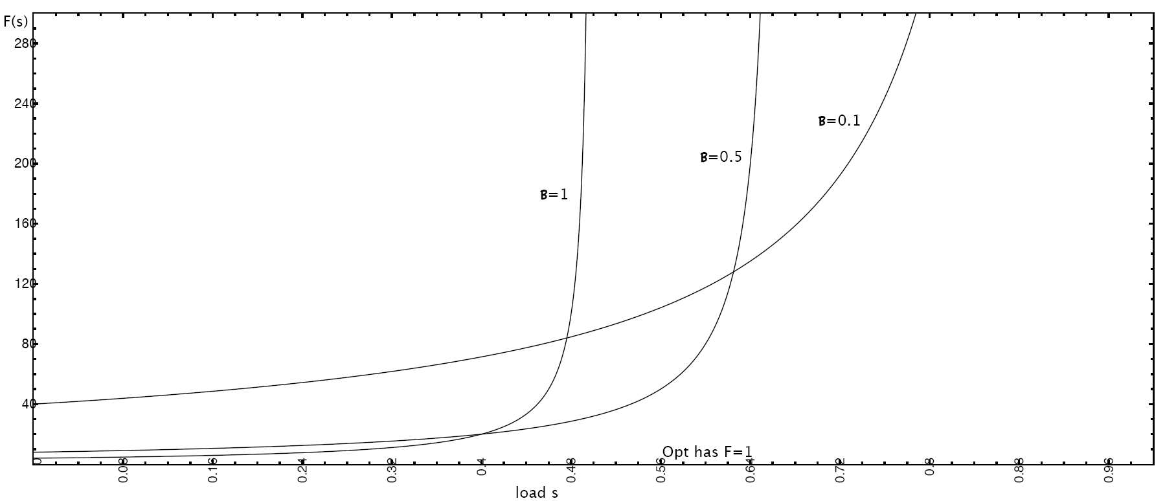

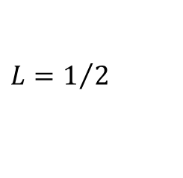
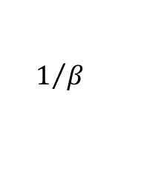
Performance vs Load Threshold
Def^{n}: A set of jobs has load if
i.e. can be optimally handled with speed L.
L
[
0
1
]
F
(
O
p
t
L
(
I
)
)
=
1
∈
,
Def^{n}:
$$F\left(A\left(I\right)\right)$$
Equi (β=1)
has the best performance,
but it only can handle half load.
$$L=1/2$$
Small β can handle
almost full load
$$L=1−β$$
but its performance
degrades with
$$1/β$$
L

Slide 23
Proof Sketch
New result
[EP]
F
(
L
A
P
S
)
⟨
β
1
+
β
+
ε
⟩
Θ
(
1
)
,
,
=
F
(
O
p
t
1
)
β
ε

Slide 24
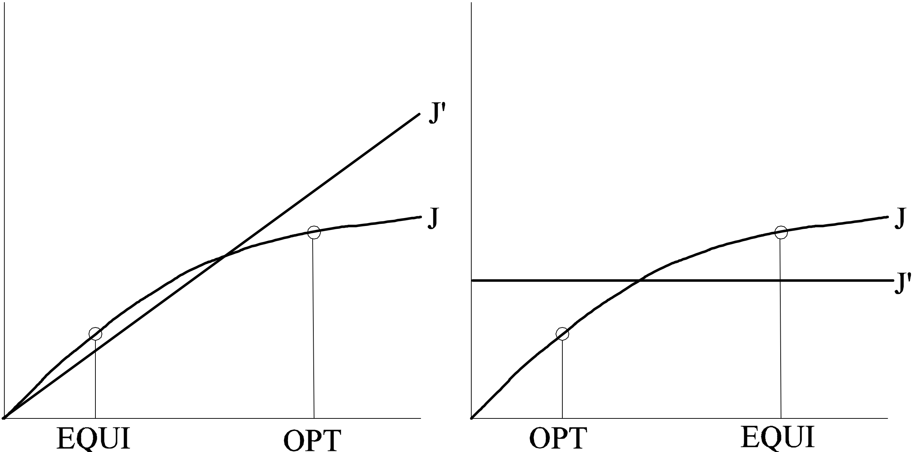
Proof Sketch
In the worst cast inputs, each phase is either sequential or parallelizable.
LAPS
LAPS

Slide 25
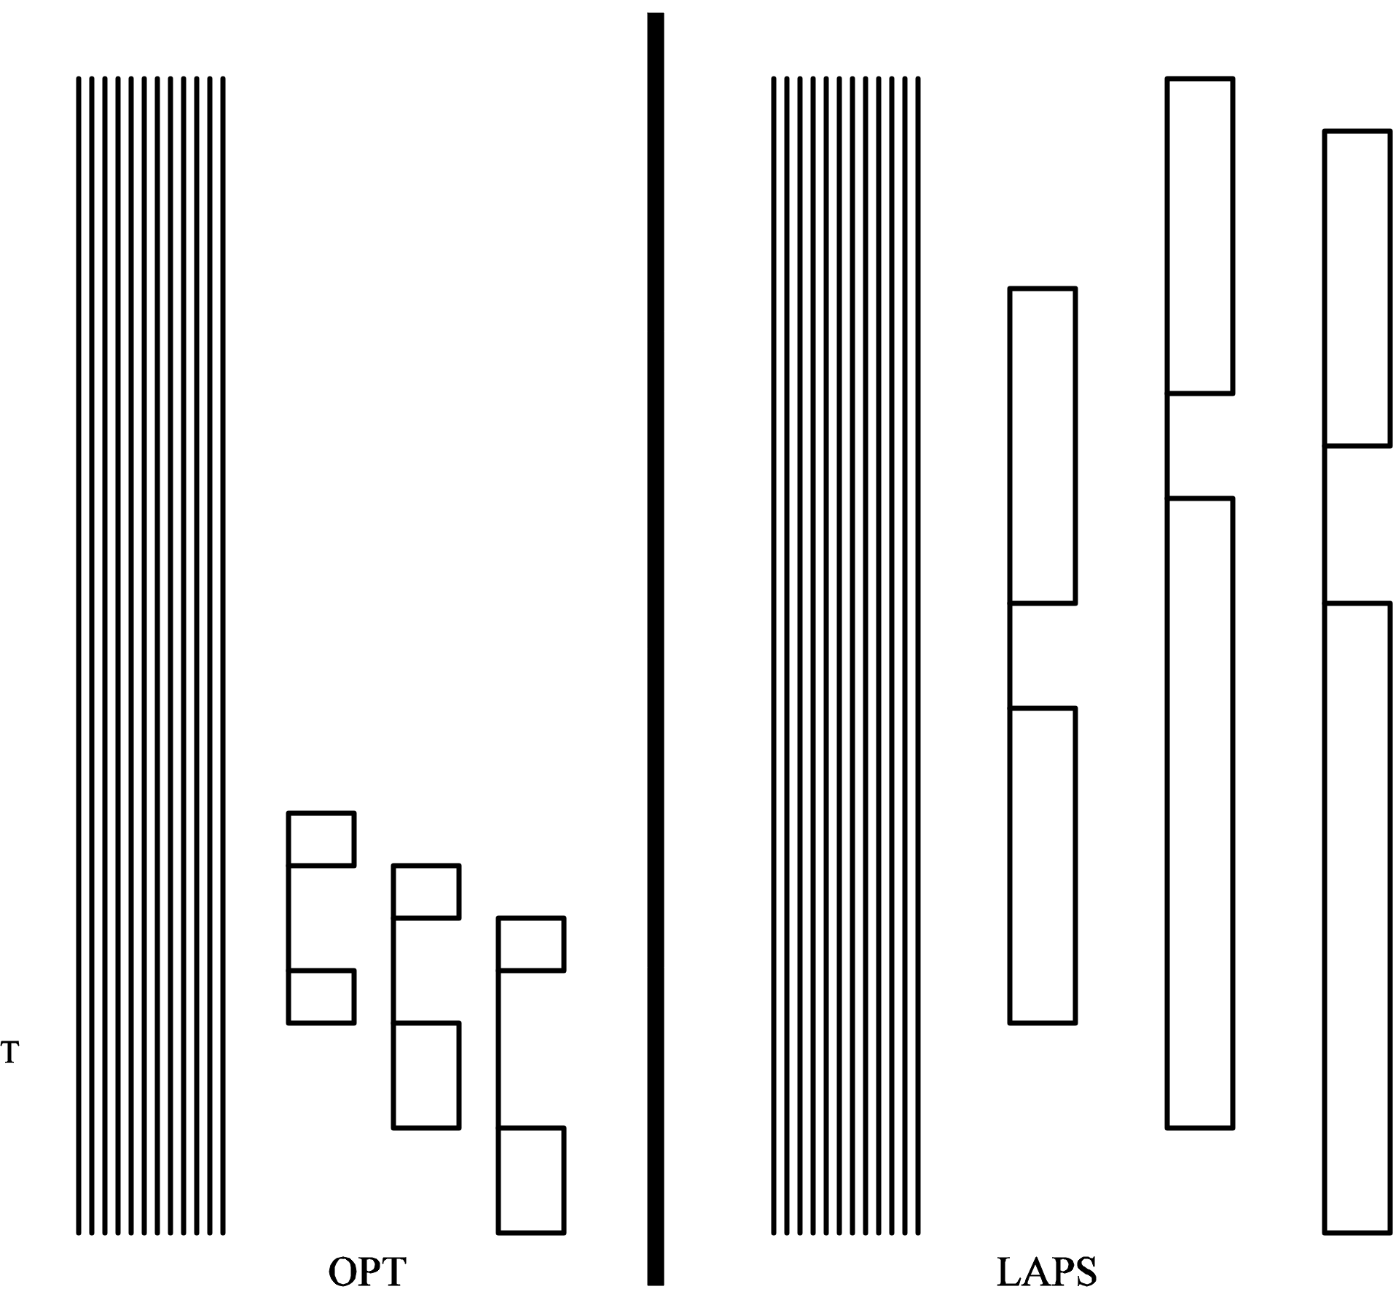
Proof Sketch

Slide 26

Potential Function
Define a potential function Φ_{t}.
It says how much debt Laps has in the bank.
Φ₀ = Φ_{final} = 0.
Φ_{t} does not increase as jobs arrive or complete.
At other times,
Result follows by integrating
$$\frac{dF\left(LAPS\right)}{dt}+\frac{dΦ}{dt}≤c⋅\frac{dF\left(Opt\right)}{dt}$$
$$F\left(LAPS\right)+Φ_{final}−Φ_{0}≤c⋅F\left(Opt\right)$$

Slide 27
Potential Function
n_{t} jobs currently alive
sorted by arrival time.
Coefficient:
1
2
3
…
n_{t}
n_{t}+1
Parallelizable work
done by Opt
not by LAPS:
…
x
x
x
n
0
n
n
t
t
x
1
x
2
x
3
t
Φ
i
·
m
a
x
(
x
0
)
=
∑
i
[
]
i
,
∈
n
t
Job arrives:
d
Φ
0
d
t
=

Slide 28
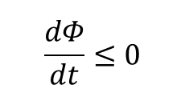
Potential Function
n jobs currently alive
sorted by arrival time.
Coefficient:
1
2
3
…
i
i+1
n_{t}
n_{t}-1
i
Parallelizable work
done by Opt
not by LAPS:
…
0
x
x
x
n
n
n
t
t
x
1
x
2
x
3
t
Φ
i
·
m
a
x
(
x
0
)
=
∑
i
[
]
i
,
∈
n
t
$$\frac{dΦ}{dt}≤0$$
Job completes:

Slide 29
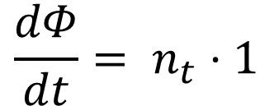
Potential Function
n jobs currently alive
sorted by arrival time.
Coefficient:
1
2
3
…
n_{t}
Parallelizable work
done by Opt
not by LAPS:
…
x
x
x
n
n
n
t
t
x
1
x
2
x
3
t
O
t
p
Φ
i
·
m
a
x
(
x
0
)
=
∑
i
[
]
i
,
∈
n
t
$$\frac{dΦ}{dt}= n_{t}⋅1$$
Opt works:

Slide 30
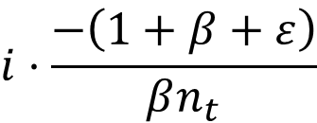
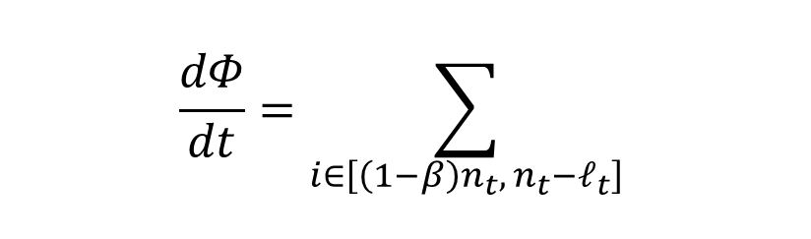
Potential Function
n jobs currently alive
sorted by arrival time.
Coefficient:
1
2
3
…
n_{t}
Parallelizable work
done by Opt
not by LAPS:
…
(
1
−
β
)
n
t
x
x
x
1
x
2
x
3
x
n
n
x
n
t
t
(
1
−
β
)
n
t
t
L
A
P
S
Φ
i
·
m
a
x
(
x
0
)
=
∑
i
[
]
i
,
∈
n
t
$$\frac{dΦ}{dt}=\sum_{i∈\left[\left(1−β\right)n_{t}, n_{t}−ℓ_{t}\right]}^{​}{​}$$
$$i⋅\frac{−\left(1+β+ε\right)}{βn_{t}}$$
LAPS works:
ℓ_{t}
# of jobs
sequential under LAPS
LAPS is a head
=

Slide 31
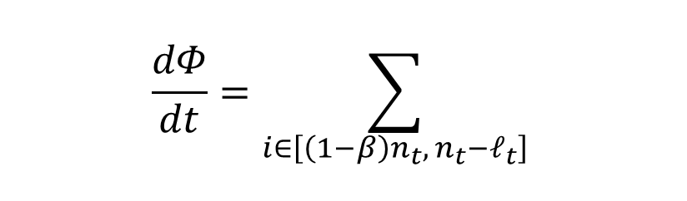
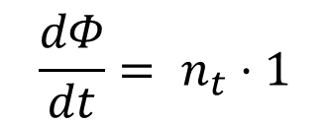
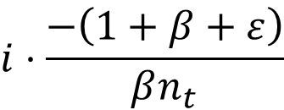
Potential Function
d
F
(
L
A
P
S
)
d
Φ
d
F
(
O
p
t
)
+
·
c
d
t
d
t
d
t
Θ
(
1
)
N
=
^
=
ℓ
n
t
ℓ
t
t
β
ε
t
# jobs alive
under Laps
resulting
competitive ratio
# jobs alive
under Opt
A page of math later,
and the proof is done.
$$\frac{dΦ}{dt}= n_{t}⋅1$$
Opt works:
$$\frac{dΦ}{dt}=\sum_{i∈\left[\left(1−β\right)n_{t}, n_{t}−ℓ_{t}\right]}^{​}{​}$$
LAPS works:
$$i⋅\frac{−\left(1+β+ε\right)}{βn_{t}}$$

Slide 32
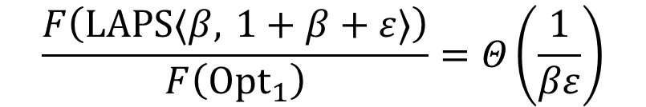
Conclusions
n_{t} jobs currently alive
sorted by arrival time.
Latest Arrival Processor Sharing
L
A
P
S
β
jobs
n
t
Resource Augmentation:
New result
[EP]
$$\frac{F\left(LAPS⟨β, 1+β+ε⟩\right)}{F\left({Opt}_{1}\right)}=Θ​\left(\frac{1}{βε}\right)$$

Slide 33
Other Models
Similar Techniques
Equi Partition CBDE:STOC97, E:STOC99
L_{k}-norms of Flow Time: [EIM:SODA11]
Broadcast: [EP:SODA02, EP:SODA04]
Many page requests
serviced simultaneously
TCP: [EDD:PAA03, E:Latin 04]
Add Incr & Mult Decr
~ EQUI
Speed Scaling: [CELLSP:STACS09, CEP:SPAA09]
Each algorithm can dynamically choose its speed s,
but it must pay for it with energy P(s) = s^{α}

Slide 34
Thank you

