Slide 1
Relations
Chapter 9
© McGraw Hill LLC. All rights reserved. No reproduction or distribution without the prior written consent of McGraw Hill LLC.

Slide 2
Chapter Summary
Relations and Their Properties.
n-ary Relations and Their Applications (not currently included in overheads).
Representing Relations.
Closures of Relations (not currently included in overheads).
Equivalence Relations.
Partial Orderings.
2

Slide 3
Relations and Their Properties
Section 9.1
3

Slide 4
Section Summary 1
Relations and Functions.
Properties of Relations.
Reflexive Relations.
Symmetric and Antisymmetric Relations.
Transitive Relations.
Combining Relations.
4

Slide 5
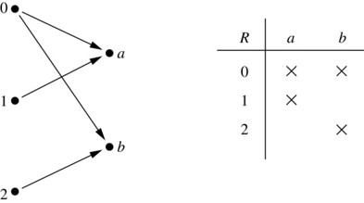
Binary Relations
Definition: A binary relation R from a set A to a set B is a subset
Example:
Let
and
is a relation from A to B.
We can represent relations from a set A to a set B graphically or using a table:
Relations are more general than functions. A function is a relation where exactly one element of B is related to each element of A.
Access the text alternative for slide images.
5

Slide 6
Binary Relations on a Set 1
Definition: A binary relation R on a set A is a subset of A × A or a relation from A to A.
Example:
Suppose that
Then
is a relation on A.
Let
The ordered pairs in the relation
are
and
6

Slide 7
Binary Relations on a Set 2
Question: How many relations are there on a set A?
Solution: Because a relation on A is the same thing as a subset of A × A, we count the subsets of A × A. Since A × A has
elements when A has n elements, and a
set with m elements has
subsets, there are subsets
of A × A. Therefore, there are relations on a set A.
7

Slide 8
Binary Relations on a Set 3
Example: Consider these relations on the set of integers:
Note that these relations are on an infinite set and each of these relations is an infinite set.
Which of these relations contain each of the pairs
(1,1), (1, 2), (2, 1), (1, −1), and (2, 2)?
Solution: Checking the conditions that define each relation, we see that the pair (1,1) is in
and
: (1,2) is in
: (2,1) is in
: (1, −1) is in
: (2,2) is in
8

Slide 9
Reflexive Relations
Definition: R is reflexive iff (a,a)
R for every element
Written symbolically, R is reflexive if and only if
Example: The following relations on the integers are reflexive:
If A = ∅ then the empty relation is reflexive vacuously. That is the empty relation on an empty set is reflexive!
9

Slide 10
Symmetric Relations
R whenever (a,b)
R for all
Definition: R is symmetric iff (b,a)
Written symbolically, R is symmetric if and only if
Example: The following relations on the integers are symmetric:
10

Slide 11
Antisymmetric Relations
A if (a,b)
Definition: A relation R on a set A such that for all a,b
and (b,a)
R, then a = b is called antisymmetric. Written symbolically,
R is antisymmetric if and only if
Example: The following relations on the integers are antisymmetric:
For any integer, if a a ≤ b and a ≤ b, then a = b.
11

Slide 12
Transitive Relations
Definition: A relation R on a set A is called transitive if whenever (a,b)
A. Written symbolically,
R is transitive if and only if
R and (b,c)
R, then (a,c)
R, for all a,b,c
Example: The following relations on the integers are transitive:
For every integer, a ≤ b and b ≤ c, then b ≤ c.
12

Slide 13
Combining Relations
we can combine them
Given two relations
using basic set operations to form new relations such as
Example: Let
and
The relations
and
can be combined using basic set operations to form new relations:
13

Slide 14
Composition
Definition: Suppose
is a relation from a set A to a set B.
is a relation from B to a set C.
Then the composition (or composite) of
with
is a relation from A to C where
if (x,y) is a member of
and (y,z) is a member of
then (x,z) is a member of
14

Slide 15
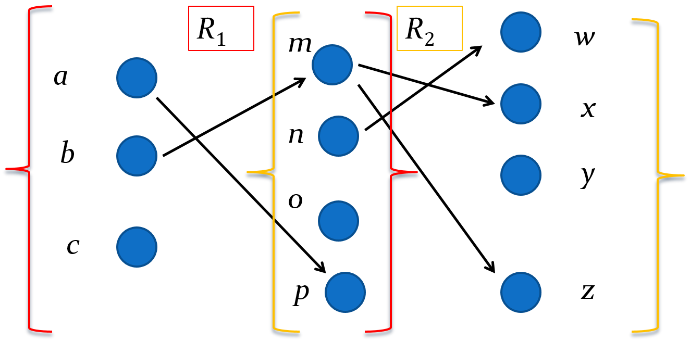
Representing the Composition of Relations
Access the text alternative for slide images.
15

Slide 16
Powers of a Relation
Definition: Let R be a binary relation on A. Then the powers
of the relation R can be defined inductively by:
Basis Step:
Inductive Step:
(see the slides for Section 9.3 for further insights)
The powers of a transitive relation are subsets of the relation. This is established by the following theorem:
Theorem 1: The relation R on a set A is transitive iff
for n = 1,2,3 . . . .
(see the text for a proof via mathematical induction)
16

Slide 17
Representing Relations
Section 9.3
17

Slide 18
Section Summary 2
Representing Relations using Matrices.
Representing Relations using Digraphs.
18

Slide 19
Representing Relations Using Matrices
A relation between finite sets can be represented using a zero-one matrix.
Suppose R is a relation from
to
The elements of the two sets can be listed in any particular arbitrary order. When A = B, we use the same ordering.
The relation R is represented by the matrix
where
The matrix representing R has a 1 as its (i,j) entry when
is
related to
and a 0 if
is not related to
19

Slide 20
Examples of Representing Relations Using Matrices 1
and
Let
Example 1: Suppose that
R be the relation from A to B containing (a,b) if
and a > b. What is the matrix representing R
(assuming the ordering of elements is the same as the increasing numerical order)?
Solution: Because
the matrix is
20

Slide 21
Examples of Representing Relations Using Matrices 2
and
Example 2: Let
Which ordered pairs are in the relation R represented by the matrix
Solution: Because R consists of those ordered pairs
with
it follows that:
21

Slide 22
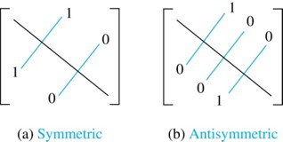
Matrices of Relations on Sets
If R is a reflexive relation, all the elements on the main diagonal of
are equal to 1.
R is a symmetric relation, if and only if
whenever
R is an antisymmetric relation,
if and only if
or
when i ≠ j.
Access the text alternative for slide images.
22

Slide 23
Example of a Relation on a Set
Example 3: Suppose that the relation R on a set is represented by the matrix
Is R reflexive, symmetric, and/or antisymmetric?
Solution: Because all the diagonal elements are equal to 1, R is reflexive. Because
is symmetric, R is
symmetric and not antisymmetric because both
and
are 1.
23

Slide 24
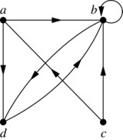
Representing Relations Using Digraphs
Definition: A directed graph, or digraph, consists of a set V of vertices (or nodes) together with a set E of ordered pairs of elements of V called edges (or arcs). The vertex a is called the initial vertex of the edge (a,b), and the vertex b is called the terminal vertex of this edge.
An edge of the form (a,a) is called a loop.
Example 7: A drawing of the directed graph with vertices a, b, c, and d, and edges (a, b), (a, d), (b, b), (b, d), (c, a), (c, b), and (d, b) is shown here.
Access the text alternative for slide images.
24

Slide 25
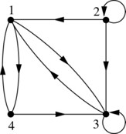
Examples of Digraphs Representing Relations
Example 8: What are the ordered pairs in the relation represented by this directed graph?
Solution: The ordered pairs in the relation are (1, 3), (1, 4), (2, 1), (2, 2), (2, 3), (3, 1), (3, 3), (4, 1), and (4, 3).
Access the text alternative for slide images.
25

Slide 26
Determining which Properties a Relation has from its Digraph
Reflexivity: A loop must be present at all vertices in the graph.
Symmetry: If (x,y) is an edge, then so is (y,x).
Antisymmetry: If (x,y) with x ≠ y is an edge, then (y,x) is not an edge.
Transitivity: If (x,y) and (y,z) are edges, then so is (x,z).
26

Slide 27
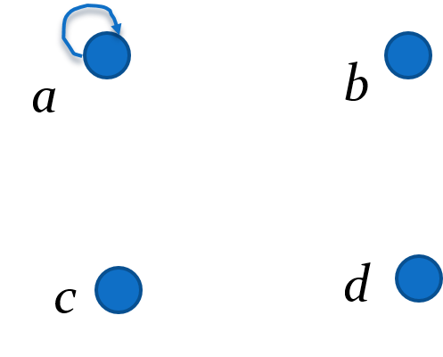
Determining which Properties a Relation has from its Digraph – Example 1
Reflexive? No, not every vertex has a loop.
Symmetric? Yes (trivially), there is no edge from one vertex to another.
Antisymmetric? Yes (trivially), there is no edge from one vertex to another.
Transitive? Yes, (trivially) since there is no edge from one vertex to another.
27

Slide 28
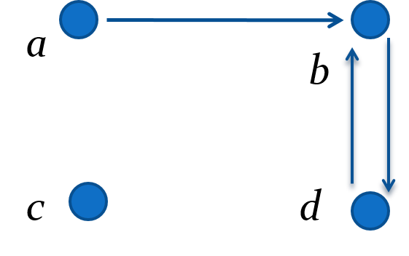
Determining which Properties a Relation has from its Digraph – Example 2
Reflexive? No, there are no loops.
Symmetric? No, there is an edge from a to b, but not from b to a.
Antisymmetric? No, there is an edge from d to b and b to d.
Transitive? No, there are edges from a to c and from c to b, but there is no edge from a to d.
28

Slide 29
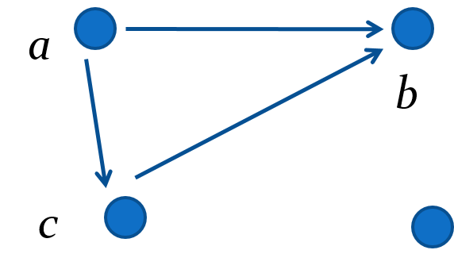
Determining which Properties a Relation has from its Digraph – Example 3
Reflexive? No, there are no loops.
Symmetric? No, for example, there is no edge from c to a.
Antisymmetric? Yes, whenever there is an edge from one vertex to another, there is not one going back.
Transitive? Yes.
29

Slide 30
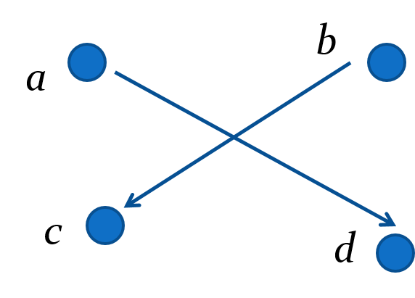
Determining which Properties a Relation has from its Digraph – Example 4
Reflexive? No, there are no loops.
Symmetric? No, for example, there is no edge from d to a.
Antisymmetric? Yes, whenever there is an edge from one vertex to another, there is not one going back.
Transitive? Yes (trivially), there are no two edges where the first edge ends at the vertex where the second edge begins.
30

Slide 31
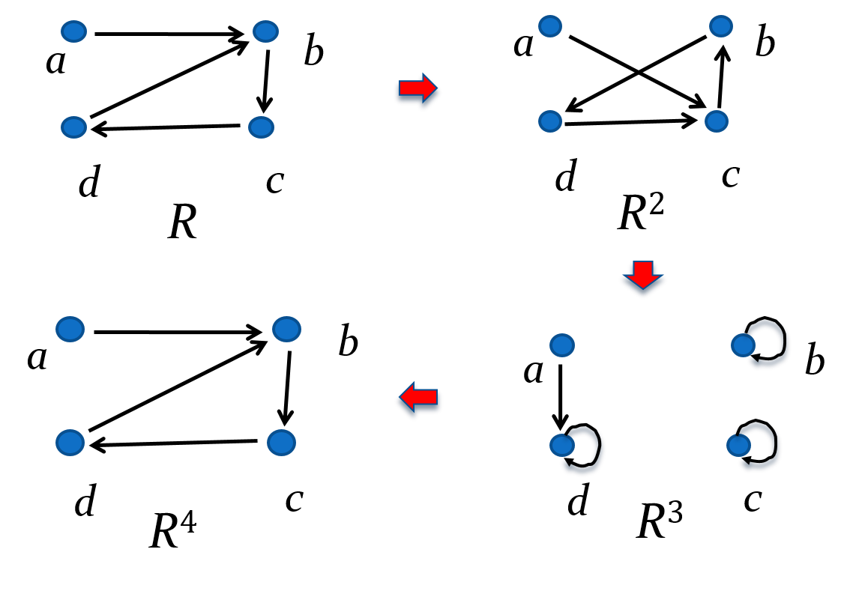
Example of the Powers of a Relation
The pair (x,y) is in
if there is a path of length n from x to y in R
(following the direction of the arrows).
Access the text alternative for slide images.
31

Slide 32
Equivalence Relations
Section 9.5
32

Slide 33
Section Summary 3
Equivalence Relations.
Equivalence Classes.
Equivalence Classes and Partitions.
33

Slide 34
Equivalence Relations
Definition 1: A relation on a set A is called an equivalence relation if it is reflexive, symmetric, and transitive.
Definition 2: Two elements a, and b that are related by an equivalence relation are called equivalent. The notation
is often used to
denote that a and b are equivalent elements with respect to a particular equivalence relation.
34

Slide 35
Strings
Example: Suppose that R is the relation on the set of strings of English letters such that a R b if and only if l(a) = l(b), where l(x) is the length of the string x. Is R an equivalence relation?
Solution: Show that all of the properties of an equivalence relation hold.
Reflexivity: Because l(a) = l(a), it follows that a R a for all strings a.
Symmetry: Suppose that a R b. Since l(a) = l(b), l(b) = l(a) also holds and b R a.
Transitivity: Suppose that a R b and b R c. Since l(a) = l(b),and l(b) = l(c), l(a) = l(a) also holds and a R c.
35

Slide 36
Congruence Modulo m
Example: Let m be an integer with m > 1. Show that the relation
is an equivalence relation on the set of integers.
Solution: Recall that a ≡ b (mod m) if and only if m divides a − b.
Reflexivity: a ≡ a (mod m) since a − a = 0 is divisible by m since
Symmetry: Suppose that a ≡ b (mod m). Then a − b is divisible by m, and so a − b = km, where k is an integer. It follows that b − a = (− k) m, so b ≡ a (mod m).
Transitivity: Suppose that a ≡ b (mod m) and b ≡ c (mod m). Then m divides both a − b and b − c. Hence, there are integers k and l with a − b = km and b − c = lm. We obtain by adding the equations: a − c = (a − b) + (b − c) = km + lm = (k + l) m.
Therefore, a ≡ c (mod m).
36

Slide 37
Divides
Example: Show that the “divides” relation on the set of positive integers is not an equivalence relation.
Solution: The properties of reflexivity, and transitivity do hold, but there relation is not transitive. Hence, “divides” is not an equivalence relation.
Reflexivity:
for all a.
Not Symmetric: For example,
but
Hence, the
relation is not symmetric.
Transitivity: Suppose that a divides b and b divides c. Then there are positive integers k and l such that b = ak and c = bl. Hence, c = a(kl), so a divides c. Therefore, the relation is transitive.
37

Slide 38
Equivalence Classes
Definition 3: Let R be an equivalence relation on a set A. The set of all elements that are related to an element a of A is called the equivalence class of a. The equivalence class of a with respect to R is denoted by
When only one relation is under consideration, we can write
without the
subscript R, for this equivalence class.
Note that
If
then b is called a representative of this equivalence class. Any
element of a class can be used as a representative of the class.
The equivalence classes of the relation congruence modulo m are called the congruence classes modulo m. The congruence class of an integer a modulo m is denoted by
For example,
38

Slide 39
Equivalence Classes and Partitions
Theorem 1: let R be an equivalence relation on a set A. These statements for elements a and b of A are equivalent:
a R b.
(ii) [a] = [b].
(iii) [a] ∩ [b] $≠$ ∅.
Proof: We show that
implies (ii). Assume that a R b. Now
suppose that c ∈ [a]. Then a R c. Because a R b and R is symmetric, b R a. Because R is transitive and b R a and a R c, it follows that b R c. Hence, c ∈ [b]. Therefore, [a]⊆ [b]. A similar argument (omitted here) shows that [b]⊆ [a]. Since [a]⊆ [b] and [b]⊆ [a], we have shown that [a] = [b].
(see text for proof that (ii) implies (iii) and (iii) implies
39

Slide 40
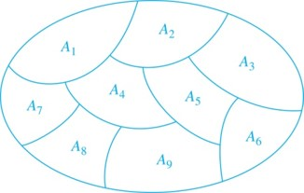
Partition of a Set
Definition: A partition of a set S is a collection of disjoint nonempty subsets of S that have S as their union. In other words, the collection of subsets
where i ∈ I (where I is an index set),
forms a partition of S if and only if
≠ ∅ for i ∈ I,
= ∅ when i ≠ j,
and
A Partition of a Set
40

Slide 41
An Equivalence Relation Partitions a Set 1
Let R be an equivalence relation on a set A. The union of all the equivalence classes of R is all of A, since an element a of A is in its own equivalence class
In
other words,
From Theorem 1, it follows that these equivalence classes are either equal or disjoint, so
when
Therefore, the equivalence classes form a partition of A, because they split A into disjoint subsets.
41

Slide 42
An Equivalence Relation Partitions a Set 2
Theorem 2: Let R be an equivalence relation on a set S. Then the equivalence classes of R form a partition of S. Conversely, given a partition
of
the set S, there is an equivalence relation R that has the sets
as its
equivalence classes.
Proof: We have already shown the first part of the theorem.
For the second part, assume that
is a partition of S. Let R be the
relation on S consisting of the pairs (x, y) where x and y belong to the same subset
in the partition. We must show that R satisfies the properties of an
equivalence relation.
Reflexivity: For every a ∈ S, (a,a) ∈ R, because a is in the same subset as itself.
Symmetry: If (a,b) ∈ R, then b and a are in the same subset of the partition, so (b,a) ∈ R.
Transitivity: If (a,b) ∈ R and (b,c) ∈ R, then a and b are in the same subset of the partition, as are b and c. Since the subsets are disjoint and b belongs to both, the two subsets of the partition must be identical. Therefore, (a,c) ∈ R since a and c belong to the same subset of the partition.
42

Slide 43
Partial Orderings
Section 9.6
43

Slide 44
Section Summary 4
Partial Orderings and Partially-ordered Sets.
Lexicographic Orderings.
Hasse Diagrams.
Lattices (not currently in overheads).
Topological Sorting (not currently in overheads).
44

Slide 45
Partial Orderings 1
Definition 1: A relation R on a set S is called a partial ordering, or partial order, if it is reflexive, antisymmetric, and transitive. A set together with a partial ordering R is called a partially ordered set, or poset, and is denoted by (S, R). Members of S are called elements of the poset.
45

Slide 46
Partial Orderings 2
Example 1: Show that the “greater than or equal” relation (≥) is a partial ordering on the set of integers.
Reflexivity: a ≥ a for every integer a.
Antisymmetry: If a ≥ b and b ≥ a , then a = b.
Transitivity: If a ≥ b and b ≥ c , then a ≥ c.
These properties all follow from the order axioms for the integers. (See Appendix 1).
46

Slide 47
Partial Orderings 3
Example 2: Show that the divisibility relation
is a
partial ordering on the set of integers.
Reflexivity:
for all integers a. (see Example 9 in Section 9.1)
Antisymmetry: If a and b are positive integers with
and
a, then a = b. (see Example 12 in Section 9.1)
Transitivity: Suppose that a divides b and b divides c. Then there are positive integers k and l such that b = ak and c = bl. Hence, c = a(kl), so a divides c. Therefore, the relation is transitive.
is a poset.
47

Slide 48
Partial Orderings 4
Example 3: Show that the inclusion relation (⊆) is a partial ordering on the power set of a set S.
Reflexivity: A ⊆ A whenever A is a subset of S.
Antisymmetry: If A and B are positive integers with A ⊆ B and B ⊆ A, then A = B.
Transitivity: If A ⊆ B and B ⊆ C, then A ⊆ C.
The properties all follow from the definition of set inclusion.
48

Slide 49
Comparability
Definition 2: The elements a and b of a poset
are
comparable if either
When a and b are elements
of S so that neither
then a and b are called
incomparable.
is used to denote the relation in any poset.
The symbol
Definition 3: If
is a poset and every two elements of S are
comparable, S is called a totally ordered or linearly ordered set, and
is called a total order or a linear order. A totally ordered
set is also called a chain.
Definition 4:
is a well-ordered set if it is a poset such that
is a total ordering and every nonempty subset of S has a least
element.
49

Slide 50
Lexicographic Order
the lexicographic
Definition: Given two posets
and
ordering on
is defined by specifying that
is less than
that is,
either if
or if
and
This definition can be easily extended to a lexicographic ordering on strings (see text).
Example: Consider strings of lowercase English letters. A lexicographic ordering can be defined using the ordering of the letters in the alphabet. This is the same ordering as that used in dictionaries.
discreet
discrete, because these strings differ in the seventh position
and e
t.
discreet
discreetness, because the first eight letters agree, but the
second string is longer.
50

Slide 51
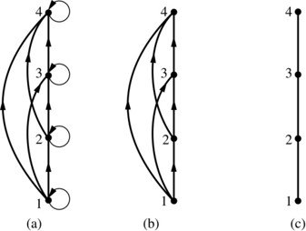
Hasse Diagrams
Definition: A Hasse diagram is a visual representation of a partial ordering that leaves out edges that must be present because of the reflexive and transitive properties.
A partial ordering is shown in (a) of the figure above. The loops due to the reflexive property are deleted in (b). The edges that must be present due to the transitive property are deleted in (c). The Hasse diagram for the partial ordering (a), is depicted in (c).
Access the text alternative for slide images.
51

Slide 52
Procedure for Constructing a Hasse Diagram
To represent a finite poset
using a Hasse diagram,
start with the directed graph of the relation:
Remove the loops (a, a) present at every vertex due to the reflexive property.
Remove all edges (x, y) for which there is an element z ∈ S
such that x
z and z
y. These are the edges that must be
present due to the transitive property.
Arrange each edge so that its initial vertex is below the terminal vertex. Remove all the arrows, because all edges point upwards toward their terminal vertex.
52

Slide 53
End of Main Content
© McGraw Hill LLC. All rights reserved. No reproduction or distribution without the prior written consent of McGraw Hill LLC.

Slide 54
Accessibility Content: Text Alternatives for Images
54

Slide 55
Binary Relations – Text Alternative
Return to parent-slide containing images.
In the left part of the picture, there are 5 points. Points 0, 1 , and 2 are placed one above the other forming a column. Points a and b are located aside forming another column. Arrows point from 0 to A, from 0 to B, from 1 to A, and from 2 to B. In the right part of the picture there is a table with two columns labeled as A and B and three rows labeled as 0,1 and 2. Some elements of the intersection of rows and columns are marked with a cross, the others are empty. Both elements of the first row are marked with a cross. Only the first element of the second line is marked with a cross, the second one is empty. The first element of the second line is empty, and the second one is marked with a cross.
Return to parent-slide containing images.
55

Slide 56
Representing the Composition of Relations – Text Alternative
Return to parent-slide containing images.
In R sub 1 on the left is a, b, and c and on the right is m, n, o, and p. a is connected to p. b is connected to m. In R sub 2 on the left is m, n, o, and p and on the right is w, x, y, and z. m is connected to x and z. n is connected to w.
Return to parent-slide containing images.
56

Slide 57
Matrices of Relations on Sets – Text Alternative
Return to parent-slide containing images.
There is a square matrix, only the main diagonal is shown. All the elements of this diagonal are 1.
There are two square matrices A and B. In the matrix A, the elements that are symmetric with respect to the main diagonal are equal; in matrix B, these elements are not equal.
Return to parent-slide containing images.
57

Slide 58
Representing Relations Using Digraphs – Text Alternative
Return to parent-slide containing images.
Points A, B, C, and D are vertices of the graph. Arrows point from A to B, from A to D, from B to D. From C to A, from C to B and from D to B. The arrow pointing from B to D does not coincide with the arrow pointing from D to B. There is a circle that starts and ends at vertex B. This circle is a loop.
Return to parent-slide containing images.
58

Slide 59
Examples of Digraphs Representing Relations – Text Alternative
Return to parent-slide containing images.
Points 1, 2, 3, and 4 are vertices of the graph. Arrows point from 1 to 4, from 1 to 3, from 2 to 1, from 2 to 3, from 3 to 1, from 4 to 1, from 4 to 3. The arrow pointing from 1 to 3 does not coincide with the arrow pointing from 3 to 1. The arrow pointing from 1 to 4 does not coincide with the arrow pointing from 4 to 1. There are loops at vertices 2 and 3.
Return to parent-slide containing images.
59

Slide 60
Example of the Powers of a Relation – Text Alternative
Return to parent-slide containing images.
R is connected to R squared which is connected to R cubed which is connected to R to the power 4. All relations are represented by four circles a, b, c, and d. R: a is connected to b. b is connected to c. c is connected to d. d is connected to b. R squared: a is connected to c. b is connected to d. c is connected to b. d is connected to c. R cubed: a is connected to d. b, c, and d have a loop each. R to the power 4: a is connected to b. b is connected to c. c is connected to d. d is connected to b.
Return to parent-slide containing images.
60

Slide 61
Hasse Diagrams – Text Alternative
Return to parent-slide containing images.
Case A. Points 1, 2, 3, and 4 located from the bottom to the top on the same line are vertices of the graph. Arrows point from 1 to 2, from 1 to 3, from 1 to 4, from 2 to 3, from 2 to 4, and from 3 to 4. There are loops at each vertex. Case B. The same graph is shown, but there are no loops at the vertices. Case C. The same graph is shown, but there are only edges connecting the vertices consequently present.
Return to parent-slide containing images.
61

