Slide 1
Advanced Counting Techniques
Chapter 8
With Question/Answer Animations
© McGraw Hill LLC. All rights reserved. No reproduction or distribution without the prior written consent of McGraw Hill LLC.

Slide 2
Chapter Summary
Applications of Recurrence Relations.
Solving Linear Recurrence Relations.
Homogeneous Recurrence Relations.
Nonhomogeneous Recurrence Relations.
Divide-and-Conquer Algorithms and Recurrence Relations.
Generating Functions.
Inclusion-Exclusion.
Applications of Inclusion-Exclusion.
2

Slide 3
Applications of Recurrence Relations
Section 8.1
3

Slide 4
Section Summary 1
Applications of Recurrence Relations.
Fibonacci Numbers.
The Tower of Hanoi.
Counting Problems.
Algorithms and Recurrence Relations (not currently included in overheads).
4

Slide 5
Recurrence Relations (recalling definitions from Chapter 2)
Definition: A recurrence relation for the sequence
is
an equation that expresses
in terms of one or more
of the previous terms of the sequence, namely,
for all integers n with
where
is a
nonnegative integer.
A sequence is called a solution of a recurrence relation if its terms satisfy the recurrence relation.
The initial conditions for a sequence specify the terms that precede the first term where the recurrence relation takes effect.
5

Slide 6
Rabbits and the Fibonacci Numbers 1
Example: A young pair of rabbits (one of each gender) is placed on an island. A pair of rabbits does not breed until they are 2 months old. After they are 2 months old, each pair of rabbits produces another pair each month. Find a recurrence relation for the number of pairs of rabbits on the island after n months, assuming that rabbits never die.
This is the original problem considered by Leonardo Pisano (Fibonacci) in the thirteenth century.
6

Slide 7
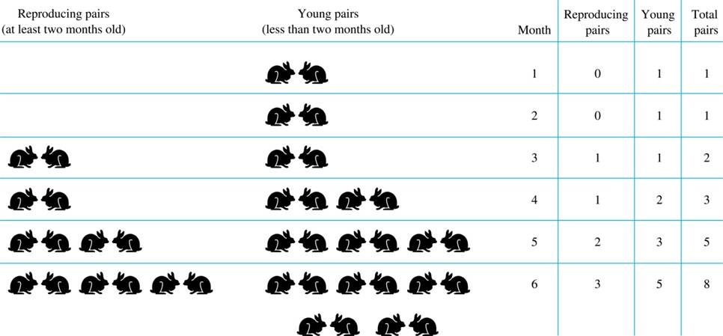
Rabbits and the Fibonacci Numbers 2
Modeling the Population Growth of Rabbits on an Island
Access the text alternative for slide images.
7

Slide 8
Rabbits and the Fibonacci Numbers 3
Solution: Let
be the number of pairs of rabbits after n months.
There are is
pairs of rabbits on the island at the end of the first month.
We also have
because the pair does not breed during the first month.
To find the number of pairs on the island after n months, add the number on the island after the previous month,
and the number of newborn pairs,
which equals
because each newborn pair comes from a pair at least two
months old.
Consequently the sequence
satisfies the recurrence relation
for n ≥ 3 with the initial conditions
The number of pairs of rabbits on the island after n months is given by the nth Fibonacci number.
8

Slide 9
The Tower of Hanoi 1
In the late nineteenth century, the French mathematician Édouard Lucas invented a puzzle consisting of three pegs on a board with disks of different sizes. Initially all of the disks are on the first peg in order of size, with the largest on the bottom.
Rules: You are allowed to move the disks one at a time from one peg to another as long as a larger disk is never placed on a smaller.
Goal: Using allowable moves, end up with all the disks on the second peg in order of size with largest on the bottom.
9

Slide 10
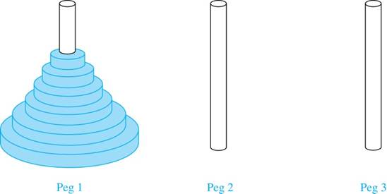
The Tower of Hanoi 2
The Initial Position in the Tower of Hanoi Puzzle
10

Slide 11
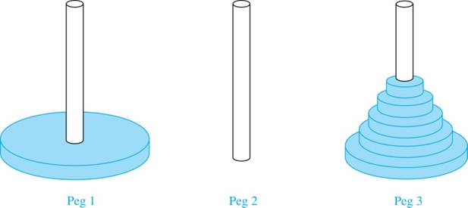
The Tower of Hanoi 3
Solution: Let
denote the number of moves needed to solve the
Tower of Hanoi Puzzle with n disks. Set up a recurrence relation for the sequence
Begin with n disks on peg 1. We can transfer the top
n −1 disks, following the rules of the puzzle, to peg 3 using
moves.
First, we use 1 move to transfer the largest disk to the second peg. Then we transfer the n −1 disks from peg 3 to peg 2 using
additional moves. This can not be done in fewer steps. Hence,
since a single disk can be
transferred from peg 1 to peg 2 in one move.
The initial condition is
11

Slide 12
The Tower of Hanoi 4
We can use an iterative approach to solve this recurrence relation by repeatedly expressing
in terms of the previous terms of the sequence.
There was a myth created with the puzzle. Monks in a tower in Hanoi are transferring 64 gold disks from one peg to another following the rules of the puzzle. They move one disk each day. When the puzzle is finished, the world will end.
Using this formula for the 64 gold disks of the myth,
days are needed to solve the puzzle, which is more than 500 billion years.
Reve’s puzzle (proposed in 1907 by Henry Dudeney) is similar but has 4 pegs. There is a well-known unsettled conjecture for the minimum number of moves needed to solve this puzzle. (see Exercises 38-45)
12

Slide 13
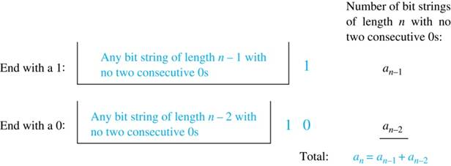
Counting Bit Strings 1
Example 3: Find a recurrence relation and give initial conditions for the number of bit strings of length n without two consecutive 0s. How many such bit strings are there of length five?
Solution: Let
denote the number of bit strings of length n without two
consecutive 0s. To obtain a recurrence relation for
note that the number of
bit strings of length n that do not have two consecutive 0s is the number of bit strings ending with a 0 plus the number of such bit strings ending with a 1.
Now assume that n ≥ 3.
The bit strings of length n ending with 1 without two consecutive 0s are the bit strings of length n −1 with no two consecutive 0s with a 1 at the end. Hence, there are
such bit strings.
The bit strings of length n ending with 0 without two consecutive 0s are the bit strings of length n −2 with no two consecutive 0s with 10 at the end. Hence, there are
such bit strings.
We conclude that
for n ≥ 3.
Access the text alternative for slide images.
13

Slide 14
Bit Strings 2
The initial conditions are:
since both the bit strings 0 and 1 do not have consecutive 0s.
since the bit strings 01, 10, and 11 do not have consecutive
0s, while 00 does.
To obtain
we use the recurrence relation three times to
find that:
satisfies the same recurrence relation as the Fibonacci
sequence. Since
Note that
we conclude that
14

Slide 15
Counting the Ways to Parenthesize a Product
Example: Find a recurrence relation for
the number of ways to parenthesize
the product of n + 1 numbers,
to specify the order of
multiplication. For example,
since all the possible ways to parenthesize 4
numbers are
Solution: Note that however parentheses are inserted in
one
“∙” operator remains outside all parentheses. This final operator appears between two of the n + 1 numbers, say
Since there are
ways to
insert parentheses in the product
and
ways to insert
parentheses in the product
we have
The initial conditions are
is the sequence of Catalan Numbers. This recurrence relation can be
solved using the method of generating functions; see Exercise 41 in Section 8.4.
The sequence
15

Slide 16
Solving Linear Recurrence Relations
Section 8.2
16

Slide 17
Section Summary 2
Linear Homogeneous Recurrence Relations.
Solving Linear Homogeneous Recurrence Relations with Constant Coefficients.
Solving Linear Nonhomogeneous Recurrence Relations with Constant Coefficients.
17

Slide 18
Linear Homogeneous Recurrence Relations
Definition: A linear homogeneous recurrence relation of degree k with constant coefficients is a recurrence relation of the form
where
are real
numbers, and
it is linear because the right-hand side is a sum of the previous terms of the sequence each multiplied by a function of n.
it is homogeneous because no terms occur that are not multiples of the
Each coefficient is a constant.
the degree is k because
is expressed in terms of the previous k terms
of the sequence.
By strong induction, a sequence satisfying such a recurrence relation is uniquely determined by the recurrence relation and the k initial conditions
18

Slide 19
Examples of Linear Homogeneous Recurrence Relations
linear homogeneous recurrence relation of degree one.
linear homogeneous recurrence relation of degree two.
not linear.
not homogeneous.
coefficients are not constants.
19

Slide 20
Solving Linear Homogeneous Recurrence Relations
The basic approach is to look for solutions of the form
where r is a constant.
Note that
is a solution to the recurrence relation
if and only if
Algebraic manipulation yields the characteristic equation:
The sequence
with
is a solution if and only if r is a
solution to the characteristic equation.
The solutions to the characteristic equation are called the characteristic roots of the recurrence relation. The roots are used to give an explicit formula for all the solutions of the recurrence relation.
20

Slide 21
Solving Linear Homogeneous Recurrence Relations of Degree Two
Theorem 1: Let
be real numbers.
Suppose that
has two distinct roots
Then the sequence
is a solution to
the recurrence relation
if and only if
are constants.
for n = 0,1,2, . . . , where
21

Slide 22
Using Theorem 1
Example: What is the solution to the recurrence relation
with
Solution: The characteristic equation is
Its roots are r = 2 and r = −1. Therefore,
is a solution to
the recurrence relation if and
only if
for some constants
To find the constants
note that
Solving these equations, we find that
Hence, the solution is the sequence
with
22

Slide 23
An Explicit Formula for the Fibonacci Numbers 1
We can use Theorem 1 to find an explicit formula for the Fibonacci numbers. The sequence of Fibonacci numbers satisfies the recurrence relation
with the initial conditions:
Solution: The roots of the characteristic equation
are
23

Slide 24
Fibonacci Numbers 2
Therefore by Theorem 1
for some constants
Using the initial conditions
we have
Solving, we obtain
Hence,
24

Slide 25
The Solution when there is a Repeated Root
Theorem 2: Let
be real numbers with
Suppose that
has one
is a
solution to the recurrence relation
repeated root
Then the sequence
if and only if
for n = 0,1,2, . . . , where
are constants.
25

Slide 26
Using Theorem 2
Example: What is the solution to the recurrence relation
with
Solution: The characteristic equation is
The only root is r = 3. Therefore,
is a solution to the
recurrence relation if and only if
where
are constants.
To find the constants
note that
Solving, we find that
Hence,
26

Slide 27
Solving Linear Homogeneous Recurrence Relations of Arbitrary Degree
This theorem can be used to solve linear homogeneous recurrence relations with constant coefficients of any degree when the characteristic equation has distinct roots.
Theorem 3: Let
be real numbers. Suppose that the
characteristic equation
has k distinct roots
Then a sequence
is a
solution of the recurrence relation
if and only if
are constants.
for n = 0, 1, 2, . . . , where
27

Slide 28
The General Case with Repeated Roots Allowed
be real numbers. Suppose that the
Theorem 4: Let
characteristic equation
has t distinct roots
with multiplicities
respectively so that
for i = 0, 1, 2, . . . ,t and
= k. Then a sequence
is a solution of the recurrence relation
if and only if
for n = 0, 1, 2, . . . , where
are constants for 1≤ i ≤ t and 0≤ j ≤
28

Slide 29
Linear Nonhomogeneous Recurrence Relations with Constant Coefficients 1
Definition: A linear nonhomogeneous recurrence relation with constant coefficients is a recurrence relation of the form:
where
are real numbers, and F(n) is a
function not identically zero depending only on n.
The recurrence relation
is called the associated homogeneous recurrence relation.
29

Slide 30
Linear Nonhomogeneous Recurrence Relations with Constant Coefficients 2
The following are linear nonhomogeneous recurrence relations with constant coefficients:
where the following are the associated linear homogeneous recurrence relations, respectively:
30

Slide 31
Solving Linear Nonhomogeneous Recurrence Relations with Constant Coefficients 1
is a particular solution of
Theorem 5: If
the nonhomogeneous linear recurrence relation with constant coefficients
then every solution is of the form
where
is a solution of the associated
homogeneous recurrence relation
31

Slide 32
Solving Linear Nonhomogeneous Recurrence Relations with Constant Coefficients 2
Example: Find all solutions of the recurrence relation
What is the solution with
Solution: The associated linear homogeneous equation is
Its solutions are
where α is a constant.
Because F(n)= 2n is a polynomial in n of degree one, to find a particular solution we might try a linear function in n, say
where c and d are constants. Suppose
that
is such a solution.
Then
becomes
Simplifying yields
It follows that cn + d is a solution if and
only if
2 + 2c = 0 and 2d − 3c = 0. Therefore, cn + d is a solution if and only if c = − 1 and d =
Consequently,
is a particular solution.
where α
is a constant.
To find the solution with
By Theorem 5, all solutions are of the form
let n = 1 in the above formula for the general solution.
Then 3 = −1 −
+ 3 α, and α =
Hence, the solution is
32

Slide 33
Divide-and-Conquer Algorithms and Recurrence Relations
Section 8.3
33

Slide 34
Section Summary 3
Divide-and-Conquer Algorithms and Recurrence Relations.
Examples.
Binary Search.
Merge Sort.
Fast Multiplication of Integers.
Master Theorem.
Closest Pair of Points (not covered yet in these slides).
34

Slide 35
Divide-and-Conquer Algorithmic Paradigm
Definition: A divide-and-conquer algorithm works by first dividing a problem into one or more instances of the same problem of smaller size and then conquering the problem using the solutions of the smaller problems to find a solution of the original problem.
Examples:
Binary search, covered in Chapters 3 and 5: It works by comparing the element to be located to the middle element. The original list is then split into two lists and the search continues recursively in the appropriate sublist.
Merge sort, covered in Chapter 5: A list is split into two approximately equal sized sublists, each recursively sorted by merge sort. Sorting is done by successively merging pairs of lists.
35

Slide 36
Divide-and-Conquer Recurrence Relations
Suppose that a recursive algorithm divides a problem of size n into a subproblems.
Assume each subproblem is of size n/b.
Suppose g(n) extra operations are needed in the conquer step.
Then f(n) represents the number of operations to solve a problem of size n satisfies the following recurrence relation:
This is called a divide-and-conquer recurrence relation.
36

Slide 37
Example: Binary Search
Binary search reduces the search for an element in a sequence of size n to the search in a sequence of size n/2. Two comparisons are needed to implement this reduction;
one to decide whether to search the upper or lower half of the sequence and
the other to determine if the sequence has elements.
Hence, if f(n) is the number of comparisons required to search for an element in a sequence of size n, then
when n is even.
37

Slide 38
Example: Merge Sort
The merge sort algorithm splits a list of n (assuming n is even) items to be sorted into two lists with n/2 items. It uses fewer than n comparisons to merge the two sorted lists.
Hence, the number of comparisons required to sort a sequence of size n, is no more than M(n) where
38

Slide 39
Example: Fast Multiplication of Integers
An algorithm for the fast multiplication of two 2n-bit integers (assuming n is even) first splits each of the 2n-bit integers into two blocks, each of n bits.
Suppose that a and b are integers with binary expansions of length 2n. Let
Let
where
The algorithm is based on the fact that ab can be rewritten as:
This identity shows that the multiplication of two 2n-bit integers can be carried out using three multiplications of n-bit integers, together with additions, subtractions, and shifts.
Hence, if f(n) is the total number of operations needed to multiply two n-bit integers, then
where Cn represents the total number of bit operations; the additions, subtractions and shifts that are a constant multiple of n-bit operations.
39

Slide 40
Estimating the Size of Divide-and-Conquer Functions 1
Theorem 1: Let f be an increasing function that satisfies the recurrence relation
whenever n is divisible by b, where a≥ 1, b is an integer greater than 1, and c is a positive real number. Then
Furthermore, when
and
where k is a
positive integer,
40

Slide 41
Complexity of Binary Search
Binary Search Example: Give a big-O estimate for the number of comparisons used by a binary search.
Solution: Since the number of comparisons used by binary search is
where n is
even, by Theorem 1, it follows that f(n) is O(log n).
41

Slide 42
Estimating the Size of Divide-and-Conquer Functions 2
Theorem 2. Master Theorem: Let f be an increasing function that satisfies the recurrence relation
whenever
where k is a positive integer
greater than 1, and c and d are real numbers with c positive and d nonnegative. Then
42

Slide 43
Complexity of Merge Sort
Merge Sort Example: Give a big-O estimate for the number of comparisons used by merge sort.
Solution: Since the number of comparisons used by merge sort to sort a list of n elements is less than M(n) where
by
the master theorem M(n) is O(n log n).
43

Slide 44
Complexity of Fast Integer Multiplication Algorithm
Integer Multiplication Example: Give a big-O estimate for the number of bit operations used needed to multiply two n-bit integers using the fast multiplication algorithm.
Solution: We have shown that
when n
is even, where f(n) is the number of bit operations needed to multiply two n-bit integers. Hence by the master theorem with a = 3, b = 2, c = C, and d = 0 (so that we have the case where
it follows that f(n) is
Note that log
Therefore the fast multiplication
algorithm is a substantial improvement over the conventional algorithm that uses
bit operations.
44

Slide 45
Generating Functions
Section 8.4
45

Slide 46
Section Summary 4
Generating Functions.
Counting Problems and Generating Functions.
Useful Generating Functions.
Solving Recurrence Relations Using Generating Functions (not yet covered in the slides).
Proving Identities Using Generating Functions (not yet covered in the slides).
46

Slide 47
Generating Functions
Definition: The generating function for the sequence
of real numbers is the infinite series
Examples:
The sequence
with
has the generating function
has the generating function
has the generating function
The sequence
with
The sequence
with
has the generating
function has the generating function
47

Slide 48
Generating Functions for Finite Sequences 1
Generating functions for finite sequences of real numbers can be defined by extending a finite sequence
into an infinite sequence by
setting
and so on.
The generating function G(x) of this infinite sequence
is a polynomial of degree n because no terms of
the form
with j > n occur, that is,
48

Slide 49
Generating Functions for Finite Sequences 2
Example: What is the generating function for the sequence 1,1,1,1,1,1?
Solution: The generating function of 1,1,1,1,1,1 is
By Theorem 1 of Section 2.4, we have
when x ≠ 1.
Consequently
is the generating
function of the sequence.
49

Slide 50
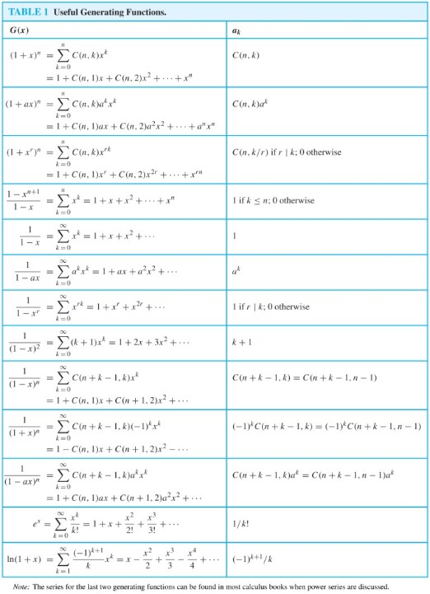
Useful Generating Functions
Access the text alternative for slide images.
50

Slide 51
Counting Problems and Generating Functions 1
Example: Find the number of solutions of
where
and
are nonnegative integers with
and
Solution: The number of solutions is the coefficient of
in the
expansion of
This follows because a term equal to is obtained in the product by picking a term in the first sum
a term in the second sum
and a term in the third sum
where
There are three solutions since the coefficient of
in the
product is 3.
51

Slide 52
Counting Problems and Generating Functions 2
Example: Use generating functions to find the number of k-combinations of a set with n elements, i.e., C(n,k).
Solution: Each of the n elements in the set contributes the term (1 + x) to the generating function
Hence
where f(x) is the generating function for
where
represents the number of k-combinations of a set
with n elements.
By the binomial theorem, we have
where
Hence,
52

Slide 53
Inclusion-Exclusion
Section 8.5
53

Slide 54
Section Summary 5
The Principle of Inclusion-Exclusion.
Examples.
54

Slide 55
Principle of Inclusion-Exclusion
In Section 2.2, we developed the following formula for the number of elements in the union of two finite sets:
We will generalize this formula to finite sets of any size.
55

Slide 56
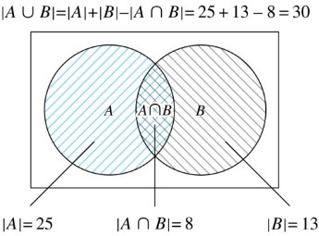
Two Finite Sets
Example: In a discrete mathematics class every student is a major in computer science or mathematics or both. The number of students having computer science as a major (possibly along with mathematics) is 25; the number of students having mathematics as a major (possibly along with computer science) is 13; and the number of students majoring in both computer science and mathematics is 8. How many students are in the class?
Solution:
Access the text alternative for slide images.
56

Slide 57
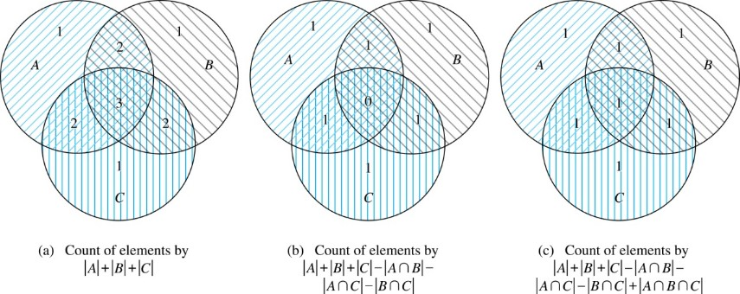
Three Finite Sets 1
Access the text alternative for slide images.
57

Slide 58
Three Finite Sets 2
Example: A total of 1232 students have taken a course in Spanish, 879 have taken a course in French, and 114 have taken a course in Russian. Further, 103 have taken courses in both Spanish and French, 23 have taken courses in both Spanish and Russian, and 14 have taken courses in both French and Russian. If 2092 students have taken a course in at least one of Spanish French and Russian, how many students have taken a course in all 3 languages.
Solution: Let S be the set of students who have taken a course in Spanish, F the set of students who have taken a course in French, and R the set of students who have taken a course in Russian. Then, we have
and
Using the equation
we obtain 2092 = 1232 + 879 + 114 −103 −23 −14 +
Solving for
yields 7.
58

Slide 59
Illustration of Three Finite Set Example
Access the text alternative for slide images.
59

Slide 60
The Principle of Inclusion-Exclusion 1
Theorem 1. The Principle of Inclusion-Exclusion: Let
be finite sets. Then:
60

Slide 61
The Principle of Inclusion-Exclusion 2
Proof: An element in the union is counted exactly once in the right-hand side of the equation. Consider an element a that is a member of r of the sets
where 1≤ r ≤ n.
It is counted C(r,1) times by
It is counted C(r,2) times by
In general, it is counted C(r,m) times by the summation of m of the sets
61

Slide 62
The Principle of Inclusion-Exclusion 3
Thus the element is counted exactly
times by the right hand side of the equation.
By Corollary 2 of Section 6.4, we have
Hence,
62

Slide 63
Applications of Inclusion-Exclusion
Section 8.6
63

Slide 64
Section Summary 6
Counting Onto-Functions.
Derangements.
64

Slide 65
The Number of Onto Functions 1
Example: How many onto functions are there from a set with six elements to a set with three elements?
Solution: Suppose that the elements in the codomain are
Let
be the properties that
are not in the range of the
function, respectively. The function is onto if none of the properties
hold.
By the inclusion-exclusion principle the number of onto functions from a set with six elements to a set with three elements is
Here the total number of functions from a set with six elements to one with three elements is
The number of functions that do not have in the range is
Similarly,
Note that
Hence, the number of onto functions from a set with six elements to a set with three elements is:
65

Slide 66
The Number of Onto Functions 2
Theorem 1: Let m and n be positive integers with m ≥ n. Then there are
onto functions from a set with m elements to a set with n elements.
Proof follows from the principle of inclusion-exclusion (see Exercise 27).
66

Slide 67
Derangements 1
Definition: A derangement is a permutation of objects that leaves no object in the original position.
Example: The permutation of 21453 is a derangement of 12345 because no number is left in its original position. But 21543 is not a derangement of 12345, because 4 is in its original position.
67

Slide 68
Derangements 2
Theorem 2: The number of derangements of a set with n elements is
Proof follows from the principle of inclusion-exclusion (see text).
68

Slide 69
Derangements 3
The Hatcheck Problem: A new employee checks the hats of n people at restaurant, forgetting to put claim check numbers on the hats. When customers return for their hats, the checker gives them back hats chosen at random from the remaining hats. What is the probability that no one receives the correct hat.
Solution: The answer is the number of ways the hats can be arranged so that there is no hat in its original position divided by
the number of permutations of n hats.
Remark: It can be shown that the probability of a derangement approaches 1/e as n grows without bound.
TABLE 1 The Probability of a Derangement.
69

Slide 70
End of Main Content
© McGraw Hill LLC. All rights reserved. No reproduction or distribution without the prior written consent of McGraw Hill LLC.

Slide 71
Accessibility Content: Text Alternatives for Images
71

Slide 72
Rabbits and the Fibonacci Numbers 2 – Text Alternative
Return to parent-slide containing images.
There is 0 reproducing pair and 1 young pair in the first month, the number of total pairs is 1. There is 0 reproducing pair and 1 young pair in the second month, the number of total pairs is 1. There is 1 reproducing pair and 1 young pair in the third month, the number of total pairs is 2. There is 1 reproducing pair and 2 young pairs in the fourth month, the number of total pairs is 3. There are 2 reproducing pairs and 3 young pairs in the fifth month, the number of total pairs is 5. There are 3 reproducing pairs and 5 young pairs in the sixth month, the number of total pairs is 8.
Return to parent-slide containing images.
72

Slide 73
Counting Bit Strings 1 – Text Alternative
Return to parent-slide containing images.
The first bit string starts with any bit string of length N minus 1 with no two consecutive zeros and ends with a 1. The number of strings of this type is A sub, N minus 1. The second bit strings starts with any bit string of length N minus 2 with no two consecutive zeros and ends with 1 0. The number of strings of this type is A sub, N minus 2. The total number of bit strings of length N with no two consecutive zeros is A sub, N minus 1, plus A sub, N minus 2.
Return to parent-slide containing images.
73

Slide 74
Useful Generating Functions – Text Alternative
Return to parent-slide containing images.
The column headers are marked as: G(x) and ak. The data is as follows: Row 1: (1 plus x) to the power n equals summation from k equals 0 through n C (n, k) times x to the power k equals 1 plus c (n, 1)x plus C (n, 2) x squared plus .. plus x to the power n and C (n, k). Row 2: (1 plus a times x) to the power n equals summation from k equals 0 through n C (n, k) a to the power k x to the power k equals 1 plus C (n, 1) a times x plus C (n, 2) a squared times x squared plus .. plus a to the power n times x to the power n and C (n, k) times a to the power k. Row 3: (1 plus x to the power r) to the power n equals summation from k equals 0 through n C (n, k) times x to the power r times k equals 1 plus C (n, 1) x to the power r plus C (n, 2) times x to the power 2 times r plus .. plus x to the power r times n and C (n, k over r) if r|k; 0 otherwise. Row 4: Fraction 1 minus x to the power n plus 1 over 1 minus x equals summation from k equals 0 through infinity x to the power k equals 1 plus x plus x squared plus... x to the power n and 1 if k lesser than or equal to n; 0 otherwise. Row 5: Fraction 1 over 1 minus x equals summation from k equals 0 through infinity x to the power k equals 1 plus x plus x squared plus ... and 1. Row 6: Fraction 1 over 1 minus a times x equals summation from k equals 0 through infinity a to the power k times x to the power k equals 1 plus a times x plus a squared times x squared plus .. and a to the power k. Row 7: 1 over 1 minus x to the power r equals summation from k equals 0 through infinity equals 1 plus x to the power r plus x to the power 2 times r and 1 if r|k; otherwise. Row 8: Fraction 1 over (1 minus x) squared equals summation 0 through infinity (k plus 1) x to the power k equals 1 plus 2 times x plus 3 times x squared, and k plus 1. Row 9: Fraction 1 over (1 minus x) to the power n equals summation from k equals 0 through infinity C (n plus k minus 1, k) times x to the power k equals 1 plus C (n, 1) times x plus c (n plus 1, 2) times x squared plus .. and C (n plus k minus 1, k) equals C (n plus k minus 1, n minus 1). Row 10: Fraction 1 over (1 plus x) to the power n equals summation k equals 0 through infinity C (n plus k minus 1, k) times (negative 1) to the power k times x to the power k equals 1 minus C (n, 1) times x plus C (n plus 1, 2) x squared.. and (negative 1) to the power k times C (n plus k minus 1, k) equals (negative 1) to the power k times C (n plus k minus 1, n minus 1). Row 11: Fraction 1 over (1 minus a times x) to the power n equals summation k equals 0 through infinity C (n plus k minus 1, k) times a to the power k times x to the power k equals 1 plus C (n, 1) times a times x plus C (n plus 1, 2) times a squared times x squared plus .. and C (n plus k minus 1, k) times a to the power k) equals C (n plus k minus 1, n minus 1) times a to the power k. Row 12: e to the power x equals summation k equals 0 through infinity fraction x to the power k over k factorial equals 1 plus x plus fraction x squared over 2 factorial plus fraction x cubed over 3 factorial plus .. and 1 over k factorial. Row 13: ln (1 plus x) equals summation k equals 1 through infinity fraction (negative 1) to the power k plus 1 over k times x to the power k equals x minus fraction x squared over 2 plus fraction x cubed over 3 minus x to the power 4 over 4 plus .. and (negative 1) to the power k plus 1 over k.
Return to parent-slide containing images.
74

Slide 75
Two Finite Sets – Text Alternative
Return to parent-slide containing images.
The number of elements in A is 25, the number of elements in B is 13. The number of elements in the intersection of A and B is 8.
Return to parent-slide containing images.
75

Slide 76
Three Finite Sets 1 – Text Alternative
Return to parent-slide containing images.
The first diagram shows count of elements by the formula number of elements in A plus the number of elements in B plus the number of elements in C. There is number 1 in exactly one of the three sets, number 2 in the intersection of any two of the sets, and number 3 in the intersection of all three sets. The second diagram shows count of elements by the formula number of elements in A plus the number of elements in B plus the number of elements in C minus the number of elements in intersection of A and B minus the number of elements in intersection of A and C minus the number of elements in intersection of B and C. There is number 1 in exactly one of the three sets and in the intersection of any two of the sets, and number 0 in the intersection of all three sets. The third diagram shows count of elements by the formula number of elements in A plus the number of elements in B plus the number of elements in C minus the number of elements in intersection of A and B minus the number of elements in intersection of A and C minus the number of elements in intersection of B and C plus the number of elements in intersection of A, B, and C. There is number 1 in exactly one of the three sets and in all intersections.
Return to parent-slide containing images.
76

Slide 77
Illustration of Three Finite Set Example – Text Alternative
Return to parent-slide containing images.
The number of elements for the sets are given below: Set S = 1232 Set F = 879 Set R = 114 Intersection of sets S and R = 23 Intersection of sets F and R = 14 Intersection of sets S and F = 103 Union of sets S, F, and R = 2092
Return to parent-slide containing images.
77

