Slide 1
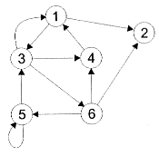

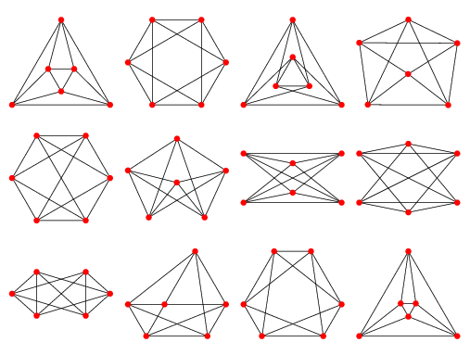
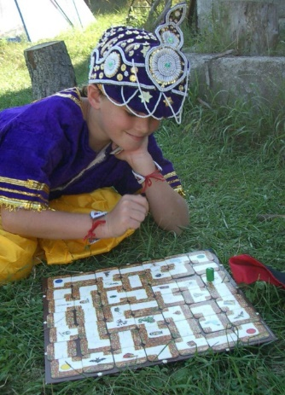
Graphs
Nodes & Edges
Applications
Definitions
Types of Graphs
Bipartite
Eulerian Path
Easy vs Hard Problems
Jeff Edmonds
York University
Lecture 6
EECS 1019

Slide 2
Definitions
Same Graph
Graph G = (V, E):
V a set of vertices (or vertices)
E a set E of edges
Vertex (or node):
Is a dot or object.
Eg: a person, city, computer, ….
Directed Edge:
A directed line between two vertices
A relation/ordered pair e=⟨a,b⟩ of two verities.
Eg: a traffic lane from a to b, a relationship a loves b
Undirected Edge:
An undirected line between two vertices
A set e={a,b} of two verities.
Eg: a 2-way road between a and b, a&b love each other
Symmetric: ∀u,v∈V, ⟨u,v⟩∈E iff ⟨v,u⟩∈E
Relationships not Location Maters
a
b
d
e
b
c
d
a
e
c
a
a
b
a
b
a
b
2

Slide 3
Definitions
Same Graph
Graph G = (V, E):
V a set of vertices (or vertices)
E a set E of edges
Vertex (or node):
Is a dot or object.
Eg: a person, city, computer, ….
Directed Edge:
A directed line between two vertices
A relation/ordered pair e=⟨a,b⟩ of two verities.
Eg: a traffic lane from a to b, a relationship a loves b
Undirected Edge:
An undirected line between two vertices
A set e={a,b} of two verities.
Eg: a 2-way road between a and b, a&b love each other
Symmetric: ∀u,v∈V, ⟨u,v⟩∈E iff ⟨v,u⟩∈E
Relationships not Location Maters
a
b
d
e
b
c
d
a
e
c
a
a
b
a
b
a
b
3

Slide 4
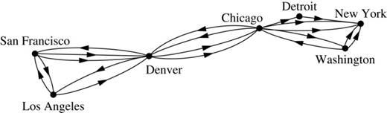
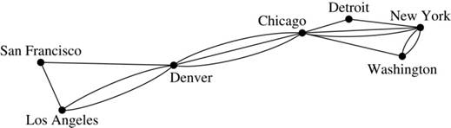
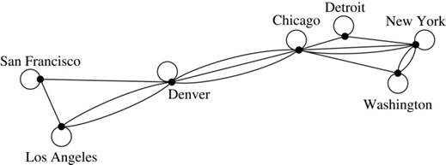
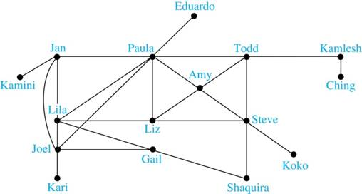
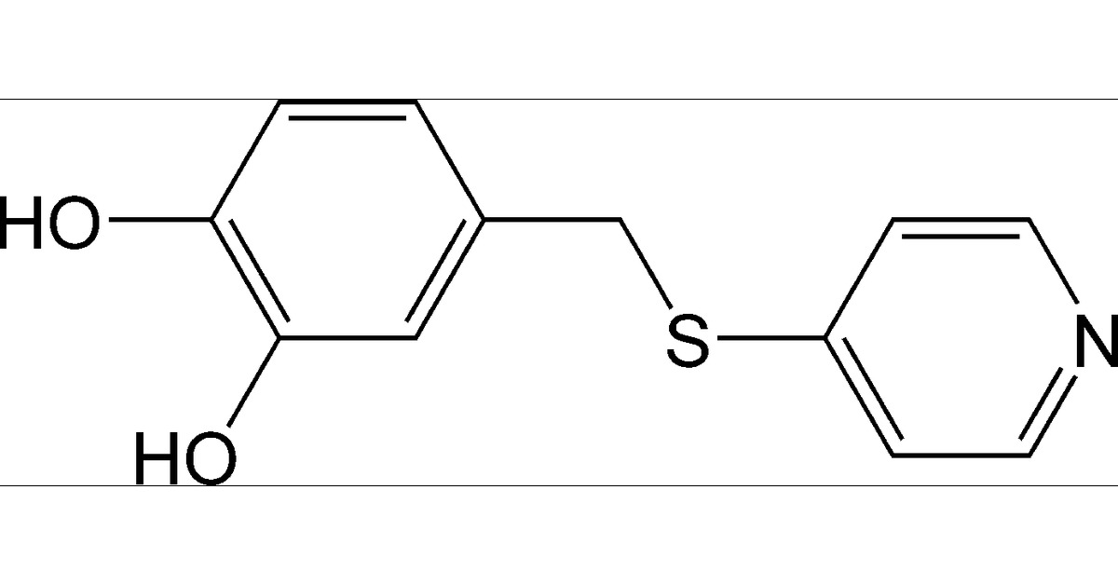
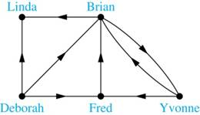
Applications
Computer Network or Flight Route:
between cities
Friendship/Collaboration/Bonds Graph:
Undirected between people/atoms
Influence Graph, Book Citations:
Directed between people/papers
4

Slide 5
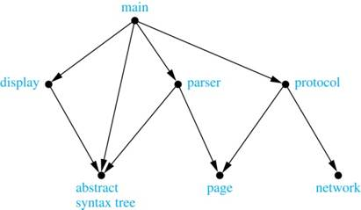
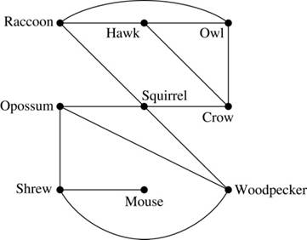
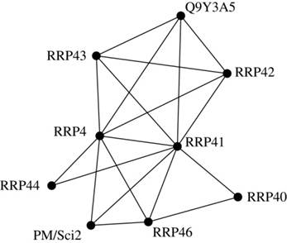
Applications
Dependency/Precedence:
Which software calls which
Job A needs to be done before B
(sequentially or in parallel schedule)
Competition/Interaction/WhoEatsWho:
animals, chemicals, drugs, …
5

Slide 6
Definitions
Multi-Edges:
The same edge appears twice in the graph.
Eg More than one road between a and b.
Self-Loop:
Edge loops back to same vertex.
Eg: circular driveway, a loves themselves.
Reflexive: ∀v∈V, ⟨v,v⟩∈E
Simple-Graph: no multi-edges and no self-loops.
a
b
a
a
b
e
c
d
6
6

Slide 7
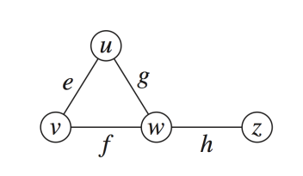
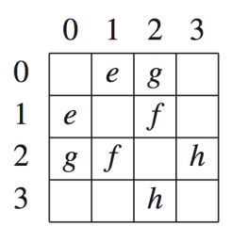
Definitions
Origin: a, Destination: b,
Endpoints: a&b of e
Incident: e&a
Adjacent: a&b
Adjacency List: w is adjacent to {u,v,z}
Adjacent Matrix:
a
e
b
a
e
b
1
1
1
1
1
1
1
1
7

Slide 8
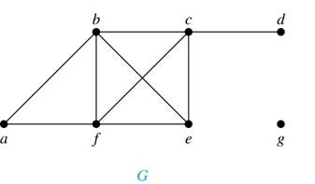
Definitions
n = |V| = # vertices
m = |E| = # edges
Neighborhood:
N(u) = { v | ⟨u,v⟩∈E }
N(a) = {b,f}
N(b) = {a,c,e,f}
N(g) = {}
N(U) = { v | ∃u∈U ⟨u,v⟩∈E }
N({a,b,g}) = N(a)∪N(b)∪N(e) = {a,b.c,e,f}
Degree:
Deg(b) = |N(a)| = 4
∑_{v} Deg(v) = 2m
each edge is counted twice
A graph with 10 vertices of degree six has 10×6/2 edges
8

Slide 9
Definitions
n = |V| = # vertices
m = |E| = # edges
Neighborhood:
N_{out}(Brian) = {Linda, Yvonne}
N_{in}(Brian) = {Deborah, Fred, Yvonne}
Degree:
Deg_{out}(Brian) = |N_{ou}(Brian)| = 2
∑_{v} Deg_{out} (v) = ∑_{v} Deg_{in} (v) = m
each edge is counted once
9

Slide 10
Definitions
Subgraph: G´⊆G
A subset of vertices and edges
Delete vertex → delete its edges
a
b
c
d
e
f

Slide 11
Definitions
Path: Sequence of vertices Path = ⟨v₀,v₁,v₂,v₃,…,v_{r}⟩
∀i∈[0,r-1] {v_{i},v_{i+1}}∈E
r+1 nodes and r edges.
Is there a path from a to a?
Yes: r = 0. Path = ⟨v₀⟩. no edges.
a
b
c
d
e
f
11

Slide 12
Definitions
Path: Sequence of vertices Path = ⟨v₀,v₁,v₂,v₃,…,v_{r}⟩
∀i∈[0,r-1] {v_{i},v_{i+1}}∈E
Simple path:
No vertex or edges is repeated.
Cycle:
Ends at the beginning.
a
b
c
d
e
f
12

Slide 13
Definitions
Path: Sequence of vertices Path = ⟨v₀,v₁,v₂,v₃,…,v_{r}⟩
∀i∈[0,r-1] {v_{i},v_{i+1}}∈E
Connected:
A pair of vertices are connected if there is a path between them.
A subgraph is connected if every pair of vertices is connected.
Connected Components:
Partition the vertices into connected components sets S₁, S₂, .., S_{r}.
a
b
c
d
e
f
Not connected
x
A partition of a set V
puts each of its elements in exactly of the parts.
y
z
13

Slide 14
Definitions
Path: Sequence of vertices Path = ⟨v₀,v₁,v₂,v₃,…,v_{r}⟩
∀i∈[0,r-1] {v_{i},v_{i+1}}∈E
Connected:
A pair of vertices are connected if there is a path between them.
A subgraph is connected if every pair of vertices is connected.
Connected Components:
Partition the vertices into connected components sets S₁, S₂, .., S_{r}.
Put a and everyone it is connected to into S₁.
Put x and everyone it is connected to into S₂.
∀i, ∀u,v∈S_{i}, ∃path from u to v.
∀u∈S_{i}, ∀v∉S_{j}, ⌐∃path from u to v.
a
b
c
d
e
f
Not connected
x
y
z
14

Slide 15
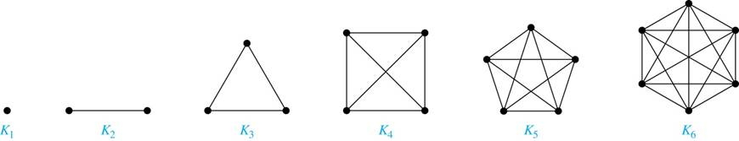
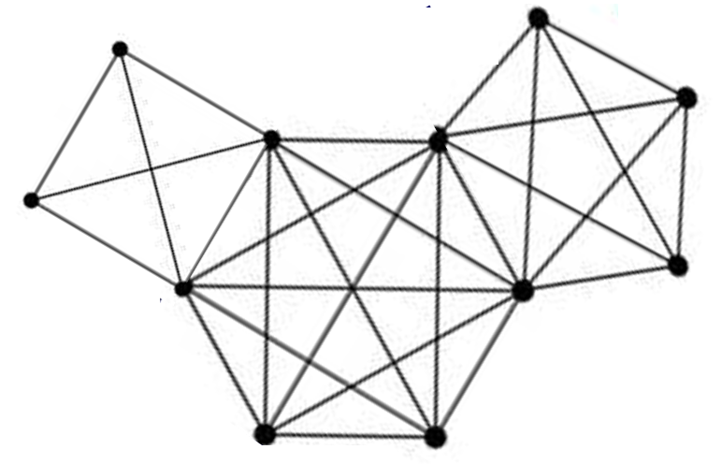
Types of Graphs
Complete:
All edges, E = { {u,v} | u≠v∈V }
Deg(u) = n-1
|E| = (n choose 2) = ½n(n-1)
Clique:
A subset of a graph that is complete.
A close-nit group of people that exclude you
Independent Set:
A subset of a graph that has no edges.
15

Slide 16
Types of Graphs
Complete:
All edges, E = { {u,v} | u≠v∈V }
Edge Weights:
Edges {a,b} can be labeled with distance from a to b.
Shortest Path:
Google maps gives shortest path between points
Triangle Inequality:
w_{{a,c}} ≤ w_{{a,b}} + w_{{b,c}}
Similar to transitivity
a
13
3
5
4
b
2
c
5
4
6
e
16

Slide 17
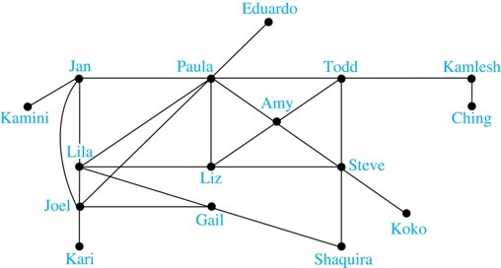
Types of Graphs
6-Degrees of Separation.:
Everyone in the world is friend-friend-friend-friend-friend-friend-friend with everyone in the world ie between every pair of people there is a path of length 6.
(100)⁶ = 10¹²
Population = 10⁹
17

Slide 18
Types of Graphs
Bacon numbers:
Edges are between actors who stared in a movie together.
Your Bacon numbers is your distance from Bacon.
??’s is 2, because she acted with someone who acted with Bacon.
Bacon
Bacon Number | Number of People
0 | 1
1 | 3,452
2 | 401,636
3 | 1,496,104
4 | 390,878
5 | 4,388
6 | 631
7 | 131
8 | 9
9 | 1
??
??
18

Slide 19

Types of Graphs
Erdős numbers:
Edges are between mathematicians who wrote a paper together.
Your Erdős numbers is your distance from Erdős.
Jeff’s is 2, because he wrote a paper with someone who wrote a paper with Erdős.
Erdős Number | Number of People
0 | 1
1 | 504
2 | 6,593
3 | 33,605
4 | 83,642
5 | 87,760
6 | 40,014
7 | 11,591
8 | 3,146
9 | 819
10 | 244
11 | 68
12 | 23
13 | 5
Erdős
Impagliazzo
Jeff
19
19

Slide 20
Types of Graphs
Tree:
Contains no cycles
Spanning Tree:
Subgraph that is a tree and reaches every vertex
Rooted tree:
Shake one vertex so edges go down.
|E| = n-1
Every vertex has one edge up except root.
Forest:
A disconnected collection of trees
Root:
a
Parent:
b
c
d
d
e
3 Children
f
A leaf has no children
Forest
20

Slide 21
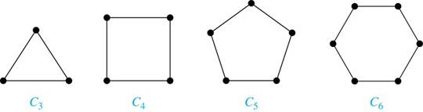
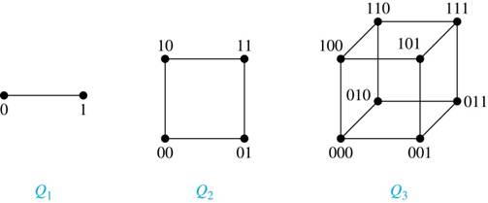
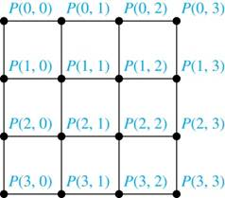
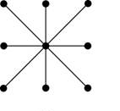
Types of Graphs
Cycle:
Deg(u) = 2
|E| = n
n-cube:
|V| = 2^{n}
Deg(u) = n
Star:
Grid:
21

Slide 22

Bipartite
South Africa was bi-partite when spit between white and black.
22

Slide 23



Bipartite
Bi-Partite:
V = V₁∪V₂ and all edges {v₁,v₂}, v₁∈V₁ and v₂∈V₂
Boys
Girls
Girls
Sam
Mary
 |  | T | T
 |  | T | T
 |  |  | T
 |  | T | T | T
Bob
Beth
Boys
John
Marilyn Monroe
Fred
Ann
Sorry
this is heteronormative.
23

Slide 24
Bipartite
Bi-Partite:
V = V₁∪V₂ and all edges {v₁,v₂}, v₁∈V₁ and v₂∈V₂
People
Jobs
Sam
President
Mary
Comp Sci
John
Therapist
Beth
Parent
Fred
Doctor
A Matching matches u_{i}∈V₁ with a v_{j}∈V₂. Noone matched twice.
3 matches. Can we match more?
4 matches. Can we get a perfect matching?
24

Slide 25
Bipartite
Bi-Partite:
V = V₁∪V₂ and all edges {v₁,v₂}, v₁∈V₁ and v₂∈V₂
People
Jobs
Sam
Hall’s Theorem:
∀S⊆V₁, |N(S)| ≥ |S|
→ everything in V₁
can be matched.
Comp Sci
John
Therapist
Fred
A Matching matches u_{i}∈V₁ with a v_{j}∈V₂. Noone matched twice.
3 matches. Can we match more?
4 matches. Can we get a perfect matching?
No! These 3 people are fighting for the same 2 jobs.
25

Slide 26
Bipartite
Bi-Partite:
V = V₁∪V₂ and all edges {v₁,v₂}, v₁∈V₁ and v₂∈V₂
Oops
A Matching: A subset of the edges so that no vertex is taken twice
26

Slide 27
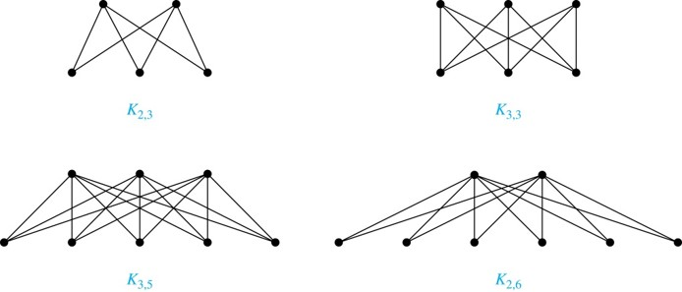
Bipartite
Bi-Partite:
V = V₁∪V₂ and all edges {v₁,v₂}, v₁∈V₁ and v₂∈V₂
Compete
|V| = |V₁|×|V₂|
27

Slide 28
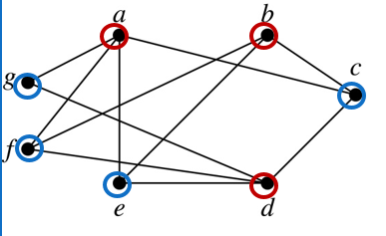
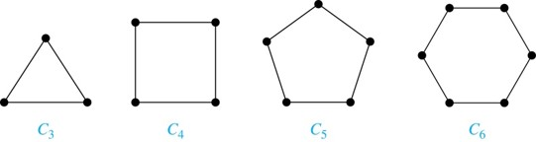
Bipartite
Bi-Partite:
V = V₁∪V₂ and all edges {v₁,v₂}, v₁∈V₁ and v₂∈V₂
Lemma: A cycle is bipartite graph ⇔ n is even
28

Slide 29
Bipartite
Bi-Partite:
V = V₁∪V₂ and all edges {v₁,v₂}, v₁∈V₁ and v₂∈V₂
Partitioning vertices: If the vertices are moved around, you can determine if it is a bipartite graph by coloring vertices red and blue, ie to be in V₁ and V₂, in a way so that no two adjacent vertices are the same color.
a
b
c
d
e
e
f
g
29

Slide 30
Bipartite
Bi-Partite:
V = V₁∪V₂ and all edges {v₁,v₂}, v₁∈V₁ and v₂∈V₂
Algorithm:
Colour some node red.
Follow an edge from a coloured to an uncoloured node. It is forced to be the opposite colour.
When all vertices are colours, check each edge that bi-chromatic.
If all edges are good, then the graph is bi-partite.
Else the edge with vertices the same colour,
can be traced back to an odd length cycle proving the graph is not bi-partite.
Lemma: A bipartite graph ⇔ contains no odd cycles
a
b
c
d
e
e
f
g
30

Slide 31
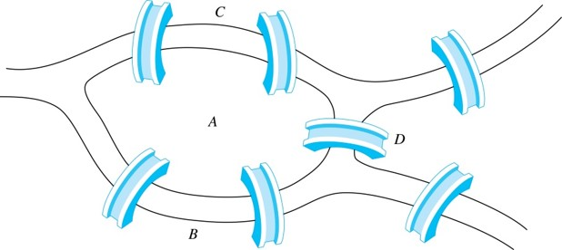
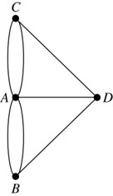
Eulerian Path/Cycle
Eulerian Path/Cycle(G): Does G contain a path/cycle that visits each edge exactly once
Multigraph Model of the Bridges of Kӧnigsberg
People wondered whether it was possible to follow a path that crosses each bridge exactly once and returns to the starting point.
The Swiss mathematician Leonard Euler proved that no such path exists. This result is often considered to be the first theorem ever proved in graph theory.

Slide 32
Eulerian Path/Cycle
Eulerian Path/Cycle(G): Does G contain a path/cycle that visits each edge exactly once
Algorithm: Case every vertex has even degree → Eulerian Cycle
Just keep walking, taking an edge never seen before.
Consider some vertex u.
Our path enters u at some point & leaves (using up 2 edges)
Later it enters u again & leaves (using up 2 edges)
Later it enters u again (using up 1 edge)
Having an even number of edges, there is always an edge to leave again.

Slide 33
Eulerian Path/Cycle
Eulerian Path/Cycle(G): Does G contain a path/cycle that visits each edge exactly once
Algorithm: Case every vertex has even degree → Eulerian Cycle
Just keep walking, taking an edge never seen before.
The node you started on is the only node you can end on.
You left it (using up 1 edge)
Later it enters u again & leaves (using up 2 edges)
Later it enters u again & leaves (using up 2 edges)
Having an even number of edges, there is always an edge to arrive back with and end.

Slide 34
Eulerian Path/Cycle
Eulerian Path/Cycle(G): Does G contain a path/cycle that visits each edge exactly once
Algorithm: Case every vertex has even degree → Eulerian Cycle
Just keep walking, taking a edge never seen before.
The node you started on is the only node you can end on.
If you return to your starting vertex
and have not reached every edge
start again.
Merge these cycles into a figure 8.

Slide 35
Eulerian Path/Cycle
Eulerian Path/Cycle(G): Does G contain a path/cycle that visits each edge exactly once
Algorithm:
Just keep walking, taking an edge never seen before.
Start at an odd degree vertex u (using up 1 edge)
Later it enters u again & leaves (using up 2 edges)
Later it enters u again (using up 1 edge)
Having an odd number of edges, there is always an edge to leave again.
The path must end at the second vertex of odd degree.
Case two vertices have odd degree → Eulerian Path

Slide 36
Eulerian Path/Cycle
Eulerian Path/Cycle(G): Does G contain a path/cycle that visits each edge exactly once
Algorithm:
Just keep walking, taking an edge never seen before.
Impossible
Odd degree vertices must be the beginning or the end of the path.
There can only be two such ends.
Case three or more vertices have odd degree → None

Slide 37
Witnesses: Easy vs Hard Optimization Problems
Instances: A set of possible inputs to the problem.
Solutions for Instance: Each instance has an exponentially large set of solutions.
Cost of Solution: Each solution has an easy to compute cost or value.
Goal: Given an instance, find a solution with optimal cost.
Algorithm: Check each possible solution.
But there are an exponential 2^{θ(n)} of these solutions to try!!!
ie more than the number of atoms in the universe
37

Slide 38
Witnesses: Easy vs Hard Optimization Problems
Easy Problems: An optimal solution can be found quickly, ie in polynomial time n^{θ(1)}.
Hard Problems:
If you found a poly-time n^{θ(1)} algorithm for any of these:
You could use that algorithm to get one for all.
Industry would be able to solve so many useful and great optimization problems.
You would be rich and famous.
Cryptography – Online Privacy/Banking WOULD BE GONE!
38

Slide 39
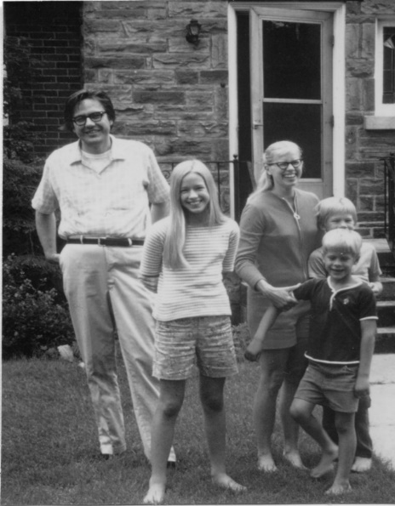
Witnesses: Easy vs Hard Optimization Problems
Can every reasonable problem be computed in a reasonable amount of time
i.e. polynomial in the size of the input?
Poly
Jack Edmonds 1965

Slide 40
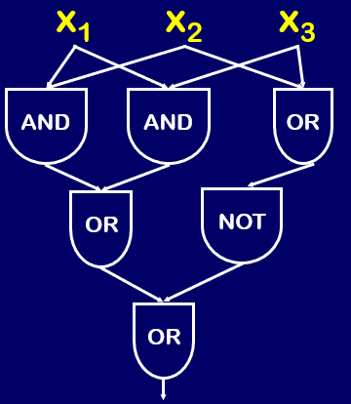
Witnesses: Easy vs Hard Optimization Problems
I
F
T
F
A Poly Computable Problem:
Given an (∧∨ ⌐) circuit C
and a T/F assignment I to the n variables.
SAT(C,I) ≡ “C(I) = True”
Algorithm:
Percolate T/F down wires
An Non-Poly Computable Problem:
SAT(C) ≡ ∃I SAT(C,I)
ie is C satisfiable?
Search Space: # of I to consider is 2^{n}.
C
F
F
T
F
F
F
Result=T or not
Poly
Jack Edmonds 1965

Slide 41

Witnesses: Easy vs Hard Optimization Problems
I is called the
witness/proof/solution
that C is satisfiable.
There is a witness/proof/solution
that of NO.
Exp
There is no witness/proof/solution
that C is NOT satisfiable.
NP
Co-NP
Non Deterministic
Polynomial Time
∃I SAT(C,I)
Poly
SAT(C,I)
Generally, if there is a witness to both Yes&No then there is a poly time algorithm
Jack Edmonds 1965

Slide 42
Witnesses: Easy vs Hard Optimization Problems
Matching(G): Does bipartitie graph G have a matching?
Easy
People
Jobs
Sam
President
Mary
Comp Sci
A matching is a witness of YES.
|N(S)| < |S| is a witness of No.
John
Therapist
Beth
Parent
Fred
Doctor

Slide 43
Witnesses: Easy vs Hard Optimization Problems
Matching(G): Does bipartitie graph G have a matching?
Vertex Cover(G): Find smallest subset of the vertices that covers each edge.
Easy
Hard
A covering is a witness of YES.
There are no witnesses of No.

Slide 44
Witnesses: Easy vs Hard Optimization Problems
Shortest Path(G,s,t): What is the shortest path in G from s to t?
Longest Path(G,s,t): What is the longest path in G from s to t?
Longest Simple Path(G,s,t): What is the longest simple path in G from s to t?
Easy
Hint: Google can do it.
Easy
Hard
s
A path is a witness of YES.
Topographical Lines is a witness of No.
3
20
20
4
2
t
5
4
6
A path is a witness of YES.
There are no witnesses of No.
∞

Slide 45
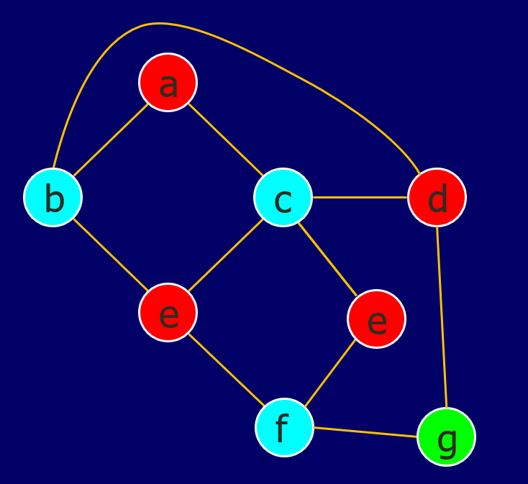
Witnesses: Easy vs Hard Optimization Problems
2-Colour(G): Can G be colored with 2 colors such that each edged has two colors?
3-Colour(G): Can G be colored with 3 colors such that each edged has two colors?
Easy
Hard
A coloring is a witness of YES.
An odd cycle is a witness of No.
A coloring is a witness of YES.
There are no witnesses of No.
45

Slide 46
Witnesses: Easy vs Hard Optimization Problems
Clique(G,k): Does G contain a clique of size k?
Clique(G,1000): Does G contain a clique of size 1000?
Poly-time n^{θ(1)} brute force algorithm: # of subsets to check = (n choose 1000) ~ n¹⁰⁰⁰
Hard
“Easy”
A clique is a witness of YES.
There are no witnesses of No.
46

Slide 47
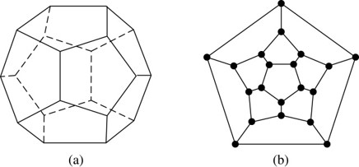
Witnesses: Easy vs Hard Optimization Problems
Graph Same(G₁,G₂): Do these graphs have the same vertices and edges, with locations and but not names of vertices changed?
Algorithm: Sort the names vertices & check neighborhoods.
Graph Isomorphism(G₁,G₂): Do these graphs have the same vertices and edges, with locations and names changed?
Easy
Not known easy
&
not known Hard
1
1
3
2
3
2
6
6-cycle: 1,3,6,5,4,2,1
N(1) = {2,3,4,6} = all but 5
N(2) = {1,3,4,5} = all but 6
4
5
6
4
5
47

Slide 48
Witnesses: Easy vs Hard Optimization Problems
Eulerian Path/Cycle(G): Does G contain a path/cycle that visits each edge exactly once?
Easy
A path is a witness of YES.
An odd degree is a witness of No.
48

Slide 49
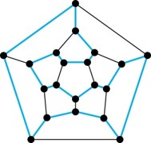
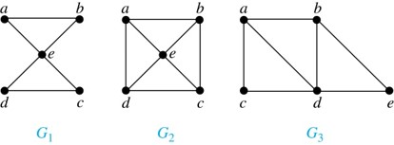
Witnesses: Easy vs Hard Optimization Problems
Eulerian Path/Cycle(G): Does G contain a path/cycle that visits each edge exactly once?
Hamiltonian Path/Cycle(G): Does G contain a path/cycle that visits each vertex exactly once?
Easy
Hard
A coloring is a witness of YES.
There are no witnesses of No.
49

Slide 50
End

