Slide 1
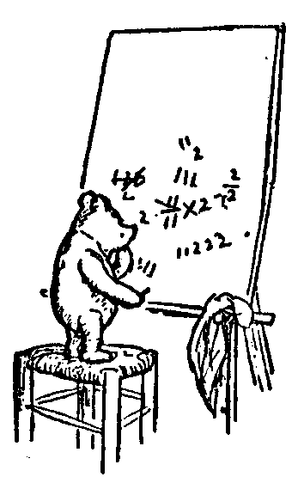
Growth Rates
n²
2^{n}
n
Growth
f(n)
log n
5
n
Growth Rates
Running Time
Classifying Functions
Notation
Intuition
Definition of Theta
Proofs
Adding Mader Easy
Jeff Edmonds
York University
Lecture 3
Math/EECS 1019

Slide 2
Growth Rates
n²
2^{n}
n
Growth
f(n)
log n
5
n
Giving an idea of how fast a function grows without going into too much detail.
For all sufficiently large n

Slide 3
Growth Rates
Growth
f(n)
5
n
“Constant:” A function f(n) is said to be Θ(1),
if it bounded between constants as n gets really big.
Yes
5
1,000,000,000,000
0.0000000000001
-5
0
8 + sin(n)
9
Yes
Yes
7
No
No
Lie in between
Yes

Slide 4
Growth Rates
2n
n
½n
Growth
f(n)
n
Linear: A function f(n)=cn is said to be Θ(n),
if it is a constant c times n.

Slide 5
Growth Rates
n²
Growth
f(n)
n
Quadratic: The function f(n)=n² measures the area of a square.
S =
1
+
2
+
3
+
. . .
+
n-1
+
n
n
n (n+1)
n
=
= Θ(n²)
2
n
n
This is too much detail.
Drop the +1.
Drop the ×½
n
n
n+1 n+1 n+1 n+1 n+1

Slide 6
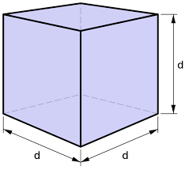
Growth Rates
n³
Growth
f(n)
n
Quadratic: The function f(n)=n³ measures the volume of a cube.

Slide 7
Growth Rates
2^{n}
Growth
f(n)
n
n digits
n bits
Exponential:
10^{n} = value of an n digits number
2^{n} = # of n bit strings
= value after doubling n times.
value =29,342,563
≈ 10^{n}
000
001
010
011
100
101
110
111
2^{n} strings

Slide 8
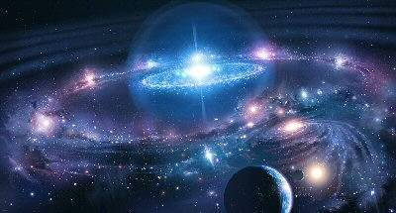

Growth Rates
2^{n}
Growth
f(n)
n
Exponential:
Let n = 60
f(60) ≈ 2⁶⁰
= (2¹⁰)⁶
= (1024)⁶
≈ (10³)⁶
= 10¹⁸
= Age of universe

Slide 9
Growth Rates
Growth
f(n)
log n
n
Logarithmic:
log₁₀n = 8 digits
log₁₀n = # digits to write n
log₂n = # bits to write n
= 3.32 log₁₀n
= # times to divide n
by 2 till you get 1.
log(n¹⁰⁰⁰) = 1000 log(n)
n=29,342,563
log₂n = 26 digits
n=100110110001011…0010100110₂

Slide 10
Growth Rates
Growth
f(n)
log n
n
Logarithmic:
log₁₀n = # digits to write n
log₂n = # bits to write n
= 3.32 log₁₀n
= # times to divide n
by 2 till you get 1.
log(n¹⁰⁰⁰) = 1000 log(n)
Differ only by a multiplicative constant.

Slide 11
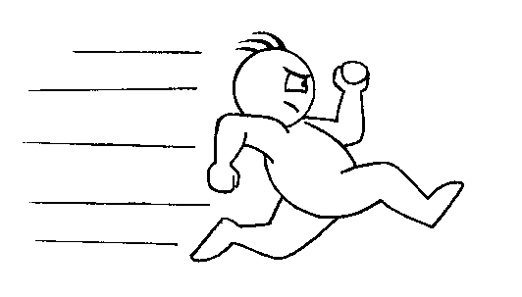
Growth Rates
Growth
f(n)
log n
n
Logarithmic:
Let n = 2⁶⁰
f(n) = log n
= 10¹⁸ = size of universe
= 60
Barely grows!

Slide 12
Growth Rates
Growth
f(n)
log n
n
Logarithmic:
Note: log(n) ≪n^{.01} ≪ n^{½}
n = 100000000000
log₁₀(n) = 10, n^{½} = 100000

Slide 13
Growth Rates
f(n) n:
10
100
1,000
10,000
5
5
5
5
5
atom
log n
3
6
9
13
amoeba
n^{1/2}
3
10
31
100
bird
n
10
100
1,000
10,000
human
n log n
30
600
9,000
130,000
my father
n²
100
10,000
10⁶
10⁸
elephant
n³
1,000
10⁶
10⁹
10¹²
dinosaur
2^{n}
1,024
10³⁰
10³⁰⁰
10³⁰⁰⁰
the universe
Note: The universe contains approximately 10⁵⁰ particles.

Slide 14
Running Time
Impossible
Halting
Mathematicians’ dream
Computable
Consider every
possible solution
(Infeasible)
Exp = 2^{n}
Considered Feasible
Poly = n^{c}
Slow sorting
Quadratic = n²
Fast sorting
nlogn
Look at input
Linear = n
Binary Search
log n
Time does not grow with input.
Constant

Slide 15
Running Time
https://www.eecs.yorku.ca/~jeff/courses/02011/#RunningTime

Slide 16
Which are more alike?
Classifying Functions
Mammals

Slide 17
Which are more alike?
Classifying Functions
Dogs

Slide 18
Classifying Functions
Vertebrates
Fish
Class
Birds
Reptiles
Mammals
Dogs
Genus
Giraffe
Individuals

Slide 19
Which are more alike?
Classifying Functions
n²
n³
2^{n}
Polynomials

Slide 20
Which are more alike?
Classifying Functions
n²
n¹⁰⁰⁰⁰⁰⁰
≪
2^{0.000001 n}
For all sufficiently large n
Polynomials

Slide 21
Which are more alike?
Classifying Functions
n²
3n²
3n³
Quadratic

Slide 22
Which are more alike?
Classifying Functions
n²
100000 n²
≪
0.000001 n³
For all sufficiently large n
Quadratic

Slide 23
Classifying Functions
Functions
Constant
“Constant:” A function f(n) is said to be Θ(1),
if it bounded by a constant as n gets really big.
Yes
5
1,000,000,000,000
0.0000000000001
-5
0
8 + sin(n)
Yes
Yes
No
No
9
5
Yes
θ(1)
7

Slide 24
Classifying Functions
θ means
“some constant”
in the exponent.
Functions
Exp
Constant
Polynomial
Exponential
Double Exp
Poly Logarithmic
Others
n! = n^{n}
n⁵
2^{5n}
5
(log n)⁵
n⁵
2^{5n}
2
2
n^{θ(1)}
2^{θ(n)}
θ(1)
(log n)^{θ(1)}
n^{θ(1)}
2^{θ(n)}
2
2
≪
≪
≪
≪
≪

Slide 25
Classifying Functions
Polynomial

Slide 26
Classifying Functions
θ means “some multiplicative
constant”.
Polynomial
= n^{θ(1)}
?
Cubic
Linear
Quadratic
Others
5n
5n²
5n³
5n⁴
θ(n)
θ(n²)
θ(n³)
θ(n⁴)
≪
≪
≪
≪
θ(n³ log⁷(n))

Slide 27
Notations
Theta | f(n) = θ(g(n)) | f(n) ≈ c g(n)
BigOh | f(n) = O(g(n)) | f(n) ≤ c g(n)
Omega | f(n) = Ω(g(n)) | f(n) ≥ c g(n)
Little Oh | f(n) = o(g(n)) | f(n) ≪ c g(n)
Little Omega | f(n) = ω(g(n)) | f(n) >> c g(n)
n² = O(n³) Smaller
n² ≤ O(n³) Stresses one function dominating another.
n² ∈O(n³) Stress function is member of class.
n³ ≠ O(n²) Not smaller

Slide 28
Notations
Theta | f(n) = θ(g(n)) | f(n) ≈ c g(n)
BigOh | f(n) = O(g(n)) | f(n) ≤ c g(n)
Omega | f(n) = Ω(g(n)) | f(n) ≥ c g(n)
Little Oh | f(n) = o(g(n)) | f(n) ≪ c g(n)
Little Omega | f(n) = ω(g(n)) | f(n) >> c g(n)
n³ = Ω(n²) Bigger
n³ ≥ Ω(g(n)) Stresses one function dominating another.
n³ ∈ Ω(n²) Stress function is member of class.
n² ≠ Ω(n³) Not bigger

Slide 29
Notations
Theta | f(n) = θ(g(n)) | f(n) ≈ c g(n)
BigOh | f(n) = O(g(n)) | f(n) ≤ c g(n)
Omega | f(n) = Ω(g(n)) | f(n) ≥ c g(n)
Little Oh | f(n) = o(g(n)) | f(n) ≪ c g(n)
Little Omega | f(n) = ω(g(n)) | f(n) >> c g(n)
n² = o(n³) Much smaller
n² ≪ o(n³) Stresses one function dominating another.
n² ∈o(n³) Stress function is member of class.
n³ ≠ o(n³) Not much smaller

Slide 30

Intuition
3(sin(n)+5)n²log(n)+7nlog¹⁰⁰ (n)+5
This level of detail is hard to figure and nobody cares.
Additive/Terms are added together
Which term grows fastest as n gets really big?
Drop low order terms
300000000000
7000000
+ 5
---------------------
300007000005
If I don’t care about the 3.
I really don’t care about the 7 or the 5.

Slide 31
Intuition
= θ(n²log(n))
≤ O(n^{2.01})
3(sin(n)+5)n²log(n)+7nlog¹⁰⁰ (n)+5
This level of detail is hard to figure and nobody cares.
Additive/Terms are added together
Which term grows fastest as n gets really big?
Drop low order terms
Multiplicative/Factors are multiplied.
Which grow and which are bounded by a constant?
Drop multiplicative constants
Get n²log(n).
Clean up more by seeing log(n)≪n^{.01}.
n = 100000000000
log₁₀ (n) = 10, n^{½} = 100000

Slide 32
Intuition
Ω(n²) ≤
= θ(n²log(n))
≤ O(n³)
≤ O(n^{2.01})
3(sin(n)+5)n²log(n)+7nlog¹⁰⁰ (n)+5
This level of detail is hard to figure and nobody cares.
Additive/Terms are added together
Which term grows fastest as n gets really big?
Drop low order terms
Multiplicative/Factors are multiplied.
Which grow and which are bounded by a constant?
Drop multiplicative constants
Get n²log(n).
Clean up more by seeing log(n)≪n^{.01}.
Clean up more by rounding up.
Clean up more ignoring which power.
= n^{θ(1)} = polynomial

Slide 33
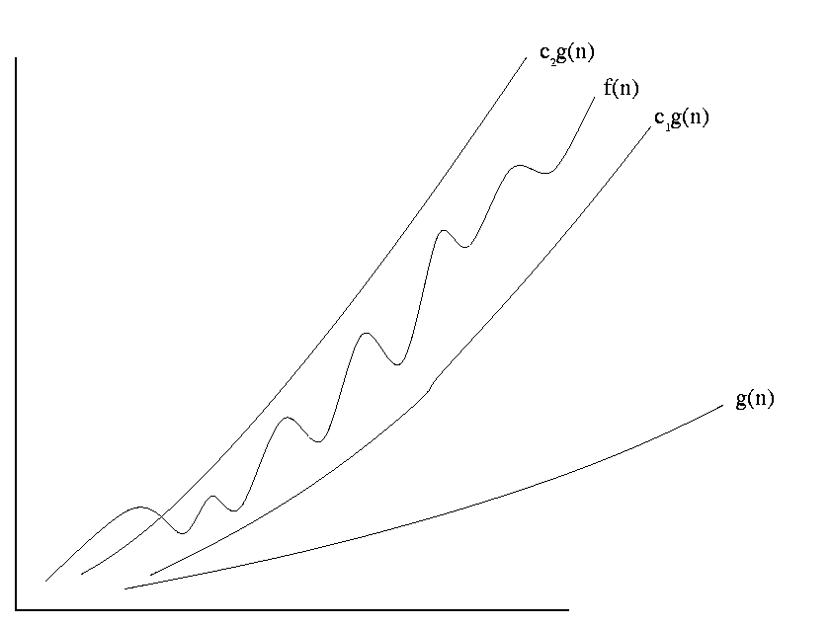
Definition of Theta
Def f(n) = θ(g(n))
∃c₁,∃c₂,∃n₀,∀n≥n₀, c₁g(n)≤f(n)≤c₂g(n)
c₂g(n)
f(n)
Def f(n) = O(g(n))
∃c₂,∃n₀,∀n≥n₀, f(n)≤c₂g(n)
c₁g(n)
Def f(n) = Ω(g(n))
∃c₁, ∃n₀,∀n≥n₀, c₁g(n)≤f(n)
n₀
n
f(n) is sandwiched between c₁g(n) and c₂g(n)
For some sufficiently small c₁ (= 0.0001)
For some sufficiently large c₂ (= 10000)
For all sufficiently large n
For some definition of “sufficiently large”

Slide 34
Definition of Theta
Def f(n) = θ(g(n))
∃c₁,∃c₂,∃n₀,∀n≥n₀, c₁g(n)≤f(n)≤c₂g(n)
= θ(n²)
Intuition: 3n²+7n+5
Drop low order terms
Drop multiplicative constant
Get n².

Slide 35
Proofs
Def f(n) = θ(g(n))
∃c₁,∃c₂,∃n₀,∀n≥n₀, c₁g(n)≤f(n)≤c₂g(n)
Proving 3n²+7n+5 = θ(n²)
Need: c_{1∃} n² ≤ 3n²+7n+5 ≤ c_{2∃} n²
Let’s do the lower bound and upper bound separately.

Slide 36
Proofs
Def f(n) = Ω(g(n))
∃c₁,∃n₀,∀n≥n₀, c₁g(n)≤f(n)
Proving 3n²+7n+5 = Ω(n²)
Need: c_{1∃} n² ≤ 3n²+7n+5
Let c_{1∃} be
Let n_{0∃} be
Let n∀≥n_{0∃} be arbitrary.
Have: c_{1∃}g(n∀) = 3n∀² ≤ 3n∀²+7n∀+5 = f(n∀)
Works ∀n≥0.
3
0
?

Slide 37
Proofs
Def f(n) = O(g(n))
∃c₂,∃n₀,∀n≥n₀, f(n)≤c₂g(n)
Proving 3n²+7n+5 = O(n²)
Need: 3n²+7n+5 ≤ c_{2∃} n²
Let c_{2∃} be
Note that c_{2∃}=3 does not work.
We could make c_{2∃}=1000000 but that lacks elegance.
We are going to give two different proofs.
Proof 1:
Make c_{2∃} as small as possible, c_{2∃}=3.0001 or c_{2∃}=4.
Works – but setting n₀ is hard.
Proof 2:
Set n₀=1 and then struggle a bit with c₂.

Slide 38
Proofs
Def f(n) = O(g(n))
∃c₂,∃n₀,∀n≥n₀, f(n)≤c₂g(n)
Proving 3n²+7n+5 = O(n²)
Need: 3n²+7n+5 ≤ c_{2∃} n²
Let c_{2∃} be
Let n_{0∃} be
Let n∀≥n_{0∃} be arbitrary.
Need: f(n_{ϖ}) = 3n∀²+7n∀+5 ≤ 4n² = c₂g(n)
7‧n+5 ≤ n²
7‧6+5 ≤ 6² false
7‧7+5 ≤ 7² false
7‧8+5 ≤ 8² true
7‧9+5 ≤ 9² true
4
8
?

Slide 39
Proofs
Def f(n) = O(g(n))
∃c₂,∃n₀,∀n≥n₀, f(n)≤c₂g(n)
Proving 3n²+7n+5 = O(n²)
Need: 3n²+7n+5 ≤ c_{2∃} n²
Let c_{2∃} be
Let n_{0∃} be
Let n∀≥n_{0∃} be arbitrary.
Need: f(n_{ϖ}) = 3n∀²+7n∀+5
= (3+ 7/n + 5/n²) n²
≤ (3+ 7/8 + 5/8²) n²
≤ ( 4 ) n²
= c₂g(n)
7. Prover can always win. Hence, the statement is true
4
8
Can we do this easier?

Slide 40
Proofs
Def f(n) = O(g(n))
∃c₂,∃n₀,∀n≥n₀, f(n)≤c₂g(n)
Proving 3n²+7n+5 = O(n²)
Need: 3n²+7n+5 ≤ c_{2∃} n²
Let c_{2∃} be
Let n_{0∃} be
Let n∀≥n_{0∃} be arbitrary.
f(n) = 3n²+7n + 5
≤ 3n²+7n²+5n²
≤ (3+7+5) n²
≤ c_{2∃}g(n∀)
7. Prover can always win.
Hence, the statement is true
3+7+5=15
1 because 1.01≤1.01²
Let’s cover the three
terms separately with:
3n² ≤ 3n²
7n ≤ 7n²
5 ≤ 5n²
Each of these needs n≥1.
1 ≤ 1
1 ≤ n
1 ≤ n²

Slide 41
Proofs
Def f(n) ≠ O(g(n))
∀c,∀n₀, ∃n≥n₀, f(n)>cg(n)
Proving 3n²+7n+5 ≠ O(n)
Let c∀ be arbitrary
Let n_{0∀} be arbitrary
Let n∃ ≥n_{0∀} be max(c∀,n_{0∀})+1
f(n∃) = 3n∃²+7n∃+5
> n∃ × n∃
> c∀ × n∃
= c∀ g(n∃)
7. Prover can always win.
Hence, the statement is true

Slide 42
Adding Made Easy
1
+
2
+
3
+
. . .
+
n-1
+
n
=
S
n (n+1)
S =
S =
Θ(n²)
2
n
S = Θ(# of terms × last term)
n
n
n
last term = n
n
n
n+1 n+1 n+1 n+1 n+1
# of terms = n

Slide 43
Adding Made Easy
Theorem: f(i) = n^{θ(1)}
increasing
∑_{i=1..n} f(i) = θ(n·f(n))
= Θ(# of terms × last term)
“Arithmetic Like”
Sequence: ⟨ 1³, 2³, 3³, 4³, 5³, …, n³⟩
Closed Formula: f(i) = a_{i} = i³
Middle Element: f(^{n}/₂) = (^{n}/₂)³ = ½³×n³ = Θ(n³)
Sum: ∑_{i=0..n} f(i) = 1³+2³+3³+4³+5³+…+(^{n}/₂)³+…+n³
Half terms are Θ(nn³)
= Θ(# of terms × last term)
= Θ(n×n³) = Θ(n⁴)
Sum: ∑_{i=0..n} i⁷ log(i)
= Θ(# of terms × last term)
= Θ(n² × (n²)⁷ log(n²))
= Θ(n¹⁶ log(n))
2

Slide 44
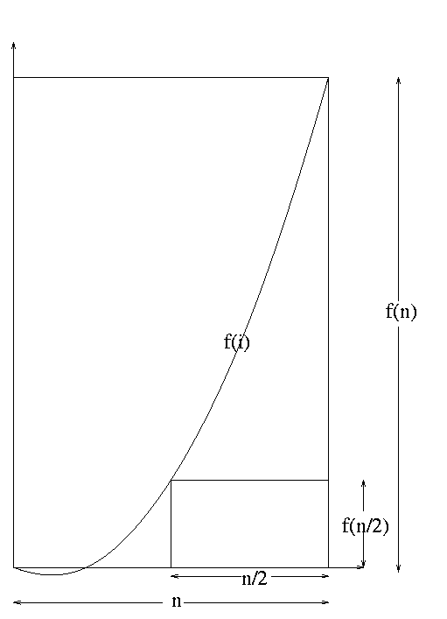
Adding Made Easy
Theorem: f(i) = n^{θ(1)}
increasing
∑_{i=1..n} f(i) = θ(n·f(n))
= Θ(# of terms × last term)
Proof:
^{n}/₂ · f(^{n}/₂)
= area of small square
≤
∑_{i=1..n} f(i)
≈ area under curve
≤
area of big square
= n · f(n)
Middle Element:
f(^{n}/₂) = (^{n}/₂)³ = ½³×n³ = Θ(n³)
Suppose A≤Β≤C and C=16A.
then ¹/₁₆C≤Β≤C.

Slide 45
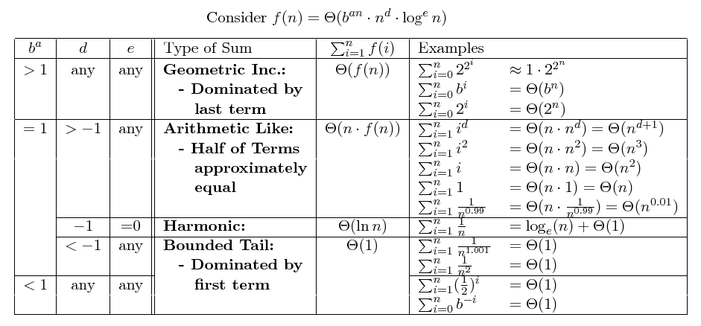
Adding Made Easy

Slide 46
End

