Slide 1
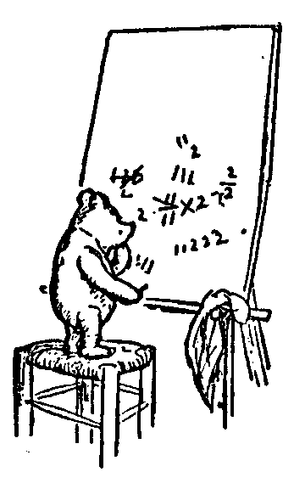
Sets, Functions, Sequences, Sums
Sets
Introduction
Proofs
Functions
Introduction
Onto, One-to-One, & Bijections
Inverses
Function Operations
Proofs
Graphs
Important Functions
Sequences/Recurrences/Sums
Arithmetic
Geometric
Fibonacci
Harmonic
Infinity
Countable
Uncountable
Uncomputable
Jeff Edmonds
York University
Lecture 2
EECS 1019

Slide 2
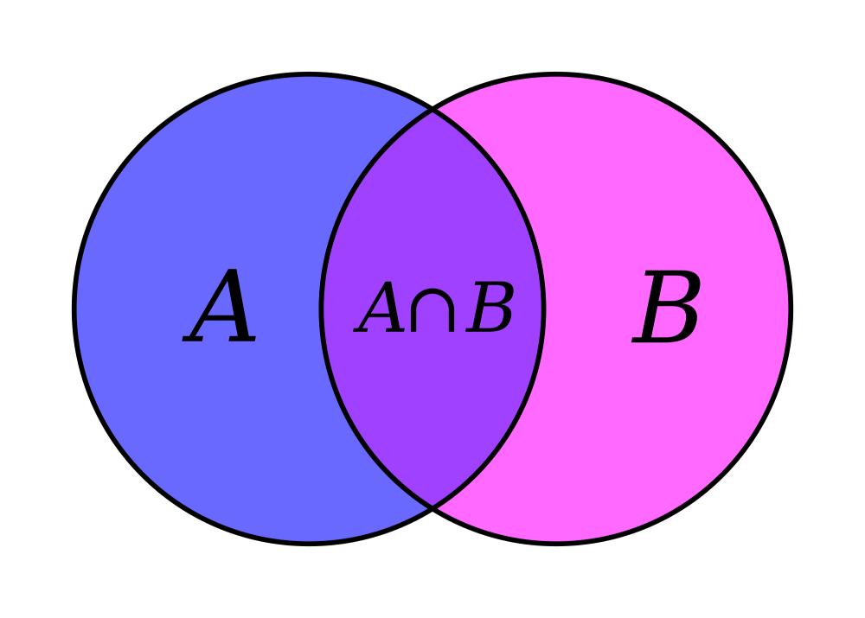


Sets
Set: Collects an unordered bunch of elements together.
Items do not appear more than once.
a ∈ A denotes that a is an element of the set A.
a ∉ A denotes that it is not.
$S=\left\{a,b,c,d\right\} = \left\{b,c,a,d\right\}$ $= \left\{a,b,c,b,c,d\right\}$

Slide 3
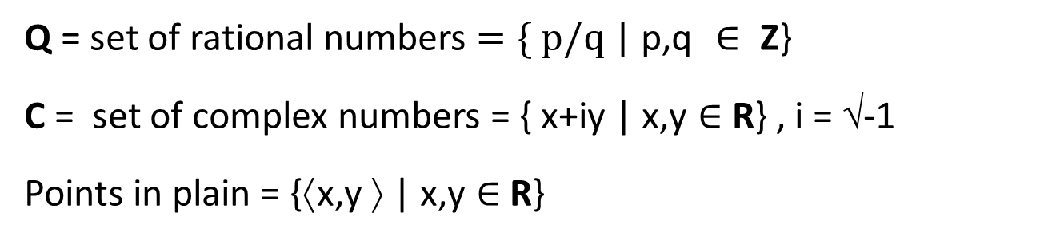




Sets
N = natural numbers = $\left\{0,1,2,3….\right\}$
Z = integers =
$$\left\{…,−3,−2,−1,0,1,2,3,…\right\}$$
$$Z^{+}$$
= positive integers =
$$\left\{1,2,3,…..\right\}$$
R = set of real numbers.
$${\text{R}}^{+}$$
= set of positive real numbers.
Q = set of rational numbers $=\{ \text{p}\text{/}\text{q} \text{| }\text{p}\text{,}\text{q} ∈ \text{Z}\text{\}}$
C = set of complex numbers = { x+iy | x,y $∈$ R} , i = √-1
Points in plain = {⟨x,y ⟩ | x,y $∈$ R}
3

Slide 4

Cardinality: number of (distinct) elements
|S| = |{3,5}| = 2
Finite set: cardinality some finite integer n
Infinite set: a set that is not finite

Slide 5
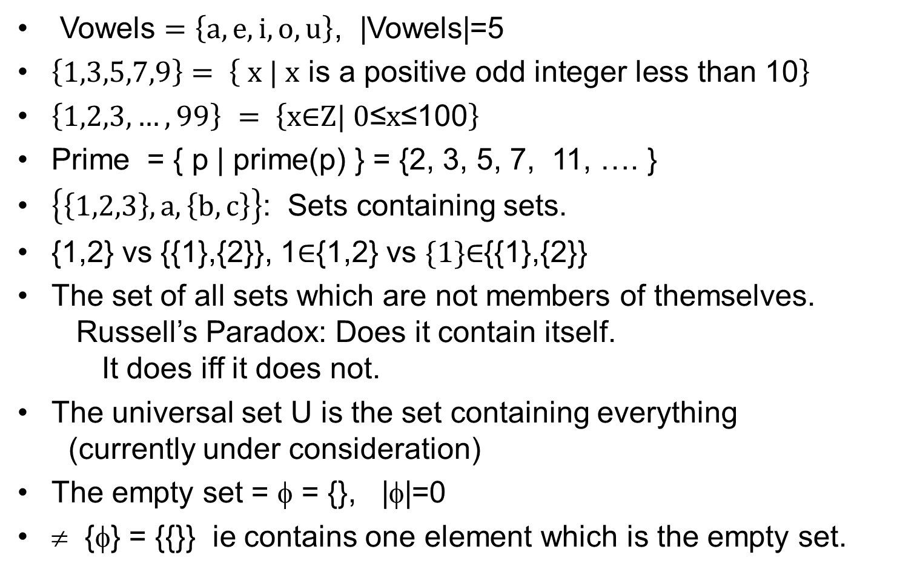
Sets
Vowels $=\left\{a,e,i,o,u\right\}$, |Vowels|=5
$\left\{1,3,5,7,9\right\}$ $= \left\{ x | x \text{is} \text{a} \text{positive} \text{odd} \text{integer} \text{less} \text{than}\text{ 10}\right\}$
$\left\{1,2,3,…,99\right\}$ $= \left\{x\text{∈}Z| 0\text{≤}x\text{≤}\text{100}\right\}$
Prime = { p | prime(p) } = {2, 3, 5, 7, 11, …. }
$\left\{\left\{1,2,3\right\},a, \left\{b,c\right\}\right\}$: Sets containing sets.
{1,2} vs {{1},{2}}, 1$\text{∈}${1,2} vs $\{1\}\text{∈}${{1},{2}}
The set of all sets which are not members of themselves.
Russell’s Paradox: Does it contain itself.
It does iff it does not.
The universal set U is the set containing everything
(currently under consideration)
The empty set = φ = {}, |φ|=0
≠ {φ} = {{}} ie contains one element which is the empty set.
5

Slide 6
Sets
closed interval
open interval
6

Slide 7
Sets
Union: A∪B = { x | (x∈A) ∨ (x∈B)}
Intersection: A∩B = { x | (x∈A) ∧ (x∈B)}
Difference: A\B = A–B = {x | (x∈A) ∧ (x∉B)}
Complement: A^{c} or Ā = {x | x ∉A} = U – A
Symmetric Different: A⊕B = (A-B)∪(B-A)
= { x | (x∈A) ⊕ (x∈B)}
A
B
A
B
A
B
A
A
B

Slide 8
Sets
A
B
C-(A∪B)
C∩(A∪B)
C∪(A∩B)
C
A
B
C
A
B
C

Slide 9
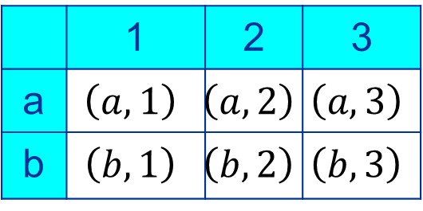

Sets
$\text{Cartesian} \text{product}\text{:} A×B=\left\{\left(a,b\right)|a∈A∧b∈B\right\}$
$A=\left\{a,b\right\} B=\left\{1,2,3\right\}$
$A×B= \left\{\left(a,1\right),\left(a,2\right),\left(a,3\right), \left(b,1\right),\left(b,2\right),\left(b,3\right)\right\}$
|A$×$B| = $|A|×|B$|
|{}$×$B| = $0×|B$| = 0
 | 1 | 2 | 3
a | $$\left(a,1\right)$$ | $$\left(a,2\right)$$ | $$\left(a,3\right)$$
b | $$\left(b,1\right)$$ | $$\left(b,2\right)$$ | $$\left(b,3\right)$$

Slide 10
Sets
Power set P(S) : set of all subsets of S.
  P(S) = 2^{S} = { A | A⊆S }
  P({ 1,2,3} ) =
  { {1,2,3}, {1,2 }, { 2,3}, { 2 },
  {1, 3}, {1 }, { 3}, { } }
|P(S)| = 2^{|S|}
|P( {1,2,3} )| = 2³ = 8
|P( {1} )| = 2¹ = 2, P( {1} ) = { {1}, {} }
|P({})| = 2⁰ = 1, P({}) = { {} }
P(S) includes {} and S.
+1
-1
+3
-3
+3
-3
+2
-2

Slide 11


Proofs
A
B
Subset: A ⊆ B: ∀x ( x∈A → x∈B)
I give you arbitrary x.
I assure you that x∈A.
I prove x∈B

Slide 12
Proofs
A
B
Subset: A ⊆ B: ∀x ( x∈A → x∈B)
iff ∀x∈A, x∈B
Proper subset: A ⊂ B: … & ∃x ( x∈B ∧ x∉A)
Note: φ ⊆ B and B ⊆ B
{ }
I give you arbitrary x∈A.
I prove x∈B
I give you an x,
and prove x∈B ∧ x∉A

Slide 13

Proofs
Equal: ∀x ( x∈A $↔$ x∈B)
iff A ⊆ B & B ⊆ A
iff [∀x∈A, x∈B] & [∀x∈B, x∈A]
Disjoint sets: A∩B = φ = {}
iff ∀x∈A, x∉B
A
B
I give you arbitrary x∈A.
I prove x∈B
I give you arbitrary x∈B.
I prove x∈A
A
B
I give you arbitrary x∈A.
I prove x∉B

Slide 14

Proofs
Inclusion-Exclusion:
$\left|A∪B\right|=\left|A\right|+\left|B\right|−\left|A∩B\right|$
A
B
A
B
A
B
A
B
=
+
-

Slide 15






Proofs
Inclusion-Exclusion:
$$\left|A\right|+\left|B\right|+|C|$$
$$\left|A∪B∪C\right|=$$
$$−\left|A∩B\right|$$
$$−\left|A∩C\right|$$
$$−\left|B∩C\right|$$
$$+\left|A∩B∩C\right|$$
A
B
A
B
A
B
A
B
1
1
1
1
1
1
1
1
=
1
+
+
1
1
1
1
1
1
1
1
1
C
C
1
C
C
A
B
A
B
A
B
1
-
-
1
-
1
1
1
1
C
C
C
A
B
+
1
A
B
A
B
A
B
C
1
2
1
1
1
1
1
1
1
=
3
1
2
2
1
1
1
1
1
1
1
C
C
C

Slide 16
Proof Techniques/Lemmas
And ∧:
Or ∨:
Implies →:
And
Or
Using:
Proving:
From:
Conclude:
From:
Conclude:
Separating And
Eval/Build ∧
α∧β
α & β
α & β
¬β
α∧β
¬(β∧γ)
Selecting Or
Eval/Build ∨
α∨β & ¬α
β
α
¬α & ¬β
α∨γ
¬(α∨β)
Cases
Excluded Middle
α∨β, α→γ, & β→γ
γ
α∨¬α & ¬(α∧¬α)
Modus Ponens
Deduction
α & α→β
β
Assume α, prove β
α→β
Cases
Eval/Build →
α∨β, α→γ, & β→γ
γ
β
¬α
α & ¬β
γ→β
α→γ
¬(α→β)
Equivalence
Contrapositive
α→β & β→α
α iff β
α→β iff ¬β→¬α iff ¬α∨β
Transitivity
De Morgan's Law
α→β & β→γ
α→γ
¬(α∧β) iff
¬α∨¬β
Double Negation: ¬¬α iff α
Commutative: α∨β iff β∨α and α∧β iff β∧α
Distributive: γ∧(α∨β) iff (γ∧α)∨(γ∧β) and γ∨(α∧β) iff (γ∨α)∧(γ∨β)
By Contradiction: From ¬α→(β&¬β), conclude α.
Inconsistent: From β and ¬β, conclude anything.

Slide 17

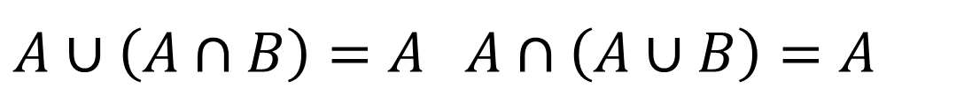
Sets
Identity laws
Domination laws
Idempotent laws
$$A∪\overline{A}=U A∩\overline{A}=∅$$
Complement laws
$$A∪B=B∪A A∩B=B∩A$$
Commutative laws
Associative laws
Distributive laws
De Morgan’s laws
$$A∪\left(A∩B\right)=A A∩\left(A∪B\right)=A$$
Absorption laws
17

Slide 18
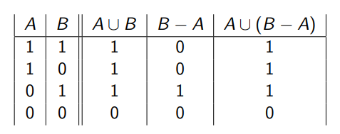
Prove: [A∪(B-A)] = [A∪B] (for all sets A and B)
Difference: A–B = {x | (x∈A) ∧ (x∉B)}
Proof by Venn Diagrams / Tables.
A
B-A
A∪B
A
B
A
B
A
B
A∪(B-A)
A
B
But |proof| = 2^{n}

Slide 19
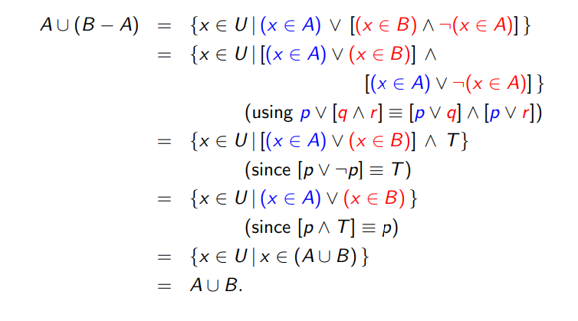
Prove: [A∪(B-A)] = [A∪B] (for all sets A and B)
Difference: A–B = {x | (x∈A) ∧ (x∉B)}
Proof by logic
Aaaaah!
Reading other people’s proof can be hard.

Slide 20
Prove: [A∪(B-A)] = [A∪B] (for all sets A and B)
Difference: A–B = {x | (x∈A) ∧ (x∉B)}
A
B-A
A∪B
A
B
A
B
A
B

Slide 21

Prove: [A∪(B-A)] = [A∪B] (for all sets A and B)
i.e. [A∪(B-A)] ⊆ [A∪B] & [A∪B] ⊆ [A∪(B-A)]
i.e. [∀x∈[A∪(B-A)], x∈[A∪B]] & [∀x∈[A∪B], x∈[A∪(B-A)]]
A
B-A
A∪B
A
B
A
B
A
B
Proof by cases:
x∈A & x∈B
x∈A & x∉B
x∉A & x∈B
x∉A & x∉B
Prove: …. & …..
Let’s try to do it with only two cases.
Must prove both

Slide 22
Prove: [A∪(B-A)] = [A∪B] (for all sets A and B)
i.e. [A∪(B-A)] ⊆ [A∪B] & [A∪B] ⊆ [A∪(B-A)]
i.e. [∀x∈[A∪(B-A)], x∈[A∪B]] & [∀x∈[A∪B], x∈[A∪(B-A)]]
A
B-A
A∪B
A
B
A
B
A
B
Prove: ∀x∈[A∪(B-A)], x∈[A∪B]
Let x be an arbitrary element in A∪(B-A).
x∈A or x∈(B-A)
Cases Goal x∈[A∪B]. Cases x∈A or x∈(B-A)
Case x∈A
x∈[A∪B]
Case x∈(B-A)
x∈B
x∈[A∪B]
x∈[A∪B]
Hence ∀x∈[A∪(B-A)], x∈[A∪B]
Def of ∪
Def of ∪
Def of -
Def of ∪
By Cases 2, 5, 8

Slide 23
Prove: [A∪(B-A)] = [A∪B] (for all sets A and B)
i.e. [A∪(B-A)] ⊆ [A∪B] & [A∪B] ⊆ [A∪(B-A)]
i.e. [∀x∈[A∪(B-A)], x∈[A∪B]] & [∀x∈[A∪B], x∈[A∪(B-A)]]
A
B-A
A∪B
A
B
A
B
A
B
Prove: ∀x∈[A∪B], x∈[A∪(B-A)]
Let x be an arbitrary element in A∪B.
x∈A or x∈B
Cases Goal x∈[A∪(B-A)]. Cases x∈A or x∈B
Case x∈A
x∈[A∪(B-A)]
Case x∈B
Def of ∪
Def of ∪
How do we prove the –A does not destroy x?

Slide 24
Prove: [A∪(B-A)] = [A∪B] (for all sets A and B)
i.e. [A∪(B-A)] ⊆ [A∪B] & [A∪B] ⊆ [A∪(B-A)]
i.e. [∀x∈[A∪(B-A)], x∈[A∪B]] & [∀x∈[A∪B], x∈[A∪(B-A)]]
A
B-A
A∪B
A
B
A
B
A
B
Prove: ∀x∈[A∪B], x∈[A∪(B-A)]
Let x be an arbitrary element in A∪B.
x∈A or x∉A
Cases Goal x∈[A∪(B-A)]. Cases x∈A or x∉A
Case x∈A
x∈[A∪(B-A)]
Case x∉A
x∈B-A
x∈[A∪(B-A)]
x∈[A∪(B-A)]
∀x∈[A∪B], x∈[A∪(B-A)]
Excluded Middle
Def of ∪
Def of - (1&5)
Def of ∪
By cases 2, 5, & 9

Slide 25
Introduction to Functions
Function: Maps the elements in one set to those in another.
A
f
B
a
b
c
1
2
3
E.g.: f(a)=2
  2 is called the image of a under f.
  a is called the preimage of 2.
Set: f({a,b}) = {2,1}
∀S⊆A: f(S) = { f(x) | x∈S }

Slide 26
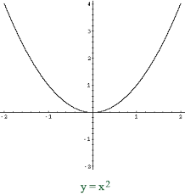
Introduction to Functions
Function: Maps the elements in one set to those in another.
A
f
B
a
b
c
1
2
3
B
A
E.g.: f(x)=x² (where A = B = reals/integers)

Slide 27
Introduction to Functions
Function: Maps the elements in one set to those in another.
A
f
B
a
b
c
1
2
3
B
d
A
Domain: A Co-domain: B
  f: A → B (→ is not “implies”)
  We assume that f is well defined on A:
  Each object/element x in A
  is mapped to some element y in B.
  ∀x∈A f(x)∈B
  Eg f(x) = √x is not defined on negative reals

Slide 28
Introduction to Functions
Function: Maps the elements in one set to those in another.
A
f
B
a
b
c
1
2
3
B
A
Function vs Relation:
  f(x) is one well defined object.
  If f maps a to both 2 and to 3,
  ⟨a,2⟩ & ⟨a,3⟩ ∈ R²
  then it is a relation.
  y²=x is a relation
  y = f(x) = √x is a function

Slide 29
Introduction to Functions
Function: Maps the elements in one set to those in another.
A
f
B
Range
a
b
c
1
2
3
B
A
Range:
  The set of elements mapped too.
  range(f) = {y | ∃x∈A f(x)=y} ⊆ B

Slide 30
Onto, One-to-One, & Bijections
Function: Maps the elements in one set to those in another.
A
f
B
Range
a
b
c
1
2
3
B
A
x
y
Onto / Surjective function:
  Every element y∈B is mapped to.
  Range = Co-domain B
∀y∈B, ∃x∈A, f(x)=y
I give you arbitrary y∈B.
I construct x∈A
I prove f(x)=y

Slide 31
Onto, One-to-One, & Bijections
Function: Maps the elements in one set to those in another.
A
f
B
Range
a
b
c
1
2
3
B
A
Onto / Surjective function:
  Every element y∈B is mapped to.
  Range = Co-domain B
∀y∈B, ∃x∈A, f(x)=y
  |A| ≥ |B|
    Everything in B is hit – maybe twice
    But things in A can’t hit more than once each.

Slide 32
Onto, One-to-One, & Bijections
Function: Maps the elements in one set to those in another.
A
f
B
a
b
c
1
2
3
B
x
y
A
x´
y´
One-to-One / Injective function:
  Elements in B do not get mapped to twice.
∀x,x´∈A [f(x)=f(x´) → x=x´]
[x≠x´ → f(x)≠f(x´)]
I give you arbitrary x,x´∈A with x≠x´.
I prove f(x)≠f(x´).

Slide 33
Onto, One-to-One, & Bijections
Function: Maps the elements in one set to those in another.
A
f
B
a
b
c
1
2
3
B
4
A
One-to-One / Injective function:
  Elements in B do not get mapped to twice.
  |A| ≤ |B|
    Every element of A “counts” off one element of B
    ie point to each as you say 1, 2, 3, 4, …
    And there may be some elements of B not hit.

Slide 34
Onto, One-to-One, & Bijections
Function: Maps the elements in one set to those in another.
A
f
B
a
b
c
1
2
3
B
4
A
One-to-One / Injective function:
  Elements in B do not get mapped to twice.
  |A| ≤ |B|
    Even if infinite, we say A is “countable”
    if it has a 1-1 mapping to the integers.
≤ |Set of Integers| = “countable”

Slide 35
Onto, One-to-One, & Bijections
Function: Maps the elements in one set to those in another.
A
f
B
a
b
c
1
2
3
B
4
A
One-to-One / Injective function:
  Elements in B do not get mapped to twice.
  If f is continuous, then f is monotone
  increasing or decreasing.
  Because if it increases & decreases
  it would not be 1-1.

Slide 36
Onto, One-to-One, & Bijections
Function: Maps the elements in one set to those in another.
A
f
B
a
b
c
1
2
3
B
A
Onto / Surjective function:
  Every element y∈B is mapped to.
∀y∈B, ∃x∈A, f(x)=y
One-to-One / Injective function:
  Elements in B do not get mapped to twice.
∀x,x´∈A [f(x)=f(x´) → x=x´].
Bijection: Both 1-1 and onto.

Slide 37
Onto, One-to-One, & Bijections
Function: Maps the elements in one set to those in another.
A
f
B
a
b
c
2
1
3
Onto / Surjective function:
  Every element y∈B is mapped to.
∀y∈B, ∃x∈A, f(x)=y
One-to-One / Injective function:
  Elements in B do not get mapped to twice.
∀x,x´∈A [f(x)=f(x´) → x=x´].
Bijection: Both 1-1 and onto.
|A| ≥ |B|
|A| ≤ |B|
|A|=|B|

Slide 38
Inverses
Function: Maps the elements in one set to those in another.
A
f
B
a
b
c
1
2
3
B
4
f ⁻¹
A
One-to-One / Injective function:
  Elements in B do not get mapped to twice.
Inverse: Mapping in the reverse direction
  f: A → B f ⁻¹: B → A
  ∀x,y f ⁻¹(y)=x iff f(x)=y
  f needs to be one-to-one.
f ⁻¹(x) ≠ ¹/_{f(x)}

Slide 39
Inverses
Function: Maps the elements in one set to those in another.
A
f
B
a
b
c
1
2
3
B
4
f ⁻¹
A
One-to-One / Injective function:
  Elements in B do not get mapped to twice.
Inverse: Mapping in the reverse direction
  f: A → B f ⁻¹: B → A
  ∀x,y f ⁻¹(y)=x iff f(x)=y
  f needs to be one-to-one.
or else don’t know how to map back!

Slide 40
Inverses
Function: Maps the elements in one set to those in another.
A
f
B
Range
a
b
c
1
2
3
B
4
f ⁻¹
A
One-to-One / Injective function:
  Elements in B do not get mapped to twice.
Inverse: Mapping in the reverse direction
  f: A → B f ⁻¹: B → A
  ∀x,y f ⁻¹(y)=x iff f(x)=y
  If not Onto / Surjective function
  f ⁻¹(3) not defined. Domain of f ⁻¹ = Range of f.

Slide 41
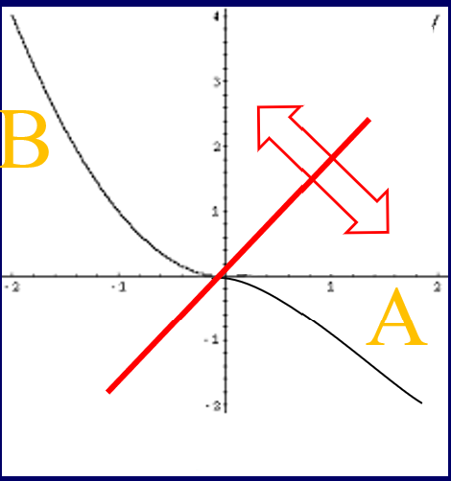
Inverses
Function: Maps the elements in one set to those in another.
A
f
B
a
b
c
1
2
3
B
4
f ⁻¹
A
One-to-One / Injective function:
  Elements in B do not get mapped to twice.
Inverse: Mapping in the reverse direction
  f: A → B f ⁻¹: B → A
  ∀x,y f ⁻¹(y)=x iff f(x)=y

Slide 42
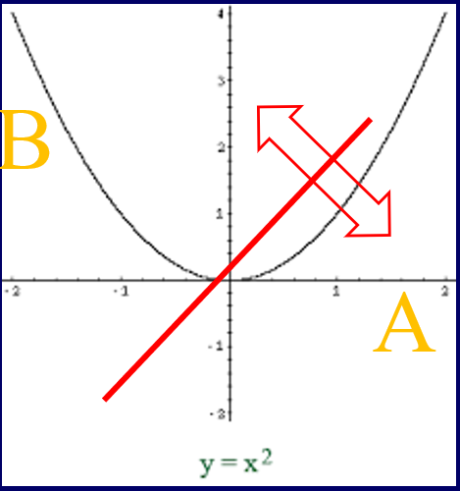
Inverses
Function: Maps the elements in one set to those in another.
A
f
B
a
b
c
1
2
3
B
4
f ⁻¹
A
One-to-One / Injective function:
  Elements in B do not get mapped to twice.
Inverse: Mapping in the reverse direction
  f: A → B f ⁻¹: B → A
  ∀x,y f ⁻¹(y)=x iff f(x)=y
  Eg: y = f(x) = x²
  x = f ⁻¹(y) = √y

Slide 43
Function Operations
Function: Maps the elements in one set to those in another.
A
f₁
B
a
b
c
2
1
3
f₂
Adding: f = f₁+f₂
  ∀x∈A f(x) = (f₁+f₂)(x) = f₁(x)+f₂(x)
  Eg: f(a) = f₁(a)+f₂(a) = 2+3 = 5
Multiplying: f = f₁×f₂
  ∀x∈A f(x) = (f₁×f₂)(x) = f₁(x)×f₂(x)
  Eg: f(a) = f₁(a)×f₂(a) = 2×3 = 6

Slide 44
Function Operations
Function: Maps the elements in one set to those in another.
A
B
C
f₁
a
b
c
2
1
3
u
v
w
f₂
Composition: f = f₂⸰f₁
  ∀x∈A f(x) = (f₂⸰f₁)(x) = f₂( f₁(x) )
  Eg: f(a) = f₂( f₁(a) ) = f₂(2) = w
  f₁ : A → B & f₂ : B → C
  Eg: f₁(x) = x², f₂(x) = x+4
  f₂( f₁(x) ) = f₂(x²) = x²+4
  f₁( f₂(x) ) = f₁(x+4) = (x+4)²

Slide 45
Function Operations
Function: Maps the elements in one set to those in another.
A
f
B
a
b
c
1
2
3
4
f ⁻¹
Composition: f = f₂⸰f₁
  ∀x∈A f(x) = (f₂⸰f₁)(x) = f₂( f₁(x) )
  (f ⁻¹ ⸰ f)(x) = f ⁻¹( f(x) ) = x
  Eg: f ⁻¹( f(a) ) = f ⁻¹(2) = a
  (f ⸰ f ⁻¹)(y) = f( f ⁻¹(y) ) = x
  Eg: f( f ⁻¹(2) ) = f(a) = 2
  f( f ⁻¹(3) ) = oops

Slide 46
Proofs
Function: Maps the elements in one set to those in another.
A
B
C
f₁
a
b
c
2
1
3
u
v
w
f₂
Onto / Surjective function: every element z∈C is mapped to.
  Lemma: If f₂ is onto, then so is f₂⸰f₁.
Wrong!

Slide 47
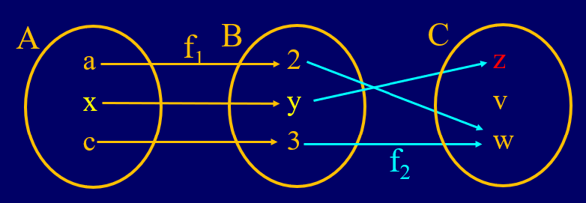
Proofs
Onto / Surjective function: every element z∈C is mapped to.
  Lemma: If f₁ and f₂ are onto, then so is f₂⸰f₁.
  α: ∀z∈C, ∃y∈B, f₂(y)=z
  β: ∀y∈B, ∃x∈A, f₁(x)=y
  γ: → ∀z∈C, ∃x∈A, (f₂⸰f₁)(x)=z
  Proof: Let z be arbitrary
I give you z.

Slide 48
Proofs
Onto / Surjective function: every element z∈C is mapped to.
  Lemma: If f₁ and f₂ are onto, then so is f₂⸰f₁.
  α: ∀z∈C, ∃y∈B, f₂(y)=z
  β: ∀y∈B, ∃x∈A, f₁(x)=y
  γ: → ∀z∈C, ∃x∈A, (f₂⸰f₁)(x)=z
  Proof: Let z be arbitrary.
    By α, there is a y for which f₂(y)=z.
I give you z.
I give you y.
α
I assure you f₂(y)=z.

Slide 49
Proofs
Onto / Surjective function: every element z∈C is mapped to.
  Lemma: If f₁ and f₂ are onto, then so is f₂⸰f₁.
  α: ∀z∈C, ∃y∈B, f₂(y)=z
  β: ∀y∈B, ∃x∈A, f₁(x)=y
  γ: → ∀z∈C, ∃x∈A, (f₂⸰f₁)(x)=z
  Proof: Let z be arbitrary.
    By α, there is a y for which f₂(y)=z.
    By β, there is a x for which f₁(x)=y.
I give you y.
I give you x.
β
I assure you f₁(x)=y.

Slide 50
Proofs
Onto / Surjective function: every element z∈C is mapped to.
  Lemma: If f₁ and f₂ are onto, then so is f₂⸰f₁.
  α: ∀z∈C, ∃y∈B, f₂(y)=z
  β: ∀y∈B, ∃x∈A, f₁(x)=y
  γ: → ∀z∈C, ∃x∈A, (f₂⸰f₁)(x)=z
  Proof: Let z be arbitrary.
    By α, there is a y for which f₂(y)=z.
    By β, there is a x for which f₁(x)=y
    (f₂ ⸰ f₁)(x) = f₂( f₁(x) ) = f₂(y) = z
I give you x.
I assure you (f₂ ⸰ f₁)(x) = z.

Slide 51
Proofs
Onto / Surjective function: every element z∈C is mapped to.
  Lemma: If f₁ and f₂ are onto, then so is f₂⸰f₁.
  α: ∀z∈C, ∃y∈B, f₂(y)=z
  β: ∀y∈B, ∃x∈A, f₁(x)=y
  γ: → ∀z∈C, ∃x∈A, (f₂⸰f₁)(x)=z
  Proof: Let z be arbitrary.
    By α, there is a y for which f₂(y)=z.
    By β, there is a x for which f₁(x)=y
    (f₂ ⸰ f₁)(x) = f₂( f₁(x) ) = f₂(y) = z
    Hence, if f₁ and f₂ are one-to-one, then so is f₂⸰f₁.

Slide 52
Proofs
One-to-One / Injective function:
  Elements in C do not get mapped to twice.
  Lemma: If f₁ and f₂ are one-to-one, then so is f₂⸰f₁.
α: ∀x,x´∈A [x≠x´ → f₁(x)≠f₁(x´)]
β: ∀y,y´∈B [y≠y´ → f₂(y)≠f₂(y´)]
γ: → ∀x,x´∈A [x≠x´ → (f₂⸰f₁)(x)≠(f₂⸰f₁)(x´)]
  Proof: Let x,x´ be arbitrary with x≠x´
    By α, f₁(x)≠f₁(x´).
    By β, f₂(y)≠f₂(y´)
    Hence, if f₁ and f₂ are one-to-one, then so is f₂⸰f₁.
Let y=f₁(x) and y´=f₁(x´)
Hence, (f₂⸰f₁)(x)≠(f₂⸰f₁)(x´)

Slide 53
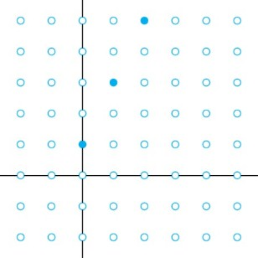
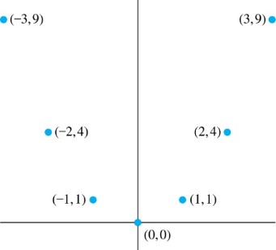
Graphs of Functions
Let f be a function from the set A to the set B. The graph of the function f is the set of ordered pairs
Graph of f(n) = 2n + 1 from Z to Z
Graph of
from Z to Z
Access the text alternative for slide images.
53

Slide 54
Some Important Functions
The floor function, denoted
is the largest integer less than or equal to x.
The ceiling function, denoted
is the smallest integer greater than or equal to x. Example:
54

Slide 55
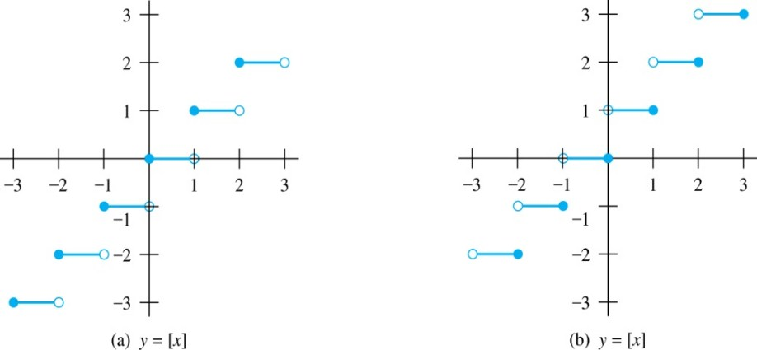
Floor and Ceiling Functions 1
Graph of (a) Floor and (b) Ceiling Functions
Access the text alternative for slide images.
55

Slide 56
Factorial Function
Definition:
denoted by
is the
product of the first n positive integers when n is a nonnegative integer.
Stirling’s Formula:
Examples:
56

Slide 57
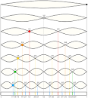
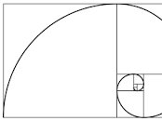
Sequences/Recurrences/Sums
Sequence: A ordered list of objects (possibly infinitely long)
⟨ a_{i} | 0 ≤ i ≤ n ⟩ = ⟨ a₀, a₁, a₂, a₃, …, a_{n} ⟩
  Arbitrary: ⟨ 3, r, 92, a, …. ⟩
  String: ⟨ H, e, l, l, o, , T, h, e, r, e, …. ⟩
  Direction: ⟨ go left, go up, go right, …. ⟩
  Arithmetic: ⟨ 0, 1, 2, 3, …, n ⟩
    Each is an additive 1 bigger.
    Linear growth
  Geometric: ⟨ 1, 2, 4, 8, 16, …, 2^{n} ⟩
    Each is a multiplicative 2 bigger.
    Exponential growth
  Fibonacci: ⟨ 0, 1, 1, 2, 3, 5, 8, 13, 21,…. ⟩
    Golden ratio
  Harmonic: ⟨ 1, ¹/₂, ¹/₃, ¹/₄, …. ⟩ From music

Slide 58
Sequences/Recurrences/Sums
Sequence: A ordered list of objects (possibly infinitely long)
⟨ a_{i} | 0 ≤ i ≤ n ⟩ = ⟨ a₀, a₁, a₂, a₃, …, a_{n} ⟩
Closed Formula: Expresses a_{i} as a function of i.
Recurrence Relation: Expresses next a_{i} as a function of previous
        as a function of previous a_{i-1}, a_{i-2}, a_{i-3}, …, a₀
Summation: ∑_{i=0}^{n} a_{i} = a₀ + a₁ + a₂ + a₃ + a₄ + … + a_{n}
Arithmetic:
Sequence: ⟨ 0, 1, 2, 3, …, n ⟩
Closed Formula: a_{i} = i
Rec Rel: a₀ = 0, a_{i} = a_{i-1} + 1
Sum: ∑_{i=0..n} = 1 + 2 + 3 + 4 + … + n
Each is an additive 1 bigger

Slide 59
Adding Made Easy
1
+
2
+
3
+
. . .
+
n-1
+
n
=
S
= number of white dots
1 2 . . . . . . . . n

Slide 60
Adding Made Easy
1
+
2
+
3
+
. . .
+
n-1
+
n
=
S
= number of white dots
n
+
n-1
+
n-2
+
. . .
+
2
+
1
=
S
= number of yellow dots
n . . . . . . . 2 1
1 2 . . . . . . . . n

Slide 61
Adding Made Easy
1
+
2
+
3
+
. . .
+
n-1
+
n
=
S
= number of white dots
n
+
n-1
+
n-2
+
. . .
+
2
+
1
=
S
= number of yellow dots
n
n
2S dots
n
= # dots in the grid
= n(n+1)
n
n
n (n+1)
S =
2
n
n+1 n+1 n+1 n+1 n+1

Slide 62
Adding Made Easy
1
+
2
+
3
+
. . .
+
n-1
+
n
=
S
n (n+1)
S =
2
n
1
1+2
1+2+3
1+2+3+4
1+2+3+4+5
1+2+3+4+5+6
1+2+3+4+5+6+7
= ½×1×2 = 1
= ½×2×3 = 3
= ½×3×4 = 6
= ½×4×5 = 10
= ½×5×6 = 15
= ½×6×7 = 21
= ½×7×8 = 28
n
n
n
n
n
We tend to focus on what happens when n gets really big.
n+1 n+1 n+1 n+1 n+1

Slide 63
Adding Made Easy
1
+
2
+
3
+
. . .
+
n-1
+
n
=
S
n (n+1)
S =
2
1
1+…+10
1+…+100
1+…+1000
1+…+10000
1+…+100000
1+…+1000000
= ½× 1× 2 = 1
= ½× 10 × 11 = 55
= ½× 100 × 101 = 5050
= ½× 1000 × 1001 = 500500
= ½× 10000 × 10001 = 50005000
= ½× 100000 × 100001 = 5000050000
= ½×1000000 ×1000001 = 500000500000
= ½× 1× 1 = 0.5
= ½× 10 × 10 = 50
= ½× 100 × 100 = 5000
= ½× 1000 × 1000 = 500000
= ½× 10000 × 10000 = 50000000
= ½× 100000 × 100000 = 5000000000
= ½×1000000 ×1000000 = 500000000000
This is too much detail.
Drop the +1.

Slide 64
Adding Made Easy
1
+
2
+
3
+
. . .
+
n-1
+
n
=
S
n (n+1)
S =
S =
Θ(n²)
2
1
1+…+10
1+…+100
1+…+1000
1+…+10000
1+…+100000
1+…+1000000
= ½× 1× 2 = 1
= ½× 10 × 11 = 55
= ½× 100 × 101 = 5050
= ½× 1000 × 1001 = 500500
= ½× 10000 × 10001 = 50005000
= ½× 100000 × 100001 = 5000050000
= ½×1000000 ×1000001 = 500000500000
= 1× 1 = 1
= 10 × 10 = 100
= 100 × 100 = 10000
= 1000 × 1000 = 1000000
= 10000 × 10000 = 100000000
= 100000 × 100000 = 10000000000
= 1000000 ×1000000 = 1000000000000
This is too much detail.
Drop the +1.
Drop the ½ .
Close enough.

Slide 65
Adding Made Easy
1
+
2
+
3
+
. . .
+
n-1
+
n
=
S
n (n+1)
S =
S =
Θ(n²)
2
n
S = Θ(# of terms × last term)
n
n
n
last term = n
n
n
n+1 n+1 n+1 n+1 n+1
# of terms = n

Slide 66
Sequences/Recurrences/Sums
Arithmetic:
Sequence: ⟨ 0, 1, 2, 3, …, n ⟩
Closed Formula: a_{i} = i
Rec Rel: a₀ = 0, a_{i} = a_{i-1} + 1
Sum: ∑_{i=0..n} a_{i} = ½ n(n+1)
= Θ(# of terms × last term)
Θ means ignoring the multiplicative constant
and low order terms.
Multiply by d
⟨ 0, d, 2d, 3d, …, dn ⟩
a_{i} = d×i
a₀ = 0, a_{i} = a_{i-1} + d
∑_{i=0..n} a_{i} = d× ½ n(n+1)
= Θ(# of terms × last term)

Slide 67
Sequences/Recurrences/Sums
Arithmetic: Multiply by d
Sequence: ⟨ 0, d, 2d, 3d, …, dn ⟩
Closed Formula: a_{i} = d×i
Rec Rel: a₀ = 0, a_{i} = a_{i-1} + d
Sum: ∑_{i=0..n} a_{i} = d× ½ n(n+1)
= Θ(# of terms × last term)
Multiply by d and add b
⟨ b, d+b, 2d+b, 3d+b, …, dn+b ⟩
a_{i} = d×i + b
a₀ = b, a_{i} = a_{i-1} + d
∑_{i=0..n} a_{i} = d× ½ n(n+1)
+ (n+1) ×b
= Θ(# of terms × last term)

Slide 68
Sequences/Recurrences/Sums
Arithmetic: Multiply by d and add b
Sequence: ⟨ b, d+b, 2d+b, 3d+b, …, dn+b ⟩
Closed Formula: a_{i} = d×i
Rec Rel: a₀ = b, a_{i} = a_{i-1} + d
Sum: ∑_{i=0..n} a_{i} = d× ½ n(n+1) + (n+1) ×b
= Θ(# of terms × last term)
  d=1 b=0: ⟨ 0, 1, 2, 3, …, n ⟩
  d=1 b=4: ⟨ 4, 5, 6, 7, …, n+4 ⟩
  d=2 b=4: ⟨ 4, 6, 8, 10, …, 2n+4 ⟩
  d=0 b=4: ⟨ 4, 4, 4, 4, …, 4 ⟩

Slide 69
Sequences/Recurrences/Sums
Arithmetic: Multiply by d and add b
Sequence: ⟨ b, d+b, 2d+b, 3d+b, …, dn+b ⟩
Closed Formula: a_{i} = d×i
Rec Rel: a₀ = b, a_{i} = a_{i-1} + d
Sum: ∑_{i=0..n} a_{i} = d× ½ n(n+1) + (n+1) ×b
= Θ(# of terms × last term)
Determine next in sequence:
⟨ 233, 426, 619, 812, 1005, … ⟩
193 193 193 193 193
next is 1005+193= 1198
d=? b=?
b = first = 233
d = a_{n}-a_{n-1} = the difference between consecutive terms

Slide 70
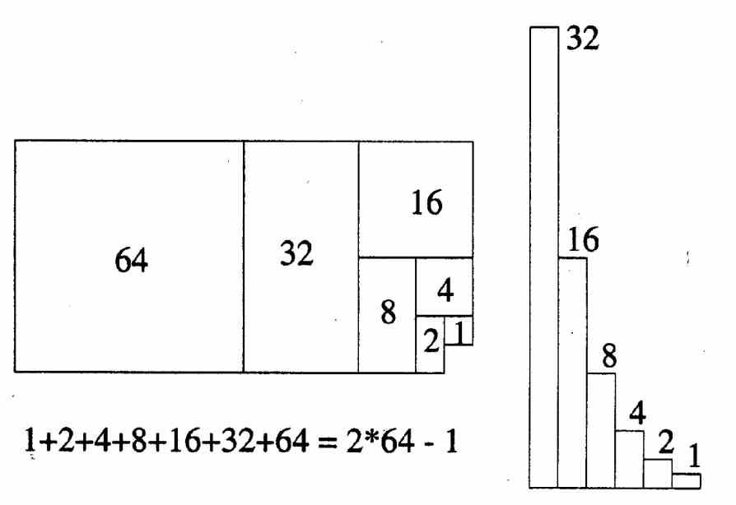
Sequences/Recurrences/Sums
Geometric:
Sequence: ⟨ 1, 2, 4, 8, 16, …, 2^{n} ⟩
Closed Formula: a_{i} = 2^{i}
Rec Rel: a₀ = 1, a_{i} = 2 × a_{i-1}
Sum:
= Θ(biggest term)

Slide 71
Sequences/Recurrences/Sums
Geometric:
Sequence: ⟨ 1, 2, 4, 8, 16, …, 2^{n} ⟩
Closed Formula: a_{i} = 2^{i}
Rec Rel: a₀ = 1, a_{i} = 2 × a_{i-1}
Sum: ∑_{i=..n} a_{i} = 2^{n+1} -1
= Θ(biggest term)
    s = ∑_{i=0..n} r^{i} = r⁰ + r¹ + r² +. . . + r^{n}
    rs = ∑_{i=0..n} r^{i+1} = r¹ + r² + r³ +. . . + r^{n+1}
    rs-s = (r-1)s = r^{n+1} - r⁰
    s = (r^{n+1}-1)/(r-1)
= Θ(biggest term)
Multiplicative factor r. (Ratio)
⟨ 1, r, r², r³, …, r^{n} ⟩
a_{i} = r^{i}
a₀ = 1, a_{i} = r × a_{i-1}
∑_{i=0..n} a_{i} = (r^{n+1}-1)/(r-1)
True whenever terms increase quickly

Slide 72
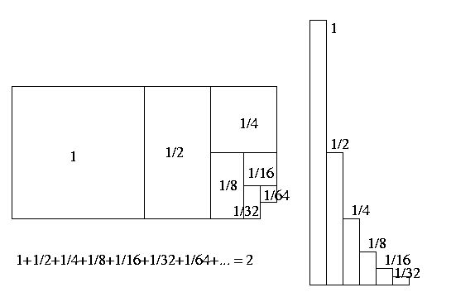
Sequences/Recurrences/Sums
Geometric:
Sequence: ⟨ 1, 2, 4, 8, 16, …, 2^{n} ⟩
Closed Formula: a_{i} = 2^{i}
Rec Rel: a₀ = 1, a_{i} = 2 × a_{i-1}
Sum: ∑_{i=..n} a_{i} = 2^{n+1} -1
= Θ(biggest term)
    r=2 : ⟨ 1, 2, 2², 2³, …, 2^{n} ⟩ = ⟨ 1, 2, 4, 8, 16, …, 2^{n} ⟩
    ∑_{i=0..n} a_{i} = (2^{n+1}-1)/1
    r=3 : ⟨ 1, 3, 3², 3³, …, 3^{n} ⟩ = ⟨ 1, 3, 9, 27, 81 …, 3^{n} ⟩
    ∑_{i=0..n} a_{i} = (3^{n+1}-1)/2
    r=¹/₂: ⟨ 1, ½ , ½², ½³, …, ¹/₂^{n} ⟩ = ⟨ 1, ¹/₂, ¹/₄, ¹/₈, …, ¹/₂^{n} ⟩
    ∑_{i=0..n} a_{i} = (½^{n+1}-1)/(½-1)
Multiplicative factor r. (Ratio)
⟨ 1, r, r², r³, …, r^{n} ⟩
a_{i} = r^{i}
a₀ = 1, a_{i} = r × a_{i-1}
∑_{i=0..n} a_{i} = (r^{n+1}-1)/(r-1)
= (1-½^{n+1})/(1-½) ≈ 2
= Θ(biggest term)

Slide 73
Sequences/Recurrences/Sums
Geometric:
Sequence: ⟨ 1, 2, 4, 8, 16, …, 2^{n} ⟩
Closed Formula: a_{i} = 2^{i}
Rec Rel: a₀ = 1, a_{i} = 2 × a_{i-1}
Sum: ∑_{i=..n} a_{i} = 2^{n+1} -1
= Θ(biggest term)
    r=2 : ⟨ 1, 2, 2², 2³, …, 2^{n} ⟩ = ⟨ 1, 2, 4, 8, 16, …, 2^{n} ⟩
    ∑_{i=0..n} a_{i} = (2^{n+1}-1)/1
    r=3 : ⟨ 1, 3, 3², 3³, …, 3^{n} ⟩ = ⟨ 1, 3, 9, 27, 81 …, 3^{n} ⟩
    ∑_{i=0..n} a_{i} = (3^{n+1}-1)/2
    r=¹/₂: ⟨ 1, ½ , ½², ½³, …, ¹/₂^{n} ⟩ = ⟨ 1, ¹/₂, ¹/₄, ¹/₈, …, ¹/₂^{n} ⟩
    ∑_{i=0..n} a_{i} = (½^{n+1}-1)/(½-1)
Multiplicative factor r. (Ratio)
⟨ 1, r, r², r³, …, r^{n} ⟩
a_{i} = r^{i}
a₀ = 1, a_{i} = r × a_{i-1}
∑_{i=0..n} a_{i} = (r^{n+1}-1)/(r-1)
= (1-r^{n+1})/(1-r) r<1
= Θ(biggest term)
= (1-½^{n+1})/(1-½) ≈ 2 when r<1
= Θ(biggest term)

Slide 74
Sequences/Recurrences/Sums
Geometric:
Sequence: ⟨ 1, 2, 4, 8, 16, …, 2^{n} ⟩
Closed Formula: a_{i} = 2^{i}
Rec Rel: a₀ = 1, a_{i} = 2 × a_{i-1}
Sum: ∑_{i=..n} a_{i} = 2^{n+1} -1
= Θ(biggest term)
    r=1: ⟨ 1, 1, 1, 1, …, 1 ⟩
    ∑_{i=0..n} a_{i} = (1^{n+1}-1)/(1-1) = 0/0 ooops
    r=-1: ⟨ 1, -1, 1, -1, …, -1 ⟩
    ∑_{i=0..n} a_{i} = ((-1)^{n+1}-1)/((-1)-1) = (1-1)/(-2) = 0
    or = (-1-1)/(-2) = 1
Multiplicative factor r. (Ratio)
⟨ 1, r, r², r³, …, r^{n} ⟩
a_{i} = r^{i}
a₀ = 1, a_{i} = r × a_{i-1}
∑_{i=0..n} a_{i} = (r^{n+1}-1)/(r-1) r>1
= (1-r^{n+1})/(1-r) r<1
= Θ(biggest term)

Slide 75
Sequences/Recurrences/Sums
Geometric: Multiplicative factor r.
Sequence: ⟨ 1, r, r², r³, …, r^{n} ⟩
Closed Formula: a_{i} = r^{i}
Rec Rel: a₀ = 1, a_{i} = r × a_{i-1}
Sum: ∑_{i=0..n} a_{i} = (r^{n+1}-1)/(r-1)
= (1 - r^{n+1})/(1-r)
= Θ(biggest term)
    r=2 c=3: ⟨ 3, 3×2, 3×2², 3×2³, …, 3×2^{n} ⟩
    = ⟨ 3, 6, 12, 24, 48, …, 3×2^{n} ⟩
    r=¹/₂ c=3: ⟨ 3, ³/₂, ³/₄, ³/₈, …, ³/₂^{n} ⟩
    r=1 c=3: ⟨ 3, 3, 3, 3, …, 3 ⟩
    r=-1 c=3: ⟨ 3, -3, 3, -3, …, -3 ⟩
Multiply by c
⟨ c, cr, cr², cr³, …, cr^{n} ⟩
a_{i} = cr^{i}
a₀ = c, a_{i} = r × a_{i-1}
∑_{i=0..n} a_{i} = c (r^{n+1}-1)/(r-1)
= c (1 - r^{n+1})/(1-r)
= Θ(biggest term)

Slide 76
Sequences/Recurrences/Sums
Geometric:
Sequence: ⟨ c, cr, cr², cr³, …, cr^{n} ⟩
Closed Formula: a_{i} = cr^{i}
Rec Rel: a₀ = c, a_{i} = r × a_{i-1}
Sum: ∑_{i=0..n} a_{i} = c (r^{n+1}-1)/(r-1) r>1
= c (1 - r^{n+1})/(1-r) r<1
= Θ(biggest term)
    Finances: Principle = P = $10. Interest = i = 5%
    a₀=P & a_{t}=a_{t-1}+i×a_{t-1} = a_{t-1}×(1+i) = P×(1+i)^{t}
      Sequence: ⟨ P, P×(1+i), P×(1+i)², P×(1+i)³, …, P×(1+i)^{n} ⟩
      Closed Formula: a_{t} = P×(1+i)^{t}
      Rec Rel: a₀ = P, a_{i} = (1+i) × a_{i-1}

Slide 77
Sequences/Recurrences/Sums
Geometric:
Sequence: ⟨ c, cr, cr², cr³, …, cr^{n} ⟩
Closed Formula: a_{i} = cr^{i}
Rec Rel: a₀ = c, a_{i} = r × a_{i-1}
  Determine next in sequence:
  ⟨ 67, 201, 603, 1809, 5427,, … ⟩
  3 3 3 3
  next is 5427×3= 16281
  r=? c=?
  c= first = 67
  r = a_{n} / a_{n-1} = the Ratio between consecutive terms

Slide 78
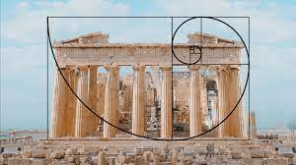
Sequences/Recurrences/Sums
Fibonacci: a_{n}≈1.618^{n} ⟨ 0, 1, 1, 2, 3, 5, 8, 13,21,…. ⟩
Rec Rel: a₀ = 0, a₁ = 1, a_{i} = a_{i-1} + a_{i-2} Sum of previous two terms
Golden Ratio: length/width = ϕ ≈ 1.618
Closed Formula: a_{i} ≈ ϕ^{i} ≈ 1.618^{i}
a_{i}
Resulting rectangle has the same ratio.
a_{i-1}
a_{i+1} = a_{i} + a_{i-1}
Add a square
a_{i}

Slide 79
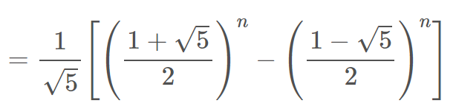
Sequences/Recurrences/Sums
Fibonacci: a_{n}≈1.618^{n} ⟨ 0, 1, 1, 2, 3, 5, 8, 13,21,…. ⟩
Rec Rel: a₀ = 0, a₁ = 1, a_{i} = a_{i-1} + a_{i-2} Sum of previous two terms
Golden Ratio: length/width = ϕ ≈ 1.618
Closed Formula: a_{i} ≈ ϕ^{i} ≈ 1.618^{i}
  a_{i} = a_{i-1} + a_{i-2}
  Plug in a_{i} ≈ ϕ^{i}
  ϕ^{i} = ϕ^{i-1} + ϕ^{i -2}
  Factor out ϕ^{i -2}
  ϕ² = ϕ + 1
  Solve
  ϕ ≈ 1.618
Does not look like an integer!
We will cover this more
in recurrence relations.

Slide 80
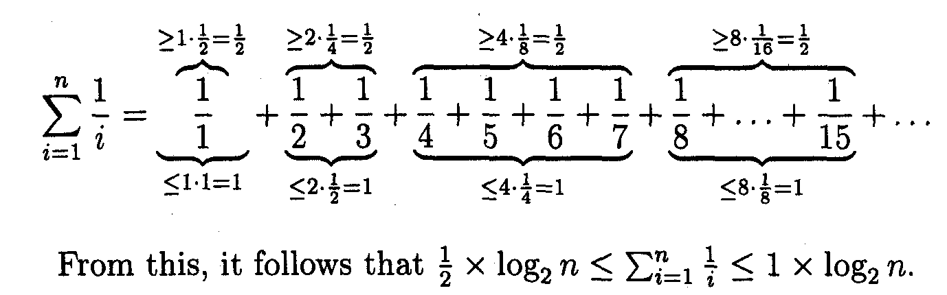
Sequences/Recurrences/Sums
Harmonic: a_{n}=¹/_{n} ⟨ 1, ¹/₂, ¹/₃, ¹/₄, …. ⟩

Slide 81
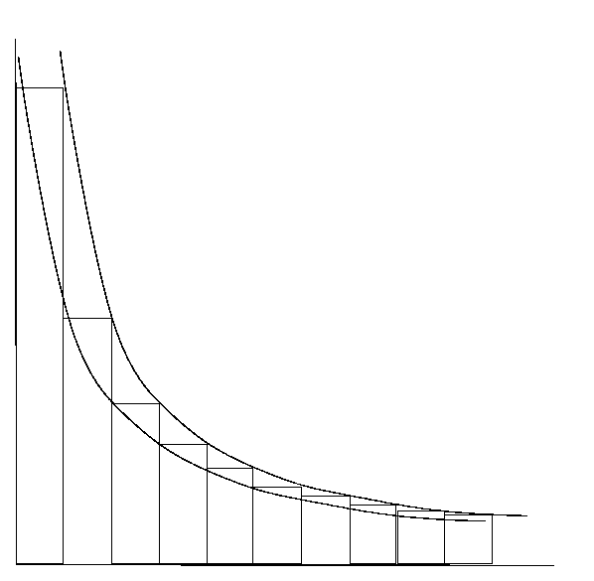
Approximating Sum by Integrating
∑_{i=1..n} f(i) ≈ ∫_{x=1..n} f(x) dx
The area under the curve
approximates the sum

Slide 82
Sum of Shrinking Function
n
f(i) = 1
∑_{i=1..n} f(i) = n

Slide 83
Sum of Shrinking Function
∞
f(i) = 1/2^{i}
∑_{i=1..n} f(i) = 2

Slide 84
Sum of Shrinking Function
n
f(i) = 1/i
∑_{i=1..n} f(i) = log n

Slide 85
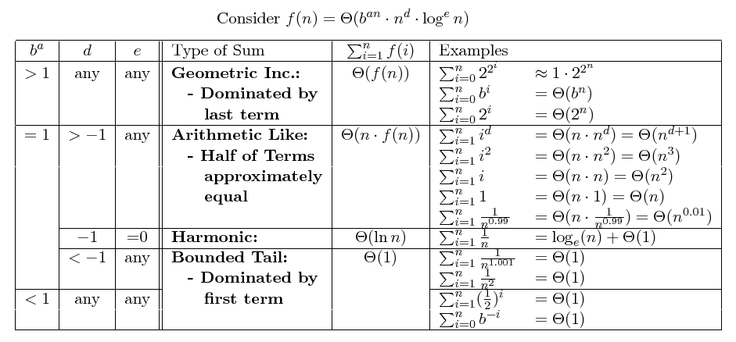
Adding Made Easy

Slide 86
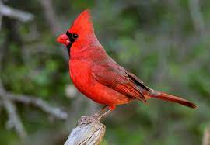
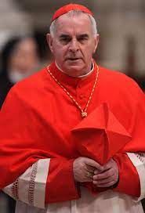
Countable Infinity
Cardinal: of the greatest importance; fundamental.
Cardinal numbers: 1, 2, 3, 4, 5, ….
the numbers that are used for counting something.
Carnality: Size of a set, eg |{ c, z, 5 }| = 3
--- Even if its size is infinite

Slide 87
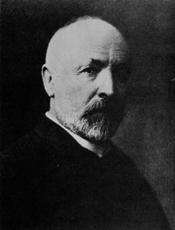
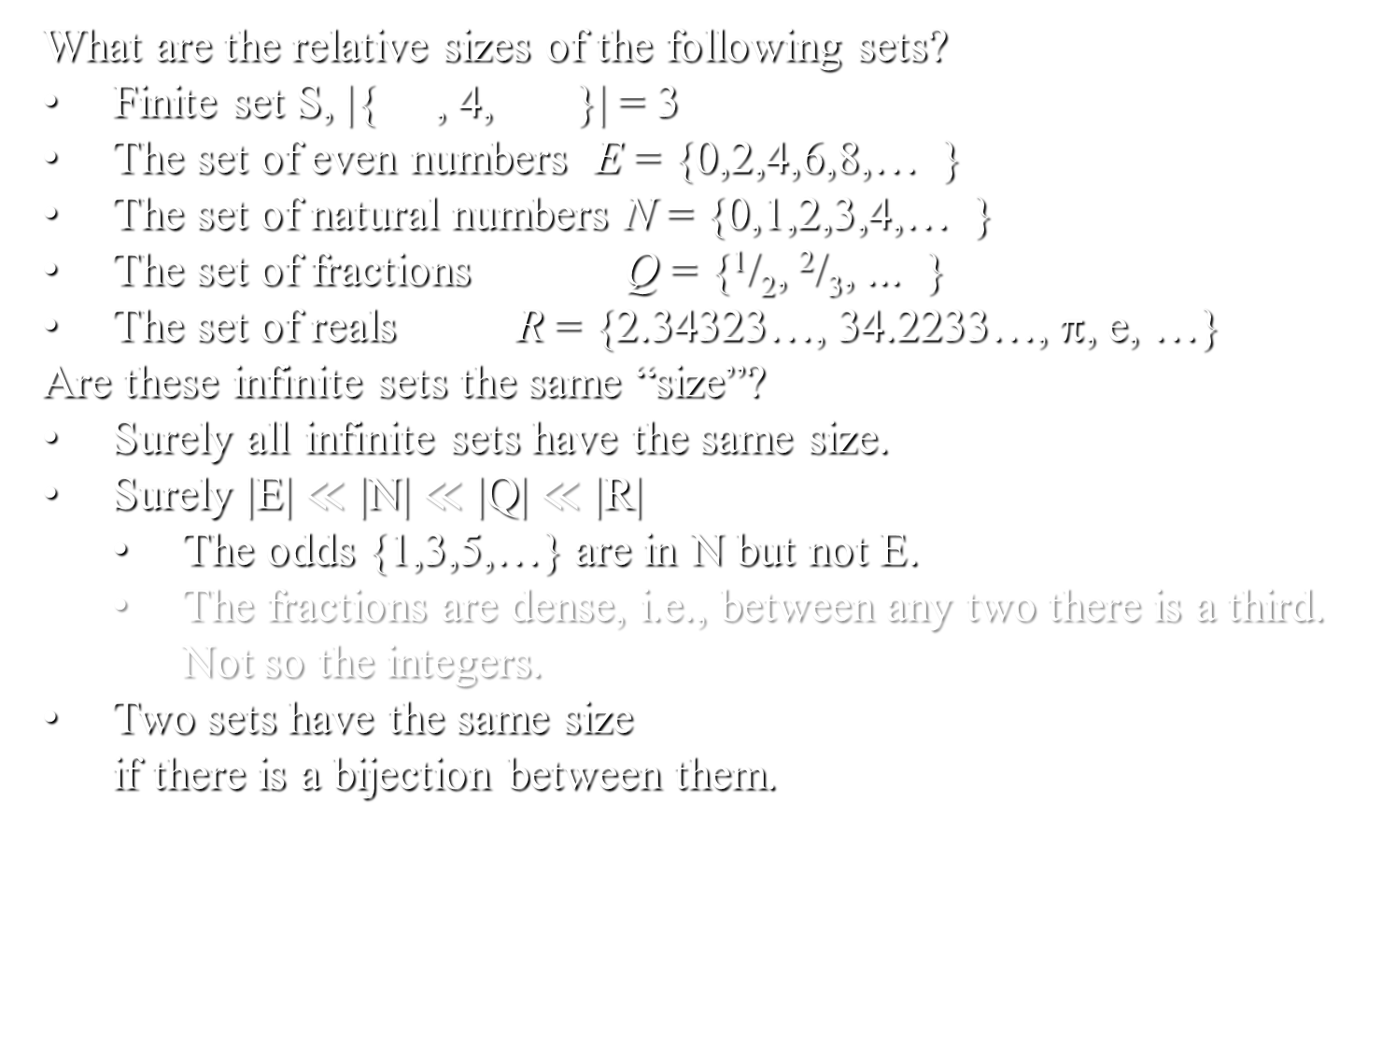
Countable Infinity
What are the relative sizes of the following sets?
Finite set S, |{ , 4, }| = 3
The set of even numbers E = {0,2,4,6,8,… }
The set of natural numbers N = {0,1,2,3,4,… }
The set of fractions Q = {¹/₂, ²/₃, ... }
The set of reals R = {2.34323…, 34.2233…, π, e, …}
Are these infinite sets the same “size”?
Surely all infinite sets have the same size.
Surely |E| $≪$ |N| $≪$ |Q| $≪$ |R|
  The odds {1,3,5,…} are in N but not E.
  The fractions are dense, i.e., between any two there is a third.
  Not so the integers.
Two sets have the same size
if there is a bijection between them.
Which
|{ , 4, }|
= |{ 1, 2, 3 }|
= 3
Cantor (1874)

Slide 88
Countable Infinity
Ints
f
Even
0
1
2
3
4
0
2
4
6
8
Aaaah!
This means these sets are the same size!
…
…
f(x)=2x
Two sets have the same size
if there is a bijection between them.
|{ , 4, }|
= |{ 1, 2, 3 }|
= 3
Cantor (1874)

Slide 89
Countable Infinity
Ints
f
Even
0
1
2
3
4
0
2
4
6
8
Aaaah!
This means these sets are the same size!
…
…
f(x)=2x
Perfect bijections require
Every object in A is mapped to a unique one in B.
And every object in B is mapped to.
TOO HARD TO DO!
Instead have two separate mappings:
One proving |A| ≤ |B|
One proving |B| ≤ |B|

Slide 90
Countable Infinity
Function: Maps the elements in one set to those in another.
f
B
A
a
b
c
1
2
3
4
5
|A| ≤ |B|: Helped by:
Elements in B not hit.
Elements in A hitting twice.
One-to-One / Injective function:
Elements in B do not get mapped to twice.
∀x,x´∈A [x≠x´ → f(x)≠f(x´)]
Has an inverse/reverse mapping
  f ⁻¹(y)=x iff f(x)=y
|A| ≤ |B|: Each of A “counts” off one of B.

Slide 91
Countable Infinity
Function: Maps the elements in one set to those in another.
f
Ints
A
a
b
c
1
2
3
4
5
Even if infinite,
we say A is “countable”
One-to-One / Injective function:
Elements in Ints do not get mapped to twice.
∀x,x´∈A [x≠x´ → f(x)≠f(x´)]
Has an inverse/reverse mapping
  f ⁻¹(y)=x iff f(x)=y
|A| ≤ |Ints|: Each of A “counts” off one Int.
.

Slide 92
Countable Infinity
1-1/Injective f does not map to B twice → (|A| ≤ |B|)
Even
f
Ints
0
2
4
6
8
0
1
2
3
4
Even ⊆ Ints
Clearly |Even| ≤ |Ints|
To “prove” it,
f(x) = x
works just fine.
…
…

Slide 93
Countable Infinity
1-1/Injective f does not map to B twice → (|A| ≤ |B|)
Ints
f
Even
0
1
2
3
4
0
2
4
6
8
Surely
|Ints| ≤ |Even|
is not true.
Wow
…
…
f(x)=2x
To prove |Ints| ≤ |Even|,
there just needs to be one 1-1 function.
Hence, |Ints| = |Even|
If this makes you feel uncomfortable….. Tough.
Cantor (1874)

Slide 94
Countable Infinity
1-1/Injective f does not map to B twice → (|A| ≤ |B|)
Reals [0,1]
Reals [0,100]
y
1
0
x
100
0
f
[0,1] ⊆ [0,100]
Clearly |[0,1]| ≤ |[0,100] |
…
…
1
To “prove” it,
f(x) = x
works just fine.

Slide 95
Countable Infinity
1-1/Injective f does not map to B twice → (|A| ≤ |B|)
Reals [0,1]
Reals (0,100)
y
1
0
x
99.9999
0.00001
[0,1] ⊆ (0,100)
Clearly |[0,1]| ≤ |(0,100)|
f
f
…
4
3
1
0
To “prove” it,
f(x) = x
works just fine.
Oops. No.
f(0) can’t be 0
because 0∉(0,100)
To “prove” it,
f(x) = x+3
works just fine.

Slide 96
Countable Infinity
1-1/Injective f does not map to B twice → (|A| ≤ |B|)
Reals (0,100)
Reals [0,1]
x
99.9999
0.00001
y
1
0
Surely
|(0,100)| ≤ |[0,1]|
is not true.
f
…
f(x)=x/100

Slide 97
Countable Infinity
1-1/Injective f does not map to B twice → (|A| ≤ |B|)
Reals [0,1]
Reals
y
1
0
x
∞
-∞
[0,1] ⊆ Reals
Clearly |[0,1]| ≤ |Reals|
f
1
0
…
To “prove” it,
f(x) = x
works just fine.

Slide 98
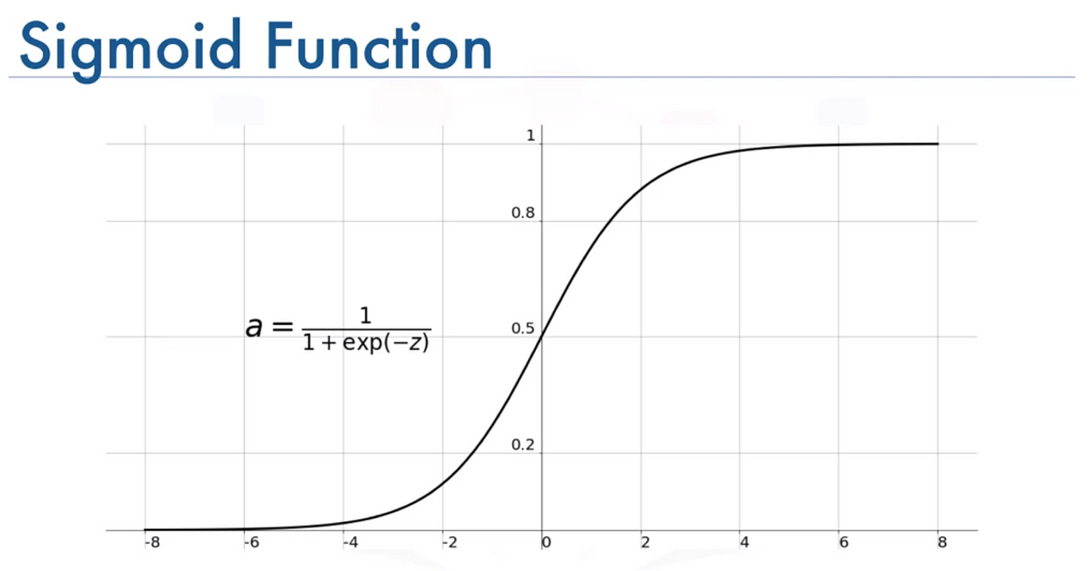
Countable Infinity
1-1/Injective f does not map to B twice → (|A| ≤ |B|)
Reals
f
Reals [0,1]
x
∞
-∞
y
1
0
Surely
|Reals| ≤ |[0,1]|
is not true.
…

Slide 99
Countable Infinity
...
...
6
⁶/₁
⁶/₂
⁶/₃
⁶/₄
⁶/₅
⁶/₆
⁶/₇
⁶/₈
All positive
fractions
5
⁵/₁
⁵/₂
⁵/₃
⁵/₄
⁵/₅
⁵/₆
⁵/₇
⁵/₈
4
⁴/₁
⁴/₂
⁴/₃
⁴/₄
⁴/₅
⁴/₆
⁴/₇
⁴/₈
3
³/₁
³/₂
³/₃
³/₄
³/₅
³/₆
³/₇
³/₈
2
²/₁
²/₂
²/₃
²/₄
²/₅
²/₆
²/₇
²/₈
...
Count them
by mapping.
1
¹/₁
¹/₂
¹/₃
¹/₄
¹/₅
¹/₆
¹/₇
¹/₈
1 2 3 4 5 6 7 8
Oops we never
get to ²/₁!
{ 1, 2, 3, 4, 5, 6, …. }
All positive integers

Slide 100
Countable Infinity
...
...
6
⁶/₁
⁶/₂
⁶/₃
⁶/₄
⁶/₅
⁶/₆
⁶/₇
⁶/₈
All positive
fractions
5
⁵/₁
⁵/₂
⁵/₃
⁵/₄
⁵/₅
⁵/₆
⁵/₇
⁵/₈
4
⁴/₁
⁴/₂
⁴/₃
⁴/₄
⁴/₅
⁴/₆
⁴/₇
⁴/₈
3
³/₁
³/₂
³/₃
³/₄
³/₅
³/₆
³/₇
³/₈
2
²/₁
²/₂
²/₃
²/₄
²/₅
²/₆
²/₇
²/₈
...
Count them
by mapping.
1
¹/₁
¹/₂
¹/₃
¹/₄
¹/₅
¹/₆
¹/₇
¹/₈
1 2 3 4 5 6 7 8
Every rational gets
mapped to some integer!
|N|=|Q|
Q is “Countable”
{ 1, 2, 3, 4, 5, 6, …. }
All positive integers

Slide 101

Countable Infinity
Let S be the set of all objects that have a finite description
such that each description uniquely identifies that object.
S = { , 4, , …..
“apple” “four” “chair”
“red chair”
“Uniquely Identifies” assures that
no description is hit twice.

Slide 102
Countable Infinity
Let S be the set of all objects that have a finite description
such that each description uniquely identifies that object.
S = { , 4, , …..
Finite description:
“apple” “four” “chair”
String of chars:
‘a’ ‘p’ ‘p’ ‘l’ ‘e’
‘f’ ‘o’ ‘u’ ‘r’
‘c’ ‘h’ ‘a’ ‘i’ ‘r’
Hex-Ascii.
61 70 70 6C 65
66 6F 75 72
63 68 61 69 72
Concatenate into
one Hex int:
6170706C65 666F7572 6368616972
Ints:
418498243685 1718580594 426952976754
Hence S is countable |S| ≤ |Ints|

Slide 103
Countable Infinity
Let S be the set of all objects that have a finite description
such that each description uniquely identifies that object.
The set of fractions
|Q| = |{¹/₂, ²/₃, ¹¹/₈ ,... }|
Do these have a finite description?
“¹/₂ ” “²/₃” “¹¹/₈”
Hence Q is countable |Q| ≤ |Ints|

Slide 104
Countable Infinity
Let S be the set of all objects that have a finite description
such that each description uniquely identifies that object.
The set of reals
|R| = |{2.34323…, 34.2233…,
Do these have a finite description?
No. If you choose a real number by rolling a dice for each digit,
then it requires an infinite description.
Cantor (1874)
Hence Reals is Uncountable |Ints| ≪ |Reals|

Slide 105
Countable Infinity
Let S be the set of all objects that have a finite description
such that each description uniquely identifies that object.
The set of reals
|R| = |{2.34323…, 34.2233…,
Does π have a finite description?
Yes. “π” is a a finite description
Any number
(even with infinite # of digits)
that can be printed by an algorithm
has a finite description.
Ie the code for algorithm.
Cantor (1874)

Slide 106
Countable Infinity
Let S be the set of all objects that have a finite description
such that each description uniquely identifies that object.
Tell me something
that needs an infinite description.
Impossible. If you can tell it to me,
then it has a finite description.
In Jeff’s religion,
in this finite universe,
objects that require an infitie description,
simply don’t exists.
Cantor (1874)

Slide 107
Uncountable Infinity
Proof that |R| > |N|
i.e. ∀List, ∃xϵR, ∀iϵN List(i)≠x
Let List be an arbitrary mapping from N to R.
i x=List(i)
12.34323834749308477599304 …
8.50949039988484877588487 …
930.93994885783998573895002 …
34.39498837792008948859069 …
0.00343988348757590125473 …
…..
Proof by
Diagonalization
We find a real number x_{diagonal} that is not in the list.
The i^{th} digit will be the i^{th} digit of the i^{th} number List(i)
increased by one (mod 10).
Let i be arbitrary in N.
I prove that List(i)≠x_{diagonal}
They differ in the i^{th} digit
x_{diagonal} = 0.41004 …

Slide 108
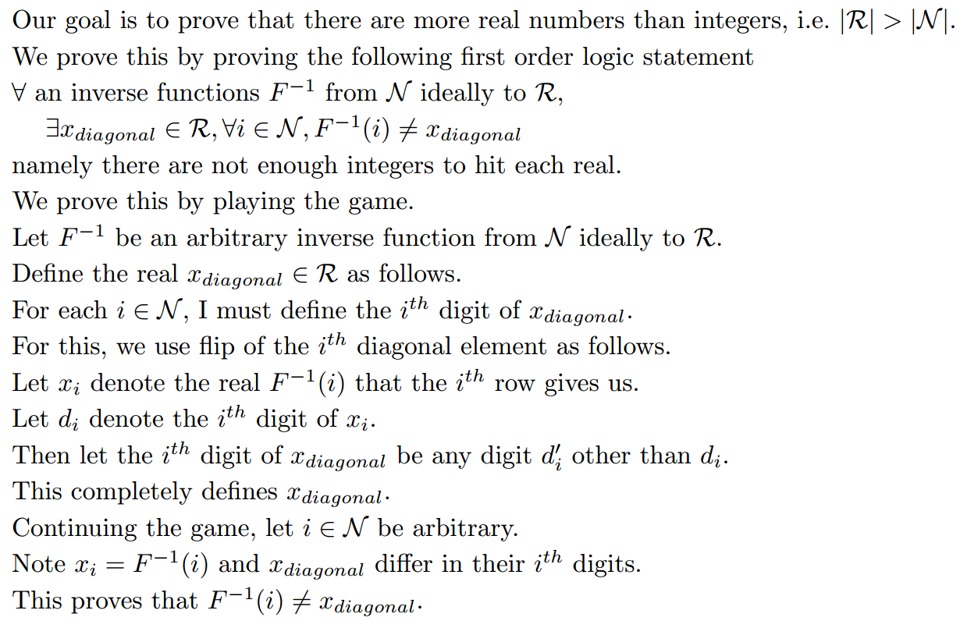
Uncountable Infinity
Proof that |R| > |N|
i.e. ∀List, ∃xϵR, ∀iϵN List(i)≠x
List
List
List
List
List
List

Slide 109
Countable Infinity
|Integers|
=
|Fractions|
≪
|Reals|
Each defined by
a finite string
Each defined by
a finite string
Most defined by
an infinite string
Set of finite subsets of the integers
{{2,3},{1,3,5,6}, … }
Each defined by a finite string
The set is countable in size
Set of possibly infinite subsets of the integers
{{2,3,…},{1,3,…}, … }
Most defined by a infinite string
The set is uncountable in size

Slide 110
Some Uncomputable Problem
|Integers|
=
|Fractions|
≪
|Reals|
Each defined by
a finite string
Each defined by
a finite string
Most defined by
an infinite string
≪
Set of Algorithms
Each defined by
a finite code
Countable in size
Set of Comp. Problems
For each input I,
must define what P does.
Most defined by
an infinite string
Uncountable in size
Most problems
do not have
an algorithm!!!
∃Prob ∀Alg ∃I Alg(I)≠Prob(I)

Slide 111
Some Uncomputable Problem
Some problem
Computable
Non-Constructive
Proofs that something exists,
in previous sections
do so by constructing the thing.
This proof does not!
Halting Problem
Turing proves that a very useful problem does not have an algorithm.
Sorting
∃Prob ∀Alg ∃I Alg(I)≠Prob(I)

Slide 112
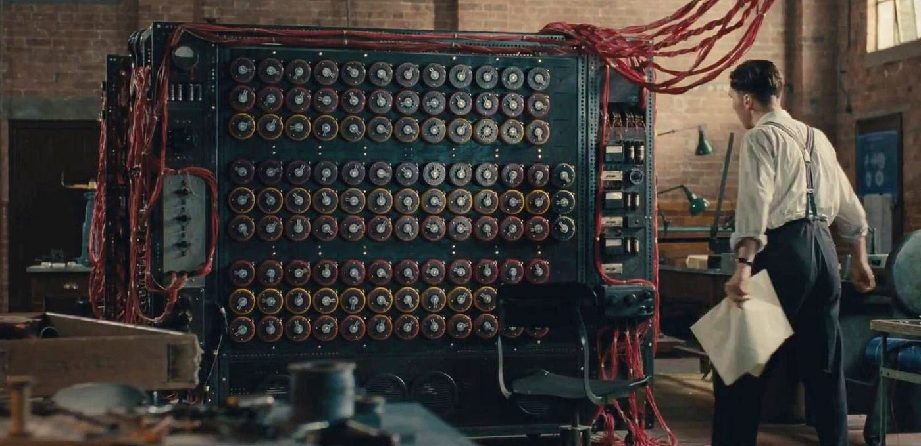
Some Uncomputable Problem
Some problem
Computable
Halting Problem
Sorting
∃Prob ∀Alg ∃I Alg(I)≠Prob(I)

Slide 113
Review Questions
Example:
  A ∪ B
Solution:
  A ∩ B
Solution:
Solution:
Solution:
Solution:
Solution:
113

Slide 114
Questions 1
Example 1: Let f be the function from
such that f(a) = 2, f(b) = 3, and f(c) = 1. Is
f invertible and if so what is its inverse?
Solution: The function f is invertible because it is a one-to-one correspondence. The inverse function
reverses the correspondence given
by f, so
114

Slide 115
Questions 2
Example 2: Let f: Z → Z be such that f(x) = x + 1. Is f invertible, and if so, what is its inverse?
Solution: The function f is invertible because it is a one-to-one correspondence. The inverse function
reverses the correspondence so
(y) = y −1.
115

Slide 116
Questions 3
Example 3: Let f: R → R be such that
Is f invertible, and if so, what is its inverse?
Solution: The function f is not invertible because it is not one-to-one.
116

Slide 117
Composition Questions 1
Example 2: Let g be the function from the set {a,b,c} to itself such that g(a) = b, g(b) = c, and g(c) = a. Let f be the function from the set {a,b,c} to the set {1,2,3} such that f(a) = 3, f(b) = 2, and f(c) = 1.
What is the composition of f and g, and what is the composition of g and f.
Solution: The composition
is defined by
  Note that
is not defined, because the range of f is not a
subset of the domain of g.
117

Slide 118
Composition Questions 2
Example 2: Let f and g be functions from the set of integers to the set of integers defined by
What is the composition of f and g, and also the composition of g and f ?
Solution:
118

