Slide 1
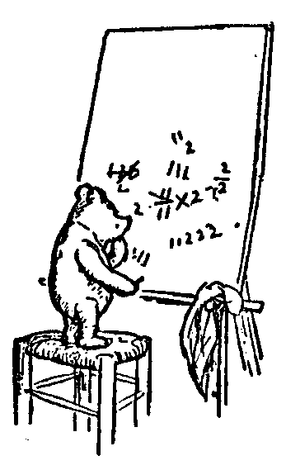

Discrete Math
Welcome
Administrative Issues
Course Overview
Jeff Edmonds
www.cse.yorku.ca/~jeff\courses/z1019
jeff@cse.yorku.ca
CSB 3044, ext. 33295
647-688-7413
Jeff Edmonds
York University
Lecture 0

Slide 2
Discrete Math
Discrete Math …
Discreet:
Being careful when you are cheating on your test.
Discrete:
Individually separate and distinct.
What???

Slide 3
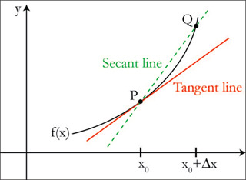
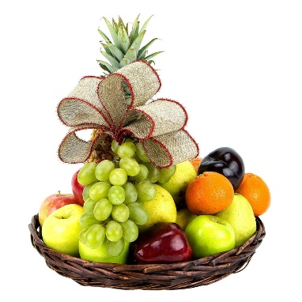
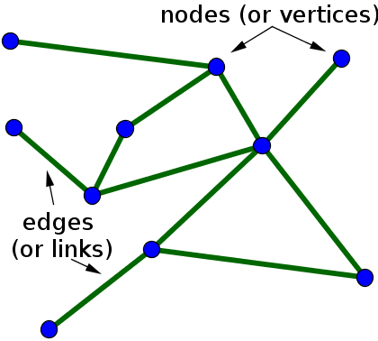
Discrete Math
Continuous
Discrete
Reals
Integers
Infinite
0
1
2
3
4
…
Finite

Slide 4
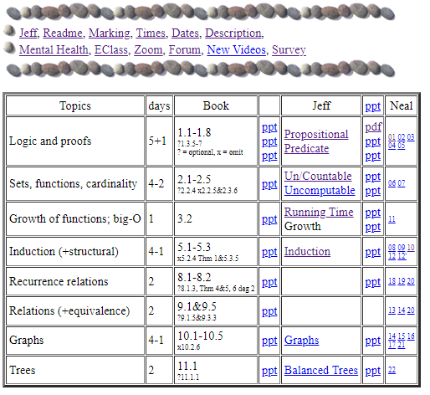
Course Material
www.cse.yorku.ca\~jeff\courses\z1019

Slide 5
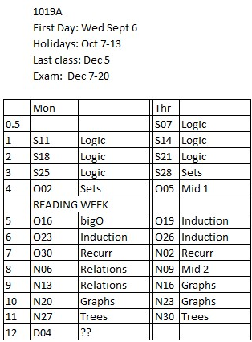
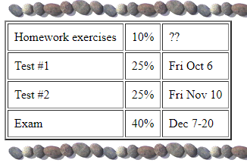
Course Material

Slide 6
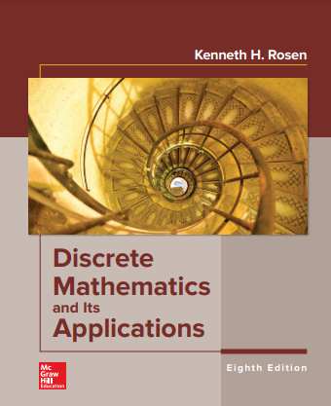
Course Info

Slide 7
Study Now!
You spend 50hrs/week
on your programming courses.
Study the material deeply
before fail the tests.

Slide 8
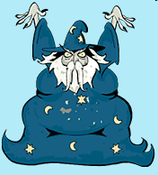
Together
Some students feel too intimidated to talk to the professor.
Actually, he is just a guy
who has been doing this for a while.

Slide 9
Together
Office hours:
Before/after class tend to be the best time.
Longer or private questions, when requested,
can be taken back to my office, CSB 3044.
Notes:
9

Slide 10
Together
Please interact with me in class.
Help me know what people
are not understanding
Slow down the slides
(Though we do have
a lot of material to cover)

Slide 11
Together
Please ask questions!
To keep the flow going
Wiggly hand:
relevant to current slide.
Stationary hand:
question about past material.
Avoid getting off topic.

Slide 12
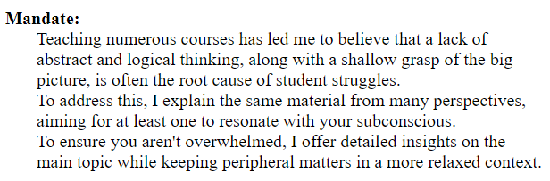
Thinking Abstractly
Thinking abstractly requires completely
changing the way you think.
Though I keep warning people,
they tend not to get it until they are
Devastated
by the midterm
Change your thinking now.

Slide 13
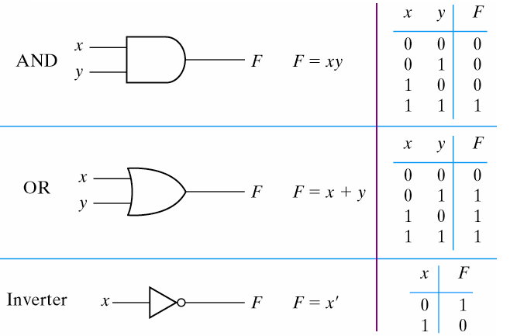
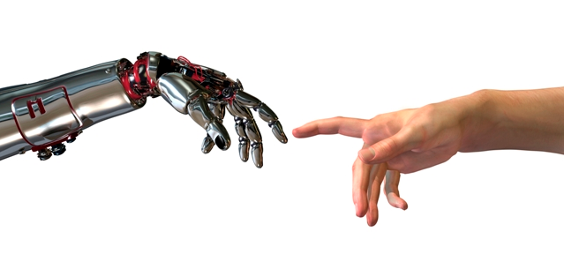
Thinking Abstractly
The psychological profiling of a successful person is mostly the ability to shift levels of abstraction, from low level to high level.
To understand the detailed workings.
To understand the big picture.
Donald Kunth

Slide 14
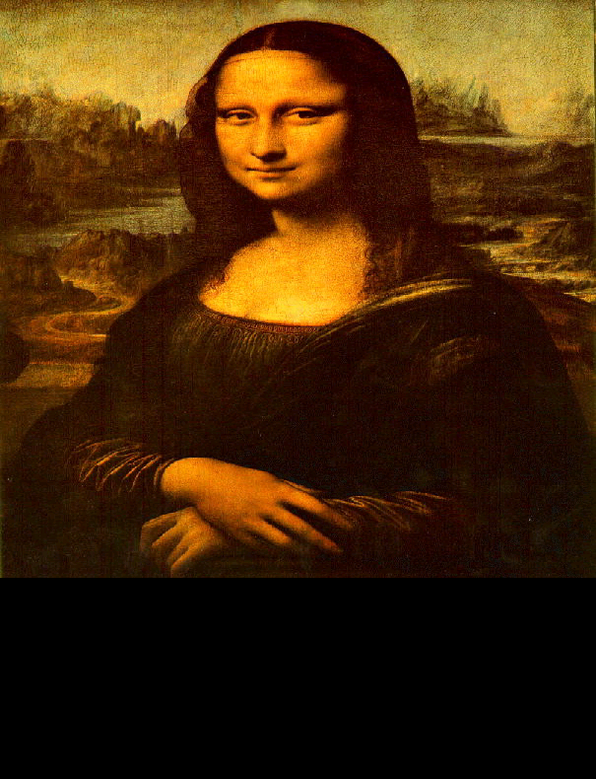
Thinking Abstractly
The psychological profiling of a successful person is mostly the ability to shift levels of abstraction, from low level to high level.
To understand the detailed workings.
To understand the big picture.
To understand complex things
in simple ways.
Donald Kunth
=

Slide 15
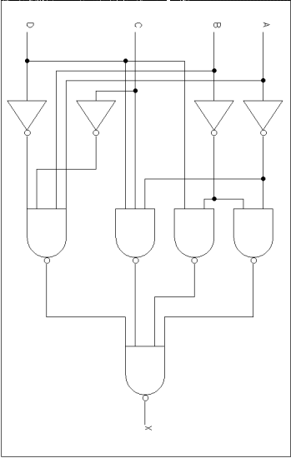
Thinking Abstractly
It is hard to think of love
in terms of the firing of neurons.
vs
Software developers view subsystems as entities with separate personalities, roles, and interactions,
not details of code.
vs

Slide 16

Thinking Abstractly
Better for communicating to friend

Slide 17
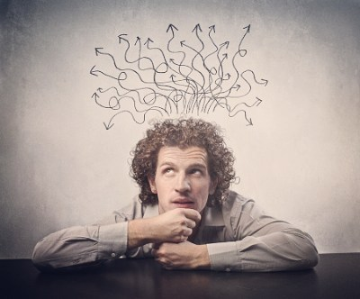
Thinking Abstractly
A form that can peculate down and
dwell in your subconscious
where the miracle leaps of inspiration happen
Your subconscious
does not understand
JAVA code.

Slide 18
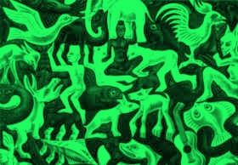
Thinking Abstractly
Paradigm Shift
Is the black the form and the green the background?
Is the green the form and the black the background?
It is helpful to have different ways of looking at it.

Slide 19
Course Material
www.cse.yorku.ca\~jeff\courses\z1019

Slide 20
Logic
Animals
All snakes are reptiles
All reptiles are animals and lay eggs
Many snakes only have one lung
Reptiles
Lay Eggs
Snakes
One lung
Similar to many questions in course/degree/life
Read question in English
Assign variables to each
atomic true/false logical proposition/statement/assertion.
Translate what you know
and the question into logic.
Solve the logic using logic rules,
formal, and informal proofs
Translate solution back to English.
Notes:
20

Slide 21
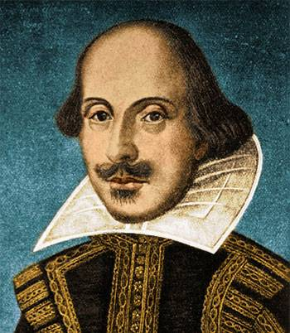
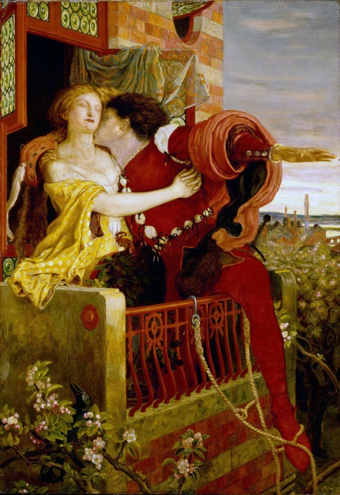
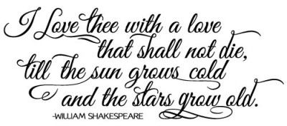
Hugely Expressive
The rules of syntax dictate
how words can be strung together into
poetry.
Verses and rhyme …
Shakespeare(1616)
I want this form to be powerful enough to
express everything I have to say about love.

Slide 22
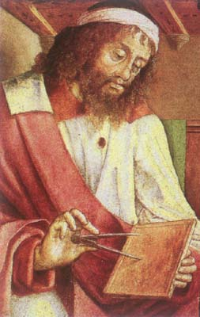
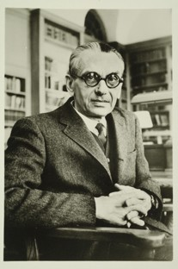
Hugely Expressive
The rules of syntax dictate
how words can be strung together into
logical sentence.
Variables x and y can represent integers.
You can use +, ×, <, =, ≥, ∀, ∃, ∧, ∨, ⌐, →.
Euclid (300 BC)
I want this form to be powerful enough to
express everything I have to say about
math.
Actually, it is hugely expressive.
This is excellent way to understand and prove
most mathematical statements.
“x is prime”
≡ ∀a ∀b (a×b=x → a=1 or b=1)
Gödel
1931

Slide 23

Hugely Expressive
The rules of syntax dictate
how words can be strung together into
logical sentence.
Variables x and y can represent integers.
You can use +, ×, <, =, ≥, ∀, ∃, ∧, ∨, ⌐, →.
Euclid (300 BC)
I want this form to be powerful enough to
express everything I have to say about
comp sci.
Here is J´ an integer encoding of Java program J.
“Java program J on input I outputs y”.
≡ ∃c ∀t (J´×…. +I´ = …. y´)
There is an integer encoding a computation c
such that for every time step t
the TM simulating J takes a legal step

Slide 24
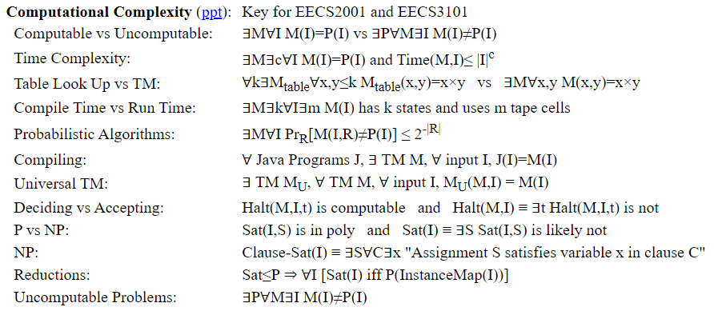
Hugely Expressive
Certainly it is key to theoretical computer science.
“Java program J on input I outputs y”.
≡ ∃c ∀t (J´×…. +I´ = …. y´)
There is an integer encoding a computation c
such that for every time step t
the TM simulating J takes a legal step

Slide 25
And
Or
Proof Techniques/Lemmas
And ∧:
Or ∨:
Implies →:
Negation ¬:
Using:
Proving:
From:
Conclude:
From:
Conclude:
Separating And
Eval/Build ∧
α∧β
α & β
α, α´, & ¬β
α∧α´ & ¬(β∧γ)
Selecting Or
Eval/Build ∨
α∨β & ¬α
β
α, ¬β & ¬β´
α∨γ & ¬(β∧β´)
Cases
Excluded Middle
α∨β, α→γ, & β→γ
γ
α∨¬α & ¬(α∧¬α)
Modus Ponens
Deduction
α & α→β
β
Assume α, prove β
α→β
Cases
Eval/Build →
α∨β, α→γ, & β→γ
γ
α, α´, & ¬β
γ→α, β→γ, ¬(α→β)
Equivalence
Contrapositive
α→β & β→α
α iff β
¬(α∧¬β) iff ¬β→¬α
α→β
Transitivity
Transitivity
α→β & β→γ
α→γ
α→β & β→γ
α→γ
Double Negation
De Morgan's Law
¬¬α
α
¬(α∧β)
¬α∨¬β

Slide 26

Predicate Logic
Predicate Logic talks about the properties of objects.
Father(x,y) ≡ “x is y’s father”
Daughter(y,x) iff Father(x,y)∧Female(y)

Slide 27
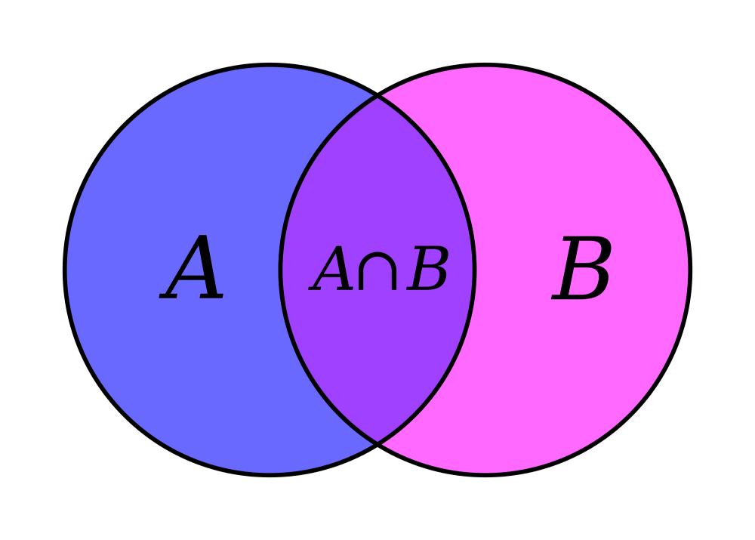
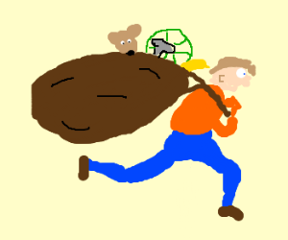
Sets
Set: Collects a bunch of elements together.
Items do not appear more than once.

Slide 28
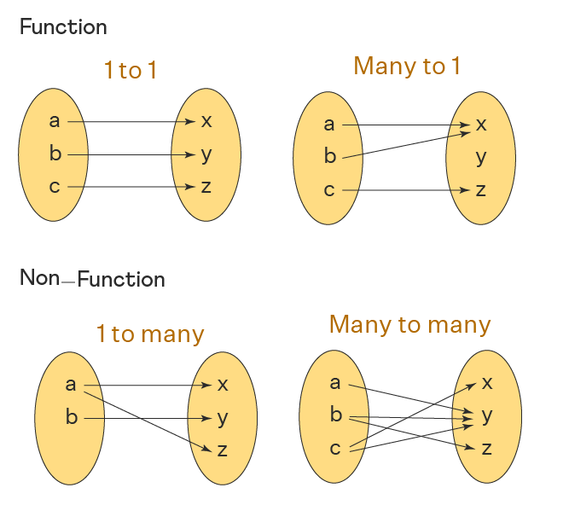
Functions
Function: Maps the elements in one set to those in another.

Slide 29
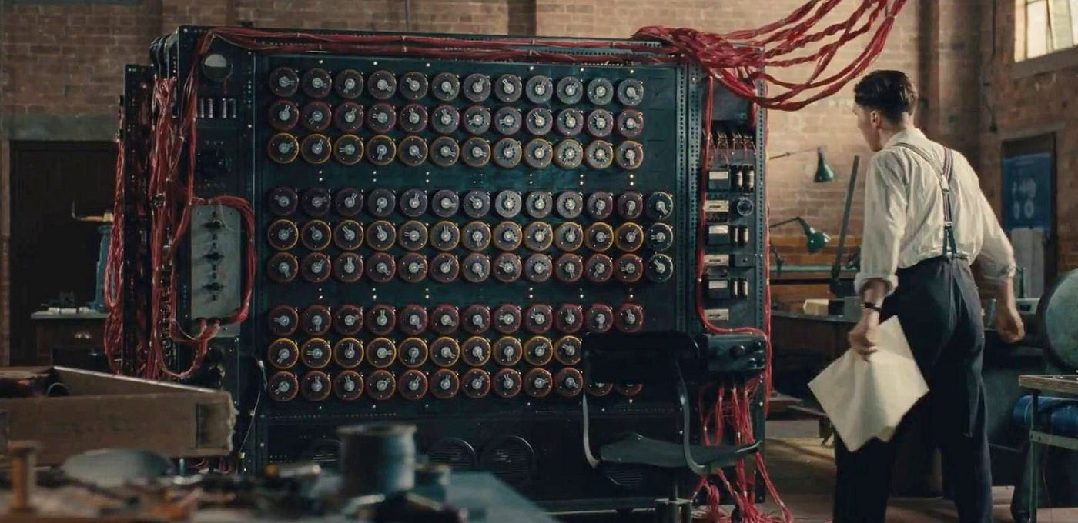
Computable

Slide 30
Growth of Functions
T(n)
10
100
1,000
10,000
log n
3
6
9
13
amoeba
n^{1/2}
3
10
31
100
bird
n
10
100
1,000
10,000
human
n log n
30
600
9,000
130,000
my father
n²
100
10,000
10⁶
10⁸
elephant
n³
1,000
10⁶
10⁹
10¹²
dinosaur
2^{n}
1,024
10³⁰
10³⁰⁰
10³⁰⁰⁰
the universe
Note: The universe contains approximately 10⁵⁰ particles.

Slide 31
Growth of Functions
Functions
Exp
Constant
Polynomial
Exponential
Double Exp
Poly Logarithmic
n⁵
2^{5n}
5
(log n)⁵
n⁵
2^{5n}
2
2
<<
<<
<<
<<
<<
n^{θ(1)}
2^{θ(n)}
θ(1)
(log n)^{θ(1)}
n^{θ(1)}
2^{θ(n)}
2
2

Slide 32
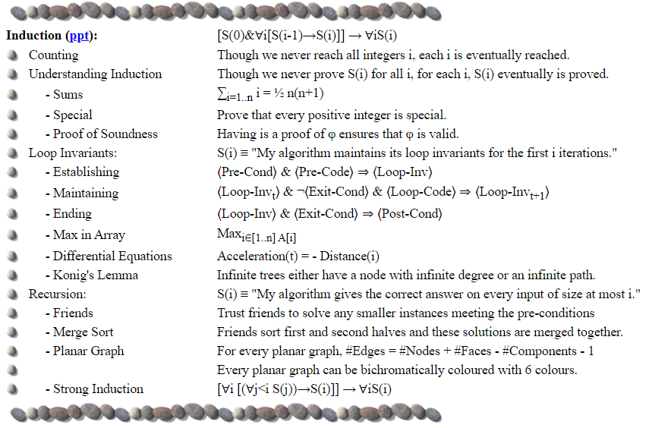
Induction

Slide 33
Recurrence Relations
T(1) = 1
T(1)
=
1
T(n) = n + 4 T(n/2)
T(n)
T(n)
n
=
n
=
T(n/2)
T(n/2)
T(n/2)
T(n/2)
T(n/2)
T(n/2)
T(n/2)
T(n/2)

Slide 34

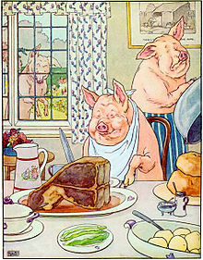
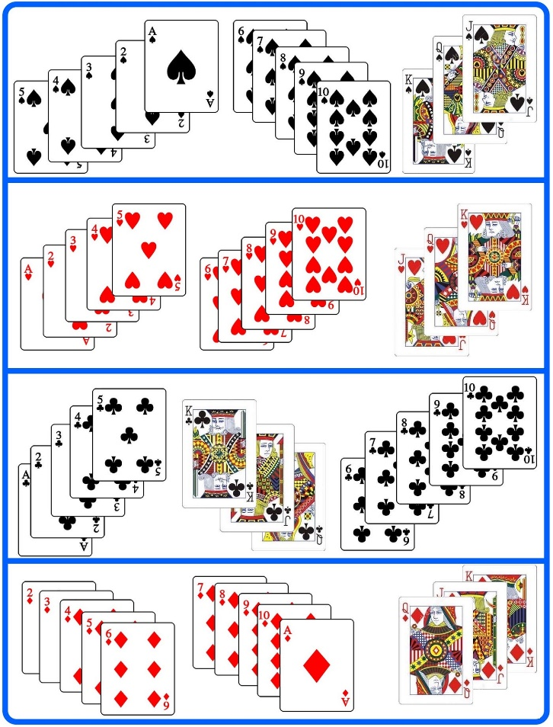
Equivalence Relations
Eg: “All people are created equal”
“We are all equal, just some of us are more equal than others.”

Slide 35
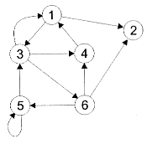
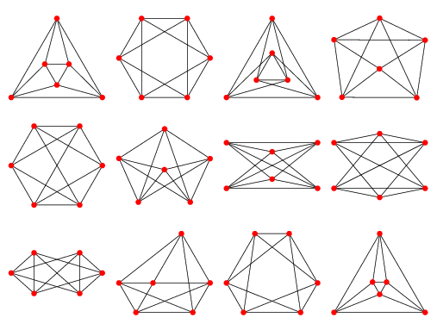
Graphs
Graph: Edges between the nodes (Directed or undirected)

Slide 36
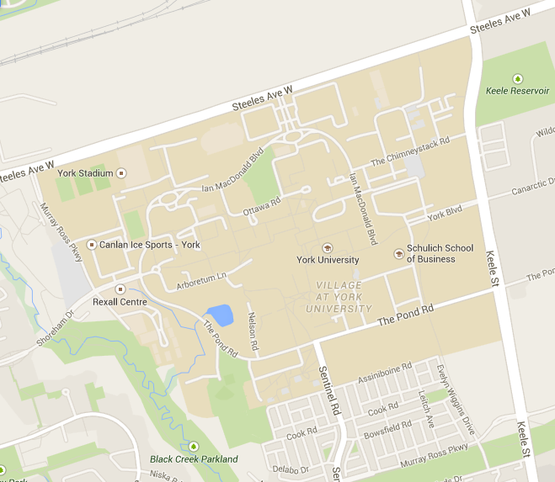
Graphs
Graph: Edges between the nodes (Directed or undirected)
Eg: Cities and roads

Slide 37

Graphs
Graph: Edges between the nodes (Directed or undirected)
Eg: Computers and networks

Slide 38
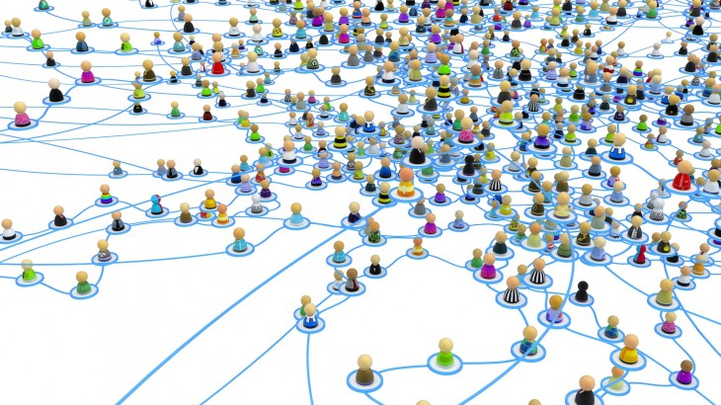
Graphs
Graph: Edges between the nodes (Directed or undirected)
Eg: Social Networks

Slide 39
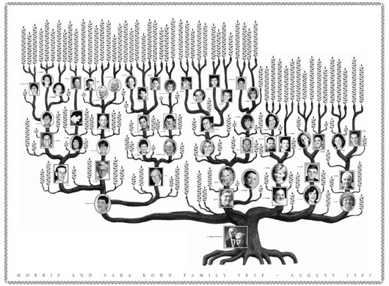
Trees
Tree: A nonlinear hierarchal structure.
Eg:
Family Tree

Slide 40
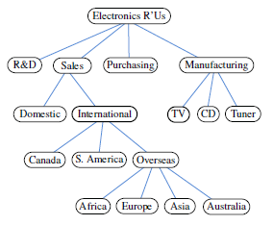
Trees
Tree: A nonlinear hierarchal structure.
Eg:
Family Tree
Company Structure

Slide 41
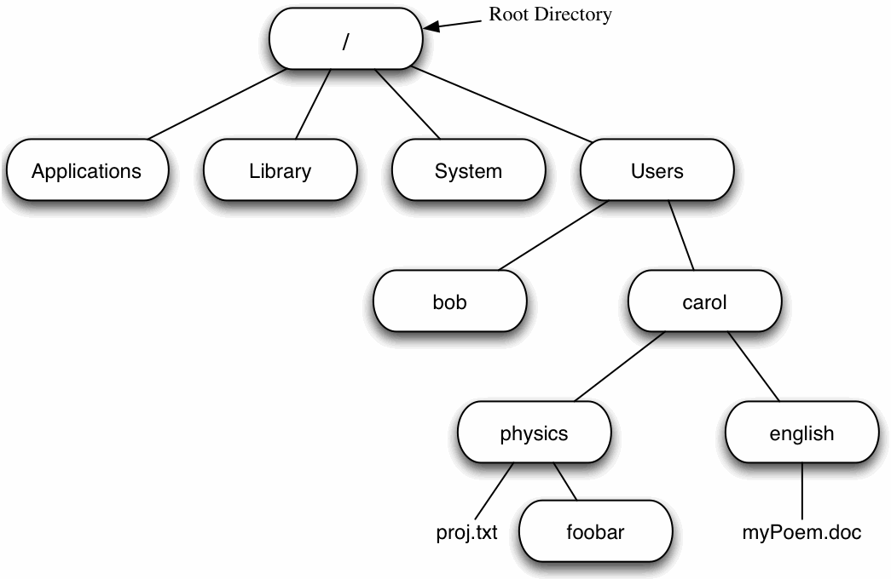
Trees
Tree: A nonlinear hierarchal structure.
Eg:
Family Tree
Company Structure
File Structure

Slide 42
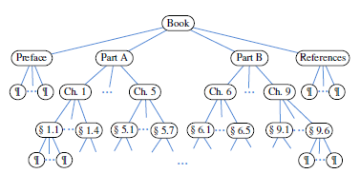
Trees
Tree: A nonlinear hierarchal structure.
Eg:
Family Tree
Company Structure
Book Organization

Slide 43
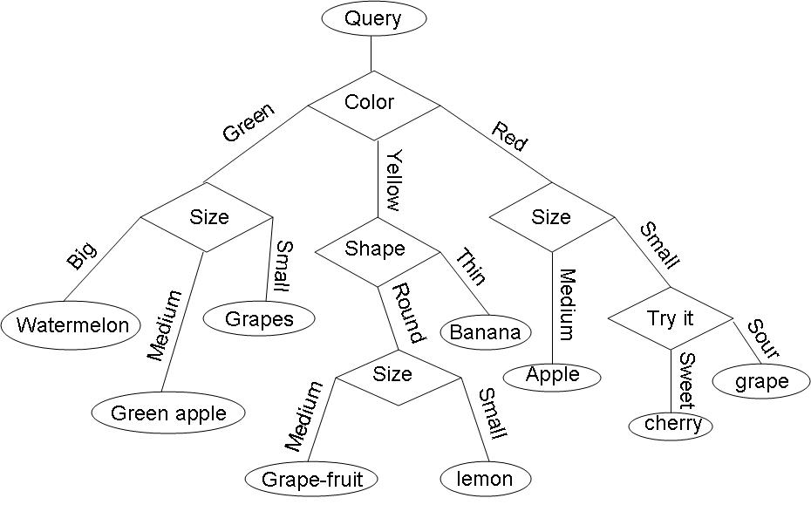
Trees
Tree: A nonlinear hierarchal structure.
Eg:
Family Tree
Company Structure
Book Organization
Decision Tree

Slide 44
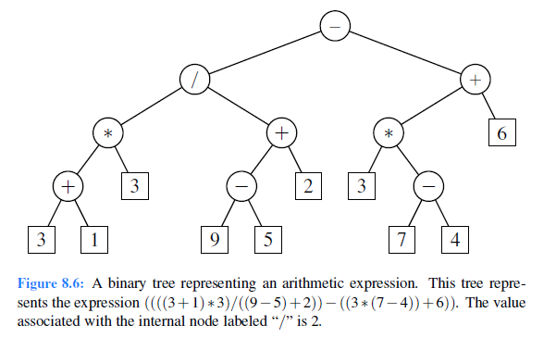
Trees
Tree: A nonlinear hierarchal structure.
Eg:
Family Tree
Company Structure
Book Organization
Decision Tree
Arithmetic Expression

Slide 45
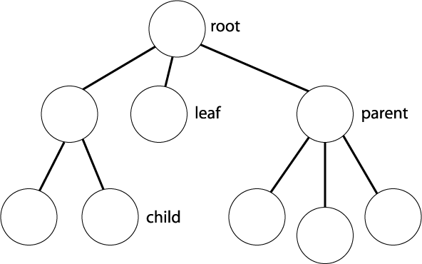

Trees
Tree: A nonlinear hierarchal structure.
A special root node.
Each node can have any number of children.
A node with no children is a leaf.
Relationships: Child, Parent, Sibling
Each node is the root of a subtree.

Slide 46
Useful Learning Techniques
Notes:
46

Slide 47
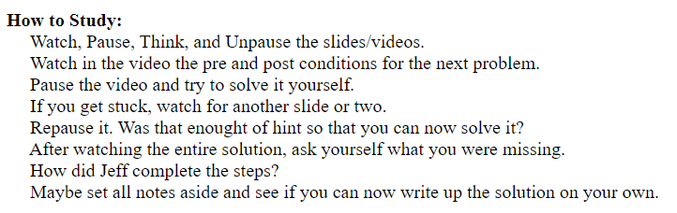
Notes:
47

Slide 48
Read Ahead
You are expected to read the lecture notes before the lecture.
This will facilitate more productive discussion during class.
Also please
proof read
assignments
& tests.
Like in an
English class

Slide 49

Explaining
We are going to test you on your ability to explain the material.
Hence, the best way of studying is to explain the material over and over again out loud to yourself, to each other, and to your stuffed bear.

Slide 50
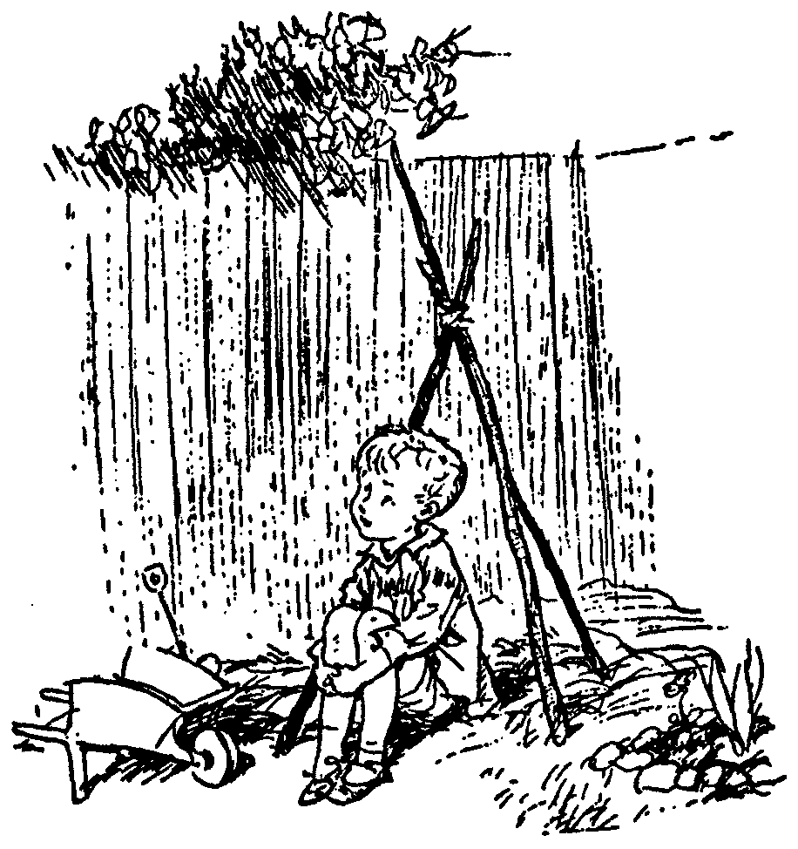
Day Dream
While going along with your day
Mathematics is not all linear thinking.
Allow the essence of the material to seep into your subconscious
Pursue ideas that percolate up and flashes of inspiration that appear.

Slide 51

Be Creative
Ask questions.
Why is it done this way and not that way?

Slide 52
Guesses and Counter Examples
Guess at potential algorithms for solving a problem.
Look for input instances for which your algorithm gives the wrong answer.
Treat it as a game between these two players.

Slide 53
Refinement:
The best solution comes from a process of repeatedly refining and inventing alternative solutions
Rudich www.discretemath.com

Slide 54
End

