Slide 1
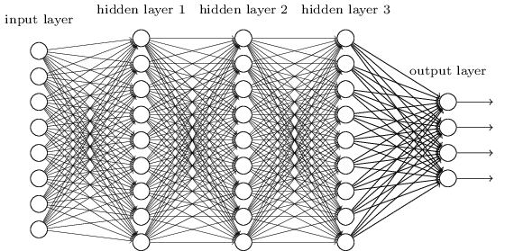
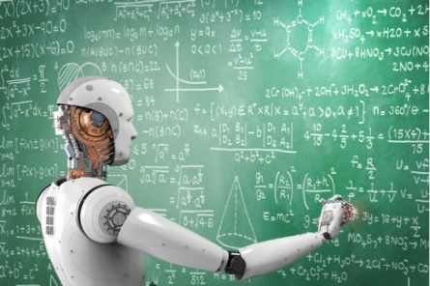
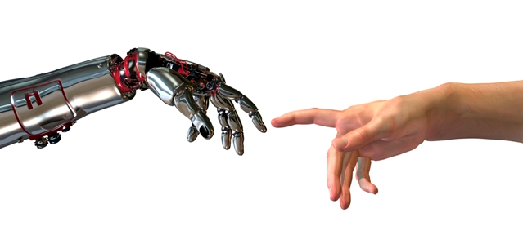
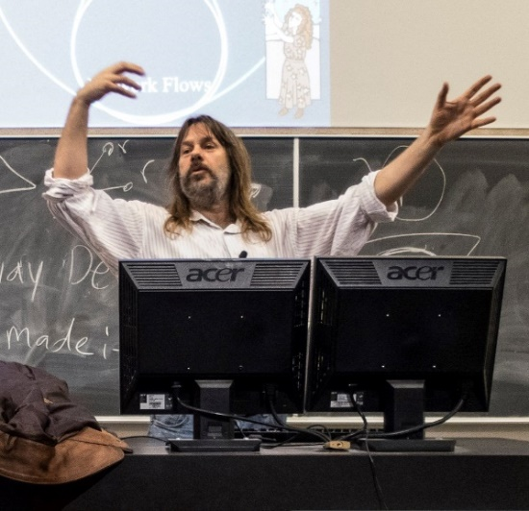
Machine Learning
Ethics
Jeff Edmonds, Comp. Sci.
www.eecs.yorku.ca/~jeff/courses/machine-learning
Notes:
4*1.5hrs - not Example …, not unsupervised.

Slide 2
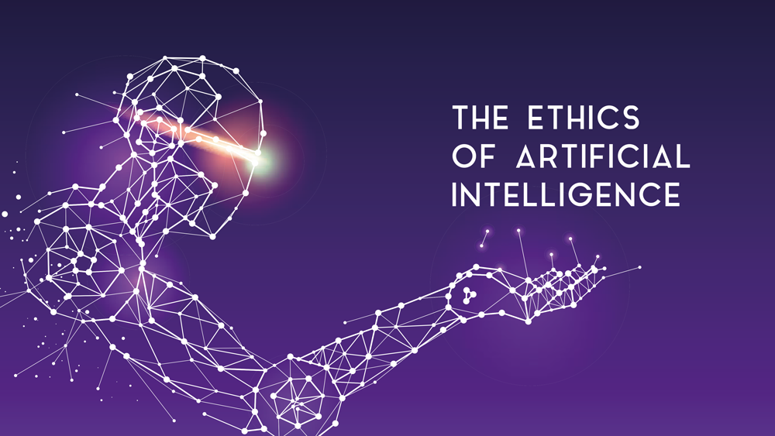
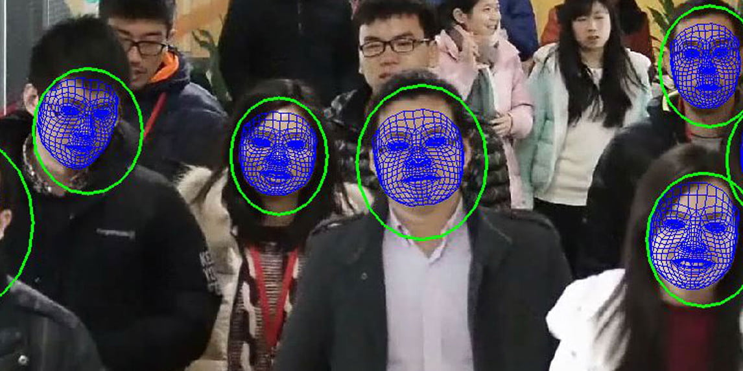
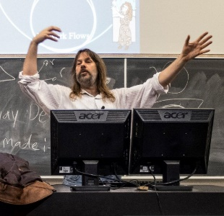
Jeff Edmonds
www.eecs.yorku.ca/~jeff/courses
Notes:
4*1.5hrs - not Example …, not unsupervised.

Slide 3
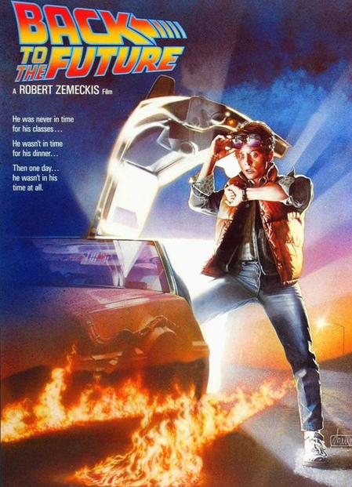
The Future is unknown
but is nigh!
For better or worse, this will change the world.
My first reaction is dominated by “Cool”
But what are the long term implications?

Slide 4
What are the positive things that machine learning is bringing the average person either now or soon?

Slide 5
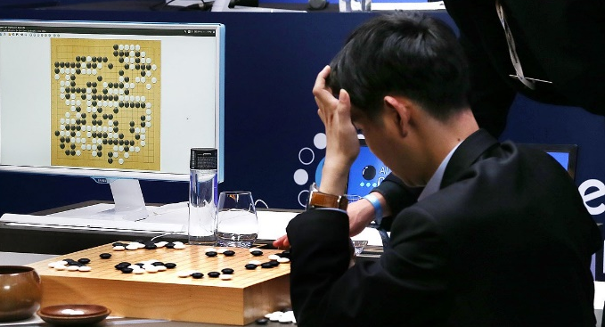
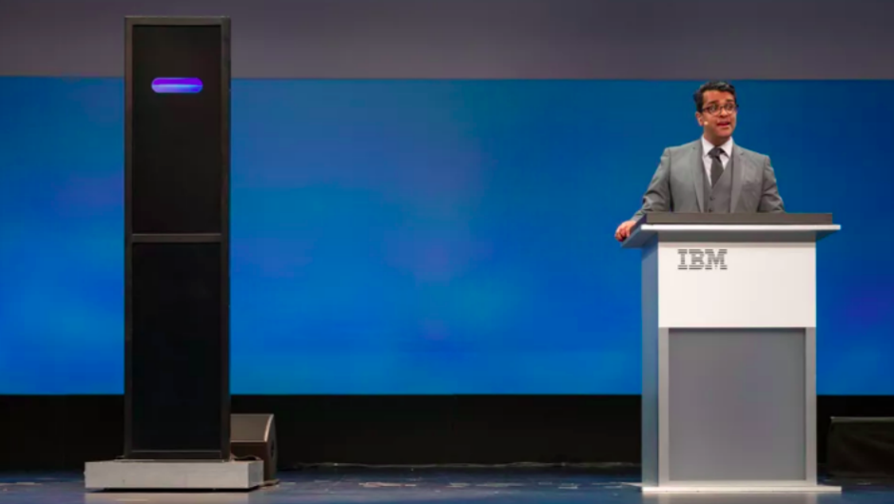
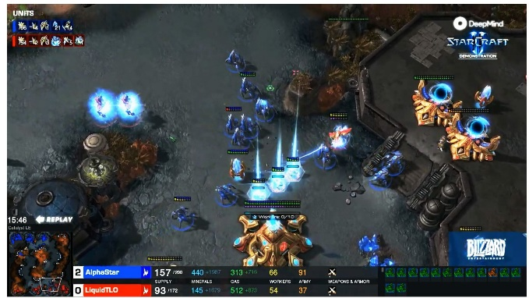
Hopeful Applications
2015/17 Learn to play any game with no human skill given.
2018 IBM Debater
May make the world much
better.
2018 win at Starcraft2
Real time decision making.
Robots

Slide 6
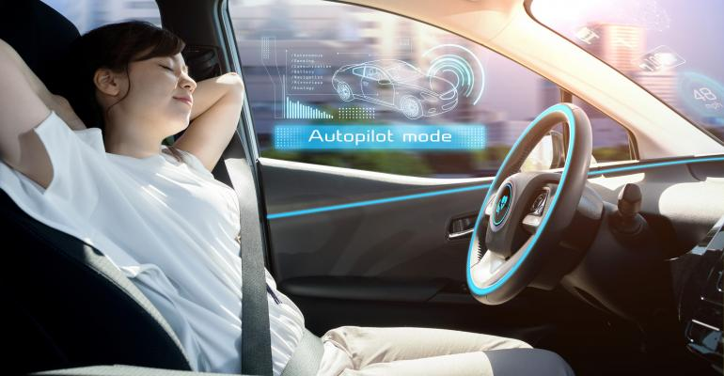
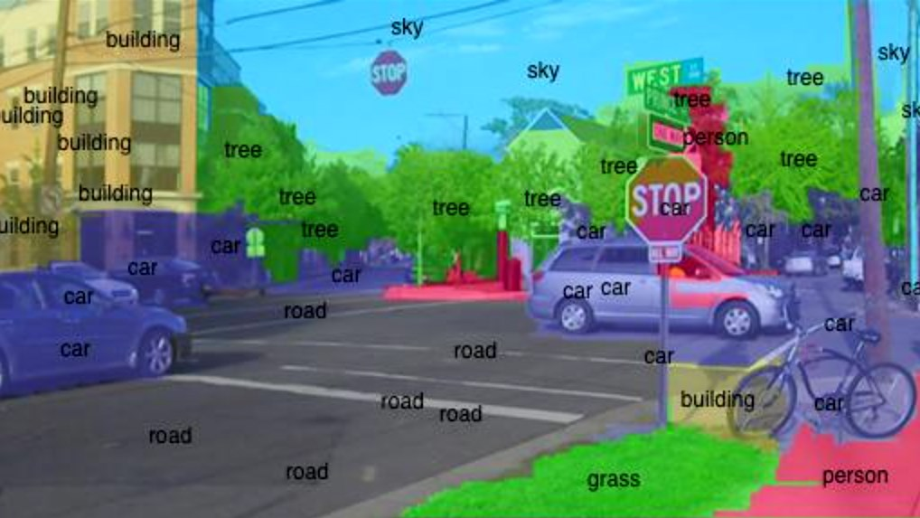
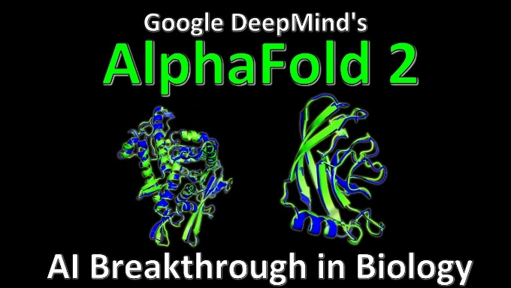
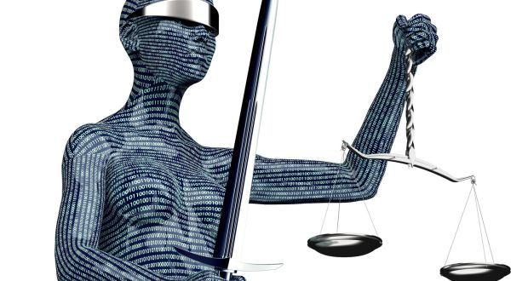
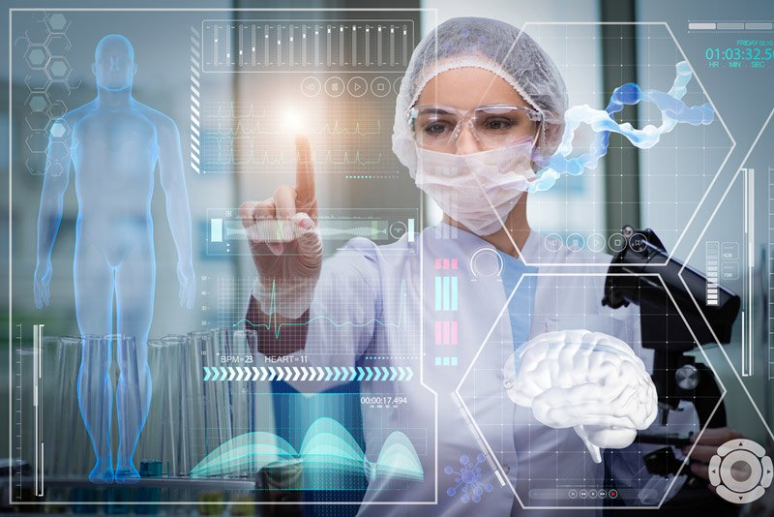
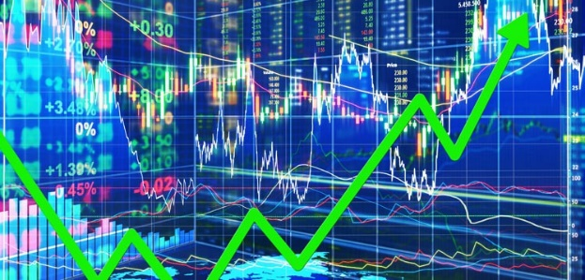
Hopeful Applications
Image processing
Self diving cars
Speech processing
May make the world much
better.
2020 protein
folding
Financial,
Medical Experts
Legal and

Slide 7
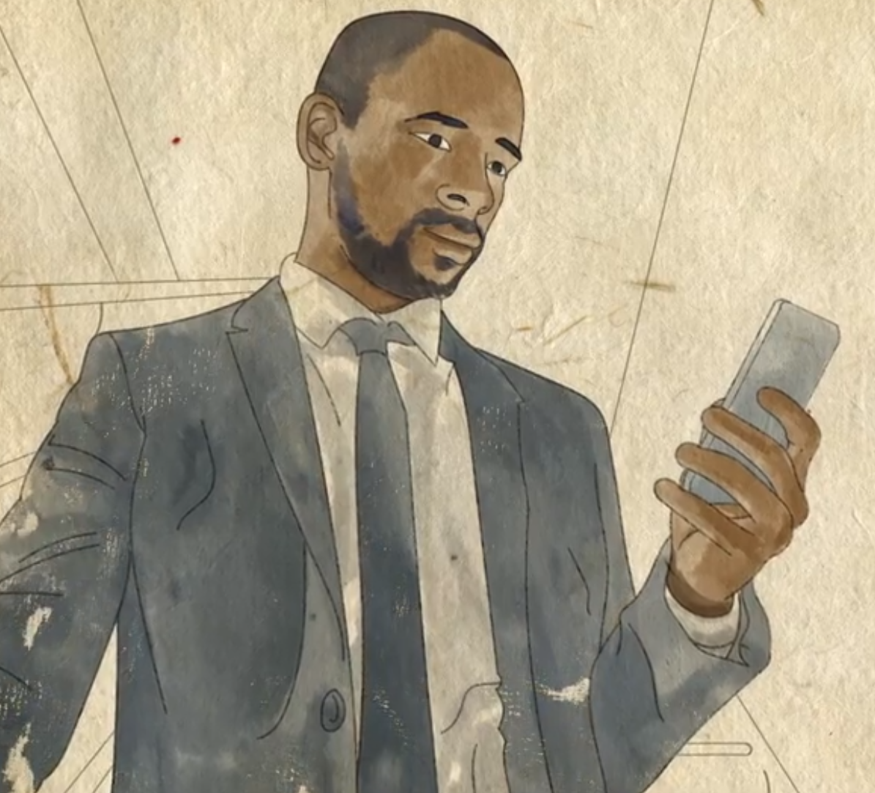
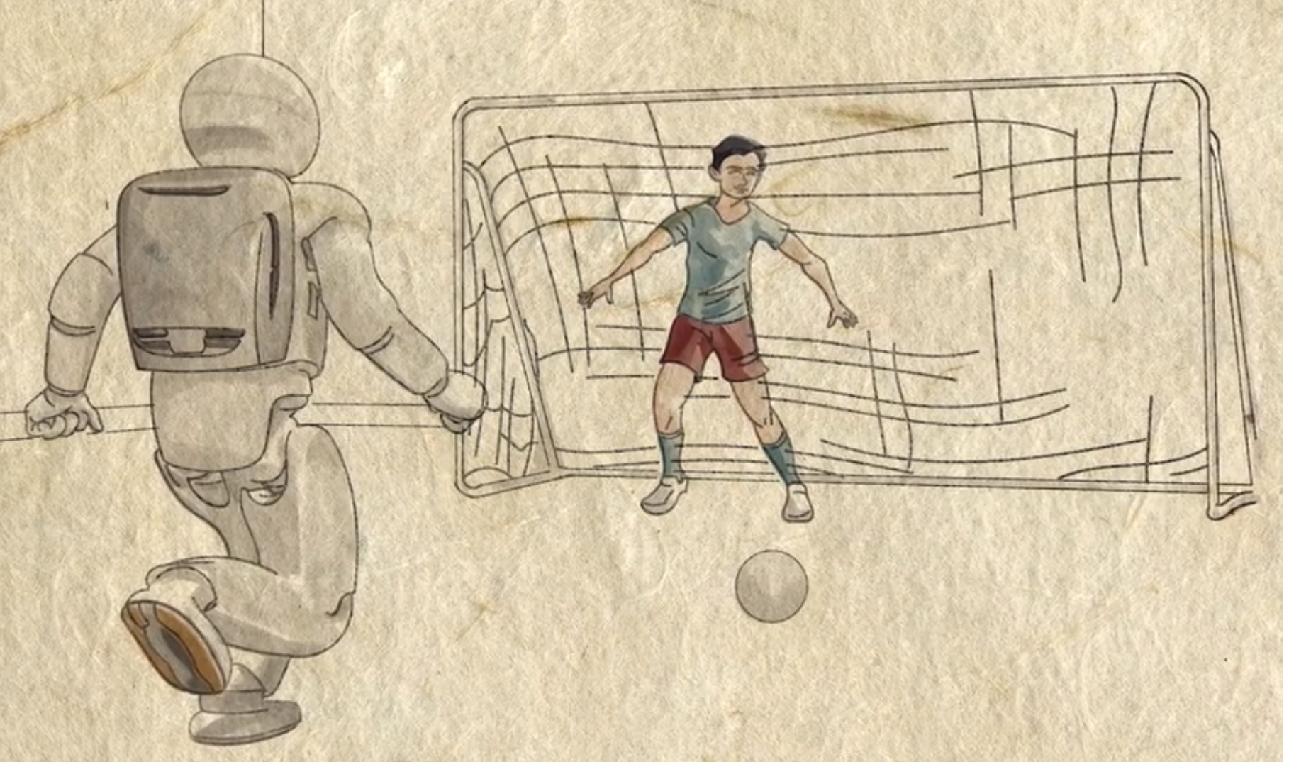
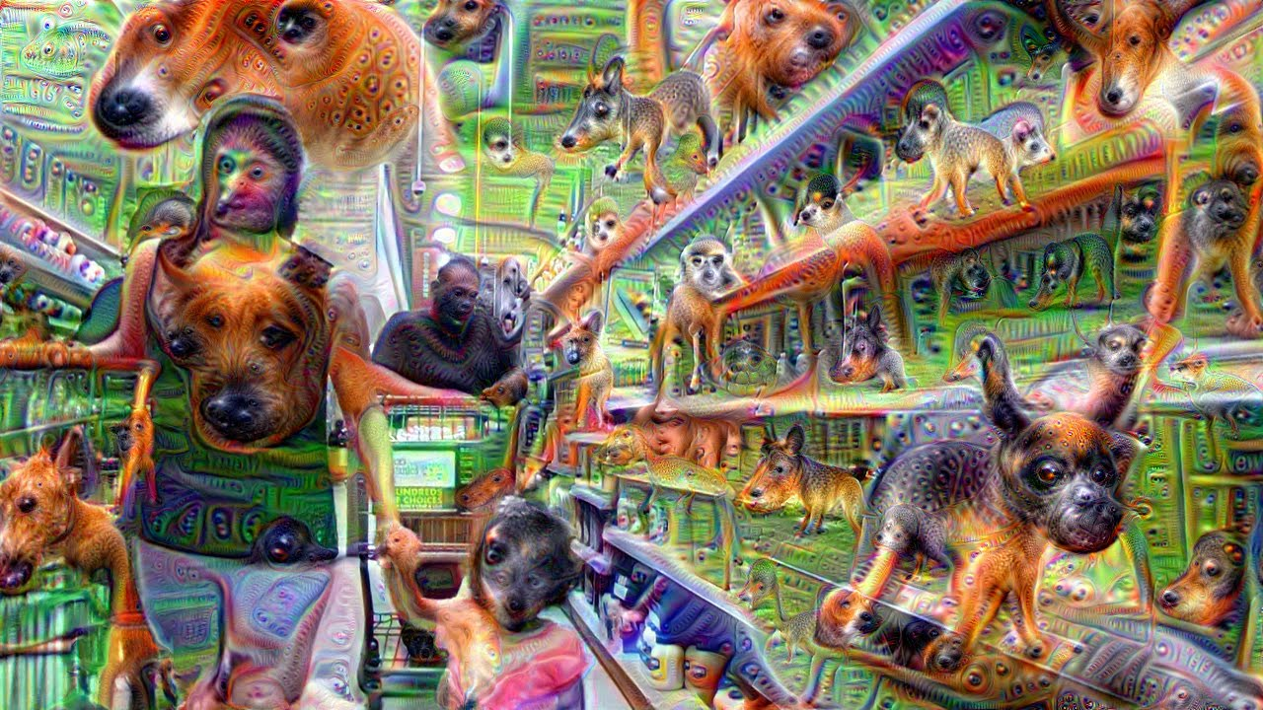
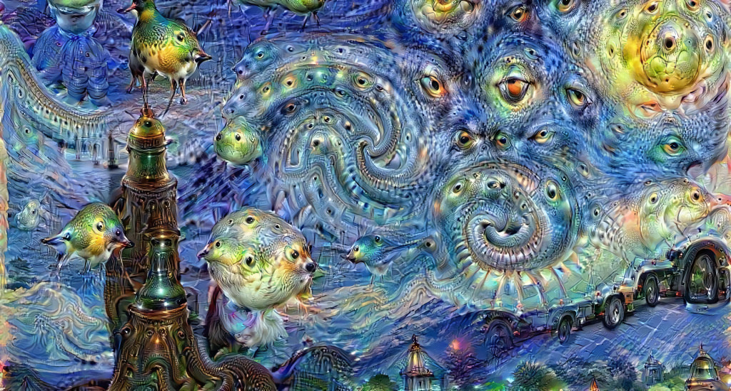
Hopeful Applications
Managing our lives
Entertainment
May make the world much
better.
Generate new art
Machine’s having nightmares

Slide 8
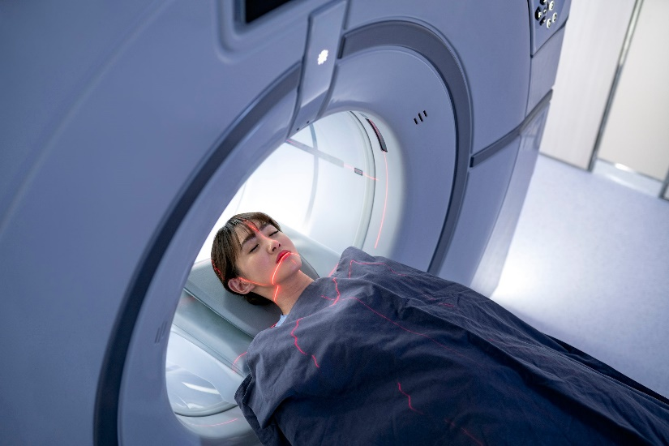
Hopeful Applications
Thoughts in a Coma
Is the person in a coma thinking?
Can we communicate with them?
y_{d} = “Think about playing tennis” or “Think about your mom”
x_{d} = MRI scans of their brain
Machine learning can learn to know y_{d} from x_{d}.
Does it know what the person in a coma is thinking?
May make the world much
better.

Slide 9
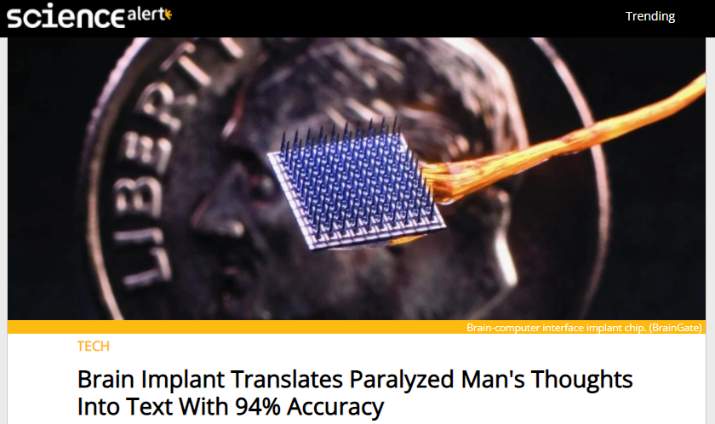
Hopeful Applications
May make the world much
better.

Slide 10
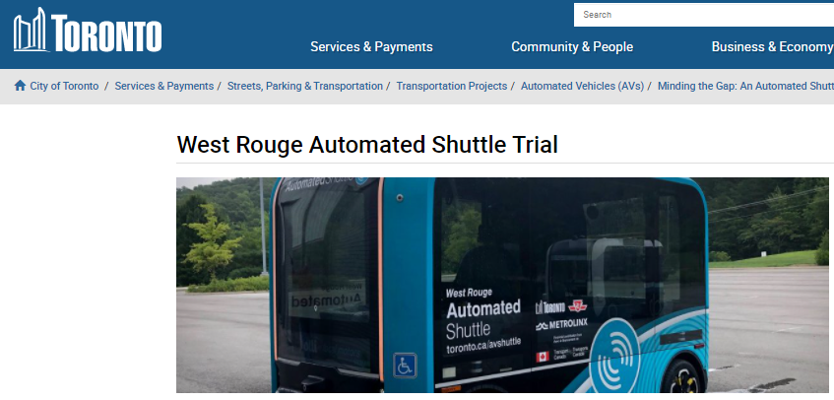
Hopeful Applications
In 2018, Google/Uber had driverless taxis pick up people.
Stopped:
Snow
Morals
Consumer confidence

Slide 11
What are the negative effects that machine learning may have on the average person either now or soon?

Slide 12
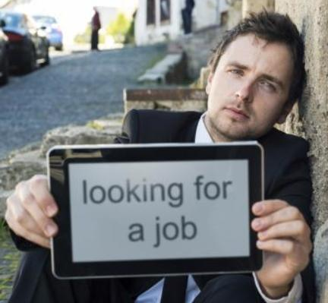
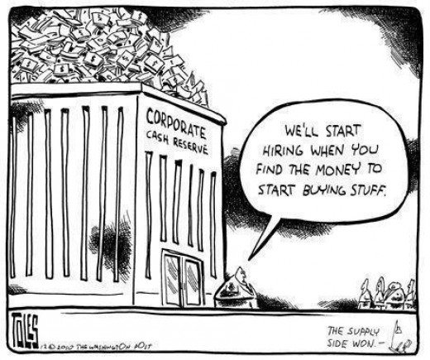
Scary Applications
In 10-15 years, half current jobs will be obsolete.
When lawyers lose their jobs, what will they do?
I am hoping for basic income

Slide 13
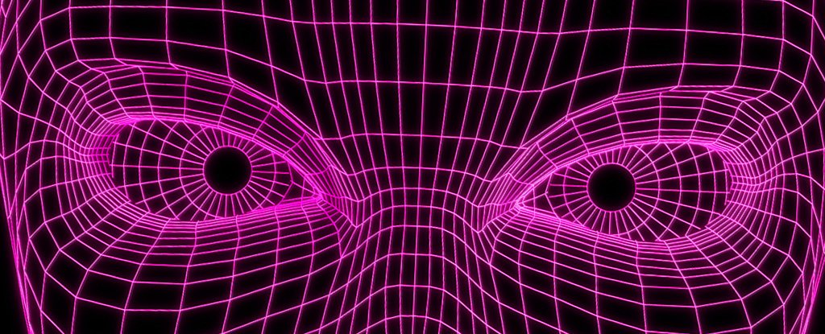
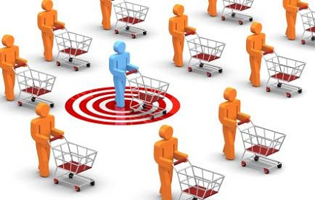
Scary Applications
By Watching You
The world may be a scarier place
Customizing your world

Slide 14
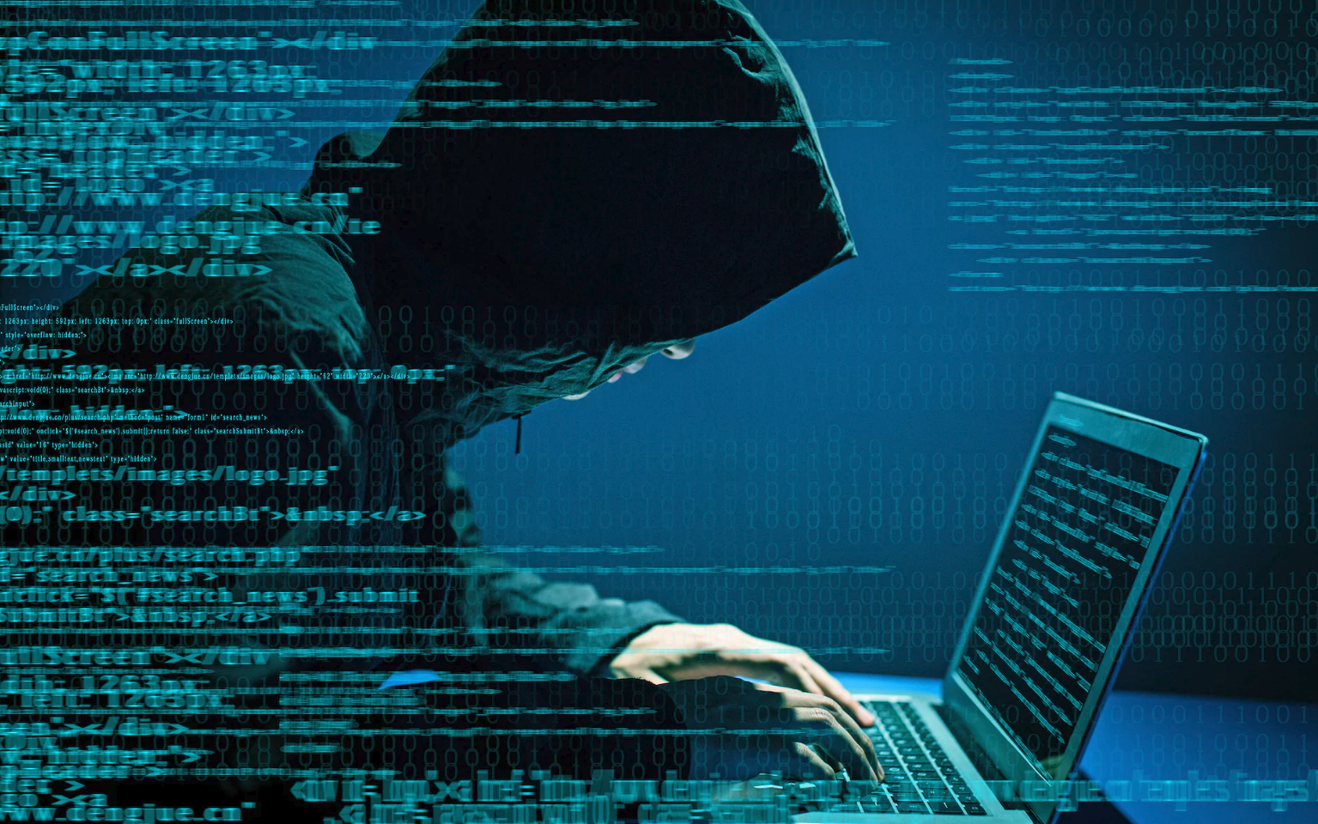
Scary Applications
By Watching You
Cyber Security
Hacking a million self driving cars?
The world may be a scarier place

Slide 15
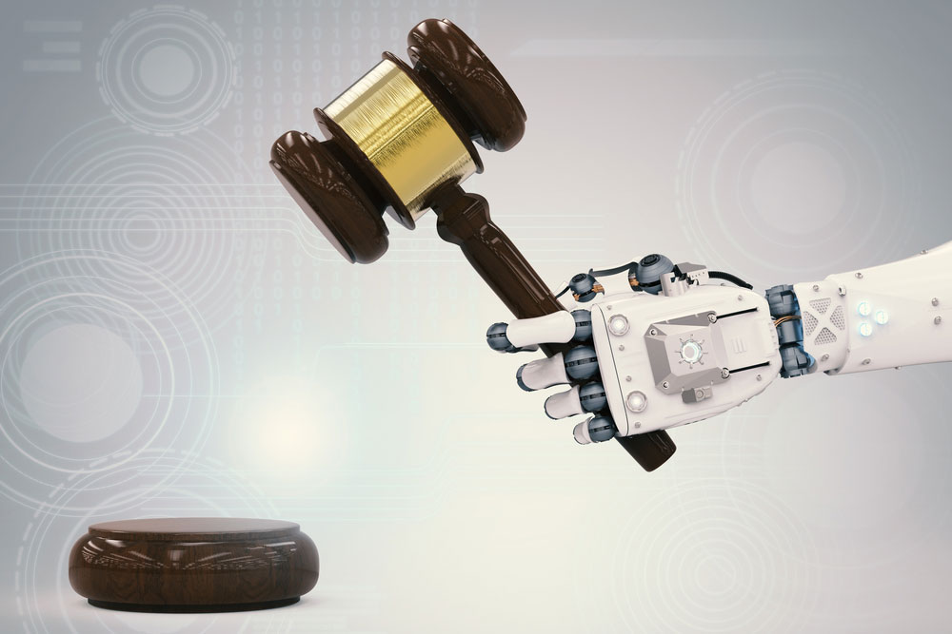
Scary Applications
By Watching You
Cyber Security
Decide who to get a mortgage or get out of jail
Is it fair?
Do we understand how it makes its decisions?
Judges

Slide 16
Scary Applications
Your criminal may be
my activist
Cyber Security
Pick out “criminals” in a crowd
Judges

Slide 17
Scary Applications
The problem with them is ???
Everyone will want one!
Killing machines
Pick out “criminals” in a crowd
Judges

Slide 18
Will AI machines be replacing humans any time soon?

Slide 19
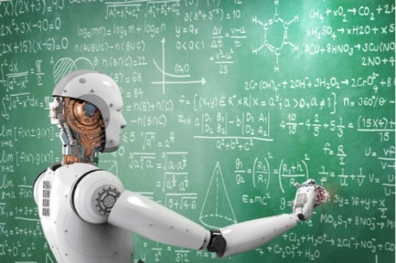
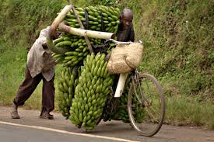
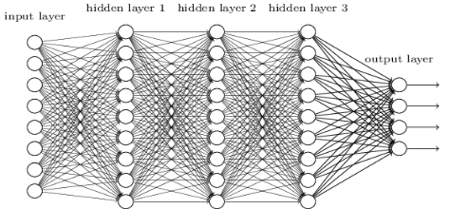
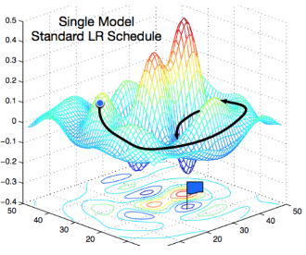
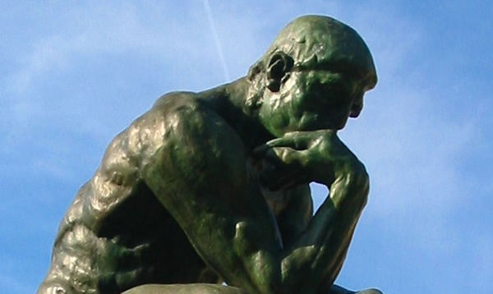
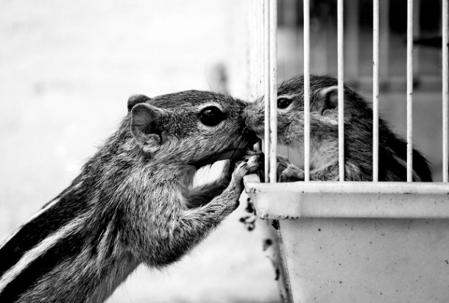
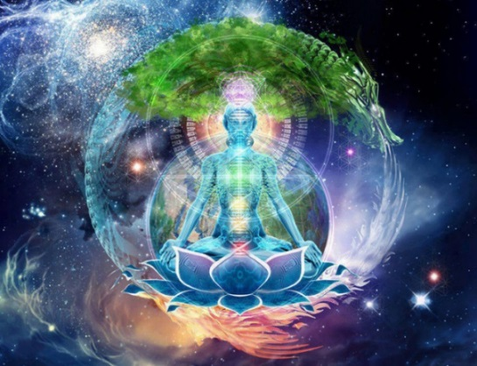
Limitations
Machine Learning
Training Data
Areas in which
machine learning is not likely to find
the pattern soon.
face
bicycle
Complex Understanding
Emotions & Empathy
Consciousness

Slide 20
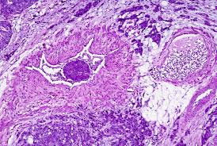
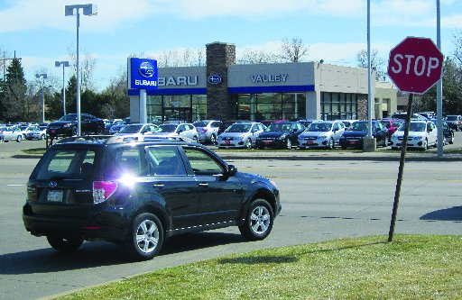
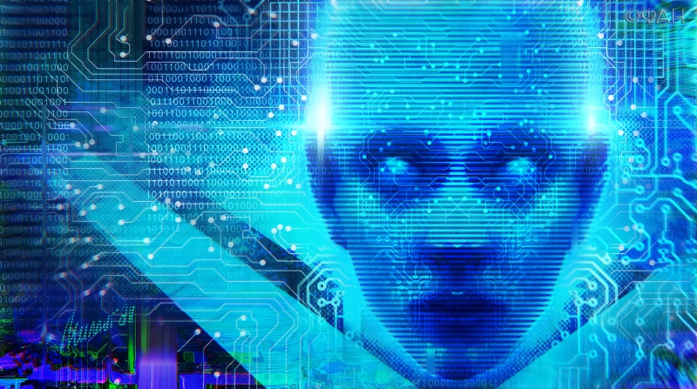
Limitations
Computer vision can now label a picture better than humans.
Unsupervised Learning: Finding pattern in data still too hard
Eg. An alien walks the world and discovers the concept of cars and stop signs even though she doesn’t know what they are.

Slide 21
Limitations
2018 IBM Debater
Great at finding arguments in data base
Poor at responding to complex argument
Hanabi Card game requiring cooperative and subtle commination between players that don't know each other.

Slide 22
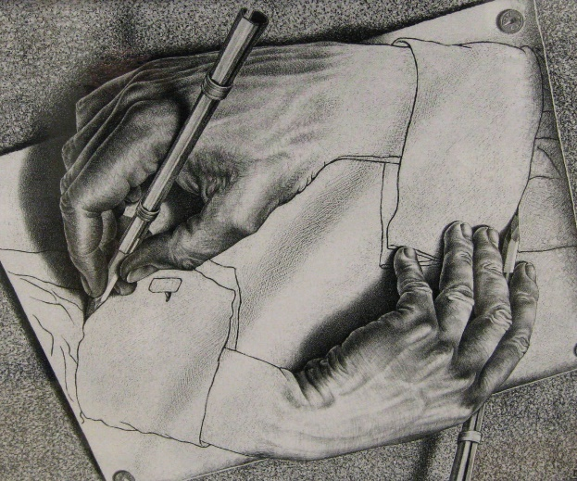
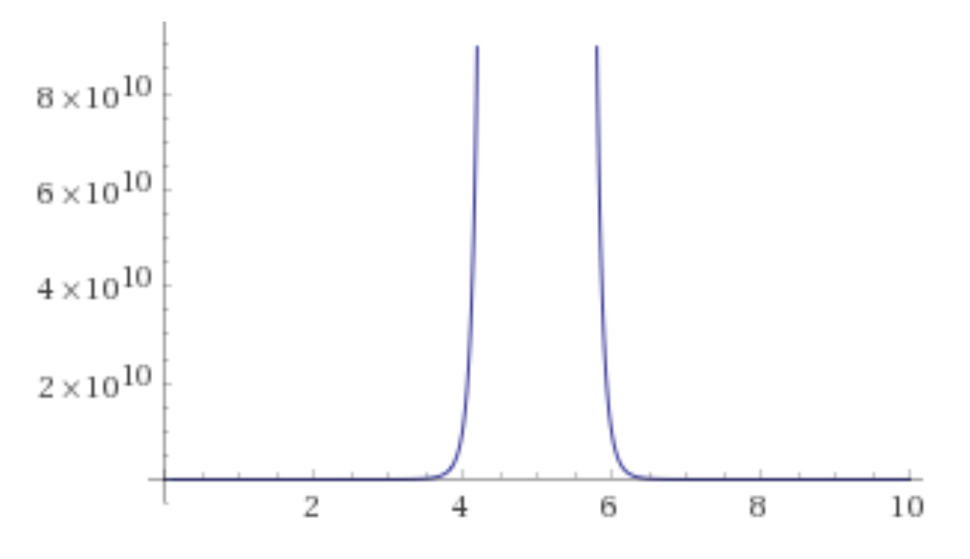
Limitations
On the other hand?
As machines get better at building new machines,
things will go fast!
Technology
What does life look like here?
12:00pm

Slide 23
How capable is AI as a judge?

Slide 24
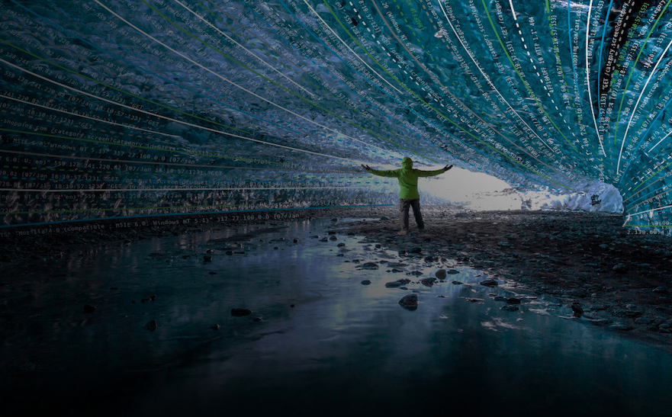
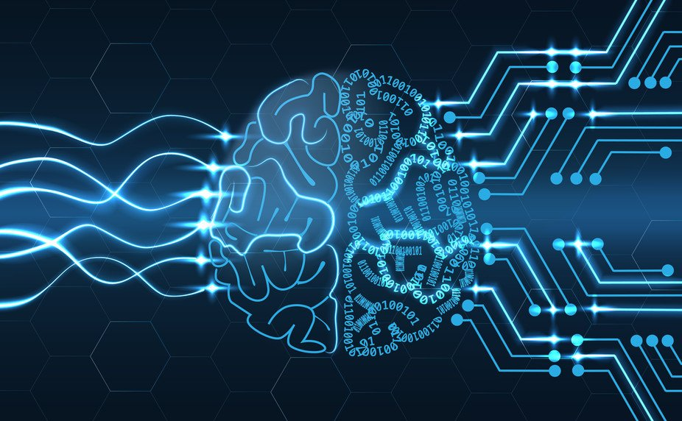
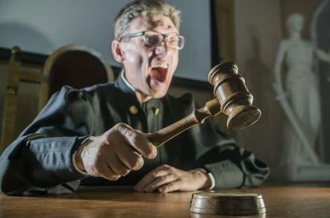
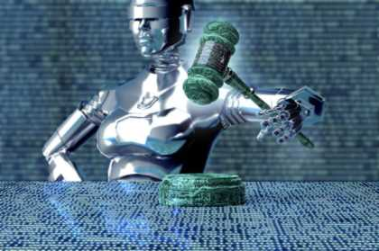
AI As A Judge
The AI is only as good as the data that it learns from.
Our data is biased.
And not understood.
We don’t understand the resulting neural net any better than we understand our own brains.
We don’t understand how the human judge makes its decision either.

Slide 25
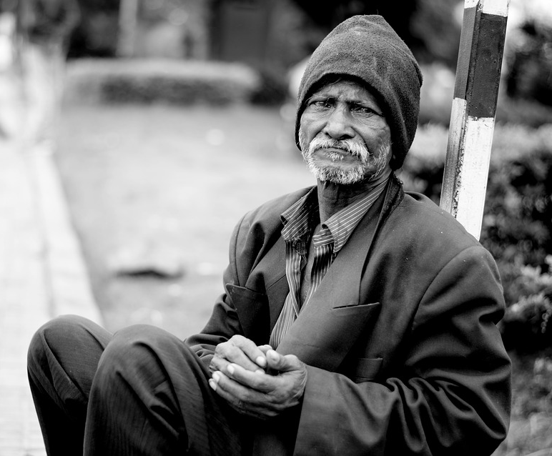
AI As A Judge
We have heard that the new AI does not recognize poor black faces.
But that is because society (and hence the data) does not recognize them.
What does it even mean not to discriminate when choosing who to give a mortgage to or let out of jail?
Don’t consider their race!
Do you consider
their neighborhood?
their job/income?
Do you focus on police and children’s aid data?
Each systematically targets poor blacks.
Built into
our data

Slide 26
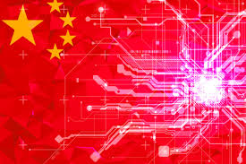
AI As A Judge
How does one decide who to kill?
Certainly we want to minimize the number of US soldiers killed.
Half truth ☺ Half sarcasm ☹
Who is the enemy?
Do we want China selling its technology to dictators?
Do we trust the US government any better?
Who do you trust?

Slide 27
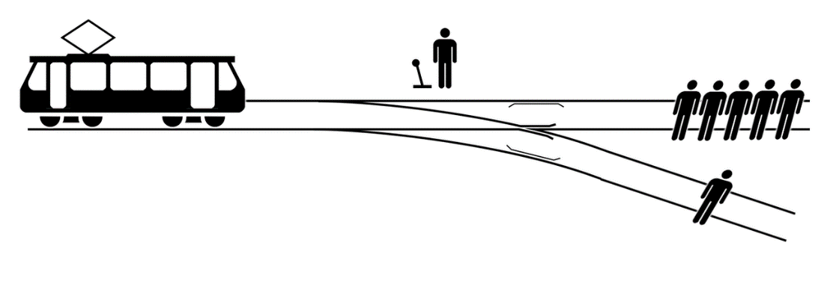
AI As A Judge
We hear of concern with AI and ethics.
It will force a public decision on such issues.
A woman jumped in front of a self-driving car and died.
The car could not have stopped in time.
But the AI “saw” her and “chose” not to try to stop.
Google temporarily stopped the program

Slide 28
What are your thoughts on social media?

Slide 29
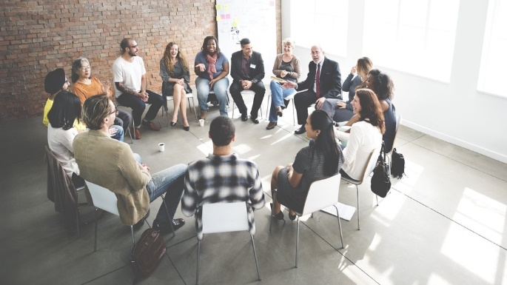
Social Media
Positive:
Great for empowering people within their community
And bringing them access to knowledge.
Negative:
Great for pushing everyone to some extreme.
Great for propaganda and fake news.
This will only get more extreme.

Slide 30
What will happen when we all loose our jobs to machines?

Slide 31
Jobs

Slide 32
Jobs
In the past, people retrained and found a new job.
I don’t think we will be so lucky this time.

Slide 33
Jobs

Slide 34
Jobs
25% to 33% of a CEO’s job can now be automated.
She says “I would really like that time back to do more high value things.”
Human Empathy
Creativity

Slide 35
Jobs
30% of the work done by a CEO.
70% of the work done by a financial trader
30% of the work done by a legal person
22% of the work done by a medical person
27% of the work done by an educators!!!!

Slide 36
Jobs
Certainly, the first step is a minimum guaranteed income for everyone.
Even if people hate their job,
they also find life meaning from it.
We will have to find other ways to find meaning.
Maybe hire half the people to entertain the other half.

Slide 37
How is the “software” of a neural net produced.

Slide 38
Magic

Slide 39
Magic
Do you know the basics
of how the things in your world work?

Slide 40
Magic
Building a Computer From Sand
GCD(a,b) = GCD(x,y)
<x,y>
⇒ <y,x mod y>
https://www.eecs.yorku.ca/~jeff/courses/fun/Building_Computer.pptx

Slide 41
Magic
Training Data
Neural Networks Deep Learning Gradient decent.
face
bicycle
Not coded by a human
Learns from LOTS of data.

Slide 42
Magic
Training Data
Machine Learning is similar to evolution
face
bicycle
Both are simple systems
making small changes based on positive feedback.
We don’t understand
the resulting brain
or neural network.
I find it oddly spiritual.
Emergent Complexity:
And what arises
is awe inspiring

Slide 43
Magic
Training Data
face
bicycle
Useful when humans are unable to explain their expertise (walking)
Useful when a pattern can be found in lots of data.

Slide 44
But how can the machine know the answers outside the training data?

Slide 45
Generalizing from Training Data
Math Theorem:
If on the randomly chosen training data,
a machine is found that gives good answers
without simply memorizing,
then we can prove that with high probability this same machine will also work well
on never seen before instances.

Slide 46
Ethics?? Leadership??

Slide 47
The Future is unknown
but is nigh!
For better or worse, this will change the world.

Slide 48
The Future is unknown
but is nigh!
We hear of concern with AI and ethics.
I don’t believe these questions are new.
For better or worse, this will change the world.
But the technology makes them more stark.
Hopefully, it will force a fruitful public discourse.

Slide 49
The Future is unknown
No doubt the people controlling the AI will be very rich and very powerful.

Slide 50
The Future is unknown
No doubt the people controlling the AI will be very rich and very powerful.
The questions are:
Will our (human) overlords be benevolent or evil.
How poor and powerless will the masses be?
Who will define, influence, and enforce morality?

Slide 51
Benevolent or Evil?
This is much more
important than the
race to the moon was.
Who do you want to lead in AI?

Slide 53
My Hope is with the Hippy Coders

Slide 54
End
Thanks
for coming
Do you have any questions?
Please give me feedback so that I can better serve you.
Notes:
54

Slide 55
Ethics
9. Imagine you have designed a machine learning system for a bank. The system uses an artificial neural network to decide whether to approve mortgages based on client income, banking and credit history, and some demographic data such as gender, ethnic background and age. The network has many layers and over 2 million parameters (weights). A client is asking you why their desired mortgage was not approved by the system and they are accusing you of discrimination based on gender. What level of detail are you able to provide them in your response by simply looking at the values of your weights? Can you easily check whether your model is making decisions based on their gender? Why or why not? (3 marks)

Slide 56
Ethics
This is a scary topic.
You put in sensitive information which is against the law.
We do not understand the weights at all so we don't know how it uses this sensitive information.
We can guess that if the labels (give mortgage) in the training data are correlated with this sensitive information then the machine will naturally learn to reflect this correlation.
I suppose you could test it by flipping the client's sensitive data and seeing if the result changes.
Even if you just ask for the client's address then
this may correlate with their race
which then in turn may correlate with whether or not they pay back their mortgage.
It is all very hard <3

Slide 57
Questions
Q: What is machine learning and why care?
Q: Positive effects on the average person?
Q: Negative effects on the average person?
Q: Will AI machines be replacing humans any time soon?
Q: How capable is AI as a judge?
Q: What are your thoughts on social media?
Q: Loosing our jobs to machines?
Q: How is the “software” of a neural net produced.

Slide 58
The Singularity
$$There is exponential growth in$$
Technology
Human population
Wealth of the rich
But what is the singularity?
$y=Y\left(t\right)$
Consider these as a
function of time.

Slide 59
The Singularity
$$\frac{\text{δ}\text{y}}{\text{δ}\text{t}}=rate of change$$
# of inventions this year
human births - deaths
income – money spent
$y=Y\left(t\right)$
Consider these as a
function of time.

Slide 60
The Singularity
$$\frac{\text{δ}\text{y}}{\text{δ}\text{t}}=0$$
We were too busy to invent anything.
$y=1$
So what we know stays constant.

Slide 61
The Singularity
$$\frac{\text{δ}\text{y}}{\text{δ}\text{t}}=1$$
We invent one new thing per year.
$y=t$
So what we know grows linearly

Slide 62
The Singularity
$$\frac{\text{δ}\text{y}}{\text{δ}\text{t}}=t$$
Our salary increases by one each year.
$y=½ t^{2}$
So our money grows quadratically.

Slide 63
The Singularity
$$\frac{\text{δ}\text{y}}{\text{δ}\text{t}}=y$$
The growth rate ≈ current value
$y=e^{t}$
Value grows exponentially.

Slide 64
The Singularity
$$\frac{\text{δ}\text{y}}{\text{δ}\text{t}}=y$$
# of inventions this year ≈ what we already know
$y=e^{t}$
Technology grows exponentially.

Slide 65
The Singularity
$$\frac{\text{δ}\text{y}}{\text{δ}\text{t}}=y$$
# births ≈ # of people having babies
$y=e^{t}$
Population grows exponentially.

Slide 66
The Singularity
$$\frac{\text{δ}\text{y}}{\text{δ}\text{t}}=y$$
# interest income ≈ amount in account.
$y=e^{t}$
Wealth grows exponentially.

Slide 67
The Singularity
$$\frac{\text{δ}\text{y}}{\text{δ}\text{t}}=y \ln^{2}(y)$$
# of inventions this year ≈ slightly super linearly in what we already know
Having AI really does change things fast.
$y=e^{t}$
Technology grows FASTER than exponentially.
$y=e^{e^{t}}$
FASTER
$y=e^{e^{e^{t}}}$
FASTER
All of these in finite time
stay finite!
FASTER

Slide 68
The Singularity
$$\frac{\text{δ}\text{y}}{\text{δ}\text{t}}=y \ln^{2}(y)$$
# of inventions this year ≈ slightly super linearly in what we already know
Having AI really does change things fast.
Y = ¹/_{(12-t)}
This does not look so bad.
When time = 12:00pm,
technology = ∞.
What does life look like here?
12:00pm

