Slide 1
With enough data and parameters
chatGPT and self-driving cars emerge.
But you have no idea
when, why and how they fail!

Slide 2
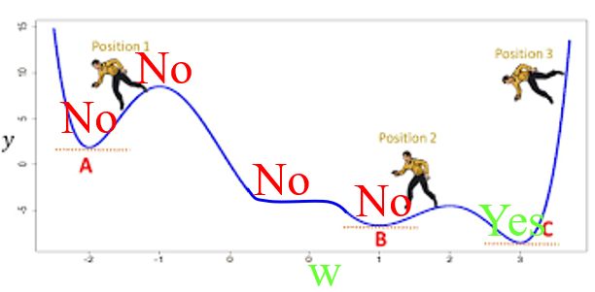
All Critical Gradient descent Solutions Are Optimal (Given Minimal Over-Parameterization)
D
$$\text{x}\text{1}$$
$$\text{x}\text{2}$$
$$…\text{x}\text{D}$$
$\vec{x}$_{d}
NN_{w}($\vec{x}$_{d})
Theorem:
Every critical point w is optimal, |⟨^{δError}/_{δwm}⟩| ≤ ε ⇒ |⟨NN_{w}($\vec{x}$_{d})-y_{d}⟩| ≤ ^{ε}/_{qr}
Optimal on training data. No talk of generalizing.
Notes:
4*1.5hrs - not Example …, not unsupervised.

Slide 3
All Critical Gradient descent Solutions Are Optimal (Given Minimal Over-Parameterization)
D
$$\text{x}\text{1}$$
$$\text{x}\text{2}$$
$$…\text{x}\text{D}$$
$\vec{x}$_{d}
NN_{w}($\vec{x}$_{d})
Theorem:
Every critical point w is optimal, |⟨^{δError}/_{δwm}⟩| ≤ ε ⇒ |⟨NN_{w}($\vec{x}$_{d})-y_{d}⟩| ≤ ^{ε}/_{qr}
I proved the same result
- but needed (1/ε)^{n} weights.
- not quantitative.
Hui Jiang
(2019)
Notes:
4*1.5hrs - not Example …, not unsupervised.

Slide 4
All Critical Gradient descent Solutions Are Optimal (Given Minimal Over-Parameterization)
D
$$\text{x}\text{1}$$
$$\text{x}\text{2}$$
$$…\text{x}\text{D}$$
$\vec{x}$_{d}
NN_{w}($\vec{x}$_{d})
Learned Critical
Fixed
Fixed
Theorem:
Every critical point w is optimal, |⟨^{δError}/_{δwm}⟩| ≤ ε ⇒ |⟨NN_{w}($\vec{x}$_{d})-y_{d}⟩| ≤ ^{ε}/_{qr}
Machine has three stages.
Notes:
4*1.5hrs - not Example …, not unsupervised.

Slide 5
All Critical Gradient descent Solutions Are Optimal (Given Minimal Over-Parameterization)
D
$$\text{x}\text{1}$$
$$\text{x}\text{2}$$
$$…\text{x}\text{D}$$
$\vec{x}$_{d}
NN_{w}($\vec{x}$_{d})
M≥D
{$\vec{x}$′_{d}} is linear independent
Theorem:
Every critical point w is optimal, |⟨^{δError}/_{δwm}⟩| ≤ ε ⇒ |⟨NN_{w}($\vec{x}$_{d})-y_{d}⟩| ≤ ^{ε}/_{qr}
Machine has three stages.
M≥D hidden nodes, i.e over-parameterization.
Produces linearly independent vectors.
Possibly:
x_{d}
$$Training data \\ Linearly independ$$
Notes:
4*1.5hrs - not Example …, not unsupervised.

Slide 6
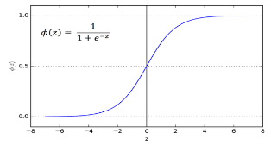
All Critical Gradient descent Solutions Are Optimal (Given Minimal Over-Parameterization)
D
$$\text{x}\text{1}$$
$$\text{x}\text{2}$$
$$…\text{x}\text{D}$$
$\vec{x}$_{d}
NN_{w}($\vec{x}$_{d})
M≥D
{$\vec{x}$′_{d}} is linear independent
Theorem:
Every critical point w is optimal, |⟨^{δError}/_{δwm}⟩| ≤ ε ⇒ |⟨NN_{w}($\vec{x}$_{d})-y_{d}⟩| ≤ ^{ε}/_{qr}
Machine has three stages.
M≥D hidden nodes
Produces linearly independent vectors.
Possibly:
- Input single value
- Distinct values
- Distinct threshold
x_{d}
$$1,2,3,4,…,D$$
Notes:
4*1.5hrs - not Example …, not unsupervised.

Slide 7
All Critical Gradient descent Solutions Are Optimal (Given Minimal Over-Parameterization)
D
$$\text{x}\text{1}$$
$$\text{x}\text{2}$$
$$…\text{x}\text{D}$$
$\vec{x}$_{d}
NN_{w}($\vec{x}$_{d})
M≥D
{$\vec{x}$′_{d}} is linear independent
Theorem:
Every critical point w is optimal, |⟨^{δError}/_{δwm}⟩| ≤ ε ⇒ |⟨NN_{w}($\vec{x}$_{d})-y_{d}⟩| ≤ ^{ε}/_{qr}
Machine has three stages.
M≥D hidden nodes
Produces linearly independent vectors.
Possibly:
- Input single value
- Distinct values
- Distinct weights
x_{d}
$$1,2,3,4,…,D$$
Vandermonde matrix
sig(5×1)
sig(5×2)
sig(5×3)
sig(5×4)
sig(6×1)
sig(6×2)
sig(6×3)
sig(6×4)
sig(8×1)
sig(8×2)
sig(8×3)
sig(8×4)
sig(9×1)
sig(9×2)
sig(9×3)
sig(9×4)
Notes:
4*1.5hrs - not Example …, not unsupervised.

Slide 8
All Critical Gradient descent Solutions Are Optimal (Given Minimal Over-Parameterization)
D
w×$\vec{x}$′_{d} = $\vec{z}$_{d}
$$\text{x}\text{1}$$
$$\text{x}\text{2}$$
$$…\text{x}\text{D}$$
$\vec{x}$_{d}
NN_{w}($\vec{x}$_{d})
Learned Critical
Theorem:
Every critical point w is optimal, |⟨^{δError}/_{δwm}⟩| ≤ ε ⇒ |⟨NN_{w}($\vec{x}$_{d})-y_{d}⟩| ≤ ^{ε}/_{qr}
Machine has three stages.
Full linear layer
Notes:
4*1.5hrs - not Example …, not unsupervised.

Slide 9
All Critical Gradient descent Solutions Are Optimal (Given Minimal Over-Parameterization)
D
$$\text{x}\text{1}$$
$$\text{x}\text{2}$$
$$…\text{x}\text{D}$$
$\vec{x}$_{d}
NN_{w}($\vec{x}$_{d})
NN₃($\vec{z}$_{d}) is sensitive
Theorem:
Every critical point w is optimal, |⟨^{δError}/_{δwm}⟩| ≤ ε ⇒ |⟨NN_{w}($\vec{x}$_{d})-y_{d}⟩| ≤ ^{ε}/_{qr}
Machine has three stages.
3. Needs to be sensitive in some way to its inputs.
Possibly:
- This stage could do nothing
Notes:
4*1.5hrs - not Example …, not unsupervised.

Slide 10
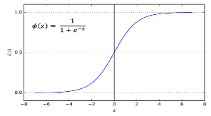
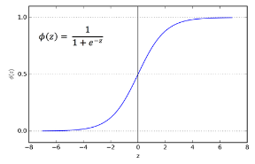
All Critical Gradient descent Solutions Are Optimal (Given Minimal Over-Parameterization)
D
$$\text{x}\text{1}$$
$$\text{x}\text{2}$$
$$…\text{x}\text{D}$$
$\vec{x}$_{d}
NN_{w}($\vec{x}$_{d})
NN₃($\vec{z}$_{d}) is sensitive
Theorem:
Every critical point w is optimal, |⟨^{δError}/_{δwm}⟩| ≤ ε ⇒ |⟨NN_{w}($\vec{x}$_{d})-y_{d}⟩| ≤ ^{ε}/_{qr}
Machine has three stages.
3. Needs to be sensitive in some way to its inputs. Possibly:
Sigmoids never “flat”
or in the sensitive region
Sigmoid
Rectilinear (ReLU)
Notes:
4*1.5hrs - not Example …, not unsupervised.

Slide 11
All Critical Gradient descent Solutions Are Optimal (Given Minimal Over-Parameterization)
D
w×$\vec{x}$′_{d} = $\vec{z}$_{d}
$$\text{x}\text{1}$$
$$\text{x}\text{2}$$
$$…\text{x}\text{D}$$
$\vec{x}$_{d}
NN_{w}($\vec{x}$_{d})
M≥D
NN₃($\vec{z}$_{d}) is sensitive
{$\vec{x}$′_{d}} is linear independent
Lemma:
For each input $\vec{x}$_{d}, we find a change $\text{∆}w\text{d}$ to the weights w
that changes the output NN_{w}($\vec{x}$_{d}) for this input,
but does not change the output NN_{w}($\vec{x}$_{d’}) for other inputs.
Proof: Sensitivity of stage 3, NN₃($\vec{z}$_{d}), gives:
∀input $\vec{x}$_{d}, ∃ change ∆$\vec{z}$_{d} to hidden values $\vec{z}$_{d} such that the output NN_{w}($\vec{x}$_{d}) for this input changes.
Notes:
4*1.5hrs - not Example …, not unsupervised.

Slide 12
All Critical Gradient descent Solutions Are Optimal (Given Minimal Over-Parameterization)
D
w×$\vec{x}$′_{d} = $\vec{z}$_{d}
$$\text{x}\text{1}$$
$$\text{x}\text{2}$$
$$…\text{x}\text{D}$$
$\vec{x}$_{d}
NN_{w}($\vec{x}$_{d})
M≥D
NN₃($\vec{z}$_{d}) is sensitive
{$\vec{x}$′_{d}} is linear independent
Lemma:
For each input $\vec{x}$_{d}, we find a change $\text{∆}w\text{d}$ to the weights w
that changes the output NN_{w}($\vec{x}$_{d}) for this input,
but does not change the output NN_{w}($\vec{x}$_{d’}) for other inputs.
Proof: Linear Independence gives
∀input $\vec{x}$_{d}, ∃$\text{∆} \text{change} w\text{d}$ to weights w such that $\vec{z}$_{d}(w+$$∆w_{d}) = $\vec{z}$_{d}(w) + $$∆$\vec{z}$_{d}
∀d'≠d, $\vec{z}$_{d'}(w+$$∆w_{d}) = $\vec{z}$_{d'}(w) + 0$$
Notes:
4*1.5hrs - not Example …, not unsupervised.

Slide 13
All Critical Gradient descent Solutions Are Optimal (Given Minimal Over-Parameterization)
D
w×$\vec{x}$′_{d} = $\vec{z}$_{d}
$$\text{x}\text{1}$$
$$\text{x}\text{2}$$
$$…\text{x}\text{D}$$
$\vec{x}$_{d}
NN_{w}($\vec{x}$_{d})
M≥D
NN₃($\vec{z}$_{d}) is sensitive
{$\vec{x}$′_{d}} is linear independent
Lemma:
For each input $\vec{x}$_{d}, we find a change $\text{∆}w\text{d}$ to the weights w
but does not change the output NN_{w}($\vec{x}$_{d’}) for other inputs.
And hence does not change Error_{d’} = (NN_{w}($\vec{x}$_{d’})-y_{d})².
Because weights $w$are critical, change $\text{∆}w\text{d}$, does not change Error($w$) = ∑_{d'} Error_{d’}.
Hence, does not change Error_{d} = (NN_{w}($\vec{x}$_{d})-y_{d})².
Notes:
4*1.5hrs - not Example …, not unsupervised.

Slide 14
All Critical Gradient descent Solutions Are Optimal (Given Minimal Over-Parameterization)
D
w×$\vec{x}$′_{d} = $\vec{z}$_{d}
$$\text{x}\text{1}$$
$$\text{x}\text{2}$$
$$…\text{x}\text{D}$$
$\vec{x}$_{d}
NN_{w}($\vec{x}$_{d})
M≥D
NN₃($\vec{z}$_{d}) is sensitive
{$\vec{x}$′_{d}} is linear independent
Lemma:
For each input $\vec{x}$_{d}, we find a change $\text{∆}w\text{d}$ to the weights w
that changes the output NN_{w}($\vec{x}$_{d}) for this input,
but does not change Error_{d} = (NN_{w}($\vec{x}$_{d})-y_{d})².
Proof Theorem: then we have the optimal value NN_{w}(x_{d}) = y_{d}.
Error E
$$\text{NN}\text{w}\text{(}\vec{x}\text{d}\text{)}$$
Notes:
4*1.5hrs - not Example …, not unsupervised.

Slide 15
Logarithmic Gradient Descent Running time
(Given Minimal Over-Parameterization and crazy assumptions)
With the amount of data D huge, each iteration of gradient decent takes O(D) time.
The number of iterations better be O(log(D)).
Previous theory bounds it by D¹⁷.
What is the minimum number of (possibly crazy) assumptions do we need to make to get the O(log(D)).
I have 10 pages of crazy math. Work on it with me!

Slide 16
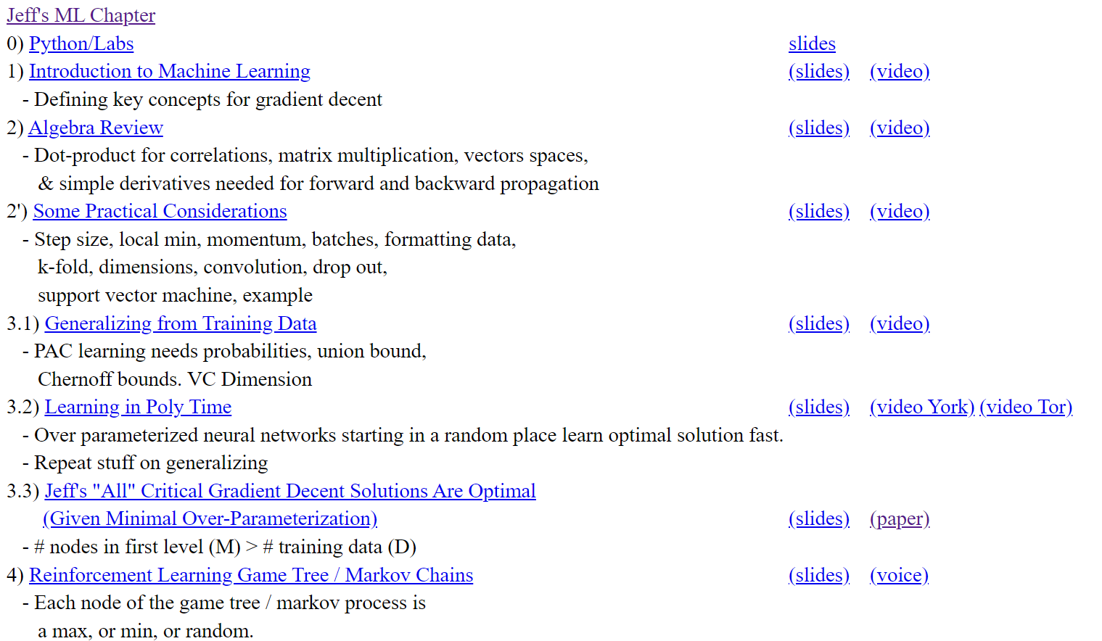
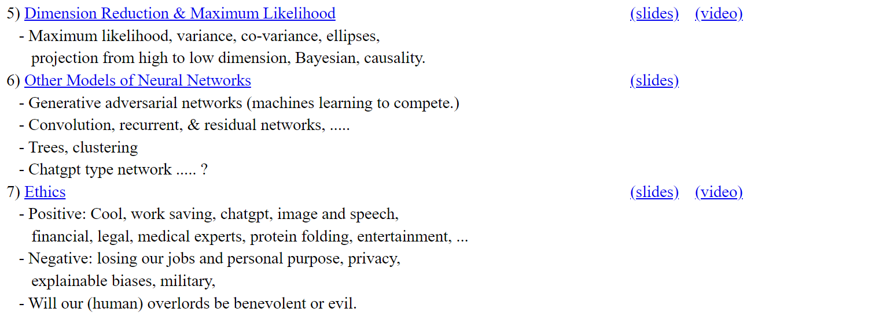
I have a lot of talks and videos
I would love
you to use.
Jeff Edmonds, Comp. Sci.
www.eecs.yorku.ca/~jeff/courses/machine-learning
Notes:
4*1.5hrs - not Example …, not unsupervised.

