Slide 1
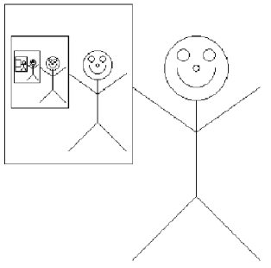
Recursion
Thinking about Algorithms Abstractly
Jeff Edmonds
York University
Lecture 3
COSC 3101

Slide 2
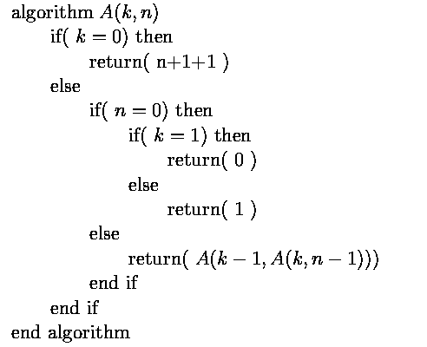
Ackermann’s Function
How big is A(5,5)?
n applications
Notes:
2

Slide 3
Ackermann’s Function
n applications
n applications
Notes:
3

Slide 4
Ackermann’s Function
n applications
n applications
Notes:
4

Slide 5
Ackermann’s Function
n applications
Notes:
5

Slide 6
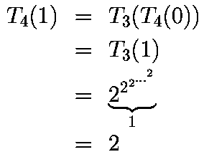
Ackermann’s Function

Slide 7
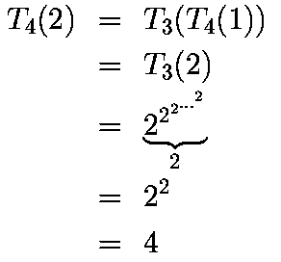
Ackermann’s Function

Slide 8
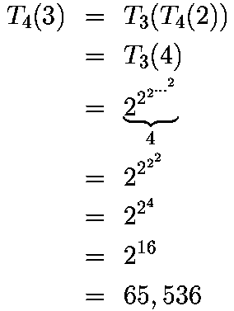
Ackermann’s Function

Slide 9
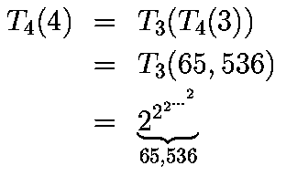
Ackermann’s Function

Slide 10
Ackermann’s Function
Notes:
10

