Slide 1
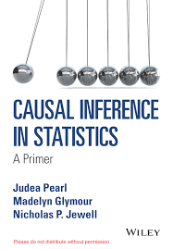
Causal
Inference
Causal Graph
D (Drug)
C (Cure)
Jeff Edmonds
York University
& David Madras

Slide 2
Causal
Inference
Causal Graph
D (Drug)
X (Young/Old)
Coloration
does not mean
causation!
Coloration:
D and C tend to happen at the same time.
Maybe D “causes” C.
Maybe C “causes” D.
Maybe X “causes” C and D.
What does “cause” even mean?
C (Cure)

Slide 3
Does the drug cause the cure?
Choose 100 random people.
Randomly give half the drug.
Watch whether they are cured.
Causal
Inference
Causal Graph
D (Drug)
C (Cure)
¬D (No Drug)
D (Drug)
# people = 100
# people = 50
# people = 50
# Cured = 25
# Cured = 33
pr[ C | ¬D ]
= 0.66
pr[ C | D ] = ³³/₅₀ = 0.50
= ²⁵/₅₀
pr[C|D] - pr[C|¬D] = 0.66-0.50 = 0.16
Drug works

Slide 4
I will save money.
Choose 100 random people.
Watch which drugs they take
and whether they are cured.
Causal
Inference
Causal Graph
D (Drug)
X (Young/Old)
Just a coincidence that half took the drug.
C (Cure)
¬D (No Drug)
D (Drug)
# people = 100
# people = 50
# people = 50
# Cured = 33
# Cured = 25
pr[ C | ¬D ] = ³³/₅₀ = 0.66
pr[ C | D ] = ²⁵/₅₀ = 0.50
pr[C|D] - pr[C|¬D] = 0.50-0.66 = -0.16
Drug doesn't work
Just a coincidence that
it is reverse answer.
What went wrong?
Maybe there was an Confounder
effecting things.
  Confounder: a variable which causally effects both the treatment (T) and the outcome (Y)

Slide 5
I will save money.
Choose 100 random people.
Watch which drugs they take
and whether they are cured.
Causal
Inference
Causal Graph
D (Drug)
X (Young/Old)
Separate our people into these young/old.
C (Cure)
¬D (No Drug)
D (Drug)
# people = 50
# people = 50
(= 10 +40)
# people = 100
(= 44 + 6)
# Cured = 33
(= 31 + 2)
# Cured = 25
(= 9 + 16)
pr[ C | ¬D ] = ³³/₅₀ = 0.66
pr[ C | D ] = ²⁵/₅₀ = 0.50
pr[C|D] - pr[C|¬D] = 0.50-0.66 = -0.16
Drug doesn't work
¬X (Young)
# people = 44
# people = 10
# Cured = 31
# Cured = 9
X (Old)
# people = 6
# people = 40
# Cured = 2
# Cured = 16

Slide 6
I will save money.
Choose 100 random people.
Watch which drugs they take
and whether they are cured.
Causal
Inference
Causal Graph
D (Drug)
X (Young/Old)
Calculate the prob of a cure
for each of the four groups.
Does the drug help the cure
for young/old?
C (Cure)
¬D (No Drug)
D (Drug)
# people = 50
# people = 50
(= 10 +40)
# people = 100
(= 44 + 6)
# Cured = 33
(= 31 + 2)
# Cured = 25
(= 9 + 16)
pr[ C | ¬D ] = ³³/₅₀ = 0.66
pr[ C | D ] = ²⁵/₅₀ = 0.50
pr[C|D] - pr[C|¬D] = 0.50-0.66 = -0.16
Drug doesn't work
Paradox!
Drug works
¬X (Young)
# people = 44
# people = 10
# Cured = 31
# Cured = 9
pr[ C | D & ¬X ]
pr[ C | ¬D & ¬X ]
= ⁹/₁₀
= 0.90
= ³¹/₄₄
= 0.70
pr[ C | D & ¬X ] - pr[ C | ¬D & ¬X ] = 0.90 – 0.70 = 0.20
X (Old)
# people = 6
# people = 40
# Cured = 2
# Cured = 16
= 0.40
pr[ C | D & X ]
pr[ C | ¬D & X]
= ¹⁶/₄₀
= ²/₆
= 0.33
pr[ C | D & X ] - pr[ C | ¬D & X ] = 0.40 – 0.33 = 0.07

Slide 7
I will save money.
Choose 100 random people.
Watch which drugs they take
and whether they are cured.
Causal
Inference
Causal Graph
D (Drug)
X (Young/Old)
Not surprising.
The old don’t cure as well.
But many things influence the cure.
This does not create a paradox.
C (Cure)
¬D (No Drug)
D (Drug)
# people = 50
# people = 50
(= 10 +40)
# people = 100
(= 44 + 6)
# Cured = 33
(= 31 + 2)
# Cured = 25
(= 9 + 16)
pr[ C | ¬D ] = ³³/₅₀ = 0.66
pr[ C | D ] = ²⁵/₅₀ = 0.50
pr[C|D] - pr[C|¬D] = 0.50-0.66 = -0.16
Drug doesn't work
Drug works
¬X (Young)
# people = 44
# people = 10
# Cured = 31
# Cured = 9
pr[ C | D & ¬X ]
pr[ C | ¬D & ¬X ]
= ⁹/₁₀
= 0.90
= ³¹/₄₄
= 0.70
X (Old)
# people = 6
# people = 40
# Cured = 2
# Cured = 16
= 0.40
pr[ C | D & X ]
pr[ C | ¬D & X]
= ¹⁶/₄₀
= ²/₆
= 0.33

Slide 8
I will save money.
Choose 100 random people.
Watch which drugs they take
and whether they are cured.
Causal
Inference
Causal Graph
D (Drug)
X (Young/Old)
Does the drug cause the cure?
Choose 100 random people.
Randomly give half the drug.
Watch whether they are cured.
C (Cure)
Drug doesn't work
¬D (No Drug)
D (Drug)
Drug works
¬X (Young)
# people = 44
# people = 10
# Cured = 31
# Cured = 9
pr[ C | D & ¬X ]
pr[ C | ¬D & ¬X ]
= ⁹/₁₀
= 0.90
= ³¹/₄₄
= 0.70
X (Old)
# people = 6
# people = 40
# Cured = 2
# Cured = 16
= 0.40
pr[ C | D & X ]
pr[ C | ¬D & X]
= ¹⁶/₄₀
= ²/₆
= 0.33

Slide 9
Yes: Old people use the drug more.
Watch which drugs they take
Causal
Inference
Causal Graph
Randomly give half the drug.
D (Drug)
X (Young/Old)
What’s going on?
Maybe age effects
who uses the drug.
C (Cure)
Drug doesn't work
¬D (No Drug)
D (Drug)
Drug works
¬X (Young)
# people = 44
# people = 10
# Cured = 31
# Cured = 9
pr[ C | D & ¬X ]
pr[ C | ¬D & ¬X ]
= ⁹/₁₀
= 0.90
= ³¹/₄₄
= 0.70
pr[¬D | ¬X] = ⁴⁴/₍₄₄₊₁₀₎ = 0.81
pr[ D | ¬X ] = ¹⁰/₍₄₄₊₁₀₎ = 0.19
X (Old)
# people = 6
# people = 40
# Cured = 2
# Cured = 16
= 0.40
pr[ C | D & X ]
pr[ C | ¬D & X]
= ¹⁶/₄₀
= ²/₆
= 0.33
pr[¬D | X ] = ⁶/₍₆₊₄₀₎ = 0.13
pr[ D | X ] = ⁴⁰/₍₆₊₄₀₎ = 0.87

Slide 10
Yes: Old people use the drug more.
Watch which drugs they take
Causal
Inference
Causal Graph
Randomly give half the drug.
D (Drug)
X (Young/Old)
What’s going on?
Maybe age effects
who uses the drug.
The two most populated groups
are on the diagonal.
And these groups make the drug look bad.
Not because of the effect of the drug on the cure
but because of the effect of age on it.
C (Cure)
Why does this matter?
Drug doesn't work
¬D (No Drug)
D (Drug)
Drug works
¬X (Young)
# people = 44
# people = 10
# Cured = 31
# Cured = 9
pr[ C | D & ¬X ]
pr[ C | ¬D & ¬X ]
= ⁹/₁₀
= 0.90
= ³¹/₄₄
= 0.70
pr[¬D | ¬X] = ⁴⁴/₍₄₄₊₁₀₎ = 0.81
pr[ D | ¬X ] = ¹⁰/₍₄₄₊₁₀₎ = 0.19
X (Old)
# people = 6
# people = 40
# Cured = 2
# Cured = 16
= 0.40
pr[ C | D & X ]
pr[ C | ¬D & X]
= ¹⁶/₄₀
= ²/₆
= 0.33
pr[¬D | X ] = ⁶/₍₆₊₄₀₎ = 0.13
pr[ D | X ] = ⁴⁰/₍₆₊₄₀₎ = 0.87

Slide 11
Watch which drugs they take
Causal
Inference
Causal Graph
Randomly give half the drug.
D (Drug)
X (Young/Old)
Lets try to fix it.
Which numbers are ground truth
about drug→cure
I can tell you those.
C (Cure)
Drug doesn't work
¬D (No Drug)
D (Drug)
Drug works
¬X (Young)
# people = 44
# people = 10
# Cured = 31
# Cured = 9
pr[ C | D & ¬X ]
pr[ C | ¬D & ¬X ]
= ⁹/₁₀
= 0.90
= ³¹/₄₄
= 0.70
pr[¬D | ¬X] = ⁴⁴/₍₄₄₊₁₀₎ = 0.81
pr[ D | ¬X ] = ¹⁰/₍₄₄₊₁₀₎ = 0.19
X (Old)
# people = 6
# people = 40
# Cured = 2
# Cured = 16
= 0.40
pr[ C | D & X ]
pr[ C | ¬D & X]
= ¹⁶/₄₀
= ²/₆
= 0.33
pr[¬D | X ] = ⁶/₍₆₊₄₀₎ = 0.13
pr[ D | X ] = ⁴⁰/₍₆₊₄₀₎ = 0.87

Slide 12
Watch which drugs they take
Causal
Inference
Causal Graph
Randomly give half the drug.
D (Drug)
X (Young/Old)
Lets try to fix it.
Which numbers are ground truth
about drug→cure
I can tell you those.
C (Cure)
These were weighted
by the wrong group sizes.
Drug doesn't work
¬D (No Drug)
D (Drug)
Drug works
¬X (Young)
# people = 44
# people = 10
pr[ C | D & ¬X ]
pr[ C | ¬D & ¬X ]
= 0.90
= 0.70
X (Old)
# people = 6
# people = 40
= 0.40
pr[ C | ¬D & X]
pr[ C | D & X ]
= 0.33

Slide 13
Watch which drugs they take
Causal
Inference
Causal Graph
Randomly give half the drug.
D (Drug)
X (Young/Old)
Lets try to fix it.
Try to make the group sizes the way I do.
Choose 100 random people.
How many are young/old depends on
the ground young/old probabilies.
Randomly give half the drug.
C (Cure)
I can tell you those.
Drug doesn't work
¬D (No Drug)
D (Drug)
Drug works
⁵⁴/₂ = 27
⁵⁴/₂ = 27
¬X (Young)
# people = 44
# people = 10
pr[¬X] = ⁽⁴⁴⁺¹⁰⁾/₁₀₀
= 0.54
pr[ C | D & ¬X ]
pr[ C | ¬D & ¬X ]
= 0.90
= 0.70
#¬X = pr[¬X] × #
= 54
⁴⁶/₂ = 23
⁴⁶/₂ = 23
X (Old)
# people = 6
# people = 40
pr[X] = ⁽⁶⁺⁴⁰⁾/₁₀₀
= 0.46
= 0.40
pr[ C | ¬D & X]
pr[ C | D & X ]
= 0.33
#X = pr[X] × #
= 46

Slide 14
Watch which drugs they take
Causal
Inference
Causal Graph
Randomly give half the drug.
D (Drug)
X (Young/Old)
Lets try to fix it.
How many of these should be cured?
Remember I gave you the ground truth about cure probabilities.
C (Cure)
¬D (No Drug)
D (Drug)
⁵⁴/₂ = 27
⁵⁴/₂ = 27
¬X (Young)
# people = 44
# people = 10
# Cured = 31
0.70 × 27 = 19
# Cured = 9
0.90 × 27 = 24
pr[ C | D & ¬X ]
pr[ C | ¬D & ¬X ]
= 0.90
= 0.70
⁴⁶/₂ = 23
⁴⁶/₂ = 23
X (Old)
# people = 6
# people = 40
# Cured = 2
0.33 × 23 = 6
# Cured = 16
0.40 × 23 = 9
= 0.40
pr[ C | ¬D & X]
pr[ C | D & X ]
= 0.33

Slide 15
Watch which drugs they take
Causal
Inference
Causal Graph
Randomly give half the drug.
D (Drug)
X (Young/Old)
Lets try to fix it.
Now compute whether the drug helps the cure.
C (Cure)
¬D (No Drug)
D (Drug)
# people = 27 + 23 = 50
# people = 27 + 23 = 50
# Cured = 19 + 6 = 25
# Cured = 24 + 9 = 33
pr[ C | ¬D ] = ²⁵/₅₀ = 0.50
pr[ C | D ] = ³³/₅₀ = 0.66
pr[C|D] - pr[C|¬D] = 0.66-0.50 = 0.16
Drug works
⁵⁴/₂ = 27
⁵⁴/₂ = 27
¬X (Young)
# people = 44
# people = 10
# Cured = 31
0.70 × 27 = 19
# Cured = 9
0.90 × 27 = 24
pr[ C | D & ¬X ]
pr[ C | ¬D & ¬X ]
= 0.90
= 0.70
⁴⁶/₂ = 23
⁴⁶/₂ = 23
X (Old)
# people = 6
# people = 40
# Cured = 2
0.33 × 23 = 6
# Cured = 16
0.40 × 23 = 9
= 0.40
pr[ C | ¬D & X]
pr[ C | D & X ]
= 0.33

Slide 16
Causal
Inference
Causal Graph
D (Drug)
X (Young/Old)
These numbers are exactly what we got from a fair experiment.
C (Cure)
¬D (No Drug)
D (Drug)
# people = 27 + 23 = 50
# people = 27 + 23 = 50
# Cured = 19 + 6 = 25
# Cured = 24 + 9 = 33
pr[ C | ¬D ] = ²⁵/₅₀ = 0.50
pr[ C | D ] = ³³/₅₀ = 0.66
pr[C|D] - pr[C|¬D] = 0.66-0.50 = 0.16
Drug works
Does the drug cause the cure?
Choose 100 random people.
Randomly give half the drug.
Watch whether they are cured.
But I saved money.
by watch which drugs people take and whether they are cured.

Slide 17
An other classic paradox.
Do women make as
much money as men?
Causal
Inference
Causal Graph
Gender
Job
This causation arrow
is the other way
Salary
Men
Women
Secretary
# people = 10
# people = 100
Salary = $40,000
Salary = $45,000
Boss
# people = 100
# people = 10
Salary = $100,000
Salary = $105,000

Slide 18
Do women get
equal pay for equal work?
Causal
Inference
Causal Graph
Gender
Job
In each job,
women get paid more!
Salary
Men
Women
Secretary
# people = 10
# people = 100
Salary = $40,000
Salary = $45,000
Boss
# people = 100
# people = 10
Salary = $100,000
Salary = $105,000

Slide 19
Do women get
equal pay?
Causal
Inference
Causal Graph
Gender
Job
Salary
No:
Avg_{men}(salary) = ¹⁰/₁₁₀ × $40k + ¹⁰⁰/₁₁₀ × $100k = $95,000
Avg_{women}(salary) = ¹⁰⁰/₁₁₀ × $40k + ¹⁰/₁₁₀ × $100k = $46,000
Men
Women
Secretary
# people = 10
# people = 100
Salary = $40,000
Salary = $45,000
Boss
# people = 100
# people = 10
Salary = $100,000
Salary = $105,000

Slide 20
Do women get
equal pay?
Causal
Inference
Causal Graph
Gender
Job
Salary
The problem is that
women are directed into jobs
that payless
Men
Women
Secretary
# people = 10
# people = 100
Salary = $40,000
Salary = $45,000
Boss
# people = 100
# people = 10
Salary = $100,000
Salary = $105,000

Slide 21
Intro to Causality
David Madras October 22, 2019

Slide 22
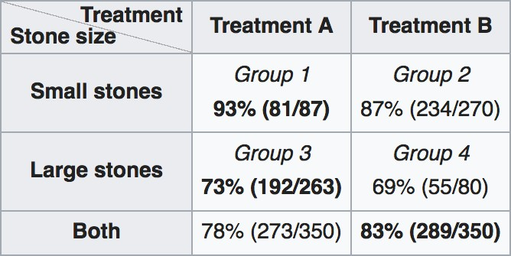
Simpson’s Paradox

Slide 23
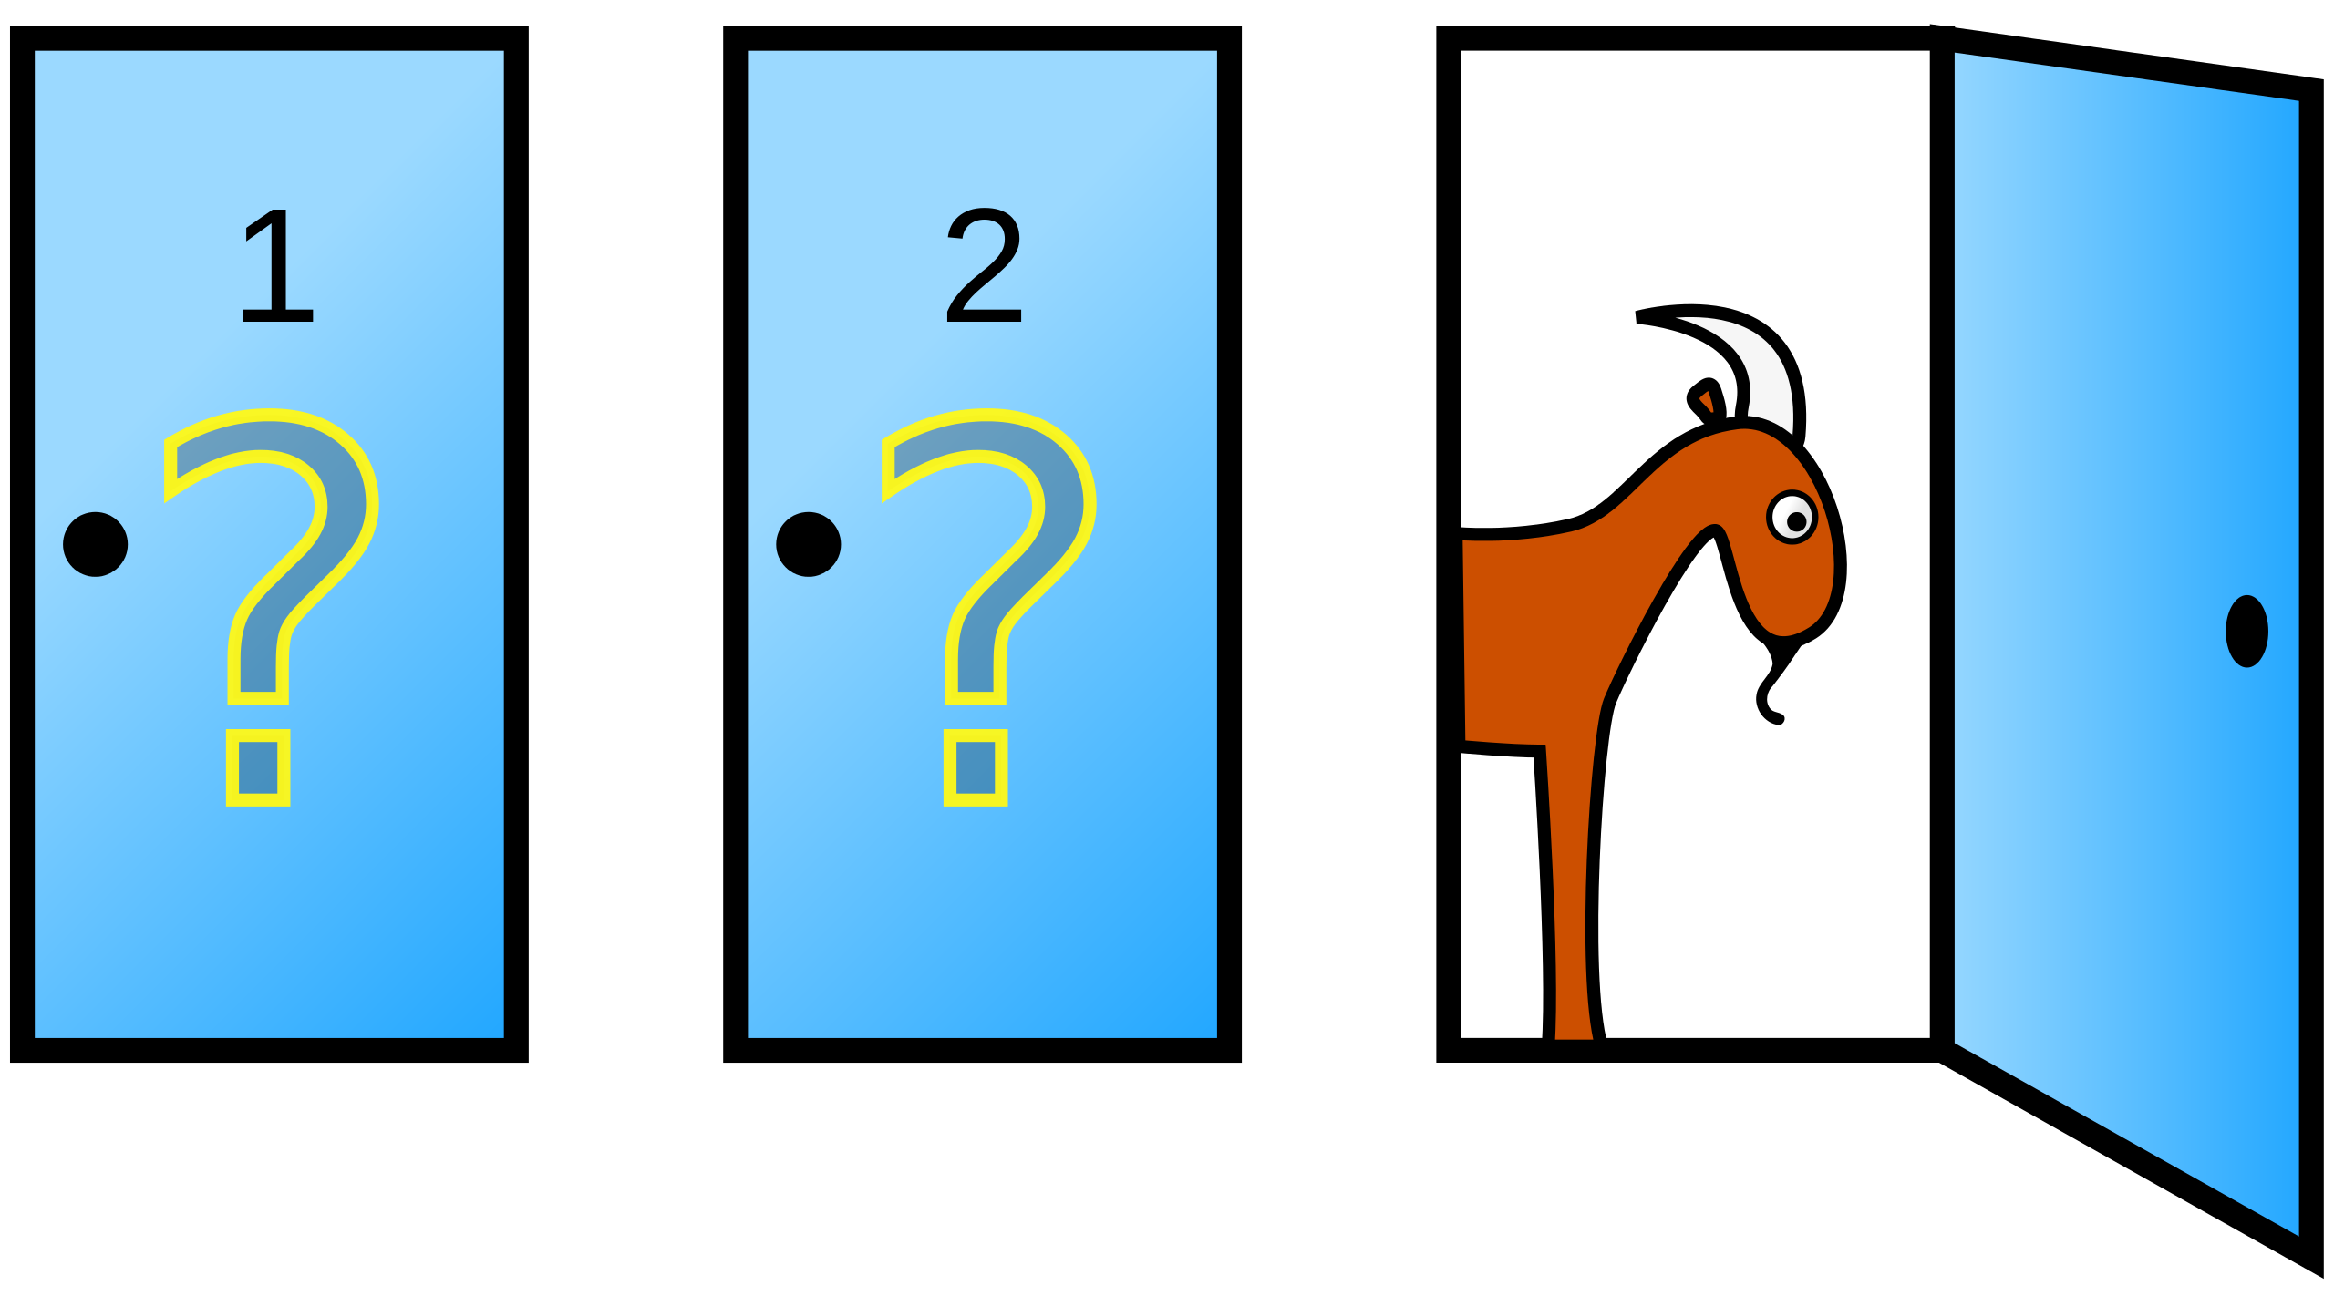
The Monty Hall Problem

Slide 24
The Monty Hall Problem
Three doors – 2 have goats behind them, 1 has a car (you want to win the car)
You choose a door, but don’t open it
The host, Monty, opens another door (not the one you chose), and shows you that there is a goat behind that door
You now have the option to switch your door from the one you chose to the other unopened door
What should you do? Should you switch?

Slide 25
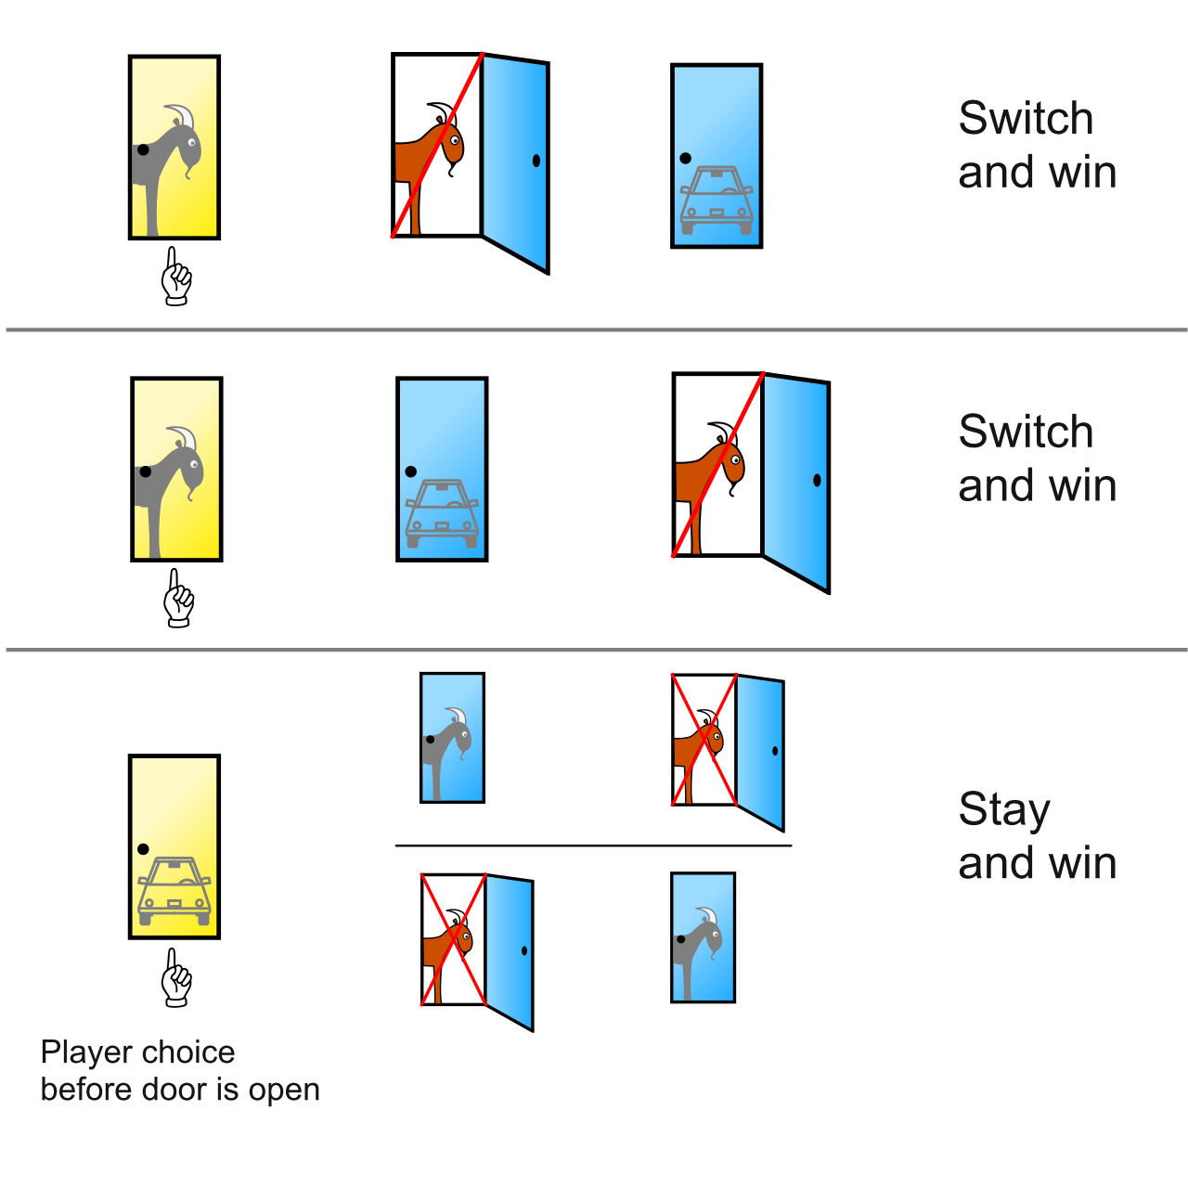
The Monty Hall Problem

Slide 26

What’s Going On?

Slide 27
Causation != Correlation
In machine learning, we try to learn correlations from data
  “When can we predict X from Y?”
In causal inference, we try to model causation
  “When does X cause Y?”
These are not the same!
  Ice cream consumption correlates with murder rates
  Ice cream does not cause murder (usually)

Slide 28
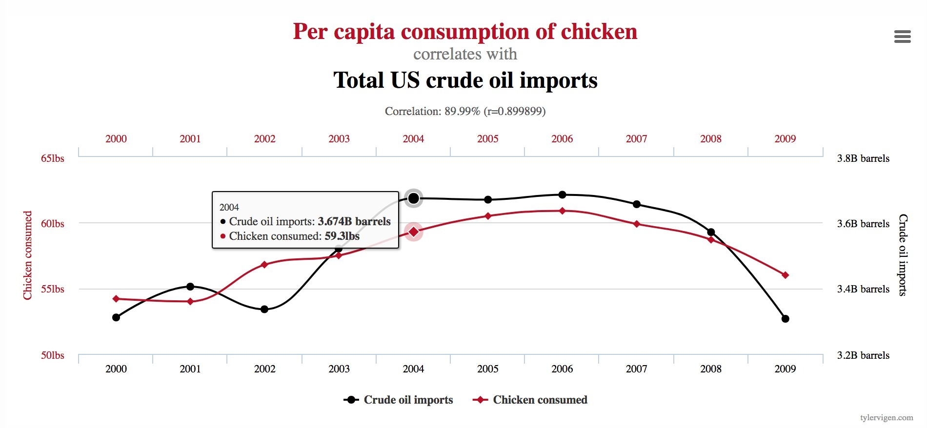
Correlations Can Be Misleading
https://www.tylervigen.com/spurious-correlations

Slide 29
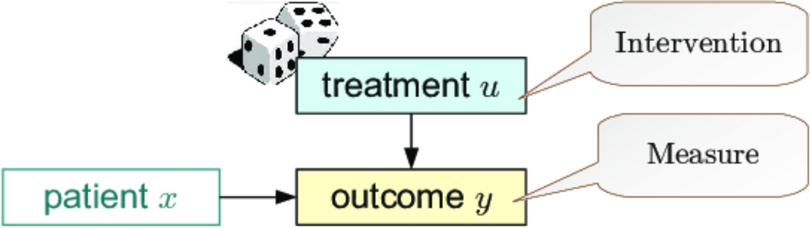
Causal Modelling
Two options:
  Run a randomized experiment

Slide 30
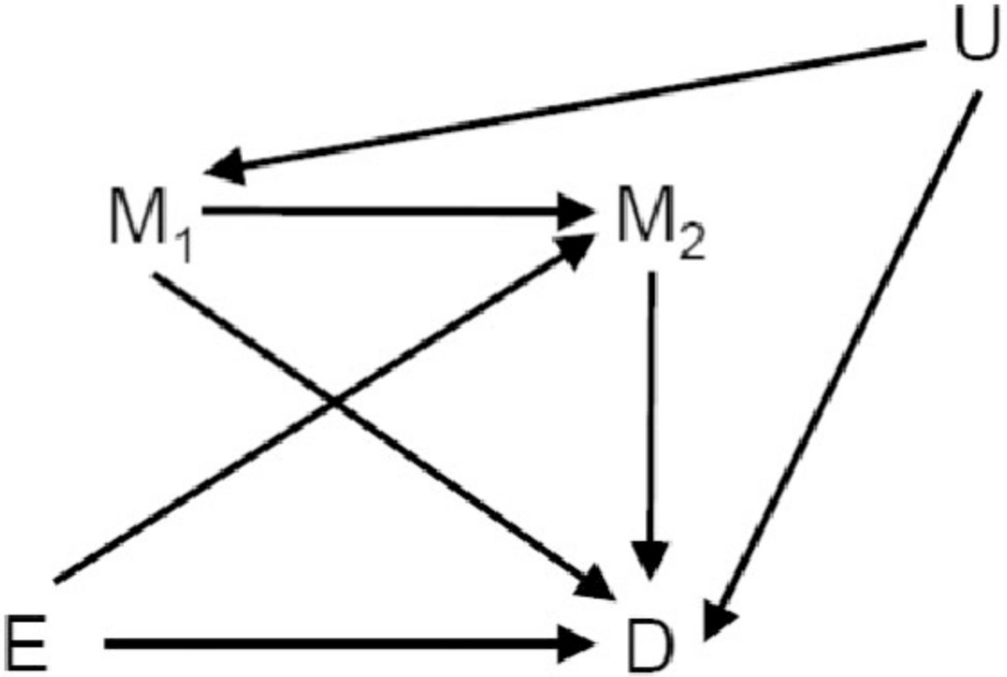
Causal Modelling
Two options:
  Run a randomized experiment
  Make assumptions about how our data is generated

Slide 31
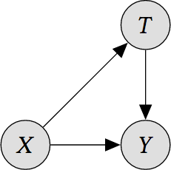
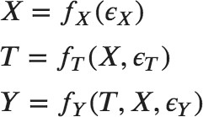
Causal DAGs
Pioneered by Judea Pearl
Describes generative process of data

Slide 32
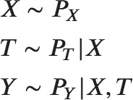
Causal DAGs
Pioneered by Judea Pearl
Describes (stochastic) generative process of data

Slide 33
Causal DAGs
T is a medical treatment
Y is a disease
X are other features about patients (say, age)
We want to know the causal effect of our treatment on the disease.

Slide 34
Causal DAGs
Experimental data: randomized experiment
  We decide which people should take T
Observational data: no experiment
  People chose whether or not to take T
Experiments are expensive and rare
Observations can be biased
  E.g. What if mostly young people choose T?

Slide 35
Asking Causal Questions
Suppose T is binary (1: received treatment, 0: did not)
Suppose Y is binary (1: disease cured, 0: disease not cured)
We want to know “If we give someone the treatment (T = 1), what is the probability they are cured (Y = 1)?”
This is not equal to P(Y = 1 | T = 1)
Suppose mostly young people take the treatment, and most were cured, i.e. P(Y = 1 | T = 1) is high
  Is this because the treatment is good? Or because they are young?

Slide 36

Correlation vs. Causation
Correlation
In the observed data, how often do people who take the treatment become cured?
The observed data may be biased!!

Slide 37


Correlation vs. Causation
Let’s simulate a randomized experiment
  i.e.
  Cut the arrow from X to T
  This is called a do-operation
Then, we can estimate causation:

Slide 38
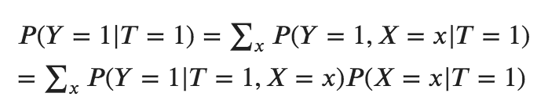
Correlation vs. Causation
Correlation
Causation – treatment is independent of X

Slide 39
Inverse Propensity Weighting
Can calculate this using inverse propensity scores
Rather than adjusting for X, sufficient to adjust for P(T | X)
P(T | X)

Slide 40
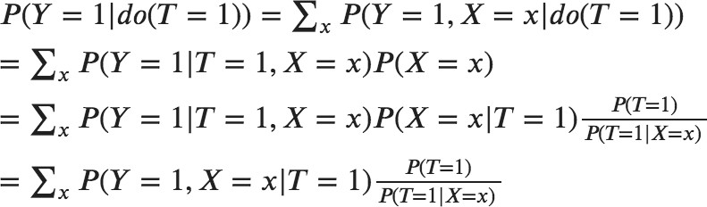
Inverse Propensity Weighting
Can calculate this using inverse propensity scores
These are called stabilized weights

Slide 41
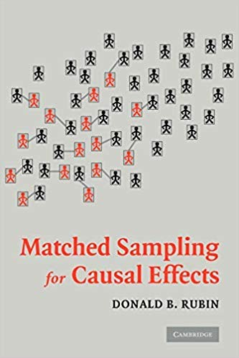
Matching Estimators
Match up samples with different treatments that are near to each other
Similar to reweighting

Slide 42
Review: What to do with a causal DAG
The causal effect of T on Y is
This is great! But we’ve made some assumptions.

Slide 43
Simpson’s Paradox, Explained

Slide 44
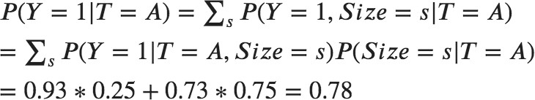
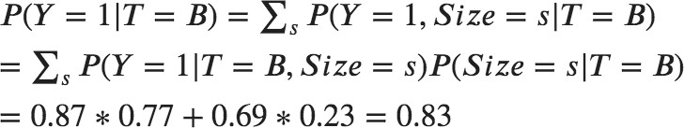
Simpson’s Paradox, Explained
Size
Trmt
Y

Slide 45
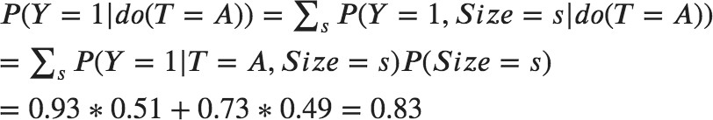
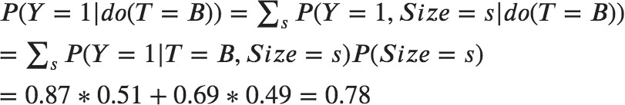
Simpson’s Paradox, Explained
Size
Trmt
Y

Slide 46
Monty Hall Problem, Explained
Boring explanation:

Slide 47
Monty Hall Problem, Explained
Causal explanation:
My door location is correlated with the car location, conditioned on which door Monty opens!
My Door
Car Location
Opened Door
https://twitter.com/EpiEllie/status/1020772459128197121

Slide 48
Monty Hall Problem, Explained
Causal explanation:
My door location is correlated with the car location, conditioned on which door Monty opens!
This is because Monty won’t show me the car
If he’s guessing also, then
correlation disappears
My Door
Car Location
Monty’s Door

Slide 49
Structural Assumptions
All of this assumes that our assumptions about the DAG that generated our data are correct
Specifically, we assume that there are no hidden confounders
  Confounder: a variable which causally effects both the treatment (T) and the outcome (Y)
  No hidden confounders means that we have observed all confounders
This is a strong assumption!

Slide 50

Hidden Confounders
Cannot calculate P(Y | do(T)) here, since U is unobserved
X
U
We say in this case that the causal effect is
unidentifiable
  Even in the case of infinite data and computation, we can never calculate this quantity
T
Y

Slide 51
What Can We Do with Hidden Confounders?
Instrumental variables
  Find some variable which effects only the treatment
Sensitivity analysis
  Essentially, assume some maximum amount of confounding
  Yields confidence interval
Proxies
  Other observed features give us information about the hidden confounder

Slide 52
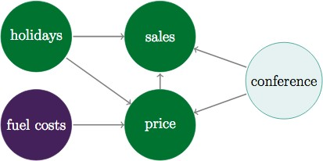
Instrumental Variables
Find an instrument – variable which only affects treatment
  Decouples treatment and outcome variation
With linear functions, solve analytically
But can also use any function approximators

Slide 53
Sensitivity Analysis
Determine the relationship between strength of confounding and causal effect
Example: Does smoking cause lung cancer? (we now know, yes)
  There may be a gene that causes lung cancer and smoking
  We can’t know for sure!
  However, we can figure out how strong this gene would need to be to result in the observed effect
  Turns out – very strong
X
Gene
Smoking
Cancer

Slide 54
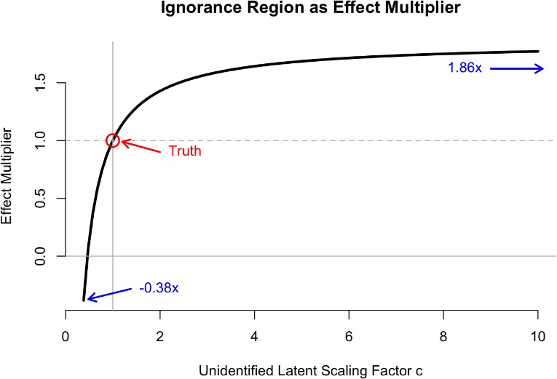
Sensitivity Analysis
The idea is: parametrize your uncertainty, and then decide which values of that parameter are reasonable

Slide 55
Using Proxies
Instead of measuring the hidden confounder, measure some proxies (V = f_{prox}(U))
  Proxies: variables that are caused by the confounder
  If U is a child’s age, V might be height
X
U
If f_{prox} is known or linear, we can estimate this effect
T
Y
V

Slide 56
Using Proxies
If f_{prox} is non-linear, we might try the Causal Effect VAE
Learn a posterior distribution P(U | V) with variational methods
However, this method does not provide theoretical guarantees
Results may be unverifiable: proceed with caution!
X
U
T
Y
V

Slide 57
Causality and Other Areas of ML
Reinforcement Learning
  Natural combination – RL is all about taking actions in the world
  Off-policy learning already has elements of causal inference
Robust classification
  Causality can be natural language for specifying distributional robustness
Fairness
  If dataset is biased, ML outputs might be unfair
  Causality helps us think about dataset bias, and mitigate unfair effects

Slide 58
Quick Note on Fairness and Causality
Many fairness problems (e.g. loans, medical diagnosis) are actually causal inference problems!
We talk about the label Y – however, this is not always observable
  For instance, we can’t know if someone would return a loan if we don’t give one to them!
  This means if we just train a classifier on historical data, our estimate will be biased
  Biased in the fairness sense and the technical sense
General takeaway: if your data is generated by past decisions, think very hard about the output of your ML model!

Slide 59

Feedback Loops
Takes us to part 2… feedback loops
When ML systems are deployed, they make many decisions over time
So our past predictions can impact our future predictions!
  Not good

Slide 60
Unfair Feedback Loops
We’ll look at “Fairness Without Demographics in Repeated Loss Minimization” (Hashimoto et al, ICML 2018)
Domain: recommender systems
Suppose we have a majority group (A = 1) and minority group (A = 0)
Our recommender system may have high overall accuracy but low accuracy on the minority group
  This can happen due to empirical risk minimization (ERM)
Can also be due to repeated decision-making

Slide 61
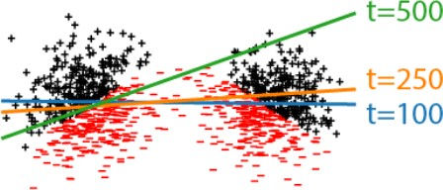
Repeated Loss Minimization
When we give bad recommendations, people leave our system
Over time, the low-accuracy group will shrink

Slide 62


Distributionally Robust Optimization
Upweight examples with high loss in order to improve the worst case
In the long run, this will prevent clusters from being underserved
This ends up being equal to

Slide 63
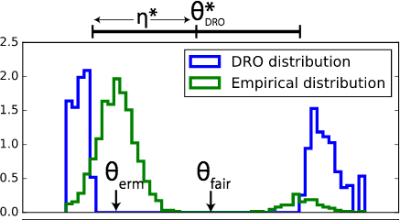
Distributionally Robust Optimization
Upweight examples with high loss in order to improve the worst case
In the long run, this will prevent clusters from being underserved

Slide 64
Conclusion
Your data is not what it seems
ML models only work if your training/test set actually look like the environment you deploy them in
This can make your results unfair
  Or just incorrect
So examine your model assumptions and data collection carefully!

Slide 65
The End

Slide 66
I will save money.
Choose 100 random people.
Watch which drugs they take
and whether they are cured.
Causal
Inference
Causal Graph
D (Drug)
X (Young/Old)
Separate our people into these young/old.
C (Cure)
¬D (No Drug)
D (Drug)
# people = 50
# people = 50
(= 10 +40)
# people = 100
(= 44 + 6)
# Cured = 33
(= 31 + 2)
# Cured = 25
(= 9 + 16)
pr[ C | ¬D ] = 33/50 = 0.66
pr[ C | D ] = 25/50 = 0.50
pr[C|D] - pr[C|¬D] = 0.50-0.66 = -0.16
Drug doesn't work
¬X (Young)
# people = 44
# people = 10
pr[¬X] = ⁽⁴⁴⁺¹⁰⁾/₁₀₀
= 0.54
# Cured = 31
# Cured = 9
pr[ C | D & ¬X ]
pr[ C | ¬D & ¬X ]
= ⁹/₁₀
= 0.90
= ³¹/₄₄
= 0.70
pr[¬D | ¬X] = ⁴⁴/₍₄₄₊₁₀₎ = 0.81
pr[ D | ¬X ] = ¹⁰/₍₄₄₊₁₀₎ = 0.19
X (Old)
# people = 6
# people = 40
pr[X] = ⁽⁶⁺⁴⁰⁾/₁₀₀
= 0.46
# Cured = 2
# Cured = 16
= 0.40
pr[ C | D & X ]
pr[ C | ¬D & X]
= ¹⁶/₄₀
= ²/₆
= 0.33
pr[¬D | X ] = ⁶/₍₆₊₄₀₎ = 0.13
pr[ D | X ] = ⁴⁰/₍₆₊₄₀₎ = 0.87

