Slide 1
Network Flow &
Linear Programming
Grad Algorithms
Network Flow
Linear Programming
Jeff Edmonds
York University
Lecture 3
COSC 6111

Slide 2
Optimization Problems
Ingredients:
  Instances: The possible inputs to the problem.
  Solutions for Instance: Each instance has an exponentially large set of solutions.
  Cost of Solution: Each solution has an easy to compute cost or value.
Specification
  Preconditions: The input is one instance.
  Postconditions: An valid solution with optimal cost. (minimum or maximum)

Slide 3

Network Flow
Instance:
  A Network is a directed graph G
  Edges represent pipes that carry flow
  Each edge <u,v> has a maximum capacity c_{<u,v>}
  A source node s out of which flow leaves
  A sink node t into which flow arrives
Goal:
Max Flow

Slide 4
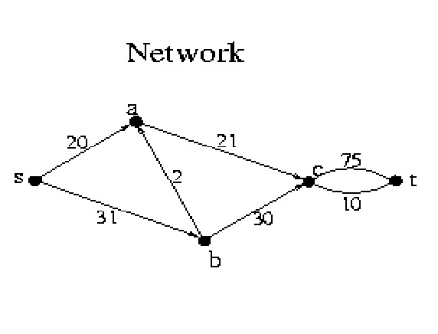
Network Flow
Instance:
  A Network is a directed graph G
  Edges represent pipes that carry flow
  Each edge <u,v> has a maximum capacity c_{<u,v>}
  A source node s out of which flow leaves
  A sink node t into which flow arrives

Slide 5
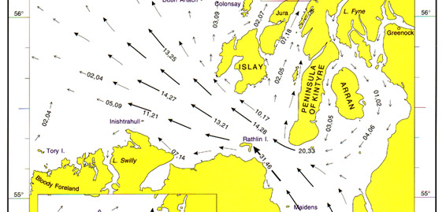
Network Flow
For some edges/pipes,
it is not clear which direction the flow should go
in order to maximize the flow from s to t.
Hence we allow flow in both directions.

Slide 6
Network Flow
Solution:
  The amount of flow F_{<u,v>} through each edge.
  Flow F_{<u,v>} can't exceed capacity c_{<u,v>}.
  No leaks, no extra flow.
    For each node v: flow in = flow out
  ∑_{u} F_{<u,v>} = ∑_{w} F_{<v,w>}

Slide 7
Network Flow
Value of Solution:
  Flow from s into the network
  minus flow from the network back into s.
  rate(F) = ∑_{u} F_{<s,u>}
- ∑_{v} F_{<v,s>}
Goal:
Max Flow

Slide 8
Min Cut
Value Solution C=<U,V>:
cap(C) = how much can flow from U to V
= ∑_{u∈U,v∈V} c_{<u,v>}
Goal:
Min Cut
U
s
V
u
v
t

Slide 9
Max Flow = Min Cut
Theorem:
  For all Networks Max_{F} rate(F) = Min_{C} cap(C)
Prove: ∀ F,C rate(F) ≤ cap(C)
Prove: ∀ flow F, alg either
  finds a better flow F
  or finds cut C such that rate(F) = cap(C)
Alg stops with an F and C for which rate(F) = cap(C)
  F witnesses that the optimal flow can't be less
  C witnesses that it can't be more.
U
V
u
v

Slide 10
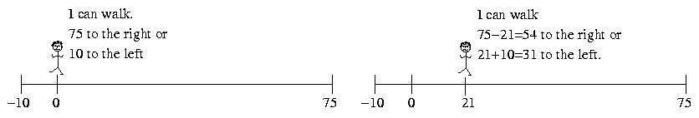
Network Flow
Walking
c_{<v,u>}
F_{<u,v>}
c_{<u,v>}
Flow Graph
Augmentation Graph
f_{<u,v>}+w
f_{<u,v>}/c_{<u,v>}
c_{<u,v>}-F_{<u,v>}
u
v
u
w
v
0/c_{<v,u>}
F_{<u,v>}+c_{<v,u>}

Slide 11
Network Flow
Walking
c_{<u,v>}
F_{<u,v>}
c_{<u,v>}
Flow Graph
Augmentation Graph
F_{<u,v>}-w
F_{<u,v>}/c_{<u,v>}
c_{<u,v>}-F_{<u,v>}
u
v
u
w
v
0/c_{<v.u>}
F_{<u,v>}+c_{<v,u>}

Slide 12

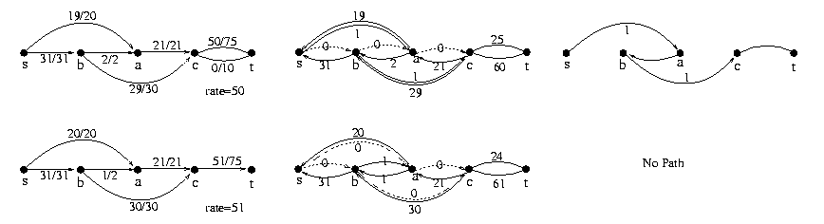
Max Flow = Min Cut
+w
-w
+w
+w
Given Flow F
  Construct Augmenting Graph G_{F}
  Find path P
  Let w be the max amount flow
  can increase along path P.
  Increase flow along path P by w.
  i.e newF = oldF + w × P

Slide 13
Max Flow = Min Cut
+w
-w
+w
+w
Given Flow F
  Construct Augmenting Graph G_{F}
  Find path P
  Let w be the max amount flow
  can increase along path P.
  Increase flow along path P by w.
  i.e newF = oldF + w × P

Slide 14
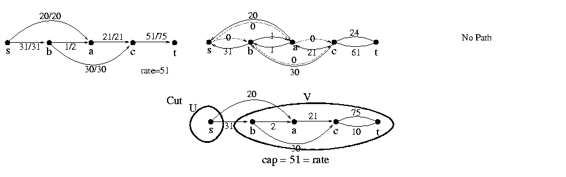
Max Flow = Min Cut
Given Flow F
  Construct Augmenting Graph G_{F}
  Find path P using BFS, DFS,
  or generic search algorithm
  No path

Slide 15
Max Flow = Min Cut
  Let F_{alg} be this final flow.
  Let cut C_{alg}=<U,V>,
    where U are the nodes reachable from s
    in the augmented graph
    and V not.
  Claim: rate(F_{alg}) = cap(C_{alg})

Slide 16
An Application: Matching
Sam | Mary
Bob | Beth
John | Sue
Fred | Ann
3 matches
Can we do better?
4 matches
Who loves whom.
Who should be matched with whom
so as many as possible matched
and nobody matched twice?

Slide 17
An Application: Matching
s
t
1
1
u
v
c_{<s,u>} = 1
  Total flow out of u = flow into u ≤ 1
  Boy u matched to at most one girl.
c_{<v,t>} = 1
  Total flow into v = flow out of v ≤ 1
  Girl v matched to at most one boy.

Slide 18
An Application: Matching
Flow
New Flow
s
t
s
t
Augmentation Graph
Augmentation Path
Alternates
  adding edge
  removing edge
  adding edge
  removing edge
  adding edge
Extra edge added
s
t

Slide 19
An Application: Matching
Sam | Mary
Bob | Beth
John | Sue
Fred | Ann
3 matches
Can we do better?
4 matches
Who loves whom.
Who should be matched with whom
so as many as possible matched
and nobody matched twice?

Slide 20
Hill Climbing
Problems:
Can our Network Flow
Algorithm get stuck
in a local maximum?
Global Max
No!
Local Max

Slide 21
Hill Climbing
Problems:
Running time?
If you take small step,
could be exponential time.

Slide 22
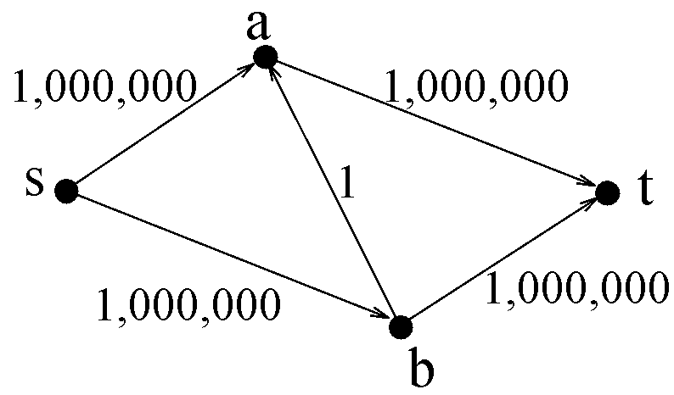
Network Flow

Slide 23
Network Flow
Add flow 1

Slide 24
Network Flow
Add flow 1

Slide 25
Hill Climbing
Problems:
Running time?
If each iteration you take
the biggest step possible,
  Alg is poly time
    in number of nodes
    and number of bits in capacities.
If each iteration you take
path with the fewest edges
  Alg is poly time
    in number of nodes

Slide 26
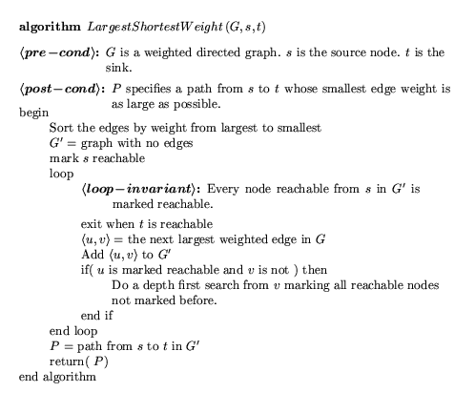
Taking the biggest step possible

Slide 27
Taking the biggest step possible
m = # edges
l = # bits to specify capacities.
The flow F_{t} must increase from 0 to up to
To be poly time, we could have F_{t} double each iteration.
But it does not ☹
m×2^{l}
F_{T} = m×2^{l}
T = log(m) + l
F₀ = 0

Slide 28
Taking the biggest step possible
R_{t} = How much the flow can increase by
= MaxFlow - F_{t}
To be poly time, we could have R_{t} half each iteration.
Or decrease by a (1-1/m) factor
R_{T} = 0
R₀ = m×2^{l}
= 0

Slide 29
Taking the biggest step possible
R_{t} = How much the flow can increase by
= MaxFlow - F_{t}
Choose any cut C = ⟨U,V⟩.
R_{t} ≤ Σ_{e∈C} augment_{e}
U
s
V
u
v
t

Slide 30
Taking the biggest step possible
Let w_{t} = amount F_{t} increases
= the min augment in augmenting path
Let Cut = ⟨U,V⟩
where nodes u∈U are reachable from s
with edges with augment amount > w_{t},
i.e. the last graph in previous algorithm
for which s is not reachable from t.
Σ_{e∈C} augment_{e} ≤ Σ_{e∈C} w_{t} ≤ m w_{t}
(where m = # edges in graph)
U
s
V
u
v
t

Slide 31
Taking the biggest step possible
R_{t} = MaxFlow – F_{t}
≤ Σ_{e∈C} augment_{e}
≤ m w_{t} ≤ m × amount F_{t} increases
≤ m × amount R_{t} decreases
R_{t+1} = R_{t} - amount R_{t} decreases
≤ R_{t} – ¹/_{m} R_{t}
= (1– ¹/_{m}) R_{t}
Decreasing by an m^{th}!
Does this stop after m iterations?
No because as decreases,
the decrease decreases.

Slide 32
Taking the biggest step possible
R_{t} = How much the flow can increase by
= MaxFlow - F_{t}
To be poly time, we could have R_{t}
decrease by a (1-1/m) factor each iteration
R_{t+1} ≤ (1– ¹/_{m}) R_{t}
R_{T} = 0
End game: ¹/₂, ¹/₄, ¹/₈, ¹/₁₆, …. ?
All flows are integers.
Hence, decreasing R_{T} < 1 is good enough.
R₀ = m×2^{l}
= 0

Slide 33
Taking the biggest step possible
R_{t+1} ≤ (1– ¹/_{m}) R_{t}
R_{T} ≤
(1– ¹/_{m})^{T} R₀
< 1

Slide 34
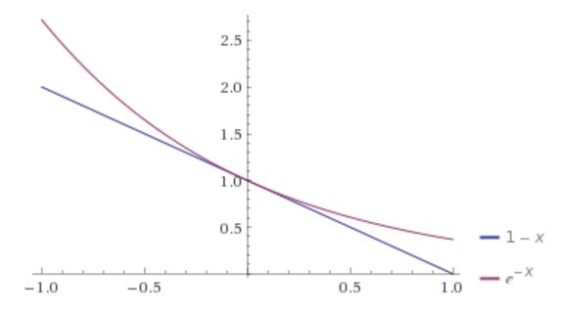
Taking the biggest step possible
(1– ¹/_{m})^{T} R₀
< 1
(e^{-1/m})^{T} R₀

Slide 35
Taking the biggest step possible
(1– ¹/_{m})^{T} R₀
< 1
(e^{-1/m})^{T} R₀
(e^{-T/m}) R₀
-^{T}/_{m} + ln(R₀) = ln(1) = 0
T = m ln(R₀)
= m ln(m×2^{l})
= m (l + ln m)
m = # edges
l = # bits to specify capacities.

Slide 36
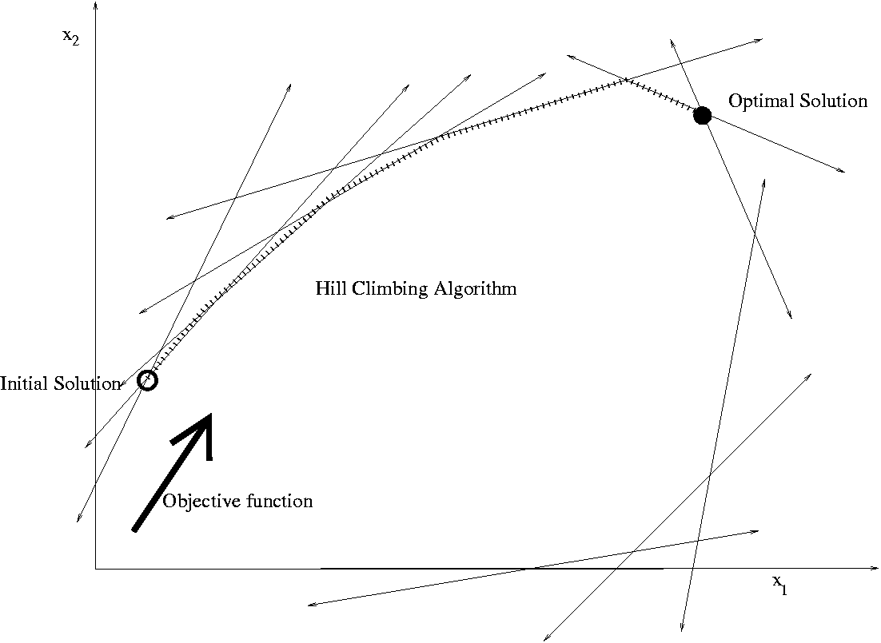
Linear Programming

Slide 37
A Hotdog
A combination of pork, grain, and sawdust, …
Constraints:
  Amount of moisture
  Amount of protein,
  …

Slide 38
The Hotdog Problem
Given today’s prices,
what is a fast algorithm
to find the cheapest hotdog?

Slide 39
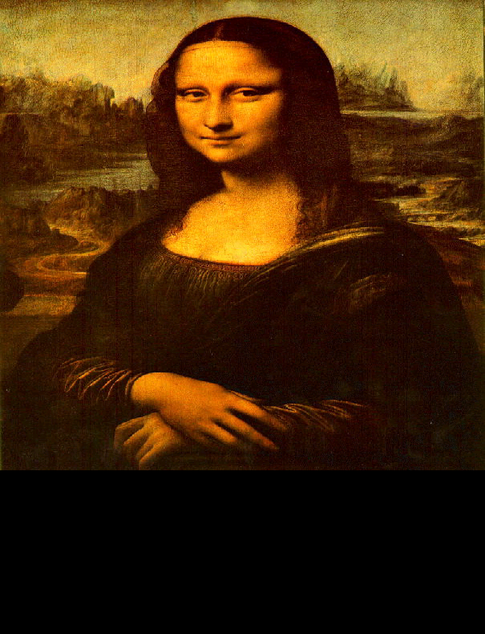
There are deep ideas within the simplicity.
Abstraction
=
Goal: Understand and think about complex things in simple ways.
There are deep ideas within the simplicity.
Rudich www.discretemath.com

Slide 40
Abstract Out Essential Details
sawdust
grain
pork
water
Amount to add: x₁, x₂, x₃, x₄
Cost: 29, 8, 1, 2
Cost of Hotdog:
29x₁ + 8x₂ + 1x₃ + 2x₄
Constraints:
  moisture
  protean,
  …
3x₁ + 4x₂ – 7x₃ + 8x₄ ≥ 12
2x₁ - 8x₂ + 4x₃ - 3x₄ ≥ 24
-8x₁ + 2x₂ – 3x₃ - 9x₄ ≥ 8
x₁ + 2x₂ + 9x₃ - 3x₄ ≥ 31

Slide 41
Abstract Out Essential Details
Minimize:
29x₁ + 8x₂ + 1x₃ + 2x₄
Subject to:
3x₁ + 4x₂ – 7x₃ + 8x₄ ≥ 12
2x₁ - 8x₂ + 4x₃ - 3x₄ ≥ 24
-8x₁ + 2x₂ – 3x₃ - 9x₄ ≥ 8
x₁ + 2x₂ + 9x₃ - 3x₄ ≥ 31

Slide 42
A Fast Algorithm
For decades people thought that there was no fast algorithm.
≈
Then one was found!
Minimize:
29x₁ + 8x₂ + 1x₃ + 2x₄
Theoretical Computer Science
finds new algorithms every day.
Subject to:
3x₁ + 4x₂ – 7x₃ + 8x₄ ≥ 12
2x₁ - 8x₂ + 4x₃ - 3x₄ ≥ 24
-8x₁ + 2x₂ – 3x₃ - 9x₄ ≥ 8
x₁ + 2x₂ + 9x₃ - 3x₄ ≥ 31

Slide 44
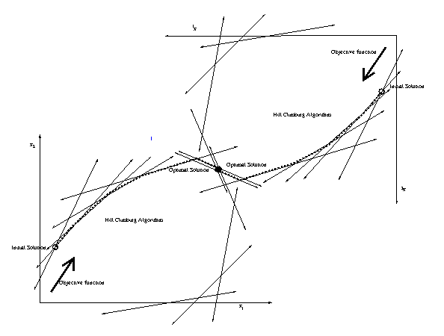
Dual
Primal

Slide 45
End

