Slide 1

Welcome
Thinking about Algorithms Abstractly
Jeff Edmonds
www.cse.yorku.ca/~jeff/courses/3101
jeff@cse.yorku.ca
CSB 3044, ext. 33295
647-688-7413
Jeff Edmonds
York University
Lecture 1
COSC 3101

Slide 2
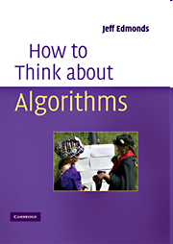
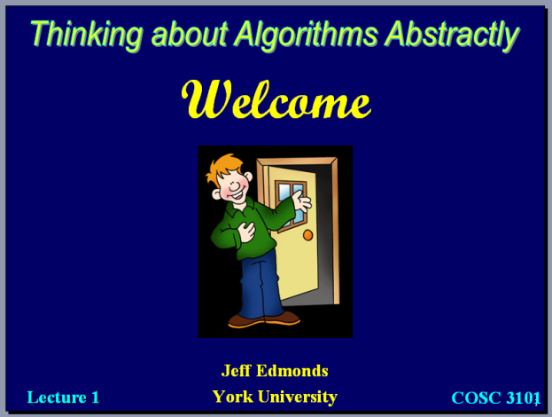
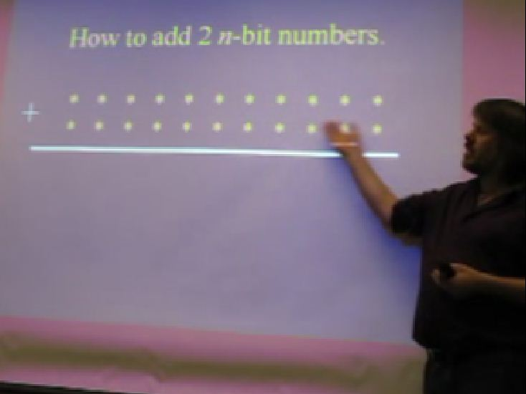
Course Material
Text
Slides
Videos
Steps, Practice Tests, Midterms, Exam
Extra Text: Cormen, Leiserson, Rivest, and Stein
"Introductin to Algorithms",
Good to have, but not needed for this course.
Notes:
2

Slide 3
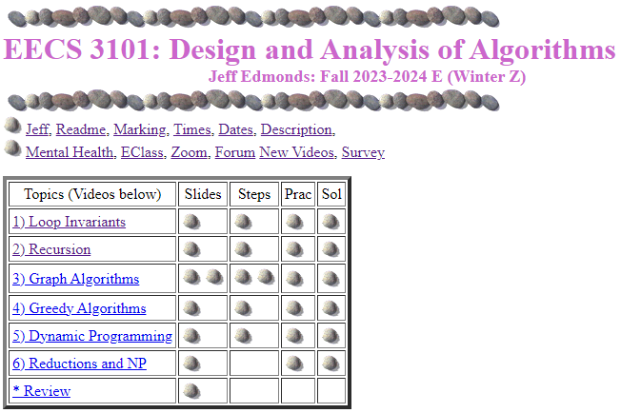
Course Material
www.cse.yorku.ca\~jeff\courses\3101

Slide 4
Course Material
Steps:
For each unit, I spoon feed you the key ideas from each unit
as a set of steps.
Learn them! Understand them!
With only them, you are on your way to passing.
Without them, you are on your way to failing.
Lectures consists of many examples of using these steps.
Practice Tests: Do them!
Text “How to Think about Algorithms”: If you prefer reading.
Notes:
4

Slide 5
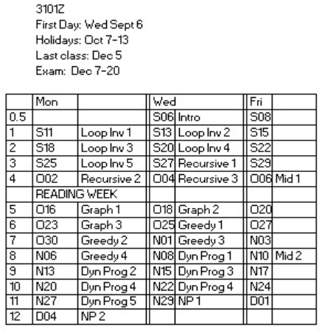
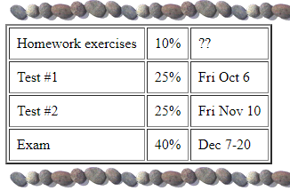
Course Material

Slide 6
Study Now!
You spend 50hrs/week
on your programming courses.
Study the material deeply
before fail the tests.

Slide 7
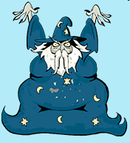
Together
Some students feel too intimidated to talk to the professor.
Actually, he is just a guy
who has been doing this for a while.

Slide 8
Together
Office hours:
Before/after class tend to be the best time.
Longer or private questions, when requested,
can be taken back to my office, CSB 3044.
Notes:
8

Slide 9
Together
Please interact with me in class.
Help me know what people
are not understanding
Slow down the slides
(Though we do have
a lot of material to cover)

Slide 10
Together
Please ask questions!
To keep the flow going
Wiggly hand:
relevant to current slide.
Stationary hand:
question about past material.
Avoid getting off topic.

Slide 11
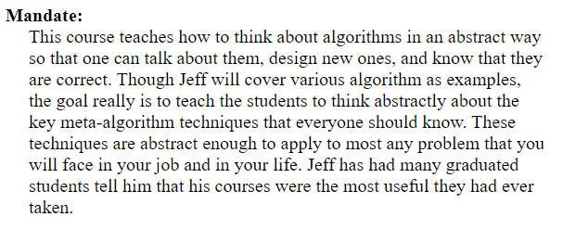
Thinking Abstractly
Thinking abstractly requires completely
changing the way you think.
Though I keep warning people,
they tend not to get it until they are
Devastated
by the midterm
Change your thinking now.

Slide 12
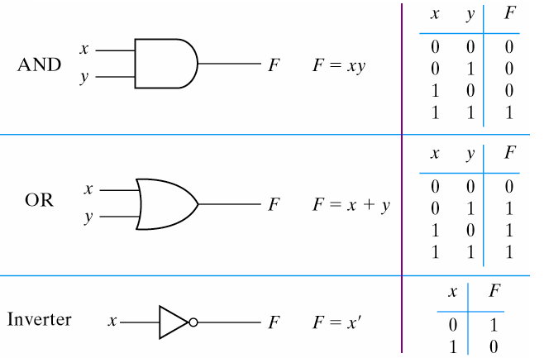
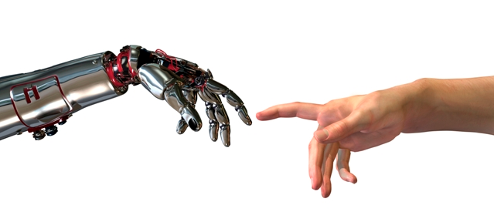
Thinking Abstractly
The psychological profiling of a successful person is mostly the ability to shift levels of abstraction, from low level to high level.
To understand the detailed workings.
To understand the big picture.
Donald Kunth

Slide 13
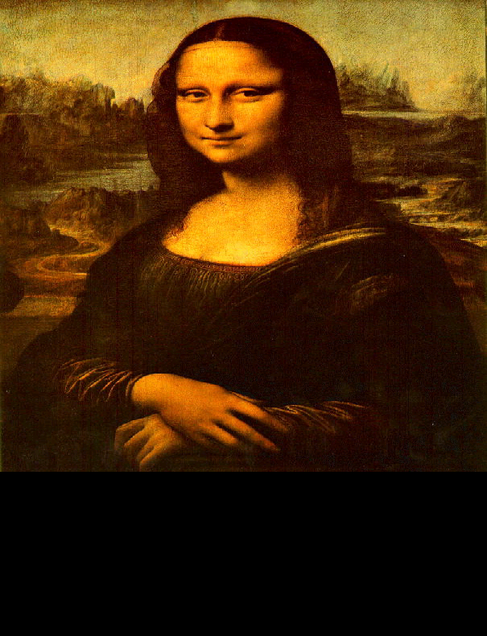
Thinking Abstractly
The psychological profiling of a successful person is mostly the ability to shift levels of abstraction, from low level to high level.
To understand the detailed workings.
To understand the big picture.
To understand complex things
in simple ways.
Donald Kunth
=

Slide 14
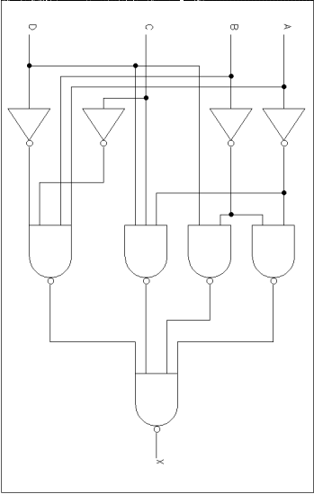
Thinking Abstractly
It is hard to think of love
in terms of the firing of neurons.
vs
Software developers view subsystems as entities with separate personalities, roles, and interactions,
not details of code.
vs

Slide 15

Thinking Abstractly
Better for communicating to friend

Slide 16

Thinking Abstractly
A form that can peculate down and
dwell in your subconscious
where the miracle leaps of inspiration happen
Your subconscious
does not understand
JAVA code.

Slide 17
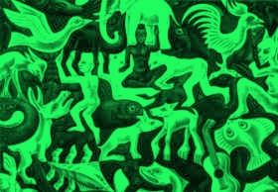
Thinking Abstractly
Paradigm Shift
Is the black the form and the green the background?
Is the green the form and the black the background?
It is helpful to have different ways of looking at it.

Slide 18
Course Content
A list of algorithms.
  Learn their code.
  Trace them until you are convinced that they work.
  Implement them.
  Worry about details.
class InsertionSortAlgorithm extends SortAlgorithm {
void sort(int a[]) throws Exception {
for (int i = 1; i < a.length; i++) {
int j = i;
int B = a[i];
while ((j > 0) && (a[j-1] > B)) {
a[j] = a[j-1];
j--; }
a[j] = B;
}}

Slide 19
Course Content
A survey of algorithmic design techniques.
Abstract thinking.
How to develop new algorithms for any problem that may arise.
Notations, analogies, and abstractions for developing,
thinking about, and describing algorithms
so correctness is transparent

Slide 20
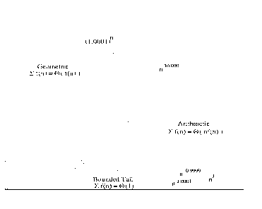
Some Math
Classifying Functions
Logic Quantifiers
f(i) = n^{Θ(n)}
∃g ∀b Loves(b,g)
∀b ∃g Loves(b,g)
Time
Time Complexity
Input Size
t(n) = Θ(n²)
Adding Made Easy
∑_{i=1} f(i).
Logs and Exps
Recurrence Relations
2ª × 2^{b} = 2^{a+b}
2^{log n} = n
T(n) = a T(n/b) + f(n)

Slide 21



Iterative Algorithms
Loop Invariants
<preCond>
codeA
loop
<loop-invariant>
exit when <exit Cond>
codeB
codeC
<postCond>
0
T+1
5 km
i-1
i
9 km
i
i
One step at a time
Code
Relay Race

Slide 22
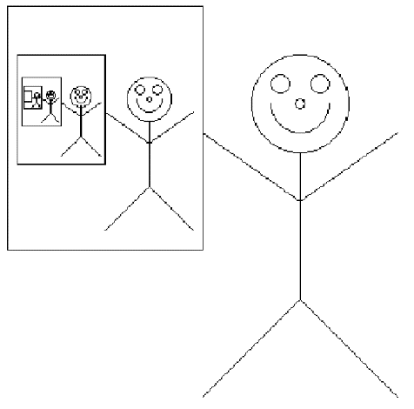
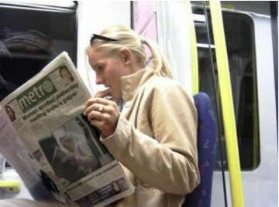
Recursive Algorithms
?
?

Slide 23
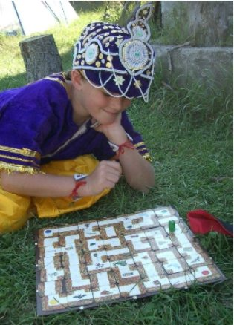
Graph Search Algorithms

Slide 24
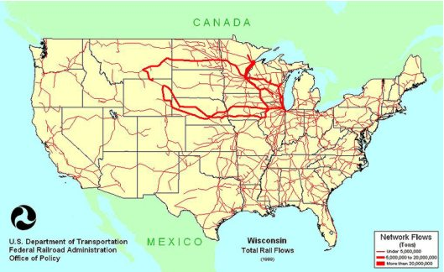
Network Flows

Slide 25
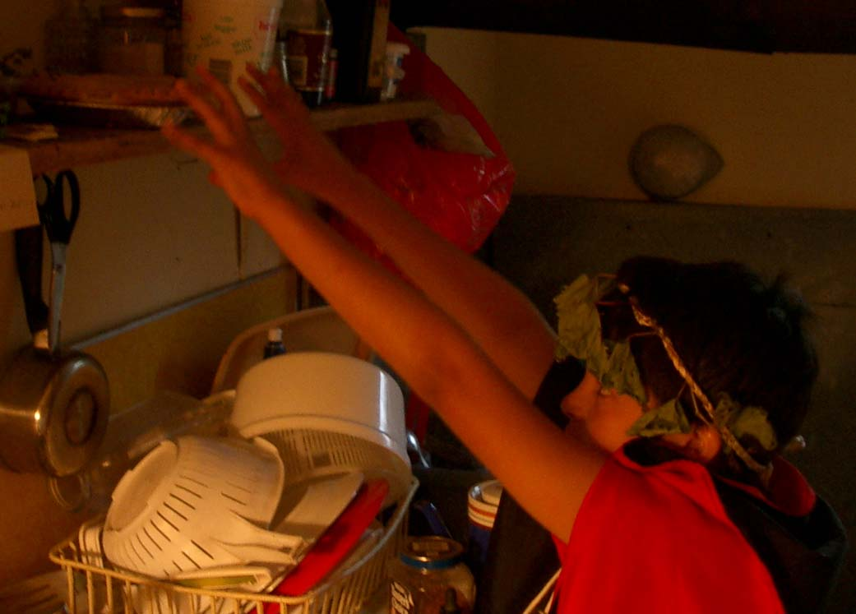
Greedy Algorithms
NEED A PIC HERE
(NOT POOH)

Slide 26

Recursive Back Tracking

Slide 27
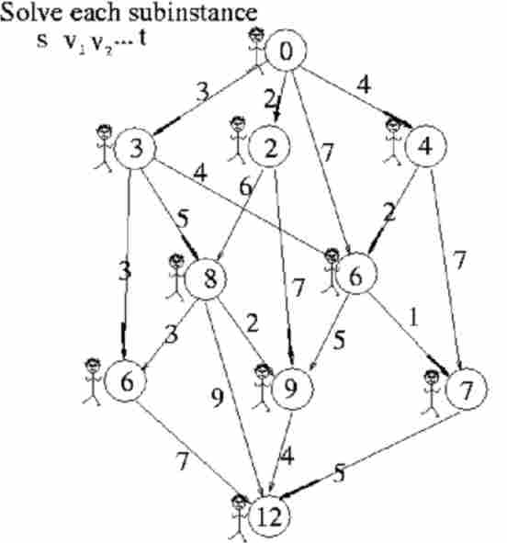
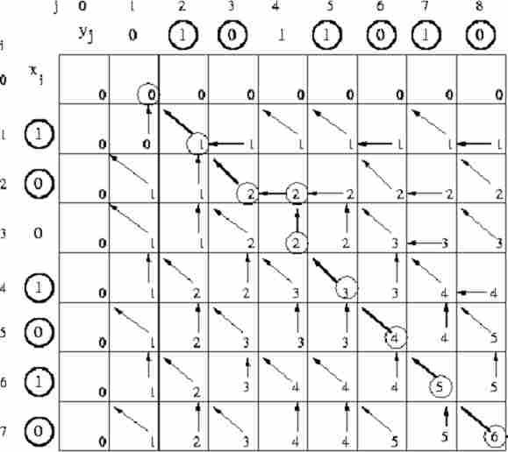
Dynamic Programing

Slide 28
Reduction
=
Rudich www.discretemath.com

Slide 29
Useful Learning Techniques
Notes:
29

Slide 30
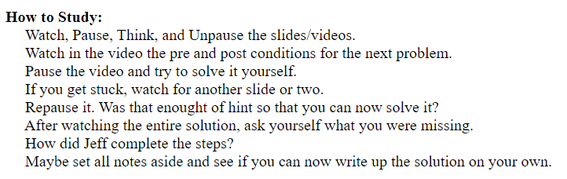
Notes:
30

Slide 31
Read Ahead
You are expected to read the lecture notes before the lecture.
This will facilitate more productive discussion during class.
Also please
proof read
assignments
& tests.
Like in an
English class

Slide 32
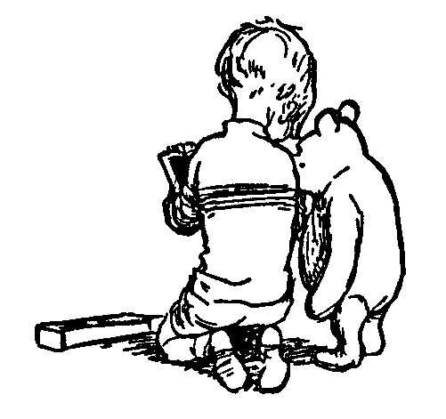
Explaining
We are going to test you on your ability to explain the material.
Hence, the best way of studying is to explain the material over and over again out loud to yourself, to each other, and to your stuffed bear.

Slide 33
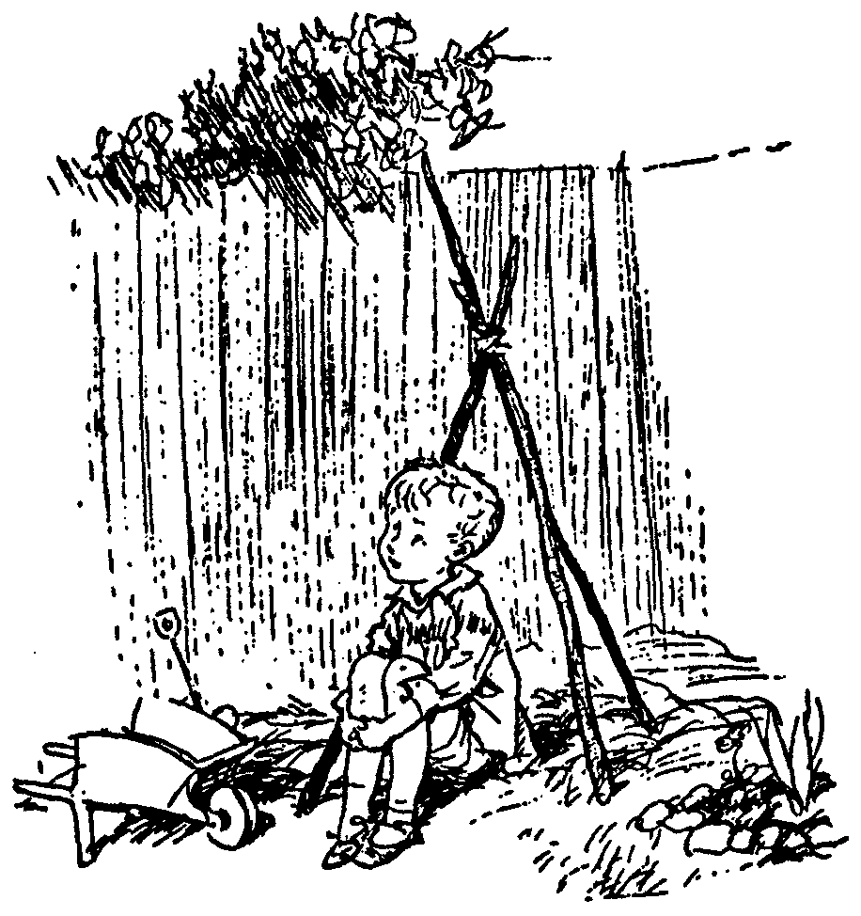
Day Dream
While going along with your day
Mathematics is not all linear thinking.
Allow the essence of the material to seep into your subconscious
Pursue ideas that percolate up and flashes of inspiration that appear.

Slide 34

Be Creative
Ask questions.
Why is it done this way and not that way?

Slide 35
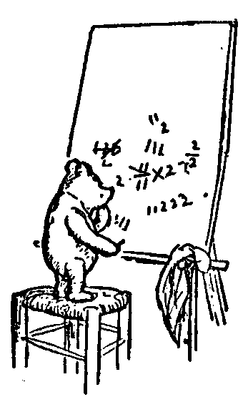
Guesses and Counter Examples
Guess at potential algorithms for solving a problem.
Look for input instances for which your algorithm gives the wrong answer.
Treat it as a game between these two players.

Slide 36
Refinement:
The best solution comes from a process of repeatedly refining and inventing alternative solutions
Rudich www.discretemath.com

Slide 37
End

Slide 38
Together
This term we will provide
two hours a week of contact hours
with the TA.
Ask me anything!
  Class material
  Help YOU solve the assignment questions.
  Material missed from previous courses
  Your love life

Slide 39
Together
This term we will provide
two hours a week of contact hours
with the TA.
We can have
  Practice Tests
  Lectures
  One-on-one time
  Group discussions
Yes!
I will be sure
to attend.

Slide 40
Together
I will take attendance!
This will effect your
participation mark!
Yes!
I will be sure
to attend.
Notes:
40

Slide 41
Together
Sorry!
I will not have time
to mark the assignments.
But we can I read your solution together during the TA hours.
This might be better anyway.

Slide 42
Together
Lets schedule the office hours now.

Slide 43
Marks
We will work you HARD:
6 assignments
5 practice tests
5 unit tests
Participation
An exam
Mark =
0%
0% ⇔ -4%
4%*5=20% ⇔ 11%*5=55%
2% ⇔ 10%
35% ⇔ 78%
Σ_{i=1..5} [ 0.04 T_{i} + 0.07 Max(T_{i},E) ]
+ [ 0.02 P + 0.08 Max(P,E) ] + 0.35 E

Slide 44
Marks
5 unit tests:
Each unit test, half the class fails.
“Fail early, fail often”
Then almost everyone starts to listen and passes the exam.
Don’t want to people who fail the midterms to give up
Want people to work on the midterms
4%*5=20% ⇔ 11%*5=55%
7% max(T_{i},E)
4% T_{i}
Notes:
44

Slide 45
Marks
Class Participation:
  Asking/Answering questions in class
  Attending office hours
  Talking to me outside of class
  Submitting a photo *

Slide 46
Marks
 | % | P1 | P2
T₁ | 4% | 60 | 25
Max(T₁,E) | 7% | 70 | 95
T₂ | 4% | 80 | 30
Max(T₂,E) | 7% | 80 | 95
…
Participation | 2% | 90 | 20
Max(P,E) | 8% | 90 | 95
Exam | 35% | 70 | 95
Σ_{i=1..5} [ 0.04 T_{i} + 0.07 Max(T_{i},E) ]
+ [ 0.02 P + 0.08 Max(P,E) ] + 0.35 E

Slide 47
What do you think about 3101?
Was by far the hardest course ever.
I got the worst midterm mark ever.
I almost gave up.
But opened a door to such an interesting world for me.
Learned to see things abstractly and from different angles
After working a few years, I realized that 3101 was the most useful course I took.

Slide 48
What do you think about 3101?
Hey Jeff,
Never thought I would say this but I missed you a little bit.
I was able to solve some interesting business programming problems - all by myself by just thinking back to the course.
The main thing I got out of the course is belief in higher self and the ability to relax.
If taken professionally, you weren't kidding that the course would be helpful for us in life and not just academically.

Slide 49
So you want to be a computer scientist?

Slide 50
Is your goal to be a mundane programmer?

Slide 51
Or a great leader and thinker?

Slide 52
Original Thinking

Slide 53
Boss assigns task:
  Given today’s prices of pork, grain, sawdust, …
  Given constraints on what constitutes a hotdog.
  Make the cheapest hotdog.
Everyday industry asks these questions.

Slide 54
Your answer:
Um? Tell me what to code.
With more sophisticated software engineering systems,
the demand for mundane programmers will diminish.

Slide 55
Your answer:
I learned this great algorithm that will work.
Soon all known algorithms
will be available in libraries.

Slide 56
Your answer:
I can develop a new algorithm for you.
Great thinkers
will always be needed.

Slide 57
Course Content
Goal: To provide a number of different notations, analogies, and abstractions within which to develop, think about, and describe algorithms.

Slide 58
Levels of Abstraction
Given a concrete algorithm, eg. MergeSort
and a concrete input, eg. <4,2,6,1,7>
trace it and prove that it works.
Given a concrete algorithm, eg. MergeSort
and an abstract input, eg. <x₁, … x_{n}>
trace it and prove that it works.
Given a “Meta Algorithm”, eg. Iterative Algs
and an abstract input, eg. <x₁, … x_{n}>
trace it and prove that it works.

Slide 59
Levels of Abstraction
Given a new computational problem on exam,
design a new concrete algorithm that solves it
following the “Meta Algorithm” steps.
If you do not get all the details of the new algorithm correct, it wont be a disaster.
If you do not get the steps of the “Meta Algorithm correct, it will be a disaster.
There are only a few “Meta Algorithms”
Learn them!

Slide 60
Levels of Abstraction
“Meta Algorithms”
  Iterative Algorithms
  Recursive Algorithms
  Greedy Algorithms
  Recursive Back Tracking
  Dynamic Programming.
  NP-Completeness

Slide 61
Levels of Abstraction
“Meta Math”
  Existential and Universal Quantifiers
  Asymptotic Growth
  Adding Made Easy Approximations
  Recurrence Relations

Slide 62
Value Correctness
Don’t tack on a formal proof of correctness after coding to make the professor happy.
It need not be mathematical mumbo jumbo.
Goal: To think about algorithms in such way that their correctness is transparent.

Slide 63
Study:
Many experienced programmers were asked to code up binary search.

Slide 64
Study:
Many experienced programmers were asked to code up binary search.
80% got it wrong
Good thing is was not for a nuclear power plant.

Slide 65
What did they lack?

Slide 66
What did they lack?
Formal proof methods?

Slide 67
What did they lack?
Formal proof methods?
Yes, likely
Industry is starting to realize that formal methods are important.
But even without formal methods …. ?

Slide 68
What did they lack?
Fundamental understanding of the algorithmic design techniques.
Abstract thinking.

