Slide 1


Object-Oriented Programming

Slide 2

Slides copied directly from Andy
(And not covered by Jeff)

Slide 3
Object-Oriented Software Design
Responsibilities:
Divide the work into different actors, each with a different responsibility. These actors become classes.
Independence:
Define the work for each class to be as independent from other classes as possible.
Behaviors:
Define the behaviors for each class carefully and precisely, so that the consequences of each action performed by a class will be well understood by other classes that interact with it.

Slide 4
Software must be
Correct: works correctly on all expected inputs.
Readable: easily understandable & verifiable by others.
Robust: capable of handling unexpected inputs that are not explicitly defined for its intended application.
Efficient: makes good use of computing time & memory resources.
Adaptable: able to evolve over time in response to changing conditions in its environment. Is easy to update & debug.
Flexible: easily generalizable to handle many related scenarios.
Reusable: the same code should be usable as a component of different systems in various applications.

Slide 5
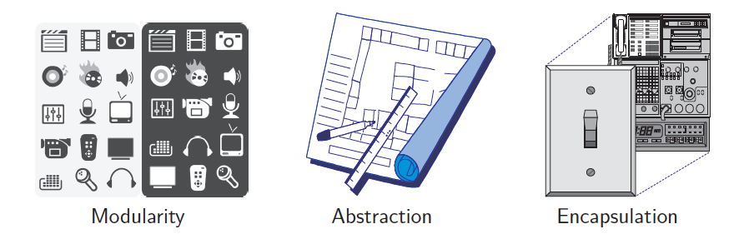
Object-Oriented Design Principles
Abstraction
Modularity
Encapsulation
Hierarchical Organization

Slide 6


Abstraction
Abstraction is to distill a system to its most fundamental parts.
  The psychological profiling of a programmer is mostly the ability
  to shift levels of abstraction, from low level to high level.
  To see something in the small and to see something in the large. – Donald Knuth
Abstraction, 1922.
By Wassily Kandinsky

Slide 7
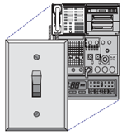
Encapsulation
Information hiding.
objects reveal only what other objects need to see.
Internal details are kept private.
This allows the programmer to implement the object as they wish, as long as the requirements of the abstract interface are satisfied.

Slide 8

Modularity
Complex software systems are hard to conceptualize, design & maintain.
This is greatly facilitated by breaking the system up into distinct modules.
Each module has a well-specified role.
Modules communicate through well-specified interfaces.
The primary unit for a module in Java is a package.

Slide 9
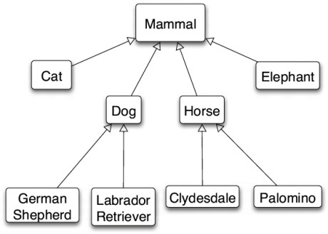
A Hierarchy

Slide 10
Hierarchical Design
Hierarchical class definitions allow efficient re-use of common software over different contexts.
«interface»
Collection
«interface»
Set
«interface»
List
«class»
TreeSet
«class»
HashSet
«class»
LinkedHashSet
«class»
ArrayList
«class»
LinkedList

Slide 11

Design Patterns
Algorithmic patterns:
Recursion
Amortization
Divide-and-conquer
Prune-and-search
Brute force
Dynamic programming
The greedy method
Software design patterns:
Iterator
Adapter
Position
Composition
Template method
Locator
Factory method

Slide 12
Abstract Data Types
Abstraction is to distill a system to its most fundamental parts.
Applying the abstraction paradigm to the design of data structures gives rise to abstract data types (ADTs) with state (data) & behavior (functionality).
An ADT is a model of a data structure that specifies the type of data stored, the operations supported on them, and the types of parameters of the operations.
An ADT specifies what each operation does, but not how it does it.
  The “how” is provided by the software that implements the ADT.
The collective set of behaviors supported by an ADT is its public interface. The interface guarantees certain invariants.
Invariant: a fact about the ADT that is always true,
e.g., a Date object always represents a valid date.

Slide 13
Class Definitions
A class serves as the primary means for abstraction in OOP.
In Java, every variable is either a base type or is a reference to an object which is an instance of some class.
Each class presents to the outside world a concise and consistent view of the objects that are its instances, without revealing too much unnecessary detail or giving others access to the inner workings of the objects.
The class definition specifies its members. These are typically instance variables (aka, fields or data members) that any instance object contains, as well as the methods, (aka, member functions) that the object can execute.

Slide 14
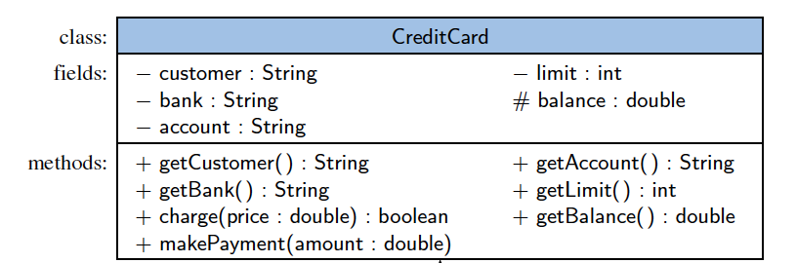
Unified Modeling Language (UML)
A class diagram has three parts.
  The name of the (concrete or abstract) class or interface
  The recommended instance variables or fields
  The recommended methods of the class.

Slide 15
Interfaces
The main structural element in Java that enforces an application programming interface (API) is an interface.
An interface contains constants & abstract methods with no bodies; all public by default.
It has no constructors & can’t be directly instantiated.
A class that implements an interface, must implement all of the methods declared in the interface
(no inheritance); otherwise won’t compile.

Slide 16
Abstract Classes
An abstract class also cannot be instantiated, but it can define one or more methods that all implementations of the abstraction will have.
Their sole purpose is to be extended.
A class must be a subclass of an abstract class to extend it & implement all its abstract methods
(or else be abstract itself).

Slide 17
Interfaces & Abstract Classes
A class that implements an interface, must implement all
of the methods declared in the interface (no inheritance); otherwise won’t compile.
As a result, unlike abstract classes, interfaces are
non-adaptable: you can’t add new methods to it
without breaking its contract.
However, interfaces offer great flexibility for its implementers: a class can implement any number of interfaces, regardless of
where that class is in the class hierarchy.

Slide 18
Inheritance
is a mechanism for modular and hierarchical organization.
A (child) subclass extends a (parent) superclass.
A subclass inherits (non-constructor) members of its superclass.
Two ways a subclass can differ from its superclass:
  Can extend the superclass by providing brand-new data members & methods (besides those inherited from the superclass, other than constructors).
  Polymorphism: may specialize an existing behavior by providing a new implementation to override an existing non-static method of the superclass .

Slide 19
Java is Single Inheritance
Java (unlike C++) is single inheritance OOL:
any class other than the root class Object,
extends exactly one parent superclass.
That is, Java classes form a tree hierarchy.
Regardless of where it is in the inheritance tree, a class can implement several interfaces.
This is multi-role playing (aka, mixin),
not multiple inheritance.

Slide 20
Class Inheritance Tree Hierarchy
Building
Apartment
House
Commercial
Building
Low-rise
Apartment
High-rise
Apartment
Two-story
House
Ranch
Skyscraper

Slide 21
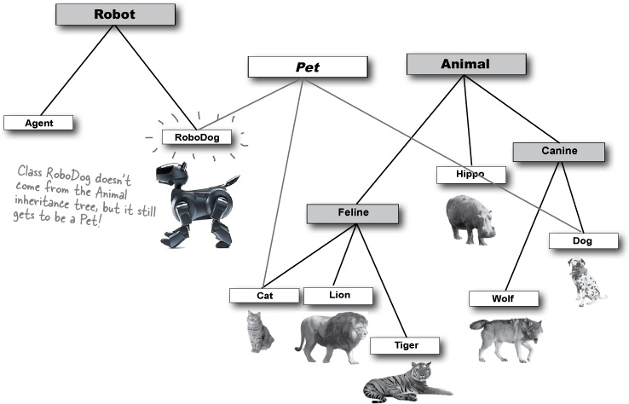
Class/interface DAG Hierarchy
Pet

Slide 22

Constructors
A user can create an
instance of a class by
using the new operator
with a method that has
the same name as the class.
Such a method, known as a constructor, establishes a new object with appropriate initial values for its instance variables.

Slide 23
Inheritance and Constructors
Constructors are never inherited in Java;
hence, every class must define a constructor
  which can refine a superclass constructor.
  must properly initialize all class fields, including any inherited fields.
The first operation within the body of a constructor must be to invoke a constructor of the superclass, which initializes the fields defined in the superclass.
A constructor of the superclass is invoked explicitly by using the keyword super with appropriate parameters.
If a constructor for a subclass does not make an explicit call to super or this as its first command, then an implicit call to super( ), the zero-parameter version of the superclass constructor, will be made.

Slide 24
Polymorphism
Polymorphism: means taking on many forms.
Example: Super var = new Sub( … );
says var is declared as Super type, but is instanceof and references an object of Sub type.
var is polymorphic; it can take one of many forms, depending on the specific class or subclass of the object to which it refers at runtime.

Slide 25
Dynamic dispatch
With polymorphism, one method works on many classes, even if the classes need different implementations of that method.
Dynamic dispatch is a process used by JVM at runtime to call the version of the overriden method most specific to actual (dynamic) type, not declared (static) type, of the polymorphic variable var.
Example: Super var = new Sub( … );
Suppose we call var.myMethod
and at runtime (var instanceof Sub) is true.
Will JVM execute var.(Sub.myMethod) or var.(Super.myMethod) ?
  JVM calls Sub.myMethod, since var refers to an instance of Sub,
  even though its static type is Super.

Slide 26
Overriding vs overloading
Overriden method selection is dynamic (uses dynamic dispatch)
Overloaded method selection is static,
based on compile-time type of the parameters.
Because overriding is the norm and overloading is the exception,
overriding sets people’s expectations for the behavior of method invocation.
Most often, instead of overloading, we can use different names.
Constructors can’t use different names & are typically overloaded, but fortunately they cannot be overriden!
See more examples on the following pages.
Motto: avoid confusing uses of overloading.

Slide 27
Example: Overriding
// ----------------------------- What does this program print?
public class Wine {
String name( ) { return “wine” ; }
}
public class SparklingWine extends Wine {
@Override String name( ) { return “sparkling wine” ; }
}
public class Champagne extends SparklingWine {
@Override String name( ) { return “champagne” ; }
}
public class Overriding {
public static void main(String[ ] args) {
Wine[ ] wines = { new Wine(), new SparklingWine(), new Champagne() } ;
for (Wine wine : wines) System.out.println( wine.name() ) ;
}
}
output:
wine
sparkling wine
champagne

Slide 28
Example: Overloading
// ------------------------- Broken! – What does this program print?
public class WineRegion {
public static String region ( Wine w ) { return “Napa Valley” ; }
public static String region ( SparklingWine s ) { return “Niagara” ; }
public static String region ( Champagne c ) { return “France” ; }
public static void main(String[ ] args) {
Wine[ ] wines = {
new Wine() ,
new SparklingWine () ,
new Champagne ()
} ;
for ( Wine w : wines ) System.out.println( region(w) ) ;
}
}
output:
Napa Valley Napa Valley Napa Valley

Slide 29
Example: Overloading - fixed
// Fixed by a single method that does an explicit instanceof test
public class WineRegion {
public static String region ( Wine w ) {
return ( w instanceof Champagne ) ? “France” :
( ( w instanceof SparklingWine ) ? “Niagara” : “Napa Valley” );
}
public static void main(String[ ] args) {
Wine[ ] wines = {
new Wine() ,
new SparklingWine () ,
new Champagne ()
} ;
for ( Wine w : wines ) System.out.println( region(w) ) ;
}
}
output:
Napa Valley Niagara
France

Slide 30
Class definition syntax
class SubClass
extends SuperClass
implements Interface1, Interface2, Interface3
{
// definitions of non-inherited instance variable // subclass constructors
// overriden superclass methods
// other, inherited, superclass methods omitted
// implementation of all interface methods
// brand-new methods
}

Slide 31
Interface definition syntax
interface YourNewInterface
extends YourInterface1 , YourInterface2, YouInterface3
{
. . .
}

Slide 32
Example
Figure
abstract class Figure {
abstract double area() ;
}
class Circle extends Figure {
final double radius ;
Circle (double radius) { this.radius = radius ; }
double area() { return Math.PI * radius * radius ; }
}
class Rectangle extends Figure {
final double length , width ;
Rectangle (double length , double width) {
this.length = length ;
this.width = width ;
}
double area() { return length * width ; }
}
class Square extends Rectangle {
Square (double side) { super(side , side) ; }
}
Circle
Rectangle
Square

Slide 33
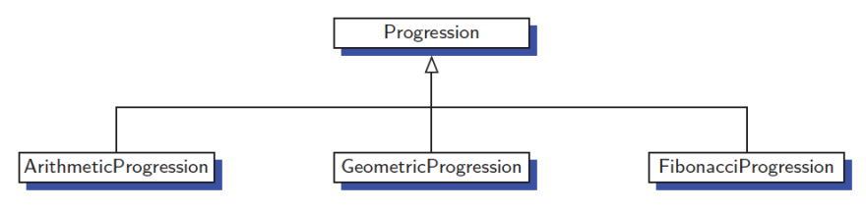
An Extended Example
A numeric progression is a sequence of numbers, where each number depends on one or more of the previous numbers.
  An arithmetic progression determines the next number by adding a fixed constant to the previous value.
  A geometric progression determines the next number by multiplying the previous value by a fixed constant.
  A Fibonacci progression uses the formula N_{i+1} = N_{i} + N_{i-1}

Slide 34
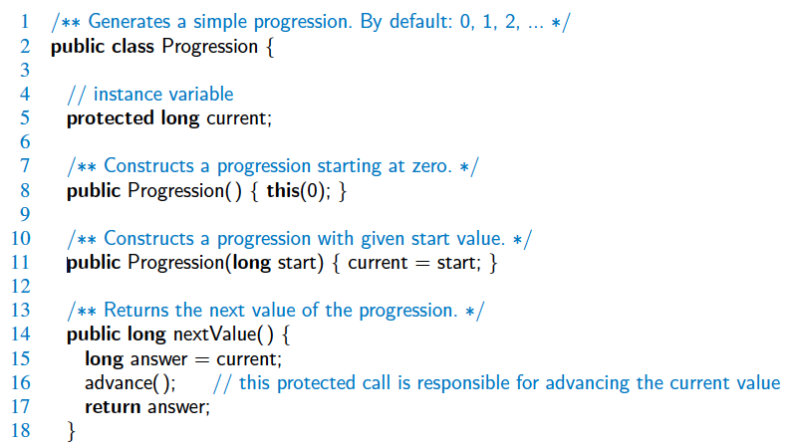
The Progression Base Class

Slide 35
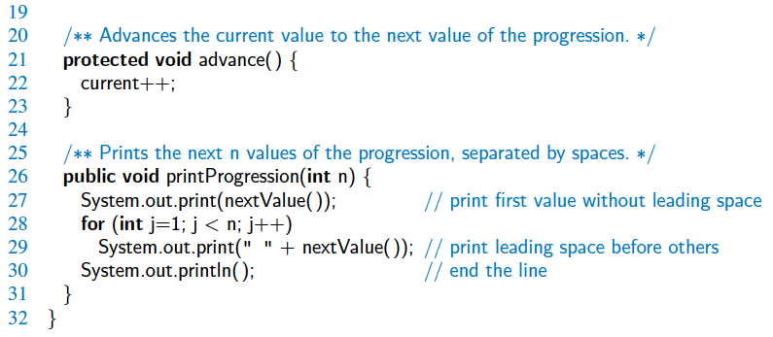
The Progression Base Class, 2

Slide 36
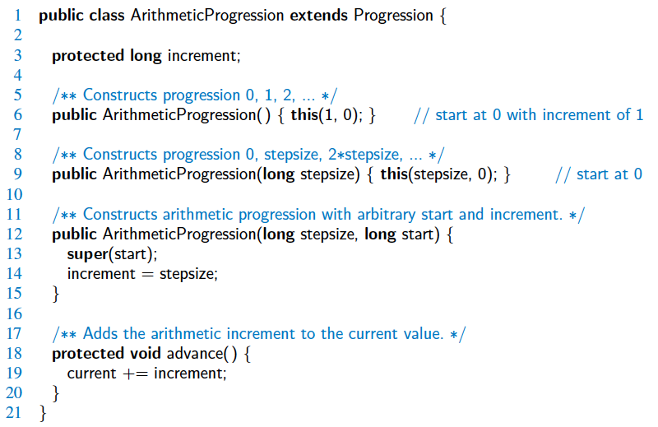
ArithmeticProgression Subclass

Slide 37
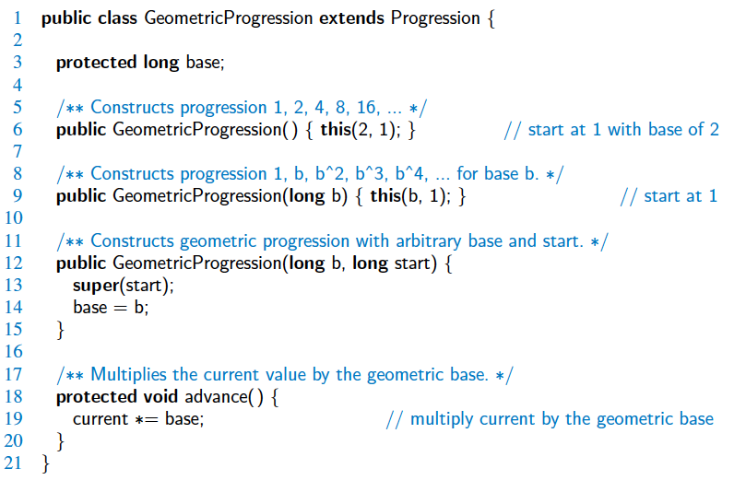
GeometricProgression Subclass

Slide 38
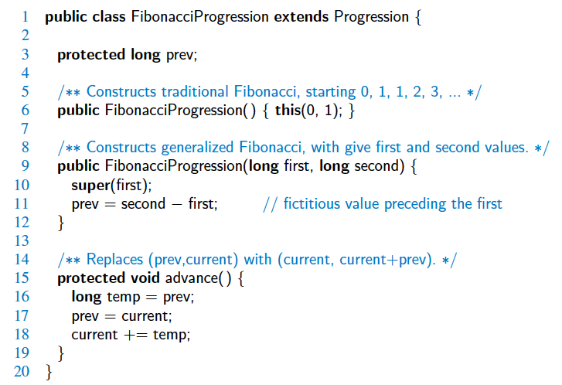
FibonacciProgression Subclass

Slide 39
Exceptions
exceptions that should not be caught or declared
Object
Java exceptions & programmer defined exceptions that must be caught or declared
(checked by compiler)
Throwable
Error
Exception
exceptions that need not be caught or declared
(not checked by compiler)
RuntimeException
Checked Exceptions
Checked Exceptions
Checked Exceptions
Checked Exceptions
NullPointerException
ArrayIndexOutOfBoundsException

Slide 40
Examples of Exceptions
Exception | Occasion for Use
IllegalArgumentException | Non-null parameter value is inappropriate
IllegalStateException | Object state is inappropriate for method invocation
NullPointerException | Parameter value is null where prohibited
IndexOutOfBoundsException | Index parameter value is out of range
ConcurrentModificationException | Concurrent modification of an object has been detected where it is prohibited
UnsupportedOperationException | Object does not support method
public class NewException extends Exception {
public NewException() { } // no message constructor
public NewException( String msg ) {super( msg ); } // detailed message constructor
}

Slide 41
Exceptions
Exceptions are unexpected events that occur during the execution of a program, for example due to:
  an unavailable resource (error – if not recoverable)
  unexpected input from a user (checked exception – if recoverable)
  a logical error on the part of the programmer (run time exception)
In Java, exceptions are objects that can be thrown by code that encounters an unexpected situation.
An exception may also be caught by a surrounding block of code that “handles” the problem.
If uncaught, an exception causes the virtual machine to stop executing the program and to report an appropriate message to the console.

Slide 42
Catching Exceptions
try {
guardedBody
} catch (exceptionType1 variable1) {
remedyBody1
} catch (exceptionType2 variable2) {
remedyBody2
} finally {
cleanupBody // e.g., close file
}
The general methodology
for handling exceptions is
a try-catch or try-catch-finally
construct in which a guarded
code fragment that might throw
an exception is executed.
If it throws an exception, then that exception is caught by having the flow of control jump to a predefined catch block that contains the code to apply an appropriate resolution.
If no exception occurs in the guarded code, all catch blocks are ignored.
If the finally block is present, it is always executed (even if no exception is thrown) and has higher precedence than catch blocks.

Slide 43
Throwing Exceptions
Exceptions originate when a piece of Java code finds some sort of problem during execution and throws an exception object.
This is done by using the throw keyword followed by an instance of the exception type to be thrown.
It is often convenient to instantiate an exception object at the time the exception has to be thrown. Thus, a throw statement is typically written as follows:
throw new exceptionType(parameters);
where exceptionType is the type of the exception and the parameters are sent to that type’s constructor.

Slide 44
The throws Clause
When a method is declared, it is possible to explicitly declare, as part of its signature, the possibility that a particular exception type may be thrown during a call to that method.
The syntax for declaring possible exceptions in a method signature relies on the keyword throws (not to be confused with an actual throw statement).
Example: the parseInt method of the Integer class has the following formal signature:
public static int parseInt(String s)
throws NumberFormatException;

Slide 45
Casting
Casting with Objects allows for conversion between classes and subclasses.
A widening conversion occurs when a type T is converted into a “wider” type U, i.e., “T IS_A U”
Example:
Super var1 = new Sub(...); // implicit widening

Slide 46
Narrowing Conversions
A narrowing conversion occurs when a type T is converted into a “narrower” type S, i.e., “S IS_A T”
In general, a narrowing conversion of reference types requires an explicit cast.
Example:
Super var1 = new Sub(...); // implicit widening
Sub var2 = (Sub) var1; // explicit narrowing

Slide 47
Generics
Java includes support for writing generic types that can operate on a variety of data types while avoiding the need for explicit casts & with type safety through compile-time type-checking.
Prior to generics (as of Java SE 5), Object was used as the universal super-type. Disadvantages:
  frequent casting to specific actual type.
  thwarted compiler’s type-checking mechanism.
The generics framework allows us to define a class in terms of a set of formal type parameters, undefined at compile time, which can then be used as the declared non-primitive type for variables, parameters, and return values within the class definition.
Those formal type parameters are later specified by actual type arguments when using the generic class as a type elsewhere in a program.

Slide 48
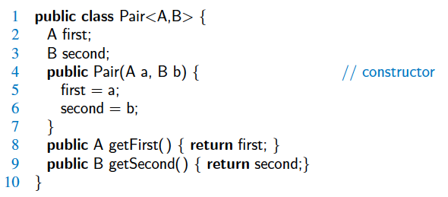
Syntax for Generics
Example: a generic paired item by composition:
Can be re-used to instantiate any paired item:
  Person: (String name, Integer age)
  Stock-ticker: (String stock , Double price)
  2D point: (Double x , Double y)

Slide 49
Type inference with generics
(as of Java SE 7)
// declare explicit actual type
Pair<String , Double > bid;
// instantiate by explicit actual type
bid = new Pair<String, Double>(“ORCL” , 32.07);
Alternatively, rely on type inference by <> (the “dymond”) :
// instantiate by type inference
bid = new Pair<> (“ORCL” , 32.07);
// combined declaration & instantiation:
Pair<String , Double > bid = new Pair<> (“ORCL” , 32.07);
String stock = bid.getFirst();
double price = bid.getSecond(); // auto unboxing

Slide 50
Bounded generics
Wild-card “?” stands for “any class or interface”
Bounded generics with wild-cards:
  <? extends T >
  stands for any subtype of T: any class or interface in the hierarchy rooted at the type represented by the generic type T.
  <? super T >
  stands for any supertype of T: the generic type <T> or higher up in its hierarchy (as direct or indirect super-class or super-interface).
Recursive type bounding:
e.g., <T extends Comparable<T> >
may be read as: “for any type T that can be compared to itself”

Slide 51
Generics on arrays
Generics are a compile-time construct
− the type information is lost at runtime.
This was a deliberate decision to allow backward compatibility with pre-generics Java code.
As a consequence:
  you can declare an array of generic type,
  but you cannot create an array of generic type,
  because the compiler doesn’t know how to create an array of an unknown component type.

Slide 52
Generics on arrays
Two important incompatibilities between arrays & generics:
  Arrays are covariant & reified
  Generics are invariant & non-reified (aka, type erase)
Covariant: A is subtype of B ⇒ A[ ] is subtype of B[ ]
Invariant: A & B distinct types ⇒
List<A> and List<B> have no hierarchical relationship
Reified: retains & enforces static (compile-time) type at runtime
Non-reified (aka, type erase): loses type information at runtime
So, how can we create “generic” arrays? … next page.

Slide 53
Generics on arrays - 1
// Object-based collection – a prime candidate for generics
// Raw type is not type-safe: any type element can be pushed into stack.
public class Stack {
private Object[ ] elements; // declaring raw type array
private int size = 0;
private static final int CAPACITY = 100;
public Stack() { // raw type constructor
elements = new Object[CAPACITY];
}
public void push (Object e) {
elements[size++] = e;
}
public Object pop() {
if (size == 0) throw new EmptyStackException();
Object result = elements[--size];
elements[size] = null; // eliminate obsolete reference
return result;
}
}

Slide 54
Generics on arrays - 2
// Initial attempt to generify Stack – won’t compile!
public class Stack<E> {
private E[ ] elements; // using “generic” array
private int size = 0;
private static final int CAPACITY = 100;
public Stack() { // “generic” type constructor
elements = new E[CAPACITY]; // compiler error
}
public void push (E e) {
elements[size++] = e;
}
public E pop() {
if (size == 0) throw new EmptyStackException();
E result = elements[--size];
elements[size] = null; // eliminate obsolete reference
return result;
}
}

Slide 55
Generics on arrays - 3
/* First solution: apply explicit cast in constructor.
* The elements array will contain only E instances from push(E).
* This is sufficient to ensure type safety, but the runtime type
* of the reified array won’t be E[]; it will always be Object[]!
*/
@SuppressWarnings(“unchecked”) // risky − use cautiously!
public Stack() {
elements = (E[ ]) new Object[CAPACITY]; // explicit cast
}
// … the rest unchanged

Slide 56
Generics on arrays - 4
/* Second solution: apply explicit cast in pop().
* Appropriate suppression of unchecked warning
*/
public E pop() {
if (size == 0) throw new EmptyStackException();
// push requires elements to be of type E, so cast is correct
@SuppressWarnings(“unchecked”)
E result = (E) elements[--size];
elements[size] = null; // eliminate obsolete reference
return result;
}
// … the rest unchanged

Slide 57
Generic Methods
public class GenericDemo {
public static <T> void reverse ( T[ ] data ) {
int low = 0 , high = data.length – 1;
while (low < high ) { // swap data[low] & data[high]
T temp = data[low];
data[low++] = data[high]; // post-increment low
data[high--] = temp; // post-decrement high
}
}
}
modifier <T> indicates that this is a generic method
A call to reverse(arr) reverses elements of array arr of any declared reference type.

Slide 58
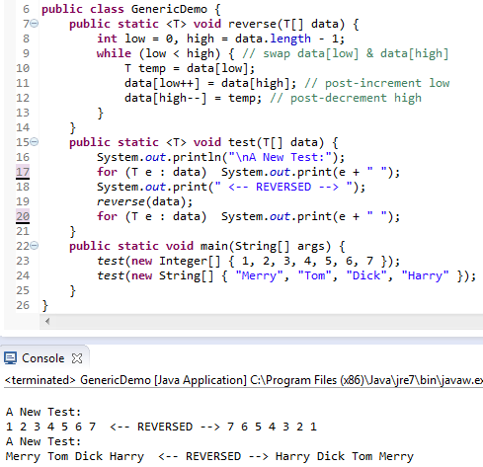

Slide 59
Bounded wildcards increase
API flexibility
For maximum flexibility, use wildcard types on input parameters that represent producers or consumers.
Don’s use wildcards on return types.
Example: method max(list) returns the maximum element of list. This needs elements of list to be Comparable so that we can apply the compareTo method on them.
  max: list is producer, Comparable is consumer.
  The attempted generic solutions follow …
Motto: PECS stands for producer-extends, consumer-super.

Slide 60
Bounded wildcards …
public static <E> E max( List<E> list)
generic E should be Comparable
public static < E extends Comparable<E> >
E max( List<E> list)
PECS
public static <E extends Comparable<? super E> >
E max( List<? extends E> list)

Slide 61
Bounded wildcards …
public static <E extends Comparable<? super E> >
E max( List<? extends E> list) {
// see Slide 7 on List ADT & Iterators
Iterator<? extends E> iterList = list.iterator() ;
E result = iterList.next() ;
while ( iterList.hasNext() ) {
E e = iterList.next() ;
if (e.compareTo(result) > 0 ) result = e ;
}
return result ;
}

Slide 62
Nested Classes
a class definition nested inside the definition of another class.
There are 4 kinds of nested classes:
  static, non-static, anonymous, local.
  All but the first are called inner classes.
The main use for nested classes is when defining a class that is strongly affiliated with another class.
  enhances encapsulation & reduces undesired name conflicts.
Nested classes are a valuable technique to implement data structures. A nested class can be used to represent a small portion of a larger data structure, or an auxiliary class that helps navigate a primary data structure.

Slide 63

Summary
object oriented design principles:
abstraction, modularity, encapsulation,
inheritance, polymorphism
program development:
  design, coding, errors, testing & debugging
ADTs
interfaces, concrete & abstract classes
exceptions
casting
generics: for an in-depth study click here or read “Effective Java”.
nested classes

Slide 64


