Slide 1

EECS 2011
Fundamentals of
Data Structures
Instructor: Andy Mirzaian

Slide 2

Slides copied directly from Andy
(And not covered by Jeff)

Slide 3

Course Topics
Fundamental data structures underlying widely-used algorithms:
    arrays, lists,
    maps, hash tables,
    priority queues,
    search trees,
    graphs
    and their algorithmic applications
Covered in an Object-Oriented context
Using the Java Programming Language

Slide 4

Course Outcomes
By the end of the course, students will be familiar with the more prevalent data structure patterns, and will be able to design and implement variations on these patterns, and use them to solve a broad range of
real-world problems.

Slide 5


Administrivia
click to open the
course web site

Slide 6

Java Primer: Part 1
Types, Classes & Operators

Slide 7
Why Java?
Java is widely available with large online support.
Embraces a full set of modern abstractions.
Java’s motto: write-once-run-anywhere.
Has variety of automatic checks for mistakes in programs, especially when used in an IDE, e.g., Eclipse.
So, it is suitable for learning to program.
EECS2011 uses Java but is not a Java course.
It is an introductory course on data structures.

Slide 8
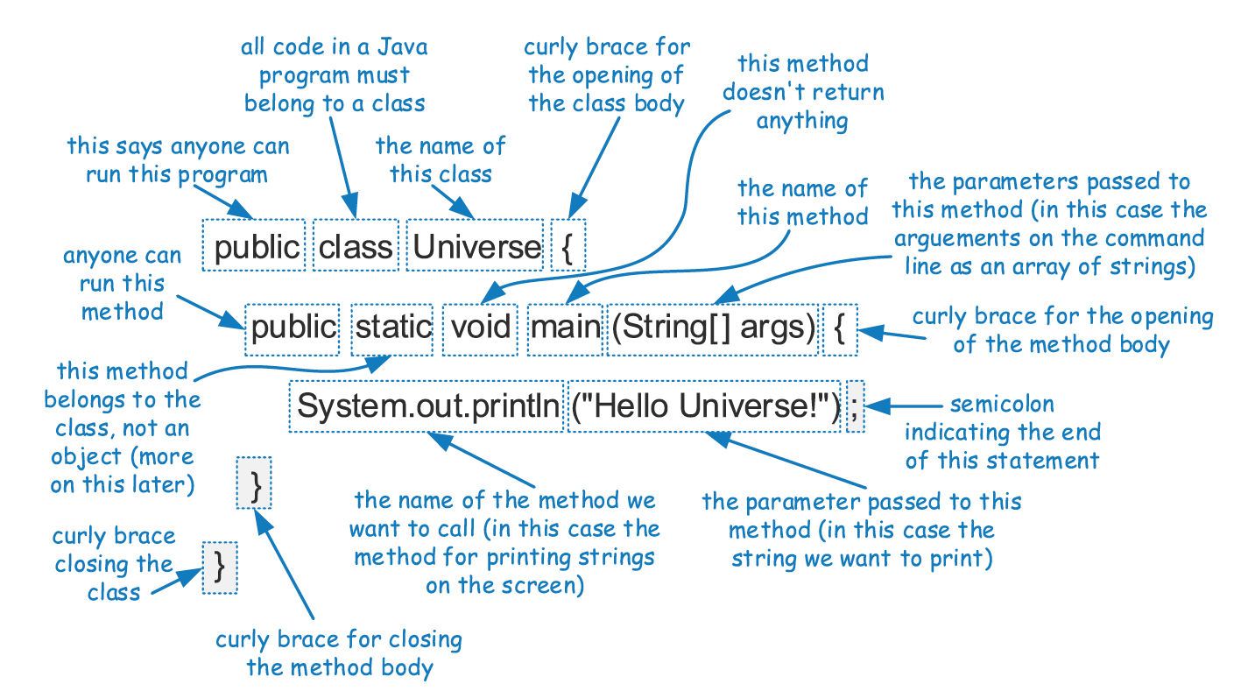
An Example Program

Slide 9
Developing a Java Program
use any text editor or IDE
to create your program
editor
Universe.java
your program (a text file)
type javac Universe.java
to compile your program
compiler
byte-code version of your program
Universe.class
JVM
type java Universe
to execute your program
“Hello Universe!”
output

Slide 10
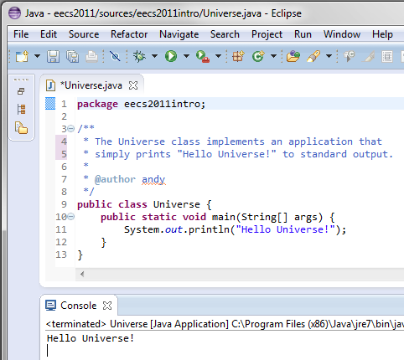
An Eclipse view
program
output

Slide 11
Components of a Java Program
In Java, executable statements are placed in functions, known as methods, that belong to class definitions.
The static method named main is the first method to be executed when running a Java program.
Any set of statements between the braces “{” and “}” define a program block.

Slide 12
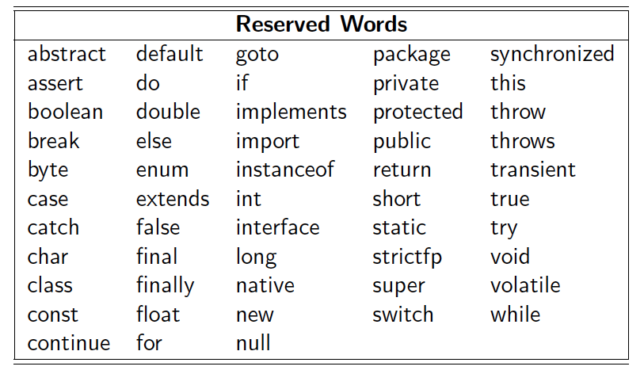
Reserved Words

Slide 13
Identifiers
An identifier is the name of a class, method, or variable.
An identifier cannot be any reserved word.
It can be any string of Java letters, beginning with a letter
( or ‘$’ or ‘_’ ), followed by letters, including digits.
Examples:
  packages: org.omg.CORBA , java.lang , eecs2011.assignments
  Classes: Name , Math , enum , MyClass , YourClass
  Interfaces: Comparable, Clonable, Iterable
  methods: verb , getValue , isEmpty , equals , clone , toString
  variables: name , counter3 , $testVariable , _testVar
  CONSTANTS: PI , MAX_INT , ELECTRON_MASS

Slide 14
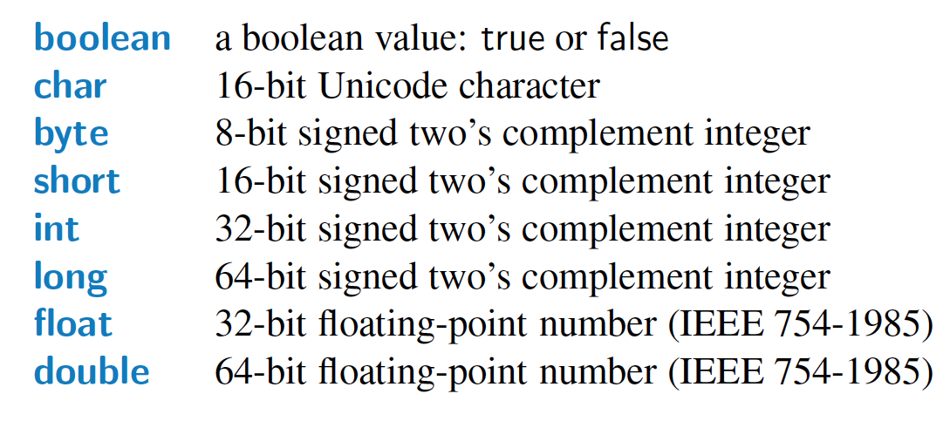
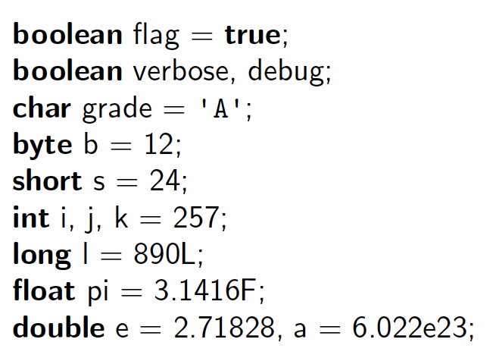
Primitive Types
Java has several primitive types, which are basic ways of storing data.
An identifier variable can be declared to hold any primitive type and it can later be reassigned to hold another value of the same type.

Slide 15



Classes and Objects
class
(prototype)
Dog
fields or
instance variables
(data)
name
breed
bark()
play()
eat()
chaseCat()
methods
(behavior)
instances
(objects)

Slide 16
Classes and Objects
Every object is an instance of a class, which serves as the type of the object and as a blueprint, defining the data which the object stores and the methods for accessing and modifying that data.
The critical members of a class in Java are the following:
  Instance variables (or fields) represent the data associated with an object of a class. Instance variables must have a type, which can either be a primitive type (such as int, float, or double) or any class type.
  Methods in Java are blocks of code that can be called to perform actions. Methods can accept parameters as arguments, and their behavior may depend on the object upon which they are invoked and the values of any parameters that are passed. A method that returns information to the caller without changing any instance variables is known as an accessor method, while an update method is one that may change one or more instance variables when called.

Slide 17
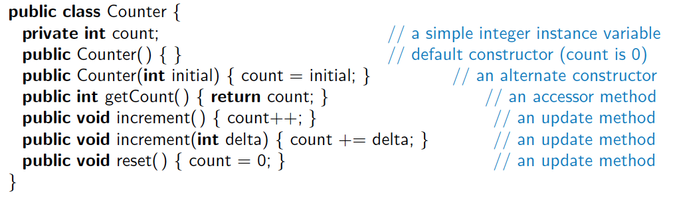
Another Example
.
.
.
.
.
.
.
.
.
This class includes one instance variable, named count,
with default value of zero, unless otherwise initialized.
The class includes 2 special methods known as constructors, 1 accessor method, and 3 update methods.

Slide 18
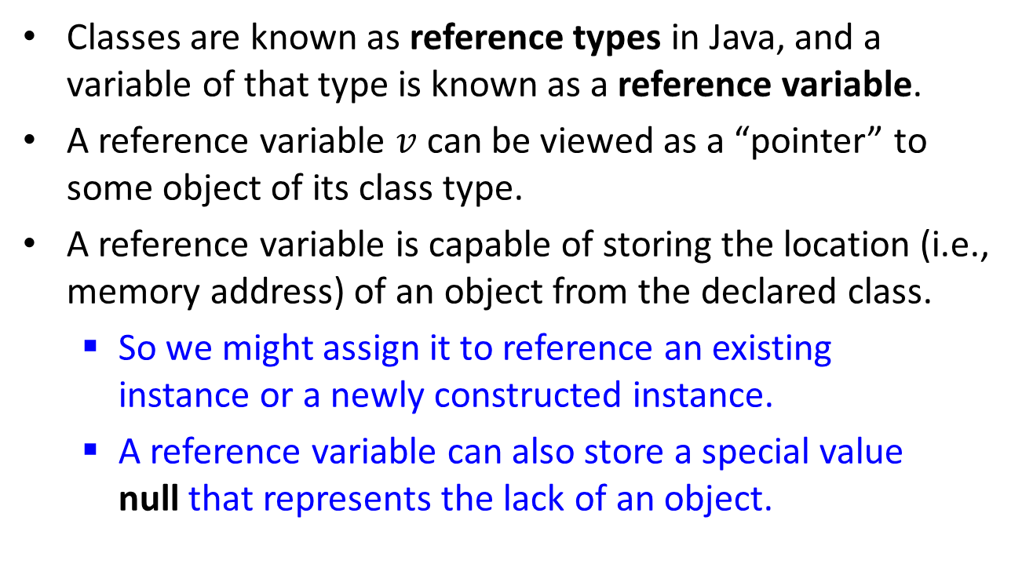
Reference Objects
Classes are known as reference types in Java, and a variable of that type is known as a reference variable.
A reference variable $v$ can be viewed as a “pointer” to some object of its class type.
A reference variable is capable of storing the location (i.e., memory address) of an object from the declared class.
  So we might assign it to reference an existing
  instance or a newly constructed instance.
  A reference variable can also store a special value
  null that represents the lack of an object.

Slide 19
Creating and Using Objects
In Java, a new object is created by using the new operator followed by a call to a constructor for the desired class.
A constructor is a method that always shares the same name as its class. The new operator returns a reference to the newly created instance; the returned reference is typically assigned to an object of that class for further use.
Example: Counter c = new Counter(167);
c
count
.
167
Counter type
reference
Counter type object

Slide 20
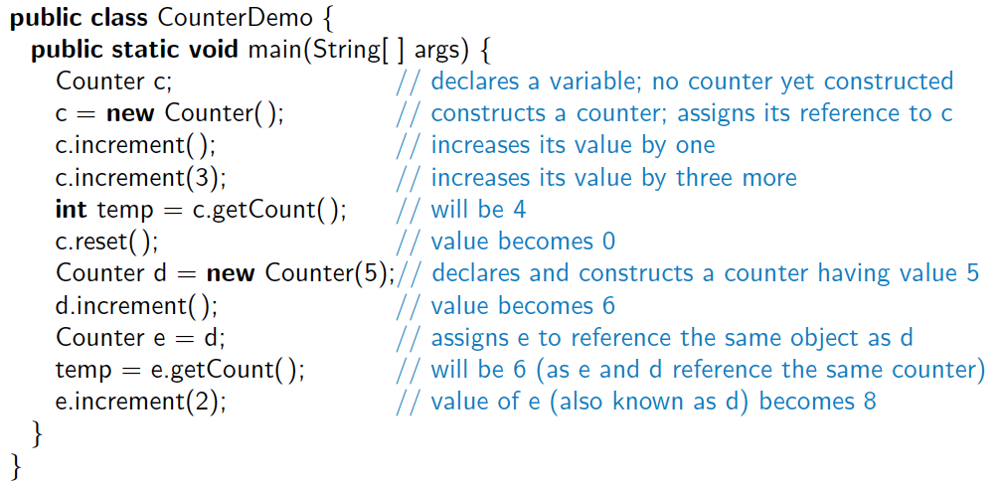
Continued Example
.
.
.
.
.
.
.
.
.
.
.
.
.
.
.
Here, a new Counter is constructed at line 4, with its reference assigned to the variable c. That relies on a form of the constructor, Counter( ), that takes no arguments between the parentheses.

Slide 21
The Dot Operator
A reference variable name of an object can be used to access the members of the object’s class.
This access is performed with the dot (“.”) operator.
Such access is done by using the object reference variable name, followed by the dot operator, followed by the member field or member method name and its parameters:
Examples:
myObject.field
myObject.myMethod ( parameters )
e.increment ( 3 ); // increments Counter e by 3
System.out.println ( e.getCount() ); // print counter value of Counter e
System.out.println ( e.count ); // Ooops! count field was private

Slide 22
Wrapper Types
There are many data structures and algorithms in Java’s libraries that are specifically designed so that they only work with object types (not primitives).
To get around this obstacle, Java defines a wrapper class for each base type.
  Java provides additional support for implicitly converting between base types and their wrapper types through a process known as automatic boxing and unboxing.

Slide 23
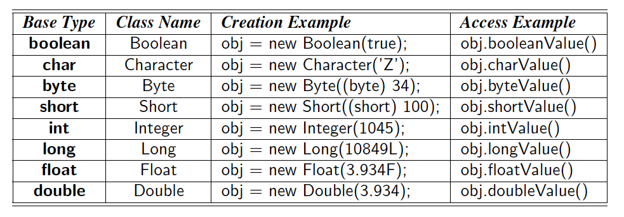
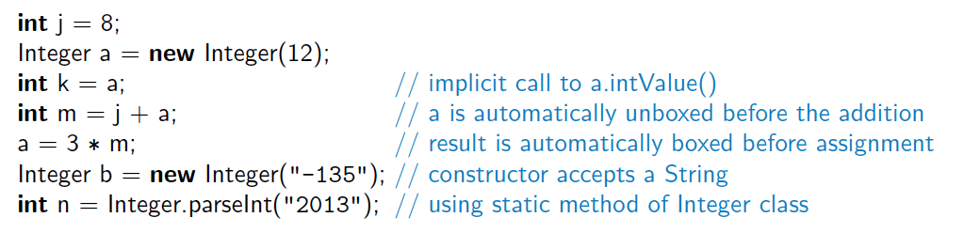
Example Wrapper Types

Slide 24
Signatures
If there are several methods with the same name defined for a class, then the Java runtime system uses the one that matches the actual number of parameters sent as arguments, as well as their respective types.
A method’s name combined with the number and types of its parameters is called a method’s signature, for it takes all of these parts to determine the actual method to perform for a certain method call.

Slide 25
Defining Classes
A class definition is a block of code, delimited by braces “{” and “}” , within which is included:
  declarations of instance variables
  member methods & constructors
  nested classes
Immediately before the definition of a class, instance variable, or method, keywords known as modifiers can be placed to convey additional stipulations about that definition.

Slide 26
Modifiers
Access modifiers: public, protected, private, default
Change modifier: final
Instantiation modifier: static
Field modifiers: transient , volatile
Method modifiers: abstract, native, synchronized

Slide 27
Access Control Modifier
Specifies who has access to a defined aspect of a class:
Private: accessible by members of the given class.
default (package-protected): accessible by classes in the same package as the given class.
protected: accessible by subclasses, as well as classes in the same package as the given class.
public: accessible by all classes.
Motto: information hiding
make each class or member as inaccessible as possible.

Slide 28
Static Modifier
When a field or method member of a class is declared as static, it is associated with the class as a whole, and is shared by all instances of that class, e.g., instanceCount.
static member access: ClassName.memberName
e.g., Math.sqrt(2) (in the Java Library package java.lang)
Primary purpose for static vs. (non-static) instance methods:
  static methods: to implement (utility) functions.
  instance methods: to implement data-type operations.

Slide 29
Other Modifiers
abstract
  method: has declaration, but no body
  class: can have abstract methods
  interface: is abstract class with only abstract methods; no fields, no constructors.
final
  field: non-resettable (constant)
  method: non-overridable
  class: cannot be abstract or sub-classed.
Other modifiers not discussed in this course:
native, synchronized, transient, volatile, strictfp

Slide 30
Parameters
A method’s parameters are defined in a comma-separated list enclosed in parentheses after the name of the method.
  A parameter consists of two parts, the parameter type and the parameter name.
  If a method has no parameters, then only an empty pair of parentheses is used.
All parameters in Java are passed by value, that is, any time we pass a parameter to a method, a copy of that parameter is made for use within the method body.
  So if we pass an int variable to a method, then that variable’s integer value is copied.
  The method can change the copy but not the original.
  If we pass an object reference as a parameter to a method, then that reference is copied (but not the object it points to).

Slide 31
The Keyword this
Within the body of a method, the keyword this is automatically defined as an “alias” to the instance upon which the method was invoked. There are three common uses:
  To store the reference in a variable, or send it as a parameter to another method that expects an instance of that type as an argument.
  To differentiate between an instance variable and a local variable or parameter with the same name.
  To allow one constructor body to invoke another constructor body.
Example: Line 4 on page 9 can be written as:
public Counter(int count) { this.count = count; }

Slide 32
Expressions and Operators
Existing values can be combined into expressions using special symbols and keywords known as operators.
The semantics of an operator depends upon the type of its operands (see “overloading” later).
Example:
int x = a + b ; // add integers a and b
String s = “rewar” + “ding” ; // concatenate strings

Slide 33
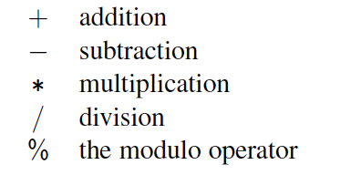
Arithmetic Operators
Java supports the following binary arithmetic operators:
If both operands have type int, then the result is an int; if one or both operands have type double, the result is a double.
Integer division has its result truncated.

Slide 34
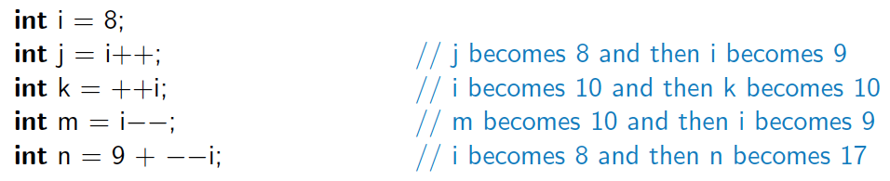
Increment and Decrement Ops
Java provides the plus-one increment (++) and decrement (−−) unary operators.
  If such an operator is used as prefix to a variable reference, then 1 is added to (or subtracted from) the variable, then its value is read into the expression.
  If it is used as postfix to a variable reference, then the value is first read, and then the variable is incremented or decremented by 1.

Slide 35
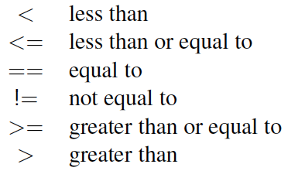
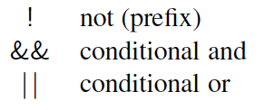
Logical Operators
Java supports the following operators for numerical values, which result in Boolean values:
Boolean values also have the following operators:
The and and or operators short circuit, in that they do not evaluate the second operand if the result can be determined based on the value of the first operand.

Slide 36
Conditional Operator
Java supports the following ternary operator:
(booleanExpression) ? valueIfTrue : valueIfFalse ;
// acts like if-then-else.
Example:
/** this method returns larger of a or b */
public static int max ( int a , int b ) {
return ( a > b) ? a : b;
}

Slide 37
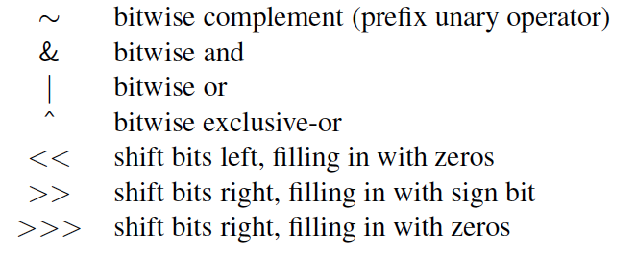
Bitwise Operators
Java provides the following bitwise operators for integers and booleans:

Slide 38
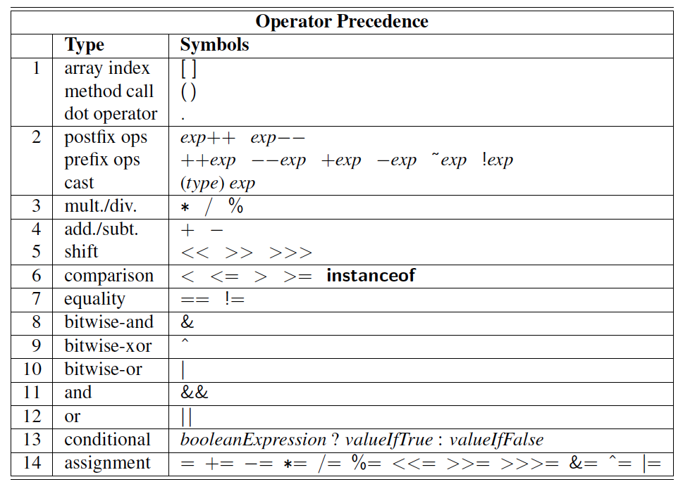
Operator Precedence
Association
Left-to-Right
Right-to-Left
Left-to-Right
Right-to-Left

Slide 39
Casting
Casting is an operation that allows us to change the type of a value.
We can take a value of one type and cast it into an equivalent value of another type.
There are two forms of casting in Java:
    explicit casting
    implicit casting.

Slide 40
Explicit Casting
Syntax: (type) exp
Here “type” is the type that we would like the expression exp to have.
This syntax may only be used to cast from one primitive type to another primitive type, or from one reference type to another reference type.
Example:
double ap = 14.696; // atmospheric pressure in psi
int round = (int) (ap + 0.5); // round to nearest integer
double apRound = (double) round; // cast back as double. Now 15.0

Slide 41
Implicit Casting
There are cases where Java will perform an implicit cast based upon the context of an expression.
You can perform a widening cast between primitive types (such as from an int to a double), without explicit use of the casting operator.
However, if attempting to do an implicit narrowing cast, a compiler error results.
Example:
int x = 2 ; double y = 20.0 ;
y = (3*y+4) / (x+2) ; // implicit widening cast. Now y == 16.0
x = (3*y+4) / (x+2) ; // Is now x == 13 ? No. Compiler error! Why?

Slide 42
Quiz
// Broken comparator - can you spot the flaw!
public int compare ( Integer first , Integer second ) {
return first < second ? -1 : ( first == second ? 0 : 1 );
}
// What would this return: –1 , 0, or 1 ?
compare( new Integer(12) , new Integer(12) ) ;

Slide 43

Part 1: Summary
Java source (.java) text file & compiled (.class) byte-code file
Reserved words & identifiers
Primitive types & reference types
Classes & objects
Class members: fields, constructors, methods, nested classes
Class & method signatures
Keyword this
new & dot ( . ) operators
Wrapper types
Modifiers: access, static, abstract, final
Expressions & operators
Operator precedence
Explicit & implicit casting

Slide 44


Slide 45
Java Primer: Part 2
I/O Methods and Control Flow

Slide 46
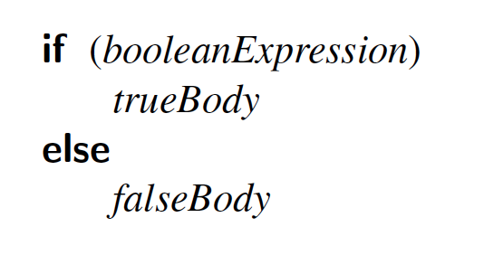
If Statements
The syntax of a simple if statement is as follows:
booleanExpression is a boolean expression and trueBody and falseBody are each either a single statement or a block of statements enclosed in braces (“{” and “}”).

Slide 47
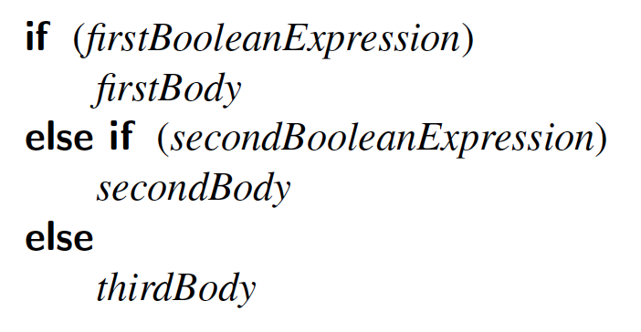
Compound if Statements
There is also a way to group a number of boolean tests, as follows:

Slide 48
Switch Statements
Java provides for multiple-value control flow using the switch statement.
The switch statement evaluates an integer, string, or enum expression and causes control flow to jump to the code location labeled with the value of this expression.
If there is no matching label, then control flow jumps to the location labeled “default”.
This is the only explicit jump performed by the switch statement, however, so flow of control “falls through” to the next case if the code for a case is not ended with a break statement.

Slide 49
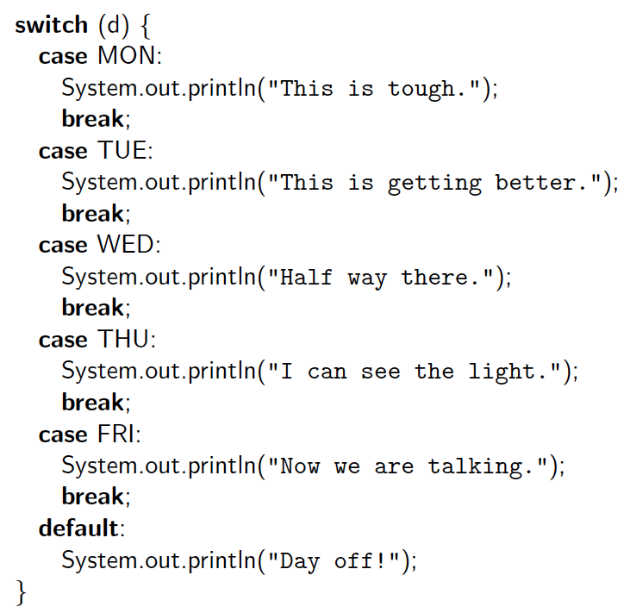
Switch Example

Slide 50
Break and Continue
Java supports a break statement that immediately terminate a while or for loop when executed within its body.
  break label // label is optional
Java also supports a continue statement that causes the current iteration of a loop body to stop, but with subsequent passes of the loop proceeding as expected.

Slide 51
While Loops
The simplest kind of loop in Java is a while loop.
Such a loop tests that a certain condition is satisfied and will perform the body of the loop each time this condition is evaluated to be true.
The syntax for such a conditional test before a loop body is executed is as follows:
while (booleanExpression)
loopBody

Slide 52
Do-While Loops
Java has another form of the while loop that allows the boolean condition to be checked at the end of each pass of the loop rather than before each pass.
This form is known as a do-while loop, and has syntax shown below:
do
loopBody
while (booleanExpression)

Slide 53
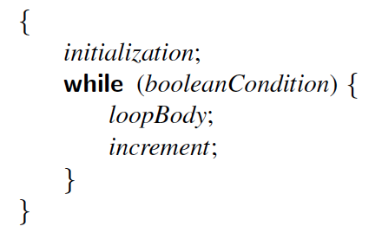
For Loops
The traditional for-loop syntax consists of four sections — an initialization, a boolean condition, an increment statement or block, and the body
  any of these four sections can be empty.
The structure is as follows:
Meaning:
for (initialization; booleanCondition; increment)
loopBody

Slide 54
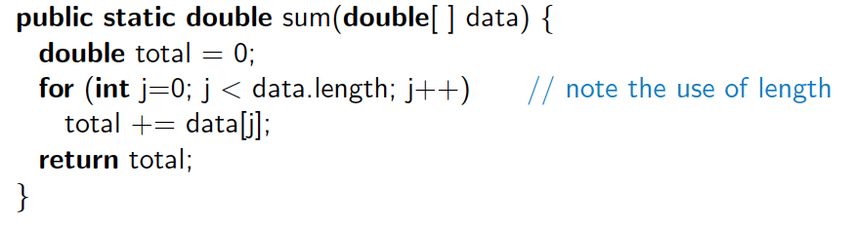
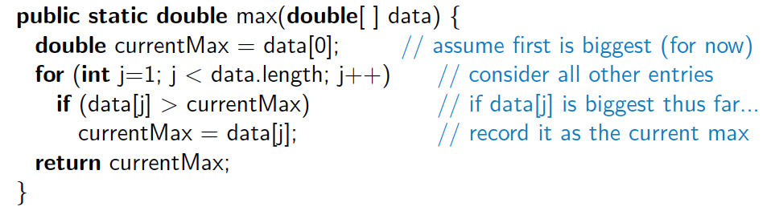
Example For Loops
Compute the sum of an array of doubles:
Compute the maximum in an array of doubles:

Slide 55
For-Each Loops
Since looping through elements of a collection is such a common construct, Java provides a shorthand notation for such loops, called the for-each loop.
The syntax for such a loop is as follows:
for (elementType name : collection)
loopBody

Slide 56
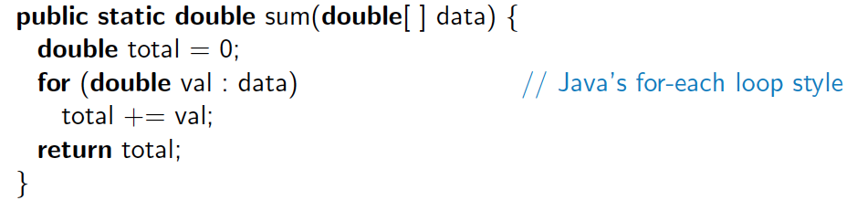
For-Each Loop Example
Computing sum of an array of doubles:
When using a for-each loop, there is no explicit use of array indices.
The loop variable represents one particular element of the array.

Slide 57
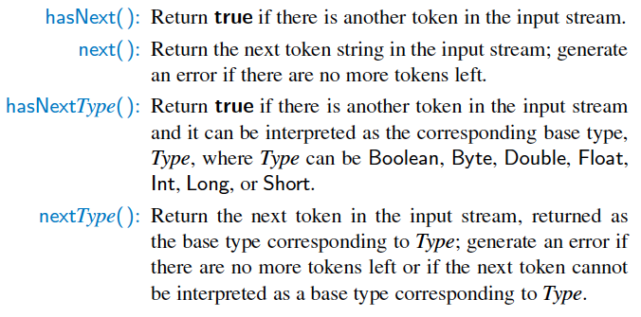
java.util.Scanner Methods
The Scanner class reads the input stream and divides it into tokens, which are strings of characters separated by delimiters.

Slide 58
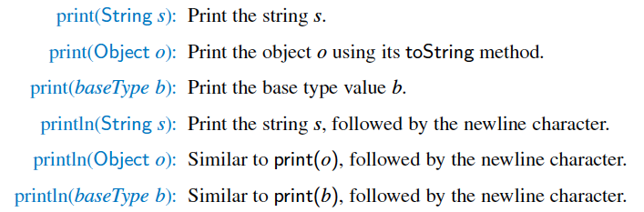
Simple Output
Java provides a built-in static object, called System.out, that performs output to the “standard output” device, with the following methods:

Slide 59
Example: Input/Output
import java.util.Scanner ;
import java.io.PrintStream ;
public class IOExample {
public static void main(String[ ] args) {
Scanner input = new Scanner(System.in) ;
PrintStream output = System.out ;
output.print(“Enter your age in years: ”) ;
double age = input.nextDouble( ) ;
output.print(“Enter your maximum heart rate: ”) ;
double rate = input.nextDouble( ) ;
double fb = (rate – age) ∗ 0.65 ;
output.println(“Your ideal fat-burning heart rate is ” + fb) ;
input.close( ) ; // potential memory leak if not closed!
}
}

Slide 60
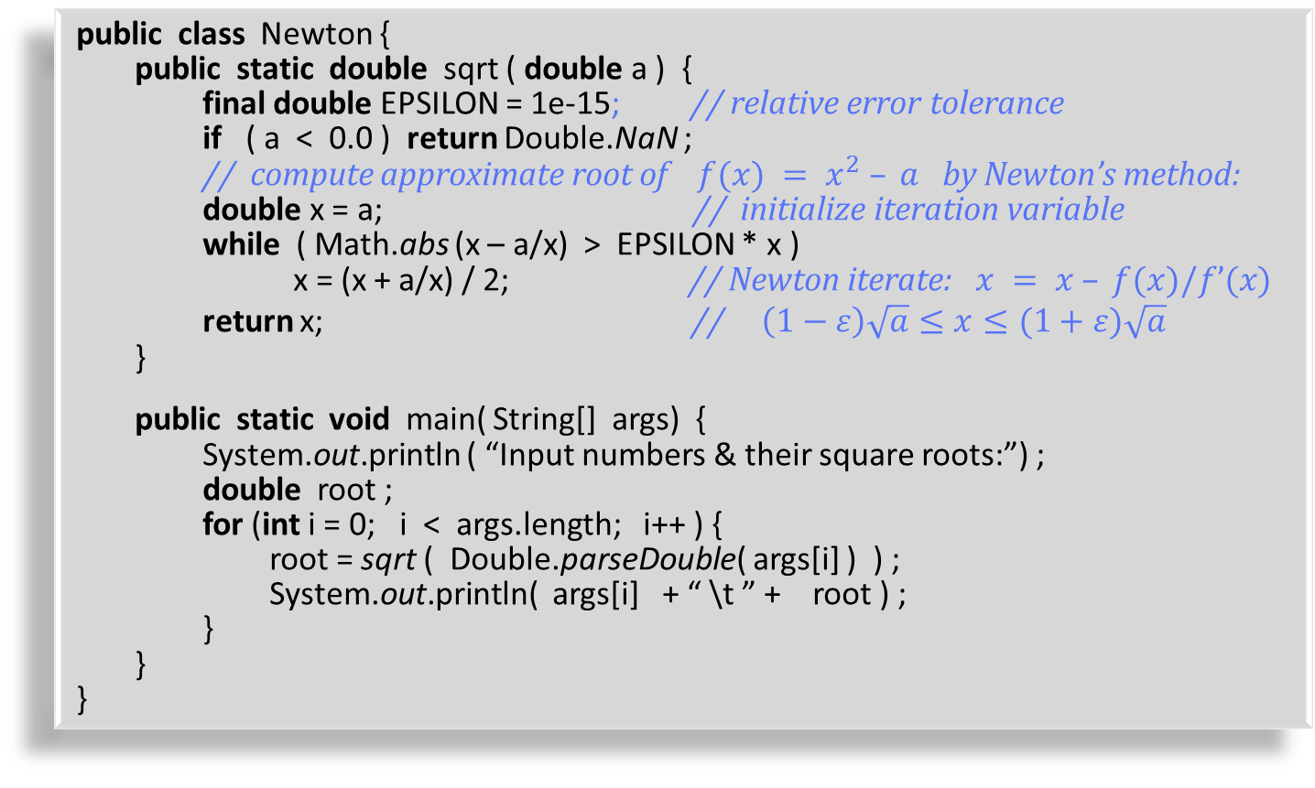
Example Program
public class Newton {
public static double sqrt ( double a ) {
final double EPSILON = 1e-15; // relative error tolerance
if ( a < 0.0 ) return Double.NaN ;
// compute approximate root of $f(x) = x^{2} – a$by Newton’s method:
double x = a; // initialize iteration variable
while ( Math.abs (x – a/x) > EPSILON * x )
x = (x + a/x) / 2; // Newton iterate: $x = x – f(x)/f’(x)$
return x; // $\left(1−ε\right)\sqrt{a}≤x≤(1+ε)\sqrt{a}$
}
public static void main( String[] args) {
System.out.println ( “Input numbers & their square roots:”) ;
double root ;
for (int i = 0; i < args.length; i++ ) {
root = sqrt ( Double.parseDouble( args[i] ) ) ;
System.out.println( args[i] + “ \t ” + root ) ;
}
}
}
Output:
Input numbers & their square roots:
-5 NaN
Infinity Infinity
0 0.0
1 1.0
2 1.414213562373095
3 1.7320508075688772
4 2.0

Slide 61
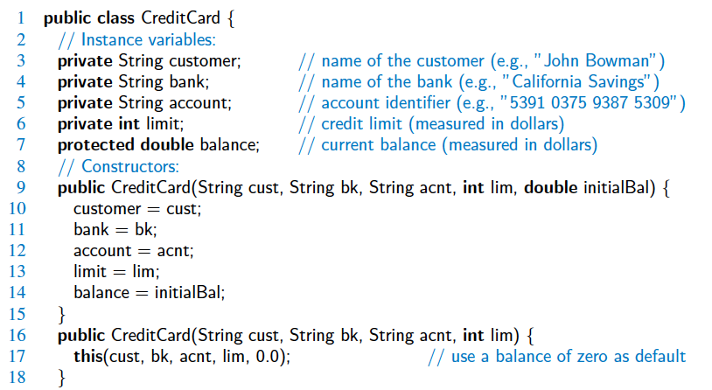
Another Program

Slide 62
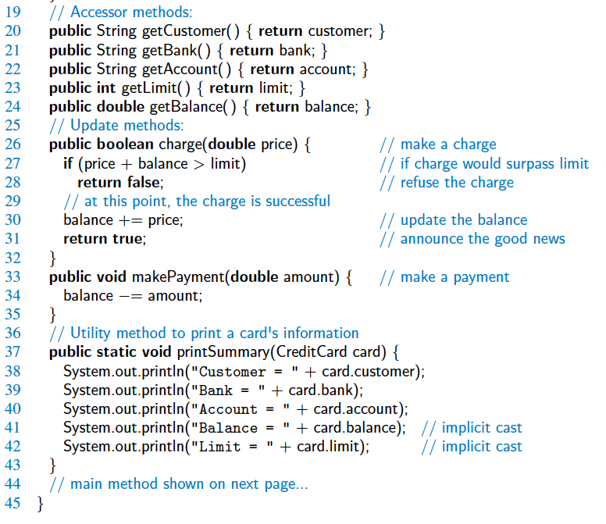
Program cont’d

Slide 63
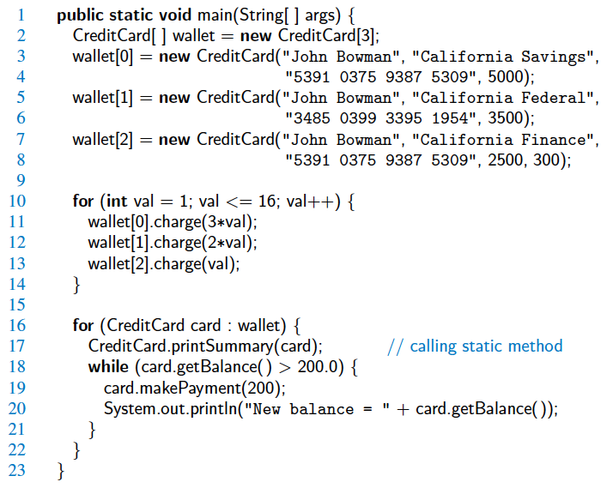
Program cont’d

Slide 64
Packages & imports
/* name of package that contains the class definition goes on the first line */
import packageName; // appears next
import java.util.Scanner;
import java.util.*;
/* static import as of Java 5
e.g., importing a class with static members */
import static packageName.PhysicalConstants.*;
import static java.lang.Math.*;
// now you can say sqrt() instead of Math.sqrt()

Slide 65
Coding
Algorithm pseudo-code facilitates
feasibility , efficiency & verification analysis
prior to time consuming & costly code development
Packages & imports
  enhanced modularity & encapsulation
  avoids naming conflicts
IDEs , e.g. Eclipse
Documentation & Style ⎯ Javadoc

Slide 66

Errors
Motto: early detection
catch mistakes as early as possible; preferably at compile time.
Compile-time int x = 1.5;
Run-time x/0;
Logical errors bugs are the bane of programmer’s existence!
Example: An “expensive” bug
  Ariane 5 European satellite
  Cost: $7B, 10 years to build
  Rocket crashed within 1 min of takeoff
  with expensive uninsured scientific cargo
  bug: unintended cast from 64-bit to 16-bit.

Slide 67
Testing & Debugging
Top-down modular testing with stubs
Bottom-up unit-testing
Regression testing on evolving software
Basic debugging by print statements or assertions:
assert ( x > 5) : “ x = ” + x ;
// if false, throw an AssertionError
Enabling & disabling assertions:
java –ea // enable assertions. Slow − used during testing
java –da // disable assertions. Fast − for production
Java debugger jdb (using breakpoints)
Advanced IDE debuggers with GUI display

Slide 68
Part 2: Summary
Control Flow Statements:
  Branching: if-then-else, switch, break, continue
  Loops: for-loop, while-loop, do-while, for-each
Simple I/O
Example programs
Packages & imports
Coding
Errors
Testing & Debugging

