Slide 1
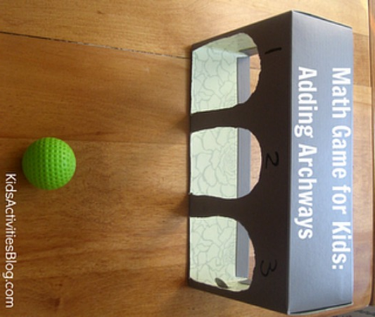
Hash Tables
Dictionary/Map ADT
Direct Addressing
Hash Tables
Random Algorithms
Universal Hash Functions
Key to Integer
Separate Chaining
Probe Sequence
Put, Get, Del, Iterators
Running Time
Simpler Schemes
Jeff Edmonds
York University
Lecture 7
COSC 2011

Slide 2
Random Balls in Bins
Throw ^{m}/₂ balls (keys)
randomly
into m bins (array cells)
The balls get spread out reasonably well.
Exp( # a balls a ball shares a bin with ) = O(1)
O(1) bins contain O(logn) balls.

Slide 3
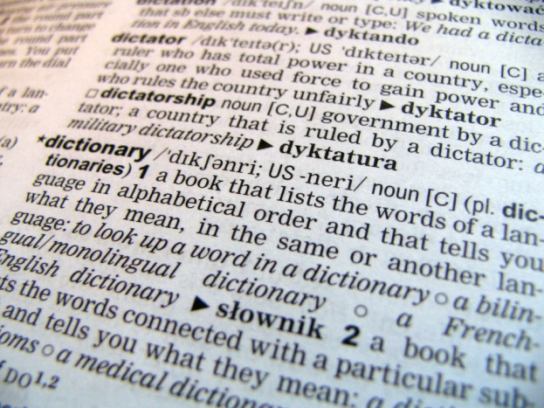
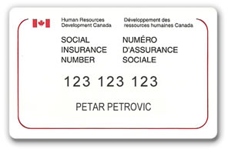
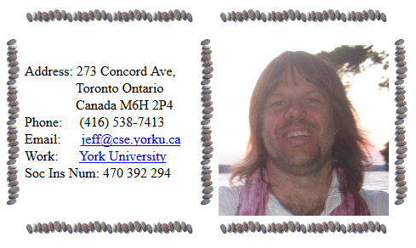
Dictionary/Map ADT
Input
⟨key, value⟩
Problem: Store value/data
associated with keys.
⟨k₁,v₁⟩
⟨k₂,v₂⟩
⟨k₃,v₃⟩
⟨k₄,v₄⟩
Examples:
key = word, value = definition
key = social insurance number
value = person’s data

Slide 4
Dictionary/Map ADT
Map ADT methods:
  put(k, v): insert entry (k, v) into the map M.
    If there is a previous value associated with k return it.
    (Multi-Map allows multiple values with same key)
  get(k): returns value v associated with key k. (else null)
  remove(k): remove key k and its associated value.
  size(), isEmpty()
  Iterator:
    keys(): over the keys k in M
    values(): over the values v in M
    entries(): over the entries ⟨k,v⟩ in M

Slide 5
Dictionary/Map ADT
Operation Output M
isEmpty() true Ø
put(5,A) null (5,A)
put(7,B) null (5,A),(7,B)
put(2,C) null (5,A),(7,B),(2,C)
put(8,D) null (5,A),(7,B),(2,C),(8,D)
put(2,E) C (5,A),(7,B),(2,E),(8,D)
get(7) B (5,A),(7,B),(2,E),(8,D)
get(4) null (5,A),(7,B),(2,E),(8,D)
get(2) E (5,A),(7,B),(2,E),(8,D)
size() 4 (5,A),(7,B),(2,E),(8,D)
remove(5) A (7,B),(2,E),(8,D)
remove(2) E (7,B),(8,D)
get(2) null (7,B),(8,D)
isEmpty() false (7,B),(8,D)

Slide 6
Dictionary/Map ADT
Input
⟨key, value⟩
Array
Problem: Store value/data
associated with keys.
⟨k₁,v₁⟩
⟨k₂,v₂⟩
⟨k₃,v₃⟩
⟨k₄,v₄⟩
₀
₁
₂
₃
₄
₅
₆
₇
⟨k₅,v₅⟩
…
Implementations:
Insert
Search
Unordered Array
O(1)
O(n)

Slide 7
Dictionary/Map ADT
Input
⟨key, value⟩
Array
Problem: Store value/data
associated with keys.
⟨2,v₃⟩
⟨4,v₄⟩
⟨7,v₁⟩
⟨9,v₂⟩
₀
₁
₂
₃
₄
₅
₆
₇
⟨6,v₅⟩
…
Implementations:
Insert
Search
Unordered Array
O(1)
O(n)
Ordered Array
O(n)
O(logn)

Slide 8
Dictionary/Map ADT
Input
⟨key, value⟩
trailer
header
nodes/positions
Problem: Store value/data
associated with keys.
⟨2,v₃⟩
⟨4,v₄⟩
⟨7,v₁⟩
⟨9,v₂⟩
entries
⟨6,v₅⟩
Implementations:
Insert
Search
Unordered Array
O(1)
O(n)
Ordered Array
O(n)
O(logn)
Ordered Linked List
O(n)
O(n)
Inserting is O(1) if you have the spot.
but O(n) to find the spot.

Slide 9
Dictionary/Map ADT
Input
⟨key, value⟩
Problem: Store value/data
associated with keys.
⟨2,v₃⟩
⟨4,v₄⟩
⟨7,v₁⟩
⟨9,v₂⟩
38
25
51
17
31
42
63
4
21
28
35
40
49
55
71
Implementations:
Insert
Search
Unordered Array
O(1)
O(n)
Ordered Array
O(n)
O(logn)
Ordered Linked List
O(n)
O(n)
Binary Search Tree
O(logn)
O(logn)

Slide 10
Dictionary/Map ADT
Input
⟨key, value⟩
Problem: Store value/data
associated with keys.
⟨5,v₁⟩
⟨9,v₂⟩
⟨2,v₃⟩
⟨7,v₄⟩
Hash Tables are very fast,
but keys have no order.
Implementations:
Insert
Search
Next
Unordered Array
O(1)
O(n)
O(n)
Ordered Array
O(n)
O(logn)
O(1)
Ordered Linked List
O(n)
O(n)
O(1)
Binary Search Tree
O(logn)
O(logn)
O(1) (Avg)
Hash Tables
Avg: O(1)
O(1)
O(n)

Slide 11
Direct Addressing
Input
⟨key, value⟩
Suppose your
array was
REALLY big.
⟨5,v₁⟩
⟨5,v₁⟩
⟨9,v₂⟩
⟨2,v₃⟩
⟨7,v₄⟩
⟨9,v₂⟩
Array
⟨2,v₃⟩
₀
₁
₂
₃
₄
₅
₆
₇
₈
₉
⟨7,v₄⟩
⟨4,v₅⟩
⟨4,v₅⟩
Where would you
store ⟨5,v₁⟩?
⟨7,?⟩
Called
Direct Addressing
Implementations:
Insert
…
Search
Next
Direct Addressing
O(1)
O(1)
O(1)

Slide 12
Direct Addressing
Input
⟨key, value⟩
Consider the universe of all possible keys.
⟨5,v₁⟩
⟨9,v₂⟩
⟨2,v₃⟩
⟨7,v₄⟩
Universe
of Keys
Array
0
1
2
3
4
5
6
7
8
9
₀
₁
₂
₃
₄
₅
₆
₇
₈
₉
The Mapping
from key
to Array Cell
is 1-1
⟨2,v₃⟩
⟨4,v₅⟩
⟨5,v₁⟩
Called
Direct Addressing
⟨7,v₄⟩
⟨9,v₂⟩
…
…
Implementations:
Insert
Search
Next
Direct Addressing
O(1)
O(1)
O(1)

Slide 13
Direct Addressing
Input
⟨key, value⟩
Consider the universe of all possible keys.
⟨5,v₁⟩
⟨9,v₂⟩
⟨2,v₃⟩
⟨7,v₄⟩
Universe
of Keys
Array
0
1
2
3
4
5
6
7
8
9
₀
₁
₂
₃
₄
₅
₆
₇
₈
₉
The Mapping
from key
to Array Cell
is 1-1
If most keys are used,
then is a fine data structure.
k₃=
k₅=
k₁=
k₄=
k₂=
⟨2,v₃⟩
⟨4,v₅⟩
⟨5,v₁⟩
Called
Direct Addressing
⟨7,v₄⟩
⟨9,v₂⟩
…
…
Implementations:
Insert
Search
Next
Direct Addressing
O(1)
O(1)
O(1)

Slide 14
Direct Addressing
Input
⟨key, value⟩
The keys used
are those of your customers.
Consider the universe of all possible keys.
⟨5,v₁⟩
⟨9,v₂⟩
⟨2,v₃⟩
⟨7,v₄⟩
Universe
of Keys
Array
0
1
2
3
4
5
6
7
8
9
₀
₁
₂
₃
₄
₅
₆
₇
₈
₉
The Mapping
from key
to Array Cell
is 1-1
k₃=
k₅=
k₁=
k₄=
k₂=
⟨2,v₃⟩
⟨4,v₅⟩
⟨5,v₁⟩
Universe of keys
is likely huge.
(eg social insurance numbers)
Called
Direct Addressing
⟨7,v₄⟩
⟨9,v₂⟩
…
…
Insert
Search
Next
Memory
O(1)
O(1)
O(1)
∞
How far is the next key?

Slide 15
Hash Tables
Input
⟨key, value⟩
The keys used
are those of your customers.
Consider an array
≈ # items stored.
Universe
of Keys
The Mapping
from key
to Array Cell
is many to one
0
1
2
3
4
5
6
7
8
9
₀
₁
₂
₃
₄
₅
₆
₇
₈
₉
Called
Hash Function
Hash(key) = i
Universe of keys
is likely huge.
(eg social insurance numbers)
…

Slide 16
Hash Tables
Input
⟨key, value⟩
Consider an array
≈ # items stored.
⟨5,v₁⟩
Universe
of Keys
⟨5,v₁⟩
⟨9,v₂⟩
⟨9,v₂⟩
⟨2,v₃⟩
⟨2,v₃⟩
The Mapping
from key
to Array Cell
is many to one
0
1
2
3
4
5
6
7
8
9
₀
₁
₂
₃
₄
₅
₆
₇
₈
₉
⟨7,v₄⟩
⟨7,v₄⟩
⟨5,?⟩
⟨4,v₅⟩
⟨4,v₅⟩
Collisions
are a problem.
Called
Hash Function
Hash(key) = i
…
Implementations:
Insert
Search
Next
Hash Function
O(1)
O(1)
O(n)

Slide 17
Hash Tables
Input
⟨key, value⟩
Consider an array
≈ # items stored.
⟨5,v₁⟩
Universe
of Keys
⟨9,v₂⟩
⟨2,v₃⟩
The Mapping
from key
to Array Cell
is many to one
0
1
2
3
4
5
6
7
8
9
₀
₁
₂
₃
₄
₅
₆
₇
₈
₉
⟨2,v₃⟩
⟨7,v₄⟩
⟨7,v₄⟩
⟨5,?⟩
⟨4,v₅⟩
Collisions
are a problem.
⟨9,v₂⟩
⟨4,v₅⟩
Called
Hash Function
Hash(key) = i
⟨5,v₁⟩
…
Choose Hash to minimize collisions.
Deal with collisions.
Implementations:
Hash Function

Slide 18
Hash Tables
Input
⟨key, value⟩
The algorithm chooses
the Hash Function
mapping
from keys
to Array Cell.
(Does not depend on input)
⟨5,v₁⟩
Universe
of Keys
⟨9,v₂⟩
⟨2,v₃⟩
2
4
5
7
9
0
1
2
3
4
5
6
7
8
9
₀
₁
₂
₃
₄
₅
₆
₇
₈
₉
⟨2,v₃⟩
⟨7,v₄⟩
⟨7,v₄⟩
⟨5,?⟩
⟨4,v₅⟩
The input I specifies
which keys are used.
⟨9,v₂⟩
⟨4,v₅⟩
Algorithm wants few collisions
⟨5,v₁⟩
Worst case input
wants lots collisions
…
Choose Hash to minimize collisions.
Implementations:
Hash Function

Slide 19
Hash Tables
Input
⟨key, value⟩
The universe of keys
is huge compared
to the array.
Hence, many keys get mapped to
each array cell.
⟨287,v₁⟩
Universe
of Keys
⟨9,v₂⟩
⟨394,v₃⟩
0
1
2
3
4
5
6
7
8
9
₀
₁
₂
₃
₄
₅
₆
₇
₈
₉
⟨482,v₄⟩
⟨583,?⟩
⟨4,v₅⟩
The worst case input I uses keys that all go to the same array cell!
⟨4,v₅⟩
⟨482,v₄⟩
⟨9,v₂⟩
⟨287,v₁⟩
⟨394,v₃⟩
⟨583,?⟩
…
Choose Hash to minimize collisions.
Implementations:
Hash Function

Slide 20
Hash Tables
Input
⟨key, value⟩
If the keys are social insurance number,
Hash(key) = i
could be the
last digit.
⟨293 183,v₁⟩
Universe
of Keys
⟨948 847,v₂⟩
⟨039 988,v₃⟩
0
1
2
3
4
5
6
7
8
9
₀
₁
₂
₃
₄
₅
₆
₇
₈
₉
⟨948 475,v₄⟩
⟨ 948 847,?⟩
⟨304 382,v₅⟩
⟨304 382,v₅⟩
⟨293 183,v₁⟩
The “random” input I would have all clients have the different last digits.
⟨948 475,v₄⟩
⟨948 847,v₂⟩
⟨039 988,v₃⟩
So few collisions
…
But what is a
“random” input I?

Slide 21
Hash Tables
Input
⟨key, value⟩
If the keys are social insurance number,
Hash(key) = i
could be the
last digits.
⟨287 005,v₁⟩
Universe
of Keys
⟨923 005,v₂⟩
⟨394 005,v₃⟩
0
1
2
3
4
5
6
7
8
9
₀
₁
₂
₃
₄
₅
₆
₇
₈
₉
⟨482 005,v₄⟩
⟨287 005,?⟩
⟨193 005,v₅⟩
The worst case input I would have all clients have the same last three digits.
⟨4,v₅⟩
⟨482,v₄⟩
⟨9,v₂⟩
⟨287,v₁⟩
⟨394,v₃⟩
⟨583,?⟩
So lots of collisions
…
In practice, do you get the worst case input?

Slide 22
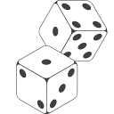
Hash Tables
Input
⟨key, value⟩
To confuse the
“worst case” input,
the mapping
Hash(key) = i
I choose is ??
⟨287 005,v₁⟩
Universe
of Keys
⟨923 005,v₂⟩
⟨394 005,v₃⟩
0
1
2
3
4
5
6
7
8
9
₀
₁
₂
₃
₄
₅
₆
₇
₈
₉
⟨482 005,v₄⟩
⟨287 005,?⟩
⟨193 005,v₅⟩
Random!
The worst case input I would have all clients have the same last three digits.
⟨4,v₅⟩
⟨482,v₄⟩
⟨9,v₂⟩
⟨287,v₁⟩
⟨394,v₃⟩
⟨583,?⟩
…

Slide 23
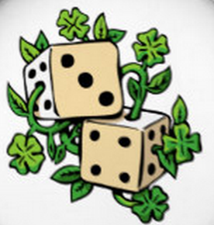
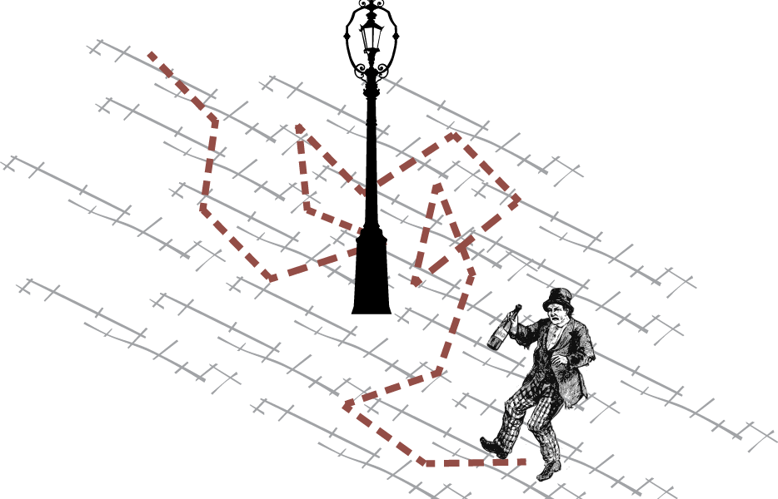
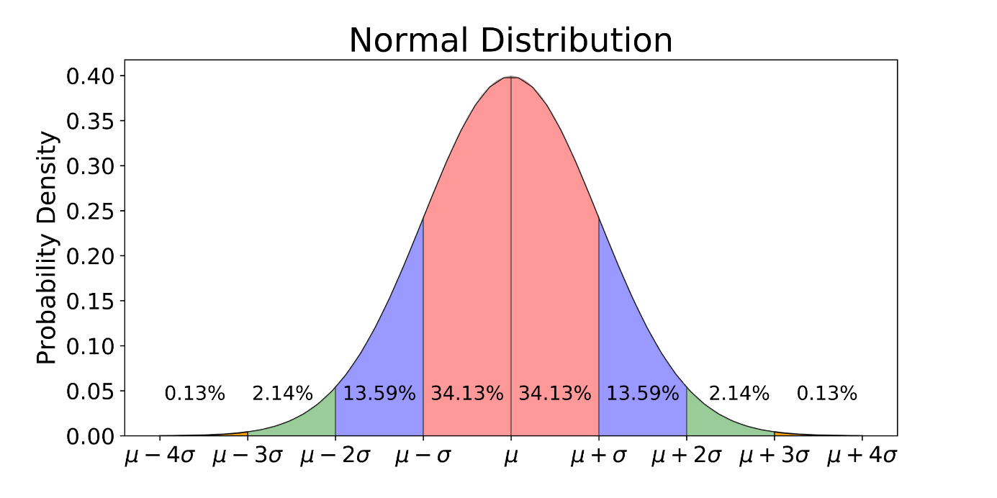
Probabilistic Algorithms

Slide 24
Probabilistic Algorithms
Problem P is computable if
∃A,
∀I,
A(I)=P(I)
& Time(A,I) ≤ T
I have an algorithm A that I claim works.
Oh yeah, I have a worst case input I for which it does not.
Actually my algorithm always gives the right answer
and is fast.

Slide 25
Probabilistic Algorithms
Problem P is computable by a random algorithm if
∃A,
∀I,
∀R,
A_{R}(I)=P(I)
Remember Quick Sort
I have a random algorithm A that I claim works.
I know the algorithm A, but not its random coin flips R.
I do my best to give you a worst case input I.
The random coin flips R are independent of the input.
And for EVERY input I,
I want the correct answer.

Slide 26
Probabilistic Algorithms
Problem P is computable by a random algorithm if
∃A,
∀I,
∀R,
A_{R}(I)=P(I)
Remember Quick Sort
Expected_{R} Time(A_{R},I) ≤ T
I have a random algorithm A that I claim works.
I know the algorithm A, but not its random coin flips R.
I do my best to give you a worst case input I.
The random coin flips R are independent of the input.
And for EVERY input I,
the expected running time (over choice of R) is great.
There are worst case coin flips but not worst case inputs.

Slide 27
Probabilistic Algorithms
Problem P is computable by a random algorithm if
∃A,
∀I,
Pr_{R}
A_{R}(I)=P(I)
≤ 2^{-|I|}
Remember Quick Sort
Expected_{R} Time(A_{R},I)
I have a random algorithm A that I claim works.
I know the algorithm A, but not its random coin flips R.
I do my best to give you a worst case input I.
Some random algorithm might give the wrong answer on exponentially few random coin flips

Slide 28
Random Hash Functions
Input
⟨key, value⟩
Fix the worst case input I
⟨287 005,v₁⟩
Universe
of Keys
⟨923 005,v₂⟩
Choose a random mapping
Hash(key) = i
⟨394 005,v₃⟩
₀
₁
₂
₃
₄
₅
₆
₇
₈
₉
⟨482 005,v₄⟩
⟨287 005,?⟩
⟨193 005,v₅⟩
287 005
We don’t expect there to be a lot of collisions.
482 005
193 005
(Actually, the random
Hash function likely is chosen and fixed before the input comes, but the key is that the worst case input does not “know” the hash function.)
394 005
923 005

Slide 29
Random Hash Functions
Input
⟨key, value⟩
Throw ^{m}/₂ balls (keys)
randomly
into m bins (array cells)
⟨287 005,v₁⟩
Universe
of Keys
⟨923 005,v₂⟩
⟨394 005,v₃⟩
₀
₁
₂
₃
₄
₅
₆
₇
₈
₉
⟨482 005,v₄⟩
⟨287 005,?⟩
⟨193 005,v₅⟩
287 005
482 005
193 005
394 005
The balls get spread out reasonably well.
Exp( # a balls a ball shares a bin with ) = O(1)
O(1) bins contain O(logn) balls.
923 005

Slide 30
Universal Hash Functions
Choose a random mapping
Hash(key) = i
Universe
of Keys
We want Hash to be
computed in O(1) time.
0
1
2
3
4
5
6
7
8
9
₀
₁
₂
₃
₄
₅
₆
₇
₈
₉
Theory people use
Hash(key) = (a×key mod p) mod N
N = size of array
p is a prime > |U|
a is randomly chosen ∈[1..p-1]
n is the number of data items.
…
a adds just enough randomness.
The integers mod p form a finite field similar to the reals.
The mod N ensures the result indexes a cell in the array.
.

Slide 31
Universal Hash Functions
Choose a random mapping
Hash(key) = i
Universe
of Keys
We want Hash to be
computed in O(1) time.
0
1
2
3
4
5
6
7
8
9
₀
₁
₂
₃
₄
₅
₆
₇
₈
₉
Theory people use
Hash(key) = (a×key mod p) mod N
N = size of array
p is a prime > |U|
a is randomly chosen ∈[1..p-1]
n is the number of data items.
Pairwise Independence
∀ k₁ & k₂ Pr_{a}( Hash_{a}(k₁)=Hash_{a}(k₂) ) = ¹/_{N}
…
Proof: Fix distinct k₁&k₂ ∈ U. Because p > |U|, k₂-k₁ mod p≠0. Because p is prime, every nonzero element has an inverse, eg 2×3mod5=1. Let e=(k₂-k₁)⁻¹. Let D = a× (k₂-k₁) mod p, a = D×e mod p, and d = D mod N. k₁&k₂ collide iff d=0 iff D = jN for j∈[0..^{p}/_{N}]
iff a = jN×e mod p. The probability a has one of these ^{p}/_{N} values is ¹/_{p} × ^{p}/_{N} = ¹/_{N}.

Slide 32
Universal Hash Functions
Choose a random mapping
Hash(key) = i
Universe
of Keys
We want Hash to be
computed in O(1) time.
0
1
2
3
4
5
6
7
8
9
₀
₁
₂
₃
₄
₅
₆
₇
₈
₉
Theory people use
Hash(key) = (a×key mod p) mod N
N = size of array
p is a prime > |U|
a is randomly chosen ∈[1..p-1]
n is the number of data items.
Pairwise Independence
∀ k₁ & k₂ Pr_{a}( Hash_{a}(k₁)=Hash_{a}(k₂) ) = ¹/_{N}
…
Insert key k. Exp( #other keys in its cell )
= Exp( Σ collision ) = Σ Exp(collision)
= n ×¹/_{N} = O(1).
⟨k₁,k⟩
⟨k₁,k⟩

Slide 33
Universal Hash Functions
Choose a random mapping
Hash(key) = i
Universe
of Keys
We want Hash to be
computed in O(1) time.
0
1
2
3
4
5
6
7
8
9
₀
₁
₂
₃
₄
₅
₆
₇
₈
₉
Theory people use
Hash(key) = (a×key mod p) mod N
N = size of array
p is a prime > |U|
a is randomly chosen ∈[1..p-1]
n is the number of data items.
Pairwise Independence
∀ k₁ & k₂ Pr_{a}( Hash_{a}(k₁)=Hash_{a}(k₂) ) = ¹/_{N}
…
Not much more independence. Knowing that Hash_{a}(k₁)=Hash_{a}(k₂)
decreases the range of a from p to p/N values. Doing this logp/logN times, likely determines a, and hence all further collisions.

Slide 34
Universal Hash Functions
Choose a random mapping
Hash(key) = i
Universe
of Keys
We want Hash to be
computed in O(1) time.
0
1
2
3
4
5
6
7
8
9
₀
₁
₂
₃
₄
₅
₆
₇
₈
₉
Theory people use
Hash(key) = (a×key mod p) mod N
N = size of array
p is a prime > |U|
a is randomly chosen ∈[1..p-1]
n is the number of data items.
This is usually written a×key+b.
The b adds randomness to which cells get hit,
but does not help with collisions.
…

Slide 35
Key to Integer
Choose a random mapping
Hash(key) = i
Universe
of Keys
abandon
abbreviation
ability
able
about
above
abroad
absence
absent
absolute
If the key is a string a₀ a₁ … a_{n−1}.
convert to an integer with
k = a₀ + a₁ z + a₂ z² + … + a_{n−1}z^{n−1}
  for fixed z
  (computed with k_{i} = a_{n−i−1} + zk_{i−1})
…

Slide 36

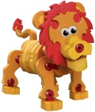




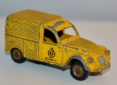
Key to Integer
Choose a random mapping
Hash(key) = i
Universe
of Keys
If the key is an object in memory,
you can use its address in memory
as the key.
…

Slide 37
Handling Collisions
Input
⟨key, value⟩
Handling Collisions
When different data items are mapped to the same cell
⟨394,v₁⟩
Universe
of Keys
⟨482,v₂⟩
⟨ 583,v₃⟩
0
1
2
3
4
5
6
7
8
9
₀
₁
₂
₃
₄
₅
₆
₇
₈
₉
₁₀
⟨394,v₁⟩
⟨583, v₃⟩
⟨482,v₂⟩
…

Slide 38
Separate Chaining
Input
⟨key, value⟩
Separate Chaining
Each cell uses external memory to store all the data items hitting that cell.
⟨394,v₁⟩
Universe
of Keys
⟨482,v₂⟩
⟨ 583,v₃⟩
0
1
2
3
4
5
6
7
8
9
₀
₁
₂
₃
₄
₅
₆
₇
₈
₉
₁₀
⟨394,v₁⟩
⟨394,v₁⟩
⟨ 583,v₃⟩
⟨583, v₃⟩
⟨482,v₂⟩
⟨482,v₂⟩
  Simple
  but requires additional memory
…

Slide 39
A Sequence of Probes
Input
⟨key, value⟩
Open addressing
The colliding item is placed in a different cell of the table
⟨394,v₁⟩
Universe
of Keys
⟨482,v₂⟩
⟨ 583,v₃⟩
0
1
2
3
4
5
6
7
8
9
₀
₁
₂
₃
₄
₅
₆
₇
₈
₉
₁₀
⟨394,v₁⟩
⟨583, v₃⟩
⟨482,v₂⟩
…

Slide 40
A Sequence of Probes
Input
⟨key, value⟩
Cells chosen by a sequence of probes.
⟨103,v₆⟩
Universe
of Keys
0
1
2
3
4
5
6
7
8
9
put(key k, value v)
i₁ = (a×k mod p) mod N
₀
₁
₂
₃
₄
₅
₆
₇
₈
₉
₁₀
⟨583, v₃⟩
5
⟨290,v₄⟩
Theory people use
i₁ = Hash(key) = (a×key mod p) mod N
⟨394,v₁⟩
N = size of array
p is a prime > |U|
a∈[1,p-1] is randomly chosen
11
1009
⟨482,v₂⟩
832
⟨903,v₅⟩
NextPrime(1000) = 1009
a×key = 832×103 = 85696
85696 mod 1009 = 940
940 mod 11 = 5
…
= i₁

Slide 41
A Sequence of Probes
Input
⟨key, value⟩
Cells chosen by a sequence of probes.
⟨103,v₆⟩
Universe
of Keys
⟨103,v₆⟩
0
1
2
3
4
5
6
7
8
9
put(key k, value v)
i₁ = (a×k mod p) mod N
₀
₁
₂
₃
₄
₅
₆
₇
₈
₉
₁₀
⟨583, v₃⟩
5
⟨290,v₄⟩
⟨394,v₁⟩
1
This was our first in the sequence of probes.
⟨482,v₂⟩
⟨903,v₅⟩
…

Slide 42
A Sequence of Probes
Input
⟨key, value⟩
Double Hash
to get sequence distance d.
⟨103,v₆⟩
Universe
of Keys
0
1
2
3
4
5
6
7
8
9
put(key k, value v)
i₁ = (a×k mod p) mod N
d = (b×k mod q) + 1
₀
₁
₂
₃
₄
₅
₆
₇
₈
₉
₁₀
⟨583, v₃⟩
5
3
⟨290,v₄⟩
A common secondary hash function.
d = Hash₂(key) = (b×key mod q) + 1
⟨394,v₁⟩
1
7
q is a prime < N
+1 to ensure d≠0
b is chosen randomly
⟨482,v₂⟩
⟨903,v₅⟩
…
b = 1
d = 103 mod 7 + 1= 3

Slide 43
A Sequence of Probes
Input
⟨key, value⟩
Double Hash
to get sequence distance d.
⟨103,v₆⟩
Universe
of Keys
0
1
2
3
4
5
6
7
8
9
put(key k, value v)
i₁ = (a×k mod p) mod N
d = (b×k mod q) + 1
for j = 1..N
i = i₁ + (j-1)×d mod N
₀
₁
₂
₃
₄
₅
₆
₇
₈
₉
₁₀
⟨583, v₃⟩
3
5
3
⟨290,v₄⟩
4
⟨394,v₁⟩
1
If N is prime,
this sequence will reach each cell.
5
d=3
⟨482,v₂⟩
⟨903,v₅⟩
2
d=3
…
3

Slide 44
A Sequence of Probes
Input
⟨key, value⟩
Stop this sequence of probes when:
⟨103,v₆⟩
Universe
of Keys
⟨103,v₆⟩
Cell is empty
or
key already there
0
1
2
3
4
5
6
7
8
9
₀
₁
₂
₃
₄
₅
₆
₇
₈
₉
₁₀
⟨583, v₃⟩
3
value
put(key k, value v)
i₁ = (a×k mod p) mod N
d = (b×k mod q) + 1
for j = 1..N
i = i₁ + (j-1)×d mod N
if ( cell(i)==empty )
cell(i) = ⟨k,v⟩
return
if ( cell_{key}(i)==k )
v_{old} = cell_{value}(i)
cell(i) = ⟨k,v⟩
return v_{old}
5
⟨290,v₄⟩
4
3
⟨394,v₁⟩
1
5
⟨482,v₂⟩
⟨903,v₅⟩
2
was not there
…
3

Slide 45
A Sequence of Probes
Input
⟨key, value⟩
A different key gets different “random”
hash values.
⟨103,v₆⟩
Universe
of Keys
⟨115,v₇⟩
⟨115,v₇⟩
0
1
2
3
4
5
6
7
8
9
₀
₁
₂
₃
₄
₅
₆
₇
₈
₉
₁₀
⟨583, v₃⟩
value
put(key k, value v)
i₁ = (a×k mod p) mod N
d = (b×k mod q) + 1
for j = 1..N
i = i₁ + (j-1)×d mod N
if ( cell(i)==empty )
cell(i) = ⟨k,v⟩
return
if ( cell_{key}(i)==k )
v_{old} = cell_{value}(i)
cell(i) = ⟨k,v⟩
return v_{old}
3
⟨290,v₄⟩
1
2
⟨394,v₁⟩
2
⟨103,v₆⟩
⟨482,v₂⟩
3
⟨903,v₅⟩
was not there
4
…

Slide 46
A Sequence of Probes
Input
⟨key, value⟩
Stop this sequence of probes when:
⟨103,v₆⟩
Universe
of Keys
⟨115,v₇⟩
Key is found
⟨103,?⟩
0
1
2
3
4
5
6
7
8
9
₀
₁
₂
₃
₄
₅
₆
₇
₈
₉
₁₀
⟨583, v₃⟩
3
value get(key k)
i₁ = (a×k mod p) mod N
d = (b×k mod q) + 1
for j = 1..N
i = i₁ + (j-1)×d mod N
if ( cell_{key}(i)==k )
return(cell_{value}(i))
5
⟨290,v₄⟩
4
3
⟨394,v₁⟩
1
⟨103,v₆⟩
5
⟨482,v₂⟩
⟨903,v₅⟩
2
⟨115,v₇⟩
…

Slide 47
A Sequence of Probes
Input
⟨key, value⟩
Stop this sequence of probes when:
⟨103,v₆⟩
Universe
of Keys
⟨115,v₇⟩
Key is found
⟨103,?⟩
or
cell is empty
0
1
2
3
4
5
6
7
8
9
₀
₁
₂
₃
₄
₅
₆
₇
₈
₉
₁₀
⟨583, v₃⟩
2
⟨477,?⟩
value get(key k)
i₁ = (a×k mod p) mod N
d = (b×k mod q) + 1
for j = 1..N
i = i₁ + (j-1)×d mod N
if ( cell_{key}(i)==k )
return(cell_{value}(i))
if ( cell(i)==empty )
return not there
6
⟨290,v₄⟩
7
5
5
⟨394,v₁⟩
3
⟨103,v₆⟩
1
⟨482,v₂⟩
⟨903,v₅⟩
⟨115,v₇⟩
6
…
X
4

Slide 48
A Sequence of Probes
Input
⟨key, value⟩
⟨103,v₆⟩
Universe
of Keys
⟨115,v₇⟩
⟨103,?⟩
0
1
2
3
4
5
6
7
8
9
₀
₁
₂
₃
₄
₅
₆
₇
₈
₉
₁₀
⟨583, v₃⟩
1
⟨477,?⟩
value del(key k)
i₁ = (a×k mod p) mod N
d = (b×k mod q) + 1
for j = 1..N
i = i₁ + (j-1)×d mod N
if ( cell_{key}(i)==k )
v_{old} = cell_{value}(i)
cell(i) = empty
return(v_{old})
Del 583
1
⟨290,v₄⟩
5
⟨394,v₁⟩
⟨103,v₆⟩
⟨482,v₂⟩
⟨903,v₅⟩
⟨115,v₇⟩
…

Slide 49
A Sequence of Probes
Input
⟨key, value⟩
Stop this sequence of probes when:
⟨103,v₆⟩
Universe
of Keys
⟨115,v₇⟩
Key is found
⟨103,?⟩
or
cell is empty
0
1
2
3
4
5
6
7
8
9
₀
₁
₂
₃
₄
₅
₆
₇
₈
₉
₁₀
X
3
deleted
⟨477,?⟩
value get(key k)
i₁ = (a×k mod p) mod N
d = (b×k mod q) + 1
for j = 1..N
i = i₁ + (j-1)×d mod N
if ( cell_{key}(i)==k )
return(cell_{value}(i))
if ( cell(i)==empty )
return not there
Del 583
5
⟨103,?⟩
⟨290,v₄⟩
4
3
⟨394,v₁⟩
1
⟨103,v₆⟩
5
⟨482,v₂⟩
⟨903,v₅⟩
2
⟨115,v₇⟩
…
Oops!
It no longer finds 103.

Slide 50
A Sequence of Probes
Input
⟨key, value⟩
⟨103,v₆⟩
Universe
of Keys
⟨115,v₇⟩
⟨103,?⟩
0
1
2
3
4
5
6
7
8
9
₀
₁
₂
₃
₄
₅
₆
₇
₈
₉
₁₀
⟨583, v₃⟩
1
deleted
⟨477,?⟩
value del(key k)
i₁ = (a×k mod p) mod N
d = (b×k mod q) + 1
for j = 1..N
i = i₁ + (j-1)×d mod N
if ( cell_{key}(i)==k )
v_{old} = cell_{value}(i)
cell(i) =
return(v_{old})
Del 583
1
⟨290,v₄⟩
5
⟨394,v₁⟩
⟨103,v₆⟩
⟨482,v₂⟩
⟨903,v₅⟩
deleted
⟨115,v₇⟩
…

Slide 51
A Sequence of Probes
Input
⟨key, value⟩
Stop this sequence of probes when:
⟨103,v₆⟩
Universe
of Keys
⟨115,v₇⟩
Key is found
⟨103,?⟩
or
cell is empty
0
1
2
3
4
5
6
7
8
9
₀
₁
₂
₃
₄
₅
₆
₇
₈
₉
₁₀
deleted
3
⟨477,?⟩
value get(key k)
i₁ = (a×k mod p) mod N
d = (b×k mod q) + 1
for j = 1..N
i = i₁ + (j-1)×d mod N
if ( cell_{key}(i)==k )
return(cell_{value}(i))
if ( cell(i)==empty )
return not there
Del 583
5
⟨103,?⟩
⟨290,v₄⟩
4
3
⟨394,v₁⟩
1
⟨103,v₆⟩
5
⟨482,v₂⟩
⟨903,v₅⟩
2
⟨115,v₇⟩
…
Excellent!

Slide 52
A Sequence of Probes
Input
⟨key, value⟩
Stop this sequence of probes when:
⟨103,v₆⟩
Universe
of Keys
Cell is empty
⟨115,v₇⟩
or
deleted
⟨103,?⟩
or
key already there
0
1
2
3
4
5
6
7
8
9
₀
₁
₂
₃
₄
₅
₆
₇
₈
₉
₁₀
deleted
2
⟨477,?⟩
value
put(key k, value v)
i₁ = (a×k mod p) mod N
d = (b×k mod q) + 1
for j = 1..N
i = i₁ + (j-1)×d mod N
if ( cell(i)==empty
cell(i) = ⟨k,v⟩
return
if ( cell_{key}(i)==k )
v_{old} = cell_{value}(i)
cell(i) = ⟨k,v⟩
return v_{old}
Del 583
7
⟨103,?⟩
⟨290,v₄⟩
4
⟨115,v₈⟩
⟨115,v₈⟩
⟨115,v₈⟩
3
⟨394,v₁⟩
⟨103,v₆⟩
)
or deleted)
⟨482,v₂⟩
1
⟨903,v₅⟩
was not there
⟨115,v₇⟩
…

Slide 53
  Iterator
Input
⟨key, value⟩
The time to iterate over all items in the data structure
(in order appearing in array)
= the size of the array N
= O(# of data time)
(because rehashing keeps the load factor O(1))
Universe
of Keys
0
1
2
3
4
5
6
7
8
9
₀
₁
₂
₃
₄
₅
₆
₇
₈
₉
₁₀
⟨394,v₁⟩
⟨193,v₃⟩
⟨472,v₄⟩
⟨938,v₂⟩
⟨873,v₅⟩
…
⟨093,v₆⟩

Slide 54
Running Time
Input
⟨key, value⟩
The load factor
r = n/N < 0.9
# data items / # of array cells.
Universe
of Keys
0
1
2
3
4
5
6
7
8
9
₀
₁
₂
₃
₄
₅
₆
₇
₈
₉
₁₀
N = 11
⟨394,v₁⟩
n = 6
⟨193,v₃⟩
r = 6/11
⟨472,v₄⟩
⟨938,v₂⟩
⟨873,v₅⟩
…
⟨093,v₆⟩

Slide 55
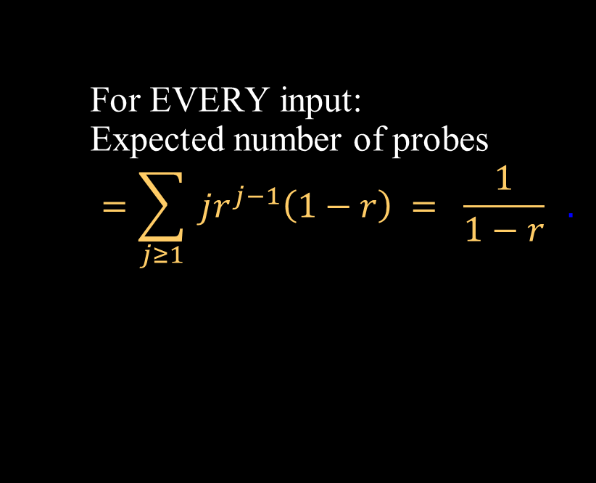
Running Time
Input
⟨key, value⟩
The load factor
r = n/N < 0.9
# data items / # of array cells.
Universe
of Keys
0
1
2
3
4
5
6
7
8
9
₀
₁
₂
₃
₄
₅
₆
₇
₈
₉
₁₀
For EVERY input:
Expected number of probes
$$=\sum_{j≥1}{ jr^{j−1}\left(1−r\right) = \frac{1}{1−r}} .$$
⟨394,v₁⟩
⟨193,v₃⟩
= O(1)
⟨472,v₄⟩
# of probes
Probability j-1 probes collide
Probability j^{th} probe
does not collide
⟨938,v₂⟩
⟨873,v₅⟩
…
⟨093,v₆⟩

Slide 56
Running Time
Input
⟨key, value⟩
The load factor
r = n/N < 0.9
# data items / # of array cells.
Universe
of Keys
0
1
2
3
4
5
6
7
8
9
₀
₁
₂
₃
₄
₅
₆
₇
₈
₉
₁₀
For EVERY input:
Expected number of probes
$$=\sum_{j≥1}{ jr^{j−1}\left(1−r\right) = \frac{1}{1−r}} .$$
⟨394,v₁⟩
⟨193,v₃⟩
= O(1)
⟨472,v₄⟩
Actually these calculations require Hash to be purely random.
If only the a is random then we only have
pair-wise independence.
If p >> n, then Jeff think the result may still be true, but he is not sure.
⟨938,v₂⟩
⟨873,v₅⟩
…
⟨093,v₆⟩

Slide 57
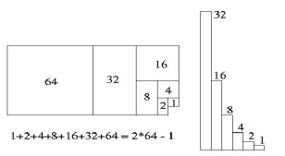
Running Time
Input
⟨key, value⟩
When the load factor gets bigger than some threshold,
rehash all items into an array that is double the size.
Universe
of Keys
0
1
2
3
4
5
6
7
8
9
₀
₁
₂
₃
₄
₅
₆
₇
₈
₉
₁₀
Total cost of doubling
= 1 + 2 + 4 + 8 + 16 + … + n
= 2n-1
amortized time
= TotalTime(n)/n
= (2n-1)/n = O(1).
⟨394,v₁⟩
⟨193,v₃⟩
⟨472,v₄⟩
⟨938,v₂⟩
⟨873,v₅⟩
…
⟨093,v₆⟩

Slide 58
Simpler Hash Functions
Input
⟨key, value⟩
There are simpler hash functions.
⟨103,v₆⟩
Universe
of Keys
⟨115,v₇⟩
⟨103,?⟩
0
1
2
3
4
5
6
7
8
9
₀
₁
₂
₃
₄
₅
₆
₇
₈
₉
₁₀
⟨115,v₈⟩
⟨477,?⟩
value
put(key k, value v)
i₁ = (a×k mod p) mod N
d = (b×k mod q) + 1
for j = 1..N
i = i₁ + (j-1)×d mod N
Del 583
⟨103,?⟩
⟨290,v₄⟩
⟨115,v₈⟩
⟨394,v₁⟩
⟨103,v₆⟩
⟨482,v₂⟩
i₁ = key mod N
for table size N prime,
could be perfectly fine.
⟨903,v₅⟩
⟨115,v₇⟩
…

Slide 59
Simpler Hash Functions
Input
⟨key, value⟩
There are simpler hash functions.
⟨103,v₆⟩
Universe
of Keys
⟨115,v₇⟩
⟨103,?⟩
0
1
2
3
4
5
6
7
8
9
₀
₁
₂
₃
₄
₅
₆
₇
₈
₉
₁₀
⟨115,v₈⟩
⟨477,?⟩
value
put(key k, value v)
i₁ = (a×k mod p) mod N
d = (b×k mod q) + 1
for j = 1..N
i = i₁ + (j-1)×d mod N
Del 583
⟨103,?⟩
⟨290,v₄⟩
1
⟨115,v₈⟩
⟨394,v₁⟩
⟨103,v₆⟩
⟨482,v₂⟩
d = 1
is called
Linear Probing
⟨903,v₅⟩
⟨115,v₇⟩
…
The items tend to clump.

Slide 60
Simpler Hash Functions
Input
⟨key, value⟩
There are simpler hash functions.
Universe
of Keys
0
1
2
3
4
5
6
7
8
9
₀
₁
₂
₃
₄
₅
₆
₇
₈
₉
₁₀
value
put(key k, value v)
i₁ = (a×k mod p) mod N
d = (b×k mod q) + 1
for j = 1..N
i = i₁ + (j-1)×d mod N
1
1
⟨394,v₁⟩
1
1
⟨193,v₃⟩
1
⟨472,v₄⟩
1
d = 1
is called
Linear Probing
⟨938,v₂⟩
1
⟨873,v₅⟩
…
⟨093,v₆⟩
The items tend to clump.

Slide 61
Simpler Hash Functions
Input
⟨key, value⟩
There are harder hash functions.
⟨103,v₆⟩
Universe
of Keys
⟨115,v₇⟩
⟨103,?⟩
0
1
2
3
4
5
6
7
8
9
₀
₁
₂
₃
₄
₅
₆
₇
₈
₉
₁₀
⟨115,v₈⟩
0
⟨477,?⟩
value
put(key k, value v)
i₀ = (a×k mod p) mod N
d = (b×k mod q) + 1
for j = 1..N
i = i₀ + (j-1)×d mod N
⟨290,v₄⟩
1
Del 583
⟨298,v₄⟩
⟨103,?⟩
⟨350,v₄⟩
⟨115,v₈⟩
⟨892,v₄⟩
2
⟨394,v₁⟩
⟨103,v₆⟩
i = i₀ + j² mod N
⟨482,v₂⟩
⟨903,v₅⟩
⟨115,v₇⟩
3
…
⟨993,v₄⟩
4

Slide 62
  End

