Slide 1
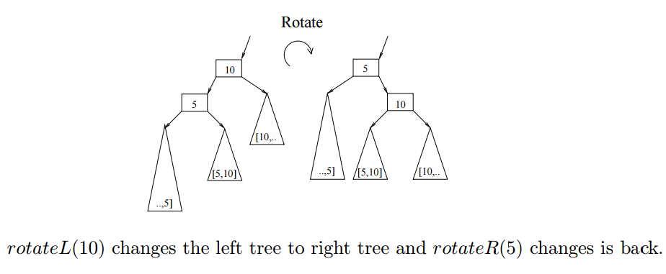
Balanced Trees
Dictionary/Map ADT
Binary Search Trees
Insertions and Deletions
AVL Trees
Rebalancing AVL Trees
Union-Find Partition
Heaps & Priority Queues
Communication & Hoffman Codes
(Splay Trees)
Jeff Edmonds
York University
Lecture 6
COSC 2011

Slide 2
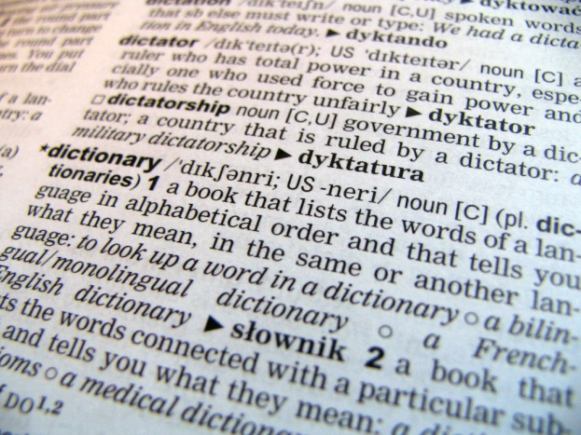


Dictionary/Map ADT
Input
⟨key, value⟩
Problem: Store value/data
associated with keys.
⟨k₁,v₁⟩
⟨k₂,v₂⟩
⟨k₃,v₃⟩
⟨k₄,v₄⟩
Examples:
key = word, value = definition
key = social insurance number
value = person’s data

Slide 3
Dictionary/Map ADT
Input
⟨key, value⟩
Array
Problem: Store value/data
associated with keys.
⟨k₁,v₁⟩
⟨k₂,v₂⟩
⟨k₃,v₃⟩
⟨k₄,v₄⟩
₀
₁
₂
₃
₄
₅
₆
₇
⟨k₅,v₅⟩
…
Implementations:
Insert
Search
Unordered Array
O(1)
O(n)

Slide 4
Dictionary/Map ADT
Input
⟨key, value⟩
Array
Problem: Store value/data
associated with keys.
⟨2,v₃⟩
⟨4,v₄⟩
⟨7,v₁⟩
⟨9,v₂⟩
₀
₁
₂
₃
₄
₅
₆
₇
⟨6,v₅⟩
…
Implementations:
Insert
Search
Unordered Array
O(1)
O(n)
Ordered Array
O(n)
O(logn)

Slide 5
Dictionary/Map ADT
Input
⟨key, value⟩
trailer
header
nodes/positions
Problem: Store value/data
associated with keys.
⟨2,v₃⟩
⟨4,v₄⟩
⟨7,v₁⟩
⟨9,v₂⟩
entries
⟨6,v₅⟩
Implementations:
Insert
Search
Unordered Array
O(1)
O(n)
Ordered Array
O(n)
O(logn)
Ordered Linked List
O(n)
O(n)
Inserting is O(1) if you have the spot.
but O(n) to find the spot.

Slide 6
Dictionary/Map ADT
Input
⟨key, value⟩
Problem: Store value/data
associated with keys.
⟨2,v₃⟩
⟨4,v₄⟩
⟨7,v₁⟩
⟨9,v₂⟩
38
25
51
17
31
42
63
4
21
28
35
40
49
55
71
Implementations:
Insert
Search
Unordered Array
O(1)
O(n)
Ordered Array
O(n)
O(logn)
Binary Search Tree
O(logn)
O(logn)

Slide 7
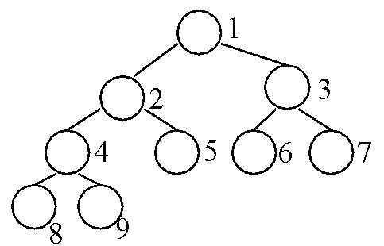

Dictionary/Map ADT
Input
⟨key, value⟩
Problem: Store value/data
associated with keys.
⟨2,v₃⟩
⟨4,v₄⟩
⟨7,v₁⟩
⟨9,v₂⟩
Heaps are good
for Priority Queues.
Implementations:
Insert
Search
Unordered Array
O(1)
O(n)
Ordered Array
O(n)
O(logn)
Binary Search Tree
O(logn)
O(logn)
Heaps
Faster: O(logn)
O(n)
Max O(1)

Slide 8
Dictionary/Map ADT
Input
⟨key, value⟩
Problem: Store value/data
associated with keys.
⟨2,v₃⟩
⟨4,v₄⟩
⟨7,v₁⟩
⟨9,v₂⟩
Hash Tables are very fast,
but keys have no order.
Implementations:
Insert
Search
Next
Unordered Array
O(1)
O(n)
Ordered Array
O(n)
O(logn)
O(1)
Binary Search Tree
O(logn)
O(logn)
O(1) (Avg)
Heaps
Faster: O(logn)
Max O(1)
Hash Tables
Avg: O(1)
O(1)
O(n)

Slide 9

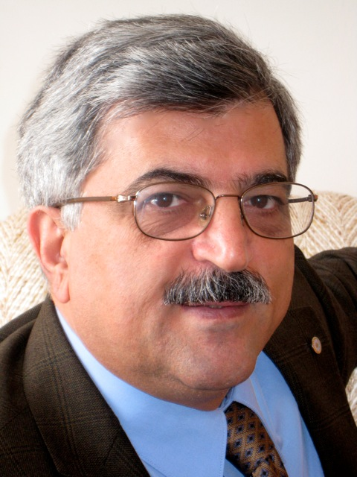
I learned AVL trees from slides from
Andy Mirzaian and James Elder and then reworked them

Slide 10
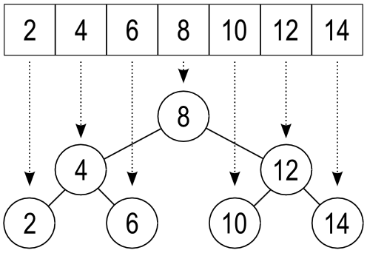
From binary search to
Binary Search Trees

Slide 11
Binary Search Tree
All nodes in left subtree ≤ Any node ≤ All nodes in right subtree
38
≤
≤
≤
25
51
17
31
42
63
4
21
28
35
40
49
55
71

Slide 12

Iterative Algorithm
Move down the tree.
Loop Invariant:
If the key is contained in the original tree,
then the key is contained in the sub-tree
rooted at the current node.
Algorithm TreeSearch(k, v)
v = T.root()
loop
if T.isExternal (v)
  return “not there”
  if k < key(v)
  v = T.left(v)
  else if k = key(v)
  return v
  else { k > key(v) }
  v = T.right(v)
  end loop
38
key 17
25
51
17
31
42
63
4
21
28
35
40
49
55
71

Slide 13
Recursive Algorithm
If the key is not at the root, ask a friend to look for it in the appropriate subtree.
Algorithm TreeSearch(k, v)
if T.isExternal (v)
  return “not there”
  if k < key(v)
  return TreeSearch(k, T.left(v))
  else if k = key(v)
  return v
  else { k > key(v) }
  return TreeSearch(k, T.right(v))
38
key 17
25
51
17
31
42
63
4
21
28
35
40
49
55
71

Slide 14
Insertions/Deletions
Insert 10
To insert(key, data):
We search for key.
Not being there,
we end up in an empty tree.
Insert the key there.
1
v
3
2
11
9
12
w
8
10
4
6
5
7

Slide 15
Insertions/Deletions
Delete 4
To Delete(key_{del}, data):
If it does not have two children,
  point its one child at its parent.
1
v
3
2
11
9
12
w
>
8
10
key_{del}
4
6
5
7

Slide 16
Insertions/Deletions
Delete 3
To Delete(key_{del}, data):
else find the next key_{next} in order
  right left left left …. to empty tree
Replace key_{del} to delete with key_{next}
  point key_{next}’s one child at its parent.
1
key_{del}
3
2
11
9
12
w
>
8
10
key_{next}
4
6
5
7

Slide 17
Performance
find, insert and remove take O(height) time
In a balanced tree, the height is O(log n)
In the worst case, it is O(n)
Thus it worthwhile to balance the tree (next topic)!

Slide 18
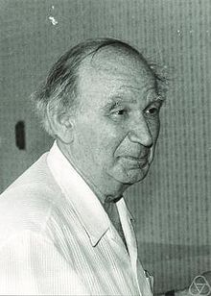
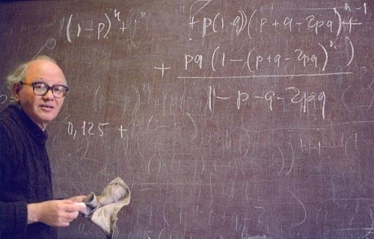
AVL Trees
The AVL tree is the first balanced binary search tree ever invented.
It is named after its two inventors, G.M. Adelson-Velskii and E.M. Landis, who published it in their 1962 paper "An algorithm for the organization of information.”

Slide 19
AVL Trees
AVL trees are “mostly” balanced.
Tree is said to be an AVL Tree if and only if
heights of siblings differ by at most 1.
height(v) = height of the subtree rooted at v.
balanceFactor(v)
= height(height(leftChild(v) - rightChild(v)))
Tree is said to be an AVL Tree if and only if
∀v balanceFactor(v) ∈ { -1,0,1 }.
balanceFactor = 2-3 =
-1
44
subtree
height
-1
+1
0-1=
subtree
height
2
3
17
78
0
1
0
0
0
32
50
88
0
0
48
62

Slide 20
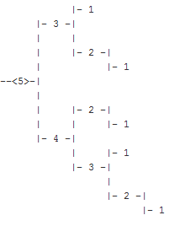
Height of an AVL Tree
Claim: The height of an AVL tree storing n keys is ≤ O(log n).
Proof: Let N(h) be the minimum the # of nodes of an AVL tree of height h.
Observe that N(0) = 0 (∅) and N(1) = 1 ( • )
For h ≥ 2, the minimal AVL tree contains
  the root node,
  one minimal AVL subtree of height h – 1,
  another of height h - 2.
That is, N(h) = 1 + N(h - 1) + N(h - 2)
> N(h - 1) + N(h - 2)
= Fibonacci(h) ≈ 1.62^{h}.
n ≥ 1.62^{h}
h ≤ log(n)/log(1.62) = 4.78 log(n)
Thus the height of an AVL tree is O(log n)
balanceFactor ≤ 1 = (h-1)-(h-2)
height = h
At least one of its
subtrees has height
h-1
h-2

Slide 21
Rebalancing
Changes heights/balanceFactors
    Subtree [..,5] raises up one
    Subtree [5,10] height does not change
    Subtree [10,..] lowers one
Does not change Binary Tree Ordering.

Slide 22
Rebalancing after an Insertion
Inserting new leaf 2 in to AVL tree
may create an imbalance.
balanceFactor = 3-1 = 2
2-2 = 0
No longer
an AVL Tree
7
rotateR(7)
4
1-1 = 0
subtree
height
1
2
3
4
Problem!
8
2
3
7
T₃
1
1
3
5
2
T₁
5
8
T₂
T₂
T₃
2
Rebalanced into
an AVL tree again.
T₁

Slide 23
Rebalancing after an Insertion
Try another example.
Inserting new leaf 6 in to AVL tree
Oops!
Not an AVL Tree.
balanceFactor = 3-1 = 2
1-3 = -2
7
rotateR(7)
4
8
1
3
4
Problem!
3
7
T₃
T₁
3
5
5
8
T₁
T₃
T₂
6
T₀
T₂
6

Slide 24
Rebalancing after an Insertion
There are 6 cases.
  Two are easier
balanceFactor ∈{-2,+2}
7
rotateR(7)
4
balanceFactor ∈{-1,0,+1}
4
Problem!
8
3
7
T₃
T₁
3
5
5
8
T₁
T₃
T₂
6
T₀
T₂
6

Slide 25
Rebalancing after an Insertion
There are 6 cases.
  Two are easier
  Half are symmetrically the same.
  This leaves two.
+2
+2
-2
-2
height
= h
height
= h
height
= h
height
= h
z
z
z
z
+1
-1
-1
+1
h-1
y
h-3
h-1
y
h-3
h-1
y
h-3
h-1
y
h-3
T₃
T₃
T₀
T₀
h-2
x
h-3
h-3
h-2
x
h-2
x
h-3
h-3
h-2
x
T₂
T₀
T₁
T₃
T₀
T₁
T₁
T₂
T₃
T₂
T₂
T₁
one is h-3 & one is h-4
one is h-3 & one is h-4
one is h-3 & one is h-4
one is h-3 & one is h-4

Slide 26
Rebalancing after an Insertion
Inserting new leaf 2 in to AVL tree
may create an imbalance in path from leaf to root.
+2
7
+1
4
Problem!
8
+1
3
5
0
balanceFactor
2
Increases heights
along path from leaf to root.

Slide 27
Rebalancing after an Insertion
The repair strategy called trinode restructuring
+2
7
4
Problem!
8
3
5
  Denote
    z = the lowest imbalanced node
    y = the child of z with highest subtree
    x = the child of y with highest subtree
2

Slide 28
Rebalancing after an Insertion
The repair strategy called trinode restructuring
Def^{n}: h = height
z
h-1
y
At least one of its
subtrees has height h-1
T₃
x
    y = the child of z with highest subtree
T₂
T₁

Slide 29
Rebalancing after an Insertion
The repair strategy called trinode restructuring
balanceFactor
+2
balanceFactor ∉ {-1,0,1}
but only got one worse with insertion
balanceFactor ∈ {-2,2}
By way of symmetry assume 2.
Def^{n}: h = height
z
Assume
balanceFactor
+1
h-1
y
h-3
balanceFactor ∉ {-1,0,1}
Cases:
balanceFactor = +1 we do now.
balanceFactor = -1 we will do later.
balanceFactor = 0 is the same as -1.
T₃
h-2
x
h-3
    z = the lowest imbalanced node
    x = the child of y with highest subtree
T₂
T₁

Slide 30
Rebalancing after an Insertion
The repair strategy called trinode restructuring
z
h-1
y
rotateR(z)
y
h-2
x
z
h-3
y ≤ z
h-2
T₃
h-2
x
h-3
T₁
h-3
h-3
T₂
T₂
T₃
T₁
This subtree is balanced.
T₁ ≤ y ≤ T₂ ≤ z ≤ T₃

Slide 31
Rebalancing after an Insertion
Rest of Tree
Rest of Tree
h
z
h-1
y
y
x
z
T₃
x
T₁
T₂
T₂
T₃
T₁
This subtree is balanced.
Is the rest of the tree sufficiently
balanced to make it an AVL tree?
Before the insert it was.
Insert made this subtree one higher.
Our restructuring made it
Hence the whole tree is an AVL Tree
back to the original height.

Slide 32
Rebalancing after an Insertion
Try another example.
Inserting new leaf 6 in to AVL tree
7
4
8
3
5
6

Slide 33
Rebalancing after an Insertion
Try another example.
Inserting new leaf 6 in to AVL tree
Oops!
Not an AVL Tree.
balanceFactor = 1-3 = -2
z
y
rotateR(z)
y
8
3
z
T₃
T₁
3
5
5
8
T₁
T₃
6
T₀
T₂
T₂
6

Slide 34
Rebalancing after an Insertion
Try another example.
Inserting new leaf 6 in to AVL tree
+2
7
-1
4
Problem!
8
-1
3
5
0
6
balanceFactor
Increases heights
along path from leaf to root.

Slide 35
Rebalancing after an Insertion
The repair strategy called trinode restructuring
+2
7
-1
4
Problem!
8
-1
3
5
  Denote
    z = the lowest imbalanced node
    y = the child of z with highest subtree
    x = the child of y with highest subtree
6

Slide 36
Rebalancing after an Insertion
The repair strategy called trinode restructuring
balanceFactor
+2
z
Def^{n}: h = height
Assume second case
balanceFactor
-1
h-1
y
h-3
T₄
h-3
h-2
x
    z = the lowest imbalanced node
    y = the child of z with highest subtree
    x = the child of y with highest subtree
T₁
T₂
T₃
one is h-3 & one maybe h-4

Slide 37
Rebalancing after an Insertion
The repair strategy called trinode restructuring
z
y ≤ x ≤ z
y
h-3
T₄
h-3
x
T₁
rotateL(y)
z
T₂
T₃
x
one is h-3 & one maybe h-4
y

Slide 38
Rebalancing after an Insertion
The repair strategy called trinode restructuring
z
x
y ≤ x ≤ z
y
h-3
y
z
T₄
rotateR(z)
h-3
x
T₁
rotateL(y)
z
T₂
T₃
x
one is h-3 & one maybe h-4
y

Slide 39
Rebalancing after an Insertion
The repair strategy called trinode restructuring
Rest of Tree
Rest of Tree
height = h
z
h-1
x
y
h-3
h-2
y
h-2
z
T₄
h-3
x
h-3
h-3
T₁
T₁
T₂
T₃
T₄
one is h-3 & one maybe h-4
T₂
T₃
This subtree is balanced.
And shorter by one.
Hence the whole is an AVL Tree
one is h-3 & one maybe h-4
T₁ ≤ y ≤ T₂ ≤ z ≤ T₃

Slide 40
Rebalancing after an Insertion
Example: Insert 12
5
7
4
3
2
19
2
3
1
2
13
31
1
3
2
1
1
1
9
15
23
4
1
1
0
0
0
0
8
11
0
0
0
0
0
0
0
0
0
0

Slide 41
Rebalancing after an Insertion
Example: Insert 12
5
7
4
3
2
19
2
3
1
2
13
31
1
3
2
1
1
1
9
15
23
4
1
1
0
0
0
0
8
11
0
0
0
0
0
0
w
0
0
0
0
Step 1.1: top-down search

Slide 42
Rebalancing after an Insertion
Example: Insert 12
5
7
4
3
2
19
2
3
1
2
13
31
1
3
2
1
1
1
9
15
23
4
1
1
0
0
0
0
8
11
0
0
0
0
0
0
1
w
12
0
0
0
0
0
Step 1.2: expand $w$ and insert new item in it

Slide 43
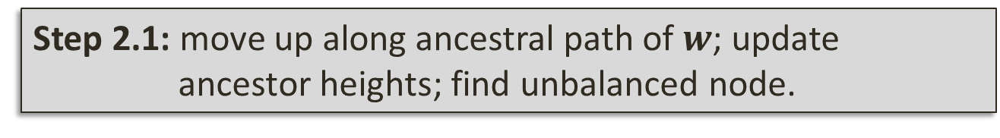
Rebalancing after an Insertion
Example: Insert 12
5
7
4
3
2
19
2
4
1
2
13
31
1
3
3
imbalance
1
1
1
9
15
23
4
1
2
0
0
0
0
8
11
0
0
0
0
0
0
1
w
12
0
0
0
0
0
Step 2.1: move up along ancestral path of $w$; update
ancestor heights; find unbalanced node.

Slide 44
Rebalancing after an Insertion
Example: Insert 12
5
7
4
3
2
19
2
4
1
2
z
13
31
1
3
3
y
1
1
1
9
15
23
4
1
2
0
0
0
0
8
x
11
0
0
0
0
0
0
1
12
0
0
0
0
0
Step 2.2: trinode discovered (needs double rotation)

Slide 45
Rebalancing after an Insertion
Example: Insert 12
5
7
4
3
2
19
2
3
1
2
x
31
11
1
3
2
2
1
y
z
1
9
13
23
4
1
1
0
0
0
0
1
8
12
15
0
0
0
0
0
0
0
0
0
0
0
Step 2.3: trinode restructured; balance restored. DONE!

Slide 46
Rebalancing after a deletion
Very similar to before.
  Unfortunately, trinode restructuring may reduce the height of the subtree, causing another imbalance further up the tree.
  Thus this search and repair process must in the worst case be repeated until we reach the root.
  See text for implementation.

Slide 47
Running Times for AVL Trees
a single restructure is O(1)
  using a linked-structure binary tree
find is O(log n)
  height of tree is O(log n), no restructures needed
insert is O(log n)
  initial find is O(log n)
  Restructuring is O(1)
remove is O(log n)
  initial find is O(log n)
  Restructuring up the tree, maintaining heights is O(log n)

Slide 48
Other Similar Balanced Trees
  Red-Black Trees
    Balanced because of rules about red and black nodes
  (2-4) Trees
    Balanced by having between 2 and 4 children
  Splay Trees
    Moves used nodes to the root.

Slide 49
Union-Find Partition Structures

Slide 50
Partitions with Union-Find Operations
makeSet(x): Create a singleton set containing the element x and return the position storing x in this set
union(A,B ): Return the set A U B, destroying the old A and B
find(p): Return the set containing the element at position p

Slide 51
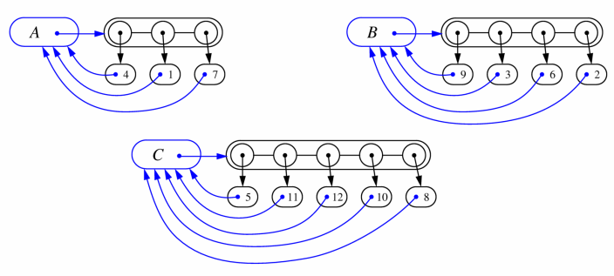
List-based Implementation
Each set is stored in a sequence represented with a linked-list
Each node should store an object containing the element and a reference to the set name

Slide 52
Analysis of List-based Representation
When doing a union, always move elements from the smaller set to the larger set
  Each time an element is moved it goes to a set of size at least double its old set
  Thus, an element can be moved at most O(log n) times
Total time needed to do n unions and finds is O(n log n).

Slide 53
Tree-based Implementation
Each set is stored as a rooted tree of its elements:
Each element points to its parent.
The root is the “name” of the set.
Example: The sets “1”, “2”, and “5”:
1
2
5
4
7
3
6
8
10
9
11
12

Slide 54
Union-Find Operations
To do a union, simply make the root of one tree point to the root of the other
To do a find, follow set-name pointers from the starting node until reaching a node whose set-name pointer refers back to itself
5
2
8
10
3
6
11
9
12
5
2
8
10
3
6
11
9
12

Slide 55
Union-Find Heuristic 1
Union by size:
  When performing a union, make the root of smaller tree point to the root of the larger
Implies O(n log n) time for performing n union-find operations:
  Each time we follow a pointer,
  we are going to a subtree of size
  at least double the size of the
  previous subtree
  Thus, we will follow at most
  O(log n) pointers for any find.
5
2
8
10
3
6
11
9
12

Slide 56
Union-Find Heuristic 2
Path compression:
  After performing a find, compress all the pointers on the path just traversed so that they all point to the root
Implies O(n log* n) time for performing n union-find operations:
  [Proof is somewhat involved and is covered in EECS 4101]
5
5
8
10
8
10
11
11
2
12
2
12
3
6
3
6
9
9

Slide 57
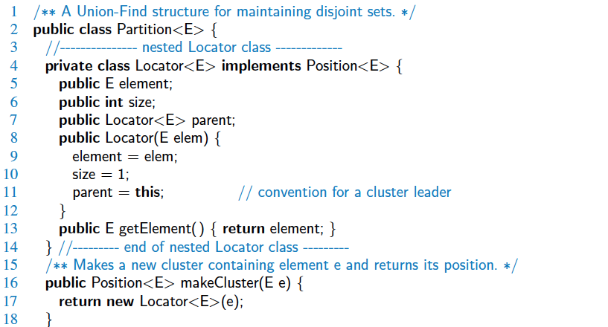
Java Implementation

Slide 58
Heaps, Heap Sort, &
Priority Queues
J. W. J. Williams, 1964
Notes:
58

Slide 59


Abstract Data Types
Restricted Data Structure:
Some times we limit what operation can be done
for efficiency
understanding
Stack: A list, but elements can only be
pushed onto and popped from the top.
Queue: A list, but elements can only be
added at the end and removed from
the front.
Important in handling jobs.
Priority Queue: The “highest priority” element
is handled next.

Slide 60
Priority Queues
 | Sorted List | Unsorted List | Heap
Items arrive with a priority. | O(n) | O(1) | O(logn)
Item removed is that with highest priority. | O(1) | O(n) | O(logn)

Slide 61
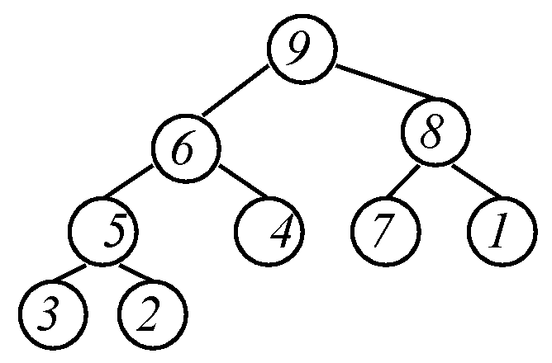
Heap Definition
Completely Balanced Binary Tree
The value of each node
≥ each of the node's children.
Left or right child could be larger.
Where can 9 go?
Maximum is at root.
Where can 1 go?
Where can 8 go?
Notes:
61

Slide 62
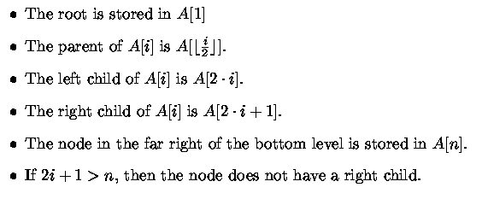
Heap Data Structure
Completely Balanced Binary Tree
Implemented by an Array

Slide 63
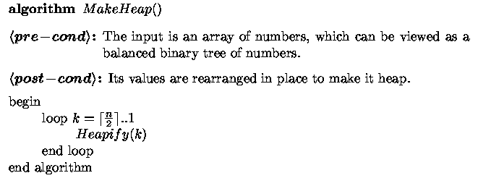
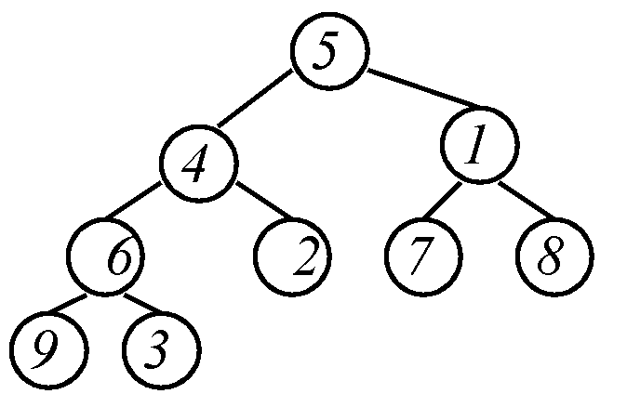
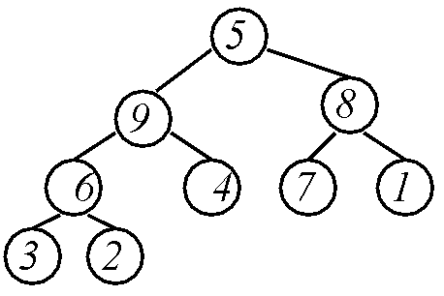
Make Heap
Get help from friends
Notes:
63

Slide 64
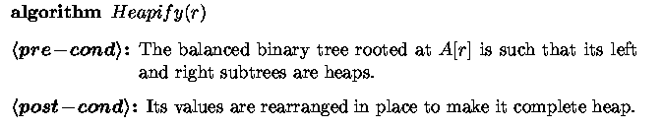
Heapify
Where is the maximum?
Maximum needs
to be at root.
?

Slide 65
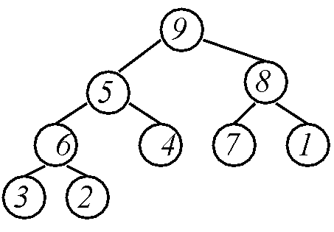
Heapify
Find the maximum.
Put it in place
?
Repeat
The 5 “bubbles” down until it finds its spot.
Notes:
65

Slide 66

Heapify
Heap
The 5 “bubbles” down until it finds its spot.

Slide 67
Heapify
Heap
Running Time:

Slide 68
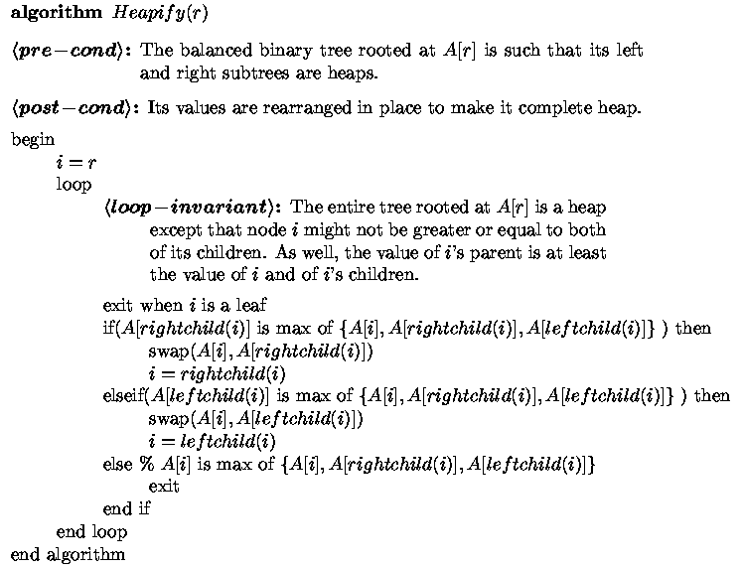
Iterative
Notes:
68

Slide 69
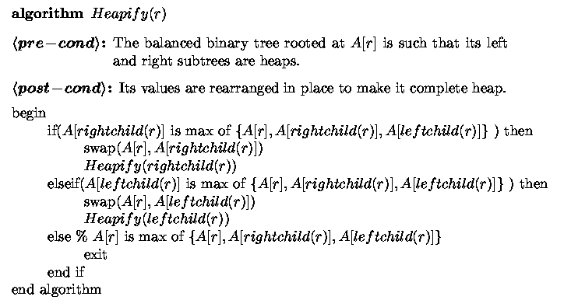
Recursive

Slide 70
Make Heap
Get help from friends

Slide 71
Make Heap
Get help from friends
Heapify

Slide 72
Make Heap
Get help from friends
Heapify
Running time:
T(n) = 2T(n/2) + log(n)
= Θ(n)
Heap

Slide 73
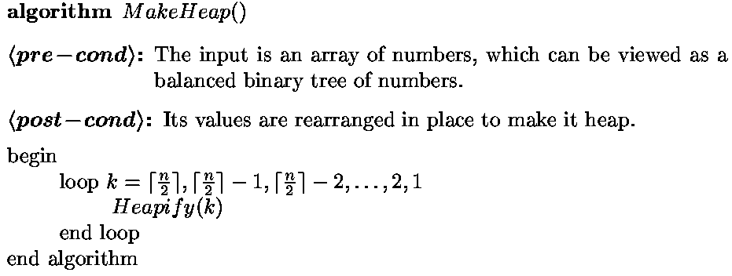

Iterative
?
Heaps
Heap

Slide 74
Iterative
?
Heap
Notes:
74

Slide 75
Iterative
?
Heap

Slide 76
Iterative
?
Notes:
76

Slide 77
Iterative
Heap

Slide 78




Iterative
Running Time:
log(n) -i
2^{log(n) -i}
i
Notes:
78

Slide 79
Heap
Pop/Push/Changes
With Pop, a Priority Queue
returns the highest priority data item.
This is at the root.
21
21

Slide 80
Heap
Pop/Push/Changes
But this is now the wrong shape!
To keep the shape of the tree,
which space should be deleted?

Slide 81
Heap
Pop/Push/Changes
What do we do with the element that was there?
Move it to the root.
3
3

Slide 82
Heap
Pop/Push/Changes
But now it is not a heap!
The left and right subtrees still are heaps.
3
3

Slide 83
Heap
Pop/Push/Changes
But now it is not a heap!
The 3 “bubbles” down until it finds its spot.
The max of these
three moves up.
3
3
Time = O(log n)

Slide 84
Heap
Pop/Push/Changes
When inserting a new item,
to keep the shape of the tree,
which new space should be filled?
21
21

Slide 85
Heap
Pop/Push/Changes
But now it is not a heap!
The 21 “bubbles” up until it finds its spot.
The max of these
two moves up.
30
30
21
21
Time = O(log n)

Slide 86
Adaptable Heap
Pop/Push/Changes
But now it is not a heap!
The 39 “bubbles” down or up until it finds its spot.
Suppose some outside user
knows about
some data item c
and remembers where
it is in the heap.
And changes its priority
from 21 to 39
27
39
21
39
21
c

Slide 87
Adaptable Heap
Pop/Push/Changes
But now it is not a heap!
The 39 “bubbles” down or up until it finds its spot.
Suppose some outside user
also knows about
data item f and its location
in the heap just changed.
The Heap must be able
to find this outside user
and tell him it moved.
39
27
39
27
f
21
c
Time = O(log n)

Slide 88
Heap Implementation
2
d
A location-aware heap entry is an object storing
  key
  value
  position of the entry in the underlying heap
In turn, each heap position stores an entry
Back pointers are updated during entry swaps
4
a
6
b
8
g
5
e
9
c

Slide 89
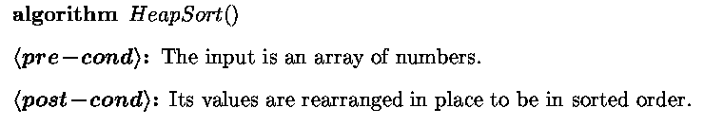
Selection Sort
Selection
Largest i values are sorted on side.
Remaining values are off to side.
Find max value on left
and put into place.
3
5
<
Exit
Exit
1
6,7,8,9
4
79 km
75 km
2
Max is easier to find if a heap.
Notes:
89

Slide 90
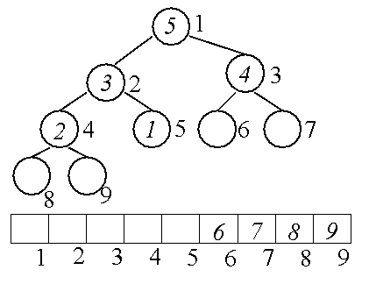
Heap Sort
Largest i values are sorted on side.
Remaining values are in a heap.
Exit
Exit
79 km
75 km

Slide 91
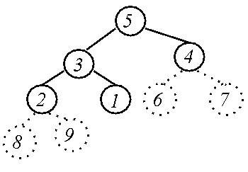
Heap Data Structure
Heap
6
7
Array
8
9
5
3
4
2
1
Heap
Array
Notes:
91

Slide 92
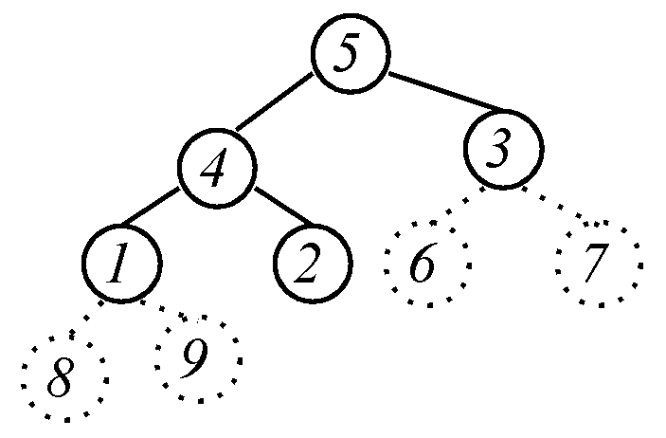
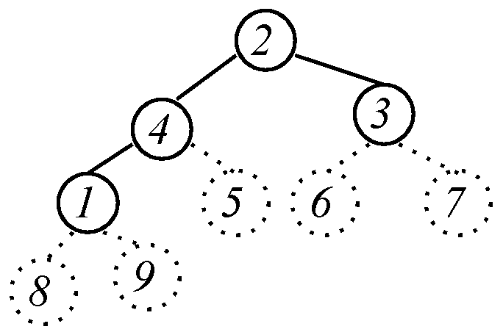



Heap Sort
Largest i values
are sorted on side.
Remaining values are
in a heap.
Exit
Put next value
where it belongs.
?
79 km
75 km
Exit
Heap

Slide 93
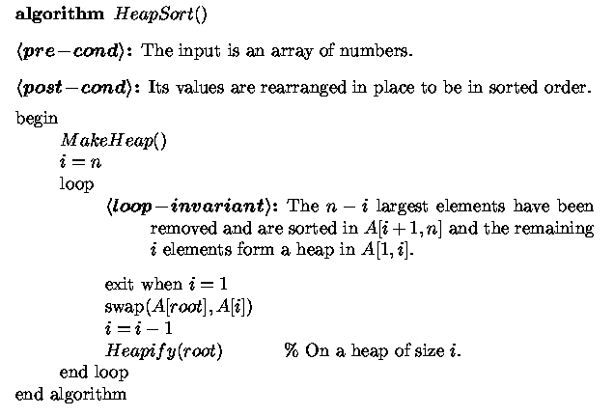

Heap Sort
Notes:
93

Slide 94
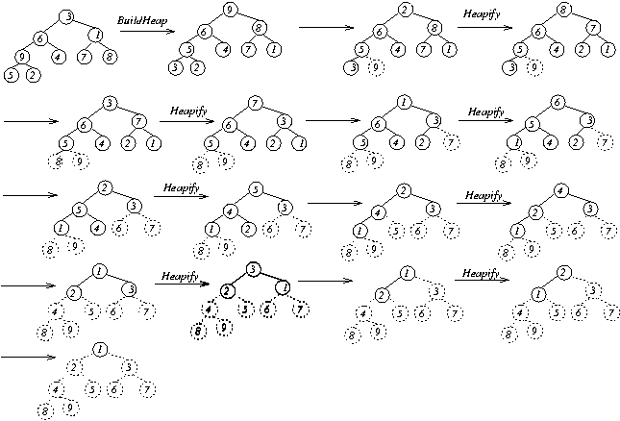
Heap Sort
?
?
?
?
?
?
?
Sorted

Slide 95


Heap Sort
Running Time:
Notes:
95

Slide 96
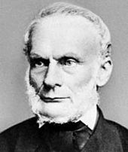


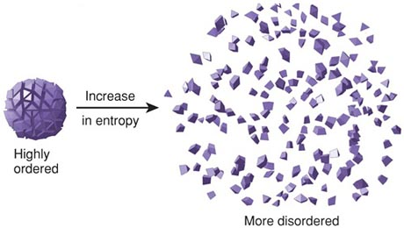
Communication & Entropy
In thermodynamics, entropy is a measure of disorder.
It is a measured as the logarithm of the number of specific ways in which the micro world may be arranged, given the macro world.
Lazare Carnot
(1803)
Purpose for log
#Poss( ) = N
Entropy( ) = log(N)
#Poss( ) =
N²
Entropy( ) = log(N²)
= 2 log(N)
High
entropy
= 2 Entropy( )
Low
entropy

Slide 97
Communication & Entropy
In thermodynamics, entropy is a measure of disorder.
It is a measured as the logarithm of the number of specific ways in which the micro world may be arranged, given the macro world.
Lazare Carnot
(1803)
Tell Uncle Lazare the location and the velocity of each particle.
The log of number of possibilities equals the number of bits to communicate it
Few bits
needed
Lots of bits
needed
01101000
Low
entropy
High
entropy

Slide 98

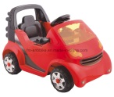



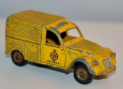
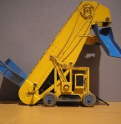

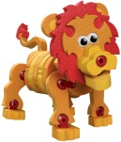
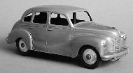




Communication & Entropy
Tell Uncle Shannon which toy you want
Bla bla bla bla bla bla
No. Please use the minimum number of bits to communicate it.
Claude Shannon
(1948)
01101000
Great, but we need a code.
011
Oops. Was that or
011
01
1
…

Slide 99

Communication & Entropy
Use a Huffman Code
described by a binary tree.
00100
Claude Shannon
(1948)
I follow the path and get
0
1
0
1
0
1
0
1
0
1
0
0
0
0
1
0
1
1
1
1

Slide 100

Communication & Entropy
Use a Huffman Code
described by a binary tree.
001000101
Claude Shannon
(1948)
I first get , the I start over to get
0
1
0
1
0
1
0
1
0
1
0
0
0
0
1
0
1
1
1
1

Slide 101
Communication & Entropy
Objects that are more likely will have shorter codes.
I get it.
I am likely to answer .
so you give it a 1 bit code.
Claude Shannon
(1948)
0
1
0
1
0
1
0
1
0
1
0
0
0
0
1
0
1
1
1
1

Slide 102
Communication & Entropy
P_{i} is the probability of the i^{th} toy.
L_{i} is the length of the code for the i^{th} toy.
The expected number of bits sent is
= Σ_{i} p_{i} ⋅ L_{i}
Claude Shannon
(1948)
We choose the code lengths L_{i} to minimized this.
Then we call it the Entropy of
the distribution on toys.
0
1
0
1
0
1
L_{i}
0
1
0
1
0
0
0
0
1
0
1
1
1
1
P_{i} = 0.01
0.01
0.02
0.02
0.08
0.02
0.02
0.031
0.05
0.11
0.13
0.495

Slide 103
Communication & Entropy
Ingredients:
  Instances: Probabilities of objects
  <p₁,p₁,p₂,… ,p_{n}>.
  Solutions: A Huffman code tree.
Cost of Solution: The expected number of bits sent
= Σ_{i} p_{i} ⋅ L_{i}
Goal: Given probabilities, find code with minimum
number of expected bits.

Slide 104

Communication & Entropy
Greedy Algorithm.
Put the objects in a priority queue sorted by probabilities.
Take the two objects with the smallest probabilities.
They should have the longest codes.
Put them in a little tree.
Join them into one object, with the sum probability.
Repeat.
0.025
0.01
0.015
0.02
0.02
0.02
0.02
0.03
0.05
0.08
0.11
0.13
0.495

Slide 105
Communication & Entropy
Greedy Algorithm.
Put the objects in a priority queue sorted by probabilities.
Take the two objects with the smallest probabilities.
They should have the longest codes.
Put them in a little tree.
Join them into one object, with the sum probability.
Repeat.
0.04
0.025
0.02
0.02
0.02
0.02
0.03
0.05
0.08
0.11
0.13
0.495

Slide 106
Communication & Entropy
Greedy Algorithm.
Put the objects in a priority queue sorted by probabilities.
Take the two objects with the smallest probabilities.
They should have the longest codes.
Put them in a little tree.
Join them into one object, with the sum probability.
Repeat.
0.04
0.025
0.04
0.02
0.02
0.03
0.05
0.08
0.11
0.13
0.495

Slide 107
Communication & Entropy
Greedy Algorithm.
Put the objects in a priority queue sorted by probabilities.
Take the two objects with the smallest probabilities.
They should have the longest codes.
Put them in a little tree.
Join them into one object, with the sum probability.
Repeat.
0.055
0.025
0.04
0.04
0.03
0.05
0.08
0.11
0.13
0.495

Slide 108

Communication & Entropy
Greedy Algorithm.
Put the objects in a priority queue sorted by probabilities.
Take the two objects with the smallest probabilities.
They should have the longest codes.
Put them in a little tree.
Join them into one object, with the sum probability.
Repeat.
0.08
0.055
0.04
0.04
0.05
0.08
0.11
0.13
0.495

Slide 109
Communication & Entropy
Greedy Algorithm.
Put the objects in a priority queue sorted by probabilities.
Take the two objects with the smallest probabilities.
They should have the longest codes.
Put them in a little tree.
Join them into one object, with the sum probability.
Repeat.
0.105
0.055
0.08
0.05
0.08
0.11
0.13
0.495

Slide 110
Communication & Entropy
Greedy Algorithm.
Put the objects in a priority queue sorted by probabilities.
Take the two objects with the smallest probabilities.
They should have the longest codes.
Put them in a little tree.
Join them into one object, with the sum probability.
Repeat.
0.16
0.105
0.08
0.08
0.11
0.13
0.495

Slide 111
Communication & Entropy
Greedy Algorithm.
Put the objects in a priority queue sorted by probabilities.
Take the two objects with the smallest probabilities.
They should have the longest codes.
Put them in a little tree.
Join them into one object, with the sum probability.
Repeat.
0.215
0.16
0.105
0.11
0.13
0.495

Slide 112
Communication & Entropy
Greedy Algorithm.
Put the objects in a priority queue sorted by probabilities.
Take the two objects with the smallest probabilities.
They should have the longest codes.
Put them in a little tree.
Join them into one object, with the sum probability.
Repeat.
0.29
0.215
0.16
0.13
0.495

Slide 113
Communication & Entropy
0.505
0.29
0.215
0.495

Slide 114
Communication & Entropy
1
0.505
0.495

Slide 115
Communication & Entropy
Greedy Algorithm.
Done when one object
(of probability 1)
1

Slide 116
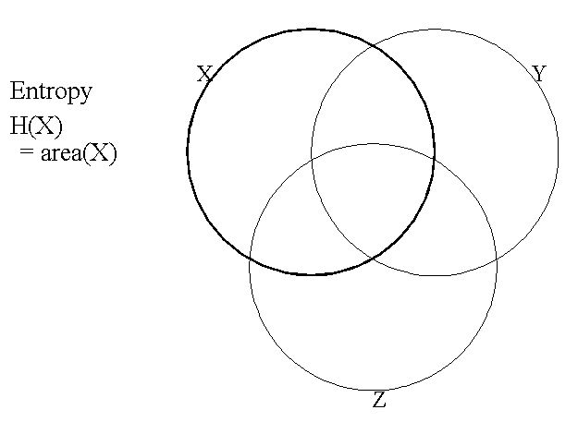
Entropy
The Entropy H(X) is the expected number of bits to communicate the value of X.
It can be drawn as the area of this circle.

Slide 117
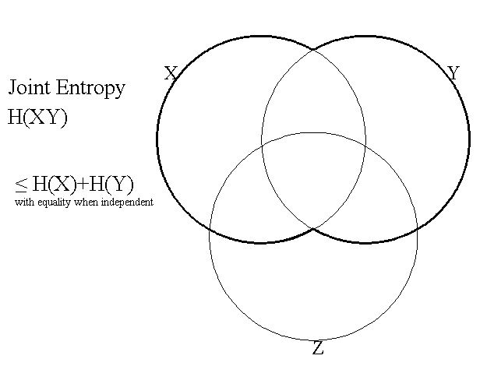
Entropy
H(XY) then is the expected number of bits to communicate the value of both X and Y.

Slide 118
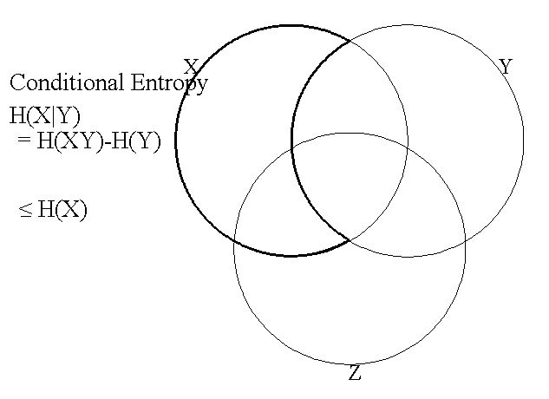
Entropy
If I tell you the value of Y, then H(X|Y) is the expected number of bits to communicate the value of X.
Note that if X and Y are independent, then knowing Y does not help and H(X|Y) = H(X)

Slide 119
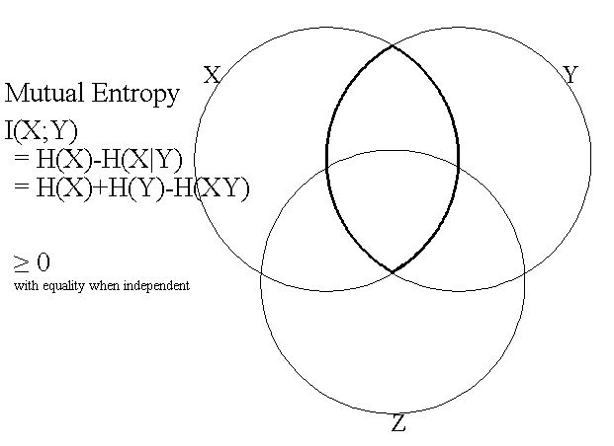
Entropy
I(X;Y) is the number of bits that are revealed about X by me telling you Y.
Or about Y by telling you X.
Note that if X and Y are independent, then knowing Y does not help and I(X;Y) = 0.

Slide 120
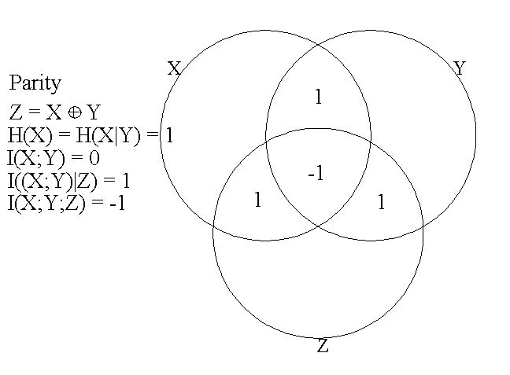
Entropy

Slide 121
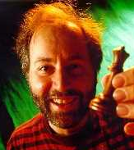
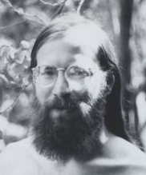
Splay Trees
Self-balancing BST
Invented by Daniel Sleator and Bob Tarjan
Allows quick access to recently accessed elements
Bad: worst-case O(n)
Good: average (amortized) case O(log n)
Often perform better than other BSTs in practice
D. Sleator
R. Tarjan

Slide 122
Splaying
Splaying is an operation performed on a node that iteratively moves the node to the root of the tree.
In splay trees, each BST operation (find, insert, remove) is augmented with a splay operation.
In this way, recently searched and inserted elements are near the top of the tree, for quick access.

Slide 123
3 Types of Splay Steps
Each splay operation on a node consists of a sequence of splay steps.
Each splay step moves the node up toward the root by 1 or 2 levels.
There are 2 types of step:
  Zig-Zig
  Zig-Zag
  Zig
These steps are iterated until the node is moved to the root.

Slide 124
Zig-Zig
Performed when the node x forms a linear chain with its parent and grandparent.
  i.e., right-right or left-left
z
x
y
T₄
T₁
y
x
T₃
T₂
z
zig-zig
T₁
T₂
T₃
T₄

Slide 125
Zig-Zag
Performed when the node x forms a non-linear chain with its parent and grandparent
  i.e., right-left or left-right
z
x
y
z
y
T₁
zig-zag
x
T₄
T₁
T₂
T₃
T₄
T₂
T₃

Slide 126
Zig
Performed when the node x has no grandparent
  i.e., its parent is the root
y
x
zig
x
T₄
w
y
w
T₃
T₁
T₂
T₃
T₄
T₁
T₂

Slide 127
Splay Trees & Ordered Dictionaries
which nodes are splayed after each operation?
method
splay node
if key found, use that node
if key not found, use parent of external node where search terminated
find(k)
insert(k,v)
use the new node containing the entry inserted
use the parent of the internal node w that was actually removed from the tree (the parent of the node that the removed item was swapped with)
remove(k)

Slide 128
Recall BST Deletion
Now consider the case where the key k to be removed is stored at a node v whose children are both internal
  we find the internal node w that follows v in an inorder traversal
  we copy key(w) into node v
  we remove node w and its left child z (which must be a leaf) by means of operation removeExternal(z)
Example: remove 3 – which node will be splayed?
1
v
1
v
3
5
2
8
2
8
6
9
6
9
w
5
z

Slide 129
Note on Deletion
The text (Goodrich, p. 463) uses a different convention for BST deletion in their splaying example
  Instead of deleting the leftmost internal node of the right subtree, they delete the rightmost internal node of the left subtree.
  We will stick with the convention of deleting the leftmost internal node of the right subtree (the node immediately following the element to be removed in an inorder traversal).

Slide 130
Performance
Worst-case is O(n)
  Example:
    Find all elements in sorted order
    This will make the tree a left linear chain of height n, with the smallest element at the bottom
    Subsequent search for the smallest element will be O(n)

Slide 131
Performance
Average-case is O(log n)
  Proof uses amortized analysis
  We will not cover this
Operations on more frequently-accessed entries are faster.
  Given a sequence of m operations, the running time to access entry i is:
  where f(i) is the number of times entry i is accessed.

Slide 132
Balanced Trees
 | Unsorted List | Sorted List | Balanced Trees | Splay Trees | Heap | Hash Tables
Search
Insert Delete
Find Max
Find Next in Order
(Priority
Queue)
(Static)
(Dictionary)
O(n)
O(log(n))
Worst case
O(n)
O(n)
O(log(n))
Practice
better
O(log(n))
O(1)
O(1)
O(log(n))
O(n)
O(n)
better
O(n)
O(1)
O(log(n))
O(1)
O(n)
O(n)
O(1)
O(log(n))
O(n)
O(n)
Amortized O(1)

