Slide 1

Text Processing

Slide 2
Topics
Notations & Terminology
Pattern Matching
  Brute Force
  Boyer-Moore Algorithm
  Knuth-Morris-Pratt Algorithm
Tries
  Standard Tries
  Compressed Tries
  Suffix Tries
  Search Engine Indexing
Text Compression and the Greedy Method
  Huffman Coding Algorithm
  The Greedy Method
Dynamic Programming
  Matrix Chain-Product
  DNA and Text Sequence Alignment

Slide 3
Pattern Matching

Slide 4

Strings
A string is a sequence of characters
  Examples:
    Python program
    HTML document
    DNA sequence
    Digitized image
An alphabet S is the set of possible characters for a family of strings
  Examples:
    ASCII
    Unicode
    {0, 1}
    {A, C, G, T}

Slide 5
Strings
Let P be a string of size m
  A substring P[i .. j] of P is the subsequence of P consisting of the characters with ranks between i and j
  A prefix of P is a substring of the type P[0 .. i]
  A suffix of P is a substring of the type P[i ..m - 1]
Given strings T (text) and P (pattern), the pattern matching problem consists of finding a substring of T equal to P
Applications:
  Text editors
  Search engines
  Biological research

Slide 6
Brute-Force Pattern Matching
The brute-force pattern matching algorithm compares the pattern P with the text T for each possible shift of P relative to T, until either
  a match is found, or
  all placements of the pattern have been tried
Brute-force pattern matching runs in time O(nm)
Example of worst case:
  T = aaa … ah
  P = aaah
  may occur in images and DNA sequences
  unlikely in English text

Slide 7
Brute-Force Pattern Matching
Algorithm BruteForceMatch(T, P) // O(nm) time
Input: text T of size n and pattern P of size m
Output: starting index of a substring of T equal to P , or -1 if no such substring exists
  for i ← 0 to n – m // test shift i of the pattern
  j ← 0
  while j < m and T[i + j] = P[j] do j ← j + 1
  if j = m return i // match at i
  end for-loop
  return – 1 // no match anywhere

Slide 8
Boyer-Moore Heuristics
The Boyer-Moore’s pattern matching algorithm is based on two heuristics:
Looking-glass heuristic: Compare P with a subsequence of T backwards
Character-jump heuristic: When a mismatch occurs at T[i] = c
  If P contains c, shift P to align the last occurrence of c in P with T[i]
  Else, shift P to align P[0] with T[i + 1]
Example:

Slide 9
Last-Occurrence Function
Boyer-Moore’s algorithm preprocesses the pattern P and the alphabet S to build the last-occurrence function L mapping S to integers,
where L(c) is defined as
  the largest index i such that P[i] = c or
  -1 if no such index exists
Example:
  S = {a, b, c, d}
  P = abacab
The last-occurrence function can be represented by an array indexed by the numeric codes of the characters
The last-occurrence function can be computed in time O(m + s), where m is the size of P and s is the size of S
c | a | b | c | d
L(c) | 4 | 5 | 3 | −1

Slide 10
The Boyer-Moore Algorithm
Case 1: j ≤ 1 + l
Algorithm BoyerMooreMatch(T, P, S)
L ← lastOccurenceFunction(P, S )
i ← j ← m – 1
repeat
  if T[i] = P[j]
  if j = 0 return i // match at i
  else i – – ; j – –
  else // character-jump
  l ← L[T[i]]
  i ← i + m – min(j, 1 + l)
  j ← m – 1
  until i > n – 1
  return – 1 // no match
Case 2: 1 + l ≤ j

Slide 11
Example

Slide 12
Analysis
Boyer-Moore’s algorithm runs in time O(nm + s)
Example of worst case:
  T = aaa … a
  P = baaa
The worst case may occur in
images and DNA sequences
but is unlikely in English text
Boyer-Moore’s algorithm is
significantly faster than the
brute-force algorithm on
English text

Slide 13
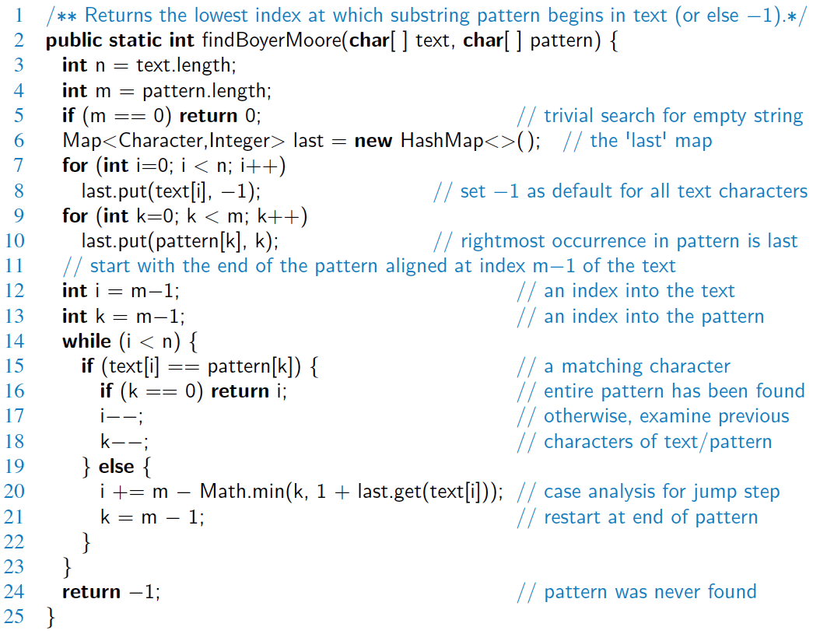
Java Implementation

Slide 14
Knuth-Morris-Pratt Algorithm
Suppose we have incrementally
processed the text T[0..i-1]
(and we are just about to start
processing T[i])
We maintain a “state” index
j∈[0..m-1] with the following:
Loop Invariant:
P[0..j-1] is the longest prefix of P that is a suffix of T[0..i-1].
Exit Condition:
i = n indicates T is completely processed.
j = m indicates a complete match!
T
i
.
.
a
b
a
a
b
.
.
.
.
.
P
a
b
a
a
b
j

Slide 15
Knuth-Morris-Pratt Algorithm
KMP algorithm compares the pattern to the text left-to-right (without back tracking in text), but shifts the pattern more intelligently than the brute-force algorithm.
When a mismatch occurs,
what is the least we can shift the pattern so as to avoid backward comparisons?
Answer: largest proper suffix
of P[0..j-1] that is a prefix of P
T
i
.
.
a
b
a
a
b
x
.
.
.
.
.
P
a
b
a
a
b
a
j
P
a
b
a
a
b
a
No need to
repeat these
comparisons
Resume
comparing
here

Slide 16
KMP Failure Function
KMP algorithm preprocesses the pattern to find matches of prefixes of the pattern with the pattern itself
The failure function F(j) is defined as the size of the largest proper suffix of P[0..j] that is also a prefix of P
KMP algorithm modifies the brute-force algorithm so that if a mismatch occurs at P[j] ≠ T[i],
we set j ← F(j – 1)
j | 0 | 1 | 2 | 3 | 4 | 5
P[j] | a | b | a | a | b | a
F(j) | 0 | 0 | 1 | 1 | 2 | 3

Slide 17
The KMP Algorithm
Algorithm KMPMatch(T, P) // text T[0..n-1] , pattern P[0..m-1]
F ← failureFunction(P) // O(m) time shown next
i ← j ← 0
while i < n do
// Loop Invariant:
// (1) P[0..j-1] is a suffix of T[0 .. i-1]
// (2) Longest prefix of P that is a suffix of T[0..i] is no longer than P[0..j]
if T[ i ] = P[ j ]
  j++ ; i++
  if j = m then return i – j + 1 // first match starting index in T
  else if j > 0 then j ← F[ j –1 ] else i++
  return –1 // no match anywhere

Slide 18
KMP Analysis
The failure function can be represented by an array and can be computed in O(m) time (see next page)
At each iteration of the loop:
  both i and the shift amount i – j are monotone
  non-decreasing
  at least one of them increases (note: F[j –1] < j )
  so, their sum, (2i – j) increases by at least 1
Hence, the loop iterates at most 2n times
So, KMP’s algorithm runs in optimal time O(m + n)

Slide 19
Computing the Failure Function
Algorithm failureFunction(P) // O(m) time
F[ 0 ] ← 0 ; i ← 1 ; j ← 0
while i < m do
// Loop Invariant:
// (0) ∀i’ < i: F[i’] = length of longest proper suffix of P[0..i’] that is a prefix of P
// (1) P[0 .. j-1] is a proper suffix of P[0..i-1]
// (2) Longest proper suffix of P[0 .. i] that is a prefix of P is also prefix of P[0..j]
if P[ i ] = P[ j ] then F[ i ] ← j+1 ; j++ ; i++
else if j > 0 then j ← F[ j-1 ] else F[ i ] ← 0 ; i++
return F //∀i: F[i] = length of longest proper suffix of P[0..i] that is a prefix of P
Analysis: The construction is similar to the KMP algorithm itself
At each iteration of the loop: 2i – j increases by at least 1
Hence, the loop iterates at most 2m times

Slide 20
Example
j | 0 | 1 | 2 | 3 | 4 | 5
P[j] | a | b | a | c | a | b
F(j) | 0 | 0 | 1 | 0 | 1 | 2

Slide 21
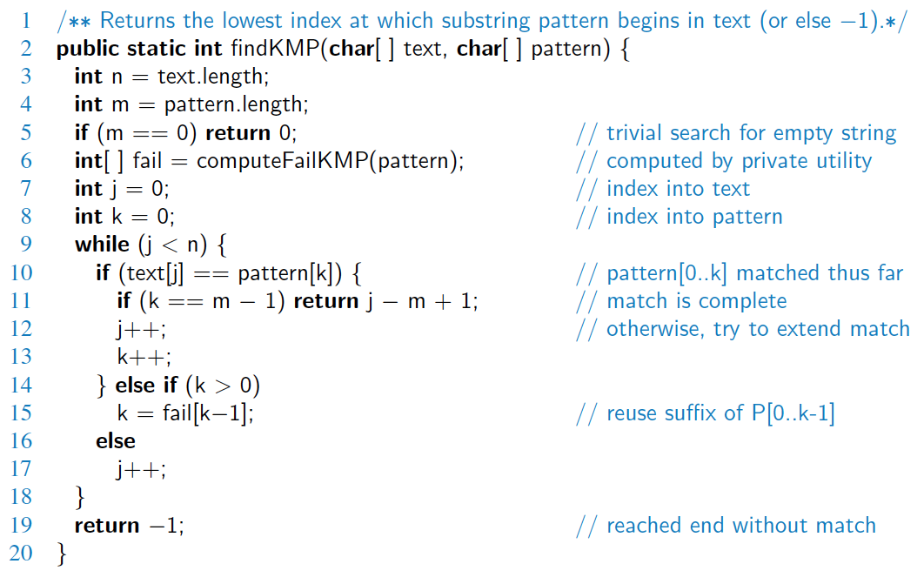
Java Implementation

Slide 22
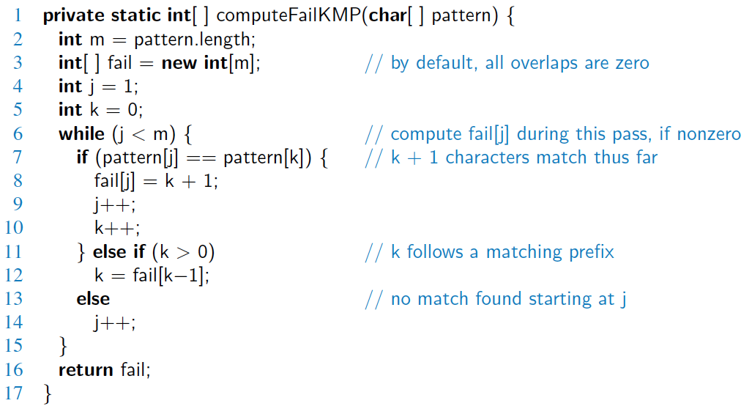
Java Implementation, 2

Slide 23
Tries

Slide 24
Preprocessing Strings
Preprocessing the pattern speeds up pattern matching queries
  After preprocessing the pattern, KMP’s algorithm performs pattern matching in time proportional to the text size
If the text is large, immutable and searched often
(e.g., works by Shakespeare), we may want to preprocess
the text instead of the pattern
A trie is a compact data structure for representing
a set of strings, such as all the words in a text
  tries support pattern matching queries
  in time proportional to the pattern size

Slide 25
Standard Tries
Standard trie for a string set S is an ordered tree such that:
  Each node but the root is labeled with a character
  The children of a node are alphabetically ordered
  The root-to-external-node paths yield the strings of S
Example: S = { bear, bell, bid, bull, buy, sell, stock, stop }

Slide 26
Analysis of Standard Tries
A standard trie uses O(n) space and supports searches, insertions and deletions in time O(dm), where:
  n = total size of the strings in S
  m = size of the string parameter of the operation
  d = size of the alphabet

Slide 27
Word Matching with a Trie
insert the words of the text into trie
Each leaf is associated w/ one particular word
leaf stores indices where associated word begins (“see” starts at index 0 & 24, leaf for “see” stores those indices)
s
e
e
a
b
e
a
r
?
s
e
l
l
s
t
o
c
k
!
0
1
2
3
4
5
6
7
8
9
10
11
12
13
14
15
16
17
18
19
20
21
22
23
s
e
e
a
b
u
l
l
?
b
u
y
s
t
o
c
k
!
24
25
26
27
28
29
30
31
32
33
34
35
36
37
38
39
40
41
42
43
44
45
46
b
i
d
s
t
o
c
k
!
b
i
d
s
t
o
c
k
!
47
48
49
50
51
52
53
54
55
56
57
58
59
60
61
62
63
64
65
66
67
68
h
e
a
r
t
h
e
b
e
l
l
?
s
t
o
p
!
69
70
71
72
73
74
75
76
77
78
79
80
81
82
83
84
85
86
87
88
b
h
s
e
i
u
e
e
t
a
l
d
l
y
a
e
l
o
47, 58
36
0, 24
r
l
l
r
l
c
p
6
78
30
69
12
84
k
17, 40,
51, 62

Slide 28
Compressed Tries
A compressed trie has internal nodes of degree at least two
It is obtained from standard trie by compressing chains of “redundant” nodes
E.g., the “i” and “d” in “bid” are “redundant” because they signify the same word

Slide 29
Compact Representation
Compact representation of a compressed trie for an array of strings:
  Stores at the nodes ranges of indices instead of substrings
  Uses O(s) space, where s is the number of strings in the array
  Serves as an auxiliary index structure

Slide 30
Suffix Trie
The suffix trie of a string X is the compressed trie of all the suffixes of X

Slide 31
Analysis of Suffix Tries
Compact representation of the suffix trie for a string X of size n from an alphabet of size d
  Uses O(n) space
  Supports arbitrary pattern matching queries in X in O(dm) time, where m is the size of the pattern
  Can be constructed in O(n) time

Slide 32
Encoding Trie (1)
A code is a mapping of each character of an alphabet to a binary code-word
A prefix code is a binary code such that no code-word is the prefix of another code-word
An encoding trie represents a prefix code
  Each leaf stores a character
  The code word of a character is given by the path from the root to the leaf storing the character (0 for a left child and 1 for a right child
00 | 010 | 011 | 10 | 11
a | b | c | d | e
a
d
e
b
c

Slide 33
Encoding Trie (2)
Given a text string X, we want to find a prefix code for the characters of X that yields a small encoding for X
  Frequent characters should have short code-words
  Rare characters may have long code-words
Example: X = abracadabra
  T₁ encodes X into 29 bits
  T₂ encodes X into 24 bits
T₁
T₂
c
d
b
a
b
r
a
r
c
d

Slide 34
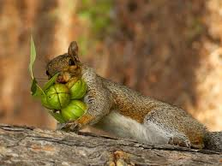
The Greedy Method
&
Text Compression

Slide 35

The Greedy Method Technique
The greedy method is a general algorithm design paradigm, built on the following elements:
  configurations: different choices, collections, or values to find
  objective function: a score assigned to configurations, which we want to maximize or minimize
It works best when applied to problems with the greedy-choice property:
  a globally-optimal solution can always be found by a series of local improvements from a starting configuration.

Slide 36
Text Compression
Given a string X, efficiently encode X into a smaller string Y
  Saves memory and/or bandwidth
A good approach: Huffman encoding
  Compute frequency f(c) for each character c.
  Encode high-frequency characters with short code words
  No code word is a prefix for another code
  Use an optimal encoding tree to determine the code words

Slide 37
Encoding Tree Example
A code is a mapping of each character of an alphabet to a binary code-word
A prefix code is a binary code such that no code-word is the prefix of another code-word
An encoding tree represents a prefix code
  Each external node stores a character
  The code word of a character is given
  by the path from the root to the
  external node storing the character
  (0 for a left child and 1 for a right child)
a
d
e
b
c
00 | 010 | 011 | 10 | 11
a | b | c | d | e

Slide 38
Encoding Tree Optimization
Given a text string X, we want to find a prefix code for the characters of X that yields a small encoding for X
  Frequent characters should have short code-words
  Rare characters should have long code-words
Example: X = abracadabra
  T₁ encodes X into 29 bits
  T₂ encodes X into 24 bits
T₁
T₂
c
d
b
a
b
r
a
r
c
d

Slide 39
Huffman’s Algorithm
Given a string X, Huffman’s algorithm construct a prefix code that minimizes the encoding size of X
It runs in time O(n + d log d),
  n is the size of X
  d is the number of distinct characters of X
A heap-based priority queue is used as an auxiliary structure

Slide 40
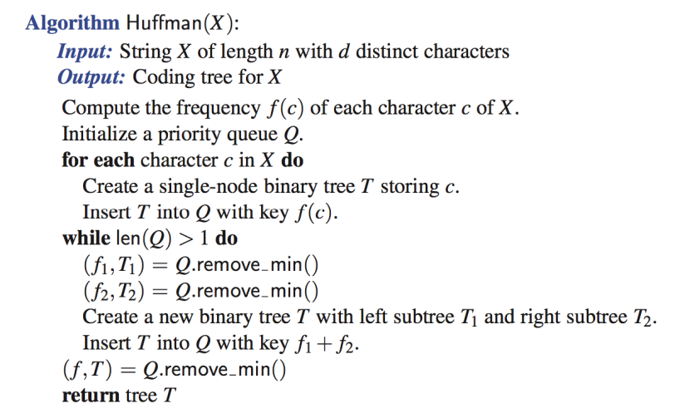
Huffman’s Algorithm

Slide 41
Example
char | code | Freq
a | 0 | 5
b | 110 | 2
c | 100 | 1
d | 101 | 1
r | 111 | 2
X = abracadabra
Frequencies
11
a | b | c | d | r
5 | 2 | 1 | 1 | 2
a
6
2
4
Code-length of X
5*1+2*3+1*3+1*3+2*3 = 23
c
d
b
r
6
a
b
c
d
r
2
4
5
2
1
1
2
a
c
d
b
r
5
2
2
4
a
b
c
d
r
a
c
d
b
r
5
2
2
5

Slide 42
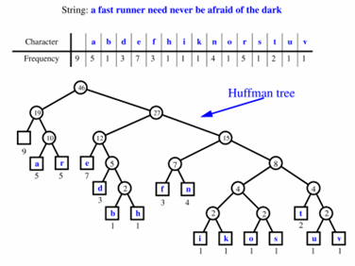
Extended Huffman Tree Example

Slide 43
Dynamic Programming

Slide 44
Matrix Chain-Products
Dynamic Programming
is a general algorithm design paradigm.
  Rather than give the general structure,
  let us first give a motivating example:
  Matrix Chain-Products

Slide 45
Review Matrix Multiplication
  C = A*B
  A is d × e and B is e × f
  O(def ) time
f
B
j
e
e
A
C
d
i
i,j
d
f

Slide 46
Matrix Chain-Products
Matrix Chain-Product:
  Compute A = A₀*A₁*…*A_{n-1}
  A_{i} is d_{i} × d_{i+1}
  Problem: How to parenthesize?
Example:
  B is 3 × 100
  C is 100 × 5
  D is 5 × 5
  (B*C)*D takes 1500 + 75 = 1575 ops
  B*(C*D) takes 1500 + 2500 = 4000 ops

Slide 47
An Enumeration Approach
Matrix Chain-Product Algorithm:
  Try all possible ways to parenthesize
  A = A₀*A₁*…*A_{n-1}
  Calculate number of ops for each one
  Pick the one that is best
Running time:
  The number of paranethesizations is equal to the number of binary trees with n external nodes
  It is called the Catalan number, and it is almost 4^{n}.
  This is exponential!
  This is a terrible algorithm!

Slide 48
A Greedy Approach
Idea 1: repeatedly select the matrix product
that uses the most operations.
Counter-example:
  A is 10 × 5
  B is 5 × 10
  C is 10 × 5
  D is 5 × 10
  Greedy idea 1 gives
  (A*B)*(C*D) which takes 500+1000+500 = 2000 ops
  Better solution:
  A*((B*C)*D) which takes 500+250+250 = 1000 ops

Slide 49
Another Greedy Approach
Idea 2: repeatedly select the matrix product
that uses the fewest operations.
Counter-example:
  A is 101 × 11
  B is 11 × 9
  C is 9 × 100
  D is 100 × 99
  Greedy idea 2 gives
  A*((B*C)*D)) which takes 109989+9900+108900 = 228789 ops
  Better solution:
  (A*B)*(C*D) which takes 9999+89991+89100 = 189090 ops
The greedy approach is not giving us the optimal value!

Slide 50
A “Recursive” Approach
Define sub-problems:
  Find the best parenthesization of A_{i}*A_{i+1}*…*A_{j}.
  Let N_{i,j} denote the number of operations done by this subproblem.
  The optimal solution for the whole problem is N_{0,n-1}.
Sub-problem optimality: The optimal solution can be defined in terms of optimal sub-problems
  There has to be a final multiplication (root of the expression tree) for the optimal solution.
  Say, the final multiply is at index i: (A₀*…*A_{i})*(A_{i+1}*…*A_{n-1}).
  Then the optimal solution N_{0,n-1} is the sum of two optimal sub-problems, N_{0,i} and N_{i+1,n-1} plus the time for the last multiplication.
  If the global optimum did not have these optimal sub-problems, we could define an even better “optimal” solution.

Slide 51
A Characterizing Equation
The global optimal has to be defined in terms of optimal sub-problems, depending on where the final multiplication is at.
Let us consider all possible places for that final op:
  Recall that A_{i} is a d_{i} × d_{i+1} dimensional matrix.
  So, a characterizing equation for N_{i,j} is the following:
Note that sub-problems are not independent
− the sub-problems overlap.

Slide 52
Dynamic Programming
Algorithm
Sub-problems overlap.
Don’t use recursion.
Instead, construct optimal sub-problems “bottom-up.”
N_{i,i}’s are easy,
so start with them
Then do length 2,3,…
sub-problems, and so on.
The running time is O(n³)
Algorithm matrixChain(S):
Input: sequence S of n matrices to be multiplied
Output: number of operations in an optimal paranethization of S
  for i ← 1.. n-1 do N_{i,i} ← 0
  for b ← 1 .. n-1 do
  for i ← 0 .. n-b-1 do
  j ← i+b
  N_{i,j} ← + ∞
  for k ← i .. j-1 do
  N_{i,j} ← min{N_{i,j} , N_{i,k} +N_{k+1,j} +d_{i} d_{k+1} d_{j+1}}

Slide 53
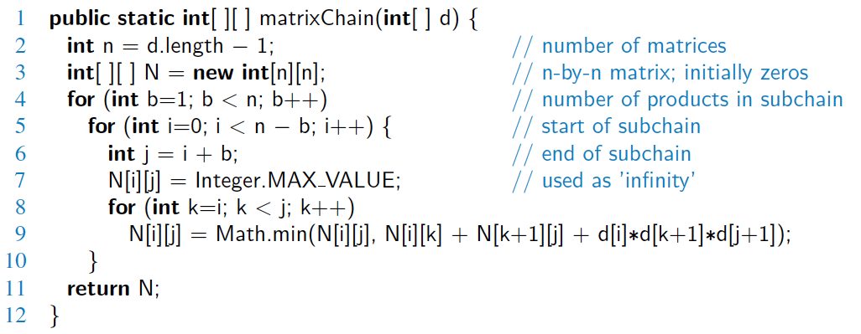
Java Implementation

Slide 54
Dynamic Programming Algorithm Visualization
The bottom-up construction fills in the N array by diagonals
N_{i,j} gets values from pervious entries in i-th row and j-th column
Filling in each entry in the N table takes O(n) time.
Total run time: O(n³)
Getting actual parenthesization can be done by remembering “k” for each N entry
N
0
1
2
j
…
n-1
0
1
…
answer
i
n-1

Slide 55
The General Dynamic Programming Technique
Applies to a problem (that at first seems to require a lot of time, possibly exponential), provided we have:
  Simple sub-problems: the sub-problems can be defined in terms of a few variables, such as j, k, l, m, and so on.
  Sub-problem optimality: the global optimum value can be defined in terms of optimal sub-problems
  Sub-problem overlap: the sub-problems are not independent, but instead they overlap
  (hence, should be constructed bottom-up).

Slide 56
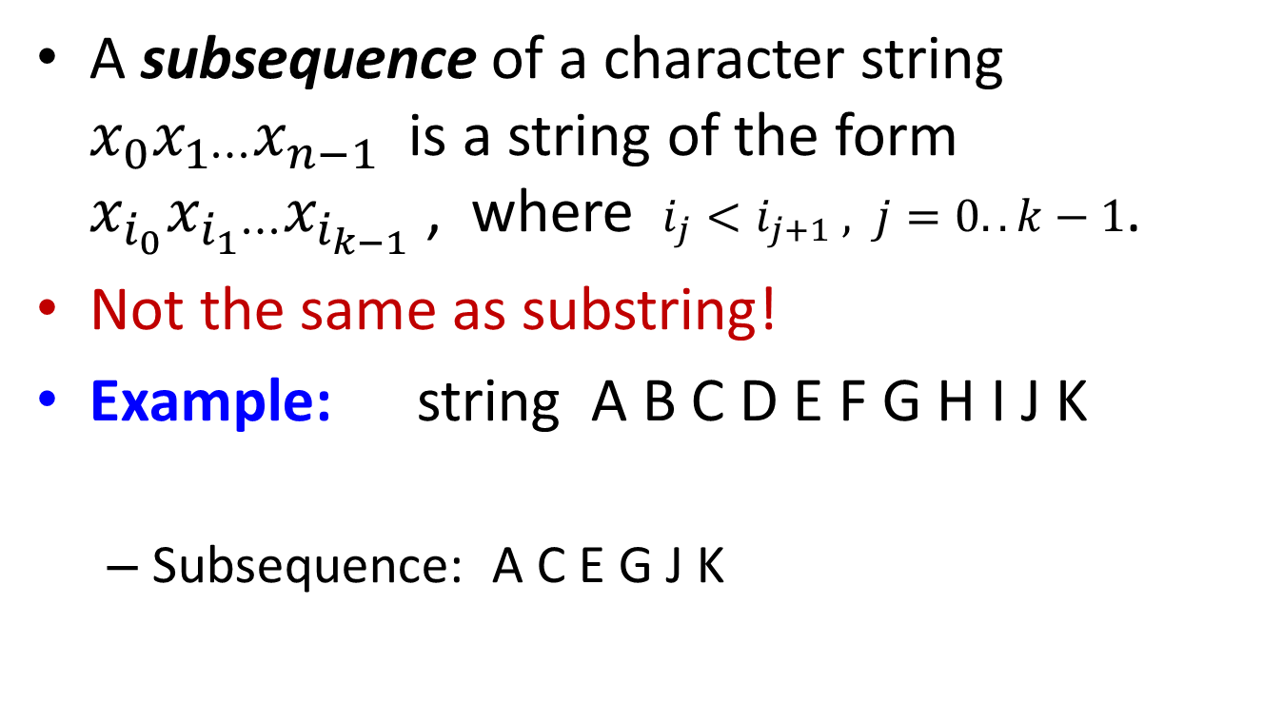
Subsequences
A subsequence of a character string $x_{0}x_{1⋯}x_{n−1}$ is a string of the form $x_{i_{0}}x_{i_{1}⋯}x_{i_{k−1}}$ , where $i_{j}<i_{j+1} , j=0..k−1$.
Not the same as substring!
Example: string A B C D E F G H I J K
  Subsequence: A C E G J K
  Not subsequence: DAGH

Slide 57
The Longest Common Subsequence (LCS) Problem
Given two strings X and Y, the longest common subsequence (LCS) problem is to find a longest subsequence common to both X and Y
Has applications to DNA similarity testing (alphabet is {A,C,G,T})
Example: ABCDEFG and XZACKDFWGH have ACDFG as a longest common subsequence

Slide 58
A Poor Approach to the LCS Problem
A Brute-force solution:
  Enumerate all subsequences of X
  Test which ones are also subsequences of Y
  Pick the longest one.
Analysis:
  If X is of length n, then it has 2^{n} subsequences
  This is an exponential-time algorithm!

Slide 59
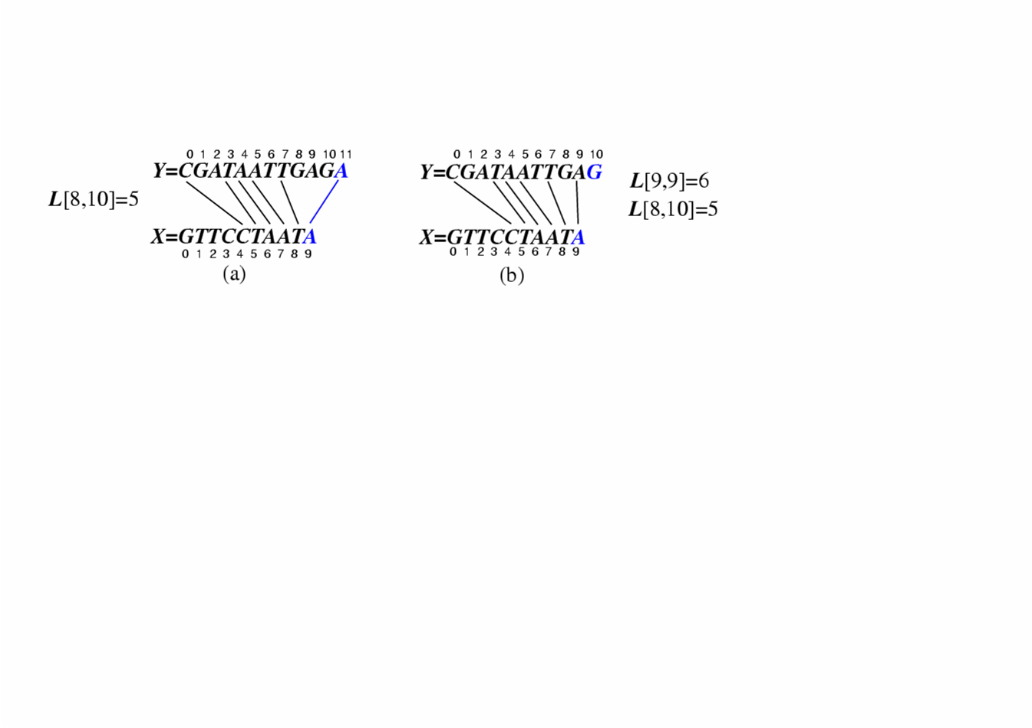
A Dynamic-Programming Approach to the LCS Problem
Define L[i,j] to be the length of the longest common subsequence of X[0..i] and Y[0..j].
Allow for -1 as an index, so L[-1,k] = 0 and L[k,-1]=0, to indicate that the null part of X or Y has no match with the other.
Then we can define L[i,j] in the general case as follows:
  If xi=yj, then L[i,j] = L[i-1,j-1] + 1 (we can add this match)
  If xi≠yj, then L[i,j] = max{L[i-1,j], L[i,j-1]} (we have no match here)
Case 1:
Case 2:

Slide 60
An LCS Algorithm
Algorithm LCS(X,Y )
Input: Strings X and Y with n and m elements, respectively
Output: For i = 0..n-1, j = 0..m-1, the length L[i, j] of a longest common
subsequence of X[0..i] = x₀x₁x₂…x_{i} and Y [0.. j] = y₀y₁y₂…y_{j}
for i ← 1 .. n-1 do L[i,-1] ← 0
for j ← 0 .. m-1 do L[-1,j] ← 0
for i ← 0 .. n-1 do
for j ← 0 .. m-1 do
if x_{i} = y_{j} then L[i, j] ← L[i-1, j-1] + 1
else L[i, j] ← max{L[i-1, j] , L[i, j-1]}
return array L

Slide 61
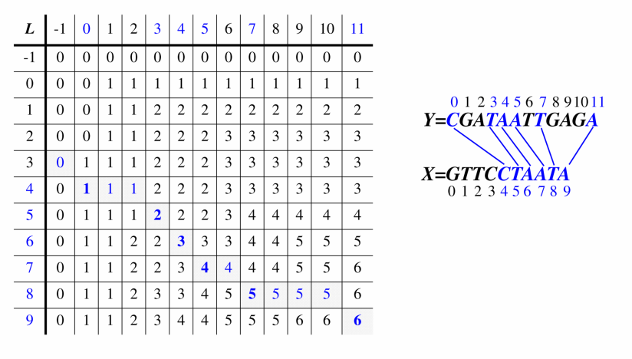
Visualizing the LCS Algorithm

Slide 62
Analysis of LCS Algorithm
We have two nested loops
  The outer one iterates n times
  The inner one iterates m times
  A constant amount of work is done inside each iteration of the inner loop
  Thus, the total running time is O(nm)
Answer is contained in L[n,m]
the subsequence can be recovered from the L table.

Slide 63
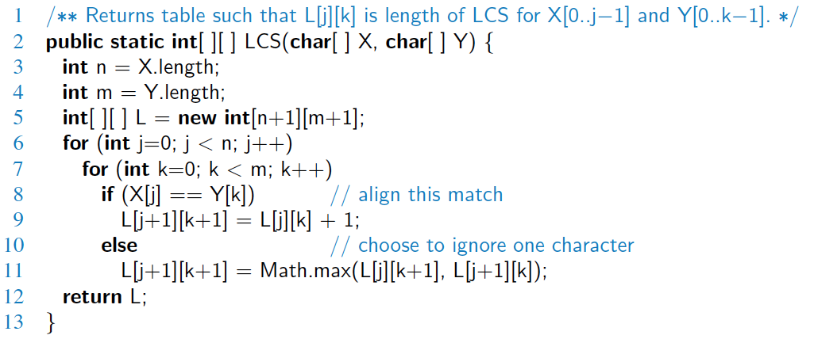
Java Implementation

Slide 64
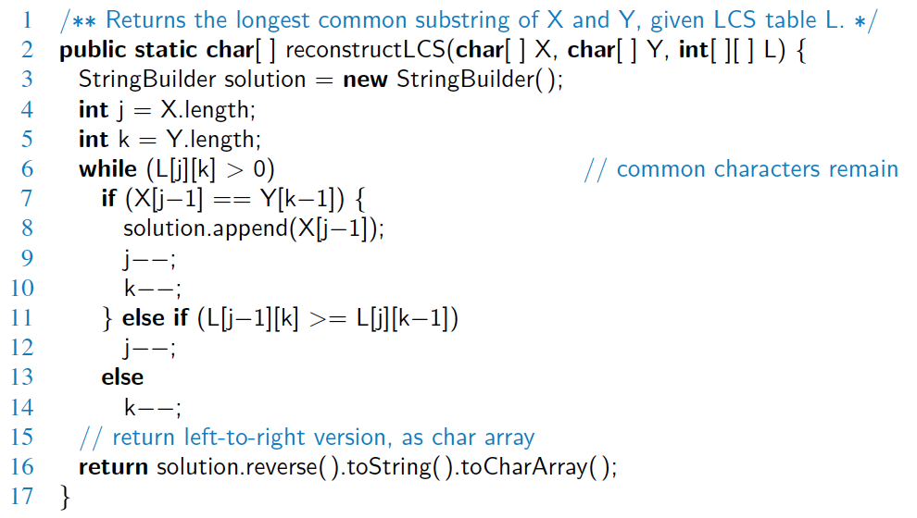
Java Implementation,
Output of the Solution

Slide 65

Summary
Pattern Matching | Brute Force Boyer-Moore Knuth-Morris-Pratt
Tries | Standard Tries Compressed Tries Suffix Tries Search Engine Indexing
Text Compression | Huffman Coding The Greedy Method
Dynamic Programming | Matrix Chain-Product Longest Common Subsequence DNA and Text Sequence Alignment

Slide 66


