Slide 1
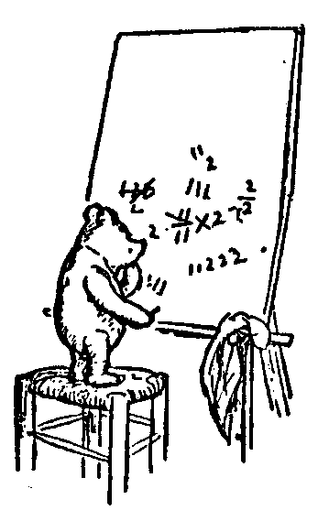
Logic for Computer Science
Computing
Computable
Time Complexity
Probabilistic Algorithms
Uncomputable
Coding Phase vs Execution Phase
Compiling Java to TM
Universal TM
Many Courses
EECS2001
Jeff Edmonds
York University
Lecture 1

Slide 2
Please feel free
to ask questions!
Please give me feedback
so that I can better serve you.
Thanks for the feedback that you have given me already.
Notes:
2

Slide 3
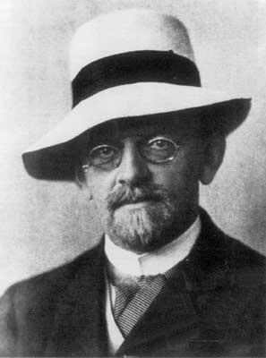
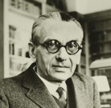
Computable
What is computation?
Hilbert (1900)
Gödel’s
Completeness and Incompleteness Theorems
1929
No hardware has been built.
All we have is logic.

Slide 4
Computable
Let P be some computational problem.
Let I be an input.
P(I) denotes the required output for problem P on input I.
P≡Sort is an example of a computational problem.
We know that the input to sorting is an array of values.
But computer theorists just assume the input I is
a generic binary string.
Sort(I) denotes the same numbers as in I but sorted.

Slide 5
Computable
Let P be some computational problem.
Let I be an input.
P(I) denotes the required output for problem P on input I.
Let A be an algorithm/machine.
A(I) denotes the output produced by algorithm A on input I.
Computable mean that some algorithm A computes it.
A≡InsertionSort is an example of an algorithm.
Computer theorists tend to assume that the algorithm is
a Turing Machine TM M.
but being Java code is the same for our purposes.
If bug free, InsertionSort(I) returns the sorted list.

Slide 6
Computable
Let P be some computational problem.
Let I be an input.
P(I) denotes the required output for problem P on input I.
Let A be an algorithm/machine.
A(I) denotes the output produced by algorithm A on input I.
Let A(I)=P(I) indicate that alg A gives the correct answer for problem P on input I.
If algorithm A is computing problem P, then we need
its output A(I) to be as required.
From a logic perspective:
P(I)=A(I) is just another T/F relation
between objects P, A, and I.

Slide 7

Computable
∃ algorithm A, ∀ input I, A(I)=P(I)
We will start with an English statement
and from it build a logic sentence.
What does computable mean?
What does computes mean?
What does solves mean?
A(I)=P(I)
∀
“Algorithm A correctly solves problem P on input I.”
“Algorithm A correctly computes problem P.”
“Computational problem P is computable”.
?
input I,
∃
algorithm A,
?
There is at least input I solved or all are solved?
There is at least one algorithm A that works or they all do?
What order do these appear in the logical sentence?
hence in the game?
He better have one algorithm A that works for every input I.

Slide 8
Computable
∃ algorithm A, ∀ input I, A(I)=P(I)
Or condensed to Solves_{P}(A∃,I)
What does each subsequence say about
** value of free variables
A(I)=P(I)
∀ I, A(I)=P(I)
∃A, ∀ I, A(I)=P(I)
“Algorithm A correctly solves problem P on input I.”
“Algorithm A correctly computes problem P.”
“Computational problem P is computable”.
How does the game go?

Slide 9
Computable
∃ algorithm A, ∀ input I, A(I)=P(I)
The read the statement left to right.
I am invested in proving that the sentence is true.
I produce a good object when it is a ∃.
I am invested in proving that the sentence is false.
Or at least giving the prover as hard of a time as I can.
I produce a worst-case object when it is a ∀.
The prover wins if the relation is true.

Slide 10
Computable
∃ algorithm A, ∀ input I, A(I)=P(I)
I have an algorithm A that I claim works.
Oh yeah,
I study A and find a worst case input I
on which it does not.
I win if A on input I gives the correct output.
This is what we do in Computer Science!
Here the P is considered free
because it is not bounded by a quantifier.
Hence, the sentence says something about P.
Note, that if P is in fact computable,
then the prover can supply a working algorithm A
and the adversary cannot give a counter example I.

Slide 11
Computable
∃ algorithm A, ∀ input I, A(I)=P(I)
I have an algorithm A that I claim works.
Oh yeah,
I study A and find a worst case input I
on which it does not.
I win if A on input I gives the correct output.
This is what we do in Computer Science!
Here the P is considered free
because it is not bounded by a quantifier.
Hence, the sentence says something about P.
Note, that if P is in fact computable,
then the prover can supply a working algorithm A
and the adversary cannot give a counter example I.

Slide 12
Time Complexity
Problem P is computable
in n² time.
∃M, ∀I, M(I)=P(I)
|I|
[ & Time(M,I)≤ ²]
n
In addition to getting the answer for P,
the running time is at most n².
Which n?
Here n is the number of bits |I| to write down the input.
Notes:
12

Slide 13

Computable
∃ algorithm A, ∀ input I, A(I)=P(I)
I want you to feel physical pain
∀Inputs x, ∃Java Program J, J(x)=P(x)
when you see

Slide 14
Computable
∃ algorithm A, ∀ input I, A(I)=P(I)
I want you to feel physical pain
∀Inputs x, ∃Java Program J, J(x)=P(x)
when you see
Problem P:
Input: x
Output: x²
We want to say that
there is a Java program J,
that solves problem P,
on every input I.
Input: | x
Code: | int J( x ) return(x×x)
Notes:
14

Slide 15
Computable
∃ algorithm A, ∀ input I, A(I)=P(I)
I want you to feel physical pain
∀Inputs x, ∃Java Program J, J(x)=P(x)
when you see
Problem P:
Input: x
Output: x²
But what you are saying is that each input value can have its own Java program!
Input: | 1 | 2 | 3 | 4 | …
Code: | int J₁( x ) return(1) | int J₂( x ) return(4) | int J₃( x ) return(9) | int J₄( x ) return(16) | …
Instead
∃Java Program J, ∀Inputs x, J(x)=P(x)
Input: | x
Code: | int J( x ) return(x×x)
Notes:
15

Slide 16

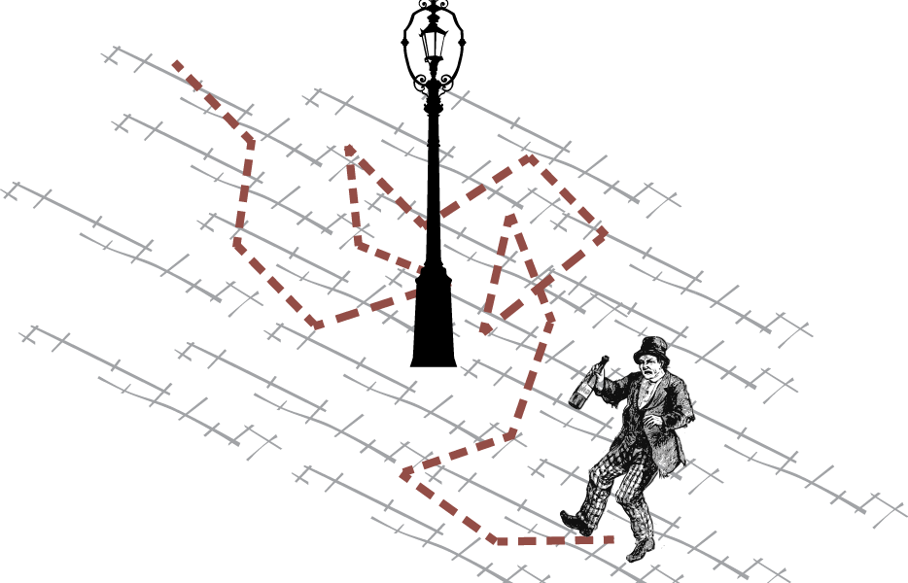
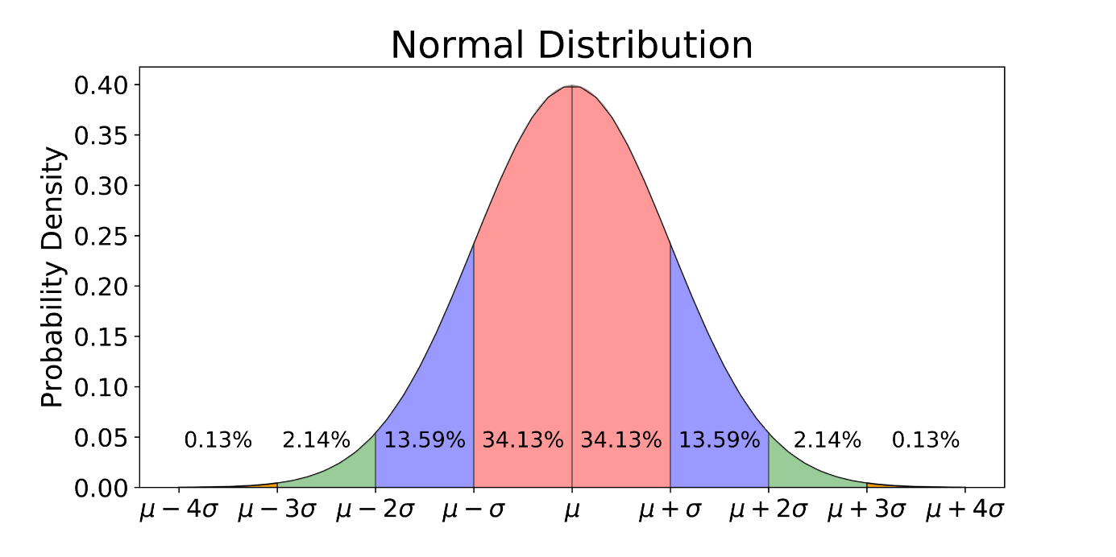
Probabilistic Algorithms

Slide 17
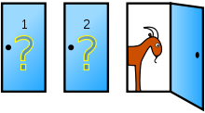
Probabilistic Algorithms
Suppose there are n doors.
Half are promised to have prizes.
The algorithm A specifies which doors are opened.
The input I specifies which doors have prizes.
The adversary, knowing your algorithm,
gives you the worst case input.

Slide 18
Probabilistic Algorithms
Problem P is computable if
∃A,
∀I,
A(I)=P(I)
& Time(A,I) ≤ T
=^{n}/₂ +1
I have an algorithm A that I claim works.
I know which doors you choose.
My input I puts no prizes
behind the first n/2 doors you look in.
Oh dear.

Slide 19
Probabilistic Algorithms
Remember Quick Sort
Problem P is computable if
∃A,
∀I,
A(I)=P(I)
& Time(A,I) ≤ T
=n²
No. Actually, I am quite mean.
I really do give a worst case input.
My algorithm A specifies to pivot with the middle item.
I know this.
My input I puts the smallest element in the middle.
Oh dear.

Slide 20
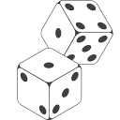
Probabilistic Algorithms
Problem P is computable by a random algorithm if
∃A,
∀I,
R,
A_{R}(I)=P(I)
I have a random algorithm A that I claim works.
My algorithm is to open random doors
hoping to find a prize.
Note that this makes all doors
symmetrically the same.

Slide 21
Probabilistic Algorithms
Problem P is computable by a random algorithm if
∃A,
∀I,
R,
A_{R}(I)=P(I)
I have a random algorithm A that I claim works.
I know the algorithm A, but not its random coin flips R.
I do my best to give you a worst case input I.
ie which doors have prizes.
Though if we open doors randomly then it does not matter.

Slide 22
Probabilistic Algorithms
Problem P is computable by a random algorithm if
∃A,
∀I,
R,
A_{R}(I)=P(I)
I have a random algorithm A that I claim works.
I know the algorithm A, but not its random coin flips R.
I do my best to give you a worst case input I.
The random coin flips R are independent of the input.
They determine which doors the algorithm opens.
There are worst case coin flips
but no worst case inputs.

Slide 23
Probabilistic Algorithms
Problem P is computable by a random algorithm if
∃A,
∀I,
R,
A_{R}(I)=P(I)
Pr_{R}
≥ 1-2^{-T}
Time(A_{R},I) ≤ T
Half the doors have prizes.
For each random door, the probability of finding a prize
is ½.
Suppose I open T doors.
The probability of finding no prize is
½×½×½×…×½ = 2^{-T}
The probability of finding a prize is
1-2^{-T}.
2⁻¹⁰ ≈ ¹/_{thousand}
2⁻²⁰ ≈ ¹/_{million}
2⁻³⁰ ≈ ¹/_{billion}

Slide 24
Probabilistic Algorithms
Problem P is computable by a random algorithm if
∃A,
∀I,
∀R,
A_{R}(I)=P(I)
Expected_{R}
Time(A_{R},I)
=2
Suppose I keep opening doors until I find a prize.
I am guaranteed to succeed.
The expected number of doors I need to open is
(How many times do you expect to flip a coin
until you get a head?)
2.

Slide 25
Uncomputable Problem
Problem P is
computable if
Problem P is
uncomputable if
∃M,
∀I,
M(I)=P(I)
∀M, ∃I, M(I) ≠ P(I)
People tend to struggle with expressing this in Predicate logic.
Their intuition tends to be wrong.
As such times, it is helpful to know how to mechanically follow the rules of formal logic.
Simply take the negation.

Slide 26
Uncomputable Problem
Problem P is
computable if
Problem P is
uncomputable if
∃M,
∀I,
M(I)=P(I)
∀M, ∃I, M(I) ≠ P(I)
Let’s understand this deeply
P is uncomputable because
  Every machine fails to compute it.
M fails to compute P because
  there is an input on which it fails.
M fails to compute P on I because
  It gives the wrong answer

Slide 27
Uncomputable Problem
Problem P is
computable if
Problem P is
uncomputable if
∃M,
∀I,
M(I)=P(I)
∀M, ∃I, M(I) ≠ P(I)
I have a machine M that I claim works.
I find one counter example input I for which his machine M fails us.
I win if M on input I gives the wrong output
Generally very hard to do.

Slide 28
Uncomputable Problem
Problem P is
computable if
Problem P is
uncomputable if
true
true
∃M,
∀I,
M(I)=Sorting(I)
∀M, ∃I, M(I) ≠ Halting(I)
∀I, ∃M, M(I) = Halting(I)
The order the players go
REALY matters.
If you don’t know if it is true or not, trust the game.

Slide 29
Uncomputable Problem
Problem P is
computable if
Problem P is
uncomputable if
true
true
∃M,
∀I,
M(I)=Sorting(I)
∀M, ∃I, M(I) ≠ Halting(I)
∀I, ∃M, M(I) = Halting(I)
true
I give you an input I.
Given I either
  Halting(I) = yes or
  Halting(I) = no.
∀I, M_{yes}(I) says yes
∀I, M_{no}(I) says no
I don’t know which,
but one of these does the trick.
A tricky one.

Slide 30

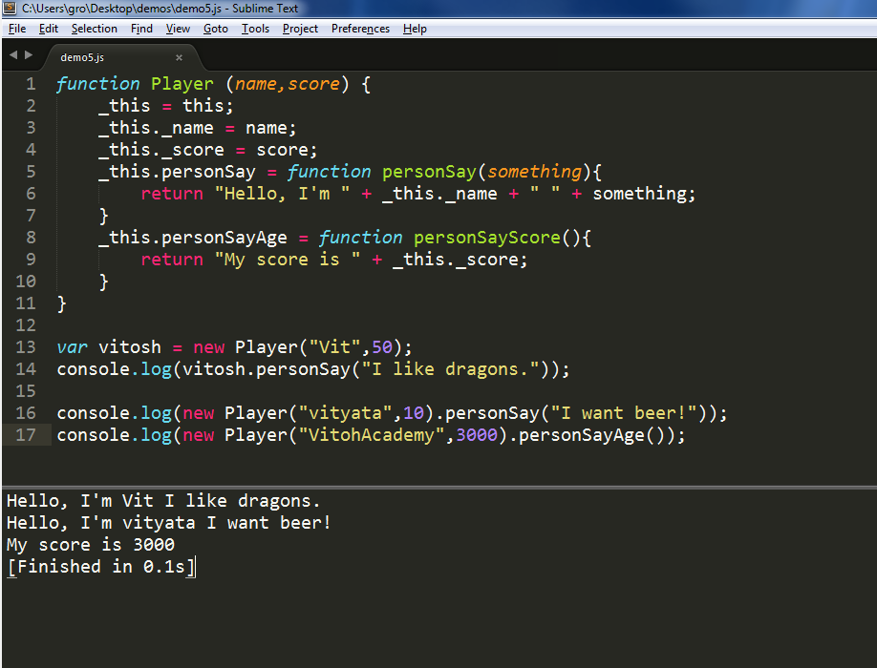
Coding Phase vs Execution Phase
∃ algorithm A, ∀ input I, A(I)=P(I)
History of Events
P
A
I
A(I)=P(I)
Coding Phase
Does not depend on input.
Compile Time Errors occur here.
Execution Phase
Depends on input.
Run Time Errors occur here

Slide 31
Coding Phase vs Execution Phase
∃ algorithm A, ∀ input I, A(I)=P(I)
∃A:
I construct this algorithm A during the Coding Phase.
Without knowing the input!
It needs a fixed finite description, i.e. code.
∀I:
I choose the input I at the begin the Execution Phase.
i.e. after I already know the algorithm A.
My input can be much bigger
than the description of the algorithm.
Its computation may require
  a lot more time.
  a lot more memory to be allocated dynamically.

Slide 32
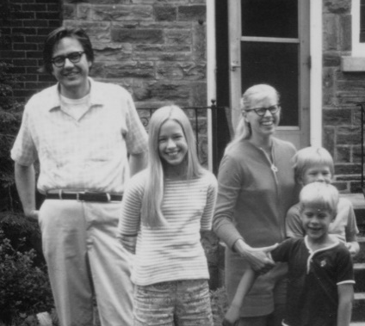
Coding Phase vs Execution Phase
∃ algorithm A, ∀ input I, A(I)=P(I)
& Lines(A,I)=k & Time(A,I)=t
A print out of the Java code A has some number of lines,
but it does not depend in the input I.
We will want to express this.
In contrast, the time t does depend on the I.
Let Lines(A,I)=k denote the number of lines of code
in algorithm A (when run on input I).
Let Time(A,I)=t denote the number of time steps taken.
∃
# k,
∃
time t,
?
?
Running time
matters.
At least one value for t or all?
At least one value for k or all?
Edmonds (1963)

Slide 33
Coding Phase vs Execution Phase
∃ algorithm A, ∀ input I, A(I)=P(I)
& Lines(A,I)=k & Time(A,I)=t
A print out of the Java code A has some number of lines,
but it does not depend in the input I.
We will want to express this.
In contrast, the time t does depend on the I.
Let Lines(A,I)=k denote the number of lines of code
in algorithm A (when run on input I).
Let Time(A,I)=t denote the number of time steps taken.
∃
# k,
∃
time t,
When does the prover choose the number of lines k?
When does the prover choose running time t?
Coding Phase
Does not depend on input.
Execution Phase
Depends on input.

Slide 34
Coding Phase vs Execution Phase
∃ algorithm A, ∀ input I, A(I)=P(I)
& Lines(A,I)=k & Time(A,I)=t
∃
# k,
∃
time t,
Switching the order of ∃ does not effect things.

Slide 35
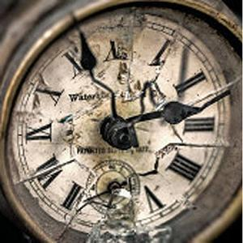
Coding Phase vs Execution Phase
∃ algorithm A, ∃ # k, ∀ input I, ∃ time t,
A(I)=P(I) & Lines(A,I)=k & Time(A,I)=t
What does each subsequence say about
** value of free variables, * set of values of outer quantifier.
A(I)=P(I) & Lines(A,I)=k & Time(A,I)=t
On input I, algorithm A solves problem P with k lines of code in time t.
“Solves” might be over stating it.
A(I)=P(I) only says that algorithm A
happens to give the correct answer on input I.
Suppose P is a hard problem and P(I)=5.
Suppose A =
Is this lucky or does A “solve” the problem?
int A( x )
return(5)
Broken clocks are correct twice a day!

Slide 36
Coding Phase vs Execution Phase
∃ algorithm A, ∃ # k, ∀ input I, ∃ time t,
A(I)=P(I) & Lines(A,I)=k & Time(A,I)=t
What does each subsequence say about
** value of free variables, * set of values of outer quantifier.
∀ input I, ∃ time t,
A(I)=P(I) & Lines(A,I)=k & Time(A,I)=t
Algorithm A solves problem P with k lines of code.
and the time depending on the input.

Slide 37
Coding Phase vs Execution Phase
∃ algorithm A, ∃ # k, ∀ input I, ∃ time t,
A(I)=P(I) & Lines(A,I)=k & Time(A,I)=t
What does each subsequence say about
** value of free variables, * set of values of outer quantifier.
∃ algorithm A, ∃ # k,
∀ input I, ∃ time t,
A(I)=P(I) & Lines(A,I)=k & Time(A,I)=t
Problem P is computable
with the number of lines of code not depending on the input
and the time depending on the input.

Slide 38
Coding Phase vs Execution Phase
∃ algorithm A, ∃ # k, ∀ input I, ∃ time t,
A(I)=P(I) & Lines(A,I)=k & Time(A,I)=t
Now explain the game used to prove this is true.
Specify who provides what and in which order and why.
Explain which values depend on which and why.
Explain how these effect both the dynamics of the game.
What is being said by the sentence?

Slide 39
Coding Phase vs Execution Phase
∃ algorithm A, ∃ # k, ∀ input I, ∃ time t,
A(I)=P(I) & Lines(A,I)=k & Time(A,I)=t
∃A ∃k:
The prover is invested in proving that the sentence is true.
He produces a good object when it is a ∃.
He starts by designing all aspects of the Algorithm A,
i.e. its code and its variables.
It is important that he does this before knowing the input, because he needs one algorithm that works for every input I.
One part of designing his algorithm A is fixing the number of lines of code it will have. We will denote this number with k.
The prover gets to choose k because not all values will work and he is invested in proving that there is at least one value that does.

Slide 40
Coding Phase vs Execution Phase
∃ algorithm A, ∃ # k, ∀ input I, ∃ time t,
A(I)=P(I) & Lines(A,I)=k & Time(A,I)=t
∀I:
The adversary is invested in proving that the sentence is false.
Or at least giving the prover as hard of a time as he can.
He produces a worst-case object when it is a ∀.
Now that the algorithm A has been fixed and is known to the adversary, the adversary can then choose the input I that is the worst for it.
∃t:
The prover can decide the running time after knowing the input.

Slide 41
Coding Phase vs Execution Phase
∃ algorithm A, ∃ # k, ∀ input I, ∃ time t,
A(I)=P(I) & Lines(A,I)=k & Time(A,I)=t
A(I)=P(I): The prover must prove that algorithm A solves P on I.
Lines(A,I)=k: And that A has k lines of code.
This assures us that k is independent of I,
because had there been an I for which k was different,
the adversary would have won the game by choosing such an I.
We say k is constant
Time(A,I)=t: The prover also must argue for the running time.
Later we will talk about how t depends on I.
i.e. with respect to the input.

Slide 42
Coding Phase vs Execution Phase
∃ algorithm A, ∃ # k, ∀ input I, ∃ time t,
A(I)=P(I) & Lines(A,I)=k & Time(A,I)=t
Is this statement true or false? Explain.
i.e decide whether the prover or the adversary wins this game.
Explain the strategy of the winning player and why he wins.

Slide 43
Coding Phase vs Execution Phase
∃ algorithm A, ∃ # k, ∀ input I, ∃ time t,
A(I)=P(I) & Lines(A,I)=k & Time(A,I)=t
If P is computable, then the sentence is true,
and hence the prover can win.
∃A ∃k:
The prover knows that P is computable.
He is able find an algorithm A that computes it.
He counts the number of lines and lets this be k.
∀I:
The adversary sadly knows that the prover’s A
does in fact solves P and have k lines.
To be a good sport, he provides an input I.
∃t:
The prover reports on the time t needed for input I.
A(I)=P(I) & Lines(A,I)=k & Time(A,I)=t so the prover wins.

Slide 44
Coding Phase vs Execution Phase
∃ algorithm A, ∃ # k, ∀ input I, ∃ time t,
A(I)=P(I) & Lines(A,I)=k & Time(A,I)=t
If P is uncomputable, then the sentence is false,
and hence the adversary can win.
∃A ∃k:
The prover sadly knows that P is uncomputable
and hence has no algorithm.
He is does his best defining an algorithm A and counts the lines k.
∀I:
The adversary knows that the prover’s A can’t solve P.
He finds an input I on which this A fails.
∃t:
The prover reports on the time needed for input I.
A(I)≠P(I) so the adversary wins.

Slide 45

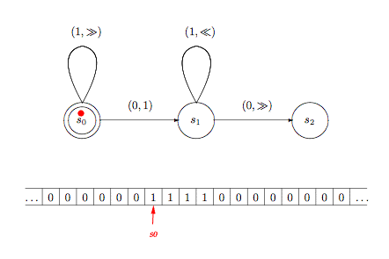
Compiling Java to TM
A: “Computational problem P
is computable by a Java Prog.”
Computable
∃ Java J, ∀ input I, P(I)=J(I)
A problem is computable
if it can be computed by
Turing Machine
Turing (1936)
I am going to define the first model of computation.

Slide 46

Compiling Java to TM
A: “Computational problem P
is computable by a Java Prog.”
Computable
∃ Java J, ∀ input I, P(I)=J(I)
Equivalent via
compiler to:
Java:
If a boy can do it, a girl can do it better.
If a Turing Machine can do it,
a Java program can simulate it.
If a Java program can do it,
a Turing Machine can simulate it.
Ζ: “Computational problem P is computable by a TM.”
Ζ:
∃
TM
M, ∀ input I, P(I)=M(I)

Slide 47
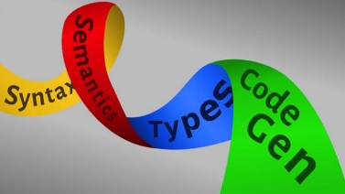
Compiling Java to TM
A: “Computational problem P
is computable by a Java Prog.”
C: “Java programs can be
simulated by TM.”
∃ Java J, ∀ input I, P(I)=J(I)
∀ Java J, ∃ TM M, ∀ I, M(I)=J(I)
J
M
This works just like the compiler
that translates Java code into Machine code.
Ζ: “Computational problem P is computable by a TM.”
Ζ:
∃
TM
M, ∀ input I, P(I)=M(I)

Slide 48
Compiling Java to TM
A: “Computational problem P
is computable by a Java Prog.”
C: “Java programs can be
simulated by TM.”
∃ Java J, ∀ input I, P(I)=J(I)
∀ Java J, ∃ TM M, ∀ I, M(I)=J(I)
Problem P is a free variable.
All the statements know and are about it.
Ζ: “Computational problem P is computable by a TM.”
Ζ:
∃
TM
M, ∀ input I, P(I)=M(I)

Slide 49

Compiling Java to TM
A: “Computational problem P
is computable by a Java Prog.”
C: “Java programs can be
simulated by TM.”
∃ Java J, ∀ input I, P(I)=J(I)
∀ Java J, ∃ TM M, ∀ I, M(I)=J(I)
Prove A&C → Ζ
Assume we have oracles that assure us of A and C.
Then prove Z.
Ζ: “Computational problem P is computable by a TM.”
Ζ:
∃
TM
M, ∀ input I, P(I)=M(I)

Slide 50
Compiling Java to TM
A: “Computational problem P
is computable by a Java Prog.”
C: “Java programs can be
simulated by TM.”
∃ Java J, ∀ input I, P(I)=J(I)
∀ Java J, ∃ TM M, ∀ I, M(I)=J(I)
I assure A.
I know P.
I give you Java J.
You give me input I.
I assure P(I)=J(I).
I assure C.
I know P.
You give me Java J.
I give you TM M.
You give me input I.
I assure M(I)=J(I).
I prove Z.
I know P.
I give you TM M.
You give me input I.
I assure P(I)=M(I).
Ζ: “Computational problem P is computable by a TM.”
Ζ:
∃
TM
M, ∀ input I, P(I)=M(I)

Slide 51
Compiling Java to TM
A: “Computational problem P
is computable by a Java Prog.”
C: “Java programs can be
simulated by TM.”
∃ Java J, ∀ input I, P(I)=J(I)
∀ Java J, ∃ TM M, ∀ I, M(I)=J(I)
I assure A.
I know P.
I give you Java J.
I assure C.
I know P.
You give me Java J.
I give you TM M.
I prove Z.
I know P.
I need to construct TM M.
Ζ: “Computational problem P is computable by a TM.”
Ζ:
∃
TM
M, ∀ input I, P(I)=M(I)

Slide 52
Compiling Java to TM
A: “Computational problem P
is computable by a Java Prog.”
C: “Java programs can be
simulated by TM.”
∃ Java J, ∀ input I, P(I)=J(I)
∀ Java J, ∃ TM M, ∀ I, M(I)=J(I)
I assure A.
I know P.
I give you Java J.
You give me input I.
I assure P(I)=J(I).
I assure C.
I know P.
You give me Java J.
I give you TM M.
You give me input I.
I assure M(I)=J(I).
I prove Z.
I know P.
I give you TM M.
You give me input I.
I assure P(I)=M(I).
I give you worst case input I.
Ζ: “Computational problem P is computable by a TM.”
Ζ:
∃
TM
M, ∀ input I, P(I)=M(I)

Slide 53
Α: ∃ Java J, ∀ input I, P(I)=J(I)
C: ∀ Java J, ∃ TM M, ∀ I, M(I)=J(I)
We know P.
Assume A & C
Z needs to prove Z.
Z needs to construct M.
Z constructs TM M.
Adversary gives
arbitrary I.
Z proves P(I)=M(I)
Ζ:
∃
TM
M, ∀ input I, P(I)=M(I)
Prove A&C → Ζ

Slide 54
Α: ∃ Java J, ∀ input I, P(I)=J(I)
A assures A.
A gives Java J.
A given I.
A assures P(I)=J(I).
Assume A

Slide 55
C: ∀ Java J, ∃ TM M, ∀ I, M(I)=J(I)
C assures C.
C given Java J.
C gives TM M.
C given I.
C assures M(I)=J(I).
Assume C

Slide 56
Α: ∃ Java J, ∀ input I, P(I)=J(I)
C: ∀ Java J, ∃ TM M, ∀ I, M(I)=J(I)
A assures A.
A gives Java J.
A given I.
A assures P(I)=J(I).
C assures C.
C given Java J.
C gives TM M.
C given I.
C assures M(I)=J(I).
We know P.
Assume A & C
Z needs to prove Z.
Z needs to construct M.
Z constructs TM M.
Adversary gives
arbitrary I.
Z proves P(I)=M(I)
by transitivity.
Ζ:
∃
TM
M, ∀ input I, P(I)=M(I)
Prove A&C → Ζ

Slide 57
Α: ∃ Java J, ∀ input I, P(I)=J(I)
C: ∀ Java J, ∃ TM M, ∀ I, M(I)=J(I)
C assures C.
C given Java J.
C gives TM M.
C given I.
C assures M(I)=J(I).
We know P.
Assume A & C
Z needs to prove Z.
Z needs to construct M.
Z constructs TM M.
Adversary gives
arbitrary I.
Z proves P(I)=M(I)
by transitivity.
A assures A.
A gives Java J.
A given I.
A assures P(I)=J(I).
Do this on a test
Ζ:
∃
TM
M, ∀ input I, P(I)=M(I)
Prove A&C → Ζ

Slide 58
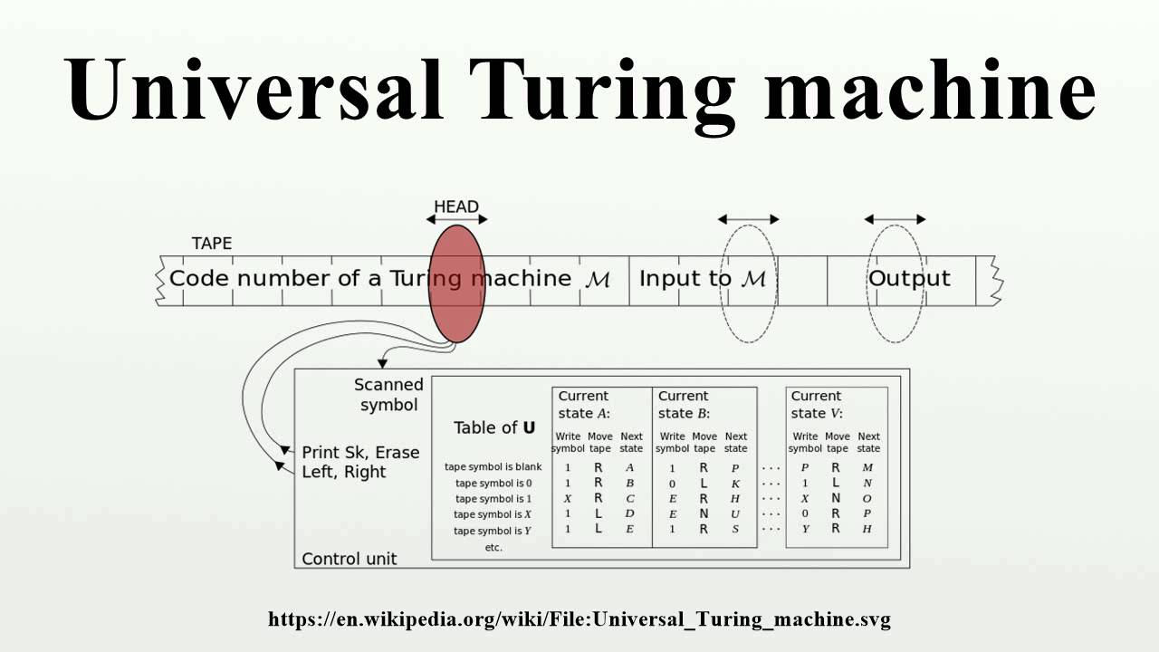
Universal TM

Slide 59

Universal TM
Compute_{M}(I,y) ≡ “M(I)=y”
A Turing Machine (1936)
is the simplest model of computation.
The current configuration of the machine is specified by
  The finite 0/1 string contained in the tape of cells.
  Which tape cell the head is on.
  A single integer specifying the current state.
There transition function δ(q,c) = ⟨q´,c´,direction⟩
current state
char seen
at head
next
state
char to write
at head
left/right direction
for head

Slide 60

Universal TM
We both know that my laptop
given some Java code J
and some input I
can run J on I
and return the result
i.e. Laptop(J,I) = J(I).
Or given the description of a TM M,
Laptop(M,I) = M(I).
A Turing Machine (TM) is a model of computation that can do anything your laptop can do.
M_{Laptop}(J,I) = J(I).
M_{Laptop}(M,I) = M(I).

Slide 61
Universal TM
M_{Laptop}(M,I) = M(I).
_{universal}
A Universal TM is a TM M_{universal} that is given
a description of a TM M and its input I
and simulates this computation.
∃ TM M_{universal} ∀ inputs I_{universal} = ⟨M,I⟩ M_{universal} (M,I) = M(I).
Predicate Logic Game:
We construct M_{universal}
The adversary gives us an arbitrary input I_{universal} = ⟨M,I⟩
(Adversary knows M_{universal} and hence
M can be much bigger than M_{universal})
Prove M_{universal} (M,I) = M(I).

Slide 62
End

