Slide 1
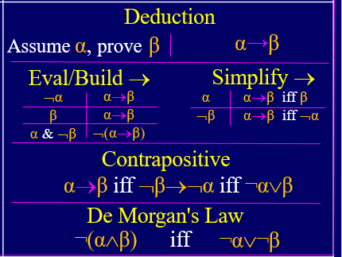
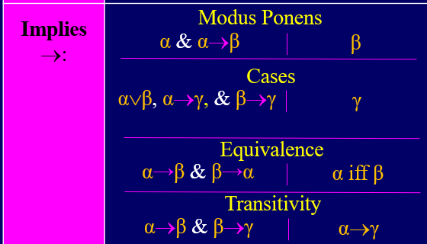
Brute Force Purple Table
1) Deduction Goal: [x=2 or x=5] → [(x−2)(x−5)=0]
2) x=2 or x=5
3) Cases Goal:
4) Case x=2:
5) (x−2)(x−5)=(2−2)(2−5)=(0)(2−5)=0
6) Case x=5:
7) (x−2)(x−5)=(5−2)(5−5)=(5−2)(0)=0
8) (x−2)(x−5)=0
9) [x=2 or x=5] → [(x−2)(x−5)=0]
Assumption/Premise
Cases (2,5,7)
Conclude Deduction
(x−2)(x−5)=0
have
need
Notes:
1

Slide 2
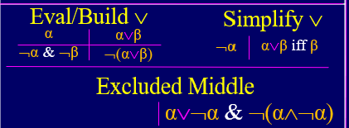
have
need

Slide 3
Brute Force Purple Table
1) Deduction Goal: [(α→β)∧(¬β∨γ)]→[¬γ→¬α]
2) (α→β)∧(¬β∨γ)
3) α→β
¬β∨γ
5) Deduction Goal:¬γ→¬α
6) ¬γ
7) ¬β
¬β→¬α
9) ¬α
10) ¬γ→¬α
11) [(α→β)∧(¬β∨γ)]→[¬γ→¬α]
Assumption/Premise
Separating ∧ (2)
Separating ∧ (2)
Assumption/Premise
Selecting or (4&6)
Contra Positive (3)
Modus Ponens (7&8)
Conclude Deduction
Conclude Deduction
have
need
Notes:
3

Slide 4
Brute Force Purple Table
1) Deduction Goal: [(¬p∨r)∧(p∨q)] → [r∨q]
2) (¬p∨r)∧(p∨q)
3) ¬p∨r
4) p∨q
5) Cases Goal: r∨q
6) p∨¬p
7) Case p:
8) r
9) r∨q
10) Case ¬p:
11) q
12) r∨q
13) r∨q
14) [(¬p∨r)∧(p∨q)] → [r∨q]
Assumption/Premise
Separating ∧ (2)
Separating ∧ (2)
Cases p∧¬p
Excluded Middle
Assumed by cases/deduction
Selecting or from (3&7)
Building/Eval Or (8)
Assumed by cases/deduction
Selecting or from (4&10)
Building/Eval Or (11)
Conclude Cases (6,9&12)
Conclude Deduction
have
need
Notes:
4

Slide 5
We seem to be stuck.
Considering all 2³=8 assignment (table method) is not that elegant.
A proof that handles all cases at the same time is better.
Branching once is a compromise.
Notes:
5

Slide 6
Brute Force Purple Table
1) Deduction Goal: α→[¬β→[(α∧¬β)∨(¬α∧β)]]
2) α
3) Deduction Goal: [¬β→[(α∧¬β)∨(¬α∧β)]]
4) ¬β
5) (α∧¬β)
6) (α∧¬β)∨(¬α∧β)]
7) [¬β→[(α∧¬β)∨(¬α∧β)]]
8) α→[¬β→[(α∧¬β)∨(¬α∧β)]]
Assumption/Premise
Assumption/Premise
Building/Eval∧(2&4)
Building/Eval or (5)
Conclude Deduction
Conclude Deduction
Notes:
6

Slide 7
Brute Force Purple Table
1) Deduction Goal: α → [[(α∧¬β)∨(¬α∧β)]→¬β]
2) α
3) Deduction Goal: [(α∧¬β)∨(¬α∧β)] → ¬β
(α∧¬β)∨(¬α∧β)
5) ¬(¬α∧β)
6) (α∧¬β)
7) ¬β
8) [(α∧¬β)∨(¬α∧β)] → ¬β
9) α → [[(α∧¬β)∨(¬α∧β)]→¬β]
Assumption/Premise
Assumption/Premise
Building/Eval ∧ (2)
Selecting Or (4&5)
Separating ∧ (6)
Conclude Deduction
Conclude Deduction
have
need
Notes:
7

Slide 8
Brute Force Purple Table
1) Deduction Goal: [(α→γ)∧(β→γ)] → [(α or β)→γ]
2) (α→γ)∧(β→γ)
3) α→γ
4) β→γ
5) Deduction Goal: (α or β) → γ
6) α or β
7) γ
8) (α or β)→γ
9) [(α→γ)∧(β→γ)] → [(α or β)→γ]
Assumption/Premise
Separating ∧ (2)
Separating ∧ (2)
Assumption/Premise
Cases (3,4&6)
Conclude Deduction
Conclude Deduction
Notes:
8

Slide 9
Brute Force Purple Table
1) Deduction Goal: [(α or β)→γ] → [(α→γ)∧(β→γ)]
2) (α or β)→γ
3) Deduction Goal: α→γ
4) α
5) α or β
6) γ
7) α→γ
8) β→γ
9) (α→γ)∧(β→γ)
10) [(α or β)→γ] → [(α→γ)∧(β→γ)]
Assumption/Premise
Assumption/Premise
Building/Eval Or (4)
Modus Ponens (2&5)
Conclude Deduction
Similar to (3-7)
Building ∧ (7&8)
Conclude Deduction
Notes:
9

Slide 10
Brute Force Purple Table
Burte Force Purple Table: From α∨β, α→γ, ∧ β→γ, conclude γ
α∨β
α→γ
β→γ
11. ⌐γ → ⌐(α∨β)
12. (α∨β) → γ
13. γ
Assume proved already
Assume proved already
Assume proved already
Contra Positive (11)
Modus Pones (1&12)
Need divine inspiration.
have
need
Notes:
10

Slide 11
Brute Force Purple Table
Burte Force Purple Table: From α∨β, α→γ, ∧ β→γ, conclude γ
α∨β
α→γ
β→γ
Deduction Goal: ⌐γ → ⌐(α∨β)
⌐γ
⌐γ → ⌐α
⌐γ → ⌐β
⌐α
⌐β
⌐(α∨β)
⌐γ → ⌐(α∨β)
(α∨β) → γ
γ
Assume proved already
Assume proved already
Assume proved already
Assume f or →
Contra Positive (2)
Contra Positive (3)
Modus Pones (5&6)
Modus Pones (5&7)
Eval/Build ∨: (8&9)
Conclude
Contra Positive (11)
Modus Pones (1&12)
have
need
Notes:
11

