Slide 2
Tautologies, Equivalences, & Proofs
And
Or
Proof Techniques/Lemmas
And ∧:
Or ∨:
Implies →:
Using:
Proving:
From:
Conclude:
From:
Conclude:
Separating And
Eval/Build ∧
Simplify ∧
α∧β
α & β
α & β
¬α
α∧β
¬(α∧β)
α
α∧β iff β
Selecting Or
Eval/Build ∨
Simplify ∨
α∨β & ¬α
β
α
¬α & ¬β
α∨β
¬(α∨β)
α∨β iff β
¬α
Cases
Excluded Middle
α∨β, α→γ, & β→γ
γ
α∨¬α & ¬(α∧¬α)
Modus Ponens
Deduction
α & α→β
β
Assume α, prove β
α→β
Cases
Eval/Build →
Simplify →
α∨β, α→γ, & β→γ
γ
¬α
β
α & ¬β
α→β
α→β
¬(α→β)
α
¬β
α→β iff β
α→β iff ¬α
Equivalence
Contrapositive
α→β & β→α
α iff β
α→β iff ¬β→¬α iff ¬α∨β
Transitivity
De Morgan's Law
α→β & β→γ
α→γ
¬(α∧β) iff
¬α∨¬β
Double Negation: ¬¬α iff α
Commutative: α∨β iff β∨α and α∧β iff β∧α
Distributive: γ∧(α∨β) iff (γ∧α)∨(γ∧β) and γ∨(α∧β) iff (γ∨α)∧(γ∨β)
By Contradiction: From ¬α→(β&¬β), conclude α.
Inconsistent: From β and ¬β, conclude anything.

Slide 3
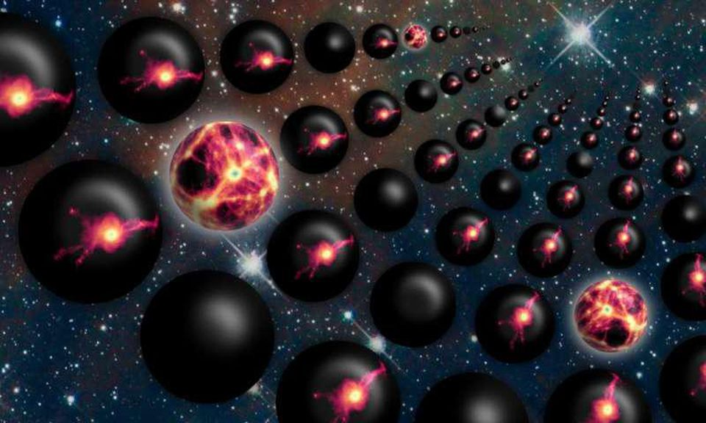
What Our Logic Is and Is Not
α | β | α→β
T | T | T
T | F | F
F | T | T
F | F | T
In which is α→β true?
⟨α,β⟩ =
⟨F,F⟩
“If is α true,
then so is β”
can be confusing because people think
of causality.
⟨T,F⟩
⟨F,T⟩
⟨T,T⟩

Slide 4
What Our Logic Is and Is Not
α | β | α→β
T | T | T
T | F | F
F | T | T
F | F | T
Suppose I tell you α→β.
⟨α,β⟩ =
⟨F,F⟩
Instead, use the
operation’s table.
“It is not true that
α is true β is not.”
⟨T,F⟩
⟨F,T⟩
⟨T,T⟩
T
T
F
α→β =
T

Slide 5
What Our Logic Is and Is Not
α | β | α→β
T | T | T
T | F | F
F | T | T
F | F | T
Telling you α is true,
eliminates other possibilities.
⟨α,β⟩ =
⟨F,F⟩
⟨T,F⟩
⟨F,T⟩
⟨T,T⟩
T
T
F
α→β =
T

Slide 6
What Our Logic Is and Is Not
α | β | α→β
T | T | T
T | F | F
F | T | T
F | F | T
In all the worlds remaining possible,
β is true.
⟨α,β⟩ =
⟨F,F⟩
⟨T,F⟩
⟨F,T⟩
⟨T,T⟩
T
T
F
α→β =
T

Slide 7
What Our Logic Is and Is Not
Modus Ponens:
From α and α→β, conclude β.
“If is α true,
then so is β”
Hey we still do use this!
α | β | α→β
T | T | T
T | F | F
F | T | T
F | F | T
From this we can conclude ….
⟨α,β⟩ =
⟨F,F⟩
⟨T,F⟩
⟨F,T⟩
⟨T,T⟩
T
T
F
α→β =
T

Slide 8
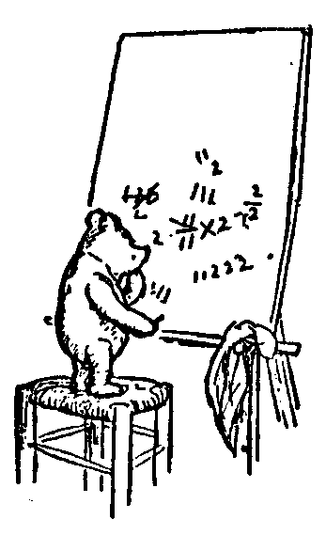
Logic and Proofs
Predicates and Quantifiers
∀boys b, Loves(b)
Math 1019
Math 1090
Objects, Predicates, & Relations
∃ & ∀
Order of Quantifiers: ∃∀ vs ∀∃
Negations
Quantifiers and Games
Humans are Mortal
Understanding from the Inside
Playing the Game
Proof by Contradiction
Formal Proofs Systems
Free and Bound Variables
Truth Game
A Game Tree
Negations
Restricted Domain
Empty Set
Sets of Tuples
Skolem/Auxiliary Functions
Oracles:
  Help from an Oracle
  Proof Game with Oracle
  Order of Quantifiers
  Example from Exercises
  Follow the Parse Tree 2 3
  Diagonal
  Function f
  Distributive Laws for ∀ and →
  Finding vs Verifing Model
Tutorials
  Euclidian Geometry
Overview of Topics
Jeff Edmonds
York University
Lecture 2
Math/EECS 1019/1090

Slide 9





∃∀ vs ∀∃
“There is a girl
for all boys to love.”
Sam
Mary
 |  |  | T
 |  |  | T
 |  |  | T
 |  |  | T
Bob
Beth
John
Marilyn Monroe
“There is a inverse (eg ¹/₃)
for all reals.”
One girl
Fred
Ann
Not clear.
Sam
Mary
 |  | T | T
 |  | T | T
 | T |  | T
 |  | T | T | T
Bob
Beth
John
Marilyn Monroe
Fred
Ann
Could be a separate girl.
Sam
Mary
 |  | T
 |  |  | T
 | T
 |  |  |  | T
“For each boy,
there is a girl.”
Bob
Beth
John
Marilyn Monroe
“For each person,
there is God.”
Fred
Ann
His special woman.

Slide 10

Proof Game with Oracle
∀U,Loves,day
∀M
∀b,∀g,∀day Loves(b, g, day) →
Prove:
∀b, ∃g, Loves(b, g, day)
I must insist that you prove this using the following game.
Three players:
Prover:
Adversary:
Oracle:
Works to prove the statement is true
provides good ∃ objects
asks for help from oracle
makes conclusion
Works to disprove the statement
provides worst case ∀ objects
defines the universe M
Assures and manifests any assumptions
about A when proving A→B
maybe defines the universe M
valid

Slide 11

Proof Game with Oracle
Three players:
Adversary:
prover:
Oracle:
If there is an implied ∀M, I go first providing
worst case U, functions, relations and free vars.
I prove formula is true
with the Adversary’s choices and the Oracle’s help.
If ∀x,
If ∃y,
If or,
If →,
I assure A from A→B.
If ∀x,
If ∃y,
If or,
If →,
provides worst x.
constructs best y.
chooses which side to prove.
get new oracle to assure LHS.
queries about his favorite x.
provides best y.
chooses which side to prove.
assures LHS, then assures the RHS.
or use modus ponens.

Slide 12


Quantifiers and Games
∀x, ∃y, y>x
Let’s understand this deeply
For All integer x,
there Exists a y
that is bigger.
x?
0?
1?
2?
3?
…
The integers go on forever.
No matter how many people are in the hot tub,
you can always fit one more.
y is bigger.
1 is bigger.
2 is bigger.
3 is bigger.
4 is bigger.

Slide 13
Quantifiers and Games
Say, I have a game for you.
We will each choose an integer.
You win if yours is bigger.
I am so nice. I will even let you go first.
Easy.
I choose a trillion trillion.
Well done. That is big!
But I choose a trillion trillion and one
so I win.
Good game.
Let me try again. I will win this time!

Slide 14

∃∀ vs ∀∃
This creates a function p=p∃(v).
Sam
Beth
p∃
Fred
Ann
∀b, ∃g, Loves(b, g)
Sam
Mary
 |  | T
 |  |  | T
 | T
 |  |  |  | T
Bob
Beth
John
Marilyn Monroe
Fred
Ann
His special woman.

Slide 15

Example
Build the Parse Tree.
Prove:
[ (∃x α(x) → ∃y β(y)) & ∀y ⌐β(y) ] → (∀y ⌐α(y))
(∃x α(x) → ∃y β(y)) & ∀y ⌐β(y)
∀y ⌐α(y)
[ ]
[ ]
∃x α(x) → ∃y β(y)
∀y ⌐β(y)
1
2
⌐∃x β(x) → ⌐∃y α(y)
∀y ⌐β(y) → ∀y ⌐α(y)
If someone assures me of ∀y ⌐β(y),
I will assure that ∀y ⌐α(y).
Done
Done

Slide 16
Our Formal Proof Systems
          Lemmas/Theorems:
            Starting with all propositional tautologies (See slides).
            Prove new lemmas with quantifiers.
            Use lemmas via substitutions.
Deduction α→β:
  Assume α(x→), prove β(x→), conclude α(x)→β(x).
  Within the assumption block
  we are only assuming that α(x→) is true for some object x→.
  Hence, from α(x→) you can conclude ∃x→ α(x→),
  but the → on the x prevents you from concluding ∀x→ α(x→).
  Similarly, add → to any free variable in your axioms.
  After the assumption block, we conclude ∀x [α(x)→β(x)],
  because we did this for an arbitrary object x→.

Slide 17
Our Formal Proof Systems
Rules (Adding/Removing ∀/∃):
These help define and to work with quantifiers.
  Removing ∀:
    From line ∀x α(x), include line α(term(x)) (eg α(x)).
  Adding ∀:
    From line α(x), include line ∀x α(x).
    Cannot be done for fixed x∃ or x→.
  Removing ∃:
    From line ∃y α(y), include line α(y∃).
    From line ∃y α(x,y), include line α(x,y∃(x)).
    Note y∃ is a fixed object while y∃(x) depends on x.
    If needed use y_{1∃}, y_{2∃}, … to make sure they are not reused.
  Adding ∃:
    From line α(term), include line ∃y α(y).
    Cannot be done if term depends on x bounded with ∀x.
  Negating ∀&∃: ¬∃x α(x) iff ∀x ¬α(x)

Slide 18
Diagonal
Build the Parse Tree.
[∃y, ∀x, α(x,y)] → [∃d, α(d,d)]
∃y, ∀x, α(x,y)
∃d, α(d,d)
I assure you
by giving ∃
and receiving ∀.
I prove
by constructing ∃
and receiving ∀.

Slide 19

Diagonal
Build intuition.
x
y∃
[∃y, ∀x, α(x,y)] → [∃d, α(d,d)]
α
y
This means there is some row
that is all true.
y∃
T
T
T
T
There is a spot on the diagonal
that is true.
Yes α(y∃,y∃).

Slide 20

Diagonal
x
∀U,α,
[∃y, ∀x, α(x,y)] → [∃d, α(d,d)]
α
y
?
I get to get to provide
the worse case universe
ie. set of objects U,
relations α.
My goal is to prove A → C.

Slide 21
Diagonal
x
y∃
∀U,α,
[∃y, ∀x, α(x,y)] → [∃d, α(d,d)]
α
Assume ∃y, ∀x, α(x,y).
I can help you!
y
T
y∃
T
T
T
T
T
My goal is to prove ∃d, α(d,d).
I need to construct a value d∃.
?
Hey, I have a value of y∃
that you can have.
My goal is to prove α(y∃,y∃).
My x is this same y∃.
I am going to give this value y∃
to x to my oracle.
Knowing ∀x, α(x,y∃) is true for every x,
I can assure you that it is true for yours.
Hence
valid.
Hence α(y∃,y∃).

Slide 22
Diagonal
[∃y, ∀x, α(x,y)] → [∃d, α(d,d)]
Formal Proof:
Goal ∃y, ∀x, α(x,y) → ∃d, α(d,d)
∃y, ∀x, α(x,y)
∀x, α(x,y∃)
α(y∃,y∃)
∃d, α(d,d)
∃y, ∀x, α(x,y) → ∃d, α(d,d)
Assume for →
Remove ∃
Remove ∀ with t=y∃
Add ∃
Conclude
have
need

Slide 23
Free Variable Fail
∀U,α,c,
Prove:
α(x) → ∀x α(x)
same
∀U,α,c,, …
α(c) → ∀x α(x)
I must prove α(x) → ∀x α(x).
α(x) → ∀x α(x)
Assume α(c).
Knowing it, I can help you!
α(c)
∀x α(x)
I need to prove ∀x α(x).
α(x)
I give you an arbitrary value x for x.
I need to prove α(x).
I know α(c) is true, but not α(x).
Ooops. The statement is not valid.

