Slide 1
Prove these:
Identity Laws:
Domination Laws:
Idempotent laws:
Double Negation Law:
Negation Laws:
Absorption Laws:
1

Slide 2
Prove these:
TABLE 7 Logical Equivalences Involving Conditional Statements.
TABLE 8 Logical Equivalences Involving Biconditional Statements.
The following content is arranged like a table.
The following content is arranged like a table.
2

Slide 3
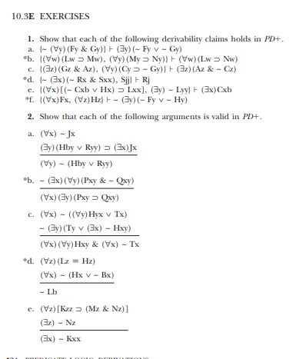
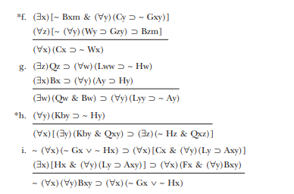

Slide 4
