Slide 1
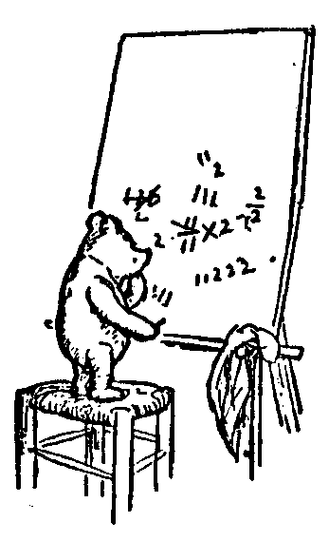
Logic for Computer Science
Vector Spaces
Vector Space
Spanning the Space
Change of Basis
Generalize
Colour
Error Correcting Codes
Fourier Transformation
Polynomials & Integer Multiplication
JPEG Image Compression
Dimension Reduction Face Recognition
Linear Transformations
Calculous
Probabilistic Markov Process
Quantum Probability
Jeff Edmonds
York University
Lecture 6.4
Math1090,EEC6111

Slide 2
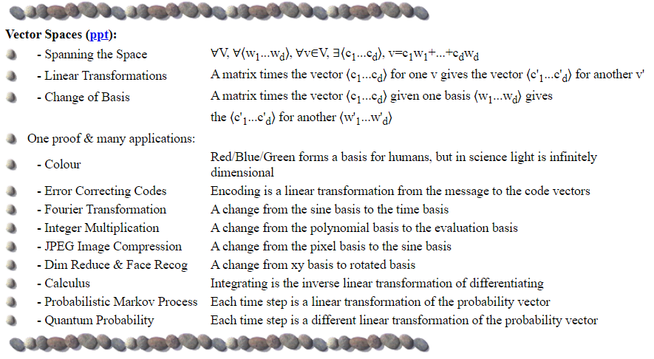
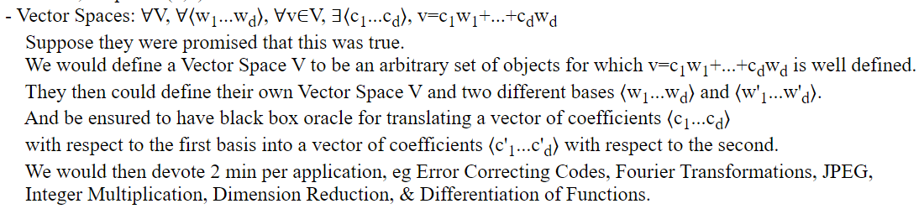
Vector Spaces

Slide 3
Vector Spaces

Slide 4
Vector Spaces
The point of formal proofs is
to prove theorems
with as few assumptions as possible
about the nature of the objects
we are talking about
so that we can find a wide range
of strange new objects
for which the same theorems are true.
Notes:
4

Slide 5
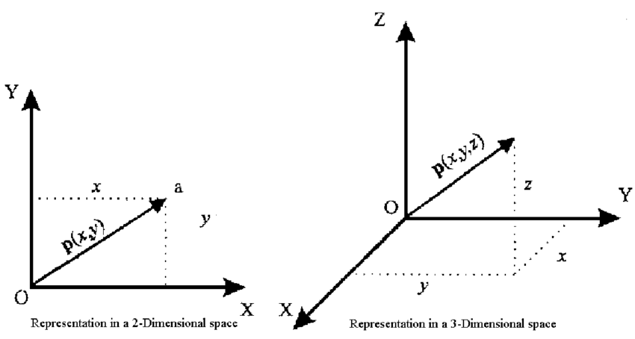
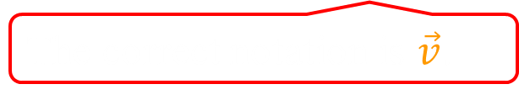
Vector Spaces
We learned about vectors in math or in physics.
Ok. So we all know about Euclidian Space.
A vector v is:
is an arrow with a direction and a length
  is a tuple of real ⟨a₁,a₂,…,a_{d}⟩ of coeficients
d is the # of dimensions.
The correct notation is $\vec{v}$.
v = ⟨a₁,a₂,a₃⟩
a₁
v = ⟨a₁,a₂⟩
a₂
a₂
a₁
a₂

Slide 6
Vector Spaces
We learned about vectors in math or in physics.
Ok. So we all know about Euclidian Space.
A vector v is:
is an arrow with a direction and a length
  is a tuple of real ⟨a₁,a₂,…,a_{d}⟩ of coefficients
d is the # of dimensions.
What can you prove?
  4
  ⟨3,4⟩
v =
  3

Slide 7
Vector Spaces
basis = ⟨w₁,w₂,…,w_{d} ⟩ of vectors
∀ vector v in the entire space
  ∃ real coefficients ⟨a₁,a₂,…,a_{d} ⟩
    v = a₁w₁+a₂w₂ +… + a_{d}w_{d}
∀
(linearly independent)
i.e. none is sum
of the others
So
We say the basis spans the space
uniquely
Can we generalize this to get something new?
Standard
  Basis = ⟨w₁,w₂⟩
  = ⟨ , ⟩
What is special
about this basis?
  ⟨3,4⟩
v =
  ⟨a₁,a₂⟩ =
  ⟨3,4⟩
Notes:
7

Slide 8
Vector Spaces
∀ basis = ⟨w₁,w₂,…,w_{d} ⟩ of vectors (linearly independent)
∀ vector v in the entire space
  ∃ real coefficients ⟨a₁,a₂,…,a_{d} ⟩
    v = a₁w₁+a₂w₂ +… + a_{d}w_{d}
    = a₁w₁+a₂w₂ +… + a_{d}w_{d}
Ok that is more cool.
Every basis
can be used to reach every place.
´
´
´
´
´
´
Standard
Strange
  Basis = ⟨w₁,w₂⟩
  = ⟨ , ⟩
  Basis = ⟨w₁,w₂⟩
  = ⟨ , ⟩
v =
v =
⟨a₁,a₂⟩ =
  ⟨3,-1⟩
  ⟨a₁,a₂⟩ =
  ⟨3,4⟩
´
´
Notes:
8

Slide 9
Vector Spaces
∀ basis = ⟨w₁,w₂,…,w_{d} ⟩ of vectors (linearly independent)
∀ vector v in the entire space
  ∃ real coefficients ⟨a₁,a₂,…,a_{d} ⟩
    v = a₁w₁+a₂w₂ +… + a_{d}w_{d}
    = a₁w₁+a₂w₂ +… + a_{d}w_{d}
´
´
´
´
´
´
Change of Basis: Converting between
  ⟨a₁,a₂,…,a_{d} ⟩ and ⟨a₁,a₂,…,a_{d} ⟩
´
´
´
Standard
Strange
  Basis = ⟨w₁,w₂⟩
  = ⟨ , ⟩
  Basis = ⟨w₁,w₂⟩
  = ⟨ , ⟩
v =
v =
⟨a₁,a₂⟩ =
  ⟨3,-1⟩
  ⟨a₁,a₂⟩ =
  ⟨3,4⟩
´
´
Notes:
9

Slide 10
Vector Spaces
∀ basis = ⟨w₁,w₂,…,w_{d} ⟩ of vectors (linearly independent)
∀ vector v in the entire space
  ∃ real coefficients ⟨a₁,a₂,…,a_{d} ⟩
    v = a₁w₁+a₂w₂ +… + a_{d}w_{d}
    = a₁w₁+a₂w₂ +… + a_{d}w_{d}
The point of formal proofs is
to prove theorems
with as few assumptions as possible
about the nature of the objects
we are talking about
so that we can find a wide range
of strange new objects
for which the same theorems are true.
´
´
´
´
´
´
Change of Basis: Converting between
  ⟨a₁,a₂,…,a_{d} ⟩ and ⟨a₁,a₂,…,a_{d} ⟩
´
´
´
Excellent
Lets talk about new things.
Notes:
10

Slide 11
Vector Spaces
Def^{n}: vectors space
vectors u,v,w ∀ reals a,b
Closed: a×u + b×v is a vector, 0×u=zero vector, 1×u=u.
Associative: u+(v+w) = (u+v)+w
Commutative: u+v = v+u
Distributive: a×(u+v) = a×u + a×v
+ Inverse: ∀v ∃u u+v=0, i.e. v=-u
Given these things,
a Math 1090 like proof
can prove our statement!
∀ basis = ⟨w₁,w₂,…,w_{d} ⟩ of vectors (linearly independent)
∀ vector v in the entire space
  ∃ real coefficients ⟨a₁,a₂,…,a_{d} ⟩
    v = a₁w₁+a₂w₂ +… + a_{d}w_{d}
Proved in the grad class.
But really not very hard.
Notes:
11

Slide 12
Vector Spaces
Def^{n}: vectors space
vectors u,v,w ∀ reals a,b
Closed: a×u + b×v is a vector, 0×u=zero vector, 1×u=u.
Associative: u+(v+w) = (u+v)+w
Commutative: u+v = v+u
Distributive: a×(u+v) = a×u + a×v
+ Inverse: ∀v ∃u u+v=0, i.e. v=-u
These conditions are not so hard to meet.
A vector v could be:
u =
v =
3u + 2v =
Arrow
knapsack
Notes:
12

Slide 13
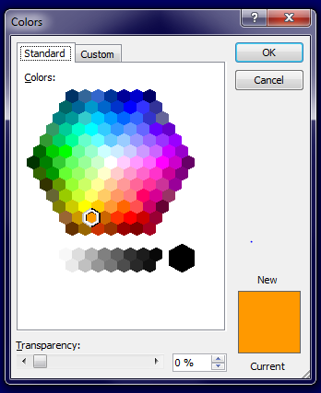
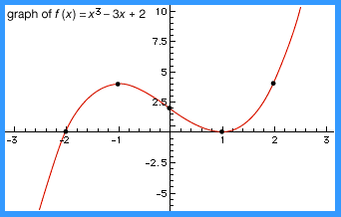
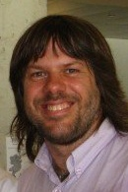
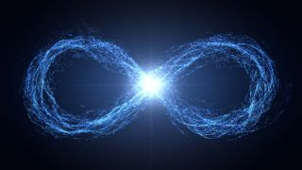
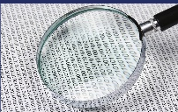
Vector Spaces
Def^{n}: vectors space
vectors u,v,w ∀ reals a,b
Closed: a×u + b×v is a vector, 0×u=zero vector, 1×u=u.
Associative: u+(v+w) = (u+v)+w
Commutative: u+v = v+u
Distributive: a×(u+v) = a×u + a×v
+ Inverse: ∀v ∃u u+v=0, i.e. v=-u
These conditions are not so hard to meet.
A vector v could be:
Arrow
knapsack
Colour
Error Correcting
Codes
Function
Image
Probabilities
& Quantum
Notes:
13

Slide 14
Vector Spaces
∀ vectors space (with some reasonable properties)
∀ basis = ⟨w₁,w₂,…,w_{d} ⟩ of vectors (linearly independent)
∀ vector v in the entire space
  ∃ real coefficients ⟨a₁,a₂,…,a_{d} ⟩
    v = a₁w₁+a₂w₂ +… + a_{d}w_{d}
    = a₁w₁+a₂w₂ +… + a_{d}w_{d}
´
´
´
´
´
´
Change of Basis: Converting between
  ⟨a₁,a₂,…,a_{d} ⟩ and ⟨a₁,a₂,…,a_{d} ⟩
´
´
´
A vector v could be:
Arrow
knapsack
Colour
Error Correcting
Codes
Function
Image
Probabilities
& Quantum
Notes:
14

Slide 15
Colour
Colour:
  Each frequency f of light is a “primary colour”.
  Each colour contains a mix of these
    ie a linear combination a₁f₁+a₂f₂ +… + a_{d}f_{d}
  What is the dimension d of this vector space?
    Infinite, because there are an infinite
    number of frequencies
  Do we see all of these colours?
A vector v could be:
Colour
Notes:
15

Slide 16
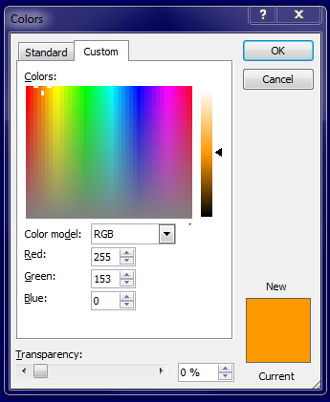
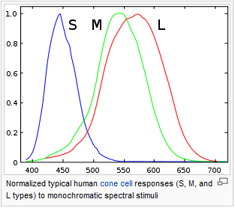
Colour
Colour:
  No, we have three sensors that detect frequency
  so our brain only returns three different real values.
  What is the dimension d of the vector space
  of colours that humans see?
  d = 3. Each colour is specified by a vector [255,153,0]
Notes:
16

Slide 17
Colour
Colour:
  The basis colours?
    Bases = <red,green,blue>
    Or = <red,blue,yellow>
Notes:
17

Slide 18
Colour
Colour:
  The basis colours?
    Bases = <red,green,blue>
    Or = <red,blue,yellow>
Change of Basis: Converting between
  ⟨a₁,a₂,…,a_{d} ⟩ and ⟨a₁,a₂,…,a_{d} ⟩
´
´
´
Standard
Strange
  Basis = ⟨w₁,w₂⟩ = ⟨ , ⟩
  Basis = ⟨w₁,w₂⟩ = ⟨ , ⟩
v =
v =
⟨a₁,a₂⟩ =
  ⟨3,-1⟩
  ⟨a₁,a₂⟩ =
  ⟨3,4⟩
´
´
Notes:
18

Slide 19
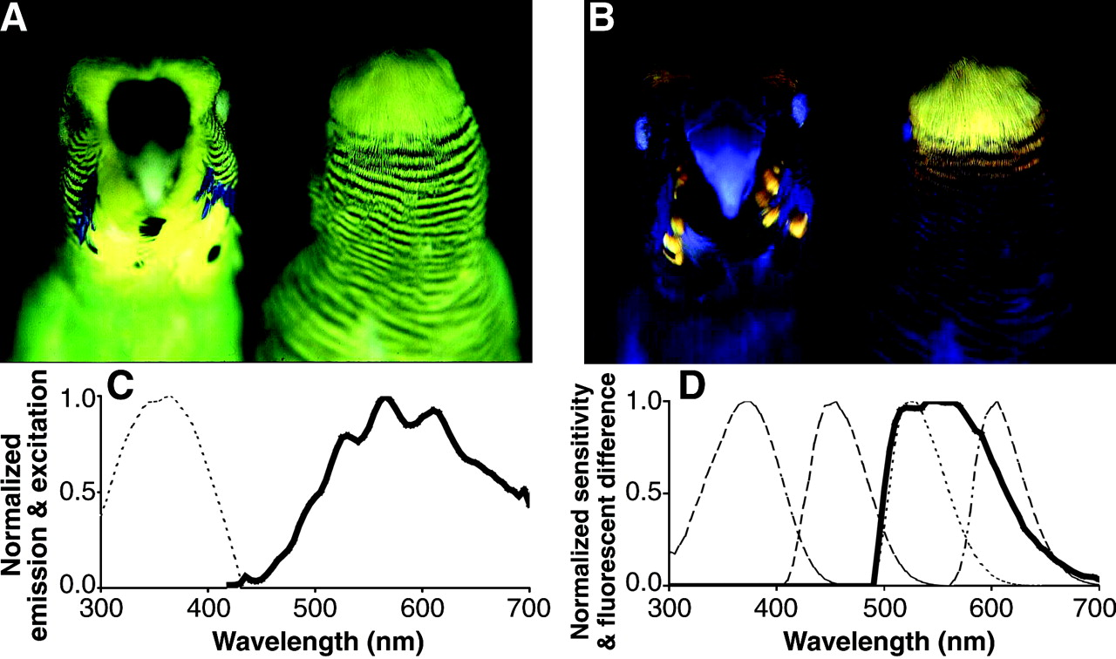
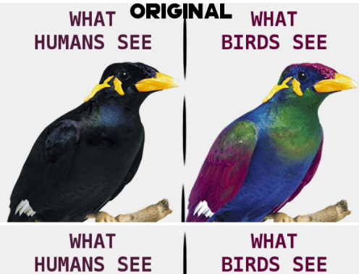
Colour
Colour:
  The basis colours?
    Bases = <red,green,blue>
    Or = <red,blue,yellow>
And a 4th dimension
Notes:
19

Slide 20
Error Correcting Codes
∀ vectors space (with some reasonable properties)
∀ basis = ⟨w₁,w₂,…,w_{n} ⟩ of vectors (linearly independent)
∀ vector v in the entire space
  real coefficients
  ⟨a₁,a₂,…,a_{d} ⟩
  v = a₁w₁+a₂w₂ +… + a_{d}w_{d}
I have a d digit message
I encode it into an n digit code
and send it to you.
I corrupt some of the digits.
I can detect up to r-1 errors.
I can correct up to ^{(r-1)}/₂ errors
and recover the message.
Error Correcting
Codes

Slide 21
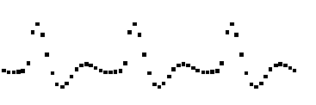
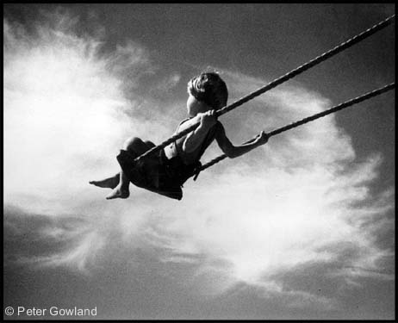
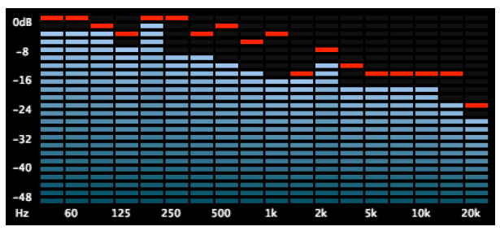
Fourier Transformation
A discrete periodic function
y[j]
j
Find the contribution
of each frequency
Swings, capacitors, and inductors
all resonate at a given frequency,
which is how the circuit picks out
the contribution of a given frequency.
Expressing a function as a sum of sine and cosine functions.

Slide 22
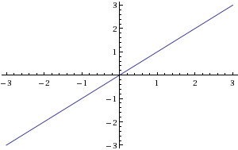
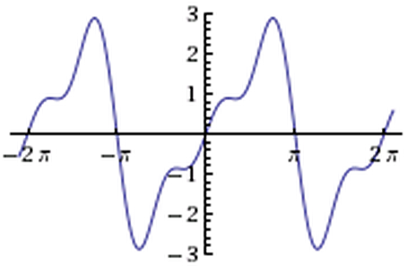
Fourier Transformation
y(x) = x
Surely this can’t be expressed
as sum of sines and cosines.
y(x) ≈ 2 sin(x) - sin(2x) + 2/3 sin(3x)

Slide 23
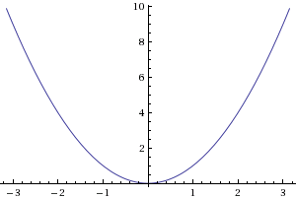
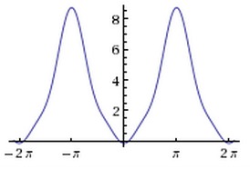
Fourier Transformation
y(x) = x²
y(x) ≈ -4 sin(x) + sin(2x) - 4/9 sin(3x)

Slide 24
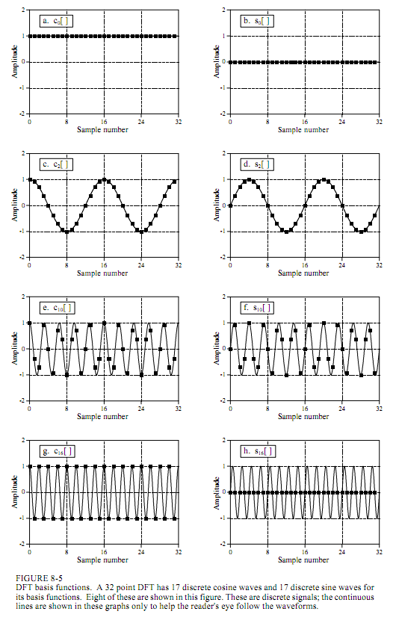
Sine & Cos
Frequency Domain
  w_{f}
´
Function = Vector
Time Domain
A discrete periodic function
The time basis
  v
  w_{j}
y[j]
I_{j}[j’]
  a_{j}
one
zero
j
j
j’
    v = a₁w₁+a₂w₂ +… + a_{d}w_{d}
    v = a₁w₁+a₂w₂ +… + a_{d}w_{d}
´
´
´
´
´
´
a_{t} = value at time t.
a_{f} = amount of frequency f.
´
Standard
Strange
  Basis = ⟨w₁,w₂⟩
  = ⟨ , ⟩
Change of Basis
  Basis = ⟨w₁,w₂⟩
  = ⟨ , ⟩
v =
v =
⟨a₁,a₂⟩ =
  ⟨3,-1⟩
  ⟨a₁,a₂⟩ =
  ⟨3,4⟩
´
´
Notes:
24

Slide 25
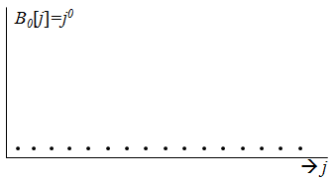
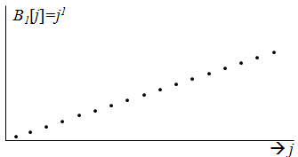
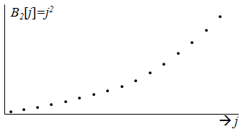
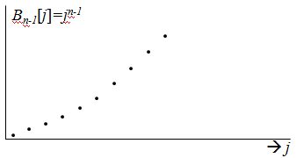
Polynomials
Polynomial Domain
w₀=1
Function = Vector
´
Time Domain
A discrete periodic function
w₁=x
The time basis
´
  w_{j}
  v
I_{j}[j’]
y[j]
  a_{j}
one
w₂=x²
zero
´
j
j
j’
w₃=x³
´
    v = a₁w₁+a₂w₂ +… + a_{d}w_{d}
v = a₀+a₁x +a₂x² + … + a_{n-1}x^{n-1}
´
´
´
´
a_{t} = value at time t.
a_{i} = coefficient of x^{i}.
´
Standard
Strange
  Basis = ⟨w₁,w₂⟩
  = ⟨ , ⟩
Change of Basis
  Basis = ⟨w₁,w₂⟩
  = ⟨ , ⟩
v =
Fitting polynomial to data.
v =
⟨a₁,a₂⟩ =
  ⟨3,-1⟩
  ⟨a₁,a₂⟩ =
  ⟨3,4⟩
´
´
Notes:
25

Slide 26
Integer Multiplication
Polynomial Domain
w₀=1
Function = Vector
´
Time Domain
A discrete periodic function
w₁=x
The time basis
´
  w_{j}
  v
I_{j}[j’]
y[j]
  a_{j}
one
w₂=x²
zero
´
j
j
j’
w₃=x³
´
    v = a₁w₁+a₂w₂ +… + a_{d}w_{d}
v = a₀+a₁x +a₂x² + … + a_{n-1}x^{n-1}
´
´
´
´
a_{t} = value at time t.
a_{i} = coefficient of x^{i}.
´
u = 93824
v = 42738
Goal: Multiply u×v
´
Normally takes O(n²) time!
n = 5 = # of digits
O(nlogn) time!
Notes:
26

Slide 27
Integer Multiplication
Polynomial Domain
w₀=1
Function = Vector
´
Time Domain
A discrete periodic function
w₁=x
The time basis
´
  w_{j}
  v
I_{j}[j’]
y[j]
  a_{j}
one
w₂=x²
zero
´
j
j
j’
w₃=x³
´
    v = a₁w₁+a₂w₂ +… + a_{d}w_{d}
v = a₀+a₁x +a₂x² + … + a_{n-1}x^{n-1}
´
´
´
´
a_{t} = value at time t.
a_{i} = coefficient of x^{i}.
´
Over here multiplying is easy.
FFT Fast Fourier Transform in O(nlogn) time!
v = 42738
= ⟨ 4, 2, 7, 3, 8 ⟩
= ⟨a₄,a₃,a₂,a₁,a₀ ⟩
= a₄x⁴ +a₃x³ +a₂x² +a₁x +a₀
= 4‧10⁴ +2‧10³ +7‧10 ² + 3‧10 + 8
= 42738
´
´
´
´
´
´
´
´
´
´
´
Notes:
27

Slide 28
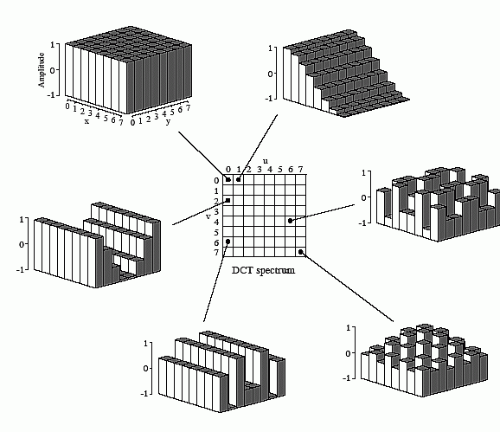

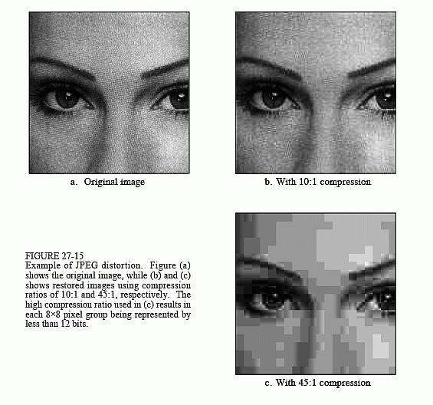
JPEG
Frequency Domain
Image
Pixel Domain
    v = a₁w₁+a₂w₂ +… + a_{d}w_{d}
    v = a₁w₁+a₂w₂ +… + a_{d}w_{d}
´
´
´
´
´
´
a_{f} = amount of frequency f.
a_{ij} = brightness of pixel ⟨ij⟩.
´
Standard
Strange
  Basis = ⟨w₁,w₂⟩
  = ⟨ , ⟩
Change of Basis
  Basis = ⟨w₁,w₂⟩
  = ⟨ , ⟩
v =
v =
⟨a₁,a₂⟩ =
  ⟨3,-1⟩
  ⟨a₁,a₂⟩ =
  ⟨3,4⟩
´
´
Notes:
28

Slide 29
JPEG
Frequency Domain
Image
Pixel Domain
FTP compression
    v = a₁w₁+a₂w₂ +… + a_{d}w_{d}
´
´
´
´
´
´
a_{f} = amount of frequency f.
´
Strange
  Basis = ⟨w₁,w₂⟩
  = ⟨ , ⟩
v =
⟨a₁,a₂⟩ =
  ⟨3,-1⟩
´
´
Notes:
29

Slide 30
Fourier Transformation
Fourier Transform
are a change of basis from the time basis to
  sine/cosine basis
  JPG
  or polynomial basis
Applications
  Signal Processing
  Compressing data (eg images with .jpg)
  Multiplying integers in n logn loglogn time.
  ….
Purposes:
  Some operations on the data are cheaper in new format
  Some concepts are easier to read from the data in new format
  Some of the bits of the data in the new format are less significant
  and hence can be dropped.

Slide 31
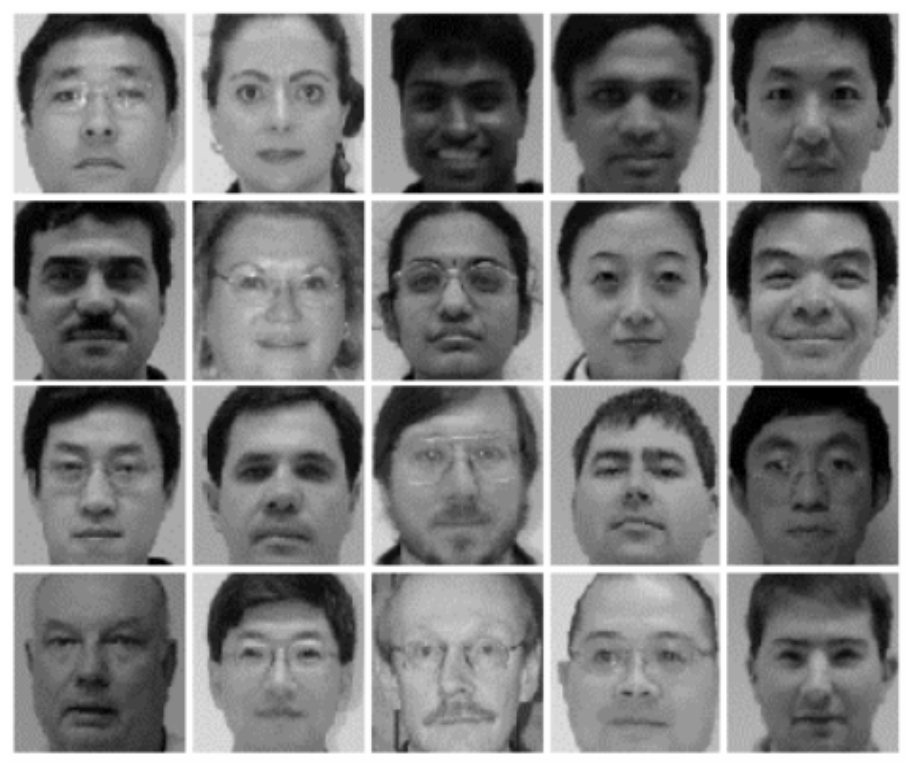
Dimension Reduction
A collection of faces
Our goal is to understand
the distribution of faces better.
By finding simple a model
explaining where this data may
have come from.

Slide 32
Dimension Reduction
A collection of faces
Represent each image by a vector
with a dimension for each pixel.
“Fit” the data with a multi-dimensional ellipse.
Transform from the standard basis ⟨x₁,…,x_{10,000}⟩
to the basis ⟨a₁,…,a_{10,000} ⟩
in the directions giving important features.
Drop all all the coordinates except for ⟨a₁,…,a₁₀₀⟩.
Each described by
10,000 numbers
pixel x₂
pixel x₁

Slide 33
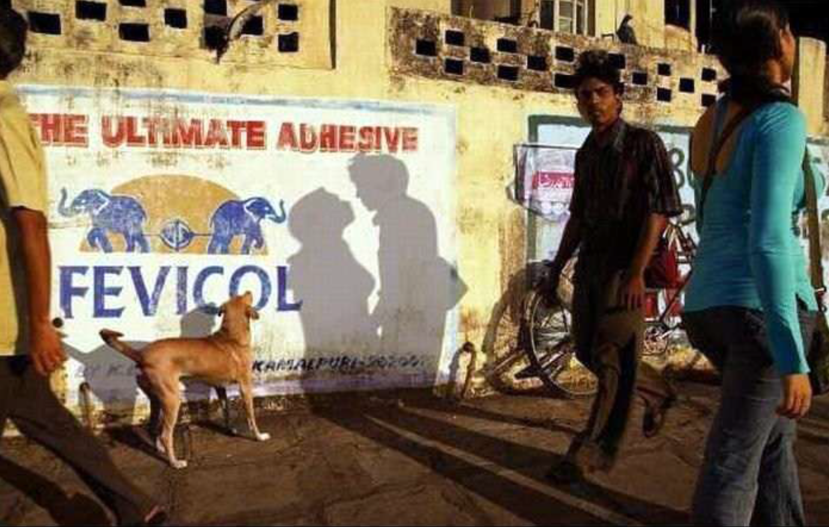
Dimension Reduction
A collection of faces
Represent each image by a vector
with a dimension for each pixel.
“Fit” the data with a multi-dimensional ellipse.
Transform from the standard basis ⟨x₁,…,x_{10,000}⟩
to the basis ⟨a₁,…,a_{10,000} ⟩
in the directions giving important features.
Drop all all the coordinates except for ⟨a₁,…,a₁₀₀⟩.
Each described by
10,000 numbers

Slide 34
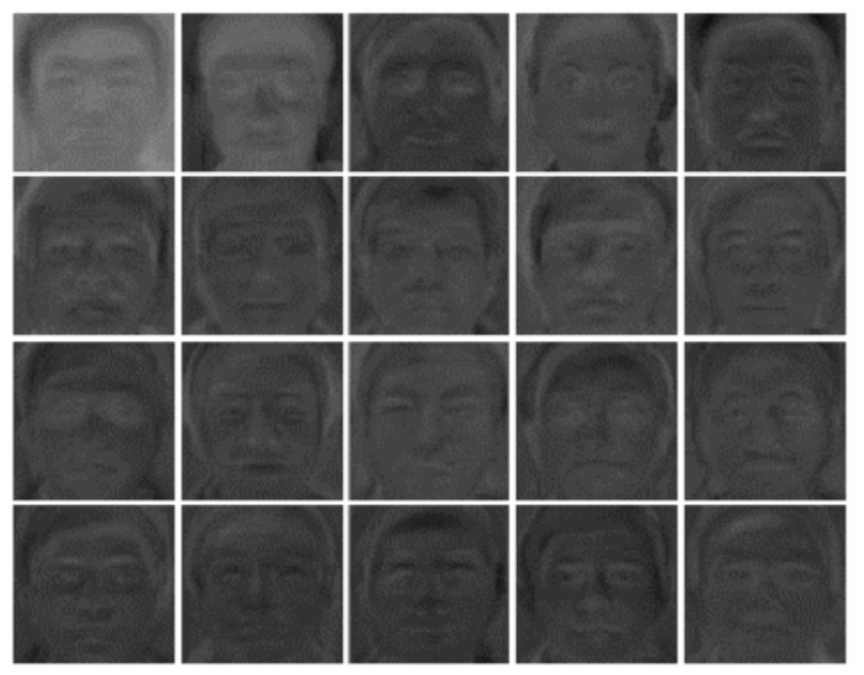
Dimension Reduction
A collection of faces
Represent each image by a vector
with a dimension for each pixel.
“Fit” the data with a multi-dimensional ellipse.
Transform from the standard basis ⟨x₁,…,x_{10,000}⟩
to the basis ⟨a₁,…,a_{10,000} ⟩
in the directions giving important features.
Drop all all the coordinates except for ⟨a₁,…,a₁₀₀⟩.
Each described by
10,000 numbers
Described by
100 numbers
Then recognize
the face using
these 100 numbers

Slide 35
Linear Transformations
Basis = [ , ]
T(
) =
T(
) =
      We only need to know where the basis vectors get mapped
      T(v) = a₁T(w₁) +a₂T(w₂) +… + a_{d}T(w_{d} )
Notes:
35

Slide 36
Integrating
f(x) = x²e^{x}sin x
Can you differentiate it?
Can you integrate it?
Sure!
f’(x) = 2xe^{x}sinx + x²e^{x}sinx + x²e^{x}cosx
Ahh? No ☹
I can!
Think of differentiation as a Linear Transformations and then invert it.
Notes:
36

Slide 37
Integrating
^{δ}/_{δx}(x²e^{x}sinx + x²e^{x}cosx + xe^{x}sinx + xe^{x}cosx + e^{x}sinx + e^{x}cosx)
⁼ 2x²e^{x}cosx + 2xe^{x}sinx + 4xe^{x}cosx + 1e^{x}sinx + 3e^{x}cosx
1 | -1 | 0 | 0 | 0 | 0
1 | 1 | 0 | 0 | 0 | 0
2 | 0 | 1 | -1 | 0 | 0
0 | 2 | 1 | 1 | 0 | 0
0 | 0 | 1 | 0 | 1 | -1
0 | 0 | 0 | 1 | 1 | 1
1
1
1
1
1
1
0
2
2
4
1
3
x²e^{x}sinx
x²e^{x}cosx
xe^{x}sinx
xe^{x}cosx
e^{x}sinx
e^{x}cosx
=
Basis =
Notes:
37

Slide 38
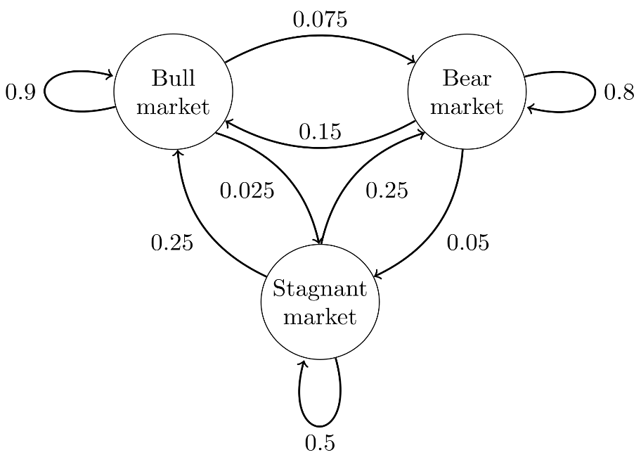

Markov Process ➔ Classical Probability
The present
specified by current state.
  A node for each state
  A dimension for each state
Bull
Bear
Stag
Bull
$$\left[\begin{matrix}.9 & .15 & .25 \\ .075 & .8 & .25 \\ .025 & .05 & .5\end{matrix}\right]\left[\begin{matrix}1 \\ \begin{aligned}0 \\ 0\end{aligned}\end{matrix}\right]=\left[\begin{matrix}.9 \\ \begin{aligned}.075 \\ .025\end{aligned}\end{matrix}\right]$$
Bear
Stag

Slide 39
Markov Process ➔ Classical Probability
The present
specified by current state.
The past
does not matter
The future
determined probabilistically.
Bull
Bear
Stag
Bull
$$\left[\begin{matrix}.9 & .15 & .25 \\ .075 & .8 & .25 \\ .025 & .05 & .5\end{matrix}\right]\left[\begin{matrix}1 \\ \begin{aligned}0 \\ 0\end{aligned}\end{matrix}\right]=\left[\begin{matrix}.9 \\ \begin{aligned}.075 \\ .025\end{aligned}\end{matrix}\right]$$
Bear
Stag

Slide 40
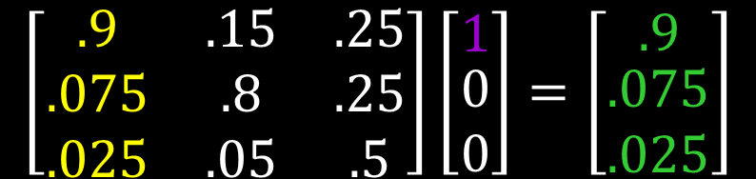

Markov Process ➔ Classical Probability
The present
specified by current state.
The past
does not matter
The future
determined probabilistically.
  Probabilities add to one
$$Pr⁡(future state|present state)$$
Bull
Bear
Stag
Bull
$$\left[\begin{matrix}.9 & .15 & .25 \\ .075 & .8 & .25 \\ .025 & .05 & .5\end{matrix}\right]\left[\begin{matrix}1 \\ \begin{aligned}0 \\ 0\end{aligned}\end{matrix}\right]=\left[\begin{matrix}.9 \\ \begin{aligned}.075 \\ .025\end{aligned}\end{matrix}\right]$$
Bear
Stag

Slide 41
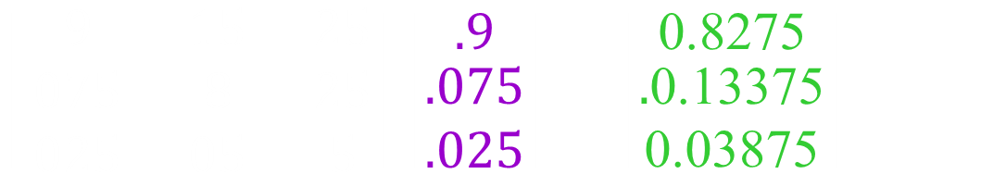
Markov Process ➔ Classical Probability
The present
  A vector of probabilities
  state is current.
  Probabilities add to one
The future determined by
a stochastic transformation.
Bull
Bear
Stag
Bull
$$\left[\begin{matrix}.9 & .15 & .25 \\ .075 & .8 & .25 \\ .025 & .05 & .5\end{matrix}\right]\left[\begin{matrix}.9 \\ \begin{aligned}.075 \\ .025\end{aligned}\end{matrix}\right]=\left[\begin{matrix}\text{0.8275} \\ \begin{aligned}.\text{0.13375} \\ \text{0.03875}\end{aligned}\end{matrix}\right]$$
Bear
Stag

Slide 42
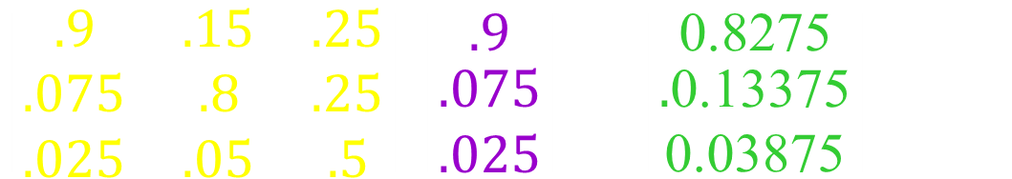
Markov Process ➔ Classical Probability
The present
  A vector of probabilities
  state is current.
  Probabilities add to one
The future determined by
a stochastic transformation.
$\operatorname{Pr}\left(future state\right)$
$= \sum_{present state}{\operatorname{Pr}\left(present state\right)Pr⁡(future state|present state)}$
Bull
Bear
Stag
Bull
$$\left[\begin{matrix}.9 & .15 & .25 \\ .075 & .8 & .25 \\ .025 & .05 & .5\end{matrix}\right]\left[\begin{matrix}.9 \\ \begin{aligned}.075 \\ .025\end{aligned}\end{matrix}\right]=\left[\begin{matrix}\text{0.8275} \\ \begin{aligned}.\text{0.13375} \\ \text{0.03875}\end{aligned}\end{matrix}\right]$$
Bear
Stag

Slide 43
Unary Matrix ➔ Quantum Probability
The present
  A vector of probabilities
  state is current.
  Probabilities add to one
The future determined by
a stochastic transformation.
$\operatorname{Pr}\left(future state\right)$
$= \sum_{present state}{\operatorname{Pr}\left(present state\right)Pr⁡(future state|present state)}$
Bull
Bear
Stag
Bull
$$\left[\begin{matrix}.9 & .15 & .25 \\ .075 & .8 & .25 \\ .025 & .05 & .5\end{matrix}\right]\left[\begin{matrix}.9 \\ \begin{aligned}.075 \\ .025\end{aligned}\end{matrix}\right]=\left[\begin{matrix}\text{0.8275} \\ \begin{aligned}.\text{0.13375} \\ \text{0.03875}\end{aligned}\end{matrix}\right]$$
Bear
Stag

Slide 44

Unary Matrix ➔ Quantum Probability
The present
  A vector of probabilities
  state is current.
  Could be negative
  (or complex)
  I read that all quantum computing
  can be done with the reals.
The future determined by
a transformation.
$\operatorname{Pr}\left(future state\right)$
$= \sum_{present state}{\operatorname{Pr}\left(present state\right)Pr⁡(future state|present state)}$
Bull
Bear
Stag
Bull
$$\left[\begin{matrix}.9 & .15 & .25 \\ .075 & .8 & .25 \\ .025 & .05 & .5\end{matrix}\right]\left[\begin{matrix}.9 \\ \begin{aligned}.075 \\ .025\end{aligned}\end{matrix}\right]=\left[\begin{matrix}\text{0.8275} \\ \begin{aligned}.\text{0.13375} \\ \text{0.03875}\end{aligned}\end{matrix}\right]$$
$$\begin{matrix}\sqrt{1/2} \\ \begin{aligned}−\sqrt{1/2} \\ 0\end{aligned}\end{matrix}$$
Bear
Stag

Slide 45
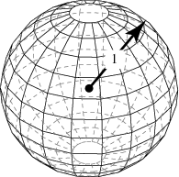
Unary Matrix ➔ Quantum Probability
The present
  A vector of probabilities
  state is current.
  Could be negative
  (or complex)
  Length of vector is 1
  (ie sum of squares)
The future determined by
a transformation.
$\operatorname{Pr}\left(future state\right)$
$= \sum_{present state}{\operatorname{Pr}\left(present state\right)Pr⁡(future state|present state)}$
unary
A rotation
preserving lengths
and angles.
Bull
Bear
Stag
Bull
$$\left[\begin{matrix}.9 & .15 & .25 \\ .075 & .8 & .25 \\ .025 & .05 & .5\end{matrix}\right]\left[\begin{matrix}.9 \\ \begin{aligned}.075 \\ .025\end{aligned}\end{matrix}\right]=\left[\begin{matrix}\text{0.8275} \\ \begin{aligned}.\text{0.13375} \\ \text{0.03875}\end{aligned}\end{matrix}\right]$$
cosθ | -sinθ
sinθ | cosθ
$$\begin{matrix}\sqrt{1/2} \\ \begin{aligned}−\sqrt{1/2} \\ 0\end{aligned}\end{matrix}$$
Bear
Stag
1

Slide 46
Unary Matrix ➔ Quantum Probability
The present
  A vector of probabilities
  state is current.
  Could be negative
  (or complex)
  Length of vector is 1
  (ie sum of squares)
The future determined by
a transformation.
$\operatorname{Pr}\left(future state\right)$
$= \sum_{present state}{\operatorname{Pr}\left(present state\right)Pr⁡(future state|present state)}$
unary
A rotation
preserving lengths
and angles.
Bull
Bear
Stag
Bull
Rows/columns
orthonormal
ie length one
and perpendicular
$$\left[\begin{matrix}.9 & .15 & .25 \\ .075 & .8 & .25 \\ .025 & .05 & .5\end{matrix}\right]\left[\begin{matrix}.9 \\ \begin{aligned}.075 \\ .025\end{aligned}\end{matrix}\right]=\left[\begin{matrix}\text{0.8275} \\ \begin{aligned}.\text{0.13375} \\ \text{0.03875}\end{aligned}\end{matrix}\right]$$
cosθ | -sinθ
sinθ | cosθ
$$\begin{matrix}\sqrt{1/2} \\ \begin{aligned}−\sqrt{1/2} \\ 0\end{aligned}\end{matrix}$$
Bear
Stag
1
M^{T} M = I

Slide 47
Unary Matrix ➔ Quantum Probability
The present
  A vector of probabilities
  state is current.
  Could be negative
  (or complex)
  Length of vector is 1
  (ie sum of squares)
The future determined by
a transformation.
$\operatorname{Pr}\left(future state\right)$
$= \sum_{present state}{\operatorname{Pr}\left(present state\right)Pr⁡(future state|present state)}$
unary
A rotation
preserving lengths
and angles.
Bull
Bear
Stag
Bull
All unary transformations
can be decomposed
into these
simple 2d rotations.
$$\left[\begin{matrix}.9 & .15 & .25 \\ .075 & .8 & .25 \\ .025 & .05 & .5\end{matrix}\right]\left[\begin{matrix}.9 \\ \begin{aligned}.075 \\ .025\end{aligned}\end{matrix}\right]=\left[\begin{matrix}\text{0.8275} \\ \begin{aligned}.\text{0.13375} \\ \text{0.03875}\end{aligned}\end{matrix}\right]$$
cosθ | -sinθ
sinθ | cosθ
$$\begin{matrix}\sqrt{1/2} \\ \begin{aligned}−\sqrt{1/2} \\ 0\end{aligned}\end{matrix}$$
Bear
Stag
1

Slide 48
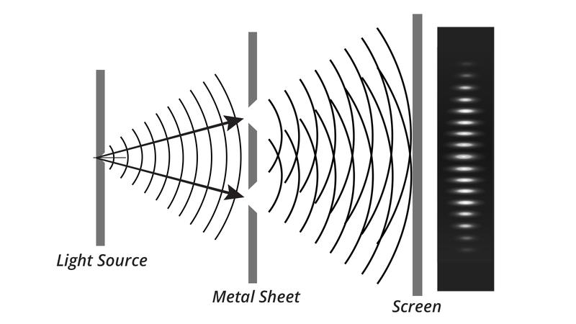
Unary Matrix ➔ Quantum Probability
A photon must be a particle
because it hits things.
Eg one hits the back screen
at a time.
  A vector of probabilities
  state is current.
  Could be negative
  (or complex)
  Length of vector is 1

Slide 49
Unary Matrix ➔ Quantum Probability
A photon must be a particle
because it hits things.
When it acts like a wave,
what is waving?
The probability distribution!
  A vector of probabilities
  state is current.
  Could be negative
  (or complex)
  Length of vector is 1

Slide 50
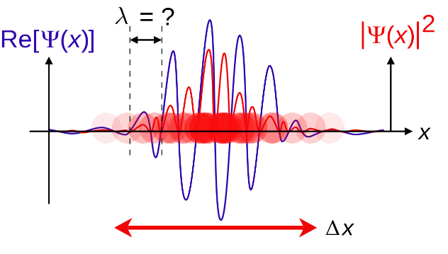
Unary Matrix ➔ Quantum Probability
Now the photon is located
probabilistically
in one of the red places.
  A vector of probabilities
  state is current.
  Could be negative
  (or complex)
  Length of vector is 1
Cross section
of red curve
gaussian × cos
real & imaginary

Slide 51
Unary Matrix ➔ Quantum Probability
Now the photon is located
probabilistically
in one of the red places.
Then it “moves”
  A vector of probabilities
  state is current.
  Could be negative
  (or complex)
  Length of vector is 1
Cross section
of red curve
gaussian × cos
real & imaginary

Slide 52
Unary Matrix ➔ Quantum Probability
A positive probability of
arriving here via slit one.
A positive probability of
arriving here via slit two.
This probabilities add.
Positive interference.
  A vector of probabilities
  state is current.
  Could be negative
  (or complex)
  Length of vector is 1
Cross section
of red curve
gaussian × cos
real & imaginary

Slide 53
Unary Matrix ➔ Quantum Probability
A positive probability of
arriving here via slit one.
A negative probability of
arriving here via slit two.
This probabilities add.
Negative interference.
  A vector of probabilities
  state is current.
  Could be negative
  (or complex)
  Length of vector is 1
Cross section
of red curve
gaussian × cos
real & imaginary

Slide 54
If you want one sample of where the system
will end up after a long time,
Markov Process ➔ Classical Probability
Mathematically, it is sufficient to follow one path.
Unary Matrix ➔ Quantum Probability
Mathematically, you must follow all paths.
because of the negative interference.
This is why
they say the quantum system is in a superposition.
I think negative probabilities is a bigger deal.

Slide 55
End

