Slide 1
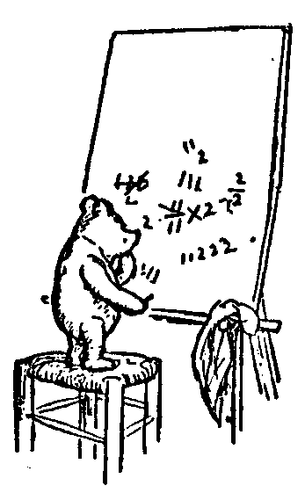
Logic and Proofs
Predicates and Quantifiers
∀boys b, Loves(b)
Review
Test 1
Objects, Predicates, & Relations
Order of Quantifiers: ∃∀ vs ∀∃
Negations
Unierse/Models
Quantifiers and Games
Understanding from the Inside
Playing the Game
Jeff Edmonds
York University
Lecture 2.5
Math/EECS 1019/1090

Slide 2
Oracle on Test 2
DO NOT DO PROBLEMS OF THE FORM:
[∀x A(x)] → [∃x A(x)]
Note the top operation is →.
This requires a oracle which we have not done.
It will not be on the test.
DO NOT DO PROBLEMS OF THE FORM:
[∀x A(x)] OR [∃x A(x)]
Notice the top operation is OR.
DO SOLVE
∀x [∃y A(x,y) or B(x,y)]
because the TOP operation is forall x
So you start by saying “Let x be arbitrary (given by adversary).

Slide 3

Objects, Predicates, & Relations
Predicates: boy(x), father(x), ...
is True if and only if object x has stated property.
Relations: loves(b,g), fatherOf(x,y), ...
is True if and only if objects have stated relation.
Defining:
fatherOf(x,y) ≡ “x is y’s father”.
father(x) ≡ ∃y fatherOf(x,y)
daughter(y,x) iff father(x,y)∧girl(y)
exist

Slide 4
Review
Be sure to know what these mean
and the difference between
∀∃ and ∃∀
∀ is A for forAll
∃ is E for Exists
4

Slide 5
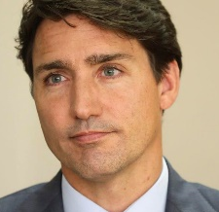
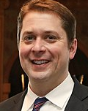
∃∀ vs ∀∃
“There is a politician that is loved by everyone.”
Sam
Bob
John
Trudeau
Fred
∃politician, ∀voters, Loves(v, p)
∀voters, ∃politician, Loves(v, p)
Sam
“Every voter loves some politician.”
Bob
Scheer
John
Trudeau
Fred

Slide 6
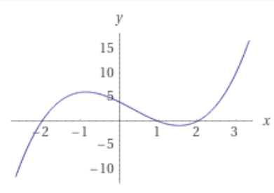
∃∀ vs ∀∃
∀x, ∃y, y=f(x)
∃y, ∀x, y=f(x)
This only says
that f is a function that is defined on the whole domain.
This also says that that f is the constant function.

Slide 7

∃∀ vs ∀∃
I want you to feel physical pain
∀Inputs x, ∃Java Program J, J(x)=P(x)
when you see
Problem P:
Input: x
Output: x²
But what you are saying is that each input value can have its own Java program!
Input: | 1 | 2 | 3 | 4 | …
Code: | int J₁( x ) return(1) | int J₂( x ) return(4) | int J₃( x ) return(9) | int J₄( x ) return(16) | …
Instead
∃Java Program J, ∀Inputs x, J(x)=P(x)
Input: | x
Code: | int J( x ) return(x×x)
Notes:
7

Slide 8

Negations
¬[ ]
Negations:
∃g, Loves(g)
A big Or
A big And
≡ ∀g, ¬[Loves(g)]
If there is not a g for which it is true,
then for all g it is not true.
De Morgan's Law
¬(α∧β) iff
¬α∨¬β
¬[ ]
Negations:
∀b, Loves(b)
≡ ∃b, ¬[ Loves(b) ]
If it is not the case that it is true for all b,
then there is a b for which it is not.
¬[ ]
Negations:
∃g, ∀b, Loves(b, g)
≡ ∀g, ¬[ ∀b, Loves(b, g) ]
≡ ∀g, ∃b, ¬[ Loves(b, g) ]

Slide 9
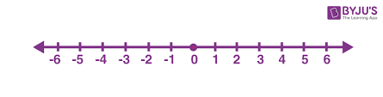




Negations
¬[ ]
Negations:
∃g, ∀b, Loves(b, g)
≡ ∀g, ¬[ ∀b, Loves(b, g) ]
≡ ∀g, ∃b, ¬[ Loves(b, g) ]
Is this right?
¬[ ]
∃y≤x Loves(y)
≡ ∀y>x ¬Loves(y)
≡ ∀y≤x ¬Loves(y)
¬Loves
¬Loves
¬Loves
Loves
y
x
Bring the negation in an switch ∃ and ∀.
We are still talking about values at most x.
¬[ ]
≡ ∀y∈Cats ¬Loves(y)
≡ ∀y∈Dogs ¬Loves(y)
∃y∈Dogs Loves(y)
Dogs
Cats
¬Loves
¬Loves
¬Loves
¬Loves
¬Loves
¬Loves
Loves
?
We are still talking about dogs

Slide 10


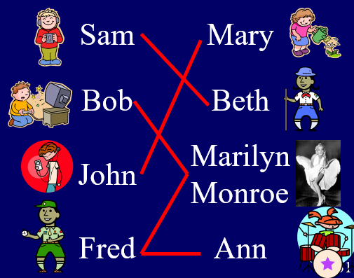
Universe/Model/Interpretation
∀b, ∃g, Loves(b,g)
∀x, ∃y, x+y=0
Whether the statement is true
depends on the Universe.
Sometimes I will assume the universe
is the one provided in the question.
What is the universe of objects for b and g?
Who loves who?
Over the Reals defines
a set of objects to be U = reals.
+, ×, ≤, 0, 1, … to be the standard.
= is fixed by the logic to always mean the two objects are the same.
= is fixed by the logic to always mean the two objects are the same.

Slide 11

Universe/Model/Interpretation
∀U,Human,Mortal,Socrates,
}
Prove:
∀M
∀x, Human(x)→Mortal(x)
Human(Socrates)
→ Mortal(Socrates)
Whether the statement is true
depends on the Universe.
A statement is Valid/Tautology
if it is true in every Universe.
When proving this,
I get to get to provide
the worse case universe
ie. set of objects U,
predicates Human & Mortal,
and fixed objects Socrates.

Slide 12


Quantifiers and Games
If I assure you that ∀b, Loves(b),
then anyone can give me his favorite boy b∀
and I assure him that Loves(b∀) is true.
Assuring
Proving
∀ ⎝
∃ ⎝
If I assure you that ∃b, Loves(b),
then I will provide my favorite boy b∃
and I assure you that Loves(b∃) is true.
For me to prove ∀b, Loves(b),
then, the adversary gives me his favorite boy b∀
and I must prove Loves(b∀) is true.
For me to prove ∃b, Loves(b),
then I will construct my favorite boy b∃
and prove that Loves(b∃) is true.
For me to prove that
some boy loves, ie, ∃b, Loves(b),
then I will construct my favorite boy b∃
and prove that Loves(b∃) is true.

Slide 13
Quantifiers and Games
Assuring
Proving
In Predicate logic,
we can state that I win the game:
∀x, ∃y, y>x
∀ ⎝
∃ ⎝
all
exist
all
exist
I will prove ∀x, [∃y, y>x].
I choose a x∀ = trillion trillion.
exist
I will prove ∃y, y>x∀.
I construct y∃ = trillion trillion and one
all
exist
I will prove y∃>x∀.
The proof of ∀x, ∃y, y>x.
Let x∀ be an arbitrary integer.
Let y∃ = x∀+1
Note y∃ = x∀+1 >x∀
And this completes the proof.
Surprisingly that completes the proof.

Slide 14
Prove:
∀x, ∃y, x+y=0
Sometimes I will assume the universe
is the one provided in the question.
Over the Reals defines
a set of objects to be U = reals.
+, ×, ≤, 0, 1, … to be the standard.
= is fixed by the logic to always mean the two objects are the same.
= is fixed by the logic to always mean the two objects are the same.

Slide 15
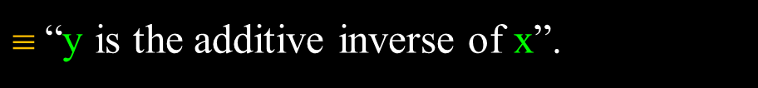


Prove:
∀x, ∃y, x+y=0
true
Or condensed to x+y∃(x)=0
Build understanding by building the statement backwards.
What does each subsequence say about
** value of free variables, * set of values of outer quantifier.
2 -2
x+y=0
$$ “y is the additive inverse of x”.
∃y, x+y=0
$$ “x has an additive inverse”.
∀x, ∃y, x+y=0
$$ “Every real has an additive inverse”.

Slide 16

Playing the Game
Prove:
∀x, ∃y, x+y=0
true (additive inverse)
∃y, ∀x, x+y=0
false (all additive inverses)
∀y, ∃x, x+y≠0
true (not all additive inverses)
∃y, ∀x, x+y=x
true (additive zero)
Proof of ∀x, ∃y, x+y=0:
Let x∀ be an arbitrary real number.
Let y∃ = -x∀
The relation is true.
x∀+y∃ = x∀ + (-x∀) = 0
Prover can always win.
Hence, the statement is true.
“Every real number has an additive inverse.”
Note that the y∃ can depend on everything that comes before it.

Slide 17

Playing the Game
Hey Adversary,
You can dictate your worst ε,
Require it to be as small as you like.
As long as I can counter with an even smaller δ.
Or a really big n₀.
You are on.
The heart of calculous is
∀ε ∃δ
∀ε ∃n₀

Slide 18
Playing the Game
Converge:
We say that the sequence f = f(1), f(2), f(3), … converges if … ?
∃c,
Prove that the sequence f = ¹/₁, ¹/₂, ¹/₃, ¹/₄, … ie f(i) = ¹/_{i} converges.
if as i gets goes in the limit to infinity
f(i) goes to some constant c.
f(i) = ¹/_{i}
i
c=0
I am trying to prove that it does converge, so I get to chooses c.
f(i) = ¹/_{i} seems to converge to c=0.

Slide 19
Playing the Game
Converge:
We say that the sequence f = f(1), f(2), f(3), … converges if … ?
∃c,
Prove that the sequence f = ¹/₁, ¹/₂, ¹/₃, ¹/₄, … ie f(i) = ¹/_{i} converges.
∀ε>0,
∃n₀,
∀n≥n₀,
|f(n)-c|≤ε
f(i) = ¹/_{i}
ε
n₀
n
i
c=0
“Goes to” means that f(i) and c get very close.
I get to decide how close I demand that they get.
And they must be that close for every big n.
I get to define the definition of “big”

Slide 20
Playing the Game
Don’t panic.
Just play the game.
Converge:
We say that the sequence f = f(1), f(2), f(3), … converges if … ?
∃c,
Prove that the sequence f = ¹/₁, ¹/₂, ¹/₃, ¹/₄, … ie f(i) = ¹/_{i} converges.
∀ε>0,
∃n₀,
∀n≥n₀,
|f(n)-c|≤ε
Proof:
Let c = 0.
Let ε>0 be arbitrary.
Let n₀ =
Let n≥n₀ be arbitrary.
|f(n)-c|
f(i) = ¹/_{i}
ε
n₀
n
i
c=0
n₀(ε)
¹/_{ε}
I am supposed to construct some value here, but don’t know how.
Let’s leave it for now.
It is a function of ε.
= |¹/_{n} -0|
≤ ¹/_{n0}
≤ε
That was not so bad.

Slide 21
Playing the Game
Converge:
We say that the sequence f = f(1), f(2), f(3), … converges if … ?
∃c,
∀c.
Prove that the sequence f = 1,-1,1,-1,… ie f(i) = (-1)^{n} converges.
∀ε>0,
∃n₀,
∀n≥n₀,
|f(n)-c|≤ε
∃ε>0,
∀n₀,
∃n≥n₀,
|f(n)-c|>ε
1
-1
i
I, the prover, am asked to prove that it converges.
But this sequence does not.
It bounces back and forth between two different values.
I will negate the statement and prove that.
This reverses the roles between
the prover and the adversary.

Slide 22
Playing the Game
Converge:
We say that the sequence f = f(1), f(2), f(3), … converges if … ?
∃c,
∀c.
Prove that the sequence f = 1,-1,1,-1,… ie f(i) = (-1)^{n} converges.
∀ε>0,
∃n₀,
∀n≥n₀,
|f(n)-c|≤ε
∃ε>0,
∀n₀,
∃n≥n₀,
|f(n)-c|>ε
1
c=1
ε=2
-1
Now I, the adversary, am asked to prove that it converges.
I will try.
I start by stating the value c that I think it is converging to.
How about c=1?
But for all the odd n, f(n)=-1
|f(n)-c|=| (-1) – (1) | = 2 = ε

Slide 23
Playing the Game
Converge:
We say that the sequence f = f(1), f(2), f(3), … converges if … ?
∃c,
∀c.
Prove that the sequence f = 1,-1,1,-1,… ie f(i) = (-1)^{n} converges.
∀ε>0,
∃n₀,
∀n≥n₀,
|f(n)-c|≤ε
∃ε>0,
∀n₀,
∃n≥n₀,
|f(n)-c|>ε
1
c=0
-1
ε=1
Now I, the adversary, am asked to prove that it converges.
I will try.
I start by stating the value c that I think it is converging to.
How about c=0?
But none of f(n)=1 or -1 are close to 0.
|f(n)-c|=| (±1) – (0) | = 1 = ε

Slide 24
Playing the Game
Converge:
We say that the sequence f = f(1), f(2), f(3), … converges if … ?
∃c,
∀c.
Prove that the sequence f = 1,-1,1,-1,… ie f(i) = (-1)^{n} converges.
∀ε>0,
∃n₀,
∀n≥n₀,
|f(n)-c|≤ε
∃ε>0,
∀n₀,
∃n≥n₀,
|f(n)-c|>ε
1
ε=1¹/₂
-1
c=-¹/₂
Now I, the adversary, am asked to prove that it converges.
I will try.
I start by stating the value c that I think it is converging to.
How about c=-¹/₂?
But for all the even n, f(n)=1
|f(n)-c|=| (1) – (-¹/₂) | = 1¹/₂ = ε

Slide 25
Playing the Game
Don’t panic.
Just play the game.
Converge:
We say that the sequence f = f(1), f(2), f(3), … converges if … ?
∃c,
∀c.
Prove that the sequence f = 1,-1,1,-1,… ie f(i) = (-1)^{n} converges.
∀ε>0,
∃n₀,
∀n≥n₀,
|f(n)-c|≤ε
∃ε>0,
∀n₀,
∃n≥n₀,
|f(n)-c|>ε
1
>ε=¹/₃
Proof:
Let c be arbitrary.
Let’s have two cases: c≤0 negative and c>0 positive.
Let’s do the c≤0 case and by symmetry skip the c>0 case.
Let ε= ¹/_{3.} (ε=1 might have been fine)
Let n₀ be arbitrary.
Let n≥n₀ be an even integer so that f(n)=1.
|f(n)-c|=| (1) – (neg) | > ¹/₃ = ε
-1
c=neg
Was that too hard?

Slide 26
Playing the Game
Continuous:
Consider the function f(x) = x²
Prove: ∀x, ∀ε>0, ∃δ>0, ∀x'∈[x−δ,x+δ], |f(x')-f(x)|≤ε
Let x>0 be arbitrary.
Let ε>0 be arbitrary.
Let δ =
Let x'≤x+δ be arbitrary.
|f(x')-f(x)| = |(x') ² - x²| ≤ |(x+δ) ² - x²| = |2xδ+δ²| = |δ(2x+δ)| = ε
ε / (2x+δ).
δ∃(ε)
We are supposed to construct some value here, but don’t know how. Let’s leave it for now, while remembering that it is a function of x and ε.
Odd to have δ on both sides,
but one could figure out δ.
Don’t panic.
To prove, just play the game.
ε
f(x)
ε
f
δ
δ
x’.
x

Slide 27
Playing the Game
Continuous:
Consider the function below.
Prove: ∀x, ∀ε>0, ∃δ>0, ∀x'∈[x−δ,x+δ], |f(x')-f(x)|≤ε
neg: ∃x, ∃ε>0, ∀δ>0, ∃x'∈[x−δ,x+δ], |f(x')-f(x)|>ε
Let x=5.
Let ε=0.0001.
Let δ be arbitrary. It could be .000000000000000000000001
Let x' = x+δ = 5+δ ∈[x−δ,x+δ]
|f(x')-f(x)| = |f(5+δ) – f(5)| ≤ |3.0002-3| = 0.0002 > 0.0001 = ε
f(5.1) = 3.0002
f
f(5) = 3
x=5

