Slide 1
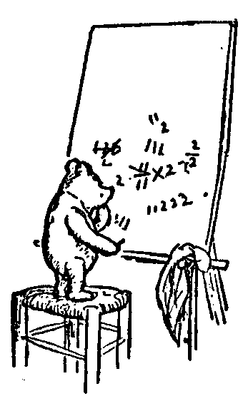
Logic for Computer Science
Our Formal Proof System
explained to Instructors
Table of contents:
Tautologies -> Lemmas
Davis Putnam Proof Systems for Tautologies
The Proof Viewed as a Game
Proofs with Game & Oracle
Modivation
Quantifier Closer - Adding Meaning
Our Formal Proof System
Examples
Our vs Forefathers' Proof Systems
Sound and Complete
Further Topics
Jeff Edmonds
York University

Slide 2

Toniann Pitassi:
I think the rules that you have are fine
and the examples are great!
When we teaching 1st year logic,
we don't do formal proofs.

Slide 3
And
Or
Proof Techniques/Lemmas
Modus Ponens:
Deduction:
Equivalence:
Contrapositive:
Transitivity:
By Cases:
By Contradiction:
Inconsistent:
Separating And:
Selecting Or:
Eval/Building:
Double Negation:
Excluded Middle:
Commutative:
De Morgan's Law:
Distributive:
From α and α→β, conclude β.
Assume α, prove β, conclude α→β.
From α→β and β→α , conclude α iff β.
From ¬β→¬α or ¬(α∧¬β), conclude α→β.
From α→β and β→γ, conclude α→γ.
From α∨β, α→γ, and β→γ, conclude γ.
From ¬α→β, and ¬α→¬β, conclude α.
From β and ¬β, conclude anything.
From α∧β, conclude α and β.
From α∨β and ¬α, conclude β.
From α, α´, & ¬β, conclude α∧α´, ¬(β∧γ), α∨γ, γ→α, β→γ,...
From ¬¬α, conclude α.
α∨¬α and ¬(α∧¬α).
α∨β iff β∨α and α∧β iff β∧α
¬(α∧β) iff ¬α∨¬β
γ∧(α∨β) iff (γ∧α)∨(γ∧β) and γ∨(α∧β) iff (γ∨α)∧(γ∨β)

Slide 4
Proof Systems, Tautologies, and Lemmas
Tautology Proof System:
α and β denote
any formula
instead of just a single variable.
Modus Ponens:
Tautologies:
Lemmas:
From φ and φ→γ, conclude γ.
Once proved can be used.
Used to define {∨, ∧,→,iff,⊕}
Once proved can be used.
From Tautologies, we prove Lemmas
Tautology:
P∧Q → P
Lemma:
From α∧β, conclude α.
α∧β → α
φ→γ
φ
γ
Proof technique is
Modus Ponens:
Deduction:
From φ
and φ→γ,
conclude γ.
Assume φ,
prove γ,
conclude φ→γ.
And the reverse direction.

Slide 5
Proofs of Tautologies
DP Computation ⇒ DP Proof
Davis-Putnam Axioms:
Assume α, prove β, conclude α→β.
From α and α´, conclude α∧α´, ¬(¬α∧γ), α∨γ, ¬(¬α∨¬α´), γ→α, ¬α→γ, and ¬(α→¬α´).
From α→Φ, and ¬α→Φ, conclude Φ.
Deduction:
Eval/Build:
Merge:
(Remove excess ¬¬. ∧&∨ commute.)
- These rules are designed to mirror a Davis-Putnam computation.
- This ensures that the system is Complete in that it can prove all valid propositional tautologies.
DP Proof of (P∧Q)→P:
Goal P → [(P∧Q)→P]
P
(P∧Q)→P
P → [(P∧Q)→P]
Goal ¬P → [(P∧Q)→P]
¬P
¬(P∧Q)
(P∧Q)→P
¬P → [(P∧Q)→P]
(P∧Q)→P
Assume for →
Evaluate: α ⇒ γ→α
Conclude
Assume for →
Evaluate: ¬β ⇒ ¬(β∧γ)
Evaluate: ¬β´ ⇒ β´→γ
Conclude
Merge: From α→Φ, and ¬α→Φ,
conclude Φ

Slide 6
Proofs of Tautologies
DP Computation ⇒ DP Proof
An instance (input) consists of a formula:
  Φ = (¬x₃ or x₅ or ¬x₆) and (x₂ or ¬x₅ or x₇) and (x₃ or ¬x₄)
Davis–Putnam algorithm:
Choose one significant variable.
Branch “trying” setting it to both F & T.
Simplify formula
Recurse.
Each of the 2^{n} paths to leaf
defines an assignment.
Evaluate Formula.
Answer:
This is just
building the 2^{n} sized table!
x₃
x₂
F
T
x₅
F
T
x₄
x₆
F
T
x₄
x₁
  Unsatisfiable,
  Satisfiable,
  or Tautology
F
T
F
T
F
T
F
T
…
…
…
…
…
…
…
…
But sometimes we can prune off branches.

Slide 7
Proofs of Tautologies
DP Computation ⇒ DP Proof
Davis-Putnam Axioms:
Assume α, prove β, conclude α→β.
From α and α´, conclude α∧α´, ¬(¬α∧γ), α∨γ, ¬(¬α∨¬α´), γ→α, ¬α→γ, and ¬(α→¬α´).
From α→Φ, and ¬α→Φ, conclude Φ.
Deduction:
Eval/Build:
Merge:
(Remove excess ¬¬. ∧&∨ commute.)
Davis–Putnam Simplification/Evaluation of Φ:
Suppose DP has followed a root-leaf path P≡⟨x₃=T, x₅=F, x₆=T, …,⟩.
If DP has simplified/evaluated sub-formula α to T and β to F,
then it would simplify/evaluate
  α∧α´, α∨γ, γ→α, β→γ, and ¬¬α to T.
  β∧γ, β∨β´, α→β to F.
Inductively this proves:
DP with P fixes φ to T iff There is a DP proof of P→φ.
DP with P fixes φ to F iff There is a DP proof of P→¬φ.

Slide 8
DP Computation: Φ
x₃
x₂
F
T
x₅
→Φ
F
T
x₄
x₆
F
T
x₁
P₁₁→Φ
P₁₂→Φ
F
T
F
T
F
T
P₈→Φ
P₉→Φ
P₁₀→Φ
P₇→Φ
P₃→Φ
P₄→Φ
P₅→Φ
P₆→Φ
P₂→Φ
P₁→Φ
DP Proof:
Consider each root-leaf path P in the Davis-Putnam Tree.
There is a DP proof of P→Φ.
Merge paths together, one fork at a time
Concluding with a proof of Φ.

Slide 9
x₃
DP Computation: Φ
x₃
T
x₅
x₆
F
F
T
P₅→Φ
P₆→Φ
Merge paths together, one fork at a time

Slide 10
x₃
DP Computation: Φ
x₃
T
x₅
x₆
F
F
T
P₁₀→Φ
P₅→Φ
P₆→Φ
DP Proof:
Goal ⟨x₃,¬x₅⟩→Φ
Assume ⟨x₃,¬x₅⟩
x₆→Φ
¬x₆→Φ
Φ
⟨x₃,¬x₅⟩→Φ
Merge paths together, one fork at a time
Assume for →
Proved before
Proved before
Merge: From x₆→Φ, and ¬x₆→Φ, conclude Φ.
Conclusion

Slide 11

The Proof Viewed as a Game
Proof:
∀b, ∃g, Loves(b, g, x)
I must insist that you prove this using the following game.
Three players: The boss,
a prover and a disprover.
The process starts by me, the boss, giving you a value for each free variable,
i.e. those with no quantifiers.
Eg, I could say x= 5.

Slide 12
The Proof Viewed as a Game
Proof:
∀b, ∃g, Loves(b, g)
The others read the statement left to right.
I produce the object when it is a ∃.
I produce the object when it is a ∀.
I can always win
if and only if
statement is true.

Slide 13

The Proof Viewed as a Game
Proof:
∀b, ∃g, Loves(b, g)
true
No! I produce b=Bob.
Knowing you chose Bob,
I produce g = Marilin Monro
Bob loves MM so I win.
Sam
Mary
b=John!
Bob
Beth
g=Mary
and I still win.
John
Marilin Monro
Fred
Ann

Slide 14
The Proof Viewed as a Game
Proof:
∀b, ∃g, Loves(b, g)
true
∃g, ∀b, Loves(b, g)
false
The order the players go
REALY matters.
Ha ha
You need to go first now!
Sam
Mary
I produce g = MM
Bob
Beth
Nope. b=John
does not love her
John
Marilin Monro
Fred
Ann

Slide 15
The Proof Viewed as a Game
Proof:
∀b, ∃g, Loves(b, g)
true
∃g, ∀b, Loves(b, g)
false
The order the players go
REALY matters.
I could only win this game if there was a single girl loved by every boy.
Sam
Mary
Bob
Beth
John
Marilin Monro
Yup
Fred
Ann

Slide 16

Proofs with Game & Oracle
Instead of proving it.
What if I assured you that
Α: ∀b, ∃g, Loves(b, g) is true?
How would you use this?
Give a strategy for game.
Use a strategy as an oracle.
Sam
Mary
Bob
Beth
Knowing ∀b, ∃g, Loves(b, g) is true
I can help you!
John
Marilin Monro
Fred
Ann

Slide 17
Proofs with Game & Oracle
Instead of proving it.
What if I assured you that
Α: ∀b, ∃g, Loves(b, g) is true?
How would you use this?
Use a strategy:
For any b that you need help with,
the strategy responds with a g
such that Loves(b, g) is true.
Sam
Mary
Sam
g∃
Beth
Bob
Beth
Α
Fred
Ann
John
Marilin Monro
Let us denote this function by g=g∃(b).
i.e. g∃(Sam) = Beth
Refered to as a Skolem Functions.
Fred
Ann

Slide 18
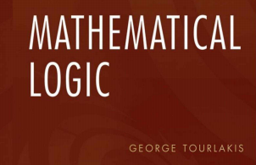
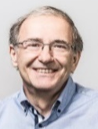
Motivation
Novice Proof:
∀x α(x) (proved somehow)
There is some rule that lets you remove a ∀x
α(x)
Novice Proof:
∃x α(x) (proved somehow)
There is some rule that lets you remove a ∃x
α(x)
What does the proof line α(x) mean?
How can it mean both ∀x and ∃x
There are complicated rules so that nuances deep in the proof distinguish these.
Can’t we just define α(x) to mean ∀x α(x)
and define α(x∃) to mean ∃x α(x) ?
Adding meaning (semantics) is bad.

Slide 19
Motivation
But the whole point is meaning!
A proof system is sound if
Everything it proves
means something that is valid (ie true in every model).
This is proved by induction on the length of the proof.
Hence, every line of the proof needs to
means something that is valid.
No
You can only follow mechanical symbol manipulation rules.
Adding meaning (semantics) is bad.

Slide 20
Adding Meaning
In order to make the proof a “Hilbert” proof,
we need each line standing alone to state something valid.
Proof systems generally assume:
∀x on the entire formula.
It is call the Universal Closure.
Toniann Pitassi
We will extend this can call it
Quantifier Closure QC(φ).

Slide 21
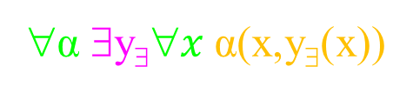
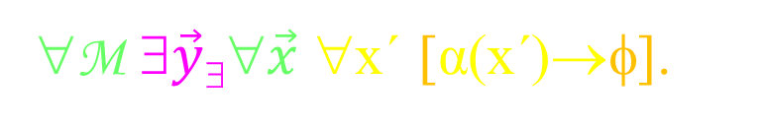
Adding Meaning
In order to make the proof a “Hilbert” proof,
we need each line standing alone to state something valid.
The “mean” of a line of our proof is
what we define as its Quantifier Closure.
Line φ in proof
Implied Meaning QC(φ)
φ
∀M ∃$\vec{y}\text{\$}$∀$\vec{x}$ ∀x´ [α(x´)→φ].
α(x,y∃(x))
∀α ∃y$\text{\$}$∀$x$α(x,y∃(x))
______ β(x´)
∀β ∀x´[α(x´)→β(x´)]
I prove QC(φ) is true
by constructing the ∃objects
and proving the final statement.
As your adversary
I give you hard ∀objects.

Slide 22
Adding Meaning
In order to make the proof a “Hilbert” proof,
we need each line standing alone to state something valid.
The “mean” of a line of our proof is
what we define as its Quantifier Closure.
Line φ in proof
Implied Meaning QC(φ)
φ
∀M ∃$\vec{y}\text{\$}$∀$\vec{x}$ ∀x´ [α(x´)→φ].
α(x,y∃(x))
∀α ∃y$\text{\$}$∀$x$α(x,y∃(x))
______ β(x´)
∀β ∀x´[α(x´)→β(x´)]
Here M is the model specifying:
the universe U of objects,
the functions f and relations R. Even +&×.
It is certainly not mentioned in Predicate syntax.
Often we don’t mention it.

Slide 23
Adding Meaning
In order to make the proof a “Hilbert” proof,
we need each line standing alone to state something valid.
The “mean” of a line of our proof is
what we define as its Quantifier Closure.
Line φ in proof
Implied Meaning QC(φ)
φ
∀M ∃$\vec{y}\text{\$}$∀$\vec{x}$ ∀x´ [α(x´)→φ].
α(x,y∃(x))
∀α ∃y$\text{\$}$∀$x$α(x,y∃(x))
______ β(x´)
∀β ∀x´[α(x´)→β(x´)]
Here y∃(x) is called a Skolem function.
It is a “fixed” value/function.
Because of the game, it can depend on
on the model M.

Slide 24
Adding Meaning
In order to make the proof a “Hilbert” proof,
we need each line standing alone to state something valid.
The “mean” of a line of our proof is
what we define as its Quantifier Closure.
Line φ in proof
Implied Meaning QC(φ)
φ
∀M ∃$\vec{y}\text{\$}$∀$\vec{x}$ ∀x´ [α(x´)→φ].
α(x,y∃(x))
∀α ∃y$\text{\$}$∀$x$α(x,y∃(x))
______ β(x´)
∀β ∀x´[α(x´)→β(x´)]
Here y∃(x) is called a Skolem function.
It is a “fixed” value/function.
When it is a function it can depend on
the value of the free variables x.

Slide 25
Adding Meaning
In order to make the proof a “Hilbert” proof,
we need each line standing alone to state something valid.
The “mean” of a line of our proof is
what we define as its Quantifier Closure.
Line φ in proof
Implied Meaning QC(φ)
φ
∀M ∃$\vec{y}\text{\$}$∀$\vec{x}$ ∀x´ [α(x´)→φ].
α(x,y∃(x))
∀α ∃y$\text{\$}$∀$x$α(x,y∃(x))
______ β(x´)
∀β ∀x´[α(x´)→β(x´)]
Here y∃(x) is called a Skolem function.
Being a function, it is really second order logic.

Slide 26
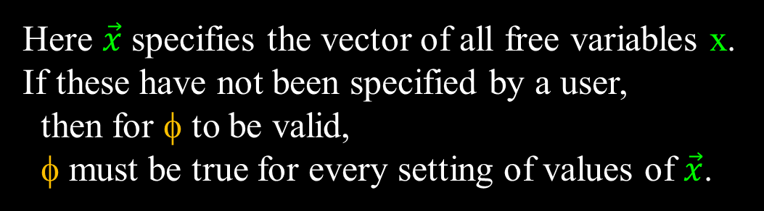
Adding Meaning
In order to make the proof a “Hilbert” proof,
we need each line standing alone to state something valid.
The “mean” of a line of our proof is
what we define as its Quantifier Closure.
Line φ in proof
Implied Meaning QC(φ)
φ
∀M ∃$\vec{y}\text{\$}$∀$\vec{x}$ ∀x´ [α(x´)→φ].
α(x,y∃(x))
∀α ∃y$\text{\$}$∀$x$α(x,y∃(x))
______ β(x´)
∀β ∀x´[α(x´)→β(x´)]
Here $\vec{x}$ specifies the vector of all free variables x.
If these have not been specified by a user,
then for φ to be valid,
φ must be true for every setting of values of $\vec{x}$.

Slide 27
Adding Meaning
In order to make the proof a “Hilbert” proof,
we need each line standing alone to state something valid.
The “mean” of a line of our proof is
what we define as its Quantifier Closure.
Line φ in proof
Implied Meaning QC(φ)
φ
∀M ∃$\vec{y}\text{\$}$∀$\vec{x}$ ∀x´ [α(x´)→φ].
α(x,y∃(x))
∀α ∃y$\text{\$}$∀$x$α(x,y∃(x))
______ β(x´)
∀β ∀x´[α(x´)→β(x´)]
  Goal is to prove α(x)→ β(x)
  ______ α(x´) assumption
  ______ …
  ______ φ(x´)
  ______ …
  x´ is a fixed but arbitrary value.
α(x´)→
α(x´)→

Slide 28
Adding Meaning
In order to make the proof a “Hilbert” proof,
we need each line standing alone to state something valid.
The “mean” of a line of our proof is
what we define as its Quantifier Closure.
Line φ in proof
Implied Meaning QC(φ)
φ
∀M ∃$\vec{y}\text{\$}$∀$\vec{x}$ ∀x´ [α(x´)→φ].
α(x,y∃(x))
∀α ∃y$\text{\$}$∀$x$α(x,y∃(x))
______ β(x´)
∀β ∀x´[α(x´)→β(x´)]

Slide 29
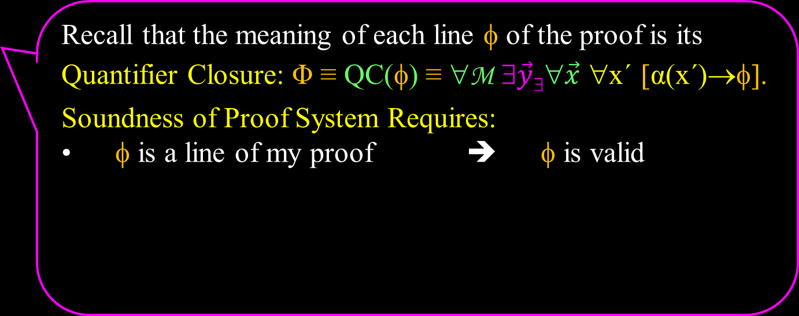
Soundness
Recall that the meaning of each line φ of the proof is its
Quantifier Closure: Φ ≡ QC(φ) ≡ ∀M ∃$\vec{y}\text{\$}$∀$\vec{x}$ ∀x´ [α(x´)→φ].
Soundness of Proof System Requires:
φ is a line of my proof ➔ φ is valid
Oops
This will not true for our proof system.

Slide 30
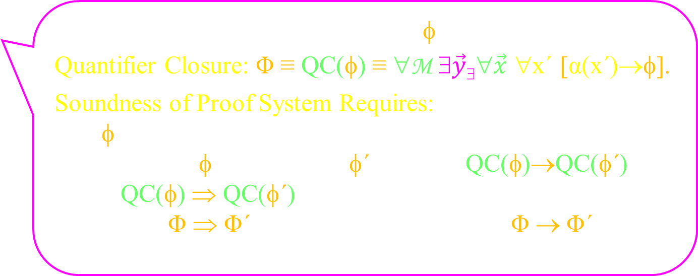
Soundness
Recall that the meaning of each line φ of the proof is its
Quantifier Closure: Φ ≡ QC(φ) ≡ ∀M ∃$\vec{y}\text{\$}$∀$\vec{x}$ ∀x´ [α(x´)→φ].
Soundness of Proof System Requires:
φ is a line of my proof ➔
“From line φ, include line φ´” ➔ QC(φ)→QC(φ´)
QC(φ) ⇒ QC(φ´)
Φ ⇒ Φ´ ➔ Φ → Φ´
QC(φ) is valid
We say “include φ´”
instead of “conclude φ´”
or “φ´ follows from φ”
Induction as before.
That’s our definition of ⇒.
That’s our definition of Φ.

Slide 31
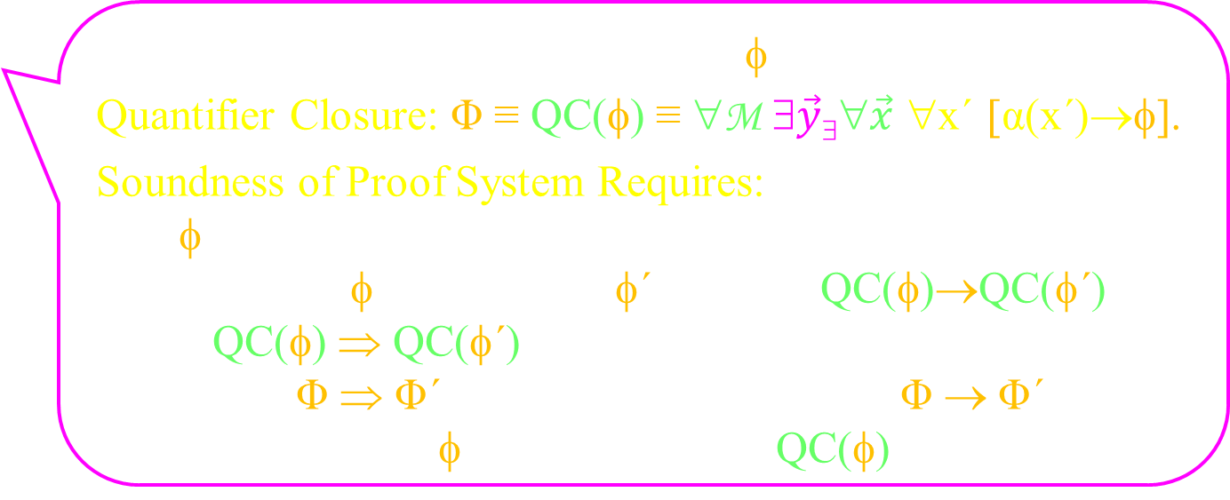
Soundness
Recall that the meaning of each line φ of the proof is its
Quantifier Closure: Φ ≡ QC(φ) ≡ ∀M ∃$\vec{y}\text{\$}$∀$\vec{x}$ ∀x´ [α(x´)→φ].
Soundness of Proof System Requires:
φ is a line of my proof ➔
“From line φ, include line φ´” ➔ QC(φ)→QC(φ´)
QC(φ) ⇒ QC(φ´)
Φ ⇒ Φ´ ➔ Φ → Φ´
Proof ends with φ ➔ QC(φ) is valid theorem
QC(φ) is valid
If you remove the y∃ and x´ notation
before the end of the proof,
then QC will have no effect
and φ is valid theorem;

Slide 32
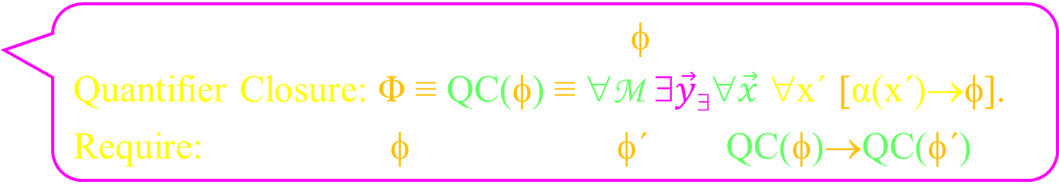
Soundness
Recall that the meaning of each line φ of the proof is its
Quantifier Closure: Φ ≡ QC(φ) ≡ ∀M ∃$\vec{y}\text{\$}$∀$\vec{x}$ ∀x´ [α(x´)→φ].
Require: “From line φ, include line φ´” ➔ QC(φ)→QC(φ´)
In our proof system:
From line α(x), include line ∀xα(x),
even though α(x)→∀xα(x) is not true.
But when α(x) is interpreted as ∀x α(x)
∀x α(x) ⇒ ∀xα(x) is quite reasonable.

Slide 33
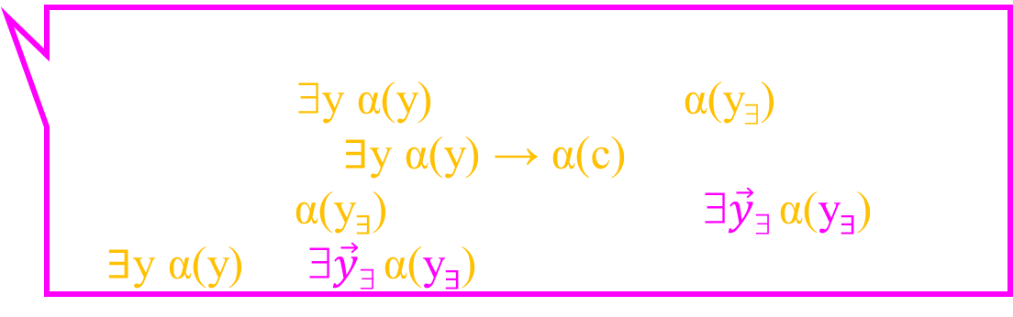
Soundness
Recall that the meaning of each line φ of the proof is its
Quantifier Closure: Φ ≡ QC(φ) ≡ ∀M ∃$\vec{y}\text{\$}$∀$\vec{x}$ ∀x´ [α(x´)→φ].
Require: “From line φ, include line φ´” ➔ QC(φ)→QC(φ´)
In our proof system:
From line ∃y α(y), include line α(y∃),
even though ∃y α(y) → α(c) is not true.
But when α(y∃) is interpreted as ∃$\vec{y}\text{\$}$α(y∃),
∃y α(y) ⇒ ∃$\vec{y}\text{\$}$α(y∃) is quite reasonable.

Slide 34

Our Formal Proof System
          Hilbert Proof:
            Each line φ of the proof has meaning
Quantifier Closure: Φ ≡ QC(φ) ≡ ∀M ∃$\vec{y}\text{\$}$∀$\vec{x}$ ∀x´ [α(x´)→φ].
  Each line follows from what comes before.
  ie “From line φ, include line φ´” ➔ QC(φ)→QC(φ´).
          Lemmas/Theorems:
            Starting with all propositional tautologies (See slides).
            Prove and use lemmas via substitutions.
Deduction α→β:
  Assume α, prove β, conclude α→β.
Rules (Adding/Removing ∀/∃):
  These help define and to work with quantifiers.

Slide 35
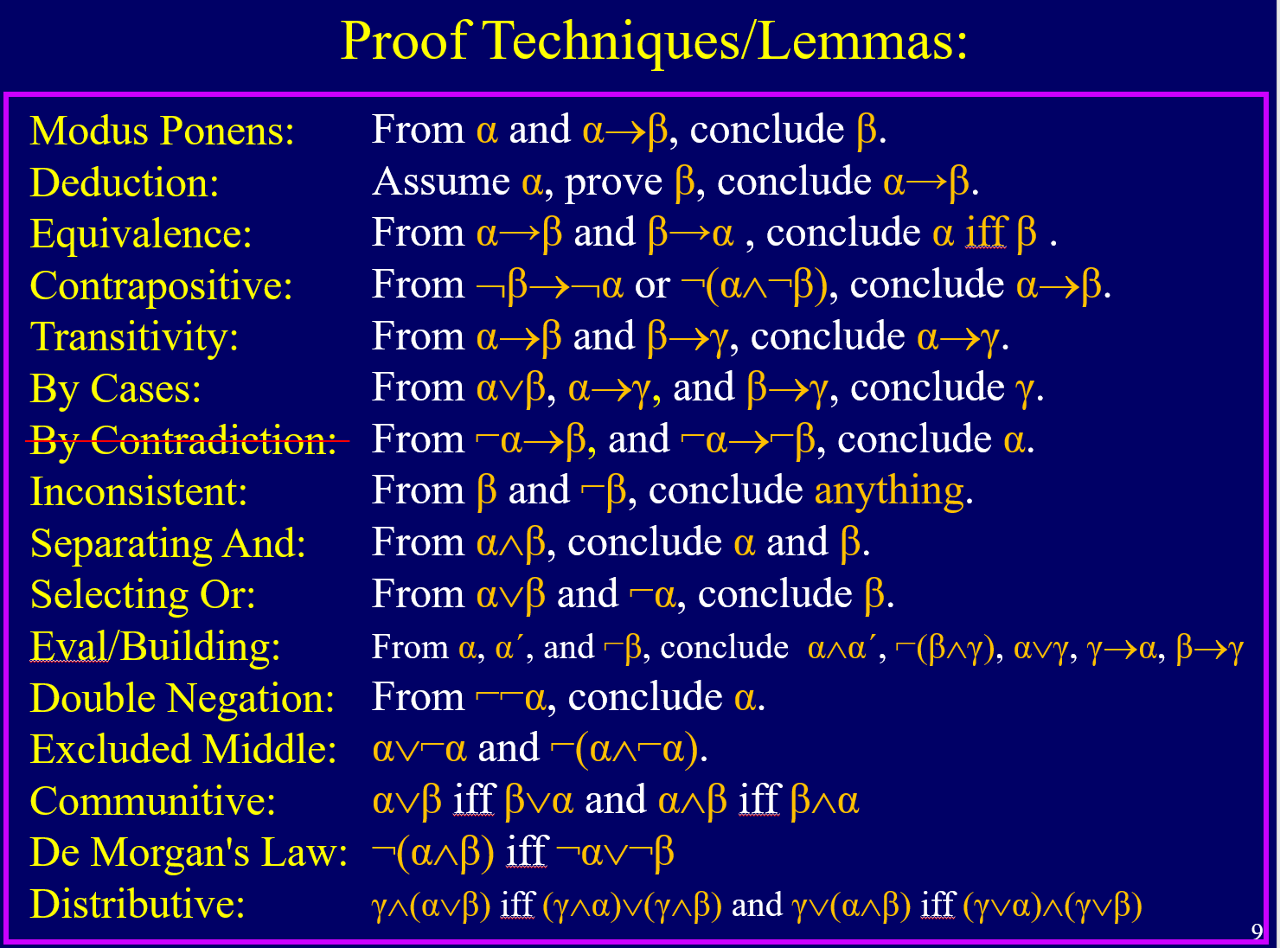
Our Formal Proof System
            Think of and prove your own.
          Lemmas/Theorems:
            Starting with all propositional tautologies (See slides).
            Prove and use lemmas via substitutions.

Slide 36
Our Formal Proof System
Lemmas via Substitutions
          Four Types of Lemmas/Theorems:
Lemmas | Sub in true/false | Sub in object
Receiving sub is a tautology | If φ(P,Q) then φ(α,β) | If α(x,y), then α(t₁,t₂)
Being subbed are equivalent | If α iff β then φ(α) iff φ(β) | If t₁=t₂ then α(t₁) iff α(t₂) and f(t₁) = f(t₂)
Modus Ponens: α & α→β ⇒ β
Equality:
  t₁=t₂: means that the two terms evaluate to
            the same object from the universe
            Axioms: x=x, x=y iff y=z, and (x=y∧y=z)→x=z

Slide 37
Our Formal Proof System
Note the ´ on the x´.
Deduction α→β:
  Assume α, prove β, conclude α→β.
  Goal is to prove α(x)→β(x)
  ______ α(x´) assumption
  ______ …
  ______ β(x´)
  α(x)→β(x) conclusion

Slide 38
Our Formal Proof System
Rules (Adding/Removing ∀/∃):
  These help define and to work with quantifiers.

Slide 39
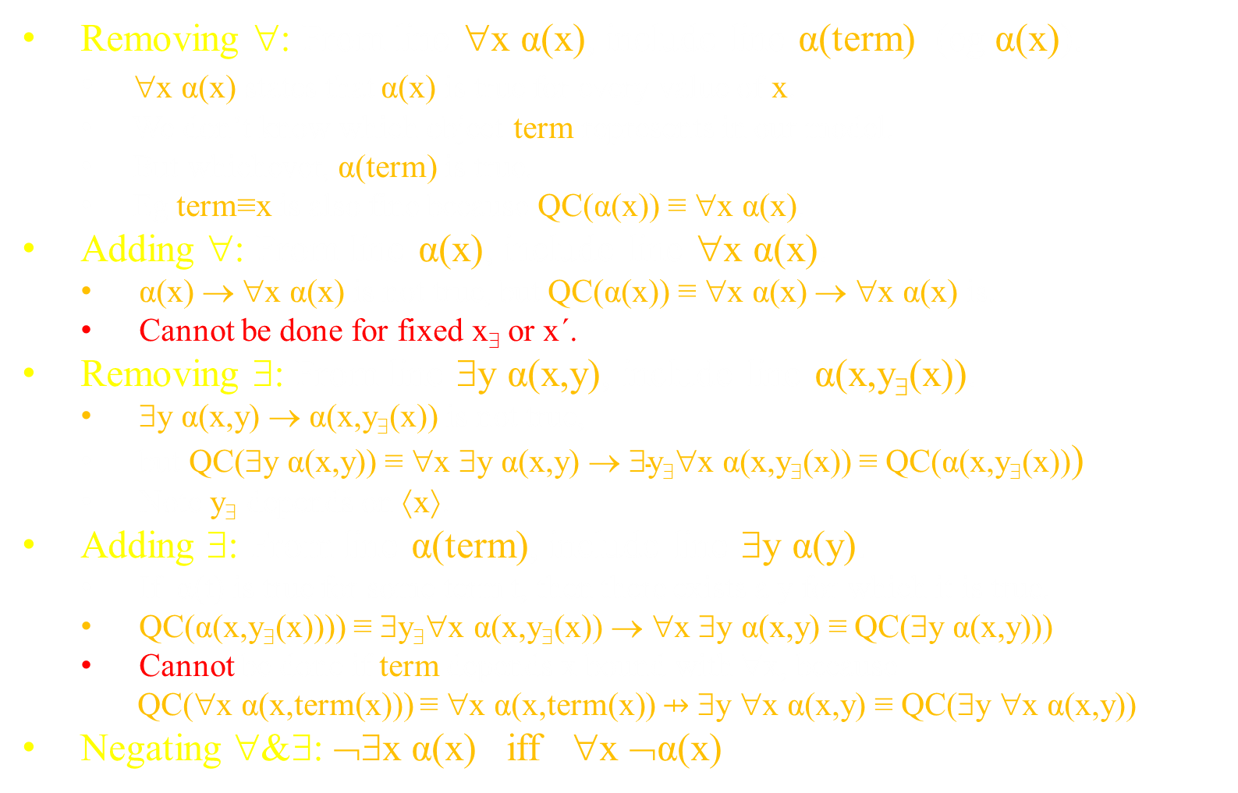
Our Formal Proof System
Removing ∀: From line ∀x α(x), include line α(term) (eg α(x)).
  ∀x α(x) states that α(x) is true for every value of x.
  We don’t know which object term represents in our model.
  But whichever, α(term) is true.
  Eg term≡x is also fine because QC(α(x)) ≡ ∀x α(x).
Adding ∀: From line α(x), include line ∀x α(x).
  α(x) → ∀x α(x) is not true, but QC(α(x)) ≡ ∀x α(x) → ∀x α(x) is.
  Cannot be done for fixed x∃ or x´.
Removing ∃: From line ∃y α(x,y), include line α(x,y∃(x)).
  ∃y α(x,y) → α(x,y∃(x)) is not true,
  but QC(∃y α(x,y)) ≡ ∀x ∃y α(x,y) → ∃$\text{y}\text{\$}$∀x α(x,y∃(x)) ≡ QC(α(x,y∃(x)))
  Note y∃ depends on ⟨x⟩.
Adding ∃: From line α(term), include line ∃y α(y).
  If α(t) is true for some term t, then there exists a y for which it is true.
  QC(α(x,y∃(x)))) ≡ ∃y∃∀x α(x,y∃(x)) → ∀x ∃y α(x,y) ≡ QC(∃y α(x,y)))
  Cannot be done if term depends x bound with ∀x, because
  QC(∀x α(x,term(x))) ≡ ∀x α(x,term(x)) ⇸ ∃y ∀x α(x,y) ≡ QC(∃y ∀x α(x,y))
Negating ∀&∃: ¬∃x α(x) iff ∀x ¬α(x)

Slide 40
Examples
∃y₁∀x₁∃y₂∀x₂ α(x₁,x₂,y₁,y₂) → ∀x₁∀x₂∃y₁∃y₂ α(x₁,x₂,y₁,y₂)
Proof:
∃y₁∀x₁∃y₂∀x₂ α(x₁,x₂,y₁,y₂)
∀x₁∃y₂∀x₂ α(x₁,x₂,y_{1∃},y₂)
∃y₂∀x₂ α(x₁,x₂,y_{1∃},y₂)
∀x₂ α(x₁,x₂,y_{1∃},y_{2∃}(x₁))
α(x₁,x₂,y_{1∃},y_{2∃}(x₁))
∃y₁∃y₂ α(x₁,x₂,y₁,y₂)
∀x₁∀x₂∃y₁∃y₂ α(x₁,x₂,y₁,y₂)
Assume for →
Remove ∃
Remove ∀
Remove ∃
Remove ∀
Adding ∃
Adding ∀
This is ok because there does exists these y.
Excellent

Slide 41
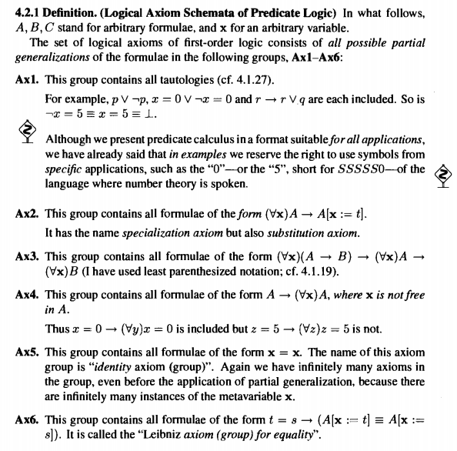
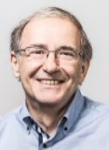
Examples
  ∀x (α(x)→β(x)) → (∀x α(x) → ∀x β(x))

Slide 42
Examples
  ∀x (α(x)→β(x)) → (∀x α(x) → ∀x β(x))
Proof:
Goal ∀x (α(x)→β(x)) → (∀x α(x) → ∀x β(x))
∀x (α(x)→β(x))
α(x)→β(x)
Goal ∀x α(x) → ∀x β(x)
∀x α(x)
α(x)
β(x)
∀x β(x)
∀x α(x) → ∀x β(x)
∀x (α(x)→β(x)) → (∀x α(x) → ∀x β(x))
Assume for →
Remove ∀
Assume for →
Remove ∀
3&6 modus ponens
Add ∀
Conclude →
Conclude →
Does not need x´ because not x free in assumption.

Slide 43

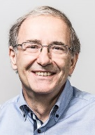

Our vs Forefathers' Proof Systems
These meta rules prove that a “meta proof”
can be compiled into a proof from the axioms.
I would rather simplify these to be a Hilbert style proof on their own.
I will now try to justify that our rules follow from these meta rules.

Slide 44
Our vs Forefathers' Proof Systems
Forefathers':
If α(x) is true for every value of x,
then it is true for any term you want to plug
Our (Removing ∀): ∀x α(x) ⇒ α(x), ∀x α(x) ⇒ α(term)
If ∀x α(x) is a line of your proof,
then you can add the line α(x)
or the line α(term)

Slide 45
Our vs Forefathers' Proof Systems
Forefathers':
If you can prove α(x), then you can prove ∀x α(x)
  Cannot be done if x is free in axioms Γ.
Our (Adding ∀): α(x) ⇒ ∀x α(x)
  Cannot be done for fixed x∃ or x´.
  Can be done for free x.
  Instead, we replace each free x in Γ with x´.
    Our (Deduction): Assume Γ(x'), prove β(x'), conclude Γ(x)⊢β(x)
    ∀x cannot be added for x´.
  In contrast, we allow add ∀x to α(u,x∃(u)),
  because ∀u α(u,x∃(u)) is “true”.
  This does cause a problem, but we will change another rule to fix it.

Slide 46
Our vs Forefathers' Proof Systems
Forefathers':
If by adding the assumption α to your axioms, you can prove β,
then you can prove α→β.
Cannot add ∀x to free variables
within the “block” of proof from α to β,
because α is in Γ. (Recall previous rule)
Can add ∀x to α→β and beyond
because it is not in Γ.
This meta-proof must end here.
Our (Deduction): Assume α(x'), prove β(x'), conclude α(x)→β(x)
We remember that by adding ' to all free variables x in α.
In our conclution, α(x)→β(x), the variable x is free.
We allow the proof to continue.

Slide 47

Our vs Forefathers' Proof Systems
Forefathers':
If you can prove ∃y α(y),
and from α(z) you can prove β,
then you can prove β.
Let β ≡ α(z).
As needed α(z) ⊢ β. Hence:
If you can prove ∃y α(y),
then you can prove α(z).
          So complicated! Lets simplify it.

Slide 48
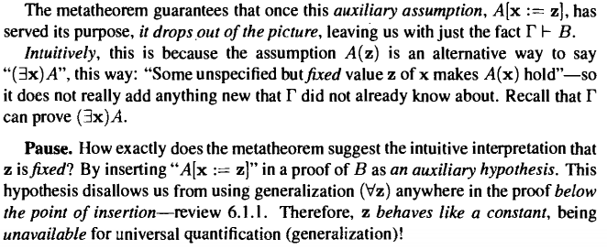
Our vs Forefathers' Proof Systems
Forefathers':
If you can prove ∃y α(y),
and from α(z) you can prove β,
then you can prove β.
Let β ≡ α(z).
As needed α(z) ⊢ β. Hence:
If you can prove ∃y α(y),
then you can prove α(z).

Slide 49
Our vs Forefathers' Proof Systems
Forefathers':
If you can prove ∃y α(y),
and from α(z) you can prove β,
then you can prove β.
Let β ≡ α(z).
As needed α(z) ⊢ β. Hence:
If you can prove ∃y α(y),
then you can prove α(z).
Novice Proof:
∀x α(x) (proved somehow)
There is some rule that lets you remove a ∀x
α(x)
Novice Proof:
∃y α(y) (proved somehow)
There is some rule that lets you remove a ∃y
α(z)
What does the proof line α(x) mean?
How can it mean both ∀x and ∃x
          Lets y∃ instead of z.
And have an implied ∃y∃.

Slide 50
Our vs Forefathers' Proof Systems
Forefathers':
Let β ≡ α(z).
As needed α(z) ⊢ β. Hence:
If you can prove ∃y α(y),
then you can prove α(z).
If you can prove ∃y α(y),
and from α(z) you can prove β,
then you can prove β.
Cannot add ∀z within the proof from α(z) to β, because α(z) is in Γ.
Our (Removing ∃): ∃y α(y) ⇒ α(y∃)
If ∃y α(y) is a line of your proof,
then you can add the line α(y∃).
If you later want to prove β, that is up to you.
Our (Adding ∀) cannot be done for y∃.
For sure the y∃ can’t appear somewhere else.

Slide 51
Our vs Forefathers' Proof Systems
Forefathers':
Let β ≡ α(z).
As needed α(z) ⊢ β. Hence:
If you can prove ∃y α(y),
then you can prove α(z).
If you can prove ∃y α(y),
and from α(z) you can prove β,
then you can prove β.
Must remove the z before ending
because z not being allowing to appear in B.
Our (Removing ∃):
We used the notation y∃(x) when α has free variables x.
We don’t care if it is removed,
because ∀u α(u,x∃(u)) is true
when interpreded to have an ∃x∃ in front.
∃y α(x,y) ⇒ α(x,y∃(x))

Slide 52
Our vs Forefathers' Proof Systems
Forefathers':
If α(t) is true for some term t,
then there exists an x for which it is true.
Our (Adding ∃): α(term) ⇒ ∃y α(y)
Cannot be done for term≡y∃(x) if x is quantified with in ∀x.
Proof:
∀x ∃y α(x,y)
∃y α(x,y)
α(x,y∃(x))
∀x α(x,y∃(x))
∃y ∀x α(x,y)
(Adding ∀):
Forefathers:
Can’t because x is in the hypothesis.
Ours: Can!
(Adding ∃):
Ours: Can’t because
x is quantified with in ∀x.
          Oops. Wrong!

Slide 53
Proving Sound
I feel that our proof system is sound
(ie only proves things that are valid)
Because we added semantic
meaning to each line in the proof
And we only allow a line to be added if it’s meaning follows from that of the previous lines.
I feel that our proof system is complete
(ie proves everything valid)
Because it can prove these axioms.
And hence by Gödel proves everything.

Slide 54
Proving Sound
Recall that the meaning of each line φ of the proof is its
Quantifier Closure: Φ ≡ QC(φ) ≡ ∀M ∃$\vec{y}\text{\$}$∀$\vec{x}$ ∀x´ [α(x´)→φ].
Soundness of Proof System Requires:
φ is a line of my proof ➔ φ is valid
Oops
This will not true for our proof system.

Slide 55
Proving Sound
Recall that the meaning of each line φ of the proof is its
Quantifier Closure: Φ ≡ QC(φ) ≡ ∀M ∃$\vec{y}\text{\$}$∀$\vec{x}$ ∀x´ [α(x´)→φ].
Soundness of Proof System Requires:
φ is a line of my proof ➔
“From line φ, include line φ´” ➔ QC(φ)→QC(φ´)
QC(φ) ⇒ QC(φ´)
Φ ⇒ Φ´ ➔ Φ → Φ´
QC(φ) is valid
We say “include φ´”
instead of “conclude φ´”
or “φ´ follows from φ”
Induction as before.
That’s our definition of ⇒.
That’s our definition of Φ.

Slide 56

Proving Sound
Removing ∀: From line ∀x α(x), include line α(term) (eg α(x)).
  ∀x α(x) states that α(x) is true for every value of x.
  We don’t know which object term represents in our model.
  But whichever, α(term) is true.
  Eg term≡x is also fine because QC(α(x)) ≡ ∀x α(x).
Adding ∀: From line α(x), include line ∀x α(x).
  α(x) → ∀x α(x) is not true, but QC(α(x)) ≡ ∀x α(x) → ∀x α(x) is.
  Cannot be done for fixed x∃ or x´.
Removing ∃: From line ∃y α(x,y), include line α(x,y∃(x)).
  ∃y α(x,y) → α(x,y∃(x)) is not true,
  but QC(∃y α(x,y)) ≡ ∀x ∃y α(x,y) → ∃$\text{y}\text{\$}$∀x α(x,y∃(x)) ≡ QC(α(x,y∃(x)))
  Note y∃ depends on ⟨x⟩.
Adding ∃: From line α(term), include line ∃y α(y).
  If α(t) is true for some term t, then there exists a y for which it is true.
  QC(α(x,term(x)))) ≡ ∀x α(x,term(x)) → ∀x ∃y α(x,y) ≡ QC(∃y α(x,y)))
  Cannot be done if term depends x bound with ∀x, because
  QC(∀x α(x,term(x))) ≡ ∀x α(x,term(x)) ⇸ ∃y ∀x α(x,y) ≡ QC(∃y ∀x α(x,y))
Negating ∀&∃: ¬∃x α(x) iff ∀x ¬α(x)

Slide 57
Proving Sound
Removing ∀: From line ∀x α(x), include line α(term) (eg α(x)).
  In fact, ∀x α(x) → α(term) is a valid in any model,
  so could be an axiom.
    ∀x α(x) states that α(x) is true for every value of x.
    We don’t know which object term represents in our model.
    But whichever, α(term) is true.
  The same is true for term≡x.
    ∀x α(x) → α(x) is also valid.
  Let see how QC effects things.

Slide 58
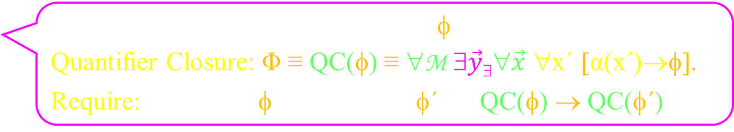
Proving Sound
Removing ∀: From line ∀x α(x), include line α(term) (eg α(x)).
Recall that the meaning of each line φ of the proof is its
Quantifier Closure: Φ ≡ QC(φ) ≡ ∀M ∃$\vec{y}\text{\$}$∀$\vec{x}$ ∀x´ [α(x´)→φ].
Require: From line φ, include line φ´ ➔ QC(φ) → QC(φ´)
Left hand side:
From line
Right hand side:
Include line
∀x α(x)
QC(∀x α(x))
≡ ∀x α(x)
α(term(x))
QC(α(term(x)))
≡ ∀x α(term(x))
→
Ideally, students will be able to look at such statement and know whether or not they are true.

Slide 59
Proving Sound
Removing ∀: From line ∀x α(x), include line α(term) (eg α(x)).
Recall that the meaning of each line φ of the proof is its
Quantifier Closure: Φ ≡ QC(φ) ≡ ∀M ∃$\vec{y}\text{\$}$∀$\vec{x}$ ∀x´ [α(x´)→φ].
Require: From line φ, include line φ´ ➔ QC(φ) → QC(φ´)
Left hand side:
From line
Right hand side:
Include line
∀x α(x)
QC(∀x α(x))
≡ ∀x α(x)
α(term(x))
QC(α(term(x)))
≡ ∀x α(term(x))
→
You cant prove it using the formal proof system that you are currently proving sound.

Slide 60
Proving Sound
Removing ∀: From line ∀x α(x), include line α(term) (eg α(x)).
Recall that the meaning of each line φ of the proof is its
Quantifier Closure: Φ ≡ QC(φ) ≡ ∀M ∃$\vec{y}\text{\$}$∀$\vec{x}$ ∀x´ [α(x´)→φ].
Require: From line φ, include line φ´ ➔ QC(φ) → QC(φ´)
Left hand side:
From line
Right hand side:
Include line
∀x α(x)
QC(∀x α(x))
≡ ∀x α(x)
α(term(x))
QC(α(term(x)))
≡ ∀x α(term(x))
→
I prefer the informal game anyway.
I think it gives the students more intuition.

Slide 61

Proving Sound
Removing ∀: From line ∀x α(x), include line α(term) (eg α(x)).
Recall that the meaning of each line φ of the proof is its
Quantifier Closure: Φ ≡ QC(φ) ≡ ∀M ∃$\vec{y}\text{\$}$∀$\vec{x}$ ∀x´ [α(x´)→φ].
Require: From line φ, include line φ´ ➔ QC(φ) → QC(φ´)
Left hand side:
From line
Right hand side:
Include line
∀x α(x)
QC(∀x α(x))
≡ ∀x α(x)
α(term(x))
QC(α(term(x)))
≡ ∀x α(term(x))
→
I assure you of α(y)
In the game, I provide a value for x.
I give the oracle y=term(x)

Slide 62
Proving Sound
Removing ∀: From line ∀x α(x), include line α(term) (eg α(x)).
Recall that the meaning of each line φ of the proof is its
Quantifier Closure: Φ ≡ QC(φ) ≡ ∀M ∃$\vec{y}\text{\$}$∀$\vec{x}$ ∀x´ [α(x´)→φ].
Require: From line φ, include line φ´ ➔ QC(φ) → QC(φ´)
Left hand side:
From line
Right hand side:
Include line
∀x α(x)
QC(∀x α(x))
≡ ∀x α(x)
α(term(x))
QC(α(term(x)))
≡ ∀x α(term(x))
→
I assure you of α(y)
Hence α(term(x)).

Slide 63
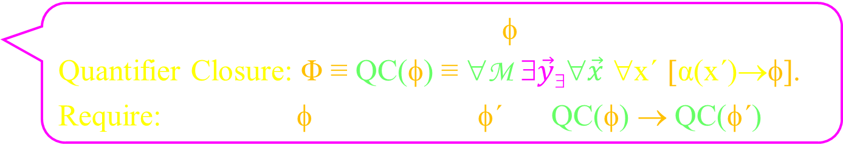
Proving Sound
Removing ∀: From line ∀x α(x), include line α(term) (eg α(x)).
  Goal is to prove α(z)→??
  __________ …
______ ∀x β(x,z´)
  ______ β(x,z´)
α(z´)→
α(z´)→
Recall that the meaning of each line φ of the proof is its
Quantifier Closure: Φ ≡ QC(φ) ≡ ∀M ∃$\vec{y}\text{\$}$∀$\vec{x}$ ∀x´ [α(x´)→φ].
Require: From line φ, include line φ´ ➔ QC(φ) → QC(φ´)
Left hand side:
From line
Right hand side:
Include line
___∀x β(x,z´)
QC(___∀x β(x,z´))
≡ ∀z´ [α(z´)→ ∀x β(x,z´)]
___β(x,z´)
QC(___β(x,z´))
≡ ∀x ∀z´ [α(z´)→β(x,z´)]
→
I assure you of ∀x β(x,z´).
In the game, I provide values for x & z´
and assure you of α(z´).

Slide 64
Proving Sound
Removing ∀: From line ∀x α(x), include line α(term) (eg α(x)).
  Goal is to prove α(z)→??
  __________ …
______ ∀x β(x,z´)
  ______ β(x,z´)
α(z´)→
α(z´)→
Recall that the meaning of each line φ of the proof is its
Quantifier Closure: Φ ≡ QC(φ) ≡ ∀M ∃$\vec{y}\text{\$}$∀$\vec{x}$ ∀x´ [α(x´)→φ].
Require: From line φ, include line φ´ ➔ QC(φ) → QC(φ´)
Left hand side:
From line
Right hand side:
Include line
___∀x β(x,z´)
QC(___∀x β(x,z´))
≡ ∀z´ [α(z´)→ ∀x β(x,z´)]
___β(x,z´)
QC(___β(x,z´))
≡ ∀x ∀z´ [α(z´)→β(x,z´)]
→
I assure you of ∀x β(x,z´).
I conclude β(x,z´).

Slide 65
Proving Sound
Adding ∀: From line α(x), include line ∀x α(x).
  This is trickier because α(x) → ∀x α(x) is not true.
Recall that the meaning of each line φ of the proof is its
Quantifier Closure: Φ ≡ QC(φ) ≡ ∀M ∃$\vec{y}\text{\$}$∀$\vec{x}$ ∀x´ [α(x´)→φ].
Require: From line φ, include line φ´ ➔ QC(φ) → QC(φ´)
Left hand side: From line
Right hand side: Include line
α(x)
QC(α(x))
≡ ∀x α(x)
∀x α(x)
QC(∀x α(x))
≡ ∀x α(x)
→
Not much to say

Slide 66
Proving Sound
Adding ∀: From line α(x), include line ∀x α(x).
  This is trickier because α(x) → ∀x α(x) is not true.
  Cannot be done for fixed x∃ or x´.
Recall that the meaning of each line φ of the proof is its
Quantifier Closure: Φ ≡ QC(φ) ≡ ∀M ∃$\vec{y}\text{\$}$∀$\vec{x}$ ∀x´ [α(x´)→φ].
Require: From line φ, include line φ´ ➔ QC(φ) → QC(φ´)
Left hand side: From line
Right hand side: Include line
α(x∃)
QC(α(x∃))
≡ ∃x∃ α(x∃)
∀x α(x)
QC(∀x α(x))
≡ ∀x α(x)
→
Sorry, I only know about x∃.
In the game, I provide a value for x.
Say oracle tell me about x.

Slide 67
Proving Sound
Adding ∀: From line α(x), include line ∀x α(x).
  This is trickier because α(x) → ∀x α(x) is not true.
  Cannot be done for fixed x∃ or x´.
Recall that the meaning of each line φ of the proof is its
Quantifier Closure: Φ ≡ QC(φ) ≡ ∀M ∃$\vec{y}\text{\$}$∀$\vec{x}$ ∀x´ [α(x´)→φ].
Require: From line φ, include line φ´ ➔ QC(φ) → QC(φ´)
Left hand side: From line
Right hand side: Include line
___β(x´)
QC(___β(x´))
≡ ∀x´ [α(x´)→β(x´)]
___∀x β(x)
QC(___∀x β(x))
≡ ∀x´ [α(x´)→ [∀x β(x)]]
→
I assure you of β(x´).
In the game, I provide a values for x´
and assure you of α(x´).

Slide 68
Proving Sound
Adding ∀: From line α(x), include line ∀x α(x).
  This is trickier because α(x) → ∀x α(x) is not true.
  Cannot be done for fixed x∃ or x´.
Recall that the meaning of each line φ of the proof is its
Quantifier Closure: Φ ≡ QC(φ) ≡ ∀M ∃$\vec{y}\text{\$}$∀$\vec{x}$ ∀x´ [α(x´)→φ].
Require: From line φ, include line φ´ ➔ QC(φ) → QC(φ´)
Left hand side: From line
Right hand side: Include line
___β(x´)
QC(___β(x´))
≡ ∀x´ [α(x´)→β(x´)]
___∀x β(x)
QC(___∀x β(x))
≡ ∀x´ [α(x´)→ [∀x β(x)]]
→
I assure you of β(x´).
Oops. That does not tell me ∀x β(x)

Slide 69
Proving Sound
Adding ∀: From line α(x), include line ∀x α(x).
  This is trickier because α(x) → ∀x α(x) is not true.
  Cannot be done for fixed x∃ or x´.
Recall that the meaning of each line φ of the proof is its
Quantifier Closure: Φ ≡ QC(φ) ≡ ∀M ∃$\vec{y}\text{\$}$∀$\vec{x}$ ∀x´ [α(x´)→φ].
Require: From line φ, include line φ´ ➔ QC(φ) → QC(φ´)
Left hand side: From line
Right hand side: Include line
___β(x´)
QC(___β(x´))
≡ ∀x´ [α(x´)→β(x´)]
___∀x β(x)
QC(___∀x β(x))
≡ ∀x´ [α(x´)→ [∀x β(x)]]
→
A model in which it is not true is as follows.
α(0)=β(0)=F and α(1)=β(1)=T.
Hence α(x´)→β(x´), but ¬(α(0)→β(1))

Slide 70
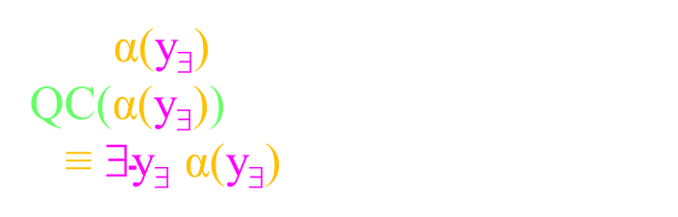
Proving Sound
Removing ∃: From line ∃y α(x,y), include line α(x,y∃(x)).
  Lets first to a simpler case: ∃y α(y) to α(y∃).
  ∃y α(y) → α(y∃) is not true.
Recall that the meaning of each line φ of the proof is its
Quantifier Closure: Φ ≡ QC(φ) ≡ ∀M ∃$\vec{y}\text{\$}$∀$\vec{x}$ ∀x´ [α(x´)→φ].
Require: From line φ, include line φ´ ➔ QC(φ) → QC(φ´)
Left hand side: From line
Right hand side: Include line
∃y α(y)
QC(∃y α(y))
≡ ∃y α(y)
α(y∃)
QC(α(y∃))
≡ ∃$\text{y}\text{\$}$ α(y∃)
→
Not much to say

Slide 71
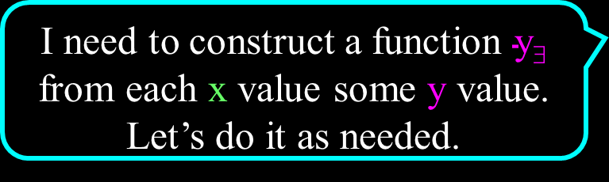
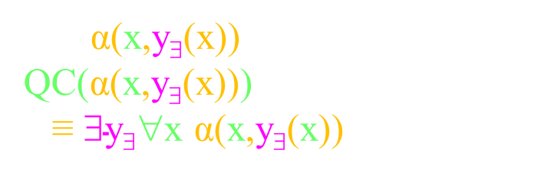
Proving Sound
Removing ∃: From line ∃y α(x,y), include line α(x,y∃(x)).
  ∃y α(x,y) → α(x,y∃(x)) is also not true,
  Note y∃ depends on ⟨x⟩.
Recall that the meaning of each line φ of the proof is its
Quantifier Closure: Φ ≡ QC(φ) ≡ ∀M ∃$\vec{y}\text{\$}$∀$\vec{x}$ ∀x´ [α(x´)→φ].
Require: From line φ, include line φ´ ➔ QC(φ) → QC(φ´)
Left hand side: From line
Right hand side: Include line
∃y α(x,y)
QC(∃y α(x,y))
≡ ∀x ∃y α(x,y)
α(x,y∃(x))
QC(α(x,y∃(x)))
≡ ∃$\text{y}\text{\$}$∀x α(x,y∃(x))
→
I need to construct a function $\text{y}\text{\$}$ from each x value some y value.
Let’s do it as needed.

Slide 72
Proving Sound
Removing ∃: From line ∃y α(x,y), include line α(x,y∃(x)).
  ∃y α(x,y) → α(x,y∃(x)) is also not true,
  Note y∃ depends on ⟨x⟩.
Recall that the meaning of each line φ of the proof is its
Quantifier Closure: Φ ≡ QC(φ) ≡ ∀M ∃$\vec{y}\text{\$}$∀$\vec{x}$ ∀x´ [α(x´)→φ].
Require: From line φ, include line φ´ ➔ QC(φ) → QC(φ´)
Left hand side: From line
Right hand side: Include line
∃y α(x,y)
QC(∃y α(x,y))
≡ ∀x ∃y α(x,y)
α(x,y∃(x))
QC(α(x,y∃(x)))
≡ ∃$\text{y}\text{\$}$∀x α(x,y∃(x))
→
I give you a y corresponding to this x.
I give you an arbitrary value of x.

Slide 73

Proving Sound
Removing ∃: From line ∃y α(x,y), include line α(x,y∃(x)).
  ∃y α(x,y) → α(x,y∃(x)) is also not true,
  Note y∃ depends on ⟨x⟩.
Recall that the meaning of each line φ of the proof is its
Quantifier Closure: Φ ≡ QC(φ) ≡ ∀M ∃$\vec{y}\text{\$}$∀$\vec{x}$ ∀x´ [α(x´)→φ].
Require: From line φ, include line φ´ ➔ QC(φ) → QC(φ´)
Left hand side: From line
Right hand side: Include line
∃y α(x,y)
QC(∃y α(x,y))
≡ ∀x ∃y α(x,y)
α(x,y∃(x))
QC(α(x,y∃(x)))
≡ ∃$\text{y}\text{\$}$∀x α(x,y∃(x))
→
I give you a y corresponding to this x.
For the adversary’s x,
I define $\text{y}\text{\$}$(x) is the y value
provided by the oracle.

Slide 74
Proving Sound
Removing ∃: From line ∃y α(x,y), include line α(x,y∃(x)).
  ∃y α(x,y) → α(x,y∃(x)) is also not true,
  Note y∃ depends on ⟨x⟩.
Recall that the meaning of each line φ of the proof is its
Quantifier Closure: Φ ≡ QC(φ) ≡ ∀M ∃$\vec{y}\text{\$}$∀$\vec{x}$ ∀x´ [α(x´)→φ].
Require: From line φ, include line φ´ ➔ QC(φ) → QC(φ´)
Left hand side: From line
Right hand side: Include line
∃y α(x,y)
QC(∃y α(x,y))
≡ ∀x ∃y α(x,y)
α(x,y∃(x))
QC(α(x,y∃(x)))
≡ ∃$\text{y}\text{\$}$∀x α(x,y∃(x))
→
For the adversary’s x,
I define $\text{y}\text{\$}$(x) is the y value
provided by the oracle.
I assure you of α(x,y).
Done

Slide 75
Proving Sound
Adding ∃: From line α(term), include line ∃y α(y).
  α(term) → ∃y α(y) is true.
    If α(t) is true for some term t,
    then there exists a y for which it is true.
Recall that the meaning of each line φ of the proof is its
Quantifier Closure: Φ ≡ QC(φ) ≡ ∀M ∃$\vec{y}\text{\$}$∀$\vec{x}$ ∀x´ [α(x´)→φ].
Require: From line φ, include line φ´ ➔ QC(φ) → QC(φ´)
Left hand side: From line
Right hand side: Include line
α(term)
QC(α(term))
≡ α(term)
∃y α(y)
QC(∃y α(y))
≡ ∃y α(y)
→
I give you the object term for which is α true.
I set y to this value
to get α(y).

Slide 76
Proving Sound
Adding ∃: From line α(term), include line ∃y α(y).
  It is fine if both α and term depend on a free variable x.
Recall that the meaning of each line φ of the proof is its
Quantifier Closure: Φ ≡ QC(φ) ≡ ∀M ∃$\vec{y}\text{\$}$∀$\vec{x}$ ∀x´ [α(x´)→φ].
Require: From line φ, include line φ´ ➔ QC(φ) → QC(φ´)
Left hand side: From line
Right hand side: Include line
α(x,term(x))
QC(α(x,term(x)))
≡ ∀x α(x,term(x))
∃y α(x,y)
QC(∃y α(x,y))
≡ ∀x ∃y α(x,y)
→
I give you y=term(x), such that α(x,y).
I give you an arbitrary value of x.

Slide 77
Proving Sound
Adding ∃: From line α(term), include line ∃y α(y).
  It is fine if both α and term depend on a free variable x.
Recall that the meaning of each line φ of the proof is its
Quantifier Closure: Φ ≡ QC(φ) ≡ ∀M ∃$\vec{y}\text{\$}$∀$\vec{x}$ ∀x´ [α(x´)→φ].
Require: From line φ, include line φ´ ➔ QC(φ) → QC(φ´)
Left hand side: From line
Right hand side: Include line
α(x,term(x))
QC(α(x,term(x)))
≡ ∀x α(x,term(x))
∃y α(x,y)
QC(∃y α(x,y))
≡ ∀x ∃y α(x,y)
→
I give you y=term(x), such that α(x,y).
I set y to this value
to get α(x,y).

Slide 78
Proving Sound
Adding ∃: From line α(term), include line ∃y α(y).
  It is fine if both α and term depend on a free variable x.
  But not if this x is quantified with in ∀x.
Recall that the meaning of each line φ of the proof is its
Quantifier Closure: Φ ≡ QC(φ) ≡ ∀M ∃$\vec{y}\text{\$}$∀$\vec{x}$ ∀x´ [α(x´)→φ].
Require: From line φ, include line φ´ ➔ QC(φ) → QC(φ´)
Left hand side: From line
Right hand side: Include line
∀x α(x,term(x))
QC(∀x α(x,term(x)))
≡ ∀x α(x,term(x))
∃y ∀x α(x,y)
QC(∃y ∀x α(x,y))
≡ ∃y ∀x α(x,y)
→
I set y to some value before I know x.
α(x,y) is true for y=term(x),
but not for your value of y.
I give you x.
Oops

Slide 79
Proving Sound
Adding ∃: From line α(term), include line ∃y α(y).
  It is fine if both α and term depend on a free variable x.
  But not if this x is quantified with in ∀x.
Recall that the meaning of each line φ of the proof is its
Quantifier Closure: Φ ≡ QC(φ) ≡ ∀M ∃$\vec{y}\text{\$}$∀$\vec{x}$ ∀x´ [α(x´)→φ].
Require: From line φ, include line φ´ ➔ QC(φ) → QC(φ´)
Left hand side: From line
Right hand side: Include line
∀x α(x,term(x))
QC(∀x α(x,term(x)))
≡ ∀x α(x,term(x))
∃y ∀x α(x,y)
QC(∃y ∀x α(x,y))
≡ ∃y ∀x α(x,y)
→
A model in which it is not true is as follows.
term(x)=x
α(0,0)= α(1,1)=T and α(0,1)=α(1,0)=F.

Slide 81
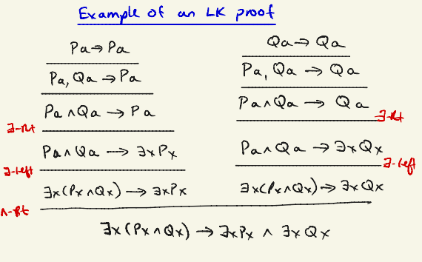
Predicate Sequent Calculus LK
Each line of the proof is a “sequent”:
α₁ ∧ ... ∧ α_{k} → β₁ ∨ ... ∨ β_{l}
I really like this proof system
If these are
ALL true.
Then SOME
of these are true.
Some 1st order formula.
A proof looks like this.
The proof system has
a left and right rule
for each of ¬ ∧ ∨ ∀ ∃.

Slide 82
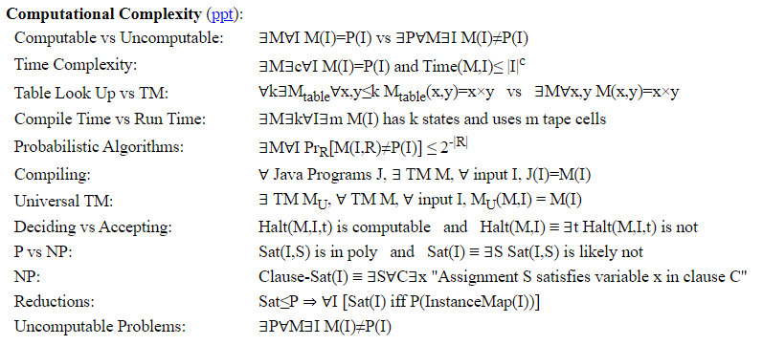
Examples

Slide 83
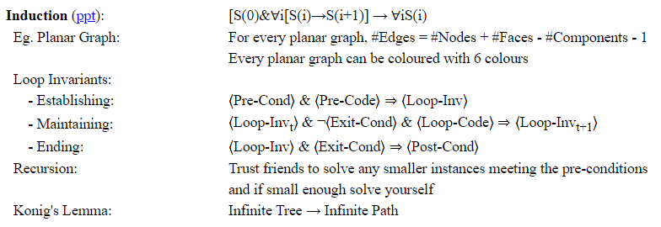
Examples

Slide 84
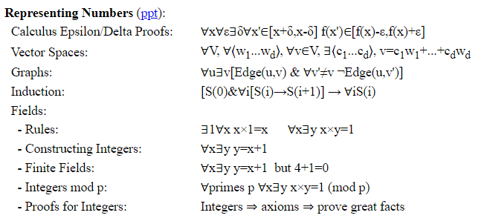
Examples

Slide 85
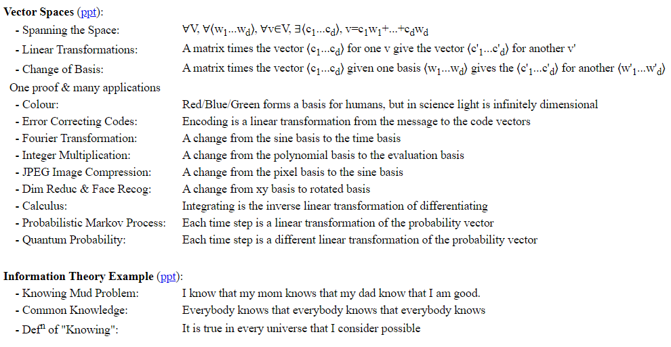
Examples

Slide 86
End

Slide 88
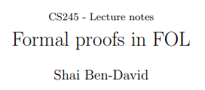
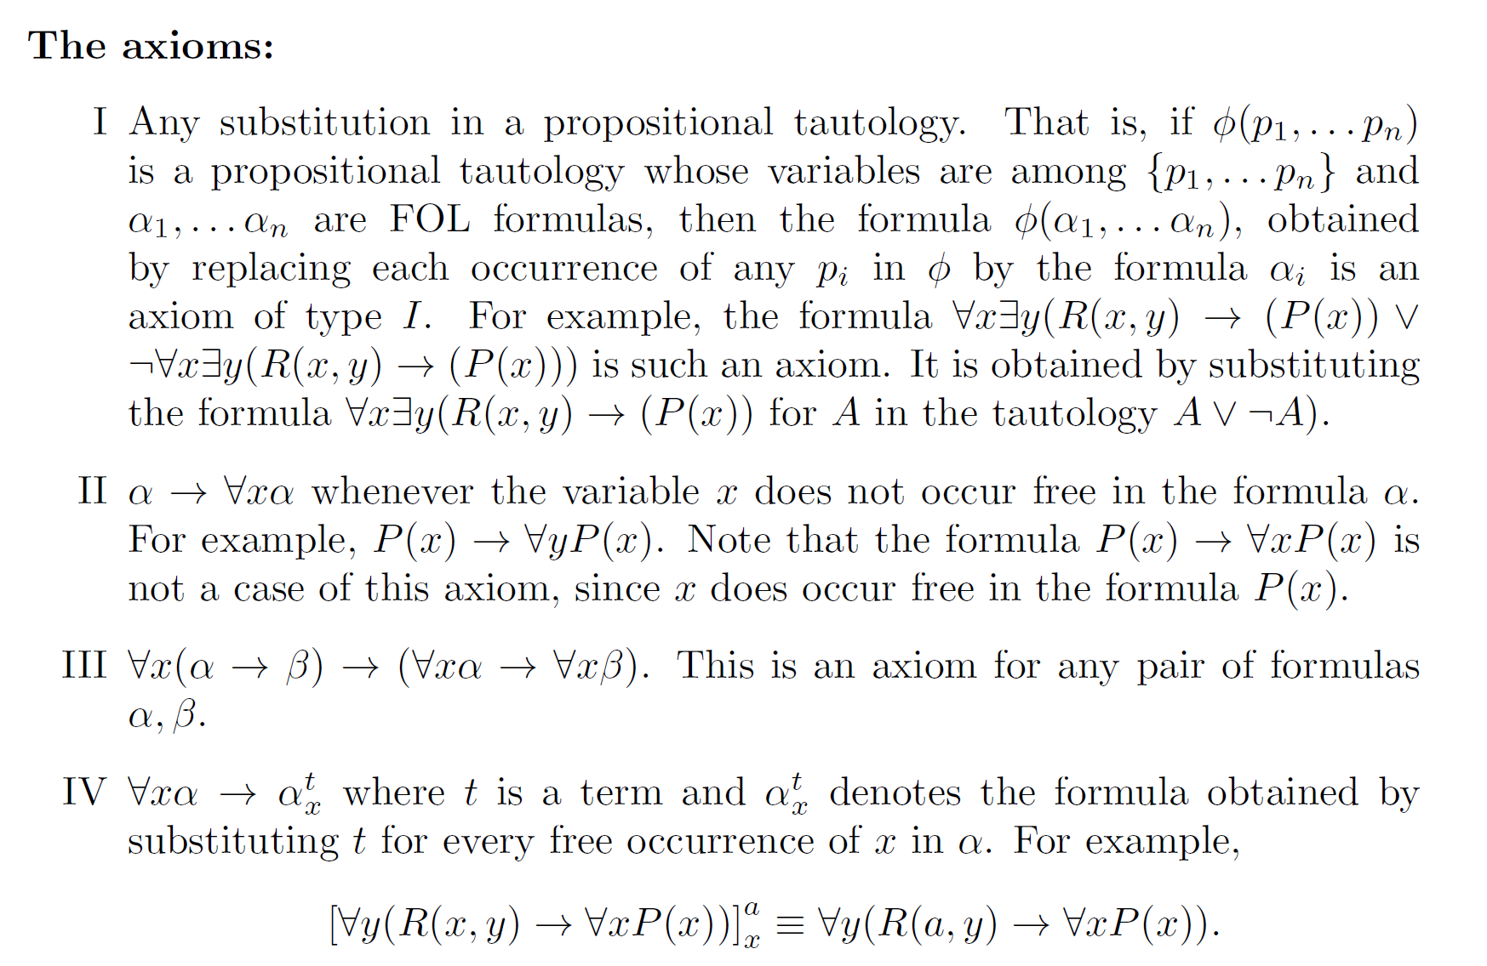

Slide 89
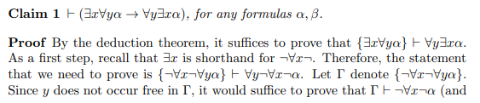
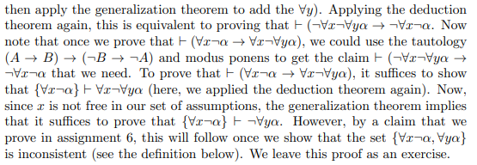
If this has a proof
then this does
then this does …
Just give me a proof.

Slide 90
