Slide 1
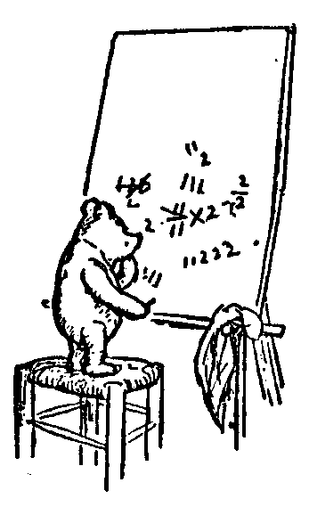
Logic and Proofs
Propositional Logic
And, Or, Not, Implies
Review
Notation Truth Tables
Tautologies
Hilbert Proof
Purple Table
Example Proofs
Jeff Edmonds
York University
Lecture 1.5
Math/EECS 1019/1090

Slide 2
Review
Aaaaah
So many slides.
Don’t panic.
Deeply understand everything in this review and you will be fine for the midterm.

Slide 3
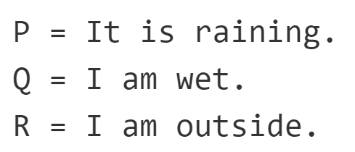
Operator's Truth Tables
 |  | And | Or | Not | Implies | If and only if | Exclusive Or
P | Q | P∧Q | P∨Q | ¬Q | P→Q | P iff Q | P⊕Q
T | T | T | T | F | T | T | F
T | F | F | T | T | F | F | T
F | T | F | T |  | T | F | T
F | F | F | F |  | T | T | F
∧ A for And
∨ is OR
→ is Implies
¬ is Not
⊕ is parity
T is for True
F is for False
Be sure to know the truth tables
for each of these operation.
Given a T/F assignment of the variables know how to evaluate any expression.
Know how to manipulate expressions
using the rules in the purple table.
∧ | T | F
T | T | F
F | F | F
∨ | T | F
T | T | T
F | T | F
¬
T | F
F | T
→ | T | F
T | T | F
F | T | T
iff | T | F
T | T | F
F | F | T
⊕ | T | F
T | F | T
F | T | F
P

Slide 4
Review
Translate between English and Math.
if p, then q
if p, q
p implies q
p is sufficient for q
q if p
q whenever p
q follows from p
q when p
p only if q
q is necessary for p
∧ A for And
∨ is OR
→ is Implies
¬ is Not
⊕ is parity
T is for True
F is for False
4

Slide 5

Tautologies, Equivalences, & Proofs
or
or
??
and
iff
A tautology is a sentence that is true
under every setting of the variables.
(A∨B) → C iff (A→C) ∨ (B→C) iff (A∧B) → C
Hence, the obvious “proof”
is build a table of all settings
and evaluate the formula under each.
A | B | C | A∨B | (A ∨B) → C | (A→ C) ∨ (B → C) | (A ∧B) → C
T | T | F | T | F | F | F
T | T | T | T | T | T | T
T | F | F | T | F | T | T
T | F | T | T | T | T | T
F | T | F | T | F | T | T
F | T | T | T | T | T | T
F | F | F | F | T | T | T
F | F | T | F | T | T | T
Equivalent
ie always the same.
Not Equivalent
ie sometimes different.
2^{# variables} cells!!!
This is called
Brute Force
Maybe we can save time.

Slide 6
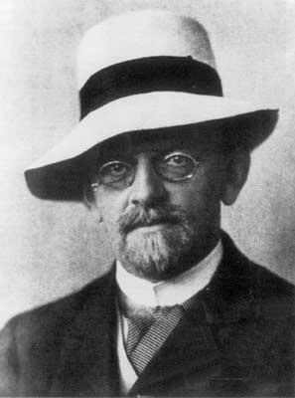
Tautologies, Equivalences, & Proofs
A Hilbert Style Proof is a sequence of formulas.
Hilbert 1920
φ₁
φ₂
φ₃
φ₄
φ₅
φ₆
….
n. φ
          Each line φ is either:
  φ_{i} ∈Axioms_{logical} ∪ Axioms_{non-logical}
Logical Axioms: Axioms_{logical}
A set of formulas that has already been proved to always be true.
Non-Logical Axioms Γ:
A set of formulas that have been given by the problem to be true.
Notes:
6

Slide 7
Tautologies, Equivalences, & Proofs
A Hilbert Style Proof is a sequence of formulas.
Hilbert 1920
φ₁
φ₂
φ₃
φ₄
φ₅
φ₆
….
n. φ
          Each line φ is either:
  φ_{i} ∈Axioms_{logical} ∪ Axioms_{non-logical}
  Follows from a lemma/rule of the form:
  “If φ_{i} and φ_{j} are lines of your proof,
  then you can add φ_{k} as a line of your proof.”
  Each such line φ_{k} should be documented
  where it came from.
The last line of the proof is our theorem φ.
Notes:
7

Slide 8
Tautologies, Equivalences, & Proofs
A Hilbert Style Proof is a sequence of formulas.
Hilbert 1920
φ₁
φ₂
φ₃
φ₄
φ₅
φ₆
….
n. φ
Label each line of your proof with
Which rule you used to produce this line
The index of the lines that you used.
Modus Pones (2&4)
Do not skip steps. (Except for dropping ¬¬)
Be sure to indent appropriately.
Notes:
8

Slide 9
Tautologies, Equivalences, & Proofs
A Hilbert Style Proof is a sequence of formulas.
Hilbert 1920
φ₁
φ₂
100. φ
Given Axioms.
have
need
Thing to be proven
Notes:
9

Slide 10
Tautologies, Equivalences, & Proofs
A Hilbert Style Proof is a sequence of formulas.
I find the formal proof is
easier to find
matches my intuition better
if I work from both ends.
If you get stuck
going down,
You can try going up.
Hilbert 1920
φ₁
φ₂
φ₃
φ₄
98. φ₅
99. φ₆
100. φ
Some of the proof games
translate into begin-end pairs.
1. Goal α→β
2. Assume α
99. β
100. Conclude α→β
have
Must link
need
have
need
You can end the numbering at 100
Notes:
10

Slide 11
Tautologies, Equivalences, & Proofs
A Hilbert Style Proof is a sequence of formulas.
I find the formal proof is
easier to find
matches my intuition better
if I work from both ends.
Hilbert 1920
φ₁
φ₂
φ₃
φ₄
98. φ₅
99. φ₆
100. φ
Some of the proof games
translate into begin-end pairs.
1. ∀x α(x)
2. α(x) Remove ∀
99. β(x)
100. ∀x β(x) Add ∀
have
Must link
need
Goal: Prove general ∀x.
Let x be an arbitrary value supplied by the adversary.
Prove it for this x.
Generalize to ∀x.
have
need
Notes:
11

Slide 12
Proof Techniques/Lemmas
And ∧:
Or ∨:
Implies →:
And
Or
Using:
Proving:
From:
Conclude:
From:
Conclude:
Separating And
Eval/Build ∧
Simplify ∧
α∧β
α & β
α & β
¬α
α∧β
¬(α∧β)
α
α∧β iff β
Selecting Or
Eval/Build ∨
Simplify ∨
α∨β & ¬α
β
α
¬α & ¬β
α∨β
¬(α∨β)
α∨β iff β
¬α
Cases
Excluded Middle
α∨β, α→γ, & β→γ
γ
α∨¬α & ¬(α∧¬α)
Modus Ponens
Deduction
α & α→β
β
Assume α, prove β
α→β
Cases
Eval/Build →
Simplify →
α∨β, α→γ, & β→γ
γ
¬α
β
α & ¬β
α→β
α→β
¬(α→β)
α
¬β
α→β iff β
α→β iff ¬α
Equivalence
Contrapositive
α→β & β→α
α iff β
α→β iff ¬β→¬α iff ¬α∨β
Transitivity
De Morgan's Law
α→β & β→γ
α→γ
¬(α∧β) iff
¬α∨¬β
Double Negation: ¬¬α iff α
Commutative: α∨β iff β∨α and α∧β iff β∧α
Distributive: γ∧(α∨β) iff (γ∧α)∨(γ∧β) and γ∨(α∧β) iff (γ∨α)∧(γ∨β)
By Contradiction: From ¬α→(β&¬β), conclude α.
Inconsistent: From β and ¬β, conclude anything.

Slide 13
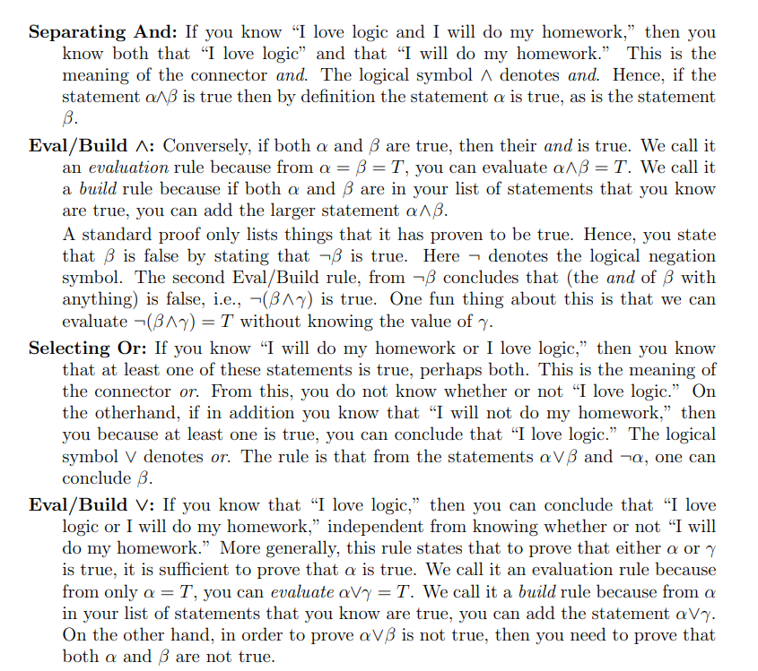

Slide 14
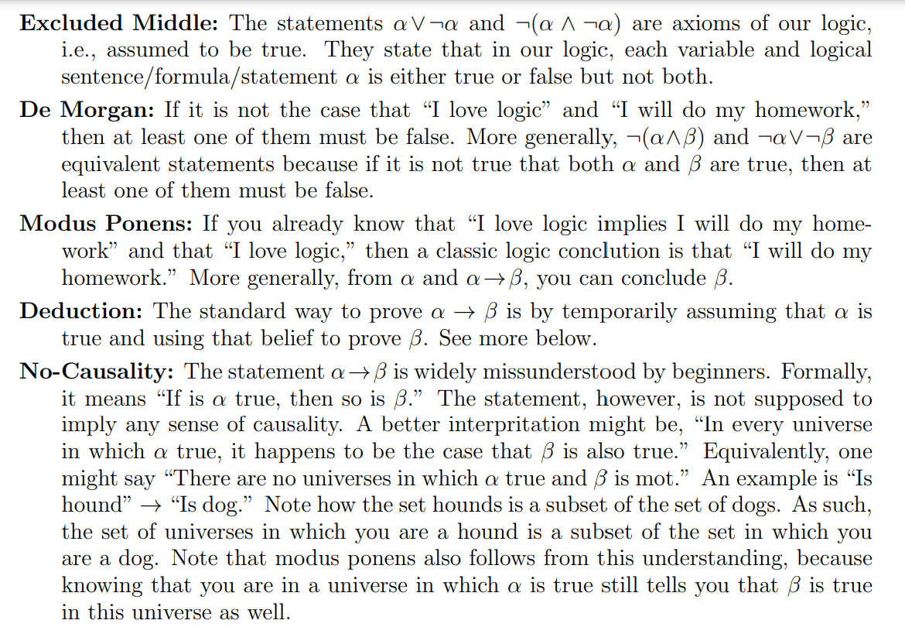

Slide 15
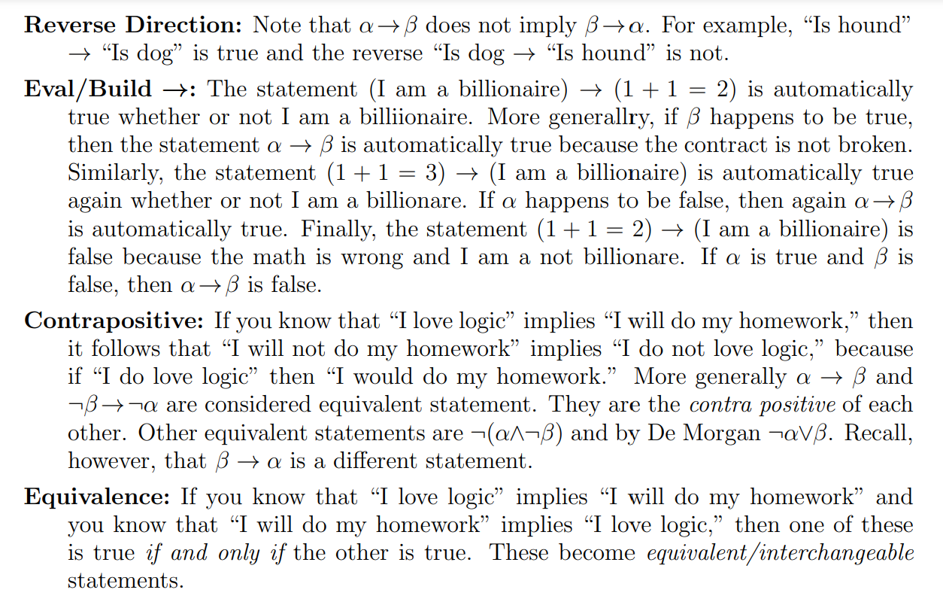

Slide 16
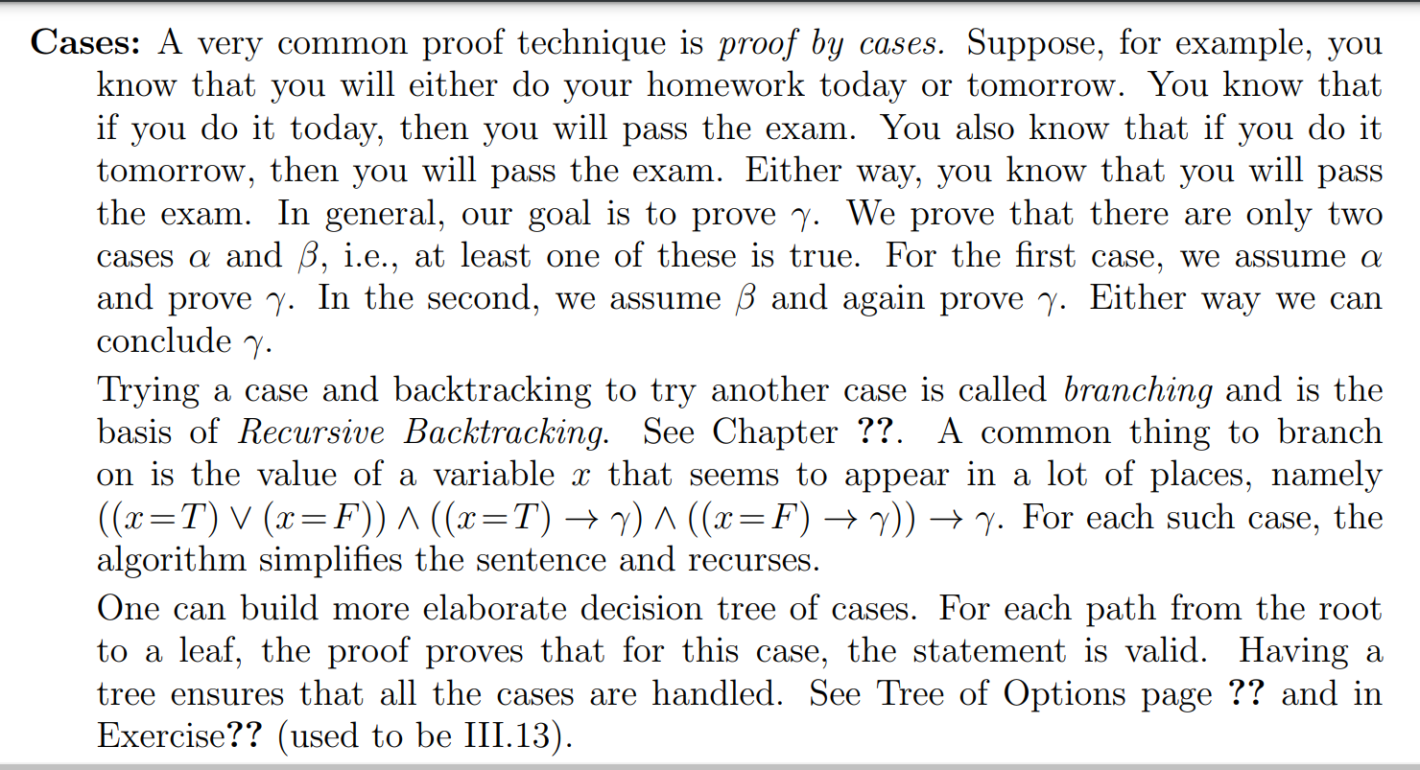

Slide 17
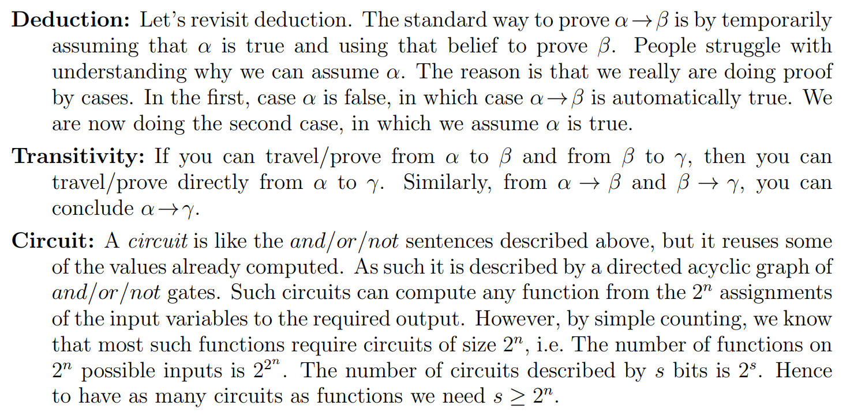

Slide 18
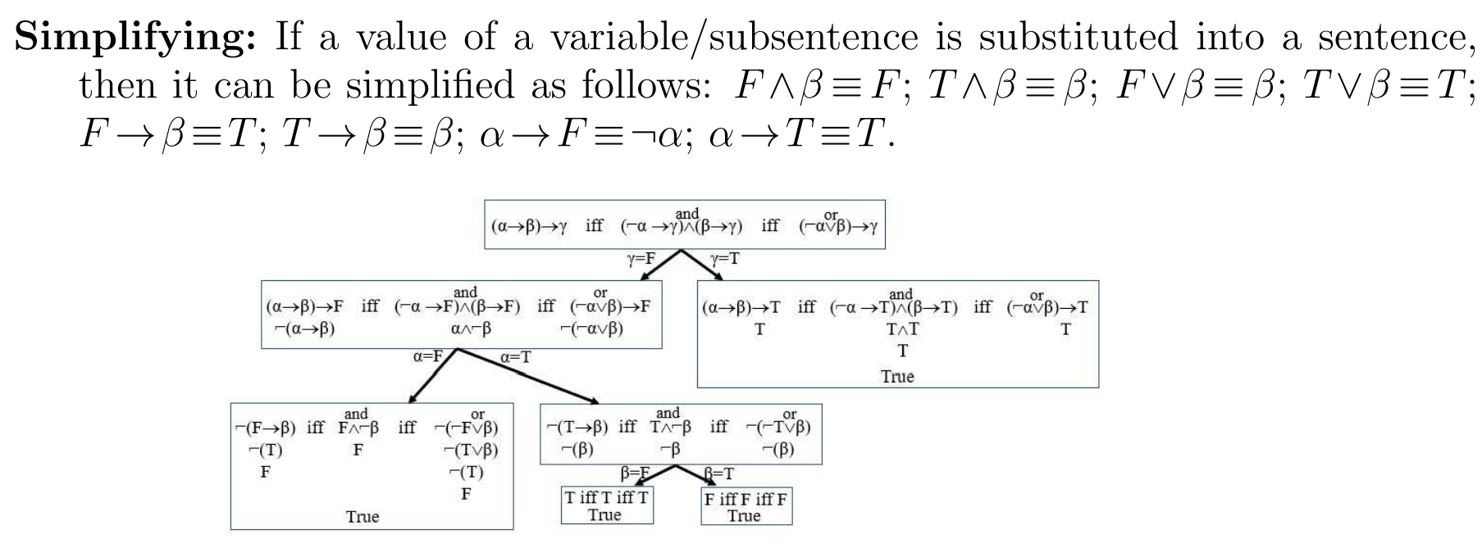

Slide 19
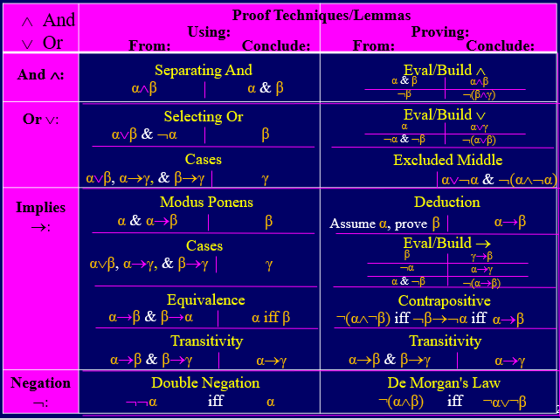
Brute Force Purple Table
Finding:
It may be hard to find
a proof for a formula.
Hilbert 1920
Try using brute force.
For each (pair of) axioms
and each rule
How can you apply the rule?
What does it produce?
Use the left column of our rules
i.e. rules that tell you how to use
statements that you already have.

Slide 20
Brute Force Purple Table
Finding:
It may be hard to find
a proof for a formula.
Hilbert 1920
Try using brute force.
What do you want to prove?
Which rules will produce it?
What formulas are
needed for this?
Use the right column of our rules
i.e. rules that tell you how to prove statements that you want.

Slide 21

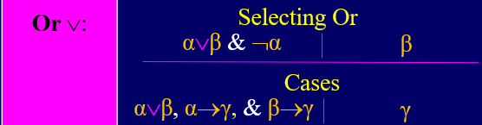
Brute Force Purple Table
1) Day or Night
2) Cases Goal: I’m happy
3) Case Day:
4) Some how prove you are happy during the day.
Case Night:
Some how prove you are happy at night.
100) I’m happy
Cases Day or Night
Assumption
Assumption
Cases (1,4,6)
have
need
How do I use this Or?
One option is to break the set of all possibilities into these cases and then prove what you want for each of the cases.
Notes:
21

Slide 22
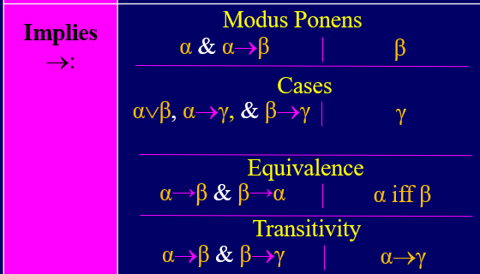
Brute Force Purple Table
1) Day → Happy
2) Day or ¬Day
3) Cases Goal: I’m happy
4) Case Day:
5) Happy
6) Case ¬Day:
Some how prove you are happy at night.
100) I’m happy
Exclude middle
Cases Day or
Assumption
Modus Ponens 1&4
Assumption
Cases (2,5,7)
¬Day
have
need
How do I use this Imples?
If I knew it was day, then at least this case is handled.
Let’s focus on the remaining cases.
Notes:
22

Slide 23


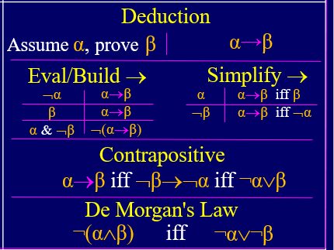

Brute Force Purple Table
1) Deduction Goal: [(α→β)∧(¬β∨γ)]→[¬γ→¬α]
2) (α→β)∧(¬β∨γ)
3) α→β
¬β∨γ
5) Deduction Goal:¬γ→¬α
6) ¬γ
7) ¬β
¬β→¬α
9) ¬α
10) ¬γ→¬α
11) [(α→β)∧(¬β∨γ)]→[¬γ→¬α]
Assumption/Premise
Separating ∧ (2)
Separating ∧ (2)
Assumption/Premise
Selecting or (4&6)
Contra Positive (3)
Modus Ponens (7&8)
Conclude Deduction
Conclude Deduction
have
need
Notes:
23

Slide 24
Hard Example
From Lemmas:
Modus Ponens: From α and α→β, conclude β.
Deduction: Assume α, prove β, conclude α→β.
Contrapositive: From ¬β→¬α, conclude α→β.
Selecting Or: From α∨β and ⌐α, conclude β.
Eval/Build: From ⌐α and ⌐β, conclude ⌐(α∨β).
Prove Lemma:
By Cases: From α∨β, α→γ, and β→γ, conclude γ.
This is going to be unnecessarily hard,
but it will give us practice proving things
with these rules
and it will be a fun puzzle.

Slide 25
Brute Force Purple Table
Burte Force Purple Table: From α∨β, α→γ, ∧ β→γ, conclude γ
α∨β
α→γ
β→γ
11. ⌐γ → ⌐(α∨β)
12. (α∨β) → γ
13. γ
Assume proved already
Assume proved already
Assume proved already
Contra Positive (11)
Modus Pones (1&12)
Need divine inspiration.
Going from the two cases to γ is too hard.
Instead, lets do the contrapositive,
ie go from ⌐γ to not the two cases.
have
need
Notes:
25

Slide 26
Brute Force Purple Table
Burte Force Purple Table: From α∨β, α→γ, ∧ β→γ, conclude γ
α∨β
α→γ
β→γ
Deduction Goal: ⌐γ → ⌐(α∨β)
⌐γ
⌐γ → ⌐α
⌐γ → ⌐β
⌐α
⌐β
⌐(α∨β)
⌐γ → ⌐(α∨β)
(α∨β) → γ
γ
Assume proved already
Assume proved already
Assume proved already
Assume f or →
Contra Positive (2)
Contra Positive (3)
Modus Pones (5&6)
Modus Pones (5&7)
Eval/Build ∨: (8&9)
Conclude
Contra Positive (11)
Modus Pones (1&12)
have
need
Notes:
26

Slide 27
https://www.eecs.yorku.ca/~jeff/courses/1090/notes/oracle.pdf
Contains examples with forall exists.
If you delete the forall exists, you get good purple table examples.
This is how I got one of the test1 questions.

Slide 28
End

