Slide 1
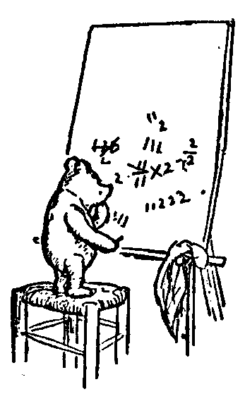
Logic for Computer Science
Computing
Computable
The Game
TM vs Java
Many Courses
EECS1090
Jeff Edmonds
York University
Lecture 0

Slide 2
Please feel free
to ask questions!
Please give me feedback
so that I can better serve you.
Thanks for the feedback that you have given me already.
Notes:
2

Slide 3


Learn The Game
Most anything in math can be represented by a logic statement.
It is then understood/proved by following the following game!
The prover must prove
the required logic statement.
Despite the worst that
the adversary can do.
Using the help of the oracle
who assures her/him that the axioms are true.

Slide 4
Tautologies, Equivalences, & Proofs
Proof Techniques/Lemmas
And ∧:
Or ∨:
Implies →:
Top
Operation
Using Oracle Assured Statement
Prover Proving Statement
From:
Conclude:
From:
Conclude:
Separating And
Eval/Build ∧
Simplify ∧
α∧β
α & β
α & β
¬α
α∧β
¬(α∧β)
α
α∧β iff β
Selecting Or
Eval/Build ∨
Simplify ∨
α∨β & ¬α
β
α
¬α & ¬β
α∨β
¬(α∨β)
α∨β iff β
¬α
Cases
Excluded Middle
α∨β, α→γ, & β→γ
γ
α∨¬α & ¬(α∧¬α)
Modus Ponens
Deduction
α & α→β
β
Assume α, prove β
α→β
Cases
Eval/Build →
Simplify →
α∨β, α→γ, & β→γ
γ
¬α
β
α & ¬β
α→β
α→β
¬(α→β)
α
¬β
α→β iff β
α→β iff ¬α
Equivalence
Contrapositive
α→β & β→α
α iff β
α→β iff ¬β→¬α iff ¬α∨β
Transitivity
De Morgan's Law
α→β & β→γ
α→γ
¬(α∧β) iff
¬α∨¬β
Double Negation: ¬¬α iff α
Commutative: α∨β iff β∨α and α∧β iff β∧α
Distributive: γ∧(α∨β) iff (γ∧α)∨(γ∧β) and γ∨(α∧β) iff (γ∨α)∧(γ∨β)
By Contradiction: From ¬α→(β&¬β), conclude α.
Inconsistent: From β and ¬β, conclude anything.

Slide 5
Tautologies, Equivalences, & Proofs
Proof Techniques/Lemmas
Exists ∃: Formal Practice Game
Forall ∀: Formal Practice Game
Implies →:
Top
Operation
Using Oracle Assured Statement
Prover Proving Statement
Give it a name
Existential Instantiation
(∃ Elimination)
"Let y´ denote the object
assumed to exist in the axiom."
The oracle assures ∃y α(y)
by providing such a y´.
Proof by Construction
Existential Generalization
(∃ Introduction)
"Let y´ be 5.“
The prover proves ∃y α(y)
by constructing such an y´.
Plugging In
Universal Instantiation
(∀ Elimination)
“Knowing it is true for all x,
it must be true for x'=6."
The oracle assures ∀x α(x)
by having the prover give x' to her.
Arbitrary/Worst Case
Universal Generalization
(∀ Introduction)
"Let x´ be arbitrary
(Adversarially chosen)."
The prover proves ∀x α(x)
by having the adversary give x’.
Modus Ponens/Inference
The oracle assures α→β
by having the prover prove α
and then assuring β.
Deduction
The prover proves α→β
by having the oracle assure him of α and going on to prove β.

Slide 6
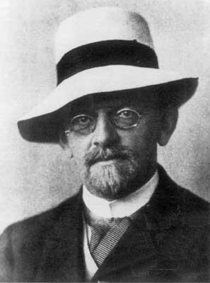
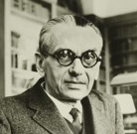
Computable
What is computation?
Hilbert (1900)
Gödel’s
Completeness and Incompleteness Theorems
1929
No hardware has been built.
All we have is logic.

Slide 7
Computable
Let P be some computational problem.
Let I be an input.
P(I) denotes the required output for problem P on input I.
P≡Sort is an example of a computational problem.
We know that the input to sorting is an array of values.
But computer theorists just assume the input I is
a generic binary string.
Sort(I) denotes the same numbers as in I but sorted.

Slide 8
Computable
Let P be some computational problem.
Let I be an input.
P(I) denotes the required output for problem P on input I.
Let A be an algorithm/machine.
A(I) denotes the output produced by algorithm A on input I.
Computable mean that some algorithm A computes it.
A≡InsertionSort is an example of an algorithm.
Computer theorists tend to assume that the algorithm is
a Turing Machine TM M.
but being Java code is the same for our purposes.
If bug free, InsertionSort(I) returns the sorted list.

Slide 9
Computable
Let P be some computational problem.
Let I be an input.
P(I) denotes the required output for problem P on input I.
Let A be an algorithm/machine.
A(I) denotes the output produced by algorithm A on input I.
Let A(I)=P(I) indicate that alg A gives the correct answer for problem P on input I.
If algorithm A is computing problem P, then we need
its output A(I) to be as required.
From a logic perspective:
P(I)=A(I) is just another T/F relation
between objects P, A, and I.

Slide 10
Computable
∃ algorithm A, ∀ input I, A(I)=P(I)
We will start with an English statement
and from it build a logic sentence.
What does computable mean?
What does computes mean?
What does solves mean?
A(I)=P(I)
∀
“Algorithm A correctly solves problem P on input I.”
“Algorithm A correctly computes problem P.”
“Computational problem P is computable”.
?
input I,
∃
algorithm A,
?
There is at least input I solved or all are solved?
There is at least one algorithm A that works or they all do?
What order do these appear in the logical sentence?
hence in the game?
He better have one algorithm A that works for every input I.

Slide 11
Computable
∃ algorithm A, ∀ input I, A(I)=P(I)
Or condensed to Solves_{P}(A∃,I)
What does each subsequence say about
** value of free variables
A(I)=P(I)
∀ I, A(I)=P(I)
∃A, ∀ I, A(I)=P(I)
“Algorithm A correctly solves problem P on input I.”
“Algorithm A correctly computes problem P.”
“Computational problem P is computable”.
How does the game go?

Slide 12

Computable
∃ algorithm A, ∀ input I, A(I)=P(I)
The read the statement left to right.
I am invested in proving that the sentence is true.
I produce a good object when it is a ∃.
I am invested in proving that the sentence is false.
Or at least giving the prover as hard of a time as I can.
I produce a worst-case object when it is a ∀.
The prover wins if the relation is true.

Slide 13
Computable
∃ algorithm A, ∀ input I, A(I)=P(I)
I have an algorithm A that I claim works.
Oh yeah,
I study A and find a worst case input I
on which it does not.
I win if A on input I gives the correct output.
This is what we do in Computer Science!
Here the P is considered free
because it is not bounded by a quantifier.
Hence, the sentence says something about P.
Note, that if P is in fact computable,
then the prover can supply a working algorithm A
and the adversary cannot give a counter example I.

Slide 14
Computable
∃ algorithm A, ∀ input I, A(I)=P(I)
I have an algorithm A that I claim works.
Oh yeah,
I study A and find a worst case input I
on which it does not.
I win if A on input I gives the correct output.
This is what we do in Computer Science!
Here the P is considered free
because it is not bounded by a quantifier.
Hence, the sentence says something about P.
Note, that if P is in fact computable,
then the prover can supply a working algorithm A
and the adversary cannot give a counter example I.

Slide 15
Learn The Game
Most anything in math can be represented by a logic statement.
It is then understood/proved by following the following game!
The prover must prove
the required logic statement.
Despite the worst that
the adversary can do.
Using the help of the oracle
who assures her/him that the axioms are true.

Slide 16
Tautologies, Equivalences, & Proofs
Proof Techniques/Lemmas
And ∧:
Or ∨:
Implies →:
Top
Operation
Using Oracle Assured Statement
Prover Proving Statement
From:
Conclude:
From:
Conclude:
Separating And
Eval/Build ∧
Simplify ∧
α∧β
α & β
α & β
¬α
α∧β
¬(α∧β)
α
α∧β iff β
Selecting Or
Eval/Build ∨
Simplify ∨
α∨β & ¬α
β
α
¬α & ¬β
α∨β
¬(α∨β)
α∨β iff β
¬α
Cases
Excluded Middle
α∨β, α→γ, & β→γ
γ
α∨¬α & ¬(α∧¬α)
Modus Ponens
Deduction
α & α→β
β
Assume α, prove β
α→β
Cases
Eval/Build →
Simplify →
α∨β, α→γ, & β→γ
γ
¬α
β
α & ¬β
α→β
α→β
¬(α→β)
α
¬β
α→β iff β
α→β iff ¬α
Equivalence
Contrapositive
α→β & β→α
α iff β
α→β iff ¬β→¬α iff ¬α∨β
Transitivity
De Morgan's Law
α→β & β→γ
α→γ
¬(α∧β) iff
¬α∨¬β
Double Negation: ¬¬α iff α
Commutative: α∨β iff β∨α and α∧β iff β∧α
Distributive: γ∧(α∨β) iff (γ∧α)∨(γ∧β) and γ∨(α∧β) iff (γ∨α)∧(γ∨β)
By Contradiction: From ¬α→(β&¬β), conclude α.
Inconsistent: From β and ¬β, conclude anything.

Slide 17
Tautologies, Equivalences, & Proofs
Proof Techniques/Lemmas
Exists ∃:
Forall ∀:
Implies →:
Top
Operation
Using Oracle Assured Statement
Prover Proving Statement
Existential Instantiation
(∃ Elimination)
Give it a name
The oracle assures ∃y α(y)
by providing such a y´.
"Let y´ denote the object
assumed to exist in the axiom."
Existential Generalization
(∃ Introduction)
Proof by Construction
The prover proves ∃y α(y)
by constructing such an y´.
"Let y´ be 5."
Universal Instantiation
(∀ Elimination)
Plugging In
The oracle assures ∀x α(x)
by having the prover give x' to her. “Knowing it is true for all x,
it must be true for x'=6."
Universal Generalization
(∀ Introduction)
Arbitrary/Worst Case
The prover proves ∀x α(x)
by having the adversary give x’.
"Let x´ be arbitrary
(Adversarially chosen)."
Modus Ponens/Inference
The oracle assures α→β
by having the prover prove α
and then assuring β.
Deduction
The prover proves α→β
by having the oracle assure him of α and going on to prove β.

Slide 18

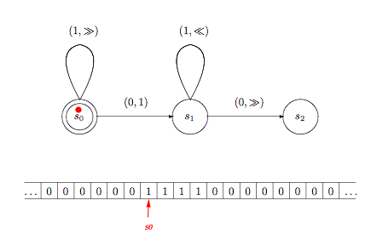
TM vs Java
I am going to define the first model of computation.
Turing (1936)
S_{TM}
Set of problems
computable by
a Turing Machine
P
Ζ: “Computational problem P is computable by a TM.”
P ∈S_{TM}

Slide 19

TM vs Java
A: “Computational problem P
is computable by a Java Prog.”
P ∈S_{Java}
S_{TM}
S_{Java}
Set of problems
computable by
a Turing Machine
Set of problems
computable by
a Java Prog.
P
P
Ζ: “Computational problem P is computable by a TM.”
P ∈S_{TM}

Slide 20
TM vs Java
We will prove that
these sets are the same.
A: “Computational problem P
is computable by a Java Prog.”
P ∈S_{TM} ⇒ P ∈S_{Java}
P ∈S_{Java}
P ∈S_{Java} ⇒ P ∈S_{TM}
S_{TM}
S_{Java}
Set of problems
computable by
a Turing Machine
Set of problems
computable by
a Java Prog.
P
P
Ζ: “Computational problem P is computable by a TM.”
P ∈S_{TM}

Slide 21
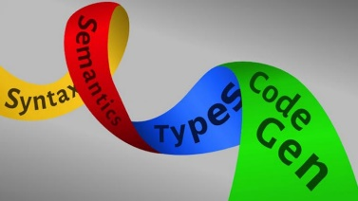
TM vs Java
P ∈S_{TM} ⇒ P ∈S_{Java}
A: “Computational problem P
is computable by a Java Prog.”
B: “Java programs can be
simulated by TM.”
P ∈S_{Java}
J
M
This works just like the compiler
that translates Java code into Machine code.
Ζ: “Computational problem P is computable by a TM.”
P ∈S_{TM}

Slide 22
TM vs Java
Prove A&B → Ζ
A: “Computational problem P
is computable by a Java Prog.”
B: “Java programs can be
simulated by TM.”
Problem P is a free variable.
All the statements know and are about it.
Ζ: “Computational problem P is computable by a TM.”

Slide 23

TM vs Java
Prove A&B → Ζ
A: “Computational problem P
is computable by a Java Prog.”
B: “Java programs can be
simulated by TM.”
Assume we have oracles that assure us of A and B.
Then the prover proves Z.
Ζ: “Computational problem P is computable by a TM.”

Slide 24
TM vs Java
Prove A&B → Ζ
A: “Computational problem P
is computable by a Java Prog.”
B: “Java programs can be
simulated by TM.”
P computable by TM,
because there is at least one fixed TM M that computes P,
because on every input I, M gets the right answer,
because P(I)=M(I).
Ζ: “Computational problem P is computable by a TM.”
∃ TM M, ∀ input I, P(I)=M(I)

Slide 25
TM vs Java
Prove A&B → Ζ
A: “Computational problem P
is computable by a Java Prog.”
B: “Java programs can be
simulated by TM.”
I give you worst case input I.
I, Z, prove Z by playing the following game:
Z constructs TM M.
Adversary gives arbitrary I.
Z proves P(I)=M(I)
(Let I be arbitrary.)
Ζ: “Computational problem P is computable by a TM.”
∃ TM M, ∀ input I, P(I)=M(I)

Slide 26
TM vs Java
Prove A&B → Ζ
A: “Computational problem P
is computable by a Java Prog.”
B: “Java programs can be
simulated by TM.”
∃ Java J, ∀ input I, P(I)=J(I)
Similar
I give you worst case input I.
I, Z, prove Z by playing the following game:
Z constructs TM M.
Adversary gives arbitrary I.
Z proves P(I)=M(I)
Ζ: “Computational problem P is computable by a TM.”
∃ TM M, ∀ input I, P(I)=M(I)

Slide 27
TM vs Java
Prove A&B → Ζ
A: “Computational problem P
is computable by a Java Prog.”
B: “Java programs can be
simulated by TM.”
∃ Java J, ∀ input I, P(I)=J(I)
I, A, assure A by playing the following game:
A gives Java J.
A is given I.
A assures P(I)=J(I).
(Let J denote that which A states exists.)
(∀ input I, and hence P(I)=J(I).
I give you worst case input I.
I, Z, prove Z by playing the following game:
Z constructs TM M.
Adversary gives arbitrary I.
Z proves P(I)=M(I)
Ζ: “Computational problem P is computable by a TM.”
∃ TM M, ∀ input I, P(I)=M(I)

Slide 28
TM vs Java
Prove A&B → Ζ
A: “Computational problem P
is computable by a Java Prog.”
B: “Java programs can be
simulated by TM.”
∃ Java J, ∀ input I, P(I)=J(I)
∀ Java J, ∃ TM M, ∀ I, M(I)=J(I)
Java programs can be simulated by TM,
because every Java program J can be simulated,
because there is a TM M simulates it,
because on every input I, M gets the same answer,
because P(I)=M(I).
Ζ: “Computational problem P is computable by a TM.”
∃ TM M, ∀ input I, P(I)=M(I)

Slide 29
TM vs Java
Prove A&B → Ζ
A: “Computational problem P
is computable by a Java Prog.”
B: “Java programs can be
simulated by TM.”
∃ Java J, ∀ input I, P(I)=J(I)
∀ Java J, ∃ TM M, ∀ I, M(I)=J(I)
I, B, assure B by playing the following game:
B given Java J.
B gives TM M.
B given I.
B assures M(I)=J(I).
Ζ: “Computational problem P is computable by a TM.”
∃ TM M, ∀ input I, P(I)=M(I)

Slide 30
TM vs Java
Prove A&B → Ζ
A: “Computational problem P
is computable by a Java Prog.”
B: “Java programs can be
simulated by TM.”
∃ Java J, ∀ input I, P(I)=J(I)
∀ Java J, ∃ TM M, ∀ I, M(I)=J(I)
Lets help each other
by passing objects around.
Ζ: “Computational problem P is computable by a TM.”
∃ TM M, ∀ input I, P(I)=M(I)

Slide 31
TM vs Java
Prove A&B → Ζ
A: “Computational problem P
is computable by a Java Prog.”
B: “Java programs can be
simulated by TM.”
∃ Java J, ∀ input I, P(I)=J(I)
∀ Java J, ∃ TM M, ∀ I, M(I)=J(I)
A assures A:
A gives Java J.
B assures B:
B gives TM M.
but first needs Java J.
Z proves Z:
Z needs to construct TM M.
Ζ: “Computational problem P is computable by a TM.”
∃ TM M, ∀ input I, P(I)=M(I)

Slide 32
TM vs Java
Prove A&B → Ζ
A: “Computational problem P
is computable by a Java Prog.”
B: “Java programs can be
simulated by TM.”
∃ Java J, ∀ input I, P(I)=J(I)
∀ Java J, ∃ TM M, ∀ I, M(I)=J(I)
A assures A:
A gives Java J.
B assures B:
B given Java J.
B gives TM M.
Z proves Z:
Z needs to construct TM M.
Ζ: “Computational problem P is computable by a TM.”
∃ TM M, ∀ input I, P(I)=M(I)

Slide 33
TM vs Java
Prove A&B → Ζ
A: “Computational problem P
is computable by a Java Prog.”
B: “Java programs can be
simulated by TM.”
∃ Java J, ∀ input I, P(I)=J(I)
∀ Java J, ∃ TM M, ∀ I, M(I)=J(I)
A assures A:
A gives Java J.
A is given I.
A assures P(I)=J(I).
B assures B:
B given Java J.
B gives TM M.
B given I.
B assures M(I)=J(I).
Z proves Z:
Z constructs TM M.
Adversary gives arbitrary I.
Z needs to prove P(I)=M(I)
I give you
worst case
input I.
Ζ: “Computational problem P is computable by a TM.”
∃ TM M, ∀ input I, P(I)=M(I)

Slide 34
TM vs Java
Prove A&B → Ζ
A: “Computational problem P
is computable by a Java Prog.”
B: “Java programs can be
simulated by TM.”
∃ Java J, ∀ input I, P(I)=J(I)
∀ Java J, ∃ TM M, ∀ I, M(I)=J(I)
A assures A:
A gives Java J.
A is given I.
A assures P(I)=J(I).
B assures B:
B given Java J.
B gives TM M.
B given I.
B assures M(I)=J(I).
Z proves Z:
Z constructs TM M.
Adversary gives arbitrary I.
Z proves P(I)=M(I) by transitivity.
I give you
worst case
input I.
Ζ: “Computational problem P is computable by a TM.”
∃ TM M, ∀ input I, P(I)=M(I)

Slide 35
TM vs Java
Prove A&B → Ζ
A: “Computational problem P
is computable by a Java Prog.”
B: “Java programs can be
simulated by TM.”
∃ Java J, ∀ input I, P(I)=J(I)
∀ Java J, ∃ TM M, ∀ I, M(I)=J(I)
Java Oracle
∃J
Compiler Oracle
∀J ∃M
Java Oracle
∀I =
Compiler Oracle
∀I =
M
J
Prover ∃M ∀I
=
P
I
Adversary
∀P
Adversary
∀I
Ζ: “Computational problem P is computable by a TM.”
∃ TM M, ∀ input I, P(I)=M(I)

Slide 36
TM vs Java
A: ∃ Java J, ∀ input I, P(I)=J(I)
B: ∀ Java J, ∃ TM M, ∀ I, M(I)=J(I)
Ζ: ∃ TM M, ∀ input I, P(I)=M(I)
Prove A&B → Ζ
Lets repeat this game.

Slide 37
TM vs Java
A: ∃ Java J, ∀ input I, P(I)=J(I)
B: ∀ Java J, ∃ TM M, ∀ I, M(I)=J(I)
Ζ: ∃ TM M, ∀ input I, P(I)=M(I)
Prove A&B → Ζ
Assume A and B and prove proves Z.
A gives Java J.
A is given I.
A assures P(I)=J(I).
B given Java J.
B gives TM M.
B given I.
B assures M(I)=J(I).
Z constructs TM M.
Adversary gives arbitrary I.
Z proves P(I)=M(I)
by transitivity.
How do you write it up on a test.

Slide 38
TM vs Java
A: ∃ Java J, ∀ input I, P(I)=J(I)
B: ∀ Java J, ∃ TM M, ∀ I, M(I)=J(I)
Ζ: ∃ TM M, ∀ input I, P(I)=M(I)
Prove A&B → Ζ
Assume A and B and prove proves Z.
A gives Java J.
A is given I.
A assures P(I)=J(I).
Z constructs TM M.
Adversary gives arbitrary I.
Z proves P(I)=M(I)
by transitivity.
B given Java J.
B gives TM M.
B given I.
B assures M(I)=J(I).
Fantastic.
Just weave the three games together.
I hope it helps.

Slide 39
TM vs Java
I
I
A: ∃ Java J, ∀ input I, P(I)=J(I)
B: ∀ Java J, ∃ TM M, ∀ I, M(I)=J(I)
I
J
I
I
M
Ζ: ∃ TM M, ∀ input I, P(I)=M(I)
I
Prove A&B → Ζ
Fantastic.
Just weave the three games together.
More formal?
Assume A and B and prove Z.
Z constructs TM M.
Adversary gives arbitrary I.
Z proves P(I)=M(I)
by transitivity.
Let J be that A assumes exists
∀ Java J, hence true for J.
Let M be that B assumes exists
Set M to be M.
Let I be arbitrary.
∀I and ∀I, hence true for I.
P(I)=J(I) and M(I)=J(I)
hence M(I)=J(I)
A gives Java J.
A is given I.
A assures P(I)=J(I).
B given Java J.
B gives TM M.
B given I.
B assures M(I)=J(I).

Slide 40
TM vs Java
I
I
A: ∃ Java J, ∀ input I, P(I)=J(I)
B: ∀ Java J, ∃ TM M, ∀ I, M(I)=J(I)
I
J
I
I
M
Ζ: ∃ TM M, ∀ input I, P(I)=M(I)
I
Prove A&B → Ζ
How do you end the formal proof.
Assume A and B and prove Z.
Z constructs TM M.
Adversary gives arbitrary I.
Z proves P(I)=M(I)
by transitivity.
M(I)=J(I)
We proved this for an arbitrary I,
hence it is true for all I.
We constructed an M for which it is true,
hence there exists an M.
Assumed A and B and proved Z,
hence conclude A&B → Ζ
A gives Java J.
A is given I.
A assures P(I)=J(I).
B given Java J.
B gives TM M.
B given I.
B assures M(I)=J(I).
M(I)=J(I)
This completes
the proof.

Slide 41
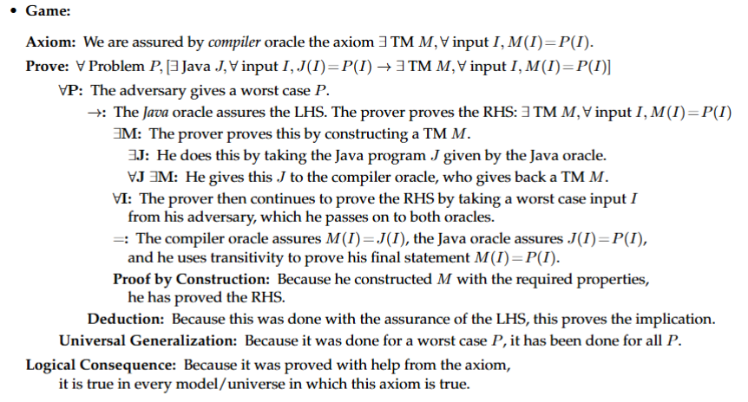

Slide 42
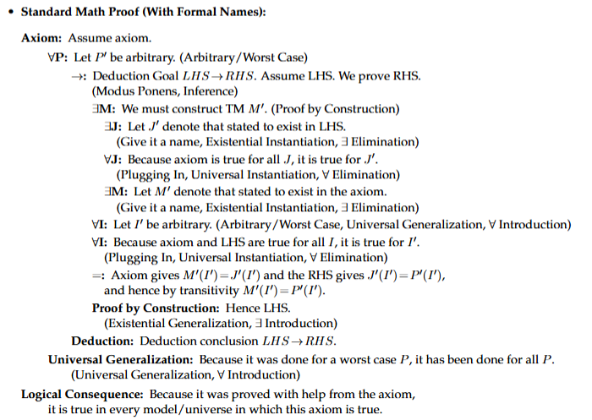

Slide 43
Please feel free
to ask questions!
Please give me feedback
so that I can better serve you.
Thanks for the feedback that you have given me already.
Notes:
43

