Slide 1
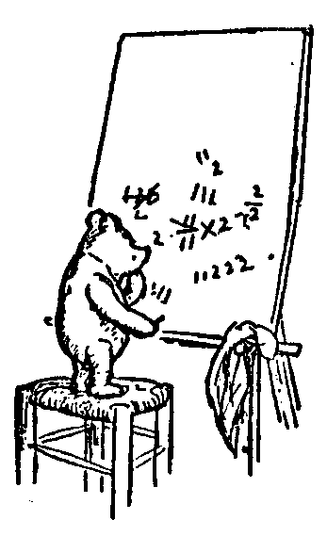
First Order Logic
for Computer Science
Our Formal Proof System
explained to Instructors
Table of contents:
Motivation and Possible Counter Examples
Our Formal Proof System
Sound and Complete
Our vs Forefathers' Proof Systems
Examples
Jeff Edmonds
York University

Slide 2

Toniann Pitassi:
I think the rules that you have are fine
and the examples are great!
I think it is strange
to just add all propositional tautologies
When we teaching 1st year logic,
we don't do formal proofs.
You should learn more: Read her and Cook’s notes.

Slide 3
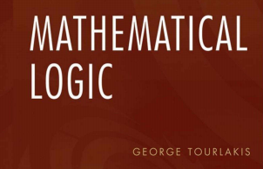

Motivation and Possible Counter Examples
Let’s be fair to George.
Def^{n} of proof system being sound and complete:
α has a proof iff α is valid/tautology
Sacred!
We are changing
the proof system!
We are changing
the definition of truth.
&
Rules should be the ones
our forefathers devised.
All else is dangerous.
Truth should be the one
our forefathers devised.
All else is dangerous.

Slide 4
Motivation and Possible Counter Examples
Let’s be fair to George.
Def^{n} of proof system being sound and complete:
α has a proof iff α is valid/tautology
Sacred!
We are changing
the proof system!
We are changing
the definition of truth.
&
But the new “truth” is only associated with new notation: y∃ and x´.
So if the proof ends with this notation removed,
then the forefather’s definition of truth reapplies.
Hence, we can ask
Is our proof system sound and complete?
(and is it a symbolic proof?)

Slide 5
Motivation and Possible Counter Examples
Let’s be fair to George.
Def^{n} of proof system being sound and complete:
α has a proof iff α is valid/tautology
Sacred!
We are changing
the proof system!
We are changing
the definition of truth.
&
We can also ask, whether the new y∃ and x´ notation
and its new meaning.
Makes things easier or harder for 1st year students.
Let us now try to motivate changing both the proof system and truth!

Slide 6
Motivation and Possible Counter Examples
α(x) → ∀x α(x) is false.
Yet to the novice,
the proof rules seems to prove it.
Novice Proof:
Assume α(x)
There is some rule that lets you add a ∀x
∀x α(x)
Done
No,
The ∀x can’t be added
if x is in a hypothesis.
This is not a local Hilbert style rule.
Instead lets locally add ' to x
when the hypothisis is made
and then not allow ∀x
to be added to x'.
A simple syntactic change.

Slide 7
Motivation and Possible Counter Examples
Formal Proof:
Goal is to prove α(x)→β(x)
______ α(x´) assumption
______ …
______ β(x´)
α(x)→β(x) conclusion
∀x α(x)→β(x) add ∀
In the indented block,
x´ is a fixed but arbitrary value.
The only difference is one can’t add ∀x.
In the conclusion,
x is free variable.
ie. implied ∀x
I don’t like the indenting.
Notes:
7

Slide 8
Motivation and Possible Counter Examples
The dual is also a problem.
∃x α(x) → α(c)
Novice Proof:
∀x α(x) (proved somehow)
There is some rule that lets you remove a ∀x
α(x)
Novice Proof:
∃x α(x) (proved somehow)
There is some rule that lets you remove a ∃x
α(x)
What does the proof line α(x) mean?
How can it mean both ∀x and ∃x
There are complicated rules so that nuances deep in the proof distinguish these.
Can’t we just define α(x) to mean ∀x α(x)
and define α(x∃) to mean ∃x α(x) ?
Adding meaning (semantics) is bad.

Slide 9
Motivation and Possible Counter Examples
But the whole point is meaning!
A proof system is sound if
Every thing it proves
means something that is valid (ie true in every model).
This is proved by induction on the length of the proof.
Hence, every line of the proof needs to
means something that is valid.
No
You can only follow mechanical symbol manipulation rules.
Adding meaning (semantics) is bad.

Slide 10
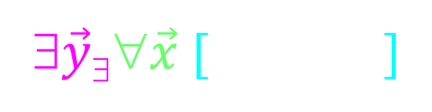
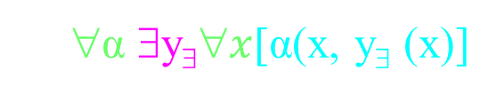
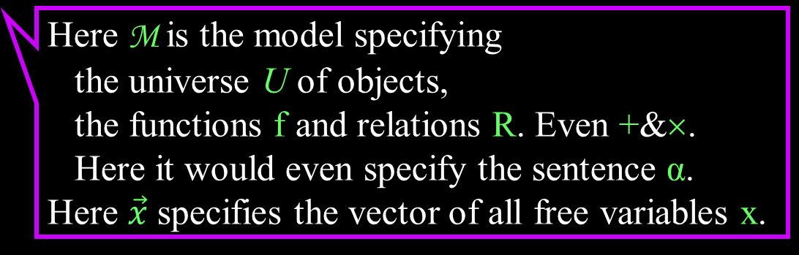
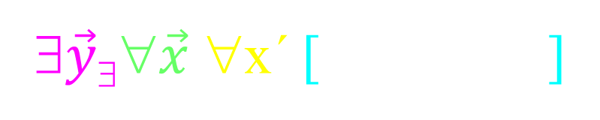
Motivation and Possible Counter Examples
In order to make the proof
a “Hilbert” proof,
we need each line standing alone to state something valid.
Line in proof
Implied Meaning
(x ,)
∀M
∃$\vec{y}\text{\$}$∀$\vec{x}$ [ ]
α(x, y∃ )
(x )
α(x, y∃ )
ie ∀α ∃y$\text{\$}$∀$x$[α(x, y∃ (x)]
∀M
∃$\vec{y}\text{\$}$∀$\vec{x}$ ∀x´ [ ]
______ β(x´)
______ β(x´)
α(x´)→
Here M is the model specifying
the universe U of objects,
the functions f and relations R. Even +&×.
Here it would even specify the sentence α.
Here $\vec{x}$ specifies the vector of all free variables x.

Slide 11
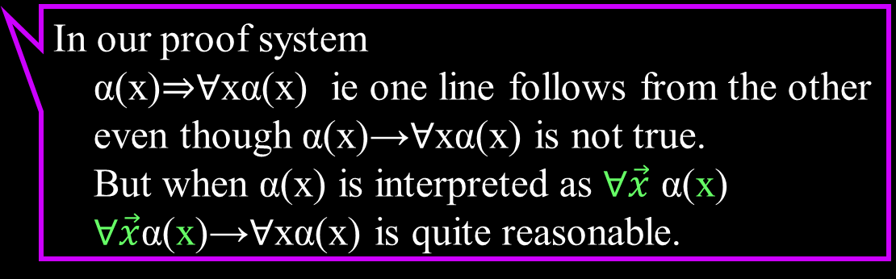
Motivation and Possible Counter Examples
In order to make the proof
a “Hilbert” proof,
we need each line standing alone to state something valid.
Line in proof
Implied Meaning
(x ,)
∀M
∃$\vec{y}\text{\$}$∀$\vec{x}$ [ ]
α(x, y∃ )
(x )
α(x, y∃ )
ie ∀α ∃y$\text{\$}$∀$x$[α(x, y∃ (x)]
∀M
∃$\vec{y}\text{\$}$∀$\vec{x}$ ∀x´ [ ]
______ β(x´)
______ β(x´)
α(x´)→
In our proof system
α(x)⇒∀xα(x) ie one line follows from the other
even though α(x)→∀xα(x) is not true.
But when α(x) is interpreted as ∀$\vec{x}$ α(x)
∀$\vec{x}$α(x)→∀xα(x) is quite reasonable.

Slide 12
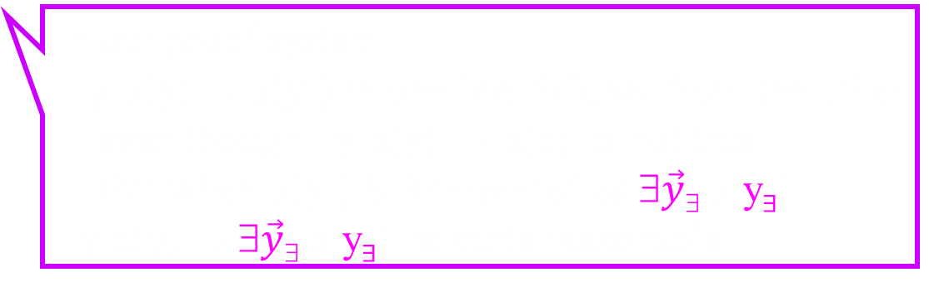
Motivation and Possible Counter Examples
In order to make the proof
a “Hilbert” proof,
we need each line standing alone to state something valid.
Line in proof
Implied Meaning
(x ,)
∀M
∃$\vec{y}\text{\$}$∀$\vec{x}$ [ ]
α(x, y∃ )
(x )
α(x, y∃ )
ie ∀α ∃y$\text{\$}$∀$x$[α(x, y∃ (x)]
∀M
∃$\vec{y}\text{\$}$∀$\vec{x}$ ∀x´ [ ]
______ β(x´)
______ β(x´)
α(x´)→
In our proof system
∃y α(y) ⇒ α(y∃) ie one line follows from the other
even though ∃y α(y) → α(c) is not true.
But when α(y∃) is interpreted as ∃$\vec{y}\text{\$}$α(y∃)
∃y α(y) ⇒ ∃$\vec{y}\text{\$}$α(y∃) is quite reasonable.

Slide 13
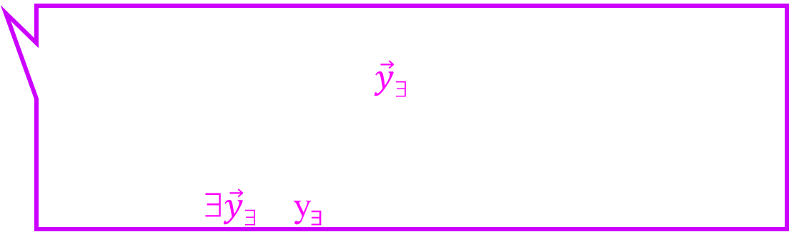
Motivation and Possible Counter Examples
In order to make the proof
a “Hilbert” proof,
we need each line standing alone to state something valid.
Line in proof
Implied Meaning
(x ,)
∀M
∃$\vec{y}\text{\$}$∀$\vec{x}$ [ ]
α(x, y∃ )
(x )
α(x, y∃ )
ie ∀α ∃y$\text{\$}$∀$x$[α(x, y∃ (x)]
∀M
∃$\vec{y}\text{\$}$∀$\vec{x}$ ∀x´ [ ]
______ β(x´)
______ β(x´)
α(x´)→
In our proof system
Note that the value of $\vec{y}\text{\$}$ depends on the model.
∃y α(y) ⇒ ∃$\vec{y}\text{\$}$α(y∃) is quite reasonable.

Slide 14
Motivation and Possible Counter Examples
∃y α(y) → α(c)
is not a tautology!
Agreed.
No more than is
∃y α(y) → α(0)
Yet your proof system
proves it!
No. We are careful to instead prove
∃y α(y) → α(y∃)
No better.
Our proof system could be made to not allow this.
Say by requiring all y∃ and x´ symbols to be removed by the end.

Slide 15
Motivation and Possible Counter Examples
∃y α(y) → α(c)
is not a tautology!
Agreed.
No more than is
∃y α(y) → α(0)
Yet your proof system
proves it!
No. We are careful to instead prove
∃y α(y) → α(y∃)
No better.
But under our new definition of truth,
it is a tautology.
Aaaah!

Slide 16

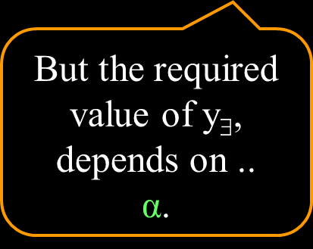


Motivation and Possible Counter Examples
Implied Meaning
∀M
∃$\vec{y}\text{\$}$∀$\vec{x}$ [ ]
(x )
α(x, y∃ )
∀α
∃y$\text{\$}$ [ ]
∃y α(y) → α(y∃)
If ∃y α(y), then for some c, α(c) is true.
Hence, ∃y$\text{\$}$, namely y$\text{\$}$=c such that
[∃y α(y) → α(y∃)] is true.
But the required value of y$\text{\$}$,
depends on ..
α.

Slide 17
Our Proof System
Lets now review the changes that we propose.

Slide 18
Our Proof System
          Lemmas/Theorems:
            Starting with all propositional tautologies (See slides)
  Prove and use lemmas via substitutions
Modus Ponens [α & α→β ➔ β]:
  For proving new sentences from previously proved ones.
Proving α→β:
  Assume α, prove β, conclude α→β
Rules (Adding/Removing ∀/∃):
  These help define and to work with quantifiers.

Slide 19
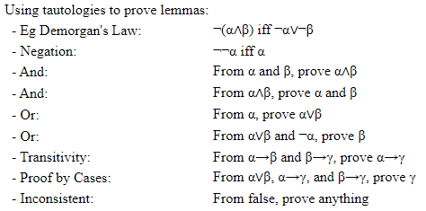
Our Proof System
Lemmas via Substitutions
            These are a few examples arising from
            propositional tautologies
            Think of and prove your own.

Slide 20
Our Proof System
Lemmas via Substitutions
          Four Types of Lemmas/Theorems:
            Using Propositional Tautologies [∀P&Q φ(P,Q)]
            Using Sentences Equivalence [α iff β]
            Using First Order Tautologies [∀x&y α(x,y)]
            Using Object Equivalence [t₁=t₂]
Lemmas | Sub in true/false | Sub in object
Receiving sub is a tautology | If φ(P,Q) then φ(α,β) | If α(x,y), then α(t₁,t₂)
Being subbed are equivalent | If α iff β then φ(α) iff φ(β) | If t₁=t₂ then α(t₁) iff α(t₂) and f(t₁) = f(t₂)
            Equality: t₁=t₂ means that the two terms evaluate to
            the same object from the universe U.
            Axioms: x=x, x=y iff y=z, and (x=y∧y=z)→x=z

Slide 21
Our Proof System
Formal Proof:
Goal is to prove α(x)→β(x)
______ α(x´) assumption
______ …
______ β(x´)
α(x)→β(x) conclusion
∀x α(x)→β(x) add ∀
In the indented block,
x´ is a fixed but arbitrary value.
The only difference is one can’t add ∀x.
In the conclusion,
x is free variable.
ie. implied ∀x
Notes:
21

Slide 22
Our Proof System
In order to make the proof
a “Hilbert” proof,
we need each line standing alone to state something valid.
Line in proof
Implied Meaning
(x ,)
∀M
∃$\vec{y}\text{\$}$∀$\vec{x}$ [ ]
α(x, y∃ )
(x )
α(x, y∃ )
ie ∀α ∃y$\text{\$}$∀$x$[α(x, y∃ (x)]
∀M
∃$\vec{y}\text{\$}$∀$\vec{x}$ ∀x´ [ ]
______ β(x´)
______ β(x´)
α(x´)→
Here M is the model specifying
the universe U of objects,
the functions f and relations R. Even +&×.
Here it would even specify the sentence α.
Here $\vec{x}$ specifies the vector of all free variables x.

Slide 23
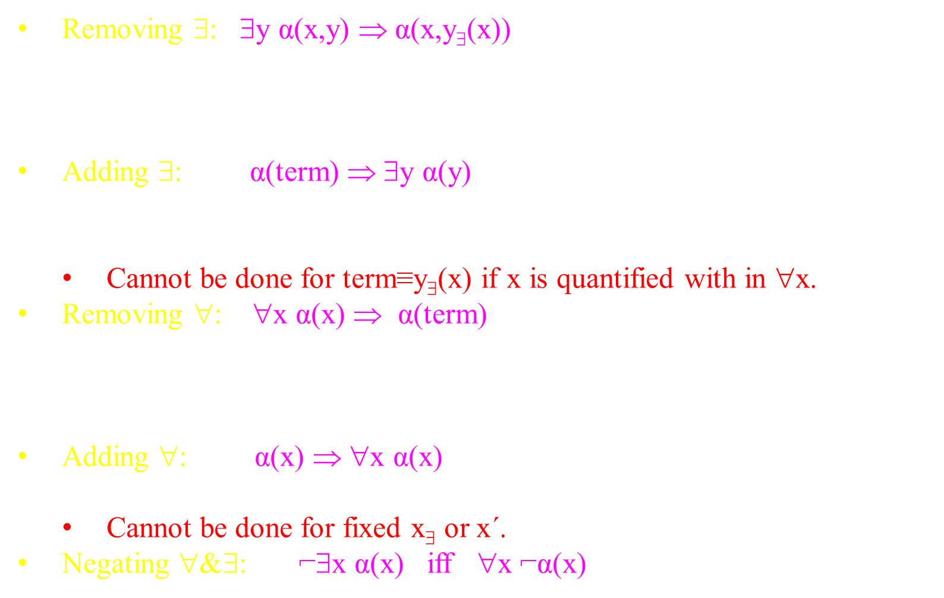
Our Proof System
Rules (Adding/Removing ∀/∃)
Removing ∃: ∃y α(x,y) ⇒ α(x,y∃(x))
  ∃y α(x,y) implies ∀x ∃y α(x,y), hence y∃ depends on ⟨x⟩.
  Recall α(x,y∃(x)) is interpreted ∃$\text{y}\text{\$}$∀x α(x,y∃(x)),
  which is the same as ∀x ∃y α(x,y)
Adding ∃: α(term) ⇒ ∃y α(y)
  If α(t) is true for some term t,
  then there exists a y for which it is true.
  Cannot be done for term≡y∃(x) if x is quantified with in ∀x.
Removing ∀: ∀x α(x) ⇒ α(term)
  If α(x) is true for every value of x,
  then it is true for any term you want to plug.
  Eg ∀x α(x) ➔ α(x) (x becomes a free variable)
Adding ∀: α(x) ⇒ ∀x α(x) (x is a free variable)
  Recall α(x) is interpreted as ∀xα(x)
  Cannot be done for fixed x∃ or x´.
Negating ∀&∃: ⌐∃x α(x) iff ∀x ⌐α(x)

Slide 24

Sound and Complete
I feel that our proof system is sound
(ie only proves things that are true)
Because we added semantic
meaning to each line in the proof
And we only allow a line to be added if it’s meaning follows from that of the previous lines.
Proofs need to be syntactic.
No semantics is allowed!

Slide 25
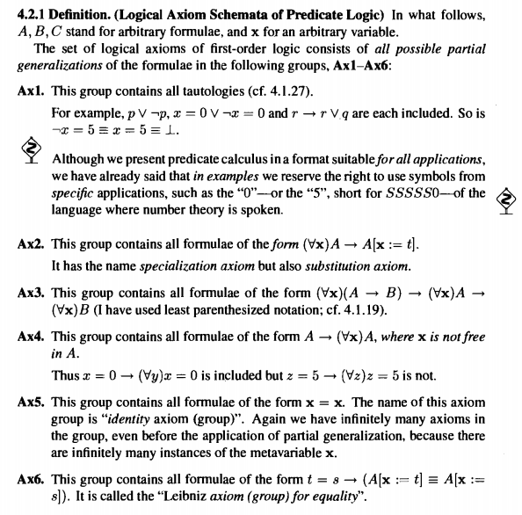
Sound and Complete
These are the axioms of our forefather’s
Hilbert proof system.
Gödel proves that the are complete.

Slide 26
Sound and Complete
I feel that our proof
system is complete
(ie proves everything true)
Because it can prove
these axioms.
And hence by Gödel
proves everything.

Slide 27


Our vs Forefathers' Proof Systems
These meta rules prove that a “meta proof”
can be compiled into a proof from the axioms.
I would rather learn and use simple rules
And not bother with
the axioms.
Aaaaaah!
The “meta proof” is not a Hilbert proof because
one line does not follow from previous.
They do follow,
when I add the semantic meaning.
Aaaaaah!

Slide 28
Our vs Forefathers' Proof Systems
I will now try to justify that our rules follow from these meta rules.

Slide 29
Our vs Forefathers' Proof Systems
Forefathers':
If α(x) is true for every value of x,
then it is true for any term you want to plug
Our (Removing ∀): ∀x α(x) ⇒ α(x), ∀x α(x) ⇒ α(term)
If ∀x α(x) is a line of your proof,
then you can add the line α(x)
or the line α(term)

Slide 30
Our vs Forefathers' Proof Systems
Forefathers':
If you can prove α(x), then you can prove ∀x α(x)
  Cannot be done if x is free in axioms Γ.
Our (Adding ∀): α(x) ⇒ ∀x α(x)
  Cannot be done for fixed x∃ or x´.
  Can be done for free x.
  Instead, we replace each free x in Γ with x´.
    Our (Deduction): Assume Γ(x'), prove β(x'), conclude Γ(x)⊢β(x)
    ∀x cannot be added for x´.
  In contrast, we allow add ∀x to α(u,x∃(u)),
  because ∀u α(u,x∃(u)) is “true”.
  This does cause a problem, but we will change another rule to fix it.

Slide 31
Our vs Forefathers' Proof Systems
Forefathers':
If by adding the assumption α to your axioms, you can prove β,
then you can prove α→β.
Cannot add ∀x to free variables
within the “block” of proof from α to β,
because α is in Γ. (Recall previous rule)
Can add ∀x to α→β and beyond
because it is not in Γ.
This meta-proof must end here.
Our (Deduction): Assume α(x'), prove β(x'), conclude α(x)→β(x)
We remember that by adding ' to all free variables x in α.
In our conclution, α(x)→β(x), the variable x is free.
We allow the proof to continue.

Slide 32

Our vs Forefathers' Proof Systems
Forefathers':
If you can prove ∃y α(y),
and from α(z) you can prove β,
then you can prove β.
Let β ≡ α(z).
As needed α(z) ⊢ β. Hence:
If you can prove ∃y α(y),
then you can prove α(z).
          So complicated! Lets simplify it.

Slide 33
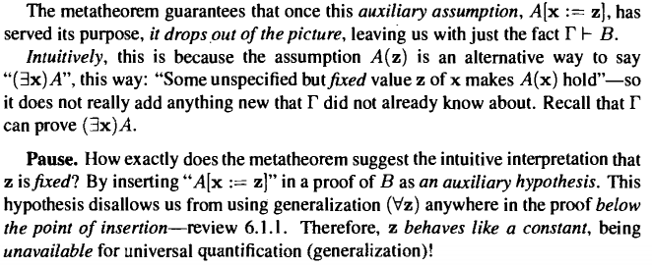
Our vs Forefathers' Proof Systems
Forefathers':
If you can prove ∃y α(y),
and from α(z) you can prove β,
then you can prove β.
Let β ≡ α(z).
As needed α(z) ⊢ β. Hence:
If you can prove ∃y α(y),
then you can prove α(z).

Slide 34
Our vs Forefathers' Proof Systems
Forefathers':
If you can prove ∃y α(y),
and from α(z) you can prove β,
then you can prove β.
Let β ≡ α(z).
As needed α(z) ⊢ β. Hence:
If you can prove ∃y α(y),
then you can prove α(z).
Novice Proof:
∀x α(x) (proved somehow)
There is some rule that lets you remove a ∀x
α(x)
Novice Proof:
∃y α(y) (proved somehow)
There is some rule that lets you remove a ∃y
α(z)
What does the proof line α(x) mean?
How can it mean both ∀x and ∃x
          Lets y∃ instead of z.
And have an implied ∃y∃.

Slide 35
Our vs Forefathers' Proof Systems
Forefathers':
Let β ≡ α(z).
As needed α(z) ⊢ β. Hence:
If you can prove ∃y α(y),
then you can prove α(z).
If you can prove ∃y α(y),
and from α(z) you can prove β,
then you can prove β.
Cannot add ∀z within the proof from α(z) to β, because α(z) is in Γ.
Our (Removing ∃): ∃y α(y) ⇒ α(y∃)
If ∃y α(y) is a line of your proof,
then you can add the line α(y∃).
If you later want to prove β, that is up to you.
Our (Adding ∀) cannot be done for y∃.
For sure the y∃ can’t appear somewhere else.

Slide 36
Our vs Forefathers' Proof Systems
Forefathers':
Let β ≡ α(z).
As needed α(z) ⊢ β. Hence:
If you can prove ∃y α(y),
then you can prove α(z).
If you can prove ∃y α(y),
and from α(z) you can prove β,
then you can prove β.
Must remove the z before ending
because z not being allowing to appear in B.
Our (Removing ∃):
We used the notation y∃(x) when α has free variables x.
We don’t care if it is removed,
because ∀u α(u,x∃(u)) is true
when interpreded to have an ∃x∃ in front.
∃y α(x,y) ⇒ α(x,y∃(x))

Slide 37
Our vs Forefathers' Proof Systems
Forefathers':
If α(t) is true for some term t,
then there exists an x for which it is true.
Our (Adding ∃): α(term) ⇒ ∃y α(y)
Cannot be done for term≡y∃(x) if x is quantified with in ∀x.
Proof:
∀x ∃y α(x,y)
∃y α(x,y)
α(x,y∃(x))
∀x α(x,y∃(x))
∃y ∀x α(x,y)
(Adding ∀):
Forefathers:
Can’t because x is in the hypothesis.
Ours: Can!
(Adding ∃):
Forefathers: Could!
Ours: Can’t because
x is quantified with in ∀x.
          Oops. Wrong!

Slide 38
Our vs Forefathers' Proof Systems
Question 1:
Assume that all y∃ and x´ notation has been removed.
Hence, truth of the last line is our forefather’s.
Is our proof system sound and complete?
(and is it a symbolic proof?)
Question 2:
Include the y∃ and x´ notation and its assumed meaning.
Is it still sound and complete?
Is it now a Hilbert Proof?
ie each line in the proof follows from previous lines.
Are these now equivalent: α⊢β, α⇒β, and α→β
Question 3: Is it easer to understand?
Thanks for humoring me

Slide 39
Examples
∃y₁∀x₁∃y₂∀x₂ α(x₁,x₂,y₁,y₂) → ∀x₁∀x₂∃y₁∃y₂ α(x₁,x₂,y₁,y₂)
Proof:
∃y₁∀x₁∃y₂∀x₂ α(x₁,x₂,y₁,y₂)
∀x₁∃y₂∀x₂ α(x₁,x₂,y_{1∃},y₂)
∃y₂∀x₂ α(x₁,x₂,y_{1∃},y₂)
∀x₂ α(x₁,x₂,y_{1∃},y_{2∃}(x₁))
α(x₁,x₂,y_{1∃},y_{2∃}(x₁))
∃y₁∃y₂ α(x₁,x₂,y₁,y₂)
∀x₁∀x₂∃y₁∃y₂ α(x₁,x₂,y₁,y₂)
Assume for →
Remove ∃
Remove ∀
Remove ∃
Remove ∀
Adding ∃
Adding ∀
This is ok because there does exists these y.
Excellent

Slide 40

Examples
  ∀x (α(x)→β(x)) → (∀x α(x) → ∀x β(x))

Slide 41
Examples
  ∀x (α(x)→β(x)) → (∀x α(x) → ∀x β(x))
Proof:
Goal ∀x (α(x)→β(x)) → (∀x α(x) → ∀x β(x))
∀x (α(x)→β(x))
α(x)→β(x)
Goal ∀x α(x) → ∀x β(x)
∀x α(x)
α(x)
β(x)
∀x β(x)
∀x α(x) → ∀x β(x)
∀x (α(x)→β(x)) → (∀x α(x) → ∀x β(x))
Assume for →
Remove ∀
Assume for →
Remove ∀
3&6 modus ponens
Add ∀
Conclude →
Conclude →
Does not need x´ because not x free in assumption.

Slide 42
Examples
Lemma ∨ 1: From α, prove α∨β.
α Assume proved already
α→(α∨β) A tautology (check truth tables)
α∨β Modus ponens using 1&2
Now that we have proved this once,
we skip theses steps
and refer to this as a lemma.
Notes:
42

Slide 43
Examples
Lemma (proof by cases):
α∨β
α→γ
β→γ
(α∨β)∧(α→γ)∧(β→γ)
[(α∨β)∧(α→γ)∧(β→γ)] → γ
γ
From α∨β, α→γ, and β→γ, prove γ.
Prove some how
Prove some how
Prove some how
By ∧ lemma from 1,2&3
A tautology (check truth tables)
Modus ponens using 4&5
Now that we have proved this once,
we skip theses steps
and refer to this as a lemma.
Notes:
43

Slide 44
Examples
or
  Distributive Law for ∃ and ∨
  ∃x (α(x) ∨ β(x)) iff (∃x α(x)) ∨ (∃x β(x))
or
→
or
γ
→
α´ ∨ β´
Lemma (proof by cases):
From α´∨β´, α´→γ, and β´→γ, prove γ.
Proof: α´∨β´ → γ
Goal α´→γ
∃x α(x)
α(x∃)
α(x∃) ∨ β(x∃)
∃x (α(x) ∨ β(x))
α´→γ
Assume for →
Remove ∃
∨ Lemma from 3
Add ∃
Conclusion

Slide 45
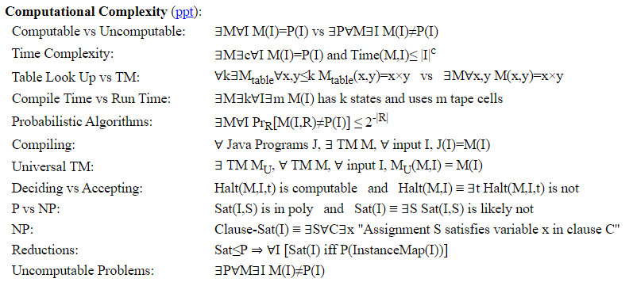
Examples

Slide 46
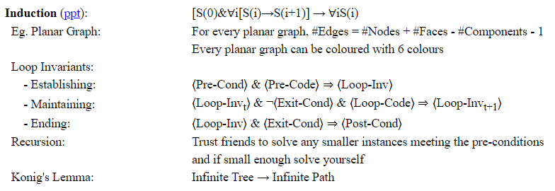
Examples

Slide 47
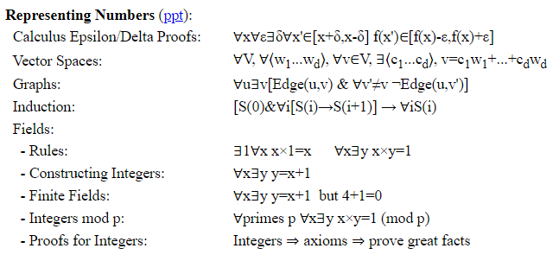
Examples

Slide 48
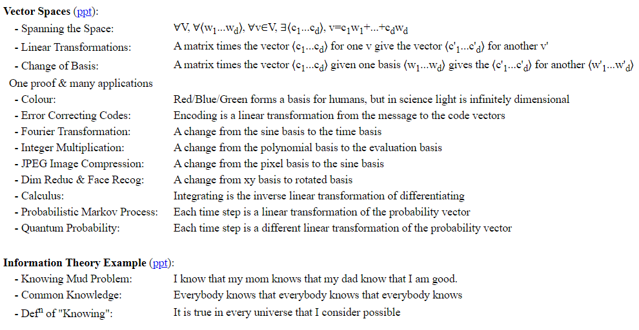
Examples

Slide 49
End

Slide 51
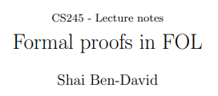
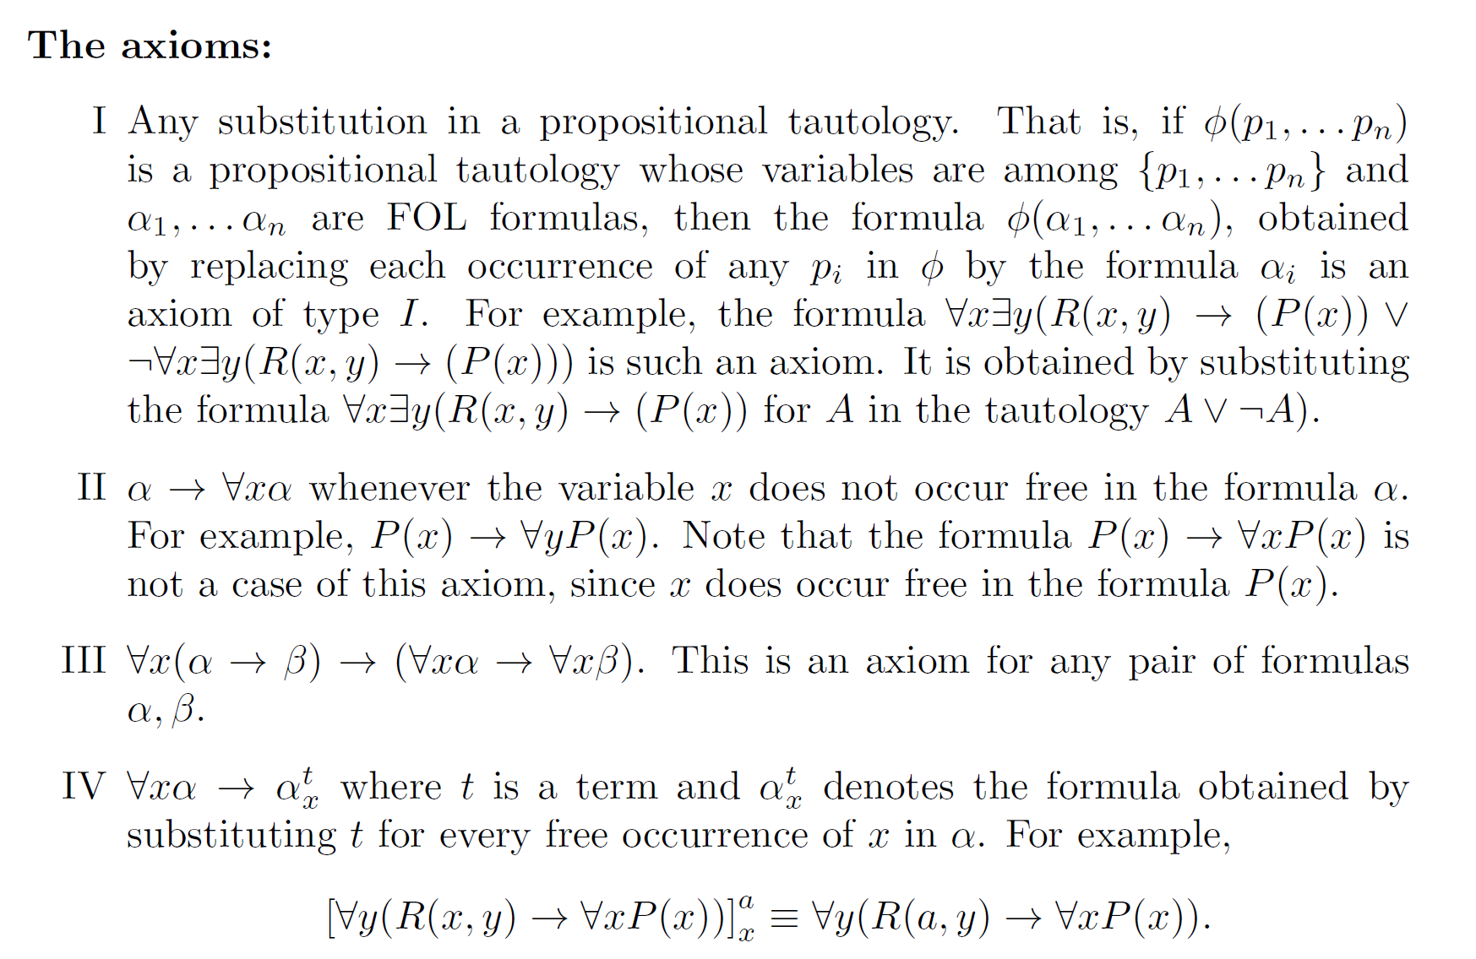

Slide 52
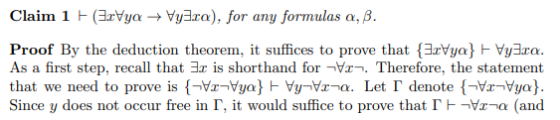
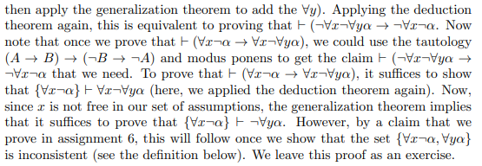
If this has a proof
then this does
then this does …
Just give me a proof.

Slide 53
