Slide 1
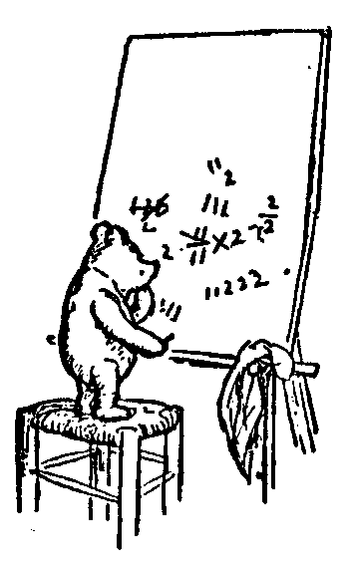

Predicate Logic
for Computer Science
Welcome
Jeff Edmonds
www.cse.yorku.ca/~jeff\courses/1090
jeff@cse.yorku.ca
CSB 3044, ext. 33295
647-688-7413
Jeff Edmonds
York University
Lecture 0

Slide 2
Study Now!
You spend 50hrs/week
on your programming course.
People do work hard
on my assignments.
But they don’t really
study the material deeply
until they fail the midterm.

Slide 3
Read Ahead
You are expected to read the lecture notes before the lecture.
This will facilitate more productive discussion during class.
Also please
proof read
assignments
& tests.
Like in an
English class

Slide 4
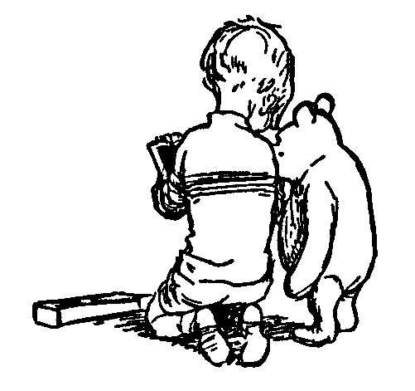
Explaining
We are going to test you on your ability to explain the material.
Hence, the best way of studying is to explain the material over and over again out loud to yourself, to each other, and to your stuffed bear.

Slide 5
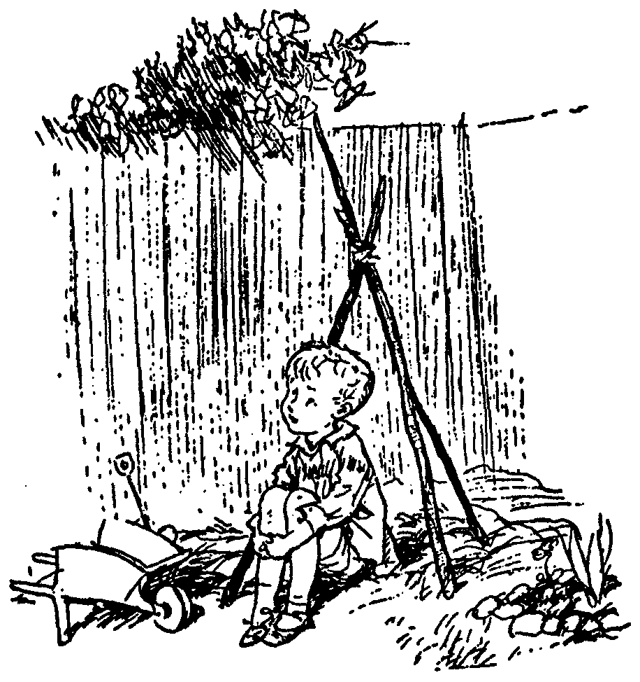
Day Dream
While going along with your day
Mathematics is not all linear thinking.
Allow the essence of the material to seep into your subconscious
Pursue ideas that percolate up and flashes of inspiration that appear.

Slide 6
Math 1090: Logic for Computer Science
I have complained for years.
Being too mechanical.
Not enough understanding.
I believe I have made it better.

Slide 7

I do believe that the material
if you could really get it
can help your math/cs studies
immensely!

Slide 8

Thinking Abstractly
This course requires completely changing
the way you think.
Though I keep warning people,
they tend not to get it until they are
Devastated
by the midterm
Change your thinking now.

Slide 9
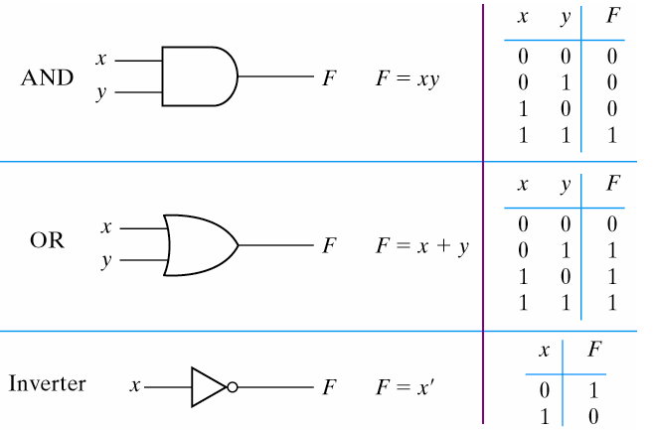
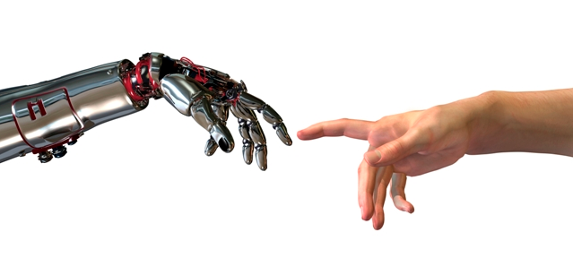
Thinking Abstractly
The psychological profiling of a successful person is mostly the ability to shift levels of abstraction, from low level to high level.
To understand the detailed workings.
To understand the big picture.
Donald Kunth

Slide 10
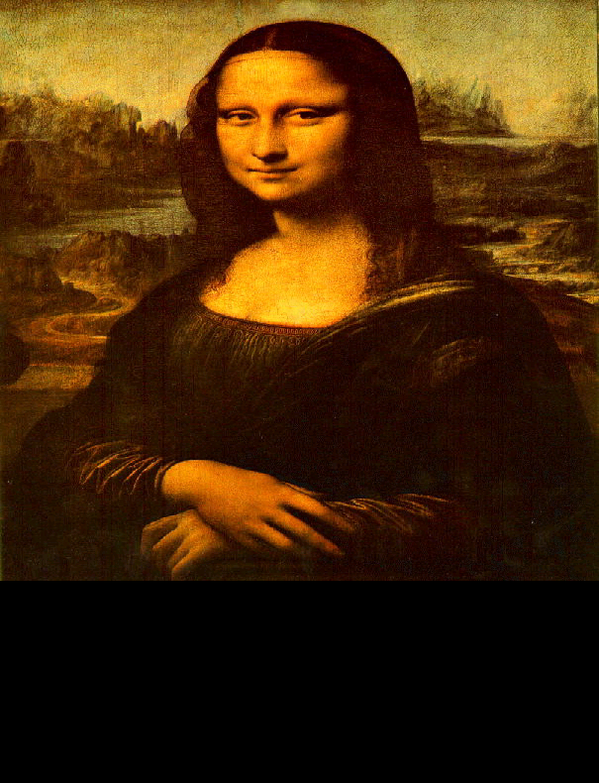
Thinking Abstractly
The psychological profiling of a successful person is mostly the ability to shift levels of abstraction, from low level to high level.
To understand the detailed workings.
To understand the big picture.
To understand complex things
in simple ways.
Donald Kunth
=

Slide 11
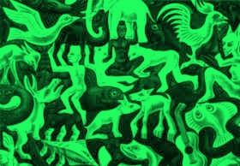
Thinking Abstractly
Paradigm Shift
Is the black the form and the green the background?
Is the green the form and the black the background?
It is helpful to have different ways of looking at it.

Slide 12
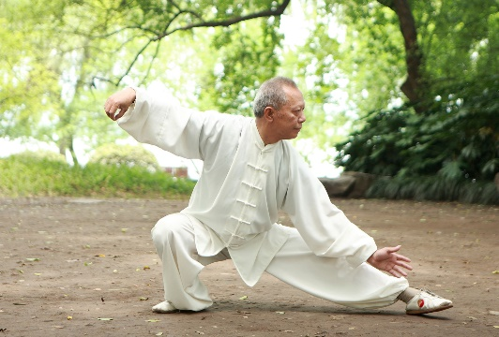
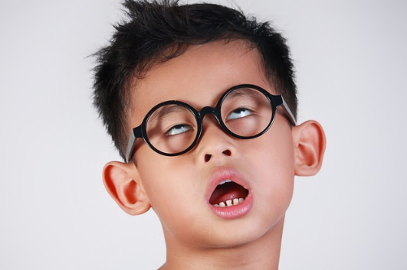

Dude! You will be starting with things that are
Too EASY
A good martial arts student will attentively repeat each fundamental technique many times.
Don’t tune out when a concept
is taught more than once.
The better students listen carefully in order to refine and develop their understanding.
Sometimes I use easy thing to teach deep things.

Slide 13


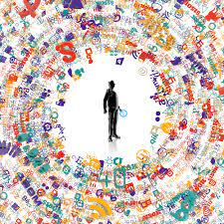
Dude! You will cover things that are
Too Hard
I hope to give you an appreciation
for the big picture
It’s really cool.
Don’t panic about details
that are too much for you.

Slide 14
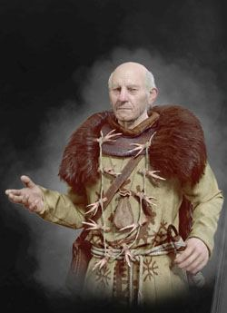
Verify vs Create
“The Rules taught should be
the ones our forefathers devised.
All else is dangerous”.
Adding meaning (semantics)
or intuition is bad.

Slide 15
Verify vs Create
I will teach you to factor.
Input: An integer x
Output: Its prime factors ⟨p₁,p₂,…,p_{r}⟩
Verify: p₁×p₂×…×p_{r} = x
Input: x = 12
Output: Factors ⟨2,2,3⟩
Verify: 2×2×3 = 12
Input: x = 7152988453
Output: Factors ⟨182983,39091⟩
Verify: 182983×39091 = 7152988453
Easy!
No problem. I know how to multiply.
I can verify that 182983×39091 = 7152988453.

Slide 16
Verify vs Create
Now the test.
Input: x = 23434551
What are the factors?
Aaaah!
You never taught me how to factor.
That is much much harder!.

Slide 17

Verify vs Create
If you give me a bunch of proofs
and teach me how to verify that they work.
This does not necessarily teach me
how to create new proofs.
Let’s try.
Aaaah!
You never taught me how to factor.
That is much much harder!.

Slide 18
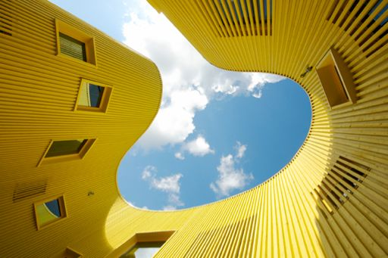
Non-Standard
I found our forefathers' formal proof system
overly complicated
and lacking (at least my) intuition

Slide 19

We will now cover the entire course.
Fast.

Slide 20

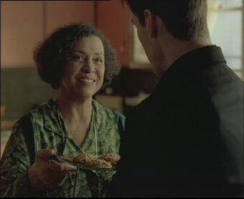
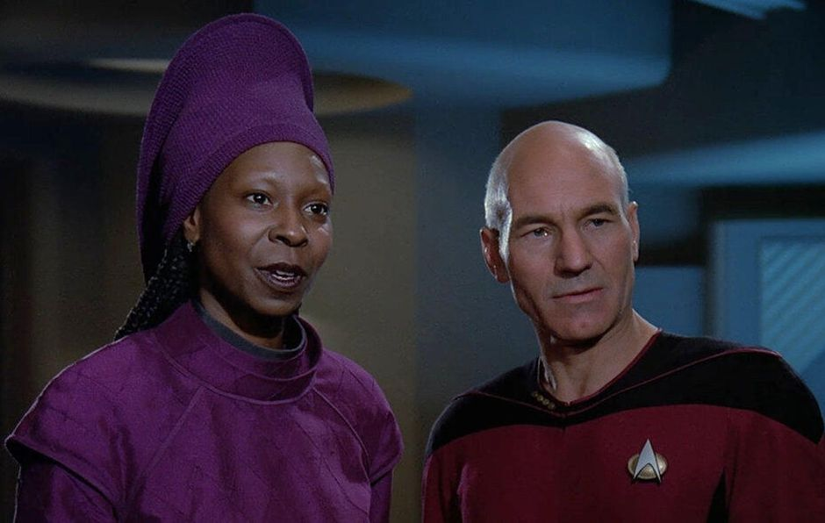
Players
My role is generally is to give rules and proofs.
I try and give a deeper understanding of logic.
Here are two of my best sister.

Slide 21
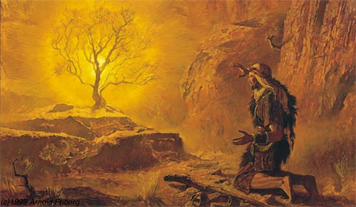
Players
My role is generally is to give rules and proofs.
I try and give a deeper understanding of logic.
We play the logic game together.
I get frustrated!

Slide 22
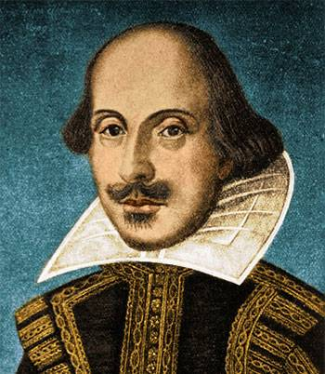
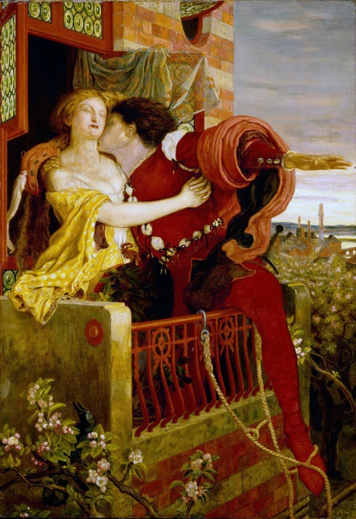
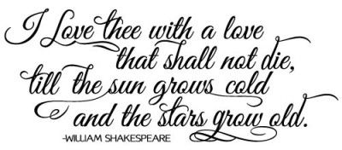
Hugely Expressive
The rules of syntax dictate
how words can be strung together into
poetry.
Verses and rhyme …
Shakespeare(1616)
I want this form to be powerful enough to
express everything I have to say about love.

Slide 23
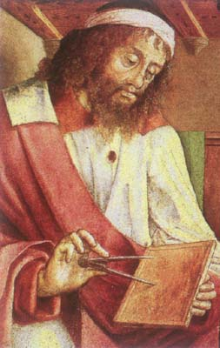
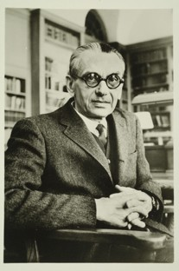
Hugely Expressive
The rules of syntax dictate
how words can be strung together into
logical sentence.
Variables x and y can represent integers.
You can use +, ×, <, =, ≥, ∀, ∃, ∧, ∨, ⌐, →.
Euclid (300 BC)
I want this form to be powerful enough to
express everything I have to say about
math.
Actually, it is hugely expressive.
This is excellent way to understand and prove
most mathematical statements.
“x is prime”
≡ ∀a ∀b (a×b=x → a=1 or b=1)
Gödel
1931

Slide 24

Hugely Expressive
The rules of syntax dictate
how words can be strung together into
logical sentence.
Variables x and y can represent integers.
You can use +, ×, <, =, ≥, ∀, ∃, ∧, ∨, ⌐, →.
Euclid (300 BC)
I want this form to be powerful enough to
express everything I have to say about
comp sci.
Here is J´ an integer encoding of Java program J.
“Java program J on input I outputs y”.
≡ ∃c ∀t (J´×…. +I´ = …. y´)
There is an integer encoding a computation c
such that for every time step t
the TM simulating J takes a legal step

Slide 25
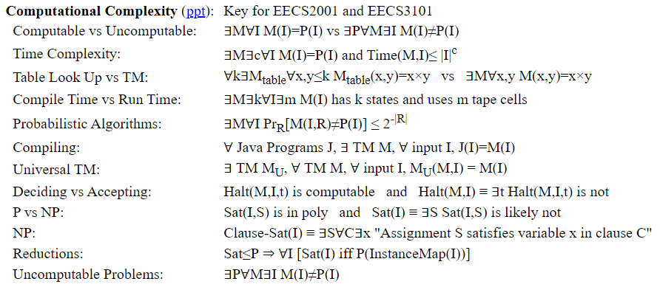
Hugely Expressive
Certainly it is key to theoretical computer science.
“Java program J on input I outputs y”.
≡ ∃c ∀t (J´×…. +I´ = …. y´)
There is an integer encoding a computation c
such that for every time step t
the TM simulating J takes a legal step

Slide 26
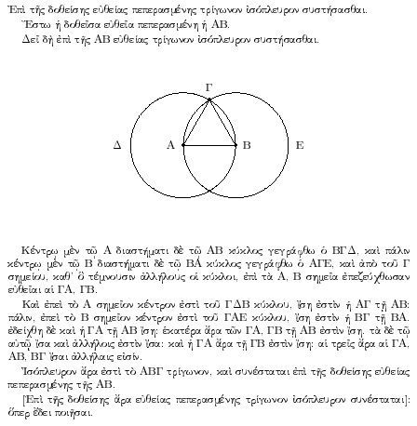
History of Proofs
Euclid said,
“ Let there be proofs”
Euclid (300 BC)
And it was good.

Slide 27
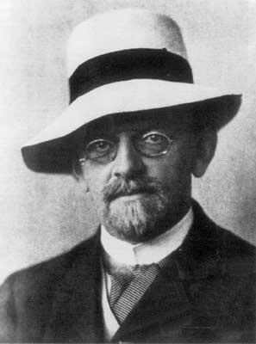
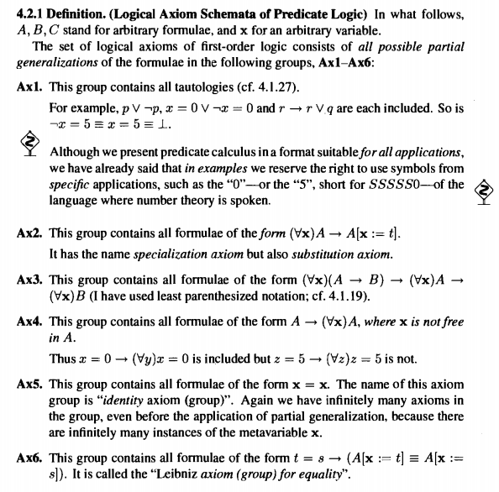


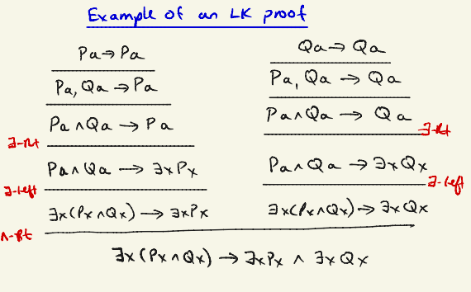
History of Proofs
In 1920, Hilbert wanted mathematics
to be formulated on a solid and complete logical foundation.
There are many formal proof systems that we use.
Hilbert
Jeff made up his own proof system.

Slide 28
History of Proofs
In 1920, Hilbert wanted mathematics
to be formulated on a solid and complete logical foundation.
Hilbert
Its is fun to have a really trimmed down proof system from which you can prove everything!
Its is fun to have a really intuitive and robust proof system from which proving things is easy!

Slide 29
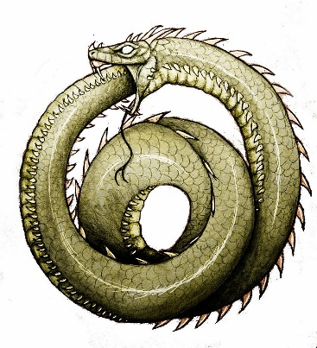
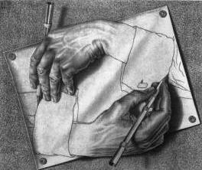
History of Proofs
If formula Φ is true in every model M´ for which the axioms Γ are true,
then it has a proof in our proof system with axioms Γ.
No formal proof system Γ is capable of proving
all valid and no invalid formulas Φ
about the integers.
Gödel’s
Completeness Theorem
1931
Incompleteness
Intuition:
A logic formula can talk about itself.
Φ = “Φ has no proof in your proof system”.
If it is true, then it has no proof.
If it is not true, then it has a proof.
Both are problems.

Slide 30

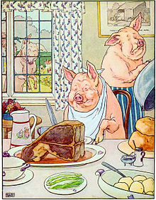
Propositional Logic
In English, a Proposition is a statement or assertion
that expresses a judgment or opinion.
Eg: “All people are created equal”
“We are all equal, just some of us are more equal than others.”
In Propositional Logic, each formula/variable evaluates to true/false.
These are combined with
Not, And, Or, Implies, and Iff
¬, ∧, ∨, →, iff
Our goal will be to prove what follows from what.

Slide 31
And
Or
Proof Techniques/Lemmas
And ∧:
Or ∨:
Implies →:
Negation ¬:
Using:
Proving:
From:
Conclude:
From:
Conclude:
Separating And
Eval/Build ∧
α∧β
α & β
α, α´, & ¬β
α∧α´ & ¬(β∧γ)
Selecting Or
Eval/Build ∨
α∨β & ¬α
β
α, ¬β & ¬β´
α∨γ & ¬(β∧β´)
Cases
Excluded Middle
α∨β, α→γ, & β→γ
γ
α∨¬α & ¬(α∧¬α)
Modus Ponens
Deduction
α & α→β
β
Assume α, prove β
α→β
Cases
Eval/Build →
α∨β, α→γ, & β→γ
γ
α, α´, & ¬β
γ→α, β→γ, ¬(α→β)
Equivalence
Contrapositive
α→β & β→α
α iff β
¬(α∧¬β) iff ¬β→¬α
α→β
Transitivity
Transitivity
α→β & β→γ
α→γ
α→β & β→γ
α→γ
Double Negation
De Morgan's Law
¬¬α
α
¬(α∧β)
¬α∨¬β

Slide 32

Predicate Logic
Predicate Logic talks about the properties of objects.
Father(x,y) ≡ “x is y’s father”
Daughter(y,x) iff Father(x,y)∧Female(y)

Slide 33
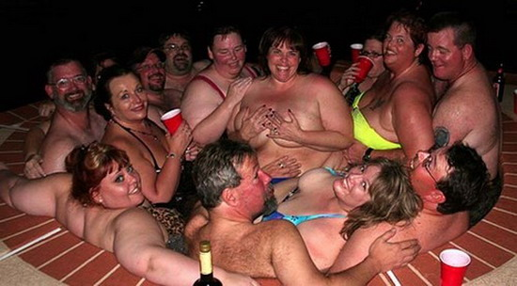
Predicate Logic
∀x, ∃y, y>x
For All integer x,
there Exists a y
that is bigger.
x?
0?
1?
2?
3?
…
The integers go on forever.
No matter how many people are in the hottub,
you can always fit one more.
y is bigger.
1 is bigger.
2 is bigger.
3 is bigger.
4 is bigger.

Slide 34
Informal Proof as a game
Predicate Logic
∀x, ∃y, y>x
Every logic sentence corresponds to a game.
Prover can always win
if and only if
statement is true.
The proof:
Let x be an arbitrary integer.
Let y = x+1
Note y = x+1 >x
Read the statement
left to right.
I, the advisory, am invested in proving that the sentence is false.
Or at least giving the prover as hard of a time as I can.
I produce a worst-case object when it is a ∀.
I, the prover, am invested in proving
that the sentence is true.
I produce a good object when it is a ∃.
The prover wins
if y>x.

Slide 35
Informal Proof as a game
Predicate Logic
As an oracle,
I can help too.
When proving α→β,
I will help you assume α.
Understanding this game is 50% of the course!

Slide 36
Predicate Logic
Informal Proof as a game
“I don’t play games".

Slide 37
Our Formal Proof Systems
Rules:
Removing ∀: From line ∀x α(x), include line α(term) (eg α(x)).
Adding ∀: From line α(x), include line ∀x α(x).
Removing ∃: From line ∃y α(x,y), include line α(x,y∃(x)).
Adding ∃: From line α(term), include line ∃y α(y).
Negating ∀&∃: ¬[∀x α(x)] iff ∃x ¬α(x).
Deduction:
    Goal is to prove α→β
    ______ α assumption
    ______ …
    ______ β
    α→β conclusion
(Not for x∃
or x´).
(Except ∀x α(x,term(x))).
(x´)
(x´)
Notes:
37

Slide 38
Abstraction
The point of formal proofs is
to prove theorems
with as few assumptions as possible
about the nature of the objects
we are talking about
so that we can find a wide range
of strange new objects
for which the same theorems are true.
Notes:
38

Slide 39
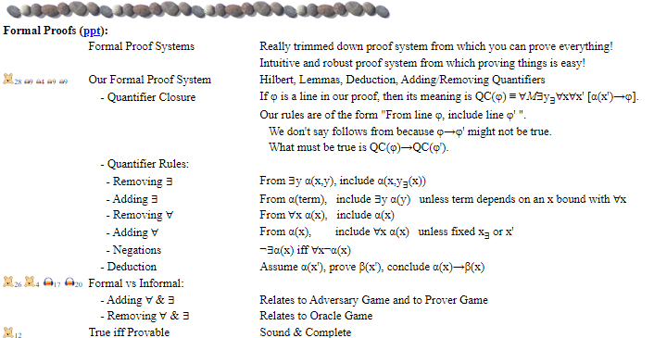
Formal Proofs

Slide 40
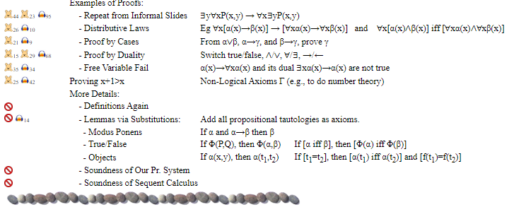
Formal Proofs

Slide 41
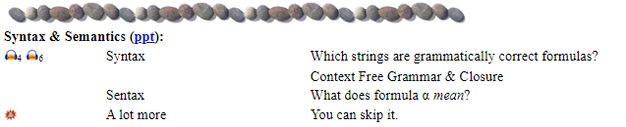

Syntax & Semantics
[
]
[
]
∃g,
∀b,
Loves(b, g, day)
→
∀b,
∃g,
Loves(b, g, day)
∃g,∀b,Loves(b,g,d)
∀b,∃g,Loves(b,g,d)
∃g
∀b
∀b,Loves(b,g,d)
∃g,Loves(b,g,d)
∀b
∃g
Loves(b,g,d)
Loves(b,g,d)

Slide 42
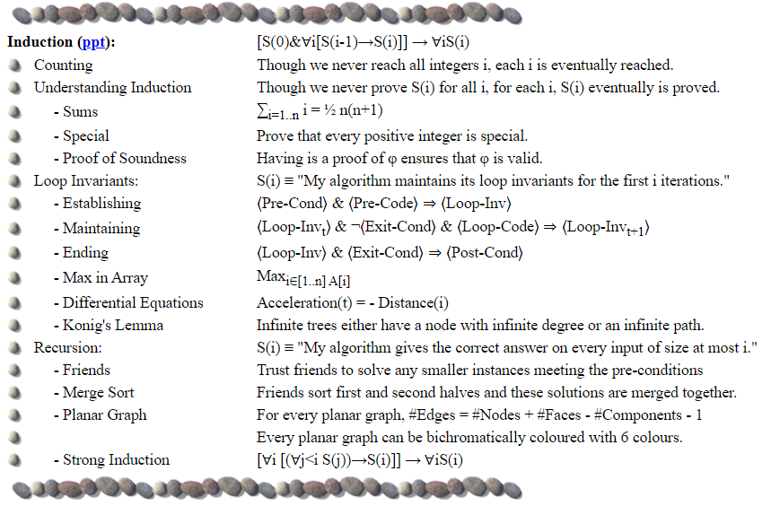
Induction

Slide 43
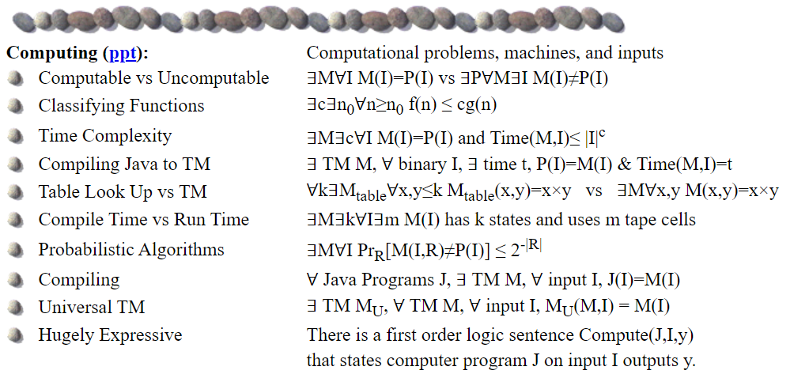
Computing

Slide 44
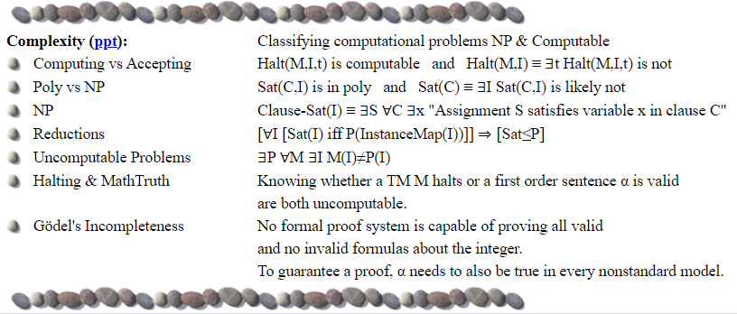
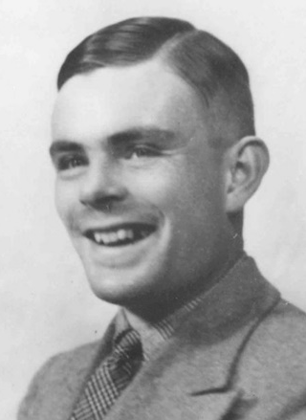
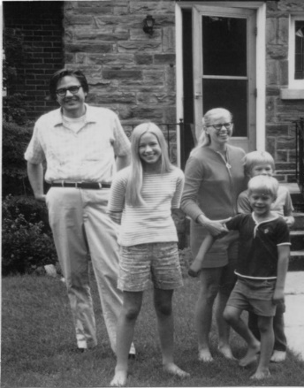
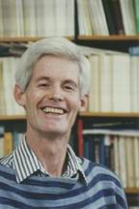
Complexity
Euclid (300 BC)
Hilbert (1900)
Gödel 1931
Turing (1936)
Edmonds 1965
Cook 1971

Slide 45
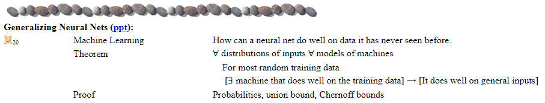
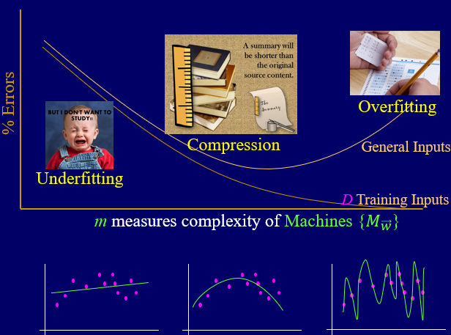
Generalizing Neural Nets

Slide 46
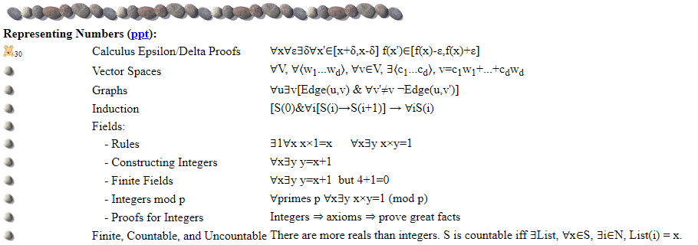
Representing Numbers

Slide 47
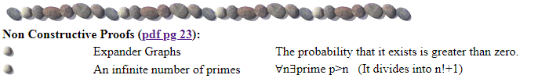
Non Constructive Proofs

Slide 48
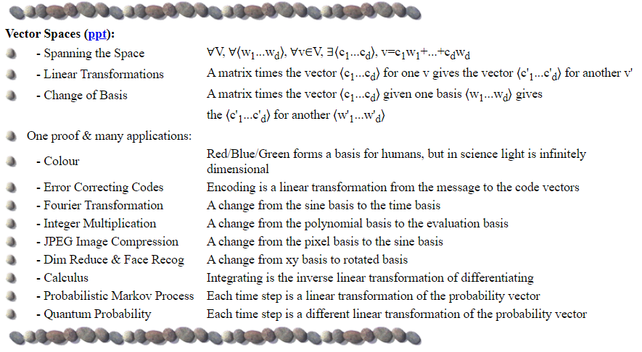
Vector Spaces

Slide 49
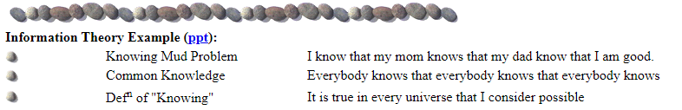
Information Theory

Slide 50
End

