Slide 1
Prove these:
Identity Laws:
Domination Laws:
Idempotent laws:
Double Negation Law:
Negation Laws:
Absorption Laws:
1

Slide 2
Prove these:
TABLE 7 Logical Equivalences Involving Conditional Statements.
TABLE 8 Logical Equivalences Involving Biconditional Statements.
The following content is arranged like a table.
The following content is arranged like a table.
2

Slide 3
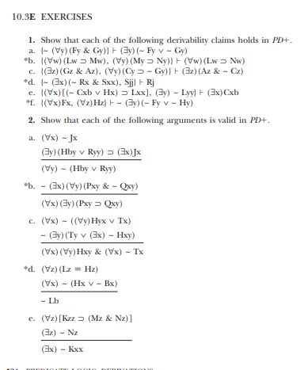
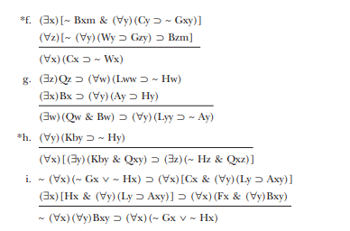

Slide 4
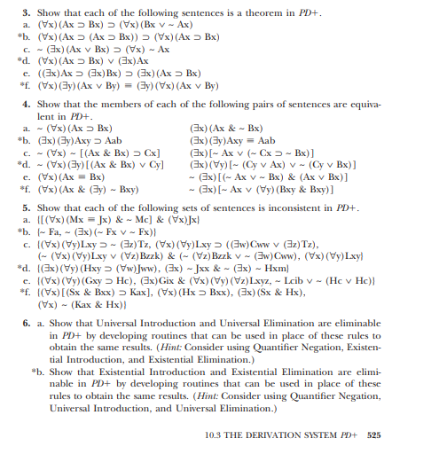

Slide 5
Midterm 2 practice questions
Source: textbook

Slide 6
5.1, 5.2, 5.3 Induction

Slide 7
Induction 5.1, 5.2, 5.3
Section5.1:3,7,11,13,15,19,21,23,25,[27],[29],31,33,37,41,45,51,55, 61,[65],67,[75].
Section5.2:3,5,[11],13,[15],[17],[23],25,[31],35,[39].
Section5.3:3(a,d),5(a,b,e),9,13,15,23,25(a,c),29,31(a),35,37,41,[43],45, [49],61(b,c).
*Selection of questions are based on course content
** [] are listed as optional questions by Neal
***Additional question selected by student is listed as (extra)

Slide 8
5.1

Slide 9
5.1-3

Slide 10
5.1-7

Slide 11
5.1-11

Slide 12
5.1-13

Slide 13
5.1-15

Slide 14
5.1-19

Slide 15
5.1-21 (youtube)

Slide 16
5.1-23

Slide 17
5.1-25

Slide 18
5.1-31

Slide 19
5.1-33

Slide 20
5.1-37

Slide 21
5.1-41 (not for midterm 2, but final maybe??)

Slide 22
5.1-45

Slide 23
5.1-51

Slide 24
5.1 – 55 hmmm…..

Slide 25
5.1-61

Slide 26
5.1-67 hmmmm…

Slide 27
5.2

Slide 28
5.2-3

Slide 29
5.2-5

Slide 30
5.2-13

Slide 31
5.2-25

Slide 32
5.2-35

Slide 33
5.3

Slide 34
Induction 5.1, 5.2, 5.3
Section5.1:3,7,11,13,15,19,21,23,25,[27],[29],31,33,37,41,45,51,55, 61,[65],67,[75].
Section5.2:3,5,[11],13,[15],[17],[23],25,[31],35,[39].
Section5.3:3(a,d),5(a,b,e),9,13,15,23,25(a,c),29,31(a),35,37,41,[43],45, [49],61(b,c).
*Selection of questions are based on course content
** [] are listed as optional questions by Neal
***Additional question selected by student is listed as (extra)

Slide 36
8.1 recurrences

Slide 37
Recurrences ch 8.1
Neal’s question list
Section8.1:1,3,9,11,13,[15],17,[21],[39],[41]. Section8.2:1,3(a,c,d,e,f),7,9,13,15,19,21,23,25,27(a,b,c,f,g),29,33,37, [39],[41],47.
*Selection of questions are based on course content
** [] are listed as optional questions by Neal
***Additional question selected by student is listed as (extra)

Slide 38
8.1- q1

Slide 39
8.1-q3

Slide 40
8.1- q9

Slide 41
8.1 – q11

Slide 42
8.1-q13

Slide 43
8.1q-17

Slide 44
8.1-q28 (extra)

Slide 45
8.1-q33,34 (extra)

Slide 46
8.2 recurrences

Slide 47
Recurrences ch 8.2
Neal’s question list
Section8.1:1,3,9,11,13,[15],17,[21],[39],[41]. Section8.2:1,3(a,c,d,e,f),7,9,13,15,19,21,23,25,27(a,b,c,f,g),29,33,37, [39],[41],47.
*Selection of questions are based on course content
** [] are listed as optional questions by Neal
***Additional question selected by student is listed as (extra)

Slide 48
8.2-q1

Slide 49
8.2-q3

Slide 50
8.2-q7

Slide 51
8.2-q9

Slide 52
8.2-q13

Slide 53
8.2-q15

Slide 54
8.2-q19

Slide 55
8.2-q21

Slide 56
8.2-q23

Slide 57
8.2-q25

Slide 58
8.2-q27 abcfg

Slide 59
8.2-q29

Slide 60
8.2-q33

Slide 61
8.2-q37

Slide 62
8.2-q47

