Slide 1

Abstract Data Types
Abstractions (Hierarchy)
Elements
Sets
Lists, Stacks, & Queues
Trees
Graphs
Iterators
Abstract Positions/Pointers
Jeff Edmonds
York University
Lecture 1
COSC 2011

Slide 2
Software Engineering
Software must be:
  Readable and understandable
    Allows correctness to be verified, and software to be easily updated.
  Correct and complete
    Works correctly for all expected inputs
  Robust
    Capable of handling unexpected inputs.
  Adaptable
    All programs evolve over time. Programs should be designed so that re-use, generalization and modification is easy.
  Portable
    Easily ported to new hardware or operating system platforms.
  Efficient
    Makes reasonable use of time and memory resources.
James Elder

Slide 3
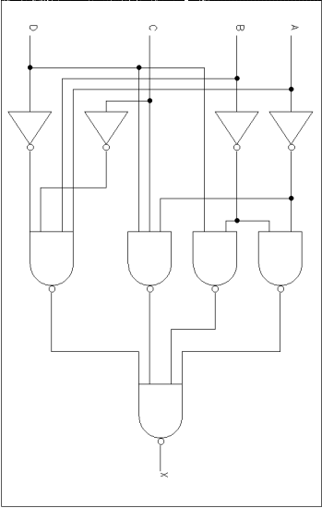
Levels
Abstraction
It is hard to think of love in terms of the firing of neurons.
vs
Software developers view subsystems as entities with separate personalities, roles, and interactions,
not details of code.
vs

Slide 4
Higher Level Abstract View
Representation of an Algorithm
Abstraction
Pros:
Cons:
Intuitive for humans
Useful for
  thinking about
  designing
  describing algorithms
View from which correctness is self evident.
Mathematical mumbo jumbo
Too abstract
Students resist it
Method of choice

Slide 5

Abstract away the inessential features of a problem
Abstraction
Value Simplicity
=
Goal: Understand and think about complex algorithm in simple ways.
Don’t tune out. There are deep ideas within the simplicity.
Steven Rudich

Slide 6
Abstraction
A Routine, Class, or Data Structure:
Three Players
End User:
Runs the program
User:
Coder using
routine.
Implementer:
Coder of the
routine.
Not part of this course.
This is us in
CSE 2011
Complicated
details are
hidden from him.
Correctness & efficiency.

Slide 7
Abstract Data Types (ADTs)
Abstraction
An ADT is a model of a data structure that specifies
  The type of data stored
  Operations supported on these data
An ADT does not specify how the data are stored or how the operations are implemented.
The abstraction of an ADT facilitates
  Design of complex systems. Representing complex data structures by concise ADTs, facilitates reasoning about and designing large systems of many interacting data structures.
  Encapsulation/Modularity. If I just want to use an object / data structure, all I need to know is its ADT (not its internal workings).
James Elder

Slide 8
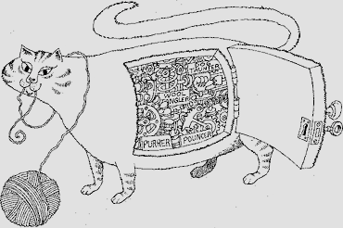
Encapsulation
Abstraction
Each object reveals only what other objects need to see.
Internal details are kept private.
This allows the programmer to implement the object as she or he wishes, as long as the requirements of the abstract interface are satisfied.
James Elder

Slide 9

Modularity
Abstraction
Complex software systems are hard to conceptualize and maintain.
This is greatly facilitated by breaking the system up into distinct modules.
Each module has a well-specified job.
Modules communicate through well-specified interfaces.
James Elder

Slide 10
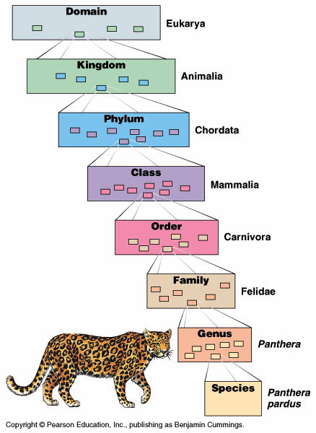
Abstraction
Hierarchical Design
Hierarchical class definitions
allows efficient re-use of software over different contexts.
and to only consider one level at a time.
Is a
James Elder

Slide 11

Abstraction
Hierarchical Design
The psychological profiling of a programmer is mostly the ability to shift levels of abstraction, from low level to high level. To see something in the small and to see something in the large.
  Donald Knuth

Slide 12
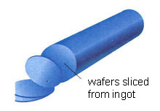
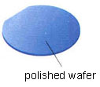



Abstraction
Hierarchical Design

Slide 13



Abstraction
Hierarchical Design
Roumani-CSE

Slide 14
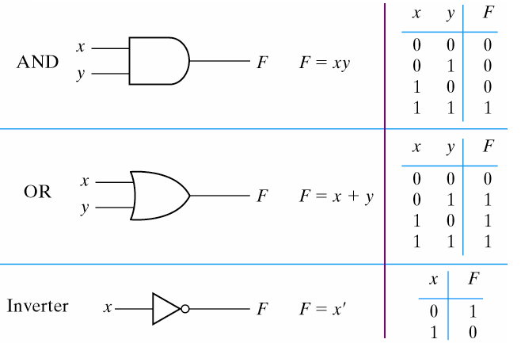

Abstraction
Hierarchical Design

Slide 15
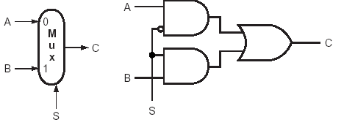

Abstraction
Hierarchical Design
Select between two alternatives A and B

Slide 16

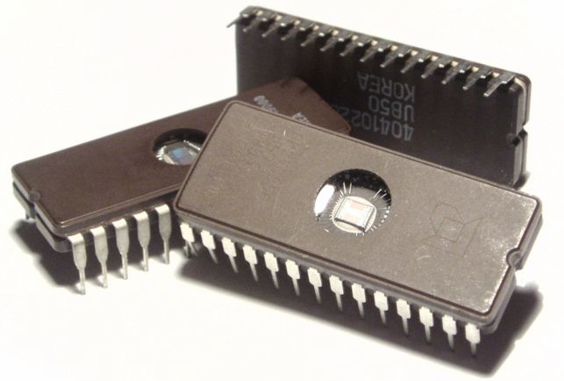
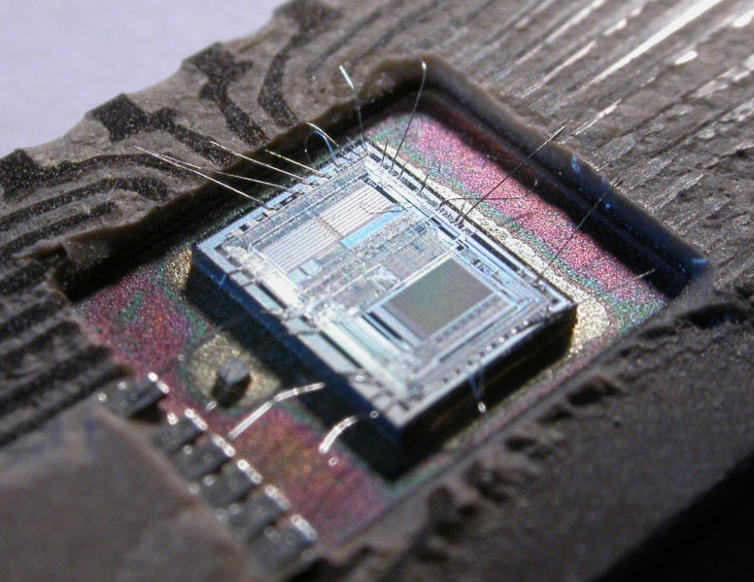
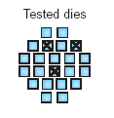
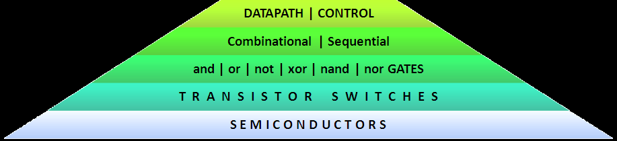
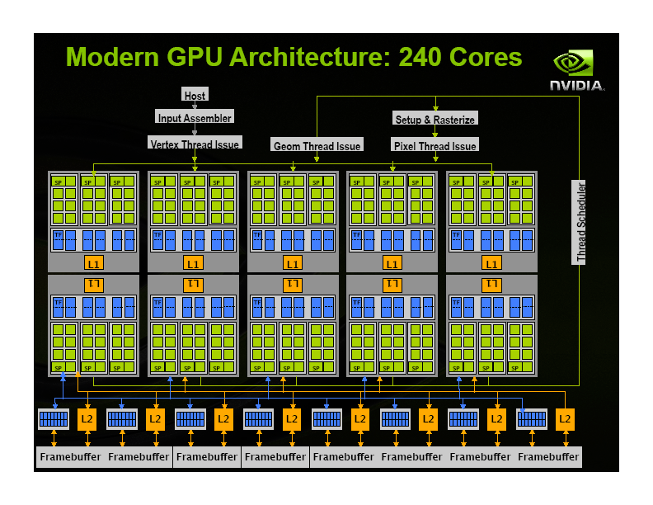
Abstraction
Hierarchical Design

Slide 17
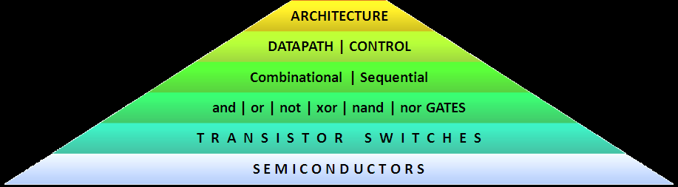
Abstraction
Hierarchical Design
CPU
I/O
DRAM

Slide 18



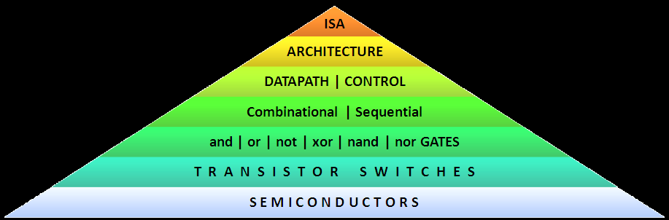
Abstraction
Hierarchical Design
la $a0, yes
addi $s0, $0, 550
add $t0, $0, $0
add $t1, $0, $0
lbl: lw $t2, list($t1)
beq $t2, $s0, ok
addi $t1, $t1, 4
slti $t2, $t1, 40
bne $t2, $0, lbl
la $a0, no
ok: addi $v0, $0, 4
syscall
jr $ra
path = googlemaps.shortestpath(home,school);
0x3c011001
0x34240028
0x20100226
0x00004020
0x00004820
0x3c011001
0x00290821
0x8c2a0000
0x51500006
0x21290004
0x292a0028
0x1540fffa
0x3c011001
0x34240031
0x20020004
0x0000000c
0x03e00008
Loader
Linker
Memory Manager
I/O Controller
Process Manager
path = graph.shortestpath(node1,code2);
element = stack.pop;
element = list.find(key);
boolean found = false;
for (int i = 0; i < 10 && !found; i++)
{
found = (target == list[i]);
}
node = graph.neigbour(node,3);

Slide 19
Abstraction
Hierarchical Design
Each level of the hierarchy
need not worry about the details of the level below
except for the contract about how it will behave.

Slide 20




Abstract Data Types
A data structure is for organizing your data.
An abstraction:
does not worry about implementation details
simplicity
intuitive understandability
user friendly

Slide 21

Abstract Data Types
Element/DataItem/Record/Object/Node:
The basic component of the data structure.
It is a box with some data in it.
The data can be read and changed.

Slide 22

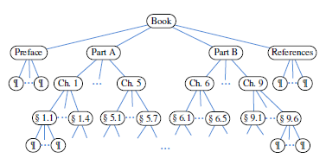
Abstract Data Types
Element/DataItem/Record/Object/Node:
The basic component of the data structure.
It is a box with some data in it.
The data can be read and changed.
Two ways of finding it.
By its location/address

Slide 23

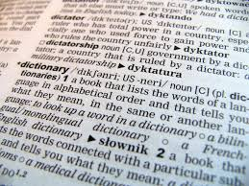
Abstract Data Types
Element/DataItem/Record/Object/Node:
The basic component of the data structure.
It is a box with some data in it.
The data can be read and changed.
Two ways of finding it.
By its location/address
By a key/identifier
  Social Insurance Number → Info about person
  Word → Definition in dictionary

Slide 24


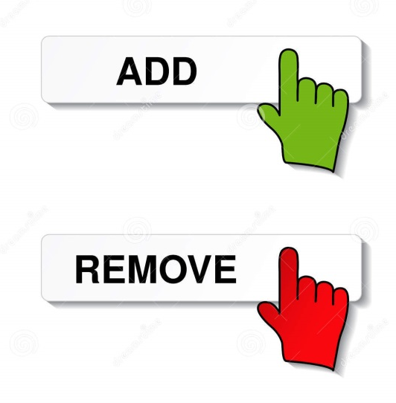
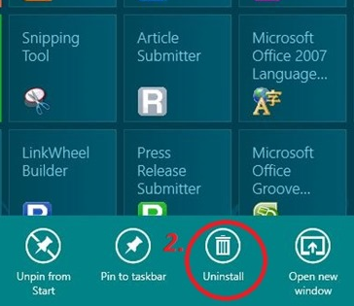

Abstract Data Types
Set: Collects a bunch of elements together.
Operations:
Create an empty set
Add/Remove an element

Slide 25
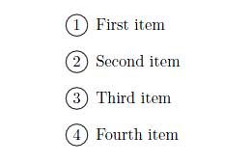

Abstract Data Types
Set: Collects a bunch of elements together.
Operations:
Create an empty set
Add/Remove an element
Iterate through elements

Slide 26
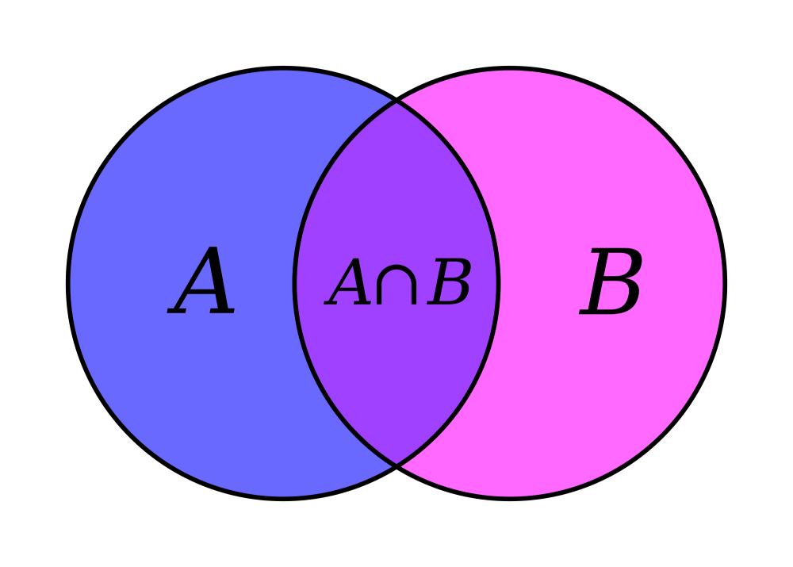
Abstract Data Types
Set: Collects a bunch of elements together.
Operations:
Create an empty set
Add/Remove an element
Iterate through elements
Union or intersect to sets

Slide 27
Abstract Data Types
Set: Collects a bunch of elements together.
Generic:
Can hold generic element type of elements
public class Set <E>
…
public class Tester1 {
Set<Integer> s; s = new
public class Tester2 {
Set<Toys> s;
s = new

Slide 28
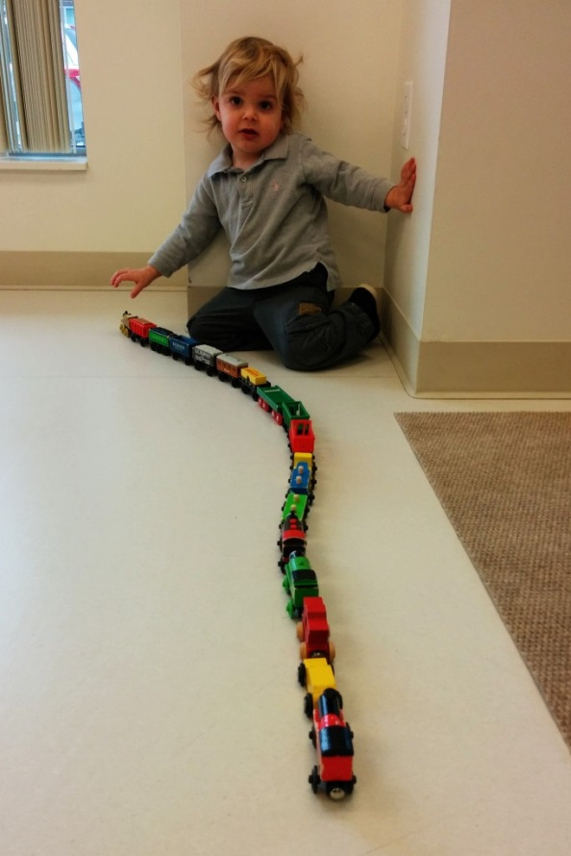

Abstract Data Types
List: A set with an order on the elements
Operations:
Add/Remove an element – specifying where
Iterate through elements – in the given order
Concatenate

Slide 29
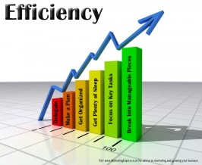



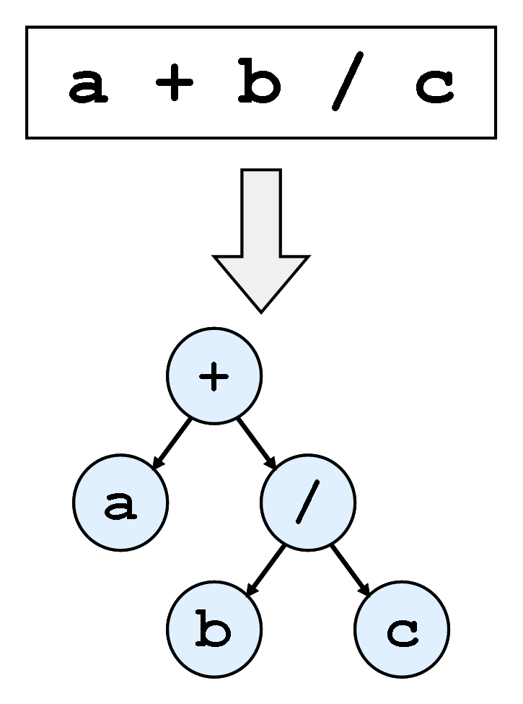
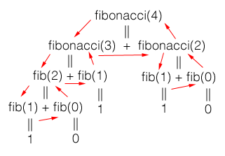

Abstract Data Types
Restricted Data Structure:
Some times we limit what operation can be done
for efficiency
understanding
Stack: A list, but elements can only be
pushed onto and popped from the top.
Applications:
  Undo sequence in a text editor
  or previous page history in a Web browser
  Recursion
  Routine A calls routine B.
  A waits on a stack till B is done.
  Parsing

Slide 30
Abstract Data Types
Restricted Data Structure:
Some times we limit what operation can be done
for efficiency
understanding
Stack: A list, but elements can only be
pushed onto and popped from the top.
Applications:
  Reversing a string:
  Push it onto a stack an then pop it off.
2
2
3
1
1
3
4
4
4
Stack
3
2
1

Slide 31


Abstract Data Types
Restricted Data Structure:
Some times we limit what operation can be done
for efficiency
understanding
Stack: A list, but elements can only be
pushed onto and popped from the top.
Queue: A list, but elements can only be
added at the end and removed from
the front.
Important in handling jobs.
Priority Queue: The “highest priority” element
is handled next.

Slide 32
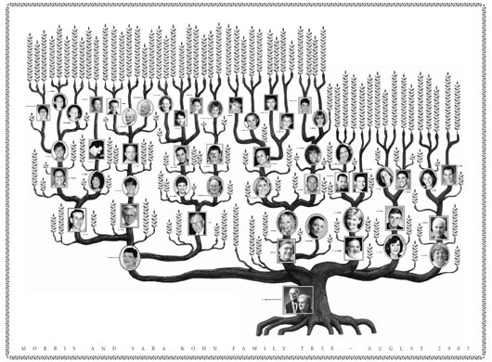
Abstract Data Types
Tree: A nonlinear hierarchal structure.
Eg:
Family Tree

Slide 33
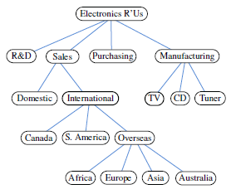
Abstract Data Types
Tree: A nonlinear hierarchal structure.
Eg:
Family Tree
Company Structure

Slide 34
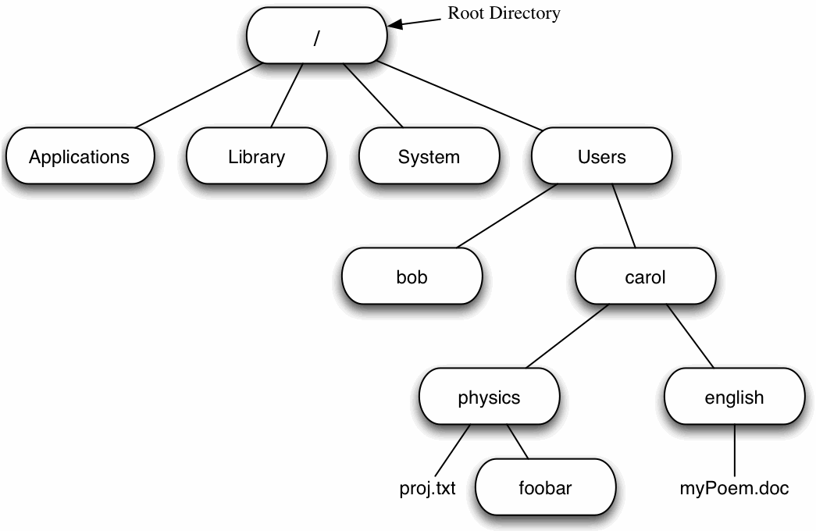
Abstract Data Types
Tree: A nonlinear hierarchal structure.
Eg:
Family Tree
Company Structure
File Structure

Slide 35
Abstract Data Types
Tree: A nonlinear hierarchal structure.
Eg:
Family Tree
Company Structure
Book Organization

Slide 36
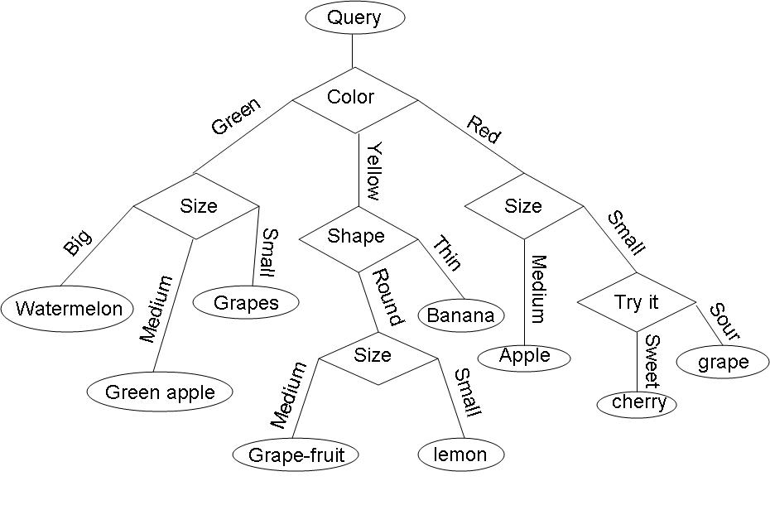
Abstract Data Types
Tree: A nonlinear hierarchal structure.
Eg:
Family Tree
Company Structure
Book Organization
Decision Tree

Slide 37
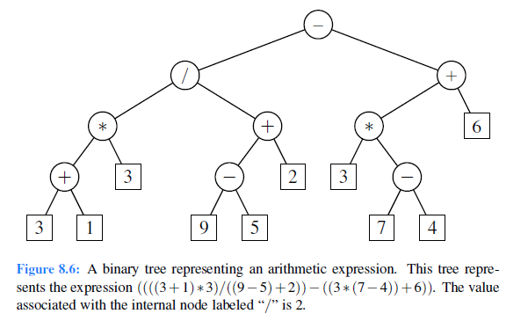
Abstract Data Types
Tree: A nonlinear hierarchal structure.
Eg:
Family Tree
Company Structure
Book Organization
Decision Tree
Arithmetic Expression

Slide 38
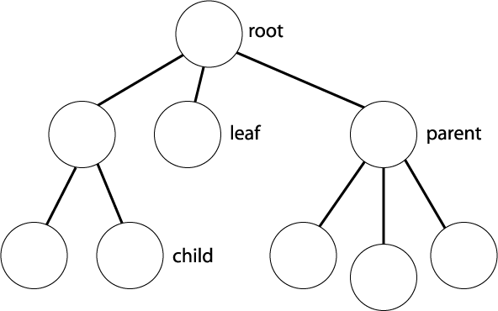

Abstract Data Types
Tree: A nonlinear hierarchal structure.
A special root node.
Each node can have any number of children.
A node with no children is a leaf.
Relationships: Child, Parent, Sibling
Each node is the root of a subtree.

Slide 39

Abstract Data Types
Tree: Two ways to view a tree
As set of nodes that you can walk around
down to a child
or across to a sibling.
or up to a parent.

Slide 40
Abstract Data Types
Tree: Two ways to view a tree
As set of nodes that you can walk around
down to a child
or across to a sibling.
Recursively: Given a tree,
each child of the root is the root of a subtree
that can be acted upon recursively.
or up to a parent.

Slide 41
Abstract Data Types
Restricted Data Structure:
Some times we limit what operation can be done
for efficiency
understanding
Binary Tree:
Each (internal) node has two children, a left and a right.
But that child may be the empty tree.
3
8
6
1
2
5
4
3
2
7
9
1

Slide 42
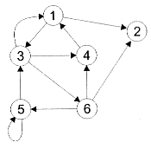
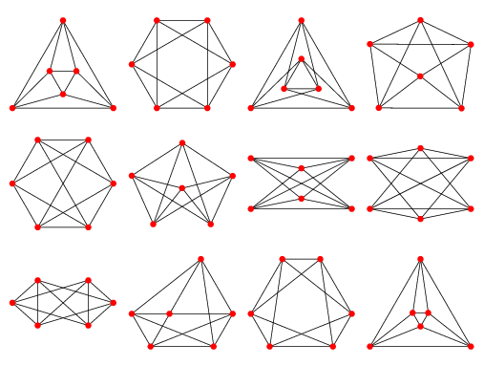
Abstract Data Types
Graph: Edges between the nodes (Directed or undirected)

Slide 43
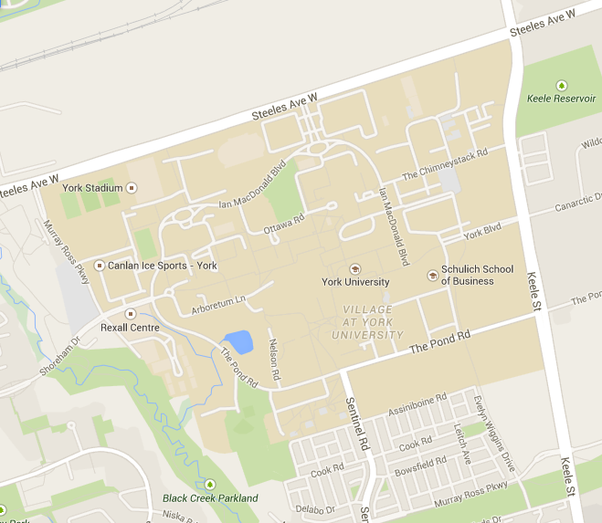
Abstract Data Types
Graph: Edges between the nodes (Directed or undirected)
Eg: Cities and roads

Slide 44

Abstract Data Types
Graph: Edges between the nodes (Directed or undirected)
Eg: Computers and networks

Slide 45

Abstract Data Types
Graph: Edges between the nodes (Directed or undirected)
Eg: Social Networks

Slide 46
Data Structures Implementations
Array List
  (Extendable) Array
Node List
  Singly or Doubly Linked List
Stack
  Array
  Singly Linked List
Queue
  Circular Array
  Singly or Doubly Linked List
Priority Queue
  Unsorted doubly-linked list
  Sorted doubly-linked list
  Heap (array-based)
Adaptable Priority Queue
  Sorted doubly-linked list with location-aware entries
  Heap with location-aware entries
Tree
  Linked Structure
Binary Tree
  Linked Structure
  Array

Slide 47
Iterators
Collections are Iteratable.
Suppose collection is an instance of a Collection.
  See
    Package java.util.
    Javadoc, provided with your java distribution.
    The Collections Java tutorial, available at http://docs.oracle.com/javase/tutorial/collections/index.html

Slide 48
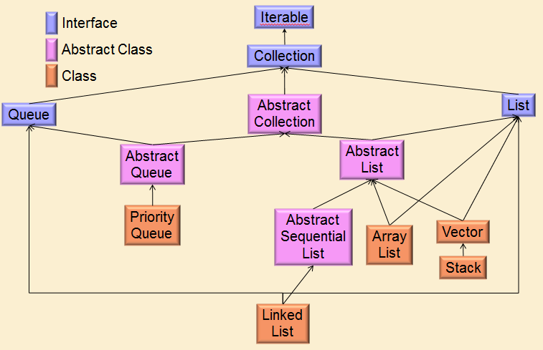
Iterators
Collections are Iteratable.
Suppose collection is an instance of a Collection.

Slide 49
Iterators
Collections are Iteratable.
Suppose collection is an instance of a Collection.
Iterator<E> it = collection.iterator();
while (it.hasNext())
System.out.println(it.next());
collection.iterator()
Creates an iterator object
enabling you to traverse through a collection
(and possibly remove elements)
it.next()
Returns the current element
(initially the first element)
Steps to the next element.
it.hasNext()
Checks if there is another element.

Slide 50
Iterators
Collections are Iteratable.
Suppose collection is an instance of a Collection.
Iterator<E> it = collection.iterator();
while (it.hasNext())
System.out.println(it.next());
Enhanced For-Each Statement
(compiles to uses o.iterator())
for (Object o : collection)
System.out.println(o);

Slide 51
Iterators
ListIterators support the following methods:
  next() and previous()
  hasNext() and hasPrevious()
  add(e), set(e), and remove (e):
  inserts, changes, and removes element at current position
  nextIndex() and previousIndex()

Slide 52


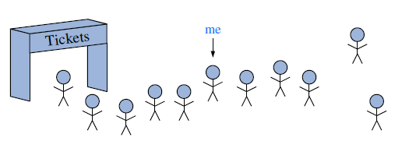

High Level Positions/Pointers
Positions: Given a data structure,
we want to have one or more current elements
that we are considering.
Conceptualizations:
Fingers in pies
Pins on maps
Little girl dancing there
Me
See Goodrich Sec 7.3 Positional Lists

Slide 53
High Level Positions/Pointers
Positions: Given a data structure,
we want to have one or more current elements
that we are considering.
Moving Them:
girl₂ = tree.child(girl₂,1);
girl₂ = tree.nextSibling(girl₂);
girl₂ = tree.nextSibling(girl₂);
girl₁ = tree.root();

Slide 54
High Level Positions/Pointers
Positions: Given a data structure,
we want to have one or more current elements
that we are considering.
Moving Them:
girl₂ = tree.child(girl₂,1)
This is a routine within the tree object.
This is the position where the girl is dancing
This is the tree object.
We must write this routine.

Slide 55
High Level Positions/Pointers
Positions: Given a data structure,
we want to have one or more current elements
that we are considering.
Moving Them:
girl₂ = tree.child(girl₂,1)
The returned child is stored in this variable.
The routine takes a parent as input
and returns it’s child.

Slide 56
High Level Positions/Pointers
Positions: Given a data structure,
we want to have one or more current elements
that we are considering.
Moving Them:
girl₂ = tree.child(girl₂,1)
This is the new value of the variable.
This is the old value of the variable.

Slide 57
High Level Positions/Pointers
Positions: Given a data structure,
we want to have one or more current elements
that we are considering.
Moving Them:
girl₂ = tree.child(girl₂,1)
Now she is located
at the child.
Girl₂ was located
at the parent.

Slide 58
High Level Positions/Pointers
Positions: Given a data structure,
we want to have one or more current elements
that we are considering.
Moving Them:
girl₁ = tree.child(girl₂,1)
girl₁
Now her friend is located
at the child.
Girl₂ is located
at the parent.

Slide 59
High Level Positions/Pointers
Positions: Given a data structure,
we want to have one or more current elements
that we are considering.
Storing Them:
A position can be stored in a variable girl₂
or in an array A[4].
A
0
1
2
3
4
5
n

Slide 60

High Level Positions/Pointers
Positions: Given a data structure,
we want to have one or more current elements
that we are considering.
Storing Them:
A position can be stored in a variable girl₂
or in an array A[4].
A position can also be stored in a data element
“pointing” at another data element.
Each element contains two fields
First storing info
Second storing the position of the next element
n

Slide 61
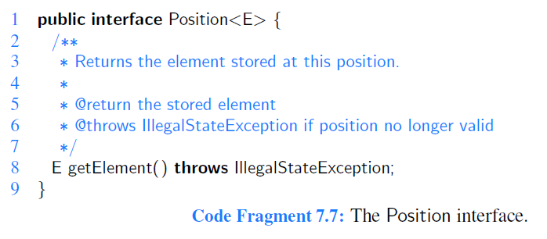
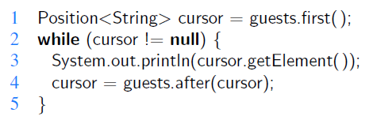
High Level Positions/Pointers

Slide 62
High Level Positions/Pointers
Position will be a class of objects.
It is not actually implemented. This will be left for later.
When implementing it, some type “E” needs to be filled in. This is like a input to the description of the class.
Each “position” object needs to have some data of this type “E”.
You can use the method getElement to ask
a “position” object to return this “E” data.

Slide 63
High Level Positions/Pointers
Position will be a class of objects.
It is not actually implemented.
The implementer may add lots of other interesting
things to such a position.
  Like the links between different positions.

Slide 64
End
Abstract Data Types

