Slide 1
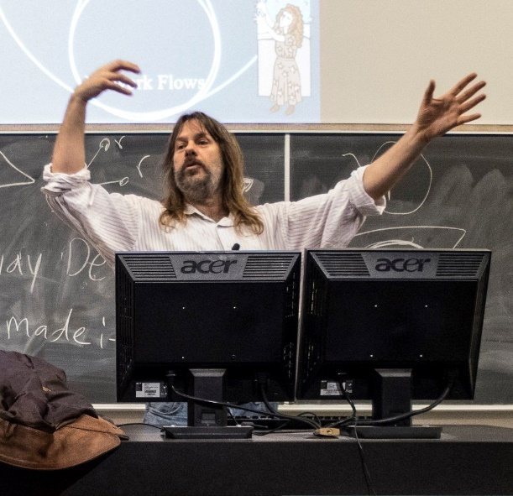
Welcome
Fundamentals of Data
Jeff Edmonds
www.cse.yorku.ca\~jeff\courses\02011
jeff@cse.yorku.ca
CSB 3044, ext. 33295
647-688-7413
Jeff Edmonds
York University
Lecture 0
COSC 2011

Slide 2

SOS Class Representative Position
Take on a leadership role in the classroom
Engage with students and with your professor
Get involved in the Bethune Community
Applications are OPEN they are DUE ON MONDAY SEPTEMBER 16TH 2019 FOR FALL AND YEAR LONG COURSES
Go to http://bethune.yorku.ca/classreps/recruitment/

Slide 3


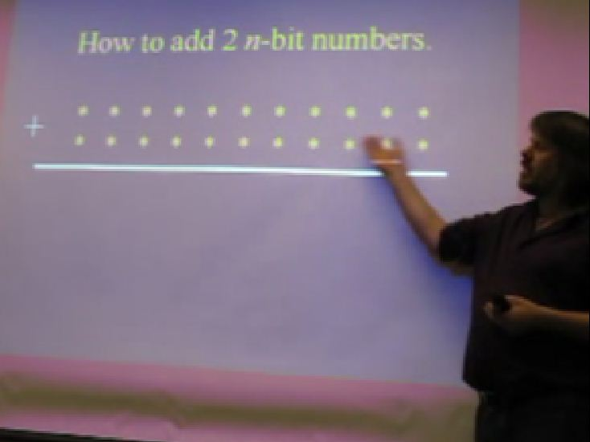
Course Material
Slides
Videos
(Remind me)
Text
Text
Steps, Assignments, Practice Tests, Unit Tests, Exam
Extra Text: Cormen, Leiserson, Rivest, and Stein
"Introductin to Algorithms",
Good to have, but not needed for this course.
Notes:
3

Slide 4
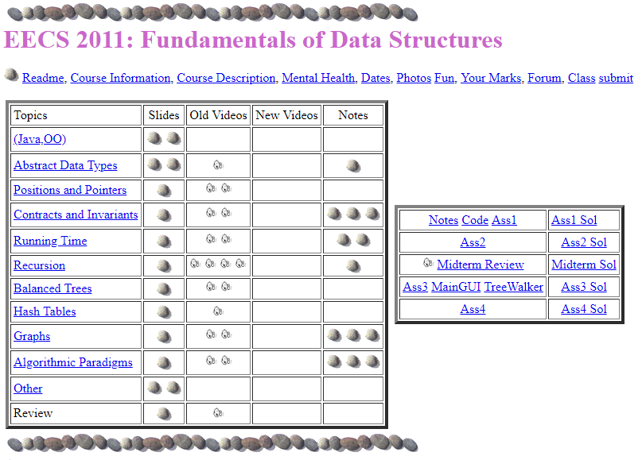
Course Material
www.cse.yorku.ca\~jeff\courses\02001\syllabus

Slide 5
A Contract to Learn
It deeply saddens me when a third of the class does not learn the material sufficiently to pass.
I will do everything in my power to help you learn this material.
I request that you do everything in your power.
Everyone can learn it.

Slide 6
Tough Love
The last few terms
I threatened them every day.
They performed better than ever before!
And my course evaluations were better.

Slide 7
Think about Algorithms
Abstractly
This course requires completely changing
the way you think about algorithms.
Though I keep warning people,
they tend not to get it until they are
Devastated
by the midterm
Change your thinking now.

Slide 8
Study Now!
Don’t just work on coding assignments!
Study the material deeply
before you fail the midterm.

Slide 9
Marks
We will work you HARD:
4 Assignments
Midterm
Exam
Participation
Mark =
5%*4 = 20%
20% (+8%)
50% (+8%)
2% (+8%)
Σ_{i=1..4} 0.05 T_{i} + 0.20 M + 0.50 E + 0.02 P
+ 0.08 Max(M,E,P)

Slide 10
Marks
Four coding assignments (in Java)
Start them early!
Talk to each other
Don’t copy
Do assignments in pairs.
Notes:
10

Slide 11
Marks
Assignments are
available now.
www.cse.yorku.ca\~jeff\courses\02001\syllabus

Slide 12
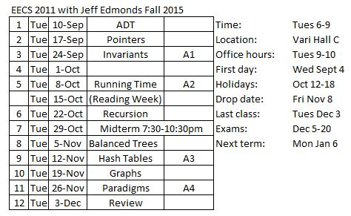
Marks

Slide 13
Marks
Class Participation:
  Asking/Answering questions in class
  Attending office hours
  Talking to me outside of class
  Submitting a photo *
  Worth 2% if you don’t need it
  and 10% if you do.

Slide 14
Together
I think it is important for people
to not feel isolated
with the material.

Slide 15
Together
You’re cool!
Are you free sometime this weekend?
Yes!
The best way to learn
is to teach each other!

Slide 16

Together
Some students feel too intimidated to talk to the professor.
Actually, he is just a guy
who has been doing this for a while.

Slide 17
Together
Office hours:
Before/after class tend to be the best time.
Longer or private questions, when requested,
can be taken back to my office, CSB 3044.
Notes:
17

Slide 18

Together
Sorry:
Given a problem
that the teacher knows a simple answer for
Determining how hard it will be for other people.
Is very HARD.
Sure it is easy AFTER we see the solution!
Hindsight is 20-20!
I ALWAYS panic that I have made it too easy
and everyone will get perfect.
Then everyone fails. ☹
Notes:
18

Slide 19
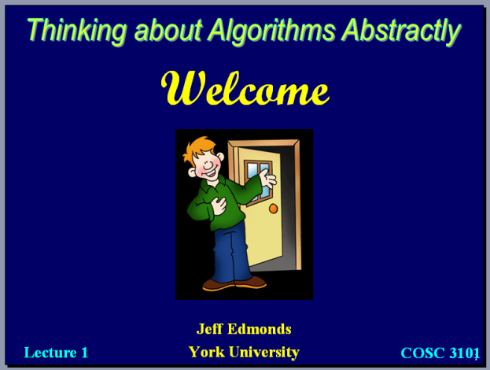
Together
Pros
Don’t have to take notes.
Lower fear level that you will miss something.
Flexible to miss a class or two
if working, parenting, sick, …
Read/watch ahead to be prepared for a good discussion.
Read/watch after to review and as a reference.
Notes:
19

Slide 20
Together
Pros
REALLY good students might feel they don’t have to come to class (some might be right).
Cons
Cocky students will think they don’t need to come class
but are wrong.
Lazy students will use them as an excuse to skip class
and then never really get to them.
Notes:
20

Slide 21
Together
Please interact with me in class.
Help me know what people
are not understanding
Slow down the slides
(Though we do have
a lot of material to cover)

Slide 22
Together
Please ask questions!
To keep the flow going
Wiggly hand:
relevant to current slide.
Stationary hand:
question about past material.
Avoid getting off topic.

Slide 23
Together
When I ask a question
to the class.
Please don’t shout out answers.
So others can think.

Slide 24
Together
In every class,
there is one student
I don’t like.
The key when talking in class is
Are you trying to
help me and the class
or win some compitition?

Slide 25
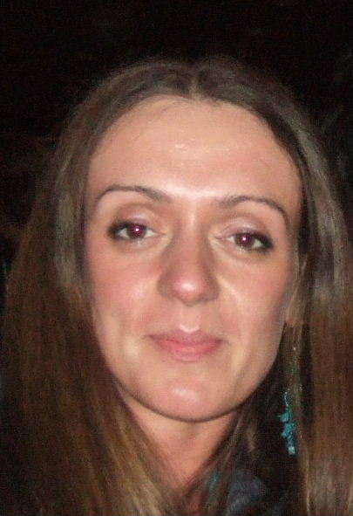
Together
Please ask questions!
Winter 06, the average of one section was much higher
than the average of the other.
(I taught them both)
My theory was that it was because a student,
Gertruda, constantly asked great questions
and everyone learned from them.
Ask questions for everyone’s sake.
10% of your mark is class participation!

Slide 26

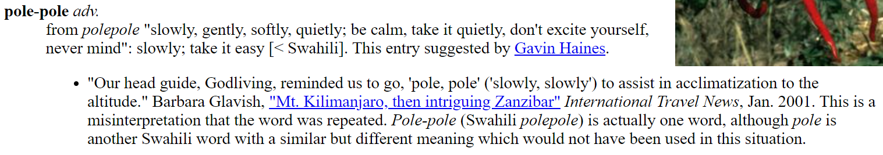
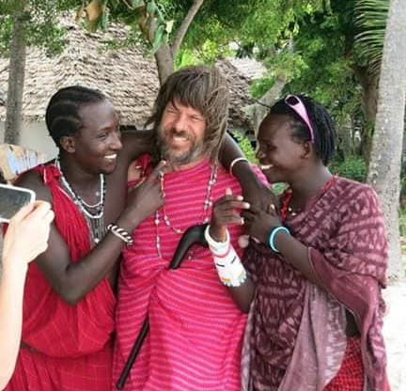

Slide 27
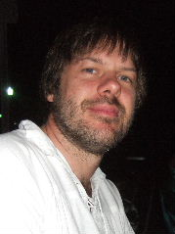
Together
Submit a Photo
What:
  Submit a photo on line
  Add a photo to your forum account
  If you would like a better rapport with your emails,
  please include a photo.
Why:
  I am very bad with names. (Sorry)
  Emails and tests are effectively anonymous.
  Needed for 10% participation mark.
  You can see the class list.
How:
  Submit
- cp photo.jpg Smith_John.jpg
- submit 2011A photos Smith_John.jpg
Notes:
27

Slide 28
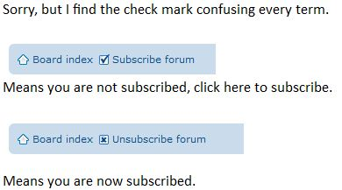
Together
Forum
  I communicate to you via the Forum.
  You are also encouraged to talk to each other this way.
  To be sure that you know when something has been posted,
  it is important to subscribe to the course forum.
  Be sure to subscribe to the course forum
  and not just to one of its topics
Notes:
28

Slide 29
Topics Covered.
www.cse.yorku.ca\~jeff\courses\02001\syllabus

Slide 30
Topics Covered.

Slide 31
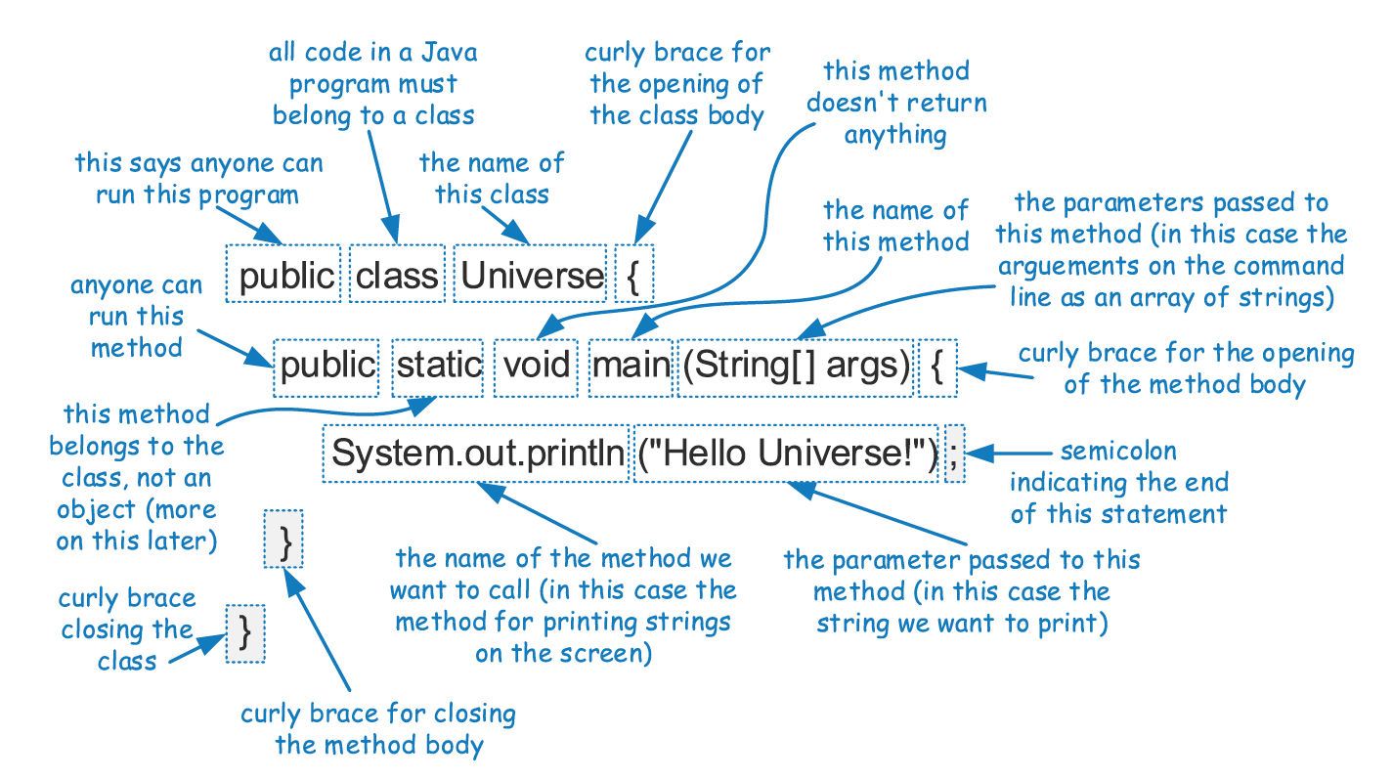
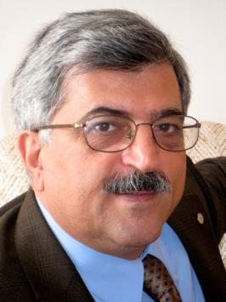
Java Primer
Slides copied directly from Andy
(And not covered by Jeff)
We “should” know Java, but I am sure we are rusty.
We will struggle through code notation together.
Ask if you have questions as we go along.

Slide 32
Object-Oriented Programming
Inheritance
Polymorphism
Dynamic dispatch
Overriding vs overloading
Slides copied directly from Andy
(And not covered by Jeff)
I would like to say that YOU “should” know this.
Truth is I don’t know it all.
I cover what I will test you on.
Let me know if you think I should learn/cover more of it.

Slide 33
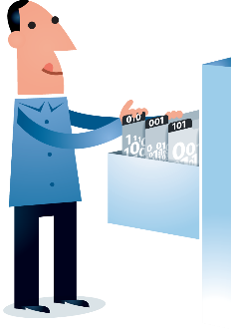

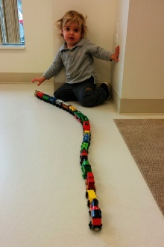
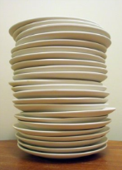
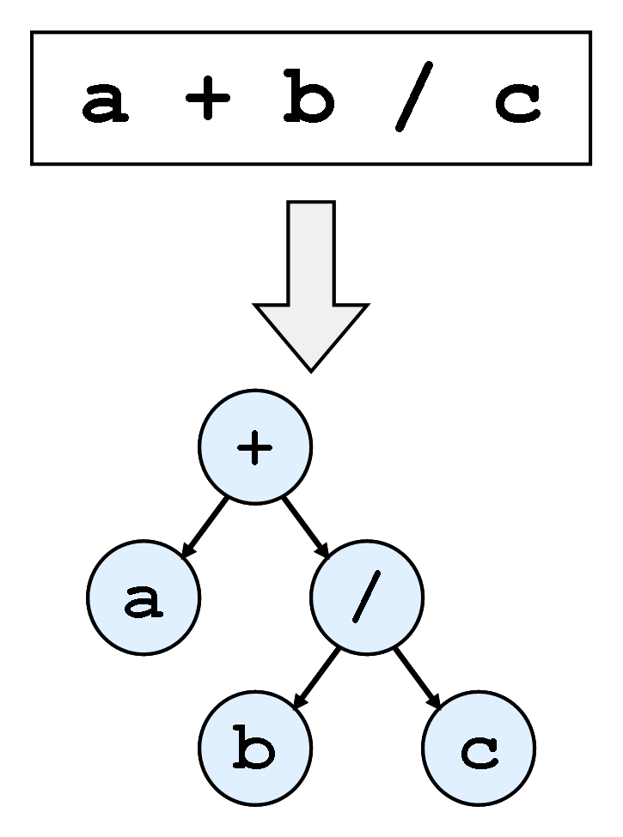
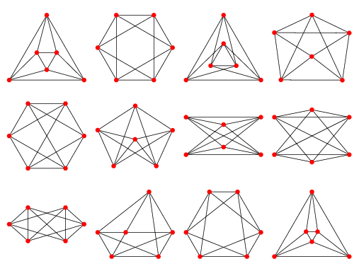
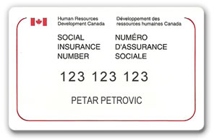
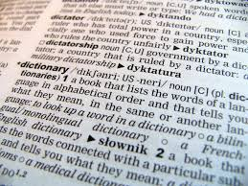
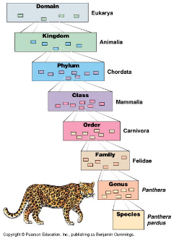
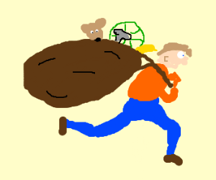
Abstract Data Types
Abstractions (Hierarchy)
Elements
Sets
Lists, Stacks, & Queues
Trees
Graphs
Iterators
Abstract Positions/Pointers
Lecture 1

Slide 34
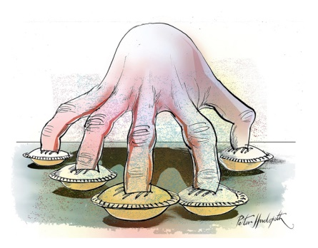

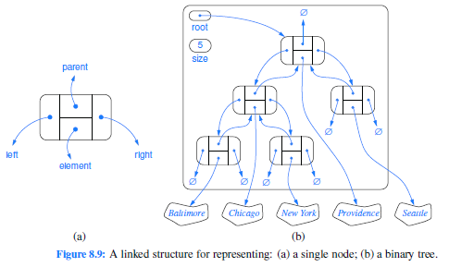
Positions and Pointers
Copy Value vs Copy Reference
Abstract Positions/Pointers
Positions in an Array
Pointer to Node
C vs Java vs Python
Building a Linked List
Walking, Dropping, and Following
Implementing Positions in Trees
Building Trees
Lecture 2

Slide 35
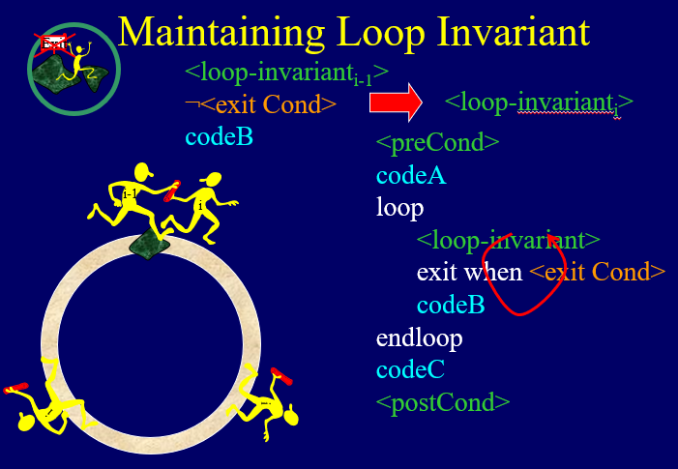
Contracts, Assertions, and Invariants
Contracts
Assertions
Loop Invariants
The Sum of Objects
Insertion and Selection Sort
Binary Search Like Examples
Bucket (Quick) Sort for Humans
Reverse Polish Notation (Stack)
Whose Blocking your View (Stack)
Parsing (Stack)
Data Structure Invariants
Stack and Queue in an Array
Linked Lists
More Pointers
Lecture 3

Slide 36
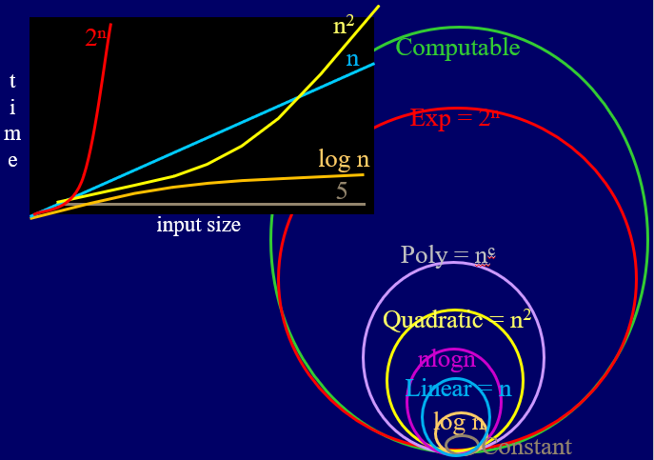
Asymptotic Analysis of Time Complexity
History of Classifying Problems
Growth Rates
Time Complexity
Linear vs Constant Time
Binary Search Time (logn)
Insertion Sort Time (Quadratic)
Don't Redo Work
Test (linear) vs Search (Exponential)
Multiplying (Quadratic vs Exponential)
Bits of Input
Cryptography
Amortized Time Complexity
Worst Case Input
Classifying Functions (BigOh)
Adding Made Easy
Logs and Exponentials
Understand Quantifiers
Lecture 4

Slide 37
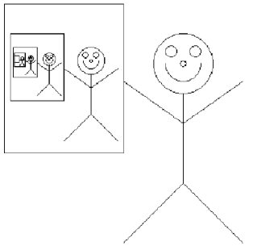
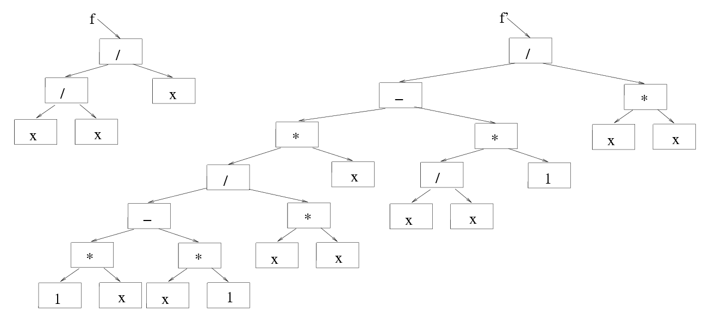
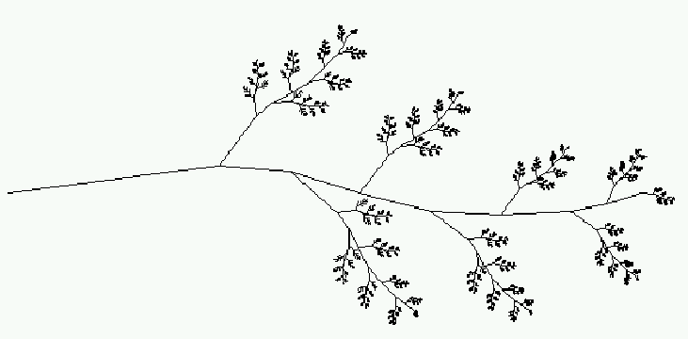
Recursion
Ruler Example
One Step at a Time
Stack of Stack Frames
Friends and Strong Induction
Recurrence Relations
Towers of Hanoi
Check List
Merge & Quick Sort
Simple Recursion on Trees
Binary Search Tree
Things not to do
Heap Sort & Priority Queues
Trees Representing Equations
Iterate over all s-t Paths
Recursive Images
Lecture 5

Slide 38
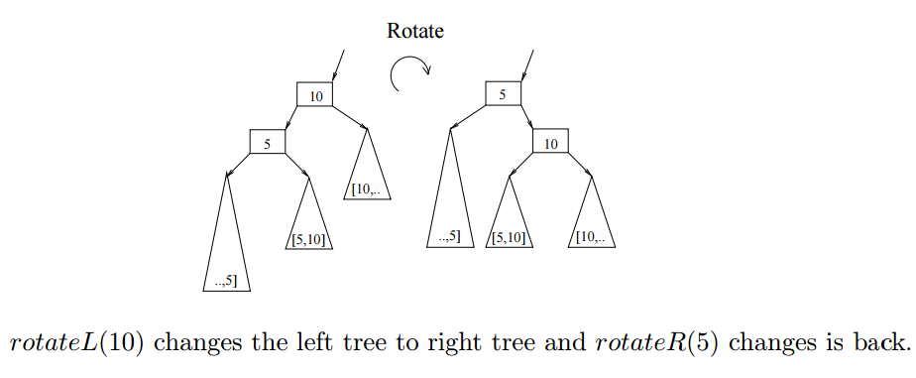
Balanced Trees
Dictionary/Map ADT
Binary Search Trees
Insertions and Deletions
AVL Trees
Rebalancing AVL Trees
Union-Find Partition
Heaps & Priority Queues
Communication & Hoffman Codes
(Splay Trees)
Lecture 6

Slide 39
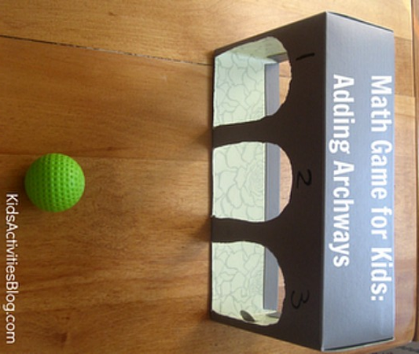
Hash Tables
Dictionary/Map ADT
Direct Addressing
Hash Tables
Random Algorithms
Universal Hash Functions
Key to Integer
Separate Chaining
Probe Sequence
Put, Get, Del, Iterators
Running Time
Simpler Schemes
Lecture 7

Slide 40
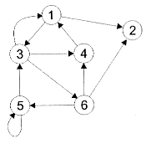

Graph ADT
Graph ADT
Generic Search
Breadth First Search
Dijkstra's Shortest Paths Algorithm
Depth First Search
Linear Order
Lecture 8

Slide 41
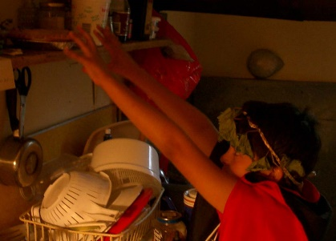
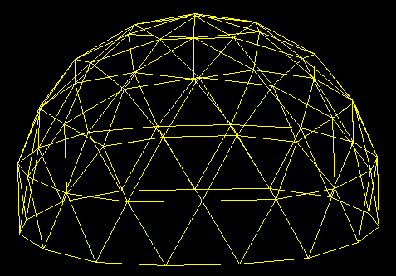

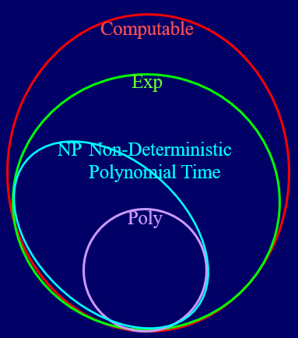
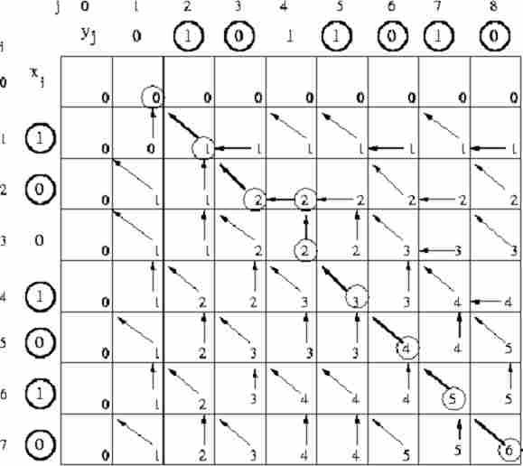

Algorithmic Paradigms
∃ g, ∀ b, Loves(b, g)
First Order Logic
Brute Force: Optimazation Problem
Greedy Algorithm: Minimal Spanning Tree
Dual Hill Climbing: Max Flow / Min Cut
Linear Programing: Hotdogs
Recursive Back Tracking: Bellman-Ford
Dynamic Programing: Bellman-Ford
NP-Complete Problems
Randomness and Probability
Lecture 9

Slide 42

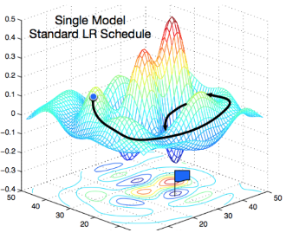
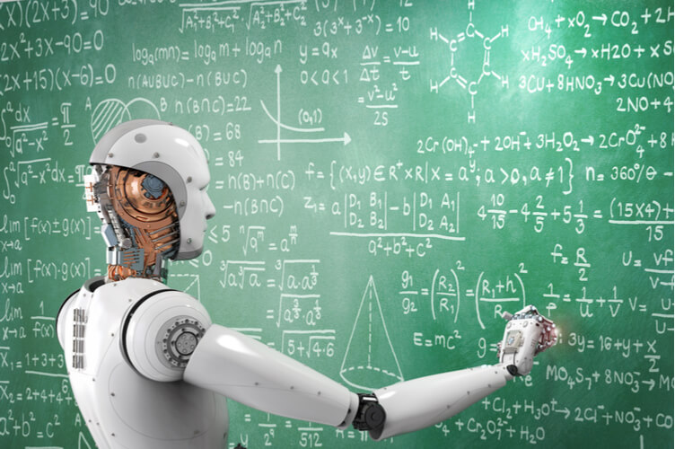
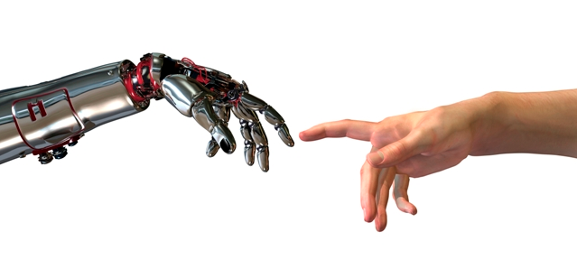
Machine Learning
Supervised Learning
Gradient Descent
Notes:
4*1.5hrs - not Example …, not unsupervised.

Slide 43
Read Ahead
You are expected to read the lecture notes before the lecture.
This will facilitate more productive discussion during class.
Also please
proof read
assignments
& tests.
Like in an
English class

Slide 44

Explaining
We are going to test you on your ability to explain the material.
Hence, the best way of studying is to explain the material over and over again out loud to yourself, to each other, and to your stuffed bear.

Slide 45
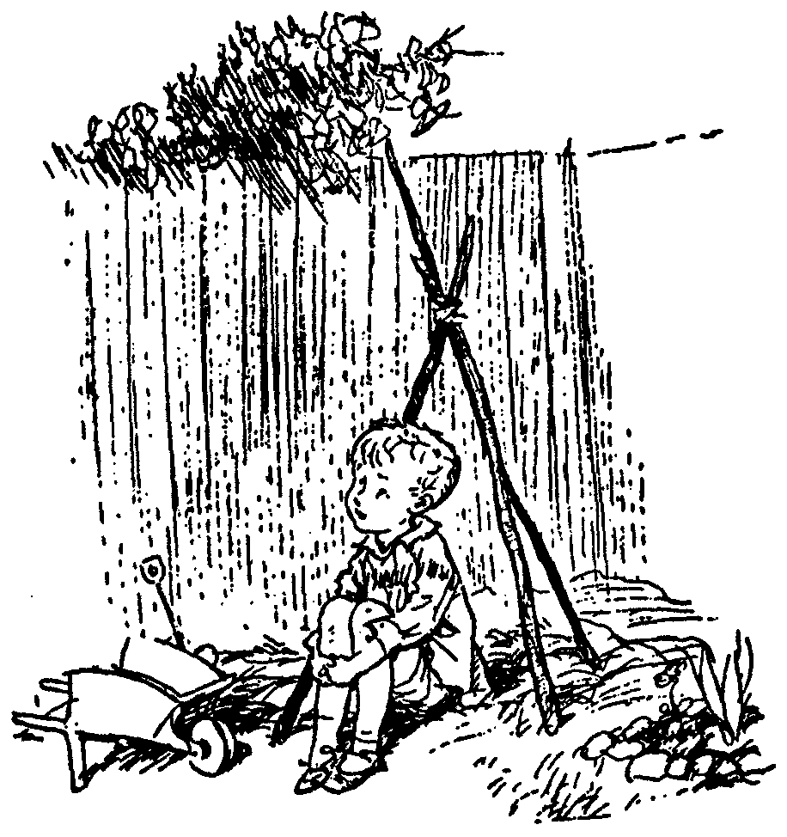
Day Dream
While going along with your day
Mathematics is not all linear thinking.
Allow the essence of the material to seep into your subconscious
Pursue ideas that percolate up and flashes of inspiration that appear.

Slide 46

Be Creative
Ask questions.
Why is it done this way and not that way?

Slide 47
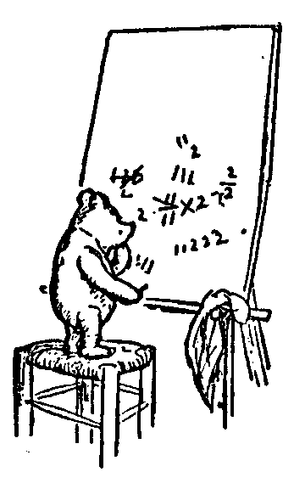
Guesses and Counter Examples
Guess at potential algorithms for solving a problem.
Look for input instances for which your algorithm gives the wrong answer.
Treat it as a game between these two players.

Slide 48
Refinement:
The best solution comes from a process of repeatedly refining and inventing alternative solutions
Rudich www.discretemath.com

Slide 49
End

