Slide 1
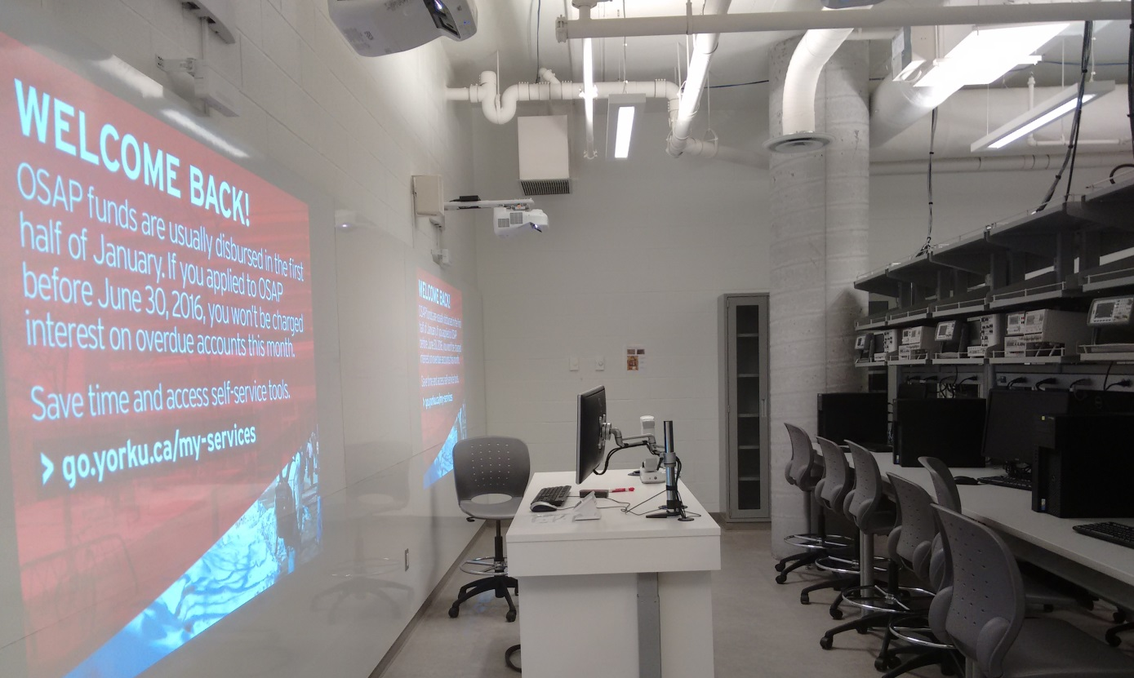
Health & Safety for EECS 2200: Electrical Circuits 2020 Fall Semester

Slide 2
Agenda: Safety for Lab From Home During COVID-19 Pandemic
Lab From Home Safety
Home Equipment Safety
Resources for Lab From Home
Technical Support for Lab from Home
YorkU Resources for Study from Home
Fall 2020

Slide 3
General Safety Rules
A major concern of engineering profession is Safety.
As engineers you will be required to protect and promote the health, safety and well-being of the community and the environment.
Working in a safe manner is more important than completing your lab.
First and foremost, you are responsible for your own safety.
So familiarize yourself with the lab resources on work from home.
Do not do anything, which puts anyone's safety at risk.
Follow all the guidelines mentioned in the manuals designed for lab from home
If you are not sure about something, then please email the TA or the lab-tech.
Fall 2020

Slide 4
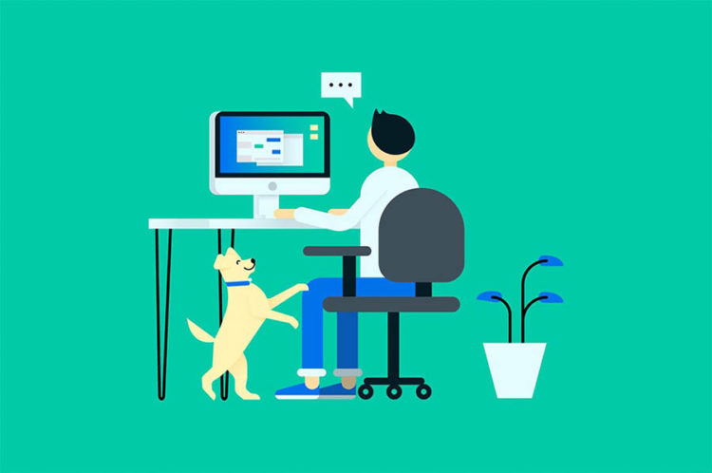
Lab From Home Safety
If you are working with 110VAC line at home
to connect small devices for lab purpose
Do not use un-grounded equipment.
Don’t cycle equipment power directly from the plugs. Use the switches.
It is your responsibility to ensure you’ve created a
space to work that is safe and healthy for you.
It is recommended that you create a space that is separate
from your regular living space, to help you have a physical
separation from work within your own home.
Fall 2020

Slide 5
Home Equipment Safety
Electrical equipment safety for lab from home
While you complete the lab from home, make sure that, the workstation has grounded electrical outlets.
Older homes may not have three-prong grounded outlets, which could be an electrical hazard particularly during lightning storms
Make sure that, the power cords are in good condition and not broken or scorched
Make sure that, the power bar surge protectors plugged in to the wall socket
Fall 2020

Slide 6
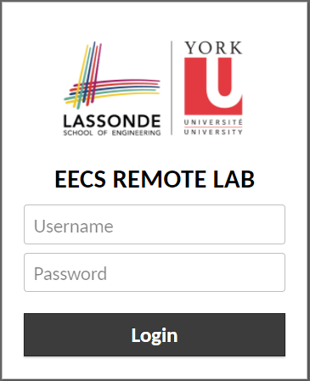
Resources for Lab from Home
EECS Remote Lab Services
EECS Remote Lab service allows you to connect to EECS lab workstations from within your web browser
It is clientless - no plugins or client software are required
Visit the EECS Remote Lab here: https://remotelab.eecs.yorku.ca/
Login to the Remote Lab using your EECS credentials.
If you are a student presently enrolled in an EECS course and do not have an EECS account, please create your account here: https://webapp.eecs.yorku.ca/activ8
Fall 2020

Slide 7
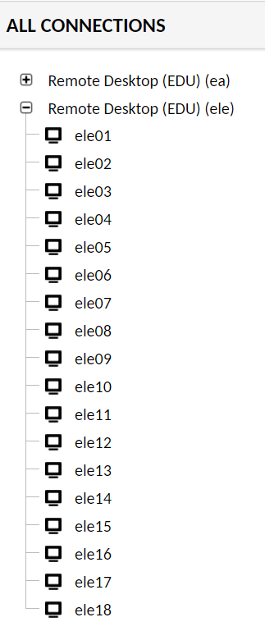
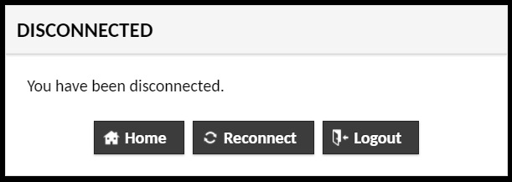
Resources for Lab from Home
EECS Remote Lab Services
Once you login to remote lab, you will see the list of ELE (BRG 334) lab computers as: ele01 – ele18
The desktops are dual boot having Windows 10 and Linux
Please note that, once you switch from Win 10 to Linux or vice versa, you will be disconnected from RemoteLab as the computer will be rebooting to switch to new mode.
Fall 2020

Slide 8
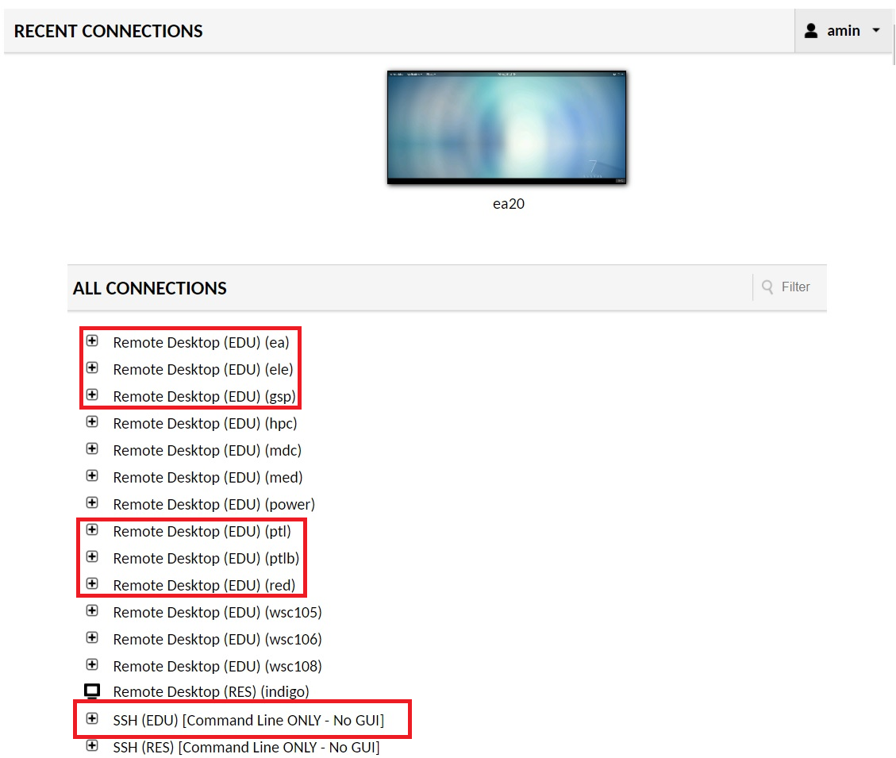
Resources for Lab from Home
EECS Remote Lab Services
Alternately EECS2200 students are also allowed to use computers in other labs.
You will also able to see other list of computers as well e.g. gsp, ptl, ea, ptlb, red etc.
Click the ‘+’ sign to expand the list
GSP (32 desktops) and PTL (32 desktops) labs are dual boot (Linux and Windows), EA (78 desktops) and PTLB (9 desktops) lab desktops are Linux, RED (3 desktops), SSH EDU is remote command line login to RED
Fall 2020

Slide 9
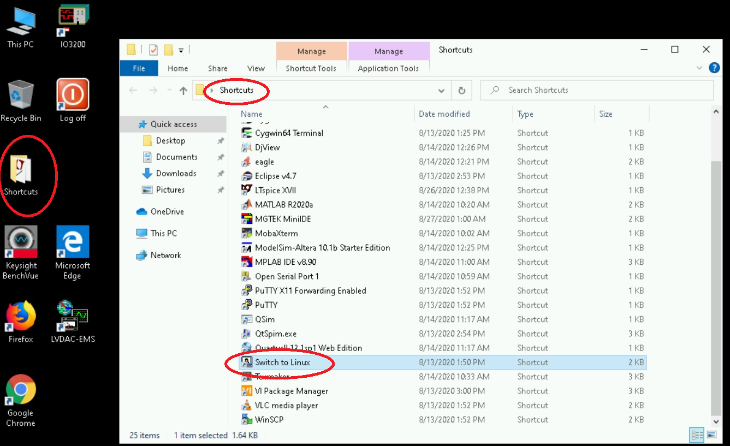
Resources for Lab from Home
Switch the desktop from
Windows 10 to Linux mode
Click the ‘Shortcuts’ folder
on the desktop
Click ‘Switch to Linux’ in the ‘Shortcuts’ folder
A new window will pop up asking permission, click yes.
Fall 2020

Slide 10
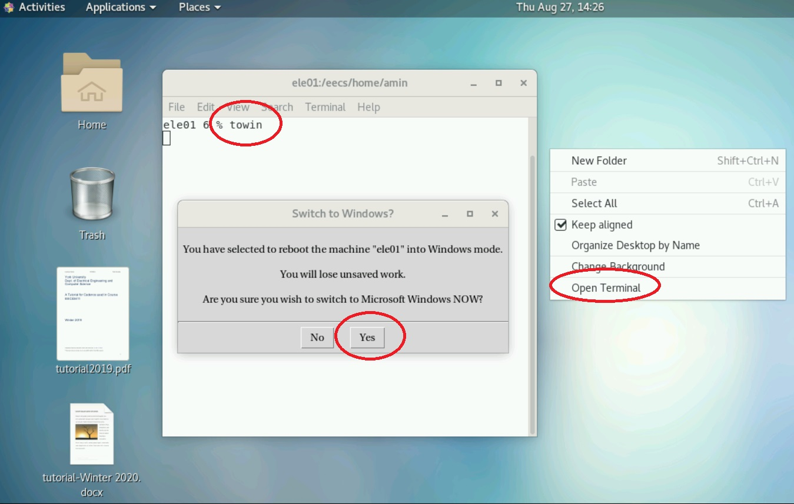
Resources for Lab from Home
Switch the desktop from
Linux to Windows 10 mode
Open a terminal
Type ‘towin’ on the terminal and hit enter
A window will pop-up to ask permission to switch to Windows.
Select yes
Fall 2020

Slide 11
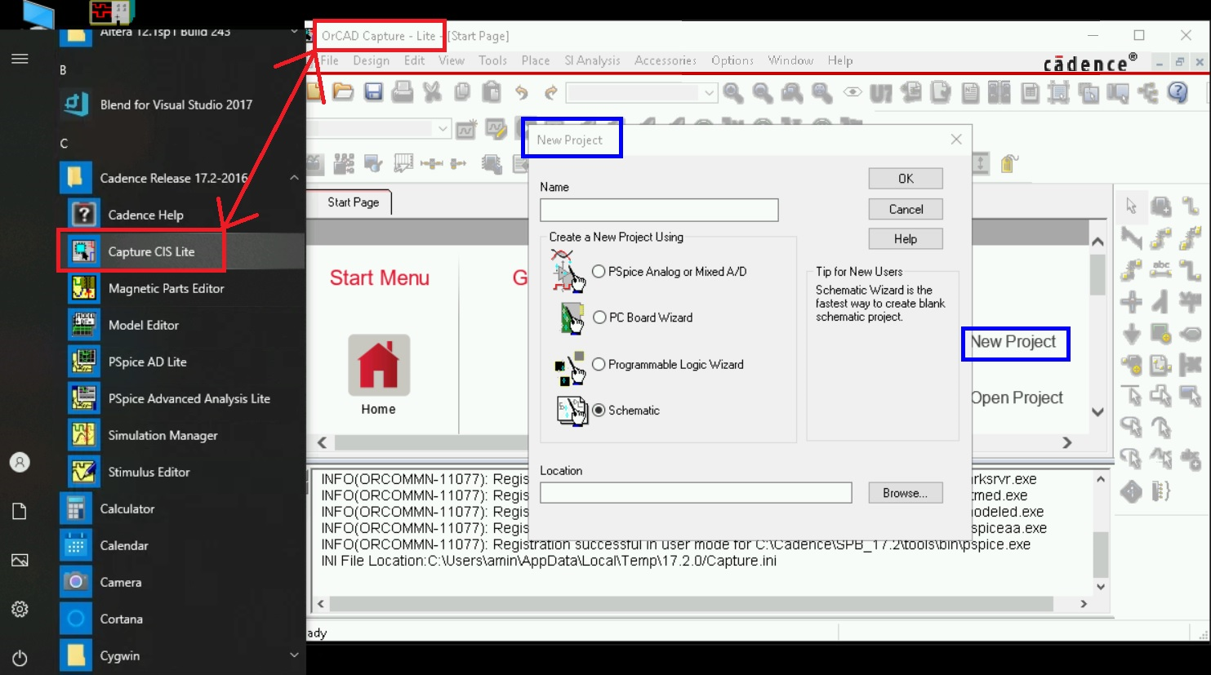
Resources for EECS2200
Software for EECS2200 lab
Most of the EECS2200 lab will be using ‘OrCAD Capture CIS Lite’ for simulation
For other lab components (e.g. video tutorial) please review eClass on Moodle
Fall 2020

Slide 12
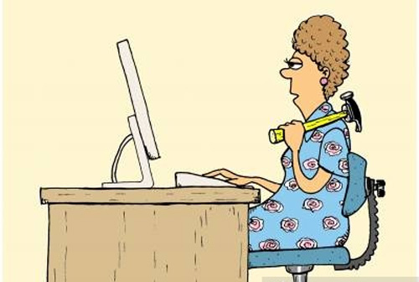
Technical Support for Lab from Home
Technical Support
Technical documentation on remotelab, EECS technical resources for lab form home, Remote access to EECS servers, ssh support, remote access with VNC, mapping network drive via ssh etc. are available on EECS wiki page:
https://wiki.eecs.yorku.ca/dept/tdb/covid19:start
https://wiki.eecs.yorku.ca/dept/tdb/services:remotelab
Contact with Tech Team
Any problems or questions using the Remote Lab should be directed to the EECS Technical Support team:
tech@eecs.yorku.ca.
Fall 2020

Slide 13
YorkU Resources for Study from Home
Please review the following links where York university provides updated academic informations in COVID-19 situations
YU Better Together:
https://yubettertogether.info.yorku.ca/
https://returntocampus.info.yorku.ca/2020/04/important-update-planning-for-the-fall-2020-term/
Mental Health Resources during COVID-19:
https://health.yorku.ca/mental-health-resources-covid19/
Off-Campus Computing:
https://uit.yorku.ca/offcampus/
2020-09-04
Safety: EECS 3451, Signals and Systems

Slide 14
Thank You!
Safety: EECS 2200, Electrical Circuits

