Slide 1
Introduction to EECS1520
Sec A: Taha Sajjad
Sec B: Onoise Gerald Kio
Sec C: Onoise Gerald Kio
Sec D: Andriy
Sec H: Hui Wang
Computer Use -- Fundamentals
F 2023 Section H. Hui Wang
Notes:
CS course for non-major students
Also told most for bio, chemrty,,, any way
My name is Hui Wang.
EECS CSE

Slide 2
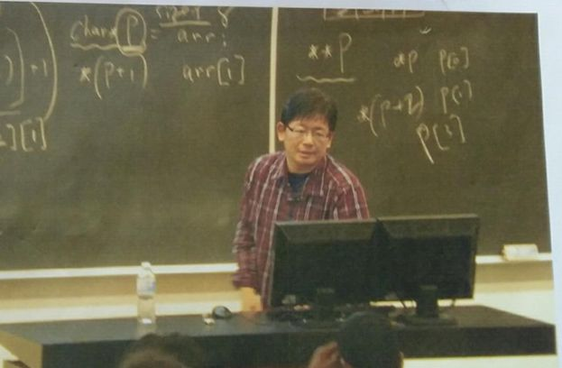
Section H. MWF 10:30-11:30
LAS B (Mon, Wed) LAS C (Fri)
Email: hui.wang@yorku.ca huiwang@eecs.yorku.ca
No eClass messages
Office hour
  Fri 11:30-12:30pm. LAS2013,
  after class
  By appointment.
Notes:
No eClass message
I will mostly turn off video to ensure smooth streaming,
if you are interested here is what I look, nothing exciting.

Slide 3
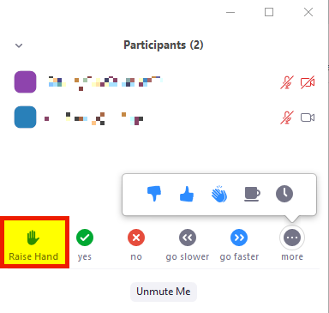


zoom online lectures (first 3 weeks so far)
MWF 2:30~3:30, 5:30~6:30 pm
keep yourself muted
questions: raise hand or use the chat window
    ‘real time’ questions will be seen and will be answered ASAP
    other questions maybe answered later
Interrupt me for critical glitches
    Lost of voice, no screen sharing
Recorded. videos will be posted hours later
privacy
    if you prefer your face not to ever be seen live, or in the recordings, disable your video and do not use a picture
  chat: for lecture-related questions only;
  no web links (use course forum for that)
Notes:
if don’t want to see video, turn off

Slide 4
website
https://eClass.yorku.ca
use the eClass (formerly Moodle until Sep 2020) page for
  Lecture links, Office hours, video links (common)
  course syllabus and outline,
  slides,
  assignments, submission links
  important dates,
  deadlines,
  announcements,
  online forum,(encouraged, rather than sending me email)
  your tentative grades,
  special consideration form (use this rather than sending emails),
  remark-request form, (use this rather than sending emails),
  and other resources
Notes:
If not first year, may seen Moodle before, change last term
If first year, just get one.
Announcement: send to the email associated with. Check that. better use yorku account
[Show eClass. Brief lecture schedule, office hour] syllabus- “Assignment 0”
Formula can even tell formula but not solutions
BTW, slides are not same as pdf, …..you are responsible for pdf only …

Slide 5
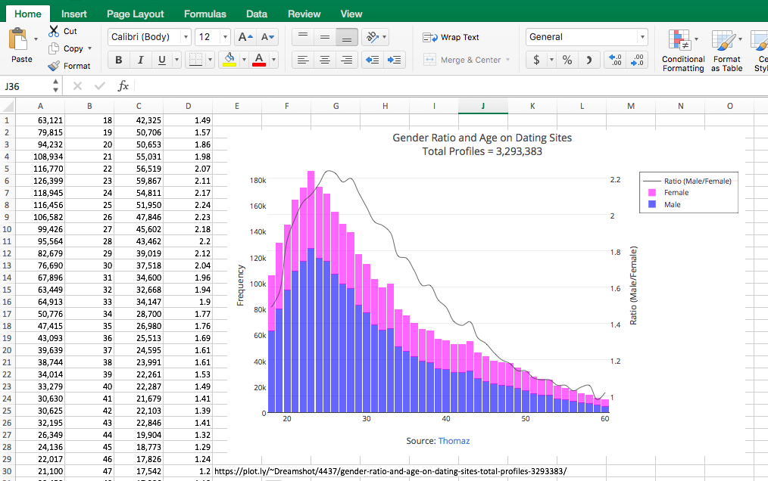
why we need this course
Computers are ubiquitous
Computers are useful
Most people are not completely aware of their capabilities (and incapabilities)
Notes:
Phone, microwave, car all computers
Buy phone, focus on memory 32 64 bits… buy computer
Show weekly expense. Sum average, max min visualize
Sqrt(2) not working excel: sqrt(16)-4 sqrt(25)-5
https://www.skipser.com/p/2/p/did-you-know-there-is-a-bug-in-windows-calculator.html

Slide 6
course outline (at a glance)
to develop a basic understanding of computer science and computer systems and their applications
  through direct experience with using a computer system and through the reading of comprehensive resources
  what this course covers is mostly general knowledge that everybody should have
to develop skills with using common applications
  such as spreadsheets, word processors, webpages, image processors, …
to develop and strengthen general problem solving skills and logical thinking
  through the use of computer tools
Notes:
We know we are not teaching programming, so general knowledge should or better
Although I like to teach progamming it is easier for me.
Skip 3

Slide 7
topics
Theory (focus of lectures)
  History of Computing
  Digital data representation (e.g., numbers, text, images, audios)
  Computer organization (e.g., gates and circuits, stored program concept)
  System administration (e.g., operating systems, and file systems)
  Computer Networking and the Internet, the WWW
Practice (assignments + lecture intro)
  Document design and creation (MS Word)
  Knowledge translation/presentation (MS Powerpoint)
  Spreadsheet design and creation (MS Excel)
  Still image manipulation (GIMP)
  Audio manipulation
  (Simple) Webpage design and creation (basic html)
Notes:
Detailed topics
History: Big pic how computers developed
Audio representation
Buy computer, memory, speed of computer when buy open word 10 sec vs 3 min, 300$ vs 1000$
Ip address router, firewall
Useful
GIMP can be considered as the free version of Photoshop – retouch pictures
Image near graduate. write report. Use excel data, image , world, use ppt to present

Slide 8
Evaluation (subject to minor changes due to course progress)
assignments 28%
  8, we consider your best 7, each 4%
tests 32%
  there are 2 tests
final exam 40%
  at fixed date/time determined by the University
  Cumulative. Tests/exam: MCQs, include assignments for the Peer Instructions
IMPORTNANT NOTE: if you are late or miss an assessment (a test, quiz, or an assignment), you will receive 0 in it,
  Tests: unless you upload a Special Consideration Form to eClass within designated deadlines.
  processed case by case. Need valid reasons. We reserve the right to ask for supporting document for
  once approved, the weight of your missing assessment is transferred to the final exam.
  no make up test, extra assignments or extra time will be provided
  Don’t do that deliberately
Notes:
Ass: as said on excel, word, ppt, etc
Asynchronous: Test 4 hours, 45min… see eClass, outline for details may not for final exam
Talk more. Don’t want you to worry too much.,..
No medical document needed. But, Deliberately: assignment easy mark why not better spread out weightage among different components..

Slide 9
Evaluation (subject to minor change due to course progress)
assignments 28%
  8 assignments, we consider your best 7, 4% each
tests 32%
  2 tests
final exam 40%
  at fixed data/time determined by the University
  Cumulative. Test/exam: MCQs, including assignments for the Peer
IMPORTNANT NOTE: if you miss a test, you will receive 0 for it,
  unless you upload a Special Consideration Form to eClass within designated deadlines
  processed case by case. Need valid reasons. We reserve the right to ask for supporting document for non-medical reasons
  once approved, the weight of your missing assessment is transferred to the final exam.
  no makeup test will be provided
  it is deemed very unusual that one missed both the two tests.
    Normally, a max of one missed test can be transferred to final exam
  don’t do that deliberately

Slide 10
available help?
for theory and practice concepts:
  course eClass page
    use slides and other resources available there, such as the online forum
  office hours
    do not let your doubts accumulate
    clarify your doubts during the lectures and office hours on a weekly basis
    note that you can go to the office hours of any instructors of the course -- everyday have at least one
  email (to your course instructor. Short problem)
    please note that it may take us 24 hours to reply to emails
    replies may sometimes be delayed before assignments or tests
Notes:
Email is for private/sensitive info.
Also not efficient for (long) explaining. Also delays, 500 students.

Slide 11
available help?
for administrative matters:
  course eClass page
    assignment deadlines and other important dates
    special consideration form are all available in the eClass page
    deadlines are firm
    if you miss any deadline, we do not accept the work by any other means, such as email
  office hours and email (to the course coordinator)
    for any administrative matter that is not addressed in the eClass page, please contact the course coordinator
    in order to comply to academic integrity and fairness, we do not make individual exceptions
Notes:
Two forms important
Online first, call
Some harsh, some nicer. To be consistent.
No exception: nearly 1000 students. Be understanding.

Slide 12
email policy
email the course coordinator only for administrative issues that have not been addressed in eClass or course outline or course forum or contain private or sensitive information
  E.g., missing grades, special accommodations
email your course instructor for short conceptual doubts that have not been addressed in eClass or course outline or course forum
  follow up in person (lecture or office hours) if you have not received a reply within a week
use your York email account
  emails sent by other accounts (yahoo, gmail, hotmail, etc.) may not be seen or replied
  you should set your eClass email to your York account, otherwise you may not receive some announcements (they may be blocked by your spam filters)
include “EECS1520” and a brief title in subject line of all your emails
include identifying and pertinent information
  your name, student number, and lecture section
  any other important information
Notes:
If Just form ok, don’t need to contact him like call center automatic
Don’t be shy
EECS1520 does matter where in the title. Even no EECS although better
Nature of the problem

Slide 13

bad email example 1
Date: Mon, 3 Dec 2018 18:39:01 -0500
From: <me@mycloud123.com>
To: armstrong@yorku.ca
Subject: [No Subject]
Are the weight of undone assignments transferred to the final exam?
Notes:
10 second. What’s wrong with this email? Hofbauser is a real prof.
In addition to being a bit rude, which I don’t care (seen ruder ones),
no course info.
can spend 15 minutes search. But
No nature of the problem
Also, name should not be different

Slide 14
bad email example 2
Date: Mon, 3 Dec 2018 18:39:01 -0500
From: <me@mycloud123.com>
To: armstrong@yorku.ca
Subject: [No Subject]
Yo Sir,
Are the weight of undone assignments transferred to the exam?
R the whts of undone assignments Xferred 2 f exam?
Notes:
10 second. What’s wrong with this email? Hofbauser is a real prof.
In addition to being a bit rude, which I don’t care (seen ruder ones),
no course info.
can spend 15 minutes search. But
No nature of the problem
Also, name should not be different

Slide 15
good email example
Date: Thu, 12 Nov 2015 16:25:06 -0500
From: <name>@my.yorku.ca
To: armstrong@yorku.ca
Subject: EECS1520 – Missed test due to personal reasons beyond my control
Parts: speicalConsiderationForm.pdf 96 KB
Good Afternoon Prof. Armstrong,
I was unable to attend Test 2. Unfortunately, I was unable to upload the completed Special Consideration Form in eClass as I missed the deadline. I know you may no longer consider it; yet, I have attached it here for your record. Please let me know if any documents can help to consider transferring the weight of my test2 to my final exam.
Sincerely,
<name> (student#: <id>), student in EECS1520 Sec C
Notes:
In addition to being polit, This email provide all the required information. and is written respectfully.

Slide 16
plagiarism
copied work will be assigned a zero grade
  both copy and original
  sometimes not immediately
  plagiarism can also result in course failure, suspension, or expulsion
  Read Senate Policy on Academic Honesty
Notes:
Even more Important in today’s online lecture
Share a story in a moment

Slide 17
collaboration
assignment discussions: encouraged
  however: implement your own solutions and understand it fully – tests usually include questions based on assignments
  may use book(s), lecture slides, internet
    however: the use of the above items is just for consultation – NEVER COPY from them
NEVER lend/borrow solutions !!!
  Changing some characters in a document, replacing some images, moving and resizing some graphs has been shown to not work
various technological means may be used to ensure academic integrity
Notes:
Not a negative word

Slide 18
how to pass EECS 1520
don’t copy assignments. Do it!
do attend classes actively
  pay attention (no social networks, chats, etc)
don’t memorize solutions – understand them
ask questions in the online forum (profs, TAs, peers are all here to help)
  Still have doubts, see any of in our office hours
practice, practice often
look it up on the internet (see next slide)
Notes:
Pay attention, don’t know if some of you are chatting, watching movies.
know it is hard to concentrate at home, but ….

Slide 19
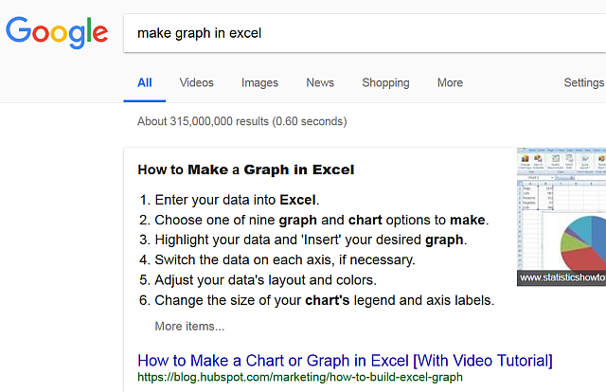
look it up
Notes:
Expand your know.
I also rely on Google.
Don’t search “1520 assignment 2” “midterm 1”.
- illegal, as discussed
- We changed

Slide 20
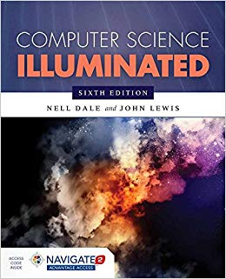
resources
We will use many web resources (we do not follow a specific textbook)
You may want to read from the following books (but they are not required)
  Computer Science Illuminated
  by Nell Dale and John Lewis, 6th ed. 2016 (or 7th,5th)
  ISBN: 9781284055917
  D is for Digital: What a well-informed person should know
  about computers and communications
  by Brian W. Kernighan, 1st ed. 2011
  ISBN: 9781463733896
  Understanding the Digital World: What You Need to Know
  about Computers, the Internet, Privacy, and Security
  by Brian W. Kernighan, 2nd ed. 2017
  ISBN: 978-0691176543
  [this is the 2nd ed. of D is for Digital]
Notes:
If want to know more other than google search, do the book. used to be textbook
Other 2 can be considered other versions of the book.

Slide 21

get microsoft office for FREE!
http://student.computing.yorku.ca/software/free-microsoft-office-365-software
total of 5 devices
available for PC, Mac, iOS, Android
Notes:
Even if you have earlier version, need to download!
It is free, newer, why not.
Later gimp

Slide 22
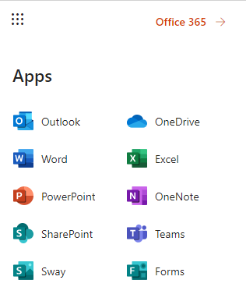
get microsoft office for FREE!
FREE Microsoft Office 365 software! | University Information Technology (UIT) (yorku.ca)
  https://uit.yorku.ca/student-services/software/free-microsoft-office-365-education-software/
total of 5 devices
available for PC, Mac, iOS, Android
Used for many assignments
Gimp later
Notes:
Even if you have earlier version, need to download!
It is free, newer, why not.
Show the link, portal
Ass1-5 give PC instruction, MAC slightly different, use forum to discuss
Later gimp

Slide 23
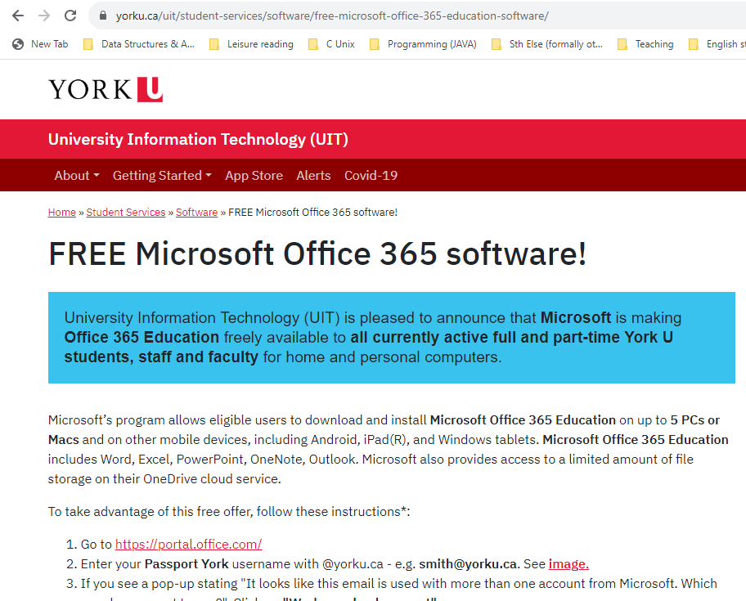
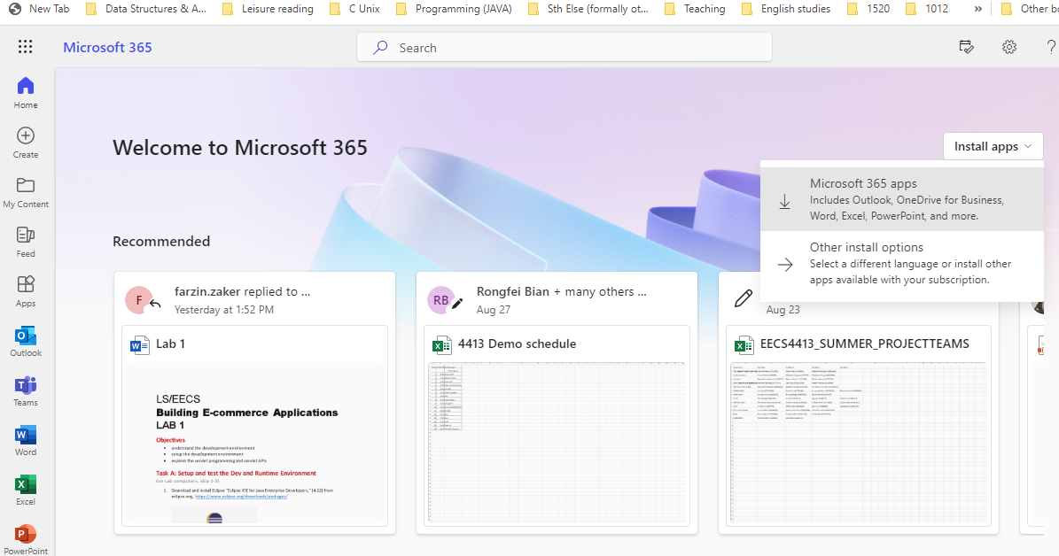
Notes:
In case cannot demo live (no time, or slow)

Slide 24
last comments for now
"..., this course is demanding in terms of time, and should not be added to an already heavy load.", quoted from the EECS Calendar
even though slides and many other resources are available online, not actively attending lectures, course forum, or office hours could severely impact your grade
The final average in this course has often been a C in last terms; it’s not easy to get an A or A+.
Notes:
Especially you want to ace a A, A+
At least watch videos.
Miss one is okay, miss 7 will not be okay.

Slide 25
Any questions so far?
  Type in chat box
  Also during lectures
“Assignment 0”
Notes:
Leave the questions at the end?

