Slide 1
EECS2031 B
Software Tools
W 2023
Feb 7, 2023 Lecture 9
Notes:
Before reading week

Slide 2
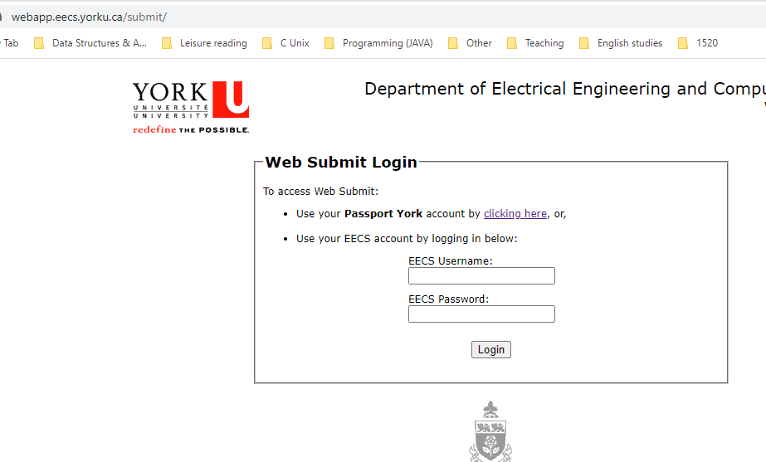

Lab4, more questions added after class.
Web-submit.
Use EECS account
Notes:
Show it

Slide 3
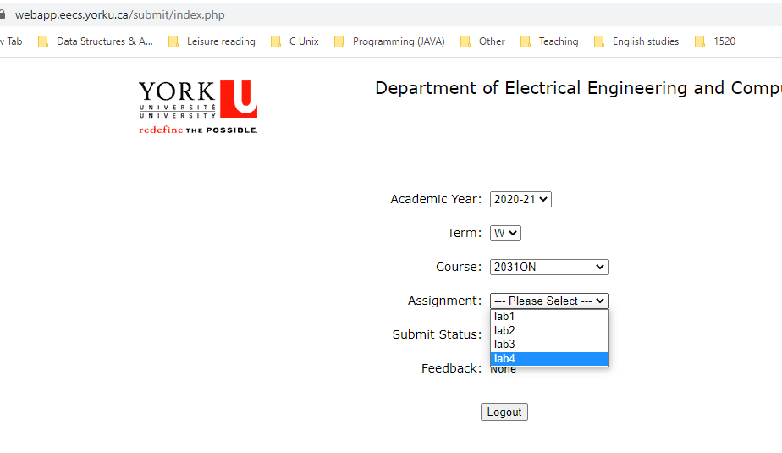
Lab4, more questions added after class.
Web-submit.
Notes:
Show it

Slide 4
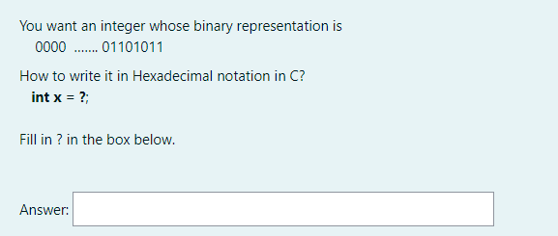
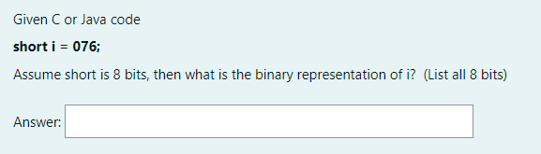
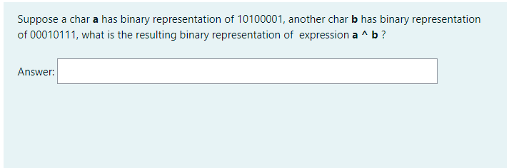
0X6B
00111110
10110110
Notes:
6B 00111110

Slide 5
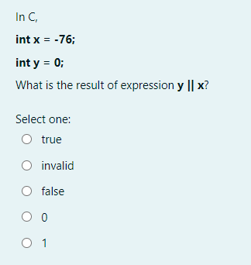
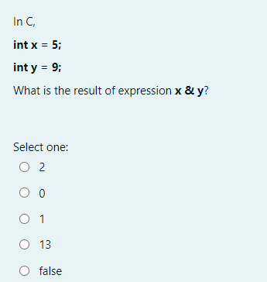
Notes:
1 1

Slide 6
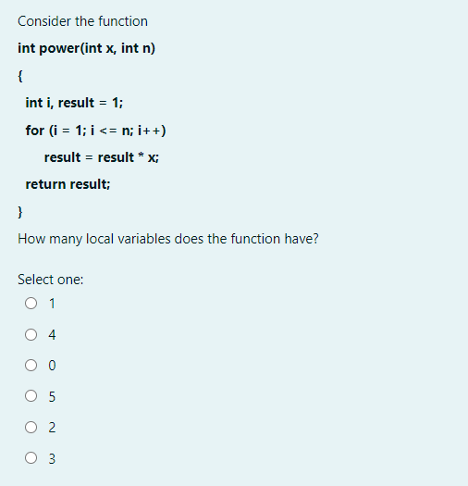
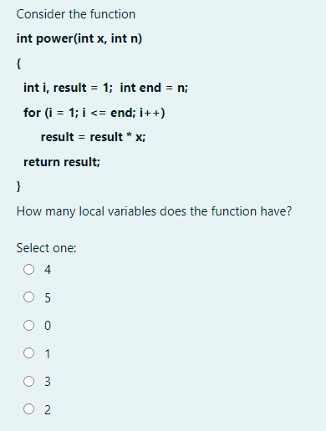
Notes:
4 We will do another small quiz if we have time

Slide 7
Ch2 wrap up
C program structure – Functions (ch4)
  Communication
  “Pass-by-value”
Categories, scope and lifetime of variables (ch4)
C Preprocessing (ch4)
Recursions (ch4)
Other C material before pointer
  C library functions
  2D array
Last week

Slide 8

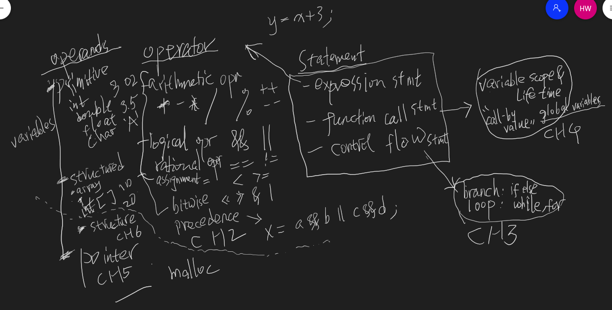
Roadmap -- How the topics are related
Global variables

Slide 9
Program structure -- Functions
A function is a set of statements that may have:
  a number of parameters --- values that can be passed to it
  a return type that describes the value of this function in an expression
Communication between functions
  by arguments and return values
  by external variable (ch1.10, ch4.3)
Functions can occur
  in a single source file
  in multiple source files

Slide 10

Functions communication by external variables one more example
#include <stdio.h>
int resu; /* external variable */
void increase (){
  resu += 100; /* grab resu */
  }
  void decrease(){
  resu -= 30; /* grab resu */
  }
int main(){
resu = 50;
increase();
decrease();
printf("%d", resu); // ? 120
}
Easier communication

Slide 11
Program structure -- Functions
A function is a set of statements that may have:
  a number of parameters --- values that can be passed to it
  a return type that describes the value of this function in an expression
Communication between functions
  by arguments and return values
  by external variable (ch1.10, ch4.3)
Functions can occur
  in a single source file
  in multiple source files

Slide 12
Multiple source files
?
Can call a function defined in another file. How
functions.c
main.c
int sum (int x, int y)
{
return x + y;
}
#include <stdio.h>
int main(){
int x =2, y =3;
printf("%d + %d = %d\n",
x,y,sum(x,y));
}
C program with two source files
gcc f1.o f2.c

Slide 13
Multiple source files
?
Can call a function defined in another file. How
functions.c
main.c
int sum (int x, int y)
{
return x + y;
}
#include <stdio.h>
#include "functions.c"
int main(){
int x =2, y =3;
printf("%d + %d = %d\n",
x,y,sum(x,y));
}
Works, but not a good practice
gcc f1.o f2.c
gcc main.c
https://stackoverflow.com/questions/31002266/why-we-should-not-include-source-files-in-c/31002641
Notes:
Don’t do it in job interview

Slide 14
Multiple source files
Declaring a function before using it, if defined in
library e.g., include <stdio.h>
later in the same source file
another source file of the program
functions.c
main.c
int sum (int x, int y)
{
return x + y;
}
#include <stdio.h>
extern int sum(int, int);
// declare
int main(){
int x =2, y =3;
printf("%d + %d = %d\n",
x,y,sum(x,y));
}
‘extern’ can be omitted (for function)
To compile: gcc main.c functions.c
gcc functions.c main.c gcc f1.o f2.c

Slide 15
Multiple source files
Declaring a function or global variable before using it, if defined in
library e.g., include <stdio.h>
later in the same source file
another source file of the program
Can use a global variable defined in another file.
How Declare it!
?
‘extern’ can be omitted (for function)
functions.c
main.c
//define global variable
int resu;
// define functions
int sum (int x, int y)
{
resu = x + y;
}
#include <stdio.h>
extern int sum(int, int);
extern int resu; // declare
int main(){
int x =2, y =3;
sum(x,y);
printf("%d\n", resu);
}
To compile: gcc main.c functions.c
gcc functions.c main.c gcc f1.o f2.c

Slide 16
C program structure – Functions
  Communication
  Pass-by-value
Categories, scope, lifetime and initialization of variables (and functions)
C Preprocessing
Recursions
Notes:
Added after class

Slide 17
Call (pass)-by-Value
In C (and JAVA), all functions are call-by-value
  Values of the arguments are passed to functions, but not the arguments themselves (call-by-reference)
…
int i =3
int j = 4
k = sum(i,j)
…
…
int sum (int x, int y)
{
int s = x + y;
return s;
}
main(){
int i=3, j=4, k;
k = sum(i,j);
}
copy
running main()
call sum()
copy
int x
running sum()
int y
17

Slide 18
Call (pass)-by-Value
In C (and JAVA), all functions are call-by-value
  Values of the arguments are passed to functions, but not the arguments themselves (call-by-reference)
…
int i =3
int j = 4
k = sum(i,j)
…
…
int sum (int x, int y)
{
int s = x + y;
return s;
}
main(){
int i=3, j=4, k;
k = sum(i,j);
}
copy
running main()
call sum()
copy
int x = i
running sum()
int y = j
18

Slide 19
Call (pass)-by-Value
In C (and JAVA), all functions are call-by-value
  Values of the arguments are passed to functions, but not the arguments themselves (call-by-reference)
…
int i =3
int j = 4
k = sum(i,j)
…
…
int sum (int x, int y)
{
int s = x + y;
return s;
}
main(){
int i=3, j=4, k;
k = sum(i,j);
}
copy
running main()
call sum()
copy
int x = 3
running sum()
int y = 4
19

Slide 20
Call (pass)-by-Value
In C (and JAVA), all functions are call-by-value
  Values of the arguments are passed to functions, but not the arguments themselves (call-by-reference)
…
int i =3
int j = 4
k = sum(i,j)
…
…
int sum (int x, int y)
{
int s = x + y;
return s;
}
main(){
int i=3, j=4, k;
k = sum(i,j);
}
copy
running main()
call sum()
copy
int x = 3
running sum()
int y = 4
int s = 7
20

Slide 21
Call (pass)-by-Value
In C (and JAVA), all functions are call-by-value
  Values of the arguments are passed to functions, but not the arguments themselves (call-by-reference)
…
int i =3
int j = 4
k = 7
…
…
int sum (int x, int y)
{
int s = x + y;
return s;
}
main(){
int i=3, j=4, k;
k = sum(i,j);
}
copy
running main()
call sum()
copy
int x = 3
running sum()
int y = 4
int s = 7
21
Notes:
Behind scene,

Slide 22

Write a short program to determine if a language is pass-by-value or pass-by-reference
Simple
void increment(int x)
{
x = x + 1;
}
void main( ) {
  int a=1;
  increment(a);
  print a;
}
Output 1:
Output 2:
pass by value
pass by reference

Slide 23
Call-by-Value does this code work?
void increment(int x, int y)
{
x ++;
y += 10;
}
void main( ) {
  int a=2, b=40;
  increment( a, b);
  printf("%d %d", a, b);
}
…
int a =2
int b = 40
running main()

Slide 24
Call-by-Value does this code work?
void increment(int x, int y)
{
x ++;
y += 10;
}
void main( ) {
  int a=2, b=40;
  increment( a, b);
  printf("%d %d", a, b);
}
Pass by value !!!
…
int a =2
int b = 40
…
int x = a= 2
int y = b=40
…
running main()
copy
running increment()
copy

Slide 25
Call-by-Value does this code work?
void increment(int x, int y)
{
x ++;
y += 10;
}
void main( ) {
  int a=2, b=40;
  increment( a, b);
  printf("%d %d", a, b);
}
same in Java
a b not incremented !
Pass by value !!!
…
int a =2
int b = 40
…
int x = 2
int y =40
…
running main()
running increment()
→ 3
→ 50
2 40

Slide 26
Call-by-Value does this code work?
void increment(int x, int y)
{
x ++;
y += 10;
}
void main( ) {
  int a=2, b=40;
  increment( a, b);
  printf("%d %d", a, b);
}
…
int a =2
int b = 40
…
running main()
….
call increment()
….
Notes:
Challeng, limit?
Before work, as it returns
ask,: result of a b

Slide 27
Call-by-Value does this code work?
void increment(int x, int y)
{
x ++;
y += 10;
}
void main( ) {
  int a=2, b=40;
  increment( a, b);
  printf("%d %d", a, b);
}
Pass by value !!!
…
int a =2
int b = 40
int x = a= 2
int y = b=40
…
running main()
….
call increment()
copy
….
running increment()
copy

Slide 28
Call-by-Value does this code work?
void increment(int x, int y)
{
x ++;
y += 10;
}
void main( ) {
  int a=2, b=40;
  increment( a, b);
  printf("%d %d", a, b);
}
same in Java
a b not incremented !
Pass by value !!!
…
int a =2
int b = 40
int x = 2
int y =40
…
  printf("%d %d", x, y);
running main()
….
call increment()
….
running increment()
→ 3
→ 50
2 40
Notes:
Shows that simply passing parameter will not work
Same in Java

Slide 29
C program structure – Functions
  Communication
  Pass-by-value
Categories, scope, lifetime and initialization of variables (and functions)
C Preprocessing
Recursions

Slide 30

Scope
Scope of a name (variable or function) – the part of program within which the name can be used – spatial property
Global variable (and functions) are all global! Outside any (other) function
Automatic (local) variables: only exist within their blocks (main, loop...):
……
  {
  int x;
  ……
  {
  int y; /* y defined here */
  ……
  }
  …… /* y not accessible here */
  }
  x++; /* x not accessible here */
same in Java
i c defined in for loop.
not accessible after loop

Slide 31
Lifetime (storage duration) -- temporal property automatic (local) variables
Come to life (allocated) the moment the function it is in is invoked/activated.
Vanishes (deallocated) when the enclosing function returns!!!
Values are not retained between function calls.
…
int i =3
int j = 4
k = sum(i,j)
int sum (int x, int y)
{
int s = x + y;
return s;
}
main(){
int i=3, j=4, k;
k = sum(i,j);
printf ("Sum is %d",k);
}
call sum()

Slide 32
Lifetime – (storage duration) automatic (local) variables
Come to life (allocated) the moment the function it is in is invoked/activated,
Vanishes (deallocated) when the enclosing function returns!!!
Values are not retained between function calls.
…
int i =3
int j = 4
k = sum(i,j)
int x = i = 3
int y = j = 4
int s = 7
…
int sum (int x, int y)
{
int s = x + y;
return s;
}
main(){
int i=3, j=4, k;
k = sum(i,j);
printf ("Sum is %d",k);
}
vanish after sum() returns
Notes:
That is why called automatic

Slide 33
Lifetime – (storage duration) automatic (local) variables
Come to life (allocated) the moment the function it is in is invoked/activated,
Vanishes (deallocated) when the enclosing function returns!!!
Values are not retained between function calls.
…
int i =3
int j = 4
k = 7
int sum (int x, int y)
{
int s = x + y;
return s;
}
main(){
int i=3, j=4, k;
k = sum(i,j);
printf ("Sum is %d",k);
}
vanish after sum() returns
i j?
Notes:
Automatic. i j same fate eventually

Slide 34
Lifetime – (storage duration) automatic (local) variables
void unique_int(void) {
int counter = 0;
printf("%d", counter);
counter++;
}
main(){
unique_int(); // 0
……
unique_int(); // 0
unique_int(); // 0
The value of local variable counter is not preserved between calls to “unique_int()”
By end of function, counter is 1, but then vanishes.
Every function call creates a brand new counter
Notes:
Another memory. Come to life
Someone ask if same memory, Maybe same mempory may be otheres

Slide 35
Lifetime external (global) variables
Permanent, as long as the program stays in memory
  Retain values from one function to the next
Can be used as an alternative for communication data between functions
But use it with caution!
int counter = 0;
void unique_int(void) {
printf("%d", counter);
counter++;
}
main(){
unique_int(); // 0
unique_int(); // 1
……
unique_int(); // 2

Slide 36
static declaration
static keyword have different meanings
  For a global variable or function, hide it from other files. Limit the scope to the rest of the source file (only)
    static int resu;
  For a local variable, make its lifetime persistent
  function(){
  static int i; // will not vanish
  }
Notes:
Get complicated

Slide 37
static declaration
static keyword have different meanings
For a global variable or function,
  hide it from other files. Limit the scope to the rest of the source file (only)
    static int resu;
For a local variable,
  make its lifetime persistent
  function(){
  static int i; // will not vanish
  }

Slide 38
static (Hiding global variable)
calc.c
main.c
int x;
static int y;
void func1 (void)
{
x--;
y++; /* y still be
accessed (later) in
this file */
}
#include <stdio.h>
extern void func1(void);
extern int x;
extern int y;
int main(){
x = 5; y = 10;
func1()
printf("%d %d\n", x,y);
}
What are outputs? Does not compile -- " undefined reference to 'y' "

Slide 39
static (Persistent local variables)
void unique_int(void) {
static int counter = 0;
printf("%d", counter);
counter++;
}
main()
unique_int(); // 0
unique_int(); // 1
unique_int(); // 2
The value of local variable counter is preserved between calls to “unique_int()”. counter is not dead!
void unique_int(void) {
static int counter;
printf("%d", counter);
counter++;
}
Initial value of counter
printf("%d",counter);
?
Notes:
Like global, in terms of maintaining values between class, but scope is still local

Slide 40

static (Persistent local variables)
void unique_int(void) {
static int counter = 0;
printf("%d", counter);
counter++;
}
main()
unique_int(); // 0
…
unique_int(); // 1
unique_int(); // 2
The value of local variable counter is preserved between calls to “unique_int()”. counter is not dead!
int unique_int(void) {
static int counter;
printf("%d", counter);
counter++;
}
Initial value of counter
printf("%d",counter);
?
Notes:
Like global in terms of having persistent lifetime, and maintaining values
Now draw
Guess last code

Slide 41
Initialization of variables
For global (static or not) variable and static local variable
  Initialization takes place at the compiling time before program is invoked
  Initialized to 0 for int if no explicit initial value is given
    So first call to unique_int()returns 0 even counter not initialized
int resu;
void decrease(){
  resu -= 30;
  }
int main(){
decrease();
printf("%d", resu);
} // -30
int unique_int(void) {
static int counter;
printf("%d", counter);
counter++;
}
unique_int(); 0
unique_int(); 1
unique_int(); 2
global
static local
Notes:
4 kinds of variables

Slide 42

Initialization of variables
For regular (non-static) local variables
  If no explicit initial value, initial values are undefined (not initialized for you). May get garbage value.
  int counter; /* counter could be 45873972 */
  while ( (c = getchar()) != EOF){
  counter++;
  }
Compiles, but weird results
  arr[20];
  int index; /* index could be 873972 */
  while (index < 20){
  arr[index]=0;
  index++;
}
Java also doesn’t initialize local variables, but let you know. ‘variable index might not have been initialized’

Slide 43
Initialization of variables
For regular (non-static) local variables
  If no explicit initial value, initial values are undefined (not initialized for you). May get garbage value.
  int occurrence(char arr[], char c){
  int count; int i;
  for(i=0; arr[i]!= '\0'; i++)
  if(arr[i] == c)
  count++;
  return count;
Compiles, but weird results
int length(char arr[]){
int i; /* i could be 1873972 */
while (arr[i] != '\0')
i++;
return i;
}
Java also doesn’t initialize local variables, but let you know. ‘variable index might not have been initialized’
Notes:
Added 21F
Length may crush

Slide 44
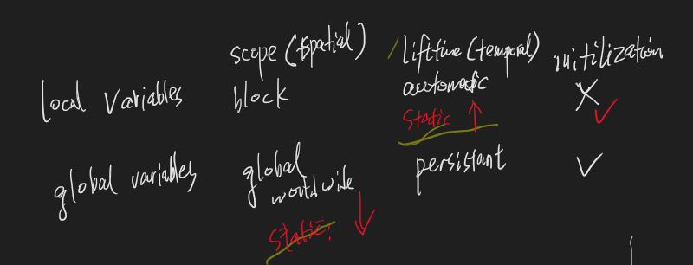
Summary of Categories, scope, life time and initialization of variables
Four different categories
  External (global) variable
  static global variable
  Local (automatic, internal) variable
  static local variable
What are the difference between them, in terms of
  scope
  lifetime
  initialization
Notes:
Write part

Slide 45
C program structure – Functions (ch4)
  Communication
  “Pass-by-value”
Categories, scope and lifetime of variables (ch4)
C Preprocessing (ch4)
Recursions (ch4)
Other C material before pointer
  C library functions
  2D array
Last lecture

Slide 46
Below pre-processing from LMY 19SU
  last time cover this

Slide 47
How C Programs are Compiled
C programs go through three stages to be compiled:
  Preprocessor - handles #include and #define etc
  Compiler - converts C code into binary processor instructions (“object code”)
  Linker - puts multiple files together, load necessary library functions (e.g., printf), and creates an executable program
preprocessor
compiler
linker
hello.c
hello.o
a.out
Handles
#include
#define

Slide 48



How C Programs are Compiled
C programs go through three stages to be compiled:
  Preprocessor - handles #include and #define etc
  Compiler - converts C code into binary processor instructions (“object code”)
  Linker - puts multiple files together, load library function (e.g. printf, strlen) and creates an executable program
preprocessor
compiler
linker
hello.c
hello.o
a.out

Slide 49
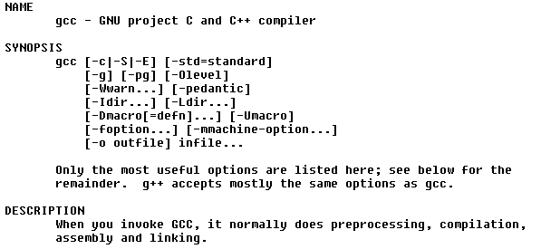
“manual”. Get used to it for help!

Slide 50
The c preprocessor
Pre-process c files before compiling it
  Handles #define and #include
    also #undefine, #if, #ifdef, #ifndef …
  Removes comments
  Output c code (to compiler)
called macros

Slide 51
Pre-processing #include #define
#include <file> -- include <stdio.h> which is library header file
#include “file” -- include "file.h" which is programmer defined
includes another file in the current file as if contents were part of the current file
  Textual replace/copy. Nothing fancy
file. .header file, which is just c code, usually contains
  Function Declarations
  External variable declaration
  Macro definitions #define
Do it in one spot so other files can just include the header file
Notes:
We will not use header much

Slide 52
Header file
file .header file, which is just c code, usually contains
  Function Declarations
  External variable declaration
  Macro definitions #define
Textual replace/copy
extern int printf ()
extern int scanf()
extern int getchar()
extern int putchar()
int sprintf () ….
#define EOF -1
….
#include <stdio.h>
main()
{
int i=2;
printf("%d\n",i);
}

Slide 53
Header file
cal.c
main.c
int x;
int y;
void func1 (void)
{
x--;
y++;
}
#include <stdio.h>
extern int x
extern int y;
void func1(void);
int main(){
y = 10; x = 5;
func1()
printf("%d %d\n", x,y);
}
gcc cal.c main.c
What are printed? 4 11
Notes:
recall

Slide 54
Header file
file.h
Better way
put declarations in a .h file
shared by all user files
extern int x
extern int y;
void func1(void);
cal.c
main.c
int x;
int y;
void func1 (void)
{
x--;
y++;
}
#include <stdio.h>
#include "file.h"
int main(){
y = 10; x = 5;
func1()
printf("%d %d\n", x,y);
}
gcc cal.c main.c // gcc only .c files

Slide 55
Header file
file.h
Better way
put declarations in a .h file
shared by all user files
extern int x
extern int y;
void func1(void);
cal.c
main.c
int x;
int y;
void func1 (void)
{
x--;
y++;
}
#include "file.h"
….
abc.c
#include "file.h"
….
def.c
#include "file.h"
….

Slide 56
#define
#define defines macros
macros substitute one value for another
e.g.
#define IN 1
state = IN;
becomes
state = 1;
#define IN = 1 // IN -> = 1
#define IN 1; // IN -> 1;

Slide 57
#define directive
Syntax #define name value
  name called symbolic constant, conventionally written in upper case
  value can be any sequence of characters
    #define Pi 3.1415
    main() {
    int i = 10 + Pi;
    }
    #define SIZE 10
    main() {
    int k [SIZE];
    }
Textual replacement
  try yourself by cpp file.c or cpp file.c > outputFile
  gcc –E file.c gcc –E file.c > outputFile
main() {
  int i = 10 + 3.1415;
}
main() {
  int k[10];
}
Java: final int SIZE = 10;

Slide 58
#define -- parameterized
Macros can also have arguments
e.g.
#define TRIPLE(x) 3 * x
y = TRIPLE(4);
becomes
y = 3 * 4;
#define SQUARE(x) x*x
y = SQUARE(5);
becomes
y = 5*5;
e.g., #define MY_PRINT(x,y) printf("%d %d\n", x,y)
MY_PRINT(3,5);
becomes
printf("%d %d\n", 3,5);
Notes:
Something new,
show in terminal
Similar to function, but will show soon, not exactly

Slide 59
#define – Be careful with operators
double overpi = 1/ TWO_PI;
becomes
double overpi = 1/2*3.14; // 0 (!)
Fix: Use parentheses defensively, e.g.
#define TWO_PI (2*3.14)
double overpi = 1/ TWO_PI;
becomes
double overpi = 1/(2*3.14); // 0.123..
#define TWO_PI 2*3.14
1.0/ TWO_PI;?
Rule1: if replacement list contains operator, use () around whole replacement list

Slide 60

#define – parameterized. Be careful with arguments
#define TRIPLE(x) 3 * x
y = TRIPLE(5+2);
becomes
y= 5+2 * 3; // 11 (!)
Fix: Use parentheses defensively, e.g.
#define TRIPLE(x) ((x) * 3 )
y= TRIPLE(5+2);
becomes
y= ((5+2) * 3); // 21
Rule2: for parameterized, put () around each parameter occurrence in the replacement list
Notes:
Lets do it

Slide 61

#define – parameterized. Be careful with arguments
#define TRIPLE(x) 3 * x
y = TRIPLE(5+2);
becomes
y= 5+2 * 3; // 11 (!)
Fix: Use parentheses defensively, e.g.
#define TRIPLE(x) ((x) * 3 )
y= TRIPLE(5+2);
becomes
y= ((5+2) * 3); // 21
#define SQUARE(x) x*x
y = SQUARE(5+2);
Rule2: for parameterized, put () around each parameter occurrence in the replacement list
Notes:
Lets do it

Slide 62
#define – parameterized. Be careful with arguments
#define TRIPLE(x) 3 * x
y = TRIPLE(5+2);
becomes
y = 3 * 5+2; // 17 (!)
Fix: Use parentheses defensively, e.g.
#define TRIPLE(x) ( 3 * (x) )
y = TRIPLE(5+2);
becomes
y = ((5+2) * 3); // 21
1/TRIPLE(3.4+2)
1.0/TRIPLE(3+2)
500/TRIPLE(3+2)
Rule2: for parameterized, put () around each parameter occurrence in the replacement list
Notes:
Enough?

Slide 63
#define – parameterized. Be careful with arguments
#define SQUARE(x) x*x
y = SQUARE(5+2);
becomes
y = 5+2*5+2; // 17 (!)
Fix: Use parentheses defensively, e.g.
#define SQUARE(x) ((x)*(x))
y = SQUARE(5+2);
becomes
y = ((5+2)*(5+2)); // 49
1/SQUARE(3.4+2)
1.0/SQUARE(3+2)
500/SQUARE(3+2)
Rule2: for parameterized, put () around each parameter occurrence in the replacement list

Slide 64
C preprocessor predefined macro names
__LINE__
__FILE__
__DATE__
__TIME__
#include <stdio.h>
main(){
printf("%s %s\n", __TIME__, __DATE__);
printf("File: %s Line: %d\n", __FILE__,__LINE__);
}
21:45:54 Feb 6 2021
File: macro.c Line:4
Useful for debugging

Slide 65
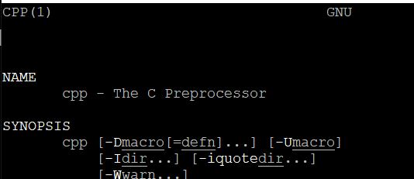
Playing with the C Preprocessor
Try:
gcc -E hello.c
gcc –E hello.c > output.txt
-E means “just run the preprocessor”
Also cpp file.c

Slide 66
Below recursions from last term L10

Slide 67
C program structure – Functions (ch4)
  Communication
  “Pass-by-value”
Categories, scope and lifetime of variables (ch4)
C Preprocessing (ch4)
Recursions (ch4)
Other C material before pointer
  C library functions
  2D array
Last lecture
Notes:
Any one does not know recursion at all?

Slide 68
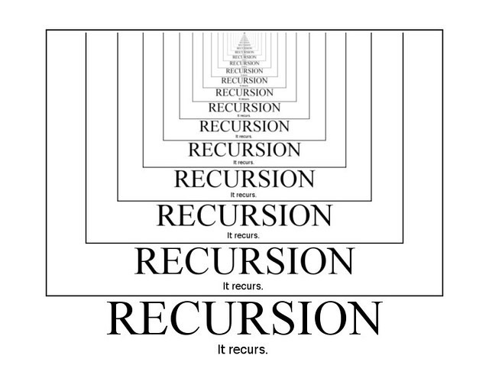

Think recursively
Notes:
One think recursively, implementation is usually straightforward
Assume Solution Smaller version of the problem

Slide 69

Think recursively
“how many people are there, from you to the end of line?”
“ 1 + the answer of the guy behind me“

Slide 70



Recursive Algorithm: smaller instance
  Assume you have an algorithm that works.
  Use it to write an algorithm that works.
To get into my house
I must get the key from a smaller house
Assume I made it.
Notes:
Assume smaller version, I get in

Slide 71
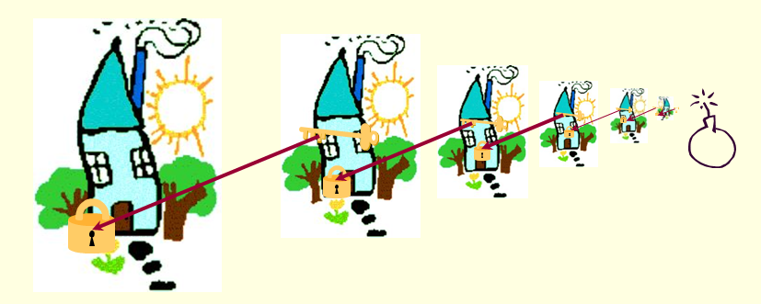
Recursion
getIn (house A) // Java
{
getIn (smaller house on the right)
pick up key for house A
open A;
}
“To get into my house
I must get the key from a smaller house
Notes:
Has a problem – base case

Slide 72
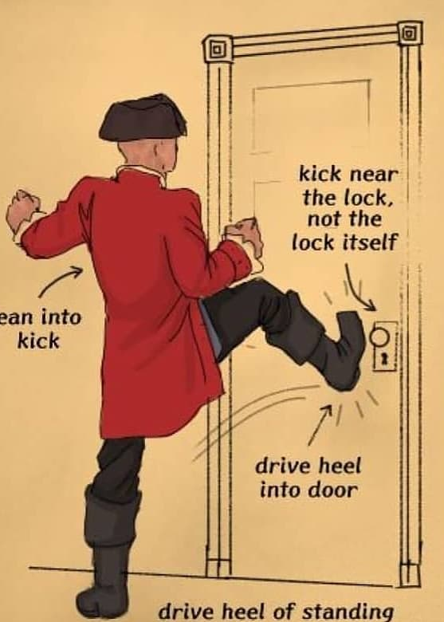
Recursive Algorithm: base cases
  Assume you have an algorithm that works.
  Use it to write an algorithm that works.
Use brute force
to get into
the smallest (shabbiest) house.

Slide 73
Recursion
getIn (house A) // Java
{
if (A is the last/smallest)
get in using brute force;
else
getIn (house on the right)
pick up key for A
open A;
}
“To get into my house
I must get the key from a smaller house
Notes:
Break the door

Slide 74
Recursion
“To get into my house
I must get the key from a smaller house
int length (string s) // Java
{ if (s contains no letter)
return 0;
//else
return 1 + length(substring on the right);
}
length(“ABCD”)
= 1 + length(“BCD”)
= 1 + ( 1 + length(“CD”))
= 1 + ( 1 + ( 1 + length(“D”)))
= 1 + ( 1 + ( 1 + (1+ length(“”) )))
= 1 + ( 1 + ( 1 + (1+ 0 ))) = 4
Notes:
The girl’s problem. anwswers. Once got recursive thinking, coding is usually trivial

Slide 75

Recursion
“To get into my house
I must get the key from a smaller house
static int length (String s)
{ if (s.equals("") // contains no letter
return 0;
return 1 + length(s.substring(1));
}
length(“ABCD”)
= 1 + length(“BCD”)
= 1 + ( 1 + length(“CD”))
= 1 + ( 1 + ( 1 + length(“D”)))
= 1 + ( 1 + ( 1 + (1+ length(“”) )))
= 1 + ( 1 + ( 1 + (1+ 0 ))) = 4
C version?

Slide 76
static int length ("ABCD")
{
if ("ABCD".equals("")
return 0;
return 1 + length("ABCD".substring(1));
}
static int length ("BCD")
{
if ("BCD".equals("")
return 0;
return 1 + length("BCD".substring(1));
}
3
4
2
int a = length("ABCD")
static int length ("CD")
{
if ("CD".equals("")
return 0;
return 1 + length("CD".substring(1));
}
System.out.println(a);
static int length ("D")
{
if ("D".equals("")
return 0;
return 1 + length("D".substring(1));
}
1
static int length ("")
{
if ("".equals("")
return 0;
return 1 + length(s.substring(1));
}
0

Slide 77
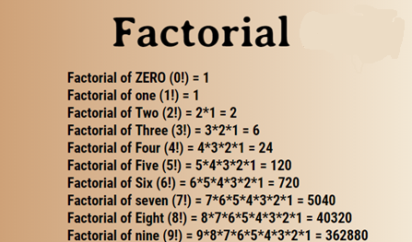
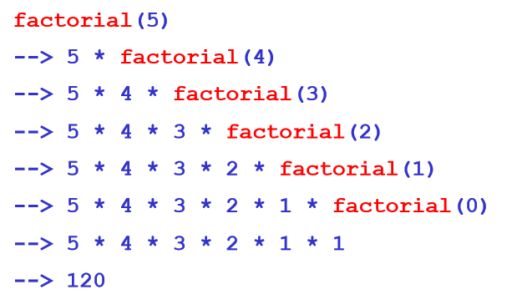
Recursion
C supports recursion
Think/define recursively `
int factorial (int n)
{
if(n == 0) /* base case */
return 1;
else
return n * factorial (n – 1);
}
Notes:
Naturally defined recursively,
Not even need to think recursively

Slide 78
static int factorial (4)
{
if(4 == 0) /* base case */
return 1;
return 4 * factorial (4 – 1);
}
Program trace, more details
static int factorial (3)
{
if(3 == 0) /* base case */
return 1;
return 3 * factorial (3 – 1);
}
6
24
2
static int factorial (2)
{
if(2 == 0) /* base case */
return 1;
return 2 * factorial (2 – 1);
}
int a = factorial(4)
1
static int factorial (1)
{
if(1 == 0) /* base case */
return 1;
return 1 * factorial (1 – 1);
}
1
static int factorial (0)
{
if(0 == 0) /* base case */
return 1;
return n * factorial (0 – 1);
}
Notes:
Base case is critical

Slide 79
int a = factorial(4)
 | 100 | main method
a |  | factorial(4)
main()
call/execution/program stack

Slide 80
int a = factorial(4)
 | 100 | main method
a |  | factorial(4)
 | 600 | factorial method
n |  | 4
result |  | 4 * factorial(3)
fact(4)
main()
call/execution/program stack

Slide 81
int a = factorial(4)
 | 100 | main method
a |  | factorial(4)
 | 750 | factorial method
n |  | 3
result |  | 3 * factorial(2)
 | 600 | factorial method
n |  | 4
result |  | 4 * factorial(3)
fact(3)
fact(4)
main()
call/execution/program stack

Slide 82
int a = factorial(4)
 | 100 | main method
a |  | factorial(4)
 | 800 | factorial method
n |  | 2
result |  | 2 * factorial(1)
 | 750 | factorial method
n |  | 3
result |  | 3 * factorial(2)
fact(2)
 | 600 | factorial method
n |  | 4
result |  | 4 * factorial(3)
fact(3)
fact(4)
main()
call/execution/program stack
Notes:
Different view of the problem

Slide 83
 | 950 | factorial method
n |  | 1
result |  | 1 * factorial(0)
int a = factorial(4)
 | 100 | main method
a |  | factorial(4)
 | 800 | factorial method
n |  | 2
result |  | 2 * factorial(1)
 | 750 | factorial method
n |  | 3
result |  | 3 * factorial(2)
fact(1)
fact(2)
 | 600 | factorial method
n |  | 4
result |  | 4 * factorial(3)
fact(3)
fact(4)
main()
call/execution/program stack

Slide 84
 | 950 | factorial method
n |  | 1
result |  | 1 * factorial(0)
int a = factorial(4)
 | 100 | main method
a |  | factorial(4)
 | 800 | factorial method
n |  | 2
result |  | 2 * factorial(1)
 | 750 | factorial method
n |  | 3
result |  | 3 * factorial(2)
fact(0)
fact(1)
fact(2)
 | 600 | factorial method
n |  | 4
result |  | 4 * factorial(3)
fact(3)
fact(4)
main()
call/execution/program stack

Slide 85
 | 950 | factorial method
n |  | 1
result |  | 1 * 1
int a = factorial(4)
 | 100 | main method
a |  | factorial(4)
 | 800 | factorial method
n |  | 2
result |  | 2 * factorial(1)
 | 750 | factorial method
n |  | 3
result |  | 3 * factorial(2)
fact(1)
fact(2)
 | 600 | factorial method
n |  | 4
result |  | 4 * factorial(3)
fact(3)
fact(4)
main()
call/execution/program stack

Slide 86
int a = factorial(4)
 | 100 | main method
a |  | factorial(4)
 | 800 | factorial method
n |  | 2
result |  | 2 * 1
 | 750 | factorial method
n |  | 3
result |  | 3 * factorial(2)
fact(2)
 | 600 | factorial method
n |  | 4
result |  | 4 * factorial(3)
fact(3)
fact(4)
main()
call/execution/program stack

Slide 87
int a = factorial(4)
 | 100 | main method
a |  | factorial(4)
 | 750 | factorial method
n |  | 3
result |  | 3 * 2
 | 600 | factorial method
n |  | 4
result |  | 4 * factorial(3)
fact(3)
fact(4)
main()
call/execution/program stack

Slide 88
int a = factorial(4)
 | 100 | main method
a |  | factorial(4)
 | 600 | factorial method
n |  | 4
result |  | 4 * 6
fact(4)
main()
call/execution/program stack

Slide 89
int a = factorial(4)
 | 100 | main method
a |  | 24
main()
call/execution/program stack

Slide 90
Recursion
C supports recursion
Think/define recursively `
“To get into my house
I must get the key from a smaller house
b^{n} = b* b^{n-1}
int power (int base, int n) // assume n >= 0
{
if(num == 0) /* base case */
return 1;
else
return base * power (base, n–1);
}

Slide 91
static int power (2, 4)
{
if(4 == 0) /* base case */
return 1;
else
return 2 * power (2, 4 – 1);
}
static int power (2, 3)
{
if(3 == 0) /* base case */
return 1;
else
return 2 * power (2, 3 – 1);
}
8
4
16
static int power (2, 2)
{
if(2 == 0) /* base case */
return 1;
else
return 2 * power (2, 2 – 1);
}
int a = power(2, 4)
2
static int power (2, 1)
{
if(n == 0) /* base case */
return 1;
else
return 2 * power (2, 1 – 1);
}
static int power (2, 0)
{
if(0 == 0) /* base case */
return 1;
else
return n * power (2, 0 – 1);
}
1
Notes:
Not complicated here. More interesting to worry
Summary c support recur, come back to stringlen problem

Slide 92
SMQ1
0X6B
00111110
10110110
Notes:
6B 00111110
Moved here 22s

Slide 93
Notes:
1 1

Slide 94
Notes:
4 We will do another small quiz if we have time

Slide 95
Finished Ch1 – 4
Other C materials before pointer
  Common library functions [Appendix of K+R]
  2D array, string manipulations
Notes:
Before ch5, two topics, both Not in book chapters. On in appendix, one is even not at all

Slide 96
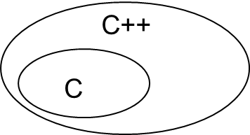
Common library functions [Appendix of K+R]
Included in C++ e.g., <cstring.h> <cmath.h>
<stdio.h>
printf()
scanf()
getchar()
putchar()
sscanf()
sprintf()
gets() puts() fgets() fputs()
fprintf()
fscanf()
<string.h>
strlen(s)
strcpy(s,s)
strcat(s,s)
strcmp(s,s)
strtok(s,s)
<stdlib.h>
int atoi(s)
double atof(s)
long atol(s)
void rand()
void system()
void exit()
int abs(int)
<ctype.h>
int islower(int)
int isupper(int)
int isdigit(int)
int isxdigit(int)
int isalpha(int)
int tolower(int)
int toupper(int)
<math.h>
sin() cos()
exp()
log()
pow()
sqrt()
ceil()
floor()
<assert.h>
assert()
<signal.h>
<limit.h>
<time.h>
……
Notes:
Related are in header files
Small linkedlist as I promised, c included in c++
Limit.h remember?

Slide 97
Common library functions [Appendix of K+R]
Included in C++ e.g., <cstring.h> <cmath.h>
<stdio.h>
printf()
scanf()
getchar()
putchar()
sscanf()
sprintf()
gets() puts() fgets() fputs()
fprintf()
fscanf()
<string.h>
strlen(s)
strcpy(s,s)
strcat(s,s)
strcmp(s,s)
strtok(s,s)
<stdlib.h>
int atoi(s)
double atof(s)
long atol(s)
void rand()
void system()
void exit()
int abs(int)
<ctype.h>
int islower(int)
int isupper(int)
int isdigit(int)
int isxdigit(int)
int isalpha(int)
int tolower(int)
int toupper(int)
<math.h>
sin() cos()
exp()
log()
pow()
sqrt()
ceil()
floor()
<assert.h>
assert()
<signal.h>
<limit.h>
<time.h>
……
Notes:
That’s way always include <stdio.h>

Slide 98
String library functions
Defined in standard library, prototype in <string.h>
unsigned int strlen(s)
  # of chars before first '\0'
  not counting first '\0' strlen("hello"); // 5
strcpy (dest, src) //strlen? 6
  strncpy(dest, src,n)
  modify dest
strcat(dest, src) dest → destsrc s1 + s2
  strncat (s1, s2, n)
  modify s1 append s2 to the end of s1
int strcmp(s1, s2) 0 if equal
  strncmp(s1,s2,n) <0 if s1<s2, >0 if s1>s2
a b c d e f \0 x b \0 y 1 ..
lexicographical order
Notes:
Unsigned . Why got warning if –Wall
Delibrately no return type for strcpy and strcat -- pointer/address

Slide 99
strcpy Compensate for the fact that cannot use = to copy strings
To get from another string (literal) <string.h>
  char message[10];
  strcpy(message, "hello")
  strlen(message)? 5 sizeof message? 10 message[4]? 'o'
  printf("%s", message)?
  strcpy(message , "OK"); ?
strlen(message)? 2 sizeof message? 10 message[4]? 'o'
printf("%s", message)? OK
0 1 2 3 4 5 6 7 8 9
. | . | . | . | . | . | . | . | . | .
0 1 2 3 4 5 6 7 8 9
H | e | l | l | o | \0 | . | . | . | .
0 1 2 3 4 5 6 7 8 9
O | K | \0 | l | o | \0 | . | . | . | .

Slide 100
strcpy Compensate for the fact that cannot use = to copy strings
To get from another string (literal) <string.h>
  char message[10];
  strcpy(message, "hello")
  strlen(message)? 5 sizeof message? 10 message[4]? 'o'
  printf("%s", message)?
  strcpy(message , "OK"); ?
strlen(message)? 2 sizeof message? 10 message[4]? 'o'
printf("%s", message)? OK
0 1 2 3 4 5 6 7 8 9
. | . | . | . | . | . | . | . | . | .
0 1 2 3 4 5 6 7 8 9
H | e | l | l | o | \0 | . | . | . | .
0 1 2 3 4 5 6 7 8 9
O | K | \0 | l | o | \0 | . | . | . | .

Slide 101
strcat Compensate for fact that can’t use + to concatenate strings
To get from another string (literal) <string.h>
  char message[10];
  strcpy(message, "hello")
  strlen(message)? 5 sizeof message? 10 message[4]? 'o'
  strcat(message , "OK"); ? //
strlen(message)? 7 sizeof message? 10 message[5]? 'O'
printf("%s", message)? HelloOK
0 1 2 3 4 5 6 7 8 9
. | . | . | . | . | . | . | . | . | .
0 1 2 3 4 5 6 7 8 9
H | e | l | l | o | \0 | . | . | . | .
Append "OK" to the end
of message.
'O' replaces 1st '\0'
0 1 2 3 4 5 6 7 8 9
H | e | l | l | o | O | K | \0 | . | .

Slide 102

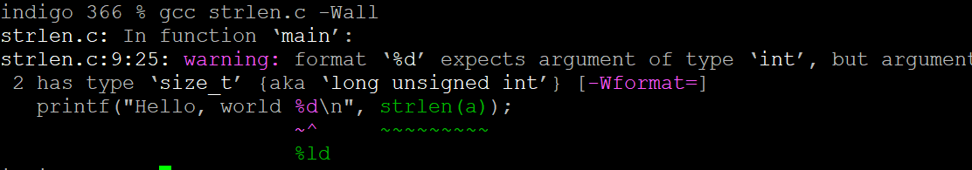
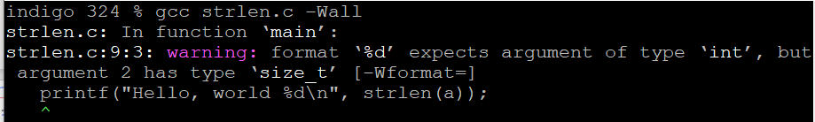

String library functions
Defined in standard library, prototype in <string.h>
unsigned int strlen(s)
  # of chars before first '\0'
  not counting first '\0' strlen("hello"); // 5
strcpy (toStr, fromStr) //strlen?
  strncpy(toStr,fromStr,n)
  modify toStr
strcat(s1, s2) s1 → s1s2 s1 + s2
  strncat (s1, s2, n)
  modify s1 append s2 to the end of s1
int strcmp(s1, s2) 0 if equal
  strncmp(s1,s2,n) <0 if s1<s2, >0 if s1>s2
a b c d e f \0 x b \0 y 1 ..
int len = strlen(line);
printf("%d\n",strlen(line));
// okay
printf("%ld\n",strlen(line)); // not required
printf("%zu\n",strlen(line)); // not required
lexicographical order
Notes:
Unsigned . Why got warning if –Wall
What warning is okay? Show it

Slide 103
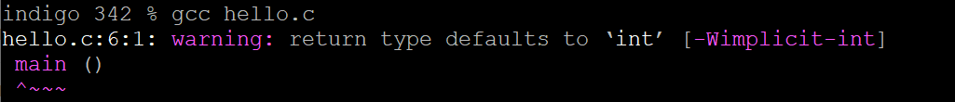
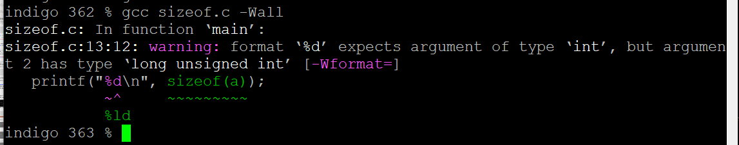

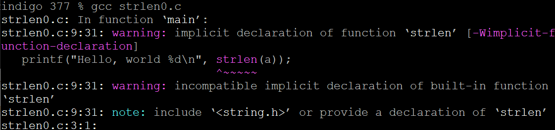
Side notes: these 3 warnings that are ok for this course
// okay
// okay
// okay
Same for sizeof
other warnings are not ok, need to fix
// okay
these warnings are not ok, need to fix
// not okay
// not okay
Notes:
These three need –Wall to see, it is ok
Others get warning, should be fixed

Slide 104
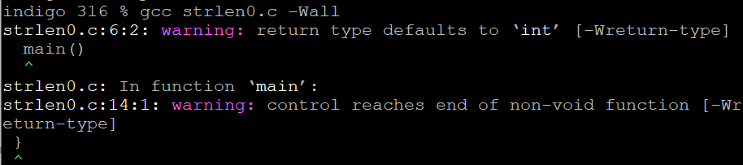
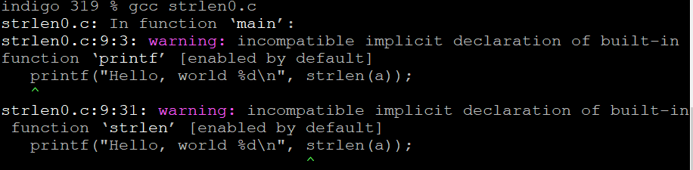
Side notes: these 3 warnings that are ok for this course
// okay
// okay
// okay
Same for sizeof
other warnings are not ok, need to fix
// not okay
// not okay
Notes:
These three need –Wall to see, it is ok
Others get warning, should be fixed

Slide 105

String library functions
Defined in standard library, prototype in <string.h>
unsigned int strlen(s)
  # of chars before first '\0'
  not counting first '\0' strlen("hello"); // 5
strcpy (dest, src) //strlen?
  strncpy(dest, src, n)
  modify dest
strcat(s1, s2) s1 → s1s2 s1 + s2
  strncat (s1, s2, n)
  modify s1 append s2 to the end of s1
int strcmp(s1, s2) 0 if equal
  strncmp(s1,s2,n) <0 if s1<s2, >0 if s1>s2
a b c d e f \0 x b \0 y 1 ..
dest = src
lexicographical order
Notes:
Unsigned . Why got warning if –Wall
Deliberately no return type for strcpy and strcat -- pointer/address
At least for now, think as void

Slide 106
String library functions
Defined in standard library, prototype in <string.h>
unsigned int strlen(s)
  # of chars before first '\0'
  not counting first '\0' strlen("hello"); // 5
strcpy (dest, src) //strlen?
  strncpy(dest, src, n)
  modify dest
strcat(s1, s2) s1 → s1s2 s1 + s2
  strncat (s1, s2, n)
  modify s1 append s2 to the end of s1
int strcmp(s1, s2) 0 if equal
  strncmp(s1,s2,n) <0 if s1<s2, >0 if s1>s2
a b c d e f \0 x b \0 y 1 ..
dest = src
lexicographical order
Notes:
Unsigned . Why got warning if –Wall
Deliberately no return type for strcpy and strcat -- pointer/address think as void now

Slide 107
String library functions
Defined in standard library, prototype in <string.h>
unsigned int strlen(s)
  # of chars before first '\0'
  not counting first '\0' strlen("hello"); // 5
strcpy (dest, src) //strlen?
  strncpy(dest, src, n)
  modify dest
strcat(s1, s2) s1 → s1s2 s1 + s2
  strncat (s1, s2, n)
  modify s1 append s2 to the end of s1
int strcmp(s1, s2) 0 if equal
  strncmp(s1, s2, n) <0 if s1<s2, >0 if s1>s2
a b c d e f \0 x b \0 y 1 ..
dest = src
lexicographical order
Notes:
Unsigned . Why got warning if –Wall
Deliberately no return type for strcpy and strcat -- pointer/address

Slide 108
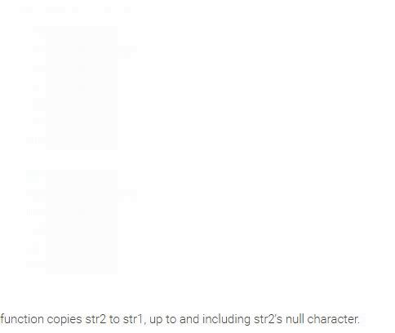
char str1[] = "NEW";
char str2[] = "YORK";
strcpy(str1, str2);
The strcpy() function copies str2 to str1, up to and including str2's null character.

Slide 109
strcpy Compensate for the fact that cannot use = to copy strings
To get from another string (literal) <string.h>
  char message[10];
  strcpy(message, "hello") // or a variable with "hello"
  strlen(message)? 5 sizeof message? 10 message[4]? 'o'
  printf("%s", message)?
  strcpy(message , "OK"); ?
strlen(message)? 2 sizeof message? 10 message[4]? 'o'
printf("%s", message)? OK
0 1 2 3 4 5 6 7 8 9
. | . | . | . | . | . | . | . | . | .
0 1 2 3 4 5 6 7 8 9
H | e | l | l | o | \0 | . | . | . | .
0 1 2 3 4 5 6 7 8 9
O | K | \0 | l | o | \0 | . | . | . | .
Notes:
Think lower level

Slide 110
strcpy Compensate for the fact that cannot use = to copy strings
To get from another string (literal) <string.h>
  char message[10];
  strcpy(message, "hello")
  strlen(message)? 5 sizeof message? 10 message[4]? 'o'
  printf("%s", message)?
  strcpy(message , "OK"); ?
strlen(message)? 2 sizeof message? 10 message[4]? 'o'
printf("%s", message)? OK
0 1 2 3 4 5 6 7 8 9
. | . | . | . | . | . | . | . | . | .
0 1 2 3 4 5 6 7 8 9
H | e | l | l | o | \0 | . | . | . | .
0 1 2 3 4 5 6 7 8 9
O | K | \0 | l | o | \0 | . | . | . | .

Slide 111
strncpy Compensate for the fact that cannot use = to copy strings
To get from another string (literal) <string.h>
  char message[10];
  strcpy(message, "hello")
  strlen(message)? 5 sizeof message? 10 message[4]? 'o'
  printf("%s", message)?
  strncpy(message , "OK",3); ?
strlen(message)? 2 sizeof message? 10 message[4]? 'o'
printf("%s", message)? OK
0 1 2 3 4 5 6 7 8 9
. | . | . | . | . | . | . | . | . | .
0 1 2 3 4 5 6 7 8 9
H | e | l | l | o | \0 | . | . | . | .
0 1 2 3 4 5 6 7 8 9
O | K | \0 | l | o | \0 | . | . | . | .

Slide 112
strncpy Compensate for the fact that cannot use = to copy strings
To get from another string (literal) <string.h>
  char message[10];
  strcpy(message, "hello")
  strlen(message)? 5 sizeof message? 10 message[4]? 'o'
  printf("%s", message)?
  strncpy(message , "OK",3); ?
strlen(message)? 2 sizeof message? 10 message[4]? 'o'
printf("%s", message)? OK
0 1 2 3 4 5 6 7 8 9
. | . | . | . | . | . | . | . | . | .
0 1 2 3 4 5 6 7 8 9
H | e | l | l | o | \0 | . | . | . | .
0 1 2 3 4 5 6 7 8 9
O | K | \0 | l | o | \0 | . | . | . | .

Slide 113
strncpy Compensate for the fact that cannot use = to copy strings
To get from another string (literal) <string.h>
  char message[10];
  strcpy(message, "hello")
  strlen(message)? 5 sizeof message? 10 message[4]? 'o'
  printf("%s", message)?
  strncpy(message , "OK",2); ?
strlen(message)? 2 sizeof message? 10 message[4]? 'o'
printf("%s", message)? OK
0 1 2 3 4 5 6 7 8 9
. | . | . | . | . | . | . | . | . | .
0 1 2 3 4 5 6 7 8 9
H | e | l | l | o | \0 | . | . | . | .
0 1 2 3 4 5 6 7 8 9
O | K | \0 | l | o | \0 | . | . | . | .

Slide 114

strncpy Compensate for the fact that cannot use = to copy strings
To get from another string (literal) <string.h>
  char message[10];
  strcpy(message, "hello")
  strlen(message)? 5 sizeof message? 10 message[4]? 'o'
  printf("%s", message)?
  strncpy(message , "OK",2); ?
strlen(message)? 5 sizeof message? 10 message[4]? 'o'
printf("%s", message)? OKllo
0 1 2 3 4 5 6 7 8 9
. | . | . | . | . | . | . | . | . | .
0 1 2 3 4 5 6 7 8 9
H | e | l | l | o | \0 | . | . | . | .
0 1 2 3 4 5 6 7 8 9
O | K | l | l | o | \0 | . | . | . | .
No \0 added

Slide 115
strncpy Compensate for the fact that cannot use = to copy strings
To get from another string (literal) <string.h>
  char message[10];
  strncpy(message, "hello", 3)
  strlen(message)? 3 sizeof message? 10
  printf("%s", message)?
  strncpy(message , "OK",1); ?
strlen(message)? 1 sizeof message? 10 message[4]? 'o'
printf("%s", message)? O
0 1 2 3 4 5 6 7 8 9
. | . | . | . | . | . | . | . | . | .
0 1 2 3 4 5 6 7 8 9
H | e | l | \0 | . | . | . | . | . | .
0 1 2 3 4 5 6 7 8 9
O | \0 | l | \0 | . | . | . | . | . | .

Slide 116
strncpy Compensate for the fact that cannot use = to copy strings
To get from another string (literal) <string.h>
  char message[10];
  strncpy(message, "hello", 3)
  strlen(message)? 3 sizeof message? 10
  printf("%s", message)?
  strncpy(message , "OK",1); ?
strlen(message)? 1 sizeof message? 10 message[4]? 'o'
printf("%s", message)? O
0 1 2 3 4 5 6 7 8 9
. | . | . | . | . | . | . | . | . | .
0 1 2 3 4 5 6 7 8 9
H | e | l | \0 | . | . | . | . | . | .
0 1 2 3 4 5 6 7 8 9
O | \0 | l | \0 | . | . | . | . | . | .

Slide 117
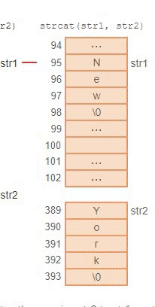
char str1[] = "NEW";
char str2[] = "YORK";
strcat(str1, str2);
The strcat() function starts at str1's null character, then copies str2 to str1, up to and including str2's null character.

Slide 118
strcat Compensate for fact that can’t use + to concatenate strings
To get from another string (literal) <string.h>
  char message[10];
  strcpy(message, "hello")
  strlen(message)? 5 sizeof message? 10 message[4]? 'o'
  strcat(message , "OK"); ? //
strlen(message)? 7 sizeof message? 10 message[5]? 'O'
printf("%s", message)? HelloOK
0 1 2 3 4 5 6 7 8 9
. | . | . | . | . | . | . | . | . | .
0 1 2 3 4 5 6 7 8 9
H | e | l | l | o | \0 | . | . | . | .
Append "OK" to the end
of message.
'O' replaces 1st '\0'
0 1 2 3 4 5 6 7 8 9
H | e | l | l | o | \0
strncat(mes,"OK",1) ?

Slide 119
strcat Compensate for fact that can’t use + to concatenate strings
To get from another string (literal) <string.h>
  char message[10];
  strcpy(message, "hello")
  strlen(message)? 5 sizeof message? 10 message[4]? 'o'
  strcat(message , "OK"); ? //
strlen(message)? 7 sizeof message? 10 message[5]? 'O'
printf("%s", message)? HelloOK
0 1 2 3 4 5 6 7 8 9
. | . | . | . | . | . | . | . | . | .
0 1 2 3 4 5 6 7 8 9
H | e | l | l | o | \0 | . | . | . | .
Append "OK" to the end
of message.
'O' replaces 1st '\0'
0 1 2 3 4 5 6 7 8 9
H | e | l | l | o | O | K | \0 | . | .

Slide 120
strncat Compensate for fact that can’t use + to concatenate strings
To get from another string (literal) <string.h>
  char message[10];
  strcpy(message, "hello")
  strlen(message)? 5 sizeof message? 10 message[4]? 'o'
  strncat(message , "OK", 1); ?
strlen(message)? 7 sizeof message? 10 message[5]? 'O'
printf("%s", message)? HelloOK
0 1 2 3 4 5 6 7 8 9
. | . | . | . | . | . | . | . | . | .
0 1 2 3 4 5 6 7 8 9
H | e | l | l | o | \0 | . | . | . | .
0 1 2 3 4 5 6 7 8 9
H | e | l | l | o | \0
strncat(mes,"OK",1) ?
Notes:
Added after

Slide 121
strncat Compensate for fact that can’t use + to concatenate strings
To get from another string (literal) <string.h>
  char message[10];
  strcpy(message, "hello")
  strlen(message)? 5 sizeof message? 10 message[4]? 'o'
  strncat(message , "OK", 1); ?
strlen(message)? 6 sizeof message? 10 message[5]? 'O'
printf("%s", message)? HelloO
0 1 2 3 4 5 6 7 8 9
. | . | . | . | . | . | . | . | . | .
0 1 2 3 4 5 6 7 8 9
H | e | l | l | o | \0 | . | . | . | .
0 1 2 3 4 5 6 7 8 9
H | e | l | l | o | O | \0 | . | . | .
\0 added
Notes:
Added after

Slide 122
strcat Compensate for the fact that cannot use + to glue strings
o get from another string (literal) <string.h>
  strcat(message, "Hi")
  strlen(message)? 4 sizeof message? 10 message[6]? 'o'
  printf("%s", message)? OKHi
  strcat(message , "Bye"); ?
  strcat(message , "B"); ?
strlen(message)? 5 sizeof message? 10 message[6]? 'o'
printf("%s", message)? OKHiB
Another example
0 1 2 3 4 5 6 7 8 9
O | K | \0 | s |  | G | O | \0 | . | .
0 1 2 3 4 5 6 7 8 9
Append "Hi" to the end
of message.
'H' replaces 1st '\0'
O | K | H | i | \0 | G | O | \0 | . | .
0 1 2 3 4 5 6 7 8 9
O | K | H | i | B | \0 | O | \0 | . | .
strncat(mes,"Bye",1)?

Slide 123
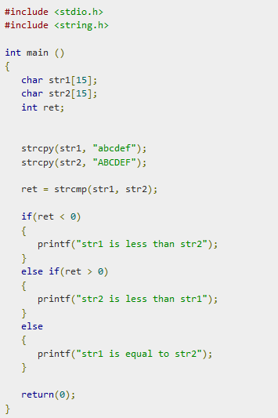
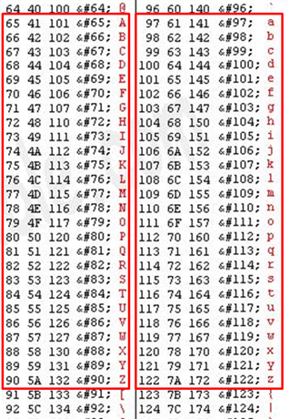

int strcmp(s1, s2)
/* lexicographical order */
.... . . . . . .
.... . . . . . .
a b c d e f \0 . . .. .
A B C D E F \0 .. . . .
"abcde" is greater than (>) "Alice"
because 'a' located after 'A' in ASCII table
strcmp("abcded","Alice" ) returns +
"HelloWorld" < "Hellothwre"
because 'W' precedes 't' in ASCII table
strcmp("HelloWorld","Hellothwre" ) -
"Hello!" equals "Hello!" 0
"base" < "baseball" -
// str1 greater than str2
// res == 0
strlen? 6
sizeof? 15
Same as Java s.compareTo(s2)
Notes:
Counter intuitive

Slide 124
int strcmp(s1, s2);
0 if equal !0 if not equal <0 if s1<s2, >0 if s1>s2
int isQuit (char arr[]){
int i;
if (arr[0]=='q' && arr[1]=='u' && arr[2]=='i' && arr[3]=='t' &&
return 1; arr[4]=='\0' )
else return 0; }
isQuit(char arr[]){
if ( strcmp(arr, "quit") == 0 )
return 1; // equal
else return 0
}
while ( strcmp (arr, "quit") !=0 )
…..
while (1) {
if ( strcmp (arr, "quit")==0)
break;
// not equal
or
// equal
while ( strcmp (arr, "quit") )
…..
while (1) {
if ( ! strcmp (arr, "quit") )
break;
// not equal
// equal
Notes:
Where is the flaw?
Counterintiutive “not equal”

Slide 125
int strcmp(s1, s2)
/* lexicographical order */
.... . . . . . .
.... . . . . . .
a b c d e f \0 . . .. .
A B C D E F \0 .. . . .
"abcded" is greater than (>) "Alice"
because 'a' located after 'A' in ASCII table
strcmp("abcded","Alice" ) returns -
"HelloWorld" < "Hellothwre"
because 'W' precedes 't' in ASCII table
strcmp("HelloWorld","Hellothwre" ) +
"Hello!" equals "Hello!" 0
// res == 0
strlen? 6
sizeof? 15
Same as Java s.compareTo(s2)

Slide 126
int strcmp(s1, s2);
0 if equal !0 if not equal <0 if s1<s2, >0 if s1>s2
int isQuit (char arr[]){
int i;
if (arr[0]=='q' && arr[1]=='u' && arr[2]=='i' && arr[3]=='t' &&
return 1; arr[4]=='\0' )
else return 0; }
isQuit(char arr[]){
if ( strcmp(arr, "quit") == 0 )
return 1; // equal
else return 0
}
while ( strcmp (arr, "quit") !=0 )
…..
while (1) {
if ( strcmp (arr, "quit")==0)
break;
// not equal
or
// equal
while ( strcmp (arr, "quit") )
…..
while (1) {
if ( ! strcmp (arr, "quit") )
break;
// not equal
// equal
Notes:
Counter intunitive

Slide 127
Common library functions [Appendix of K+R]
Included in C++ e.g., <cstring.h> <cmath.h>
<stdio.h>
printf()
scanf()
getchar()
putchar()
sscanf()
sprintf()
gets() puts() fgets() fputs()
fprintf()
fscanf()
<string.h>
strlen(s)
strcpy(s,s)
strcat(s,s)
strcmp(s,s)
strtok(s,s)
<stdlib.h>
int atoi(s)
double atof(s)
long atol(s)
void rand()
void system()
void exit()
int abs(int)
<ctype.h>
int islower(int)
int isupper(int)
int isdigit(int)
int isxdigit(int)
int isalpha(int)
int tolower(int)
int toupper(int)
<math.h>
sin() cos()
exp()
log()
pow()
sqrt()
ceil()
floor()
<assert.h>
assert()
<signal.h>
<limit.h>
<time.h>
……

Slide 128
character library functions
Defined in standard library, prototype in <ctype.h>
int islower(int ch) ch >='a' && ch <='z'
int isupper(int ch) ch >='A' && ch <='Z'
int isalpha(int ch) islower(ch) || isupper(ch)
int isdigit(int ch) ch >='0' && ch <='9'
int isalnum(int ch) isalpha(ch) or isdigit(ch)
int isxdigit(int ch) '0'-'9', 'a'-'f','A'-'F',
int tolower(int ch) if (isupper(ch))
int toupper(int ch) return ch + ('a' – 'A');
else return ch;
ch not changed
Notes:
Lab2 overhead

Slide 129
Example
#include<stdio.h>
/* copying input to output with
upper-case converted to lower-case letters */
main(){
  int c;
  c= getchar();
  while (c != EOF)
  {
    if (c >= 'A' && c <= 'Z’)
      c += 'a'- 'A’;
    ' */
    putchar(c);
    c = getchar();
  }
  return 0;
}
  c= getchar();
  while (c != EOF)
  {
    if (isupper(c))
      c = tolower(c);
    putchar(c);
    c = getchar();
  }
  return 0;
}
java.lang.Character
public static boolean isUpperCase(char ch)
public static boolean isLowerCase(char ch)
public static char toUpperCase(char ch)
public static char toLowerCase(char ch)

Slide 130
Common library functions [Appendix of K+R]
Included in C++ e.g., <cstring.h> <cmath.h>
<stdio.h>
printf()
scanf()
getchar()
putchar()
sscanf()
sprintf()
gets() puts() fgets() fputs()
fprintf()
fscanf()
<string.h>
strlen(s)
strcpy(s,s)
strcat(s,s)
strcmp(s,s)
strtok(s,s)
<stdlib.h>
int atoi(s)
double atof(s)
long atol(s)
void rand()
void system()
void exit()
int abs(int)
<ctype.h>
int islower(int)
int isupper(int)
int isdigit(int)
int isxdigit(int)
int isalpha(int)
int tolower(int)
int toupper(int)
<math.h>
sin() cos()
exp()
log()
pow()
sqrt()
ceil()
floor()
<assert.h>
assert()
<signal.h>
<limit.h>
<time.h>
……

Slide 131
Utility library functions: number conversion …
Defined in standard library, prototype in <stdlib.h>
int atoi("string" s) "6"
double atof("string" s) "3.24"
long atol ("string" s)
int rand(void) void srand(unsigned seed)
void abort(void)
void exit(int) EXIT_SUCESS, EXIT_FAILURE
int system(commandString)
int abs(int) long labs(long)
void qsort(……) // quick sort
malloc, calloc, free
Notes:
You already see rand in my question I gave

Slide 132
C and Unix are closely related
#include<stdio.h>
int main()
{
system("ls -l"); // execute unix command line ls -l
system("mkdir xxx"); // execute unix command line mkdir xxx
printf("%s", "===\n");
system("ls -l");
}
total 0
drwx------ 2 huiwang faculty 6 Jan 28 23:11 dir1
===
total 0
drwx------ 2 huiwang faculty 6 Jan 28 23:11 dir1
drwx------ 2 huiwang faculty 6 Jan 28 23:11 xxx

Slide 133
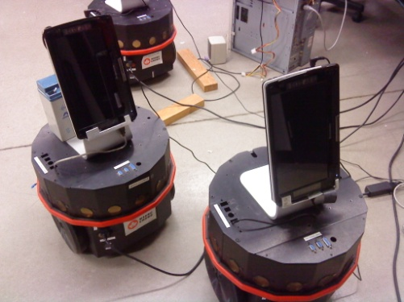
For your information
void initializeHardware(void)
{ /* initialize hardware */
if(connect_robot("/dev/ttyUSB0", 38400) == FALSE){
fprintf(stderr,"unable to connect to robot\n");
sprintf(buf, "aplay ./sounds/%s", sth_wrong.wav);
system(buf); //system("aplay ./sounds/sth_wrong.wav")
// execute unix command aplay ./…wav
exit(EXIT_FAILURE);
}
// else connected
enableSonars();
system("aplay ./sounds/wakingUp.wav");
}
aplay - command-line sound recorder
and player for ALSA soundcard driver
Notes:
When you do Junit, even JS

Slide 134
Common library functions [Appendix of K+R]
Included in C++ e.g., <cstring.h> <cmath.h>
<stdio.h>
printf()
scanf()
getchar()
putchar()
sscanf()
sprintf()
gets() puts() fgets() fputs()
fprintf()
fscanf()
<string.h>
strlen(s)
strcpy(s,s)
strcat(s,s)
strcmp(s,s)
strtok(s,s)
<stdlib.h>
int atoi(s)
double atof(s)
long atol(s)
void rand()
void system()
void exit()
int abs(int)
<ctype.h>
int islower(int)
int isupper(int)
int isdigit(int)
int isxdigit(int)
int isalpha(int)
int tolower(int)
int toupper(int)
<math.h>
sin() cos()
exp()
log()
pow()
sqrt()
ceil()
floor()
<assert.h>
assert()
<signal.h>
<limit.h>
<time.h>
……

Slide 135
Diagnostics library functions
Defined in standard library, prototype in <assert.h>
void assert(int expression)
  int x = -1;
  assert(x > 0)
  print Assertion failed: expression, file file, line lnum
  Then abort()
Look at <time.h>
a.out: sprintf.c:20: main: Assertion `i < 5' failed.
Abort
For your information

Slide 136
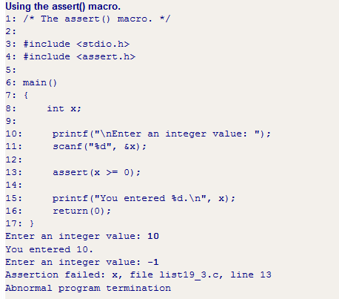
For your information

Slide 137
Common library functions [Appendix of K+R]
Included in C++ e.g., <cstring.h> <cmath.h>
<stdio.h>
printf()
scanf()
getchar()
putchar()
sscanf()
sprintf()
gets() puts() fgets() fputs()
fprintf()
fscanf()
<string.h>
strlen(s)
strcpy(s,s)
strcat(s,s)
strcmp(s,s)
strtok(s,s)
<stdlib.h>
int atoi(s)
double atof(s)
long atol(s)
void rand()
void system()
void exit()
int abs(int)
<ctype.h>
int islower(int)
int isupper(int)
int isdigit(int)
int isxdigit(int)
int isalpha(int)
int tolower(int)
int toupper(int)
<math.h>
sin() cos()
exp()
log()
pow()
sqrt()
ceil()
floor()
<assert.h>
assert()
<signal.h>
<limit.h>
<time.h>
……

Slide 138
math library functions
Defined in standard library, prototype in <math.h>
Need to link by -lm
double sin(double x), cos(x), tan(x)
double asin(x) acos(x) atan(x) …
double exp(x) e^{x}
double log(x) -- ln(x)
double log10(x)
double pow(x,y) x^{y}
double sqrt(x) √x
double ceil(x) smallest int not less than x, as a double!
double floor(x)largest int not greater than x, as a double!
x, y are of type double
return double
sqrt(9.0) evaluates to 3.0
pow(6.0, 2.0) evaluates to 36.0

Slide 139
How C Programs are Compiled
C programs go through three stages to be compiled:
  Preprocessor - handles #include and #define etc
  Compiler - converts C code into binary processor instructions (“object code”)
  Linker - puts multiple files together, load library function (e.g. printf, strlen) and creates an executable program
preprocessor
compiler
linker
hello.c
hello.o
a.out

Slide 140
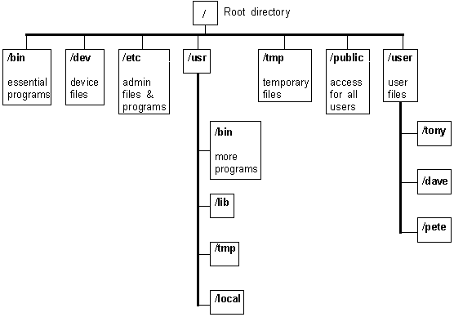
Some complier options
Option: -llibrary
  Link with object library gcc –lm main.c
    Links math object library (if use pow() ceil() sin() etc)
    Needed in the lab
    Don’t forget to use #include <math.h> at the beginning
  gcc main.c –lp
    Links pthread …..
libc.so
ibm.so
FYI
stdio.h
string.h
/include
Notes:
Tones of question

Slide 141
How C Programs are Compiled
C programs go through three stages to be compiled:
  Preprocessor - handles #include and #define etc
  Compiler - converts C code into binary processor instructions (“object code”)
  Linker - puts multiple files together, load library function (e.g. printf) and creates an executable program
preprocessor
compiler
linker
hello.c
hello.o
a.out

Slide 142
Some complier options
Option: -llibrary
  Link with object library gcc –lm main.c
    Links math object library (if use pow() ceil() sin() etc)
    Don’t forget to use #include <math.h> at the beginning
  gcc main.c –lp
    Links pthread …..

Slide 143
SMQ1
0X6B
00111110
10110110
Notes:
6B 00111110
Moved here 22F

Slide 144
Notes:
1 1

Slide 145
Notes:
4 We will do another small quiz if we have time

Slide 146
Common library functions [Appendix of K+R]
Included in C++ e.g., <cstring.h> <cmath.h>
<stdio.h>
printf()
scanf()
getchar()
putchar()
sscanf()
sprintf()
gets() puts() fgets() fputs()
fprintf()
fscanf()
<string.h>
strlen(s)
strcpy(s,s)
strcat(s,s)
strcmp(s,s)
strtok(s,s)
<stdlib.h>
int atoi(s)
double atof(s)
long atol(s)
void rand()
void system()
void exit()
int abs(int)
<ctype.h>
int islower(int)
int isupper(int)
int isdigit(int)
int isxdigit(int)
int isalpha(int)
int tolower(int)
int toupper(int)
<math.h>
sin() cos()
exp()
log()
pow()
sqrt()
ceil()
floor()
<assert.h>
assert()
<signal.h>
<limit.h>
<time.h>
……

Slide 147
stdio library functions
Defined in standard library, prototype in <stdio.h>
getchar, putchar
scanf, printf
/* read from, print to a string */
sscanf, sprintf
gets, fgets, puts, fputs /*read write line */
fscanf, fprintf
……

Slide 148

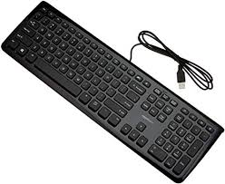
Basic I/O functions
<stdio.h>
int printf (char *format, arg1, …. );
  Formats and prints arguments on standard output (screen or >
  printf("This is a test %d \n", x) outputFile)
int scanf (char *format, arg1, …. );
  Formatted input from standard input (keyboard or < inputFile)
  scanf("%d %c", &x, &y)
int sprintf (char * str, char *format, arg1,…..);
  Formats and prints arguments to char array (string) str
  sprintf( str, "This is a test %d \n", x) // nothing print on stdout!
int sscanf (char * str, char *format, arg1, …. );
  Formatted input from char array (string) str
  sscanf(str, "%d %c", &x, &y) // tokenize string str based on spcification
Notes:
“13 A”

Slide 149
strings: set /get in general
H | e | l | l | o | \0
  char message[20];
To get from another string (literal) – strcpy prototype <string.h>
  strcpy(message, "hello")
  char str[] = "Hi"; strcpy(message , str); Hi\0
sprintf -- Defined in standard library, prototype in <stdio.h>
  sprintf(message, “%s there!”, ”hi”); → “hi there
  sprintf(message, "%s %d %f", "john",12, 2.3);
  "john 12 2.300000"
  sprintf(message, "%s %d-%.3f", "john",12, 2.3);
  "john 12-2.300"
sscanf(message, "%s %d-%f", name, &age, &rate );
  "john 12 2.3" ?
format and then write to message \0 added
Way of generating/tokenizing a string
tokenizing string message
Notes:
As a string, \0 added
Strcpy + strcat + strcat cumbersome
Animation added 21F

Slide 150
#include <stdio.h>
main(){
char message [30];
int age =20; char name[]="john"; double rate = 4.3456;
printf("%s %d %f\n", name, age, rate); // john 20 4.345600
printf("%s %d-%.3f\n", name, age, rate); // john 20-4.346
// format and write to message
sprintf(message, "%s %d-%.3f", name, age, rate); // no screen
printf("%s\n", message); // john 20-4.346
int age2; float rate2; char name2[20];
// tokenize message
sscanf(message, "%s %d-%f", name2, &age2, &rate2);
printf("%s\n", name2); // john
printf("%d\n", age2); // 20
printf("%f\n",rate2); // 4.346000
printf("%.3f\n",rate2); // 4.346
}
Notes:
Above hr, is first lecture, not related to this course

Slide 151
No live lab session today and tomorrow
Lab4 first part posted today
SMQ1 this Friday 7pm~3am.
Assignment1 soon

Slide 152
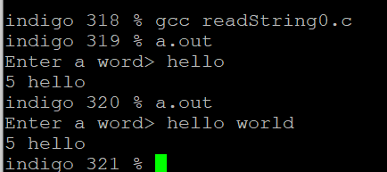
stdio library functions
Defined in standard library, prototype in <stdio.h>
getchar, putchar
scanf, printf
/* read from, print to a string */
sscanf, sprintf
gets, fgets, puts, fputs /*read write line */
fscanf, fprintf
……
scanf ("%s", my_strg);

Slide 153
set on the fly, read whole line (with spaces)
char message[20];
To get a line (potentially with spaces) at a time:
  scanf("%[^\n]s", message);
  gets(message) fgets(message, 10, stdin)
To print a string
  printf("%s",message)
  puts(message) fputs(message, stdout)
No &
Deprecated
Removed in C11
Read in '\n' at the end.
'H' 'i' 'o' 'k' '\n' '\0' ….
Print with added '\n' at the end
Notes:
Stdin pointer to file, but think as keyword now

Slide 154

int main()
{ char str[40];
scanf("%s", str);
printf("%s\n", str);
}
red 199 % a.out
hello the world!
hello
red 200 %
int main()
{ char str[40];
scanf(" %[^\n]s", str);
printf("%s\n", str);
}
red 199 % a.out
hello the world!
hello the world!
red 200 %
hello the world!\0
hello the world!\n\0
int main()
{ char str[40];
fgets (str, 40, stdin);
fputs(str, stdout);
//or printf("%s", str);
}
red 199 % a.out
hello the world!
hello the world!
red 200 %
No \n needed

Slide 155
int main()
{ char str[40];
fgets(str, 40, stdin);
while (strcmp(str, "quit"))
{
fputs(str); // \n printed
// printf("%s", str);
// read again
fgets(str, 40, stdin);
}
}
red 199 % a.out
hello the world!
hello the world!
This is good
This is good
quit
quit
quit
quit
……
Notes:
Before small thing, print extra line. But more important, when strcmp
Tones of questions from students

Slide 156
int main()
{ char str[40];
fgets(str, 40, stdin);
while (strcmp(str, "quit\n"))
{
fputs(str); // \n printed
// printf("%s", str);
// read again
fgets(str, 40, stdin);
}
}
red 199 % a.out
hello the world!
hello the world!
This is good
This is good
quit
red 200 %
int main()
{
char str[40];
while (1)
{
fgets (str, 40, stdin);
if (! strcmp(str, "quit\n"))
break; // ==0
fputs(str, stdout);
}
}
No &
Be careful the '\n'
str[ strlen(str)-1 ] = '\0'
Notes:
Before small thing, print extra line. But more important, when strcmp
Tones of questions from students
Someone remove /n before processing srt[ strlen(str) -1 ] = ‘\0’

Slide 157
int main()
{ char str[40];
scanf(" %[^\n]s", str);
while (strcmp(str, "quit"))
{
printf("%s\n",str);
// read again
scanf(" %[^\n]s", str);
}
}
red 199 % a.out
hello the world!
hello the world!
This is good
This is good
quit
red 200 %
int main()
{
char str[40];
while (1)
{
scanf(" %[^\n]s", str);
if (! strcmp(str, "quit"))
break;
puts(str);
}
}
str does not contain '\n'

Slide 158
 | Non-string (int, char, float…) | String
Read scanf, sscanf fgets… | &x | arrName
Write printf, sprintf fputs… | x | arrName
& except String
no &
  char message[40];
  char name[20]; int age, float rate, char le;
  scanf("%s %d %f %c", name, &age, &rate, &le);
  sscanf(message, "%s %d %f %c", name, &age, &rate, &le);
  printf("%s %d %f %c", name, age, rate, le);
  sprintf(message, "%s %d %f %c", name, age, rate, le);
Notes:
Usually okay with fgets only \n pay attention
But have hard time with sprints, sscanf
No worries, work on lab4.

Slide 159
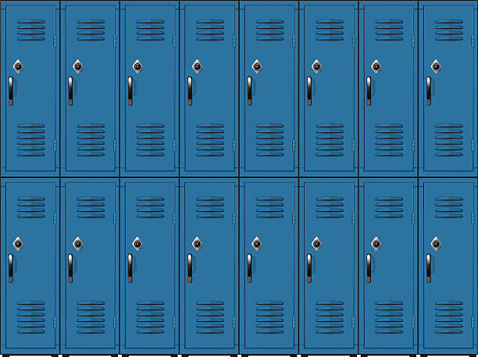

Finished Ch1 – 4
Other C materials before pointer
  Common library functions [Appendix of K+R]
  2D array, table of strings
Notes:
Last topic before pointers

Slide 160
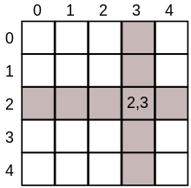

Multi-dimension array, array of arrays
col 0 col 1
row 0
row 1
row 2
a[0][0] | a[0][1]
a[1][0] | a[1][1]
a[2][0] | a[2][1]
int arr2D[3][2];
Size: type bytes * column * row
  4 * 2 * 3 = 24 bytes
Initialization when declaring:
  int arr2D[3][2] = {1,1,2,4,3,9};
  int arr2D[3][2] = {{1,1},{2,4},{3,9}}
Access: arry2D[2][1] 9
size? How stored?
// 3 rows, 2 columns
0 1
0
1
2
1 | 1
2 | 4
3 | 9
Same in Java
Notes:
Or initialize later with loop
array2D[1][0] ?

Slide 161
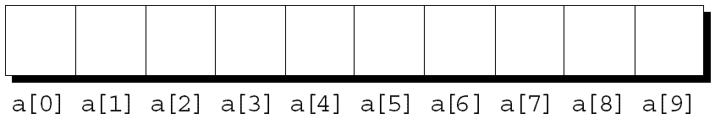

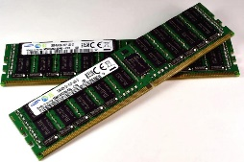
Multi-dimension array how are they stored
int arr1D[10];
  Size: type bytes * number of element
    4 * 10 = 40 bytes
int arr2D[3][2]
  Size: type bytes * row * column
    4 * 3 * 2 = 24 bytes
col 0 col 1
row 0
a[0][0] | a[0][1]
a[1][0] | a[1][1]
a[2][0] | a[2][1]
row 1
row 2
row 0
row 1
row 2
aa[0][0] | a[0][1] | a[1][0] | a[1][1] | a[2][0] | a[2][1]
Notes:
Flattened. We visualize as 2D
Short will be 4*3*2 in a moment will see char, which will be 1

Slide 162
An example
col 0 col 1
row 0
a[0][0] | a[0][1]
a[1][0] | a[1][1]
a[2][0] | a[2][1]
int main(){
  int a [3][2] = {{1,2},{3,4},{5,6}};
  printf("sizeof: %d\n", sizeof a);
  int i, j;
  for(i=0; i<3; i++){
  for(j=0; j<2; j++)
  printf("%d ", a[i][j]);
  printf("\n") ;
  }
  a[0][1] = 100;
  a[2][1] *= 10;
  printf("\n");
  for(i=0; i<3; i++){
  for(j=0; j<2; j++)
  printf("%d ", a[i][j]);
  printf("\n") ;
  }
}
row 1
row 2
sizeof: 24
1 2
3 4
5 6
1 100
3 4
5 60
Notes:
Sizeof ?
//Can initialize later, using loops
No way to print whole row, use nested loops
Any question?

Slide 163
col 0 col 1 col 2
a[0][0] | a[0][1] | a[0][1]
a[1][0] | a[1][1] | a[0][1]
row 0
int main(){
/* 2D array declaration*/
int arr[2][3];
int i, j;
for(i=0; i<2; i++) {
for(j=0;j<3;j++) {
printf("Enter value for arr[%d][%d]:", i, j);
scanf("%d", &arr[i][j]); // cell level
}
}
//Displaying array elements
for(i=0; i<2; i++) {
for(j=0;j<3;j++) {
printf("%d ", arr[i][j]);
if(j==2)
printf("\n");
}
}
}
row 1
Enter value for arr[0][0]:1
Enter value for arr[0][1]:2
Enter value for arr[0][2]:30
Enter value for arr[1][0]:4
Enter value for arr[1][1]:50
Enter value for arr[1][2]:6
1 2 30
4 50 6
Notes:
&arr[i][j] no () needed, a bit later

Slide 164
Multi-dimension char array, array of strings
0 1 2 3 4 5
Array of “strings”
char messages[3][6]
  ={"Hello","Hi", "Ther"};
Size?
Each row (e.g., message[0]) is a (1-D) char array (string)
  printf("%s", messages[0]); Hello
  printf("%d", strlen(messages[1])); 2
  strcmp (messages[0], messages[2]); a negative number
  printf("%c", messages[2][1]); h
0
1
2
H | e | l | l | o | \0
H | i | \0 | . | . | .
T | h | e | r | \0 | .
type bytes * row * column 1 * 3 *6 = 18 bytes
Notes:
An important usage in C is
Store table of strings. Later see another way
Size someone says 14 – count actual chars
Anyone lost here? Lots people find its hard. Not sure why. %c for first, %s for last?

Slide 165
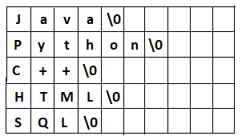
={ {'J','a','v','a','\0’},
{'P','y','t','h','o','n','\0’},
{'C','+','+','\0’},
{'H','T','M','L','\0’},
{'S','Q','L','\0'} };
char lang[5][10]={"Java", "Python", "C++", "HTML","SQL"};
for(int i=0;i<5;i++)
printf("%s %d", lang[i], strlen(lang[i]));;
lang[0] = "Kotlin"; // invalid cannot directly assign a
// we must do char level,
// or, use lib function copy the string
strcpy(lang[0], "Kotlin"); // valid
printf("Enter 5 rows“);
for(i=0; i<5; i++)
scanf("%s",lang[i]);
With space?

Slide 166
Multi-dimension array, array of strings each row is a 1D string set in general
Get from another string (literal)
strcpy prototype <string.h>
  strcpy(messages[0], "hello")
  str[] = "Hi"; strcpy(messages[1], str);
sprintf sscanfefined in standard library, prototype <stdio.h>
  sprintf(messages[1], "%s %d %f", "john",12,2.3);
  sscanf(messages[2],"%s %d %f", name, &age,&wage);
char messages[3][10]
Write to the first/2nd row
format and then write to 2nd row
tokenizing the 3rd row

Slide 167
Multi-dimension array, array of strings each row is a 1D string set on fly
0 1 2 3 4 5
for int i=0…2
scanf("%s",message[i]);
printf("%s", message[0]);
printf(message[1]);
To read in a line with space into a row at a time:
  scanf("%[^\n]s", messages[0]);
  gets(messages[0]) fgets(messages[0], 10, stdin)
To print a row
  printf ("%s", messages[0]);
  puts(messages[1]) fputs(messages[2], stdout)
0
1
2
H | e | l | l | o | \0
To read a word into a row
  scanf("%s", messages[1]);
  // read into row 2
H | i | \0 | . | . | .
T | h | e | r | \0 | .
No &
depreciated
read into the first row
append \n at end

Slide 168
={ {'J','a','v','a','\0’},
{'P','y','t','h','o','n','\0’},
{'C','+','+','\0’},
{'H','T','M','L','\0’},
{'S','Q','L','\0'} };
char lang[5][10]={"Java", "Python", "C++", "HTML","SQL"};
int i,j;
for(i=0;i<5;i++)
printf("%s\n", lang[i]);
for(i=0;i<5;i++){
fputs(lang[i],stdout);
printf("\n");
}
  for(i=0; i<5; i++){
  for(j=0; j<10; j++)
  printf("%c", lang[i][j]); // putchar(lang[i][j]);
  printf("\n");
  }
Notes:
Added 21F after (1st) class
fputs no \n

Slide 169

  for(i=0; i<5; i++)
  for(j=0; j<10; j++)
  printf("%c ", lang[i][j]);
  printf("\n");
={ {'J','a','v','a','\0’},
{'P','y','t','h','o','n','\0’},
{'C','+','+','\0’},
{'H','T','M','L','\0’},
{'S','Q','L','\0'} };
char lang[5][10]={"Java", "Python", "C++", "HTML","SQL"};
for(int i=0;i<5;i++)
printf("%s %d", lang[i], strlen(lang[i]));;
lang[0] = "Kotlin"; // invalid cannot directly assign a
// we can do char level,
lang[0][0]='K'; lang[0][1]='o' ……
// or, use lib function copy the String
strcpy(lang[0], "Kotlin"); // valid
printf("Enter 5 rows");
for(i=0; i<5; i++)
scanf("%s",lang[i]); or fgets(lang[i], 10, stdin);
for(int i=0;i<5;i++)
fputs(lang[i],stdout);
? How scanf(), strcpy (), sscanf(), fgets(), change argument if pass-by-value?
? How could Mr. Main’s paper get color changed?
Notes:
Bit overwhelming….Lab4, office hours.

Slide 171
Finished Ch1 – 4
Other C materials before pointer
  Common library functions [Appendix of K+R]
  2D array, table of strings
  Recursions
  pre-processor
Ch5: Pointers

Slide 172
Think recursively

Slide 173
Think recursively
“how many people are there, from you to the end of line?”
“ 1 + the answer of the guy behind me“

Slide 174
Recursion
“To get into my house
I must get the key from a smaller house
int length (string s) // Java
{ if (s contains no letter)
return 0;
return 1 + length(substring on the right);
}
length(“ABCD”)
= 1 + length(“BCD”)
= 1 + ( 1 + length(“CD”))
= 1 + ( 1 + ( 1 + length(“D”)))
= 1 + ( 1 + ( 1 + (1+ (1+length(“”) )))
= 1 + ( 1 + ( 1 + (1+ (1+0) ))) = 4

Slide 175
Recursion
“To get into my house
I must get the key from a smaller house
int length (String s) // Java
{ if (s.equals("") // contains no letter
return 0;
return 1 + length(s.substring(1));
}
length(“ABCD”)
= 1 + length(“BCD”)
= 1 + ( 1 + length(“CD”))
= 1 + ( 1 + ( 1 + length(“D”)))
= 1 + ( 1 + ( 1 + (1+ (1+length(“”) )))
= 1 + ( 1 + ( 1 + (1+ (1+0) ))) = 4
C version?

Slide 176
Recursion
C supports recursion
Think/define recursively `
“To get into my house
I must get the key from a smaller house
int factorial (int n)
{
if(n == 0) /* base case */
return 1;
else
return n * factorial (n – 1);
}

Slide 177
Recursion
C supports recursion
Think/define recursively `
“To get into my house
I must get the key from a smaller house
int power (int base, int n) // assume n >= 0
{
if(num == 0) /* base case */
return 1;
else
return base * power (base, n–1);
}

Slide 178
Finished Ch1 – 4
Other C materials before pointer
  Common library functions [Appendix of K+R]
  2D array, table of strings
  Recursions
  pre-processor
Ch5: Pointers

Slide 179
set on the fly, read whole line (with spaces)
char message[20];
To get a line (potentially with spaces) at a time:
  scanf("%[^\n]s", message);
  gets(message) fgets(message, 10, stdin)
To print a string
  printf("%s",message)
  puts(message) fputs(message, stdout)
No &
Depreciated
Removed in C11
Read in '\n' at the end.
'H' 'e' 'l' 'l' 'o' '\n' '\0' ….
Be careful the '\n'
Print with '\n' at the end

Slide 180
int main()
{ char str[40];
printf("Enter a line\n");
fgets (str, 40, stdin);
/* write content to stdout */
fputs(str, stdout);
//printf("s", str);
}
red 199 % a.out
Enter a line
hello the world!
hello the world!
red 200 %
No \n needed
int main()
{
char str[40];
while (1)
{
fgets (str, 40, stdin);
if (! strcmp(str, "quit\n"))
break; // ==0
fputs(str, stdout);
}
}
red 199 % a.out
hello the world!
hello the world!
This is good
This is good
quit
red 200 %
No &
Be careful the '\n'

Slide 181
void initializeHardware(void)
{ /* initialize hardware */
if(connect_robot("/dev/ttyUSB0", 38400) == FALSE){
fprintf(stderr,"unable to connect to robot\n");
sprintf(buf, "aplay ./sounds/%s", sth_wrong.wav);
system(buf); //buf: "aplay ./sounds/sth_wrong.wav"
exit(EXIT_FAILURE);
}
// else connected
enableSonars();
system("aplay ./sounds/wakingUp.wav");
}
aplay - command-line sound recorder
and player for ALSA soundcard driver

Slide 182
Finished Ch1 – 4
Other C materials before pointer
  Common library functions [Appendix of K+R]
  2D array, string manipulations

Slide 183
Multi-dimension array, array of strings
0 1
0
1
2
a[0][0] | a[0][1]
a[1][0] | a[1][1]
a[2][0] | a[2][1]
int arr2D[3][2]; // 3 rows, 2 columns
Size: type bytes * column * row
  4 * 2 * 3 = 24 bytes
Initialization:
  int arr2D[3][2] = {1,1,2,4,3,9};
  int arr2D[3][2] = {{1,1},{2,4},{3,9}}
Access: arry[2][1] 9
size? How stored?
0 1
0
1
2
1 | 1
2 | 4
3 | 9
Same in Java

Slide 184
Multi-dimension array how are they stored
int arr1D[10];
  Size: type bytes * number of element
    4 * 10 = 40 bytes
int arr2D[3][2]
  Size: type bytes * column * row
    4 * 2 * 3 = 24 bytes
row 0
a[0][0] | a[0][1]
a[1][0] | a[1][1]
a[2][0] | a[2][1]
row 1
row 2
row 0
row 1
row 2
aa[0][0] | a[0][1] | a[1][0] | a[1][1] | a[2][0] | a[2][1]

Slide 185
Multi-dimension char array, array of strings
Array of “strings”
char messages[3][6]
  ={"Hello","Hi", "There"};
Size? type bytes * column * row 1 * 3 *6 = 18 bytes
Each row (e.g., message[0]) is a (1-D) char array (string)
  printf("%s", messages[0]); Hello
  printf("%d", strlen(messages[1])); 2
  strcmp ( messages[0], messages[2]); -1
  scanf("%s", messages[1]); read into row 2
  printf("%c", messages[2][1]); h
0 1 2 3 4 5
0
1
2
H | e | l | l | o | \0
H | i | \0 | . | . | .
T | h | e | r | e | \0

Slide 186
Multi-dimension array, array of strings set in general
Get from another string (literal)
strcpy prototype <string.h>
  strcpy(messages[0], "hello")
  str[] = "Hi"; strcpy(messages[1], str);
sprintf sscanfefined in standard library, prototype <stdio.h>
  sprintf(messages[1], "%s %d %f", "john",12,2.3);
  sscanf(messages[2],"%s %d %f", name, &age,&wage);
char messages[3][10]
format and then write to 2nd row
tokenizing the 3rd row

Slide 187
Multi-dimension array, array of strings each row is a string
0 1 2 3 4 5
for int i=0…2
scanf("%s",message[i]);
printf("%s", message[0]);
printf(message[1]);
To read in a line into a row at a time:
  scanf("%[^\n]s", messages[0]);
  gets(messages[0]) fgets(messages[0], 10, stdin)
To print a row
  printf ("s", messages[0]);
  puts(messages[1]) fputs(messages[2], stdout)
0
1
2
H | e | l | l | o | \0
H | i | \0 | \0 | \0 | \0
T | h | e | r | e | \0
No &
depreciated
append \n at end
? How could scanf(), fgets(), strcpy () change argument if pass-by-value?
? How could Mr. Main’s paper get color changed?

Slide 188
Finished Ch1 – 4
Other C materials before pointer
  Common library functions [Appendix of K+R]
  2D array, string manipulations

Slide 189
Now it is time to start POINTERS!!!

Slide 190
Lab 4 release tomorrow
Shorter than lab3
  Due before next Wednesday

Slide 191
  Suppose flag’s representation is
  000 …..11111111
  flags = flags & (1<<3)
  What is flag’s representation
    00001000. keep 3rd bit, turn off all others 000…00001000
  flags = flags & ~(1<< 3)
  What is flag’s representation
    00001000->11110111. Turn 3rd bit off (set to 0), others no change 000 …..11110111

Slide 192
Storage

Slide 193
Multi dimension array, array of strings set on the fly
Array of “strings”
char messages[3][10]
  ={“Hello”,
  ”Hi”,”There”};
for (int i=0…3)
scanf(“%s”,message[i]);
printf(“%s”, message[0]);
printf(message[1]);
To get a line at a time:
  gets(message[o]) fgets(message[0], 10, stdin)
  puts(message[0]) fputs(message[0], stdout)
0
1
2
H | e | l | l | o | \0
H | i | \0
T | h | e | r | e | \0

Slide 194
Multi dimension array, array of strings set on the fly
for int i=0…3
scanf(“%s”,message[i]);
printf(“%s”, message[0]);
printf(message[1]);
To get a line at a time:
  gets(message[0]) fgets(message[0], 10, stdin)
  scanf(” %[^\n]s”, message[0]);
To print a string
  puts(message[0]) fputs(message[0], stdout)
0
1
2
H | e | l | l | o | \0
H | i | \0
T | h | e | r | e | \0
Be careful the ‘\n’

Slide 195
String library functions
Defined in standard library, prototype <string.h>
unsigned int strlen() sizeof/strlen
  not counting‘/0’ char[]=“hello”; int[]={2,3};
strcpy() strcpy(toStr, fromStr);
  strncpy(toStr,fromStr,n)
strcat() strcat(s1, s2); → s1s2
  strncat (s1, s2, n)
int strcmp() strcmp(s1, s2); 0 if equal
  strncmp(s1,s2,n)

Slide 196
Pretty ready for POINTERS

Slide 197
character library functions
Defined in standard library, prototype <ctype.h>
int isalpha(int ch) return non-zero, zero
int isdigit(int ch)
int isalnum(int ch)
int islower(int ch)
int isupper(int ch)
int tolower(int ch)
int toupper(int ch)

Slide 198
Utility library functions
Defined in standard library, prototype <stdlib.h>
double atof(‘string’ s) “3.24”
int atoi(‘string’ s) “6”
long atol (‘string’s)
int rand(void) void srand(unsigned seed)
void abort(void)
void exit() EXIT_SUCESS, EXIT_FAILURE
int system(commandString)
int abs(int)
memloc, calloc, free

Slide 199
#include<stdio.h>
int main()
{
system("ls -l");
system("mkdir xxx");
printf(“%s”,”\n”)
system("ls -l");
}

Slide 200
void initializeHardware(void)
{ /* initialize hardware */
if(connect_robot(1, MODEL_SCOUT2, "/dev/ttyUSB0", 38400) == FALSE){
fprintf(stderr,"reactived: unable to connect to robot hardware\n");
sprintf(buf, “aplay ./sounds/%s &", sth_wrong.wav);
system(buf);
exit(1);
}
enableSonars();
system(“wakingUp.wav”);
}

Slide 201
Diagnostics library functions
Defined in standard library, prototype <assert.h>
void assert(int expression)
int x = -1;
assert(x > 0)
print Assertion failed: expression, file file, line lnum
Then abort()
Look at <time.h>
a.out: sprintf.c:20: main: Assertion `i < 5' failed.
Abort

Slide 202
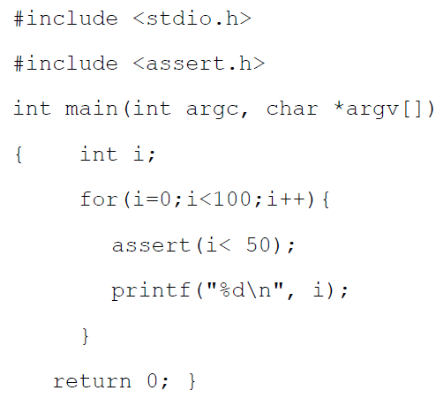

Slide 203
math library functions
Defined in standard library, prototype <math.h>
Need to link by -lm
double sin(x), cos(x), tan(x)
double asin(x) acos(x) atan(x) …
exp(x) e^{x}
log(x) ln(x)
log10(x)
pow(x,y)int
sqrt(x)
ceil(x), floor(x)

Slide 204
Some complier options
Option: -llibrary
  Link with object library gcc main.c –lm
  Links math object library (if use pow() round() sin()etc)
  Don’t forget to use #include <math.h> at the beginning

Slide 205
#include <stdio.h>
#include <string.h>
#include <ctype.h>
#include <stdlib.h>
#define TABLESIZE 50
int main(int argc, char *argv[])
{
char inputs[TABLESIZE][50];
int count = 0; int i;
char wageS[10]; char ageS[10]; char name[60];
int age; float wage;
printf("input name age and wage: ");
scanf("%s %s %s", name, ageS, wageS);
while (strcmp(name,"xx"))
{ ……
slu1

Slide 206
while(strcmp(name,"xx")){ // while (1) …..break
/* strcat(name," "); strcat(name, ageS); strcat(name," "); strcat(name, wageS); strcpy(inputs[count], name);
*/
sprintf(inputs[count], "%s %s %s", name, ageS,wageS);
age = atoi(ageS) + 10;
wage = atof(wageS) *1.5;
name[0] = toupper(name[0]);
}
sprintf(inputs[count+1], "%s %d %.1f", name,age,wage);
scanf("%s %s %s", name, ageS, wageS );
count += 2;
} /* end of while */
printf("\nrecords generated %s %s\n", __DATE__, __TIME__);
for(i=0; i< count; i++) printf(“%s\n”,inputs[i]);
slu1

Slide 207
printf("input name age and wage: ");
scanf("%s %d %lf", name, &age, &wage);
while (strcmp(name,"xx"))
{
sprintf(inputs[count], "%s %d %.1f", name, age,wage);
age += 10;
wage = wage *1.5;
for(i=0; i< strlen(name); i++){
name[i] = toupper(name[i]);
} name[i] = '\0';
sprintf(inputs[count+1], "%s %d %.1f", name,age,wage);
printf("input name age and wage: ");
scanf("%s %d %lf", name, &age, &wage );
count += 2;
}
slu2

Slide 208
slu3
printf("input name age and wage: ");
fgets(inputs[count], 50, stdin); /* add a /n */
while(1){
if(inputs[count][0]=='x' && inputs[count][1]=='x')
break;
sscanf(inputs[count],"%s %d %lf", name, &age, &wage);
age += 10; wage *= 1.5; …..
sprintf(inputs[count+1],"%s %d %.1f\n“,mname,age,wage);
} printf("\nrecords generated %s %s\n", __DATE__, __TIME__);
for(i=0; i< count; i++)
fputs(inputs[i],stdout) /* puts(inputs[i]); */

Slide 209
slu4
printf("input name age and wage: ");
/* fgets(inputs[count], 50, stdin); add a /n */
scanf(" %[^\n]s",inputs[count]);
while(1){
/*if ( ! strcmp(name,"xx")) */
if(inputs[count][0]=='x' && inputs[count][1]=='x')
break;
sscanf(inputs[count],"%s %d %lf", name, &age, &wage);
age += 10; wage *= 1.5; …..
sprintf(inputs[count+1],"%s %d %.1f", name,age,wage);
} printf("\nrecords generated %s %s\n", __DATE__, __TIME__);
for(i=0; i< count; i++)
puts(inputs[i]); /* fputs(inputs[i],stdout) */

Slide 210
Now it is time to start POINTERS!!!

Slide 211
Finished Ch1 – 4
Next lab 4 ….. Lab test mode, but continue from pre-lab
Assignment 1 post last week …. work in group if you like

Slide 212
#if - Conditional Compilation
Often used for platform-specific features
#if defined(__sun)||defined(__sgi)
#define HAVE_RTCLOCK 1
#else
#undef HAVE_RTCLOCK
#endif /* __sun || __sgi */

Slide 213
#include & Header Files
#include inserts the contents of another file at this point (we talked about this before)
#include is usually used for header files, and header files are really just C code
  Function declarations
  Macro definitions
  External Variable declarations
Do this in one spot so other files can just include the header file

Slide 214
Multiple Files Revisited
Looking at last day’s example (calc.c, main.c)
Introduce “calc.h” a header file
Contains declarations for “res” and “square”
calc.h
extern int res;
void square(int x)

Slide 215
Multiple Files Revisited
Now include this header file in both C files
Note that we still need to define “res”
calc.c
main.c
#include <calc.h>
void square(int x)
{
res = x*x;
}
#include <calc.h>
int res; /*!!*/
int main() {
square(5);
printf(“%d\n”,
res);
}

Slide 216
Putting It All Together
A common use of #ifndef is to protect header files from being included more than once
calc2.h
#ifndef CALC2_H
#define CALC2_H
extern int res;
void square(int x);
#endif

Slide 217
Playing with the C Preprocessor
Try:
cc -E wc.c
or with any other C file
“-E” means, “just run the preprocessor”
You may want to look at cc(1) to read about the
“-D” option

Slide 218
Multiple Files
This example is in /cs/course/2031/code_samples/
Compile as:
cc -o calc main.c calc.c
You will find the following files:
  “calc” - the program
  “main.o” and “calc.o” - object files
So what are object files?

Slide 219
How C Programs are Compiled
We’ll talk about the preprocessor shortly
When compiling multiple files, all .c files are converted to .o files
Then all .o files are combined (linked) to make a program.

Slide 220
How C Programs are Compiled
You do not have to do this all in one step
“-c” creates just objects files (“compiles” only)
cc -c main.c
output defaults to “main.o”
cc -c calc.c
cc -o main main.o calc.o

Slide 221
Functions?
We have already seen how to call functions as part of an expression:
while ((c = getchar()) != EOF) …
getchar() is a function with no arguments and a return type of “int”
getchar() returns the next character from the standard input
Q: why does it return “int” instead of “char”?

Slide 222
int main()?
Why use:
int main()
instead of:
void main()?
The return value of main() is the program’s exit status - in main():
return x == exit(x)

Slide 223
Undeclared Functions?
The following program works (as written)
int main() {
printf(“Hello, world\n”);
}
However, we never define or declare “printf”?
Assume:
int printf();

Slide 224
static (Persistent Variables)
Normally variables are not initialized for you (i.e. their values are undefined)
However, for static variables (and external variables) they are explicitly initialized to zero
So the first call to unique_int() returns 0

Slide 225
Some complier options
Option –c
  Suppress the linking process and produce a .o file for each source file listed
    gcc –c main.c cal.c generates main.o and calc.o
  Several .o files can be subsequently linked by the gcc command. gcc main.o calc.o
Option: -llibrary
  Link with object library gcc main.c –lm
  Links math object library (if use pow() round() sin()etc)
  Don’t forget to use #include <math.h> at the beginning

Slide 226
#define
A macro should only be defined once
#define X 5
#define X 3 -- warning
The name of a macro is important (not its arguments)
#define X(x) x
#define X(x,y) x+y -- warning

Slide 227
#define
Macros in substituted values are also evaluated:
#define Y Z y
#define Z z
Y
gives
z y

Slide 228
#define
However - there is no recursion:
#define Y Z y
#define Z Y z
Y
gives
Y z y
Any given macro is only substituted once

Slide 229
## operator
## is the macro concatenation operator
puts two names together without space between them
#define GLUE(x,y) x##y
GLUE(foo,bar)
gives
foobar

Slide 230
#if - Conditional Compilation
We can also use the preprocessor to select what code to compile
#if 1
…… /* This gets compiled */
#else
…… /* This doesn’t */
#endif

Slide 231
#if - Conditional Compilation
#if takes a constant integer expression and macros can be used
#define DEBUG 1
#if DEBUG
printf(“debugging message\n”);
#endif

Slide 232
#if - Conditional inclusion
#ifndef THISFILE
#define THISFILE
#define ….
#define ….
#endif /* THISFILE*/

Slide 233
Declaring Functions
We can omit argument names
  int sum(int, int);
The type of arguments is what matters
But, good practice recommends putting names
char *strcpy(char *, char *);
char *strcpy(char *dest, char *src);
What if we don’t want any arguments?

Slide 234
Type conversions
type function (){
return expr;
}
If expr is not of type type, compiler
  produces a warning
  converts expr (as if by assignment) to the return type of the function
  should avoid
  int function (){
  double x;
  return x; /* return (int)x if you have to
  } tell the complier you know
  what you are doing (losing) */

Slide 235
Static declaration
By default, all global symbols (functions and global variables) in a source file are visible to the world.
Undesirable as it ‘pollutes’ the global namespace and may expose sensitive data.
Using static keyword in front of a global variable or function
  static resu;
  static void sum(int)

Slide 236
#define
How to define a macro MAX(A,B) to represent the maxmium value of A and B
#define MAX(A,B) ((A)>(B)? (A):(B))

Slide 237
‘#’ operator
In macros, ‘#’ can be used to make a string
  #define PRINT(x) printf(“%s\n”,#x)
  PRINT(hello there);
  gives
  printf(“%s\n”,“hello there”);
  adds quotes, escapes double-quotes, e.g.
  PRINT(“hello there”)
  gives
  printf(“%s\n”,“\”hello there\””);

Slide 238
#undef
A macro should only be defined once
#define X 5
#define X 3 -- warning
However, what we can define, we can undefine
#define X 3
X is replaced with “3”
#undef X
X is not replaced
#define X 4
X is replaced with “4”

Slide 239
#if - Conditional Compilation
We can also test to see if a macro is defined
#define DEBUG /* no value needed */
#if defined(DEBUG)
  printf(“debugging\n”);
#endif
#if !defined(DEBUG)
printf(“not debugging\n”);
#endif

Slide 240
#if - Conditional Compilation
defined() and !defined() are so common we have constructs for them:
#define DEBUG
#ifdef DEBUG
printf(“debugging\n”);
#endif
#ifndef DEBUG
printf(“not debugging\n”);
#endif

Slide 241
#if - Conditional Compilation
#define FRANCE
main()
{ #ifdef US printf(“compiled for USA”);
#endif
#ifdef UK printf(“compiled for UK”);
#endif
#ifdef FRANCE printf(“compiled for FR”);
#endif
#ifndef GERMAN printf(“no Germ version”);
#endif }

Slide 242
C preprocessor
#include <> “”
#define
#undefine
#if defined #endif
#ifdef #endif
#if !defined # endif
#ifndef #endif

Slide 243
C preprocessor predefined macro names
_ _LINE_ _
_ _FILE_ _
_ _DATE_ _
_ _TIME_ _
main(){
printf("%s %s\n", __TIME__, __DATE__);
printf("%s %d\n", __FILE__,__LINE__);
}
21:45:54 Jan 28 2013
macro.c 7
Useful for debugging

Slide 244
C preprocessor predefined macro names
_ _LINE_ _ _ _FILE_ _
_ _DATE_ _ _ _TIME_ _ _ _FUNCTION_ _
Useful for debugging
fprintf (stderr, "Internal error: " "negative string length " "%d at %s, line %d.", length, __FILE__, __LINE__);
__FUNCTION__ gcc
__fun__ c99

Slide 245
C preprocessor #include #define
C executables are built in three stages
preprocessor
compiler
linker
hello.c
a.out
hello.o
Handles #include
#define
# if
# __time__
…
Converts C code into binary processor instructions
Puts multiple files together and creates and executable program
macros

Slide 246
Declaring Arrays
As variables
int k[5];
int k[5] = {1,5,3,2,25}; /*array initializer */
int k[5] = {1}; /* valid. (rest is “0”) */
int k[3] = {1,4}; /*valid (k[0]=1, k[1]=4,k[2]=0)
int k[3] ={1,4,2,1 } /*invalid */
int k[ ] ={1,5,3,2,25}; /*valid*/
int k[ ]; /*invalid */

Slide 247
Accessing Arrays
You can only assign to array members individually
This means you cannot assign to an array
Array / strings can not be copied as a whole
int i, k[4], j[4];
for (i=0; i<4; i++)
  j[i]= i;
k = j; /* invalid */
k = {1,2,3,4 }; /* invalid */

Slide 248
Lab 2
r >> 5 << 6; g >> 5 << 3; b >> 5;
r | g | b
mask = 7 << 5;
r = r & mask; g = g & mask; b = b & mask;
r << 1; g >> 2; b >> 5;
r | g | b
r = r & 224; g = g & 224; b = b & 224;
r << 1; g >> 2; b >> 5;
r | g | b

Slide 249
Some announcements

Slide 250
Life time automatic variables
Come to life when the function it is in is invoked,
Vanishes when the function returns
Values are not retained between function calls.
…
int i =3
int j = 4
int k
int sum (int x, int y)
{
int s = x + y;
return s;
}
main(){
int i=3, j=4, k;
k = sum(i,j);
printf (“%d”,k);
}
call sum()
vanish after sum() returns

Slide 251
Life time automatic variables
Come to life when the function it is in is invoked,
Vanishes when the function returns
Values are not retained between function calls.
…
int i =3
int j = 4
int k
int sum (int x, int y)
{
int s = x + y;
return s;
}
main(){
int i=3, j=4, k;
k = sum(i,j);
printf (“%d”,k);
}
call sum()
vanish after sum() returns

Slide 252
Strings == Character Arrays !
There is no separate “string” type in C
  String s = “Hello”;
Strings are just arrays of char that end with ‘\0’
  char s[]=“Hello”; /* size? length? */
  char s []= {‘H’,’e’,’l’,‘l’,’o’,’\0’}
char s[50];
s[0]= ‘H’; s[1] = ‘e’ ….. S[5]=‘\0’
H | e | l | l | o | \0

Slide 253
Other small things
Typedef
typedef int INTEGER
INTEGER x = 4;
man
  man chmod cp …
  man 3 scanf() strlen()
diff youslu myslu

