Slide 1
Digital data representation
Topic for the next few weeks
Representing Numbers
Representing Texts
Representing Audio
Representing Images and graphics
Representing Videos

Slide 2
Representing Numbers
1 + 1 = 10 ?!?
Examples provided by Jones & Bartlett Learning

Slide 3
Representing Numbers
Positional representation
Decimal (base 10)
Binary (base 2)
Octal (base 8)
Hex (base 16)
Conversion between different bases
Binary, Hex, Oct to Decimal (recap)
Binary to/from Hex, Octal
Decimal to Binary, Hex, Oct
Signed Binary representation – 2’s complement
Decimal to 2’s complement (Binary)
2’s complement (Binary) to decimal
Binary representation of fractions.
Binary to Decimal
Decimal to Binary
2
Notes:
Picture, o.w get lost in the journey
Easy fore me, unlike history. Not bragging, every year very challenging
I will try my best, you also try harder

Slide 4
Representing Numbers
Positional representation
Decimal (base 10)
Binary (base 2)
Octal (base 8)
Hex (base 16)
Conversion between different bases
Binary, Hex, Oct to Decimal (recap)
Binary to/from Hex, Octal
Decimal to Binary, Hex, Oct
Signed Binary representation – 2’s complement
Decimal to 2’s complement (Binary)
2’s complement (Binary) to decimal
Binary representation of fractions.
Binary to Decimal
Decimal to Binary
2
Notes:
Easy today.
If today not working today then cannot survive,
So lets try best

Slide 5
Representing Numbers
Positional representation
Decimal (base 10)
Binary (base 2)
Octal (base 8)
Hexadecimal (base 16)
Conversion between different bases
Binary, hex, oct to decimal (recap)
Binary to/from hex and octal
Decimal to binary, hex, octal
Signed binary representation – 2’s complement
2’s complement (binary) to decimal
Decimal to 2’s complement (binary)
Binary representation of fractions
Binary to decimal
Decimal to binary
2
Notes:
Picture, o.w get lost in the journey
Easy fore me, unlike history. Not bragging, every year very challenging
I will try my best, you also try harder

Slide 6
Representing Numbers
Positional representation
Decimal (base 10)
Binary (base 2)
Octal (base 8)
Hexadecimal (base 16)
Conversion between different bases
Binary, hex, oct to decimal (recap)
Binary to/from hex and octal
Decimal to binary, hex, octal
Signed binary representation – 2’s complement
2’s complement (binary) to decimal
Decimal to 2’s complement (binary)
Binary representation of fractions
Binary to decimal
Decimal to binary
2
Notes:
Picture, o.w get lost in the journey
Easy fore me, unlike history. Not bragging, every year very challenging
I will try my best, you also try harder

Slide 7
Numbers
Natural numbers
Zero and any number obtained by repeatedly adding one to it.
Examples: 100, 0, 45645, 32
Negative whole numbers
Values less than 0, indicated with a “–” sign before the left-most digit
Examples: −24, −1, −45645, −32
Side note: Hyphen -, Minus −, N-dash –, and M-dash — are four different typographical symbols; use them correctly in your writing See https://en.wikipedia.org/wiki/Dash for details
2

Slide 8
Numbers
Integers
Values that are either a natural number, or a negative whole number
Examples: 249, 0, −45645, −32
Rational Numbers
Values that are integers, or the quotient of two integers
Examples: −249, −1, 0, 3/7, −2/5
NOTE: π, e, √2, √5… are irrational numbers
3

Slide 9
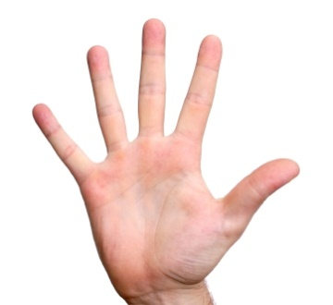
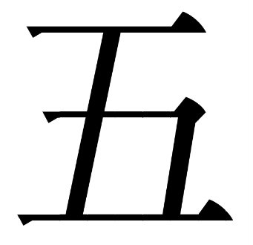
Representing Numbers
How many ways can we represent the numeric value “five”?
5
V
Tally marks used in most of Europe, Zimbabwe, Australia, New Zealand and North America.
Notes:
Tally marks, for sport events

Slide 10
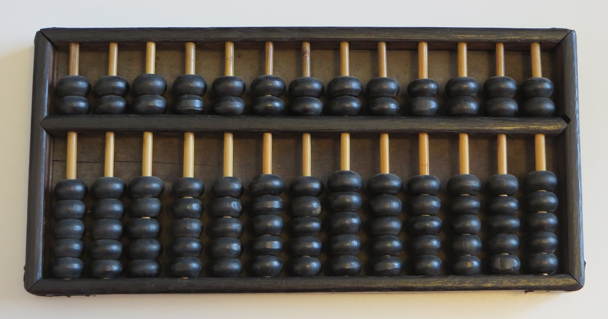
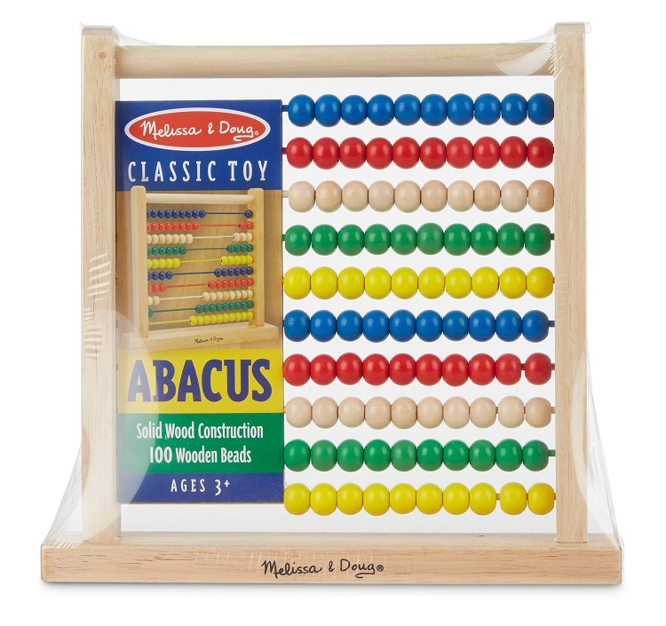
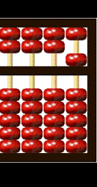
Abacus
amazon.com
Notes:
Rule, but only rule I remember, +1 6 +2 7
Abacas is positional representation, 5, but next not 5 anymore

Slide 11
Positional Notation
428$ four hundreds and twenty-eight
248$ two hundreds and forty-eight
1820$ One thousand, eight hundreds and twenty
2108$ two thousand, one hundreds and eight
Decimal, how many letters
Notes:
Everyone from Kingardon can read. Why 1820 not
Position
Daily Base 10
So far okay, or, already lost?

Slide 12
Positional Notation
48¢ forty-eight cents
428$ four hundreds and twenty-eight dollars
1820 lbs one thousand, eight hundreds and twenty lbs
2108 kgs two thousand, one hundreds and eight kgs
Decimal, how many letters
Notes:
Everyone from Kingardon can read. Why 1820 not
Position
Daily Base 10
So far okay, or, already lost?

Slide 13
Positional Notation
1
Notes:
Image ancient people, before invent geek numbers

Slide 14
Positional Notation
1

Slide 15
Positional Notation
1

Slide 16
Positional Notation
9
8
7
6
5
4
3
2
1
1
Notes:
How to do 10? 1000 ancient people are smart

Slide 17
Positional Notation
9
8
7
6
5
4
3
2
1
10
1
Notes:
People smart

Slide 18
Positional Notation
9
8
7
6
5
4
3
2
1
10
1

Slide 19
Positional Notation
9
8
7
6
5
4
3
2
1
10
1

Slide 20
Positional Notation
9
8
7
6
5
4
3
2
1
10
1

Slide 21
Positional Notation
9
8
7
6
5
4
3
2
1
10
1
Notes:
Echo disk has different weightage.
How to do 20?

Slide 22
9
8
7
6
5
4
3
2
1
10
1

Slide 23
Positional Notation
9
8
7
6
5
4
3
2
1
10
1
Notes:
Echo disk has different weighage.
How to do 30?

Slide 24
9
8
7
6
5
4
3
2
1
10
1

Slide 25
Positional Notation
9
8
7
6
5
4
3
2
1
1000
(10³)
100
(10²)
10
(10¹)
1
(10⁰)
Notes:
What value? 18 disks to represent 99

Slide 26
Positional Notation
9
8
7
6
5
4
3
2
1
1000
(10³)
100
(10²)
10
(10¹)
1
(10⁰)

Slide 27
Positional Notation
9
8
7
6
5
4
3
2
1
1000
(10³)
100
(10²)
10
(10¹)
1
(10⁰)

Slide 28
Positional Notation
9
8
7
6
5
4
3
2
1
1000
(10³)
100
(10²)
10
(10¹)
1
(10⁰)
1820
Notes:
Draw couple on 10 1 part

Slide 29
Positional Notation
10⁴ 10³ 10² 10¹ 10⁰
10000 1000 100 10 1
Allows us to count past 10 while using just 10 digits
Each column of a number represents a power of the base. The exponent is the order of magnitude for the column
Notes:
Here summary.
May not think about position, or take for granted

Slide 30
Positional Notation
10⁴ 10³ 10² 10¹ 10⁰
10000 1000 100 10 1
The Decimal system is based on the number of digits we (usually) have
Notes:
10 power of sth formally math

Slide 31
Positional Notation
… 10⁴ 10³ 10² 10¹ 10⁰
… 10000 1000 100 10 1
The magnitude of each column is the base, raised to its exponent

Slide 32
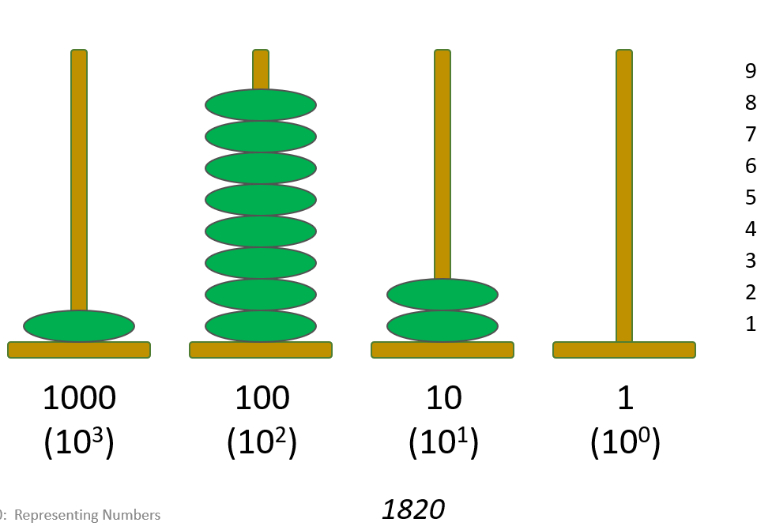
Positional Notation
10⁴ 10³ 10² 10¹ 10⁰
10000 1000 100 10 1
1 8 2 0
1000 +800 +20 +0
=1820
The magnitude of a number is determined by multiplying the magnitude of the column by the digit in the column and summing the products

Slide 33
Positional Notation
10⁴ 10³ 10² 10¹ 10⁰
10000 1000 100 10 1
2 7 9 1 6
20000+7000 +900 +10 +6
=27916
The magnitude of a number is determined by multiplying the magnitude of the column by the digit in the column and summing the products
Another example
Notes:
Draw. Anyone lost already?

Slide 34
Representing Numbers
Positional representation
Decimal (base 10)
Binary (base 2)
Octal (base 8)
Hexadecimal (base 16)
Conversion between different bases
Binary, hex, oct to decimal (recap)
Binary to/from hex and octal
Decimal to binary, hex, octal
Signed binary representation – 2’s complement
2’s complement (binary) to decimal
Decimal to 2’s complement (binary)
Binary representation of fractions
Binary to decimal
Decimal to binary
2
Notes:
Picture, o.w get lost in the journey
Easy fore me, unlike history. Not bragging, every year very challenging
I will try my best, you also try harder

Slide 35
Non-Decimal Number Systems
Number can be in any base, 2, 3, 4, …, 8, 9,10,11… 16 …..
Decimal is base 10 and has 10 digit symbols:
0, 1, 2, 3, 4, 5, 6, 7, 8, 9 [0 ~ 10-1]
Binary is base 2 and has 2 digit symbols:
0,1 [0 ~ 2-1]
Octal is base 8 and has 8 digit symbols:
0,1,2,3,4,5,6,7 [0 ~ 8-1]
Hexdecimal is base 16 and has 16 digit symbols:
0,1,2,3,4,5,6,7,8,9, A,B,C,D,E,F [0 ~16-1]
For a value to exist in a given base, it can only contain the digits in that base, which range from 0 up to (but not including) the base.
[ 0 ~ base-1 ]
What bases can these values be in? 122, 198, 178, G1A4
Notes:
Generally base

Slide 36
Positional Notation
An n-digit unsigned integer in base b
(d_{i} is the digit in the i^{th} position in the number)
The number: ( d_{n − 1} d_{n − 2} … d_{i} … d₁ d₀ )_{b}
Its value =
d_{n − 1}×b^{n − 1} + d_{n − 2}×b^{n − 2} + ... + d_{i}×b^{i} ... + d₁×b¹ + d₀×b⁰
Examples:
(642)₁₀ = 6×10² + 4×10¹ + 2×10⁰ = 642
(5073)₈ = 5×8³ + 0×8² + 7×8¹ + 3×8⁰ = 2619
(1011)₂ = 1×2³ + 0×2² + 1×2¹ + 1×2⁰ = 11
7
Notes:
Another rule. Draw 2³ 2² 2¹ 2⁰ Mega

Slide 37
Binary
Binary is base 2 and has 2 digit symbols:
0,1
8
(2³)
4
(2²)
2
(2¹)
1
(2⁰)

Slide 38
Binary
Binary is base 2 and has 2 digit symbols:
0,1
8
(2³)
4
(2²)
2
(2¹)
1
(2⁰)
0001
Notes:
0001
How to do 2?

Slide 39
Binary is base 2 and has 2 digit symbols:
0,1
8
(2³)
4
(2²)
2
(2¹)
1
(2⁰)
0010 Not 10 checkback
Notes:
0010 Not 10, check back

Slide 40
Binary is base 2 and has 2 digit symbols:
0,1
8
(2³)
4
(2²)
2
(2¹)
1
(2⁰)

Slide 41
Binary is base 2 and has 2 digit symbols:
0,1
8
(2³)
4
(2²)
2
(2¹)
1
(2⁰)

Slide 42
Binary is base 2 and has 2 digit symbols:
0,1
8
(2³)
4
(2²)
2
(2¹)
1
(2⁰)
Notes:
Not 101 ,

Slide 43
Binary is base 2 and has 2 digit symbols:
0,1
8
(2³)
4
(2²)
2
(2¹)
1
(2⁰)

Slide 44
Binary is base 2 and has 2 digit symbols:
0,1
8
(2³)
4
(2²)
2
(2¹)
1
(2⁰)
Notes:
Must be 7

Slide 45
Binary is base 2 and has 2 digit symbols:
0,1
8
(2³)
4
(2²)
2
(2¹)
1
(2⁰)

Slide 46
Binary is base 2 and has 2 digit symbols:
0,1
8
(2³)
4
(2²)
2
(2¹)
1
(2⁰)
Notes:
1001

Slide 47
Binary is base 2 and has 2 digit symbols:
0,1
8
(2³)
4
(2²)
2
(2¹)
1
(2⁰)

Slide 48
Binary is base 2 and has 2 digit symbols:
0,1
8
(2³)
4
(2²)
2
(2¹)
1
(2⁰)

Slide 49
Binary is base 2 and has 2 digit symbols:
0,1
8
(2³)
4
(2²)
2
(2¹)
1
(2⁰)

Slide 50
Binary is base 2 and has 2 digit symbols:
0,1
8
(2³)
4
(2²)
2
(2¹)
1
(2⁰)

Slide 51
Binary is base 2 and has 2 digit symbols:
0,1
8
(2³)
4
(2²)
2
(2¹)
1
(2⁰)

Slide 52
Binary is base 2 and has 2 digit symbols:
0,1
8
(2³)
4
(2²)
2
(2¹)
1
(2⁰)
Notes:
1111 16 how trick

Slide 53
Binary Numbers and Computers
Computers have storage units called binary digits or bits
for instance,
Low Voltage = 0
High Voltage = 1 all bits are 0 or 1
An analog and a digital signal
22
Degradation of analog and digital signals

Slide 54
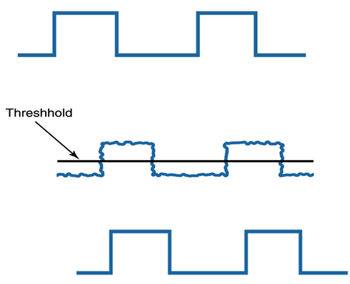
Binary Numbers and Computers
Computers have storage units called binary digits or bits
for instance,
Low Voltage = 0
High Voltage = 1 all bits are 0 or 1
22

Slide 55
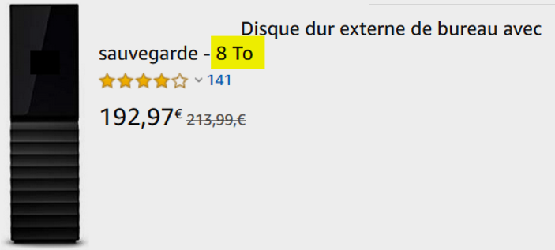
Binary Numbers and Computers
Byte
8 bits
The number of bits in a word determines the word length of the computer, which is usually a multiple of 8
32-bit machines
64-bit machines etc.
Longer words – performance and other benefits
NOTE: technically, byte does not need to be 8 bits; it’s a de facto standard
A similar term is octet (in French, it’s used more than byte); it is always 8 bits

Slide 56
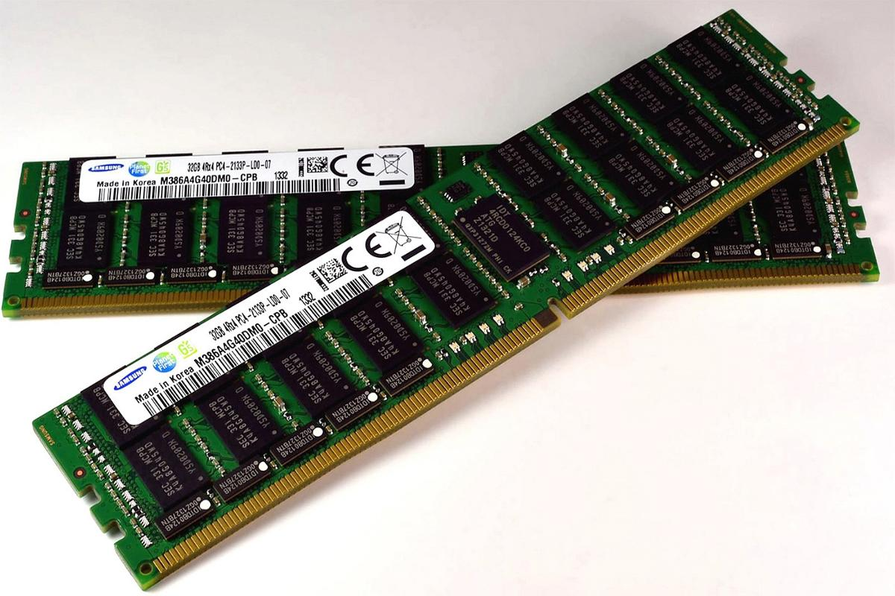
Bit/byte/K/M/G/T
int x;
1 bit
1 byte (8 bits)
4 byte (32 bits)

Slide 57
= 26
Notes:
Binary summary

Slide 58
A Single Byte
2⁷ 2⁶ 2⁵ 2⁴ 2³ 2² 2¹ 2⁰
128 64 32 16 8 4 2 1
1 1 1 1 1 1 1 1
128 +64 +32 +16 +8 +4 + 2 + 1
=255

Slide 59
A Single Byte
2⁷ 2⁶ 2⁵ 2⁴ 2³ 2² 2¹ 2⁰
128 64 32 16 8 4 2 1
1 1 1 1 1 1 1 1
128 +64 +32 +16 +8 +4 + 2 + 1
=255

Slide 60
A Single Byte
2⁷ 2⁶ 2⁵ 2⁴ 2³ 2² 2¹ 2⁰
128 64 32 16 8 4 2 1
1 1 1 1 1 1 1 1
128 +64 +32 +16 +8 +4 + 2 + 1
=255

Slide 61
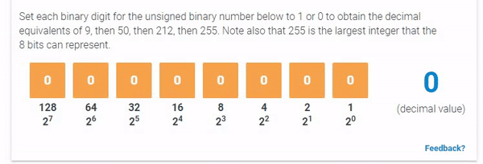
A Single Byte
2⁷ 2⁶ 2⁵ 2⁴ 2³ 2² 2¹ 2⁰
128 64 32 16 8 4 2 1
1 1 1 1 1 1 1 1
128 +64 +32 +16 +8 +4 + 2 + 1
=255

Slide 62
A Single Byte
2⁷ 2⁶ 2⁵ 2⁴ 2³ 2² 2¹ 2⁰
128 64 32 16 8 4 2 1
0 0 0 0 0 0 0 0
0 +0 +0 +0 +0 +0 + 0 + 0
=0
There is also a representation for zero, giving 256 (2⁸) possible combinations of 0 and 1 in 8 bits
1 bit: 2 values (0, 1); 2 bits: 4 values (00, 01, 10, 11); …
Every one bit added doubles the range of values

Slide 63
A Single Byte
2⁷ 2⁶ 2⁵ 2⁴ 2³ 2² 2¹ 2⁰
128 64 32 16 8 4 2 1
1 1 1 1 1 1 1 1
128 +64 +32 +16 +8 +4 + 2 + 1
=255
255 is the largest value (in decimal) that can be expressed using 8 bits
Max using 2 bits?
Max using 4 bits?

Slide 64
Binary representations
3 2 8
3*10² + 2*10¹ + 8*10⁰ =
300 + 20 + 8 = 328
Decimal 328
10² 10¹ 10⁰
8
(2³)
4
(2²)
2
(2¹)
1
(2⁰)
…
2² 2¹ 2⁰
… 2⁵ 2⁴ 2³
Binary
0 0 0 0 0 0 0 0 0 0 0 0 0 1 0 1
… 2⁶ 2⁵ 2⁴ 2³
2² 2¹ 2⁰
1*2² + 0*2¹ + 1*2⁰ =
4 + 0 + 1 = 5

Slide 65
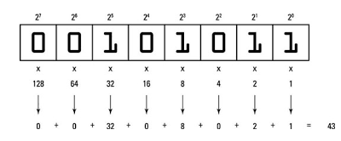
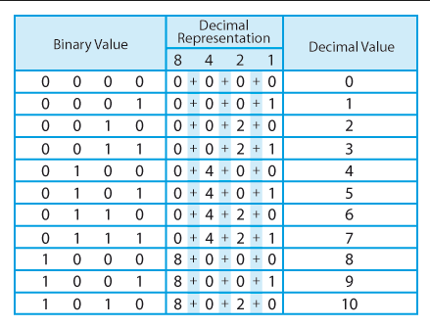
Notes:
Do it again

Slide 66
Binary, Oct and Hex to Decimal
Give the Decimal equivalent of the following
Binary 000…010₂
Binary 000…..0111₂
Binary 000…..1010₂
Binary 000…11010 ₂
Binary 000…1010111 ₂
Binary 000…10100010 ₂
2
7
10
26
87
162

Slide 67
Arithmetic in Binary
Remember that there are only 2 digit symbols in binary, 0 and 1
0 + 0 is 0
0 + 1 is 1
1 + 1 is 0 with a carry
Carry Values
1 0 1 1 1 1 1
1 0 1 0 1 1 1
+1 0 0 1 0 1 1
1 0 1 0 0 0 1 0

Slide 68
Binary representations, arithmetic
3 + 4 ?
00…0 0 1 1
00…0 1 0 0
00…0 1 1 1
3 + 1 ?
0 0…0 0 1 1
0 0…0 0 0 1
0 0 …01 0 0
3 + 5 ?
0 0…0 0 1 1
0 0…0 1 0 1
0 0…1 0 0 0
7
4
8
Remember that there are only 2 digit symbols in binary, 0 and 1
1 + 1 is 0 with a carry
1+1+1 is 1 with a carry
3 + 7 ?
0 0…0 0 1 1
0 0…0 1 1 1
0 0…1 0 1 0
1 0 1 1 1 1 1
1 0 1 0 1 1 1
+1 0 0 1 0 1 1
1 0 1 0 0 0 1 0
10
87
75
162
Notes:
Our notation , carry draw on below

Slide 69
Representing Numbers
Positional representation
Decimal (base 10)
Binary (base 2)
Octal (base 8)
Hex (base 16)
Conversion between different bases
Binary, Hex, Oct to Decimal (recap)
Binary to/from Hex, Octal
Decimal to Binary, Hex, Oct
Signed Binary representation – 2’s complement
Decimal to 2’s complement (Binary)
2’s complement (Binary) to decimal
Binary representation of fractions.
Binary to Decimal
Decimal to Binary
2

Slide 70
Representing Numbers
Positional representation
Decimal (base 10)
Binary (base 2)
Octal (base 8)
Hexadecimal (base 16)
Conversion between different bases
Binary, hex, oct to decimal (recap)
Binary to/from hex and octal
Decimal to binary, hex, octal
Signed binary representation – 2’s complement
2’s complement (binary) to decimal
Decimal to 2’s complement (binary)
Binary representation of fractions
Binary to decimal
Decimal to binary
2
Notes:
Picture, o.w get lost in the journey
Easy fore me, unlike history. Not bragging, every year very challenging
I will try my best, you also try harder

Slide 71
For base B, B digit symbols
[0~B-1]
= 851
= 46687

Slide 72
For base B, B digit symbols
[0~B-1]
= 851
= 46687

Slide 73
Positional Notation
Octal is base 8 and has 8 digit symbols:
0,1,2,3,4,5,6,7
7
6
5
4
3
2
1
64
(8²)
8
(8¹)
1
(8⁰)

Slide 74
Positional Notation
Octal is base 8 and has 8 digit symbols:
0,1,2,3,4,5,6,7
7
6
5
4
3
2
1
64
(8²)
8
(8¹)
1
(8⁰)

Slide 75
Positional Notation
Octal is base 8 and has 8 digit symbols:
0,1,2,3,4,5,6,7
7
6
5
4
3
2
1
64
(8²)
8
(8¹)
1
(8⁰)

Slide 76
Positional Notation
Octal is base 8 and has 8 digit symbols:
0,1,2,3,4,5,6,7
7
6
5
4
3
2
1
64
(8²)
8
(8¹)
1
(8⁰)
Notes:
Next? 18? Draw 18

Slide 77
Positional Notation
Octal is base 8 and has 8 digit symbols:
0,1,2,3,4,5,6,7
7
6
5
4
3
2
1
64
(8²)
8
(8¹)
1
(8⁰)

Slide 78
Positional Notation
Octal is base 8 and has 8 digit symbols:
0,1,2,3,4,5,6,7
7
6
5
4
3
2
1
64
(8²)
8
(8¹)
1
(8⁰)
Must be 63, why?
Notes:
Must be 63, why? Next is 64
Just a trick. If not comfortable, just go with traditional way, always work

Slide 79
Positional Notation
Octal is base 8 and has 8 digit symbols:
0,1,2,3,4,5,6,7
7
6
5
4
3
2
1
64
(8²)
8
(8¹)
1
(8⁰)

Slide 80
Positional Notation
Octal is base 8 and has 8 digit symbols:
0,1,2,3,4,5,6,7
7
6
5
4
3
2
1
64
(8²)
8
(8¹)
1
(8⁰)
Ask to do
Notes:
Will tell 345 base 8, as it can also be decimal, hex
Ask you to do answer next page?

Slide 81
Others To decimal
3 4 5
3*10² + 4*10¹ + 5*10⁰ =
300 + 40 + 5= 345
Decimal 328
10² 10¹ 10⁰
1 0 1
1*2² + 0*2¹ + 1*2⁰ =
4 + 0 + 1 = 5
2² 2¹ 2⁰
Binary
3 4 5
3*8² + 4*8¹ + 5*8⁰ =
192 + 32 + 5 = 229
Octal 345
8² 8¹ 8⁰
3 8 5
3 4 9
Octal
You should know these conversions.
Notes:
Like 01210 binary

Slide 82
= 851
10
11
12
13
14
15
= 46687
Notes:
46687 later

Slide 83
F
E
D
C
B
A
9
8
7
6
5
4
3
2
1
Positional Notation
256
(16²)
16
(16¹)
1
(16⁰)
Notes:
09 BTW not valid in Oct

Slide 84
F
E
D
C
B
A
9
8
7
6
5
4
3
2
1
Positional Notation
256
(16²)
16
(16¹)
1
(16⁰)
BTW, not valid for base 8
Notes:
009 BTW, not valid for base 8

Slide 85
F
E
D
C
B
A
9
8
7
6
5
4
3
2
1
Positional Notation
256
(16²)
16
(16¹)
1
(16⁰)

Slide 86
F
E
D
C
B
A
9
8
7
6
5
4
3
2
1
Positional Notation
256
(16²)
16
(16¹)
1
(16⁰)

Slide 87
F
E
D
C
B
A
9
8
7
6
5
4
3
2
1
Positional Notation
256
(16²)
16
(16¹)
1
(16⁰)
Check with cleavebook
Notes:
9A 154

Slide 88
F
E
D
C
B
A
9
8
7
6
5
4
3
2
1
Positional Notation
256
(16²)
16
(16¹)
1
(16⁰)
Check with cleavebook
Notes:
BC 188

Slide 89
F
E
D
C
B
A
9
8
7
6
5
4
3
2
1
Positional Notation
256
(16²)
16
(16¹)
1
(16⁰)
Must be 255

Slide 90
F
E
D
C
B
A
9
8
7
6
5
4
3
2
1
Positional Notation
256
(16²)
16
(16¹)
1
(16⁰)

Slide 91
F
E
D
C
B
A
9
8
7
6
5
4
3
2
1
Positional Notation
256
(16²)
16
(16¹)
1
(16⁰)
Notes:
345 -> 837 next page
Before 345 in base 8 229 345

Slide 92
Others To decimal
3 4 5
3*10² + 4*10¹ + 5*10⁰ =
300 + 40 + 5= 345
Decimal 328
10² 10¹ 10⁰
1 0 1
1*2² + 0*2¹ + 1*2⁰ =
4 + 0 + 1 = 5
2² 2¹ 2⁰
Binary
3 4 5
3*8² + 4*8¹ + 5*8⁰ =
192 + 32 + 5 = 229
Octal 345
8² 8¹ 8⁰
3 4 5
3*16² + 4*16¹ + 5*16⁰ =
3*256 + 4*16 + 5 *1 =
768 + 64 + 5 = 837
Hex 345
16² 16¹ 16⁰
You should know these conversions.
3 H
3 G 5
Notes:
Do the cleaver calculator
Now should be alarmed. But valid base 20

Slide 93
Non-Decimal Number Systems
Number can be in any base, 2, 3, 4, …8, 10, 13, 15, 16 …..
Decimal is base 10 and has 10 digit symbols:
0, 1, 2, 3, 4, 5, 6, 7, 8, 9
Binary is base 2 and has 2 digit symbols:
0,1
Octal is base 8 and has 8 digit symbols:
0,1,2,3,4,5,6,7
Hexdecimal is base 16 and has 16 digit symbols:
0,1,2,3,4,5,6,7,8,9, A,B,C,D,E,F
base 5 and has ? digit symbols
base 7 and has ? digit symbols
0,1,2,3,4
0,1,2,3,4,5,6
For a value to exist in a given base, it can only contain the digits in that base, which range from 0 up to (but not including) the base.
[ 0 ~ base-1 ]
What bases can these values be in? 122, 198, 178, G1A4
Notes:
Another kind of questions
122 can be base 3 4 5 …. Do 122₄ 26 122₅ 37
Base >=10
G >= 17

Slide 94
Representing Numbers
Positional representation
Decimal (base 10)
Binary (base 2)
Octal (base 8)
Hexadecimal (base 16)
Conversion between different bases
Binary, hex, oct to decimal (recap)
Binary to/from hex and octal
Decimal to binary, hex, octal
Signed binary representation – 2’s complement
2’s complement (binary) to decimal
Decimal to 2’s complement (binary)
Binary representation of fractions
Binary to decimal
Decimal to binary
2

Slide 95
Positional Notation
An n-digit unsigned integer in base b
(d_{i} is the digit in the i^{th} position in the number)
The number: ( d_{n − 1} d_{n − 2} … d_{i} … d₁ d₀ )_{b}
Its value =
d_{n − 1}×b^{n − 1} + d_{n − 2}×b^{n − 2} + ... + d_{i}×b^{i} ... + d₁×b¹ + d₀×b⁰
Examples:
(642)₁₀ = 6×10² + 4×10¹ + 2×10⁰ = 642
(5073)₈ = 5×8³ + 0×8² + 7×8¹ + 3×8⁰ = 2619
(1011)₂ = 1×2³ + 0×2² + 1×2¹ + 1×2⁰ = 11
(3214)₅ =
= 434
7
Notes:
Now should do any base. Do the 3214 -> 434

Slide 96
Converting Binary to Decimal
What is the decimal equivalent of the binary number 1101110?
1 x 2⁶ = 1 x 64 = 64
+ 1 x 2⁵ = 1 x 32 = 32
+ 0 x 2⁴ = 0 x 16 = 0
+ 1 x 2³ = 1 x 8 = 8
+ 1 x 2² = 1 x 4 = 4
+ 1 x 2¹ = 1 x 2 = 2
+ 0 x 2º = 0 x 1 = 0
= 110 in base 10
Notes:
110

Slide 97
Converting Octal to Decimal
What is the decimal equivalent of the octal number 642?
642₈
6 x 8² = 6 x 64 = 384
+ 4 x 8¹ = 4 x 8 = 32
+ 2 x 8º = 2 x 1 = 2
= 418 in base 10
11
Notes:
418

Slide 98
Converting Hexadecimal to Decimal
What is the decimal equivalent of the hexadecimal number DEF?
DEF₁₆
D x 16² = 13 x 256 = 3328
+ E x 16¹ = 14 x 16 = 224
+ F x 16º = 15 x 1 = 15
= 3567 in base 10
Remember, the digit symbols in base 16 are 0,1,2,3,4,5,6,7,8,9,A,B,C,D,E,F
No cal in test, but simpler…
Notes:
3567
Check with cleave? Lower letter deliberately

Slide 99
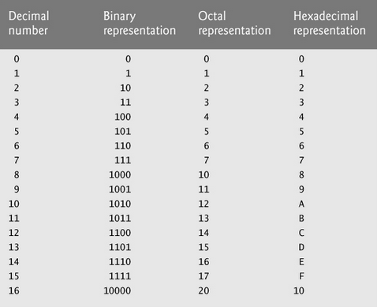
a=16 a=10000 ₂ a= 20 ₈ a= 10 ₁₆
a=76 a=1001100 ₂ a= 114 ₈ a= 4C ₁₆

Slide 100
Positional Notation
An n-digit unsigned integer in base b
(d_{i} is the digit in the i^{th} position in the number)
The number: ( d_{n − 1} d_{n − 2} … d_{i} … d₁ d₀ )_{b}
Its value =
d_{n − 1}×b^{n − 1} + d_{n − 2}×b^{n − 2} + ... + d_{i}×b^{i} ... + d₁×b¹ + d₀×b⁰
Examples:
(642)₁₀ = 6×10² + 4×10¹ + 2×10⁰ = 642
(5073)₈ = 5×8³ + 0×8² + 7×8¹ + 3×8⁰ = 2619
(1011)₂ = 1×2³ + 0×2² + 1×2¹ + 1×2⁰ = 11
(3214)₅ =
= 434
7
Notes:
Now should do any base. Do the 3214 -> 434

Slide 101
Representing Numbers
Positional representation
Decimal (base 10)
Binary (base 2)
Octal (base 8)
Hexadecimal (base 16)
Conversion between different bases
Binary, hex, oct to decimal (recap)
Binary to/from hex and octal
Decimal to binary, hex, octal
Signed binary representation – 2’s complement
2’s complement (binary) to decimal
Decimal to 2’s complement (binary)
Binary representation of fractions
Binary to decimal
Decimal to binary
2

Slide 102
Large Numbers
255 is the largest integer that can be represented in 8 bits, but larger values can be represented with more bits.
For example, 27916 is represented by:
0110110100001100
Can you remember the Binary representation?
Notes:
Communicate error
27916 is better but calculate

Slide 103
Large Numbers
255 is the largest integer that can be represented in 8 bits, but larger values can be represented with more bits.
For example, 27916 is represented by:
011011010000110
Can you remember the Binary representation?

Slide 104
Short Forms for Binary
Because large numbers require long strings of Binary digits, short forms have been developed to help deal with them.
An early system used was called Octal
It’s based on the 8 patterns in 3 bits
Later system used was called Hexadecimal,
It’s based on the 16 patterns in 4 bits

Slide 105
Binary to/from others -- why Hex and Octal
I want an int with representation 0011011010000110
, how to denote it?
Inconvenient to write 0011011010000110
1 1 0 1 1 0 1 0 0 0 0 1 1 0
2¹³ 2¹² 2¹¹ 2¹⁰ 2⁹ 2⁸ 2⁷ 2⁶ 2⁵ 2⁴ 2³ 2² 2¹ 2⁰
8192 4096 1024 512 128 4 2 = 13958
Decimal
0 1 0 0 1 1 0 0
1*2⁶ +1*2³ +1*2² =
64 + 8 + 4 int a = 76
a = 0114
Octal
1 1 4
Easier way?
Hex 0x34F
0 1 0 0 1 1 0 0
a = 0X4C
= 0x4c
Hex
4 C

Slide 106
Short Forms for Binary - Octal
111 | 7
110 | 6
101 | 5
100 | 4
011 | 3
010 | 2
001 | 1
000 | 0
0011011010000110
Can be shortened by dividing the number into 3-bit chunks, starting from the least significant bit and replacing each with a single Octal digit

Slide 107
Short Forms for Binary - Octal
111 | 7
110 | 6
101 | 5
100 | 4
011 | 3
010 | 2
001 | 1
000 | 0
000011011010000110
0 3 3 2 0 6
Inserted to make a complete group of 3 bits
0 3 3 2 0 6
Notes:
33206
Other way also easy colleague convert back to binary

Slide 108
Binary to Octal Examples
Try these:
111100₂
100101₂
111001₂
1100101₂
Hint: when the leftmost group has fewer than three digits, fill with zeroes from the left:
1100101 = 1 100 101 = 001 100 101
110011101

Slide 109
Binary to Octal Examples
Try these:
111100₂ = 74₈
100101₂ = 45₈
111001₂ = 71₈
1100101₂ = 145₈
Hint: when the leftmost group has fewer than three digits, fill with zeroes from the left:
1100101 = 1 100 101 = 001 100 101
110011101₂ = 635₈

Slide 110
Short Forms for Binary - Hexadecimal
0111 | 7 | 1111 | F
0110 | 6 | 1110 | E
0101 | 5 | 1101 | D
0100 | 4 | 1100 | C
0011 | 3 | 1011 | B
0010 | 2 | 1010 | A
0001 | 1 | 1001 | 9
0000 | 0 | 1000 | 8
It was later determined that using base 16 and 4 bit patterns would be more efficient
2 hex digits = 8 bits (1 byte)
Since there are only 10 numerical digits, 6 letters were added to complete the set of hexadecimal digits

Slide 111
Short Forms for Binary - Hexadecimal
0111 | 7 | 1111 | F
0110 | 6 | 1110 | E
0101 | 5 | 1101 | D
0100 | 4 | 1100 | C
0011 | 3 | 1011 | B
0010 | 2 | 1010 | A
0001 | 1 | 1001 | 9
0000 | 0 | 1000 | 8
0011011010000110
can be short-formed by dividing the number into 4-bit chunks -- starting from the least significant bit (LSB) -- and replacing each with a single Hexadecimal digit.
0011011010000110
Notes:
LSB
3686

Slide 112
Short Forms for Binary - Hexadecimal
0111 | 7 | 1111 | F
0110 | 6 | 1110 | E
0101 | 5 | 1101 | D
0100 | 4 | 1100 | C
0011 | 3 | 1011 | B
0010 | 2 | 1010 | A
0001 | 1 | 1001 | 9
0000 | 0 | 1000 | 8
0011011010000110
3 6 8 6
Number base notations:
3686₁₆
(3686)₁₆
3686h
3686_{hex}
0x3686
Used in this course, math literature
Used in computer science articles
Some prog. languages

Slide 113
Binary to/from others -- why Hex and Octal
“I want an int with representation 0011011010000110, how to code it in C?”
Inconvenient to write 11011010000110
1 1 0 1 1 0 1 0 0 0 0 1 1 0
Decimal
2¹³ 2¹² 2¹¹ 2¹⁰ 2⁹ 2⁸ 2⁷ 2⁶ 2⁵ 2⁴ 2³ 2² 2¹ 2⁰
13958₁₀
8192+4096+1024+512+128+4+2= 13958
1 1 0 1 1 0 1 0 0 0 0 1 1 0
Octal
33206₈
3 3 2
0 6
easier
Hex 0x34F
1 1 0 1 1 0 1 0 0 0 0 1 1 0
Hex
3 6
8 6
3686₁₆
easier
You should know these conversions (both ways).
Notes:
summary

Slide 114
Binary to/from others -- why Hex and Octal
I want an int with representation 01001100, how to denote it?
Inconvenient to write 01001100
0 1 0 0 1 1 0 0
Decimal
1*2⁶ +1*2³ +1*2² =
64 + 8 + 4 76
2⁷ 2⁶ 2⁵ 2⁴ 2³ 2² 2¹ 2⁰
0 1 0 0 1 1 0 0
114₈
Octal
1 1 4
Hex 0x34F
0 1 0 0 1 1 0 0
4C₁₆
4c₁₆
Hex
4 12 -- C
You should know these conversions (both ways).
Notes:
Another simpler example

Slide 115
Binary to Hexadecimal Examples
Try these:
11011100₂
10110101₂
10011001₂
110110101₂
Hint: when the leftmost group has fewer than four digits, fill with zeroes on the left:
110110101 = 1 1011 0101 = 0001 1011 0101
1101001011101₂

Slide 116
Binary to Hexadecimal Examples
Try these:
11011100₂ = DC₁₆
10110101₂ = B5₁₆
10011001₂ = 99₁₆
110110101₂ = 1B5₁₆
Hint: when the leftmost group has fewer than four digits, fill with zeroes on the left:
110110101 = 1 1011 0101 = 0001 1011 0101
1101001011101₂ = 1A5D₁₆

Slide 117
Summary: base conversion methods
10
decimal
Sum scaled positional values
(1011)₂ = 1×2³ + 0×2² + 1×2¹ + 1×2⁰ = 11
(5073)₈ = 5×8³ + 0×8² + 7×8¹ + 3×8⁰ = 2619
2
binary
3-bit
grouping
4-bit
grouping
0011011010000110
3 6 8 6
8
oct
16
hex
000011011010000110
0 3 3 2 0 6

Slide 118
Representing Numbers
Positional representation
Decimal
Binary
Octal
Hex
Conversion between different bases
Binary, Hex, Oct to Decimal (recap)
Binary to/from Hex, Octal (special relations)
Decimal to Binary, Hex, Oct
Signed Binary representation – 2’s complement
Decimal to 2’s complement (Binary)
2’s complement (Binary) to decimal
Binary representation of fractions.
Binary to Decimal
Decimal to Binary
2
Notes:
Opsite to
But mathematic

Slide 119
Representing Numbers
Positional representation
Decimal (base 10)
Binary (base 2)
Octal (base 8)
Hexadecimal (base 16)
Conversion between different bases
Binary, hex, oct to decimal (recap)
Binary to/from hex and octal
Decimal to binary, hex, octal
Signed binary representation – 2’s complement
2’s complement (binary) to decimal
Decimal to 2’s complement (binary)
Binary representation of fractions
Binary to decimal
Decimal to binary
2

Slide 120
How to extract the Least Significant Digit
$${\left(d_{n−1}d_{n−2}{⋯d}_{1}d_{0}\right)}_{b}$$
$$=d_{n−1}∗b^{n−1}+d_{n−2}∗b^{n−2}+⋯+d_{1}∗b^{1}+d_{0}∗b^{0}$$
$$=\left(d_{n−1}∗b^{n−2}+d_{n−2}∗b^{n−3}+⋯+d_{1}∗b^{0}\right)∗b+d_{0}$$
$$={\left(d_{n−1}d_{n−2}{⋯d}_{1}\right)}_{b} ∗ b + d_{0}$$
One less digit
Example: ${ \left(402213\right)}_{5} = {\left(40221\right)}_{5} ×5 + 3$
Example: ${ \left(402213\right)}_{10} = {\left(40221\right)}_{10}×10 + 3$
Example: ${ \left(40221\right)}_{10} = {\left(4022\right)}_{10}×10 +1$
Divide base, remainder gives the right most digit.
(quotient) Divide base, remainder gives the 2nd right most digit.
(new quotient) Divide base, remainder gives the 3rd right most digit.
….

Slide 121
Converting Decimal to Other Bases
Divide base, remainder gives the right most digit.
Divide base, remainder gives the 2nd right most digit.
Divide base, remainder gives the 3rd right most digit.
….
Algorithm for converting number in base 10 to other bases (e.g., base b)
While (the quotient is not zero)
Divide the decimal number by the new base b.
Make the remainder the next digit to the left in the answer.
Replace the original decimal number with the quotient.
$${\left(d_{n−1}d_{n−2}{⋯d}_{1}d_{0}\right)}_{b} (divide by b ) = \underset{Quotient}{\underbrace{{\left(d_{n−1}d_{n−2}{⋯d}_{1}\right)}_{b}}} × b + \underset{Remainder}{\underbrace{{ d}_{0} }}$$
Notes:
Little less obvious now.
So just remember the rule

Slide 122
Converting Decimal to Binary
What is 9 (base 10) in binary (base 2)?
Try it!
What is 37 (base 10) in binary (base 2)?
Try it!

Slide 123
Converting Decimal to Binary
Quotient Remainder (division by 2)
9 ( 9 = 2*4 + 1)
4 1
2 0
1 0
0 1
1
0
0
1
( 9 ) ₁₀ = ( 1 0 0 1 ) ₂
Let’s check by converting back
Notes:
As long as smaller, last step

Slide 124
Converting Decimal to Binary
Quotient Remainder (division by 2)
37 ( 37 = 2*18 + 1)
18 1
9 0
4 1
2 0
1 0
0 1
1
0
0
1
0
1
( 3 7 ) ₁₀ = ( 1 0 0 1 0 1 ) ₂
Let’s check by converting back

Slide 125
Converting Decimal to Octal
What is 43 (base 10) in base 8?
Try it!
What is 1988 (base 10) in base 8?
Try it!
Notes:
Idea is exactly the same just by 8

Slide 126
Converting Decimal to Octal
Quotient Remainder (division by 8)
43 ( 43 = 8*5 + 3)
5 3
0 5
5
3
( 43) ₁₀ = ( 53) ₈
Let’s check by converting back

Slide 127
Converting Decimal to Octal
Quotient Remainder (division by 8)
1988 ( 1988 = 8*248 + 4)
248 4
31 0
3 7
0 3
3
7
0
4
( 1988) ₁₀ = ( 3704) ₈
Let’s check online
Notes:
3704 Rememb 7c4 in a mementy

Slide 128
Converting Decimal to Hexadecimal
What is 43 (base 10) in base 16?
Try it!
What is 1988 (base 10) in base 16?
Try it!
What is 3567 (base 10) in base 16?
Try it!

Slide 129
Converting Decimal to Hexadecimal
Quotient Remainder (division by 16)
43 ( 43 = 16*2 + 11)
2 11 = B
0 2
2
B
( 43) ₁₀ = ( 2B) ₁₆
Let’s check by converting back

Slide 130
Converting Decimal to Hexadecimal
Quotient Remainder (division by 16)
1988 ( 1988 = 16*124 + 4)
124 4
7 12 = C
0 7
7
C
4
( 1988) ₁₀ = ( 7C4) ₁₆
Let’s check online
Notes:
Queient 4 7
7c4

Slide 131
Converting Decimal to Hexadecimal
Quotient Remainder (division by 16)
3567 ( 3567 = 16*222 + 15)
222 15 = F
13 14 = E
0 13 = D
D
E
F
( 3567) ₁₀ = ( DEF) ₁₆
Did earlier other way
Exercise for you
Let’s check online
Notes:
Quotient 16 … DEF may skio

Slide 132
Summary: base conversion methods
Sum scaled positional values
10
b
Repeated division by b
2
3-bit
grouping
4-bit
grouping
8
16
Notes:
10 -> b needed for fraction part, keep in mind

Slide 133
Summary: base conversion methods
10
decimal
Repeated division by base
List remainders ← ← ←
Sum scaled positional values
(5073)₈ = 5×8³ + 0×8² + 7×8¹ + 3×8⁰ = 2619
(1011)₂ = 1×2³ + 0×2² + 1×2¹ + 1×2⁰ = 11
2
binary
3-bit
grouping
4-bit
grouping
0011011010000110
3 6 8 6
8
oct
16
hex
000011011010000110
0 3 3 2 0 6
Notes:
Good question: 8 <-> 16
No direct way
Harder via 10
Easier via 2 split 3, group 4

Slide 134
Extra: Oct <-> Hex
2
binary
3-bit
grouping
4-bit
grouping
8
oct
000011011010000110
16
hex
3 6 8 6
3 3 2 0 6
Split 3 bits
Group 4 bits
Group 3 bits
Split 4 bits

Slide 135
Representing Numbers
Positional representation
Decimal (base 10)
Binary (base 2)
Octal (base 8)
Hex (base 16)
Conversion between different bases
Binary, Hex, Oct to Decimal (recap)
Binary to/from Hex, Octal (special relation)
Decimal to Binary, Hex, Oct
Binary representation of negative numbers – 2’s complement
2’s complement (Binary) to decimal
Decimal to 2’s complement (Binary)
Binary representation of fractions.
Binary to Decimal
Decimal to Binary
2
Notes:
2 Little harder topic today

Slide 136
Representing Numbers
Positional representation
Decimal (base 10)
Binary (base 2)
Octal (base 8)
Hexadecimal (base 16)
Conversion between different bases
Binary, hex, oct to decimal (recap)
Binary to/from hex and octal
Decimal to binary, hex, octal
Signed binary representation – 2’s complement
2’s complement (binary) to decimal
Decimal to 2’s complement (binary)
Binary representation of fractions
Binary to decimal
Decimal to binary
2

Slide 137
So far, assume all bits are values. For n bits/poles, how many different values? Max and min value?
One bit/pole
Two bits/poles
3 bits/poles?
total
min
max
0
1
0 0
0 1
1 0
1 1
Notes:
Relations of poles/bits to values

Slide 138
So far, assume all bits are values. For n bits/poles, how many different values? Max and min value?
3 bits/poles
7 bits/poles?
8 bits/poles?
32 bits/poles?
0 0 0
0 0 1
0 1 0
0 1 1
1 0 0
1 0 1
1 1 0
1 1 1
total
min
max
8 0 7

Slide 139
So far, assume all bits are values. For n bits/poles, how many different values? Max and min value?
7 bits/poles 2⁷ = 128 values. 0000000 1111111 0~127
8 bits/poles 2⁸ = 256 values. 00000000 11111111 0~255
32 bits/poles 2³² = 4,294,967,296 values. 000…0 111…1
n bits/poles 2^{n} values. 0 ~ 2^{n} -1
total
min
max
0~4,294,967,295
Notes:
Blue is important to memorize

Slide 140
How To Create a Negative Number
In digital electronics you cannot simply put a minus sign in front of a number to make it negative.
You must represent a negative number in a fixed-length binary number system. All signed arithmetic must be performed in a fixed-length number system.
A physical fixed-length device (usually memory) contains a fixed number of bits (usually 4-bits, 8-bits, 16-bits) to hold the number.
2

Slide 141
Integers: Ordinary Signed Representation
Leftmost bit represents sign (0 = “+”, 1 = “−”). The remaining bits represent an ordinary binary number. sign bit 0 1 0 1 = + 5
1 1 0 1 = − 5
0 0 0 0 = + 0
1 0 0 0 = − 0
0 has two different representations.
How to eliminate this wasted redundancy and ambiguity?
“1’s complement”
Notes:
Agree 2 things: left most, 0 + 1 –
N-1 bits now , before all n bits
First version, simple, soon stopped using,
Mathematically redundant

Slide 142
Integers: Ordinary Signed Representation
Let’s find -7 and -12 using Ordinary Signed Representation in an 8-bit binary system
8-bit binary system
sign bit | $$2^{6}$$ | $$2^{5}$$ | $$2^{4}$$ | $$2^{3}$$ | $$2^{2}$$ | $$2^{1}$$ | $2^{0}$
0 | 0 | 0 | 0 | 0 | 1 | 1 | 1
= + 7
1 | 0 | 0 | 0 | 0 | 1 | 1 | 1
= - 7
0 | 0 | 0 | 0 | 1 | 1 | 0 | 0
= + 12
1 | 0 | 0 | 0 | 1 | 1 | 0 | 0
= - 12

Slide 143
Integers: Ordinary Signed Representation
Now let’s add +7 and -7 using Ordinary Signed Representation in an 8-bit binary system
1
1
1
7
+ (-7)
0
0 0 0 0 0 1 1 1
+ 1 0 0 0 0 1 1 1
1 0 0 0 1 1 1 0
As you can see the result is not zero and that cannot be correct
This method is not accurate if we need to perform operations such as addition or subtraction
0 has two different representations
How to eliminate this wasted redundancy, inaccuracy and ambiguity?

Slide 144
2’s Complement Notation
2’s complement is one possible solution.
The leftmost bit represents not only sign, but negative positional value.
3 2 1 0 ( bit positions )
$−2^{3} 2^{2} 2^{1} 2^{0}$ ( positional values )
1 1 0 1 ( the number ) = $−2^{3}∗$1 ${+ 2}^{2}∗1 + 2^{1}∗0 +{ 2}^{0}∗1$
= $−8 + 4 + 0 + 1$
=$−3$
Notes:
Memory term: 2’s complement
Both a sign and value before (1’s compliment) just sign
Have to tell. If not, or no say, 1101 -> 13

Slide 145
2’s Complement Notation
$n$ bits e.g., $n =2$
MAX 011 = +3 $2^{n−1}−1$
010 = +2
001 = +1
000 = 0
111 = – 1
110 = – 2
101 = – 3
MIN 100 = ${ \text{–} 4 −2}^{n−1}$
4 values
4 values
3 bits/poles 2³ values. 0 ~ 2³ -1
3 bits --2’s complement 2³ values. -2³⁻¹ ~ 2³⁻¹ -1
Notes:
One feature of 2’s
Still 8 combinations so 8 values.
Abs off by 1

Slide 146
2’s Complement Notation
$n$ bits e.g., $n = 8$
MAX 01111111 = +$2^{n−1}−1$ = +127
01111110
…
00000010 = +2
00000001 = +1
00000000 = 0
11111111 = – 1
11111110 = – 2
…
MIN 10000000 = ${−2}^{n−1}$ = –128
128 values
128 values
8 bits/poles 2⁸ values. 0 ~ 2⁸ -1
8 bits --2’s complement 2⁸ values. -2⁸⁻¹ ~ 2⁸⁻¹ -1

Slide 147
Signed vs. unsigned, summary
Assume all n bits are magnitudes.
Max value:
Min value:
How many values:
Range: 0~2^{n}-1
1111111….11111
0000000….00000
2^{n}
Assume 2’s complement.
Max value:
Min value:
How many values:
Range: -2^{n-1} ~ 0 ~ 2^{n-1}-1
3 bits, 2’s complement, max and min value?
0111111….11111
1000000….00000
4 values
2^{n}
4 values
half
half
4 bits ?
8 bits ?
Notes:
Min: if a little, then lager -128 -127
Used to have this kind of question
4 bits 16 0 ~ 7 -1 ~ -8
You can list, but general, half, ….

Slide 148
2’s Complement (binary) → Decimal
Be given the # of bits
If MSB is 0 → decimal value is positive
Convert from binary to decimal as normal 0110 →
If MSB is 1 → decimal value is negative 1101 →
Negative value definition (approach 1)
Take the remaining (or all) bits
Flip the bits (i.e., 0→1, 1→0) (approach 2)
Add 1
Convert from binary to decimal as normal, remember the sign
For example (assume 4 bits):
0110 → 6
1101 → −((0010) +1) → −(0011) → −3
1001 → −((0110) +1) → −(0111) → −7
11100110 → - (00011001 +1) → - (00011010) → -26
Notes:
2’s com: binary
Already talked, formalize again
Another approach - sth, what is sth - ( )
Examples, use two approaches.

Slide 149
Decimal → 2’s Complement (binary)
If decimal is positive, convert to binary (26, how?)
If decimal is negative
Convert absolute value to binary (26, how?)
Flip the bits (i.e., 0→1, 1→0)
Add 1
Set the MSB to be 1
For example:
6 → 0110 assume 4 bits
−6 → (6→0110) → 1001+1 → 1010 assume 4 bits
-3 (3→0011) → assume 4 bits
-7 (7→0111) →
-17 assume 8 bits
-26 assume 8 bits
-37 assume 8 bits
unsigned
10
1010 ?
-6
signed
Be given the # of bits
Not 10
1101
1001
(17→00010001) 11101111
(26→ 00011010) 11100110
(37→00100101) 11011011
Notes:
Another way, litter harder
26 ask. Have we learned?
beauty of : both way flip+1
Check back how?

Slide 150
2’s Complement Examples assume 8 bits
Example #1 -5 ?
5 = 00000101
↓↓↓↓↓↓↓↓
Complement Digits
11111010
+1
Add 1
-5 = 11111011
Example #2 -13?
13 = 00001101
↓↓↓↓↓↓↓↓
Complement Digits
11110010
+1
Add 1
-13 = 11110011
Notes:
Examples of the 2’s Complement Process.

Slide 151
Interpretations of Binary Patterns
4 bits, max min?
unsigned
signed
Binary | Decimal (All values) | Hexadecimal | 2's Complement (left most is sign)
1111 | 15 | F | −1
1110 | 14 | E | −2
1101 | 13 | D | −3
1100 | 12 | C | −4
1011 | 11 | B | −5
1010 | 10 | A | −6
1001 | 9 | 9 | −7
1000 | 8 | 8 | −8
0111 | 7 | 7 | 7
0110 | 6 | 6 | 6
0101 | 5 | 5 | 5
0100 | 4 | 4 | 4
0011 | 3 | 3 | 3
0010 | 2 | 2 | 2
0001 | 1 | 1 | 1
0000 | 0 | 0 | 0
8
8
Notes:
16 values
Different ways to interprate,
Half

Slide 152
Arithmetic in 2’s Complement (remember it’s a fixed length system)
00 + 00 = 00
00 + 01 = 01
01 + 00 = 01
01 + 01 = 10
−3 | in 2’s complement |  | 11111101
+1 | in 2’s complement | + | 00000001
-2 |  |  | 11111110
+ -3 (111101) -5 (111011) + 2 -127 (10…1) +1
29 (00011101) - 23 (0010111) 23-29
Notes:
Check back 2nd approach (easier)
1 – 3 just use addition

Slide 153
Arithmetic in 2’s Complement (remember it’s a fixed length system)
00 + 00 = 00
00 + 01 = 01
01 + 00 = 01
01 + 01 = 10
−2 | in 2’s complement |  | 11111110
+5 | in 2’s complement | + | 00000101
3 | discard the carry bit | 1 | 00000011
+ -3 (111101) -5 (111011) + 2 -127 (10…1) +1
29 (00011101) - 23 (0010111) 23-29
Notes:
Shows sometimes complicated
Rule: if 8 bit, discard the carry

Slide 154
Arithmetic in 2’s Complement (remember it’s a fixed length system)
00 + 00 = 00
00 + 01 = 01
01 + 00 = 01
01 + 01 = 10
−1 | in 2’s complement |  | 11111111
+1 | in 2’s complement | + | 00000001
0 | discard the carry bit | 1 | 00000000
+ -3 (111101) -5 (111011) + 2 -127 (10…1) +1
29 (00011101) - 23 (0010111) 23-29
Notes:
One more example

Slide 155
POS + NEG → POS Answer
Take the 2’s complement of the negative number and use regular binary addition.
9
+ (-5)
4
⎯→
00001001
11111011
+
←⎯
1]00000100
8th Bit = 0: Answer is Positive
Disregard 9th Bit
00000101
↓↓↓↓↓↓↓↓
11111010
+1
11111011
2’s
Complement
Process

Slide 156
POS + NEG → NEG Answer
Take the 2’s complement of the negative number and use regular binary addition.
(-9)
+ 5
-4
11110111
00000101
⎯→
+
←⎯
11111100
8th Bit = 1: Answer is Negative
11111100
↓↓↓↓↓↓↓↓
00000011
+1
00000100
00001001
↓↓↓↓↓↓↓↓
11110110
+1
11110111
To Check:
Perform 2’s
Complement
On Answer
2’s
Complement
Process

Slide 157
NEG + NEG → NEG Answer
Take the 2’s complement of both negative numbers and use regular binary addition.
(-9)
+ (-5)
-14
⎯→
11110111
2’s Complement
Numbers, See
Conversion Process
In Previous Slides
11111011
⎯→
+
←⎯
1]11110010
8th Bit = 1: Answer is Negative
Disregard 9th Bit
11110010
↓↓↓↓↓↓↓↓
00001101
+1
00001110
To Check:
Perform 2’s
Complement
On Answer

Slide 158
POS + NEG → POS Answer
Take the 2’s complement of the negative number and use regular binary addition.
+7
+ (-7)
0
⎯→
00000111
11111001
+
←⎯
1]00000000
Disregard 9th Bit
00000111
↓↓↓↓↓↓↓↓
11111000
+1
11111001
As you can see with using 2’s complement, the result is zero which is correct
2’s
Complement
Process

Slide 159
Number Overflow
If each value is stored using 8 bits, then 126 + 3 overflows:
01111110
+ 00000011
10000001
Apparently, 126 + 3 is −127. This overflow error is the result of trying to represent an infinite range in a finite one
Even present-day 64-bit computers cannot operate with all integers because only finitely many of them can be represented as 64-bit binary numbers
Max value?
-128 ~ 127
Notes:
Max 127
3 bits 7 even unsigned, but for 17

Slide 160
Representing Numbers
Positional representation
Decimal
Binary
Octal
Hex
Conversion between different bases
Binary, Hex, Oct to Decimal (recap)
Binary to/from Hex, Octal (special relation)
Decimal to Binary, Hex, Oct
Signed Binary representation – 2’s complement
Decimal to 2’s complement (Binary)
2’s complement (Binary) to decimal
Binary representation of fractions.
Binary to Decimal
Decimal to Binary
2
Notes:
First easier

Slide 161
Representing Numbers
Positional representation
Decimal (base 10)
Binary (base 2)
Octal (base 8)
Hexadecimal (base 16)
Conversion between different bases
Binary, hex, oct to decimal (recap)
Binary to/from hex and octal
Decimal to binary, hex, octal
Signed binary representation – 2’s complement
2’s complement (binary) to decimal
Decimal to 2’s complement (binary)
Binary representation of fractions
Binary to decimal
Decimal to binary
2

Slide 162
Positional Notation extended to fractions
The number: (d_{n − 1} d_{n − 2} … d₁ d₀ . d₋₁ d₋₂ d₋₃…)_{b}
integral/whole part
fractional part
decimal/radix point
Its value =
d_{n − 1}×b^{n − 1} + d_{n − 2}×b^{n − 2} + ... + d₁×b¹ + d₀×b⁰ + d₋₁×b⁻¹ + d₋₂×b⁻² × d₋₃×b⁻³ …
Examples:
(64.27)₁₀ = 6×10¹ + 4×10⁰ + 2×10⁻¹ + 7×10⁻² = 64.27
(50.73)₈ = 5×8¹ + 0×8⁰ + 7×8⁻¹ + 3×8⁻² = 40.921875
(10.11)₂ = 1×2¹ + 0×2⁰ + 1×2⁻¹ + 1×2⁻² = 2.75
$$0.125 0.015625$$
$$0.5 0.25$$
7
Notes:
1st easier.
Not about how stored in memory, just notation

Slide 163
Fractions: Binary Decimal
(1 0 . 1 1 )₂ = 2¹ + 2⁻¹ + 2⁻² = 2.75
$$2^{1} 2^{0} 2^{−1} 2^{−2}$$
$$2 1 0.5 0.25$$
Note: Integer/whole part: (1 0 )₂ = 2
Fractional part: (. 1 1 )₂ = .75
These can each be converted separately.
(1 0 0 1 . 0 1 )₂ =
9.25
10.875
(1 0 1 0 . 1 1 1)₂ =
(1 0 1 1 . 1 0 1)₂ =
11.625
7
Notes:
Again
Can do separately
ask

Slide 164
Fractions: Binary Decimal
Example 1:
$${\left(2 . 7 5\right)}_{10} = {\left( ?\right)}_{2}$$
${\left(2 \right)}_{10} = {\left( 1 0 \right)}_{2}$ [repeated division by 2, described earlier]
${\left(. 7 5\right)}_{10} = {\left( . 1 1 \right)}_{2}$ [repeated multiplication by 2, described next]
.75 * 2 = 1 . 5 [ extract integer part: 0/1, repeat on fraction]
.5 * 2 = 1 . 0 [ stop when fraction becomes 0, or you run out of available bit positions]
$${\left(2 . 7 5\right)}_{10} = {\left( 1 0 . 1 1 \right)}_{2}$$
7
Notes:
Separately, really have to separate, as they are different algorithms

Slide 165
Decimal to binary 37.75 100101.11
Integral part
Keep on: ÷ base
List: Remainder ← ←
New: Quotient
Stop: when quotient is 0
Fractional part
Keep on: × base
List: Integral part → →
New: Fractional part
Stop: when fractional is 0
or, run out of bits
20.625
20.25 10100.01

Slide 166
Fractions: Decimal to Binary
Example 2: ${\left(37. 25\right)}_{10} = {\left( ?? .?? \right)}_{2}$
37/2 = 18 1
18/2 = 9 0
9/2 = 4 1
4/2 = 2 0
2/2 = 1 0
1/2 = 0 1
[repeated division by 2]
$1 0 01 0 1$
.25 * 2 = 0 .5
.5 * 2 = 1.0
[repeated multiplication by 2
$100101$.01
$$0 1$$
Verify: ${\left(100101.01\right)}_{2} = {32+4+1+0∗2}^{−1} {+ 1∗2}^{−2} = 37+0.25$
37.75
10.875
11.625
7
Notes:
Completely different, but kind of opposite

Slide 167
Fractions: Decimal to Binary
Example 3: ${\left(. 3285\right)}_{10} = {\left( . ?????? \right)}_{2}$
.3285 * 2 = 0 .657 ⎯⎯⎯→ 0
.657 * 2 = 1 .314 ⎯⎯⎯→ 1
.314 * 2 = 0 . 628 ⎯⎯⎯→ 0
.628 * 2 = 1 . 256 ⎯⎯⎯→ 1
.256 * 2 = 0 . 512 ⎯⎯⎯→ 0
.512 * 2 = 1 . 024 ⎯⎯⎯→ 1
fraction .024 not 0 yet ⎯⎯→ may round up
${\left(. 3285\right)}_{10} is between {\left( . 010101 \right)}_{2}$ and ${ \left( . 010110 \right)}_{2}$
Verify: ${\left( . 010101 \right)}_{2} = 2^{−2}+2^{−4}+ 2^{−6} = .328125 (closer!)$
${\left( . 010110 \right)}_{2} = 2^{−2}+2^{−4}+ 2^{−5} = .34375$
2.3 .???? assume 4 bits 10.0100 (2.25)
10.0101 2.3175
7
Notes:
.3
Show the website https://www.rapidtables.com/convert/number/decimal-to-binary.html

Slide 168
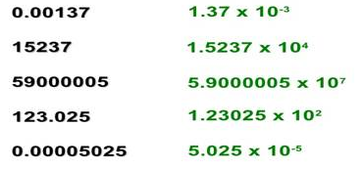
Scientific Notation
Very large and very small numbers are often represented such that their order of magnitude can be compared.
E.g., an electron's mass is about 0.00000000000000000000000000000091093826 kg.
In scientific notation, this is written 9.1093826 × 10⁻³¹ kg.
E.g., Earth's mass is about 5,973,600,000,000,000,000,000,000 kg.
In scientific notation, this is written 5.9736 × 10²⁴ kg.
In general, any number can be expressed as follows:
a × b^{e}
where e is an integer, and a is a real
number, and b is a natural number > 1
Notes:
https://www.mathsisfun.com/numbers/scientific-notation.html

Slide 169
Representing Real Numbers in Decimal
For your information
A real value in base 10 can be defined by the following formula where the exponent is an integer
sign × mantissa × 10^{exponent}
This representation is called floating point because the radix point “floats” left or right, depending on the value of exponent
Representing floating point in computers is considered beyond this course. If you are interested, search IEEE 754 in the internet
In a 64-bit floating point number, only 53 bits are used for mantissa
Lower precision if you use f.p. numbers when integer ones could also work
The idea of these slides was to show you that all different types of numbers can be represented in computers by using only 0 and 1
yet in some cases not as accurate as they are in real world
Notes:
As said, we did not talk how it stored in memory – complicated. Challenging e.g., 2.3

Slide 170
How many bits is enough?
For your information
Recording Earth coordinates with 1 cm precision
log₂(40 000 000 m *100 cm/m) ~ 32 bits per coordinate
Jeff Bezos’ wealth (2019) with $0.01 precision
log₂($112.4 billion * 100) ~ 44 bits
Human mass with 100 g precision
log₂(635 * 10) ~ 13 bits
635 kg was the highest mass of a person ever, according to Google
Outside air temperature with 0.1 degree precision
log₂(10*(58−(−88)) ~ 11 bits
Generally, you need log₂10 (~3.32) binary digits for every decimal one

Slide 171
Representing Numbers
Representing Texts
Representing Audio
Representing Images and graphics
Representing Videos

Slide 172
Representing Numbers
Positional representation
Decimal
Binary
Octal
Hex
Conversion between different bases
Binary, Hex, Oct to Decimal (recap)
Binary to/from Hex, Octal (special relation)
Decimal to Binary, Hex, Oct
Signed Binary representation – 2’s complement
Decimal to 2’s complement (Binary)
2’s complement (Binary) to decimal
Binary representation of fractions.
Binary to Decimal
Decimal to Binary
2

Slide 173
Representing Numbers
Positional representation
Decimal (base 10)
Binary (base 2)
Octal (base 8)
Hexadecimal (base 16)
Conversion between different bases
Binary, hex, oct to decimal
Binary to/from hex and octal (special relations)
Decimal to binary, hex, octal
Signed binary representation – 2’s complement
2’s complement (binary) to decimal
Decimal to 2’s complement (binary)
Binary representation of fractions
Binary to decimal
Decimal to binary
2

Slide 174
Binary, Oct and Hex → Decimal
Give the Decimal equivalent of the following
Binary 00111010 ₂ = ( )₁₀
Octal 137 ₈ = ( )₁₀
Hex 13C ₁₆ = ( )₁₀
132 ₄ = ( )₁₀
122 ₃ = ( )₁₀
58
95
316
30
17

Slide 175
Binary → Oct and Hex
Given binary representation 00111010₂, how to represent it in Oct and Hex?
Octal ( 72 )₈
Hex ( 3A )₁₆
( 322 )₄
Given Oct representation 73₈ , what is the binary representation?
Given Hex representation 73₁₆, what is the binary representation?
Given Hex representation 4B₁₆, what is the binary representation?
Given representation 322₄, what is the binary representation?
Oct and Hex → Binary
00111011
01110011
01001011
Notes:
Will not ask to base 5, as it is not 2^{x}

Slide 176
Decimal → Binary, Oct and Hex
Given decimal 37₁₀, how to represent it in Binary, Oct and Hex? How many base2, base8, base16 digits
Binary 100101
Octal 45₈
Hex 25₁₆
Base 4 211₄
Base 5 122₅

Slide 177
2’s complement (binary) ←→ decimal
0110 → 6 assume 4 bits 2’s complement
1001 → −((0110) +1) → −(0111) → −7 assume 4 bits 2’s complement
1101 → −((0010) +1) → −(0011) → −3 assume 4 bits 2’s complement
11100110 → - (00011001 +1) → - (00011010) → -26 assume 8 bits
5 → 0101 assume 4 bits
−6 → (6→0110) → 1001+1 → 1010 assume 4 bits
-3 (3→0011) → assume 4 bits
-7 (7→0111) →
-17 assume 8 bits
-26 assume 8 bits
-37 assume 8 bits

Slide 178
Assume 8 bits, do the following calculation in binary
3 + 4
3+1
3+5
3+7
10 - 3 (11111101)
- 5 (11111011) + 2
- 127 (10…1) +1
29 (00011101) - 23 (00010111)
23-29

Slide 179
Factions ←→ decimal
$${\left(10.111\right)}_{2} = {\left( . ?????? \right)}_{10}$$
2.875
$${\left(100101.11\right)}_{2} = {\left( . ?????? \right)}_{10}$$
37.75
$${\left(37.75\right)}_{10} = {\left( . ?????? \right)}_{2}$$
100101.11
$${\left(20. 25\right)}_{10} = {\left( . ?????? \right)}_{2}$$
10100.01
$${\left(20. 625\right)}_{10} = {\left( . ?????? \right)}_{2}$$
10100 .101
$${\left(2. 3285\right)}_{10} = {\left( . ?????? \right)}_{2}$$
$${\left(2. 3\right)}_{10} = {\left( . ?????? \right)}_{2}$$

Slide 180
Valid or not?
(1234)₁₀
(87120)₈
(12AB)₁₆
(3AB)₁₂
(525)₅
(1010101)₁₀

Slide 181
Signed vs. unsigned, summary
Assume all n bits are magnitudes.
Max value:
Min value:
How many values:
Range: 0~2^{n}-1
1111111….11111
0000000….00000
2^{n}
Assume 2’s complement.
Max value:
Min value:
How many values:
Range: -2^{n-1} ~ 0 ~ 2^{n-1}-1
3 bits, 2’s complement, max and min value?
0111111….11111
1000000….00000
4 values
2^{n}
4 values
4 bits ?
8 bits ?
Notes:
Min: if a little, then lager -128 -127
Used to have this kind of question
4 bits 16 0 ~ 7 -1 ~ -8
You can list, but general, half, ….

Slide 182
Representing Numbers
Representing Texts
Representing Audio
Representing Images and graphics
Representing Videos

