Slide 1
EECS 6590: High Performance Computer Networks
Uyen Trang (U.T.) Nguyen
Dept. of Electrical Engineering & Computer Science
York University

Slide 2
COURSE INFORMATION
Monday and Wednesday, 16:00-17:30
Location: BERG-211 (Bergeron Building)
First lecture: September 5
Course web page: www.cse.yorku.ca/course/6590A
Prerequisite: a course on computer networks
Focus: wireless ad hoc networking
Mobile ad hoc networks
Wireless mesh networks
(Wireless sensor networks)

Slide 3
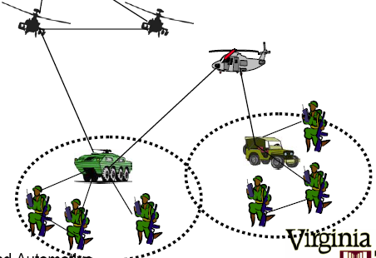
Mobile Ad hoc Networks (MANETs)
A form of wireless ad hoc networking; devices are mobile.
Design, implementation: extremely challenging
Dynamic topology
Severe bandwidth constraints
Limited battery life
Limited survivability

Slide 4
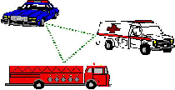

APPLICATIONS OF MANETs
Military operations
Search and rescue operations
Vehicular networking
Robot communications
Mobile social networks
Internet of Things

Slide 5
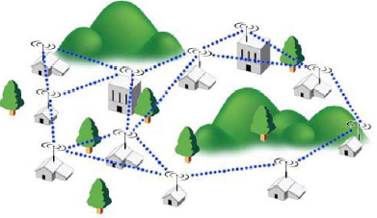
Wireless Mesh Networks (WMN)
Support multi-hop wireless connections
Fast, inexpensive deployment
Applications:
home, community, enterprise networking
public transportation
vehicle-to-vehicle communication
emergency/disaster sites
Internet of Things
5G mesh networking

Slide 6
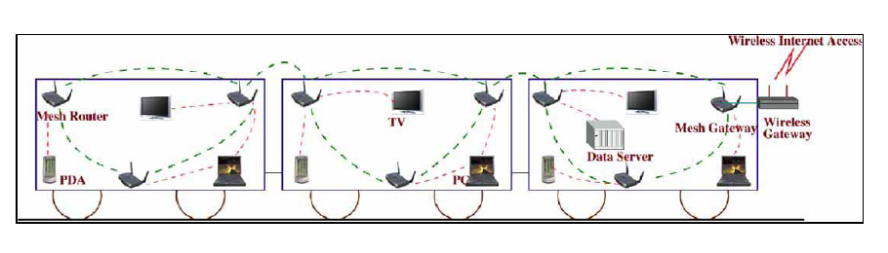
Transportation Systems

Slide 7
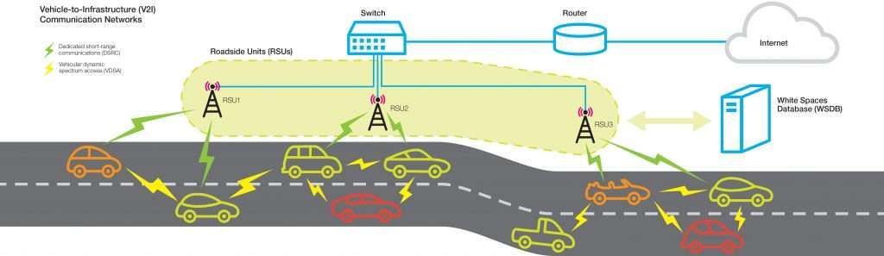
Vehicle-to-vehicle communication

Slide 8
Topics To Be Covered
Architectures
Routing
Medium access control
Transport protocols
Multicasting and broadcasting
Security
Standards (e.g., IEEE 802.11, 802.16)
Design and implementation principles
Technical writing
Presentation skills (slides, delivery styles)

Slide 9
GRADING SCHEME
35% ─ Tests (2)
10% ─ Class attendance and discussions
15% ─ Presentation of research papers
40% ─ Project
Research, design and implementation
Report
Oral presentations

Slide 10
REFERENCES
Wireless Mesh Networking: Architectures, Protocols and Standards
by Yan Zhang, Jijun Luo and Honglin Hu (Editor)
Publisher: Auerbach (2006)
Wireless Mesh Networks
by Ian Akyildiz and Xudong Wang
Publisher: Wiley (2009)
Ad Hoc Wireless Networks : Architectures and Protocols
by C. Siva Ram Murthy and B.S. Manoj
Publisher: Prentice Hall PTR (2004)

Slide 11
Contact Info
Email: utn@cse.yorku.ca
Home page: www.cse.yorku.ca/~utn
Office: LAS-2024
Phone: (416) 736-2100 ext. 33274

