Slide 1

node2vec: Scalable Feature Learning for Networks
Aditya Grover et al.
Presented By:
Saim Mehmood Ahmadreza Jeddi

Slide 2
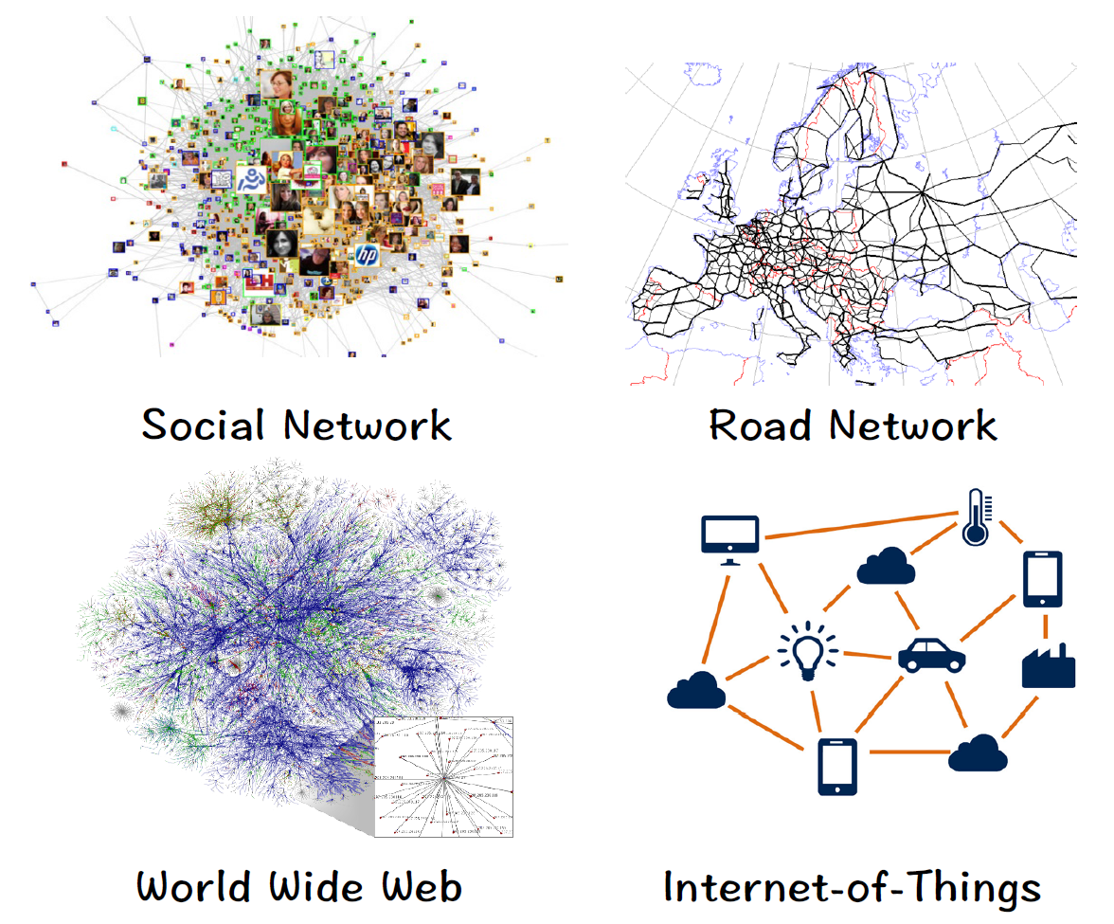
Background: Networks
Ubiquitous in real world.
Examples include:
  Social, Road, World Wide Web & IoT etc.
A flexible and general data structure.
  Many types of data can be formulated as networks.

Slide 3
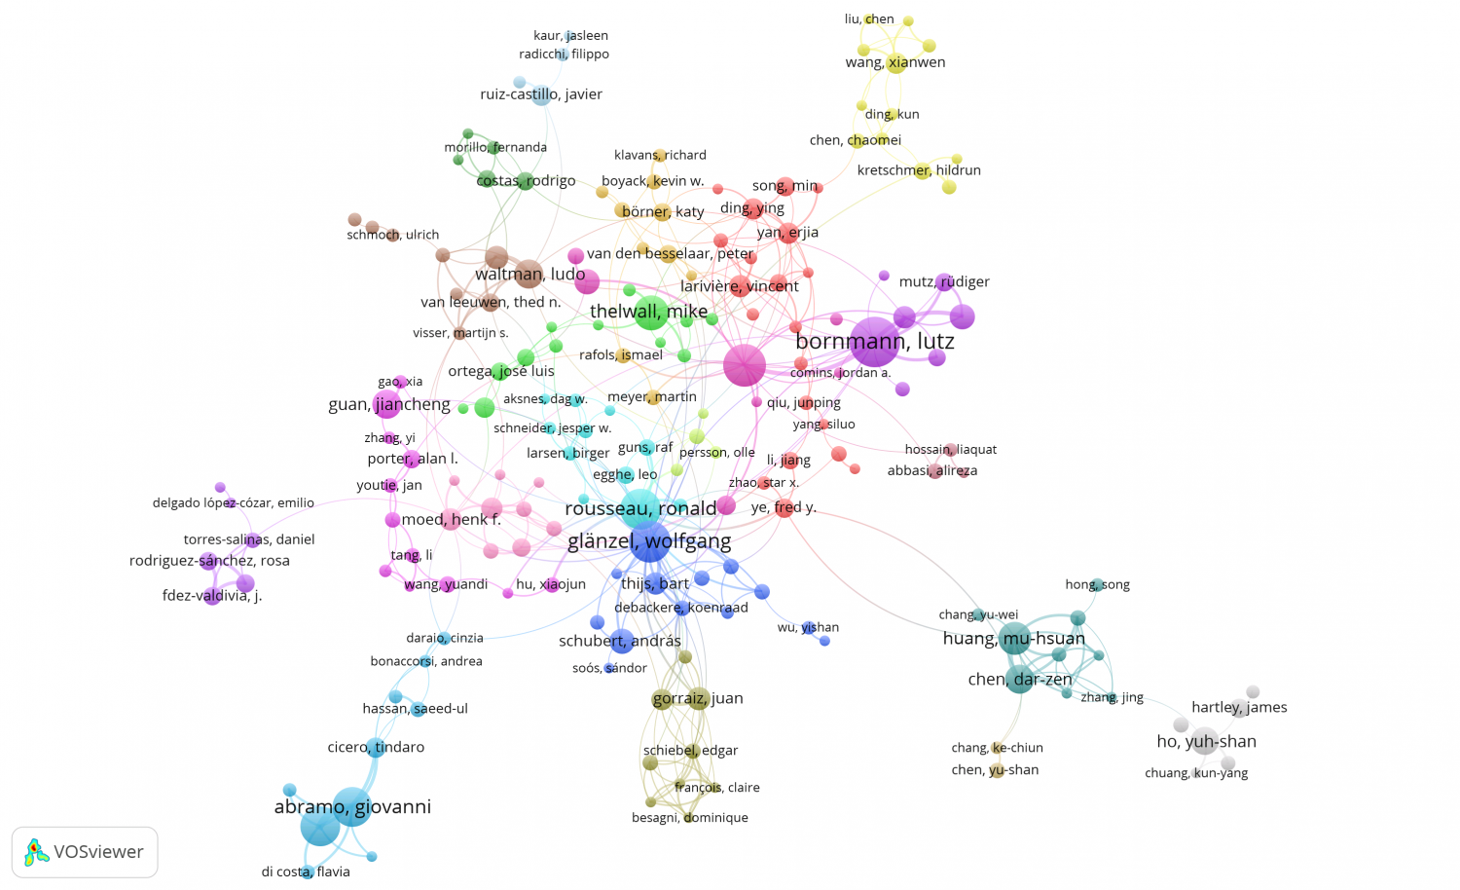
Network Mining: Ranking
Edges between nodes identify the co-authorship of papers.
Ranking helps in discovering the
most influential author.

Slide 4
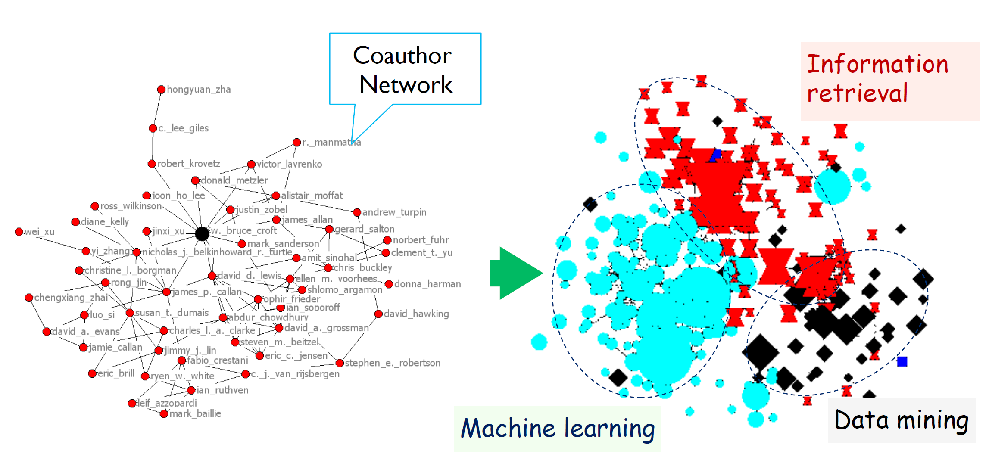
Network Mining: Community Detection
Who tend to work together?
Dividing graph representation
into set of communities:
  Machine Learning, Information Retrieval & Data Mining

Slide 5
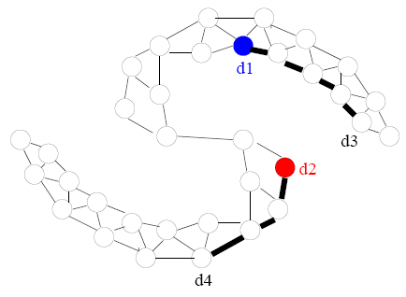
Tasks: Node Classification
Interested in predicting the most probable labels of nodes in a network.
Social networks: predicting interests of users.
Protein-protein interaction (PPI) network: predicting functional labels of proteins.
Example: d1 is democrat, d2 is republican. What about d3 & d4?

Slide 6
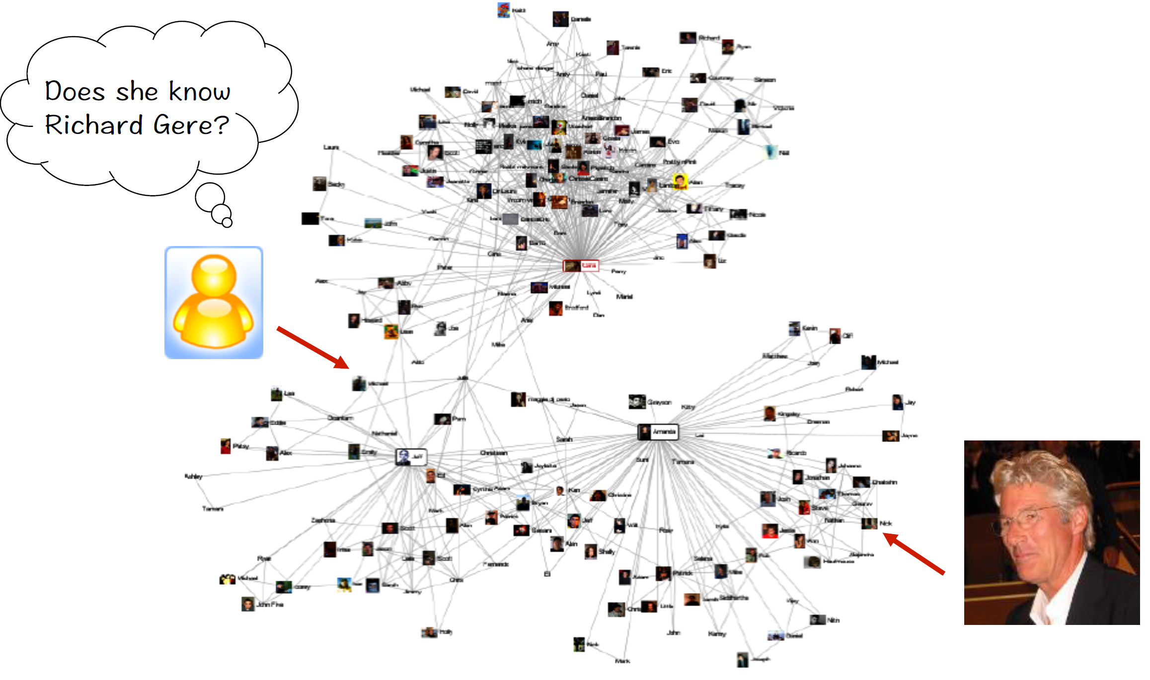
Tasks: Link Prediction
We wish to predict whether a pair of nodes in a network have an edge connecting them.
Usefulness of Link Prediction:
  In genomics, it helps us discover novel interactions between genes.
  In social networks, it can identify real-world friends.

Slide 7
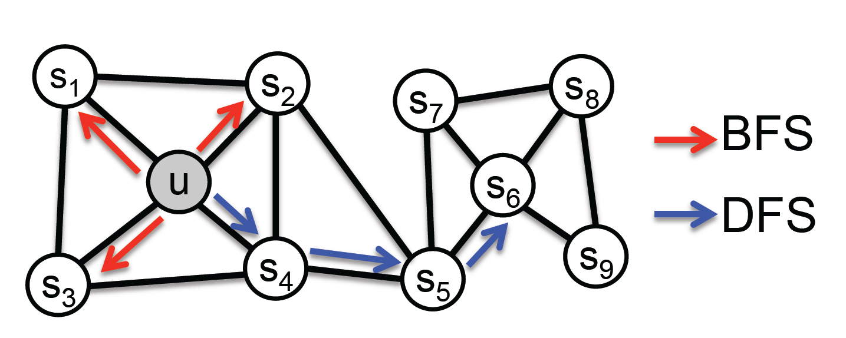
Contribution & Main Idea
Their key contribution is in defining a flexible notion of a node’s network neighborhood.
By choosing an appropriate notion, node2vec can learn representations that organize nodes based on their network roles (structural equivalence) and communities (homophily) they belong to.

Slide 8
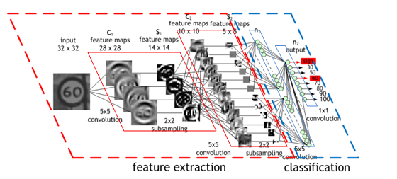
Word2Vec
Representation (feature) learning:
Automatically learn representations needed for feature detection
Exampel: CNNs
Tell things like:
1) neural networks take numbers
2) not all the datasets are originally in numerical form
3) for words, we sometimes use oneHot, here to learn we also use oneHot

Slide 9
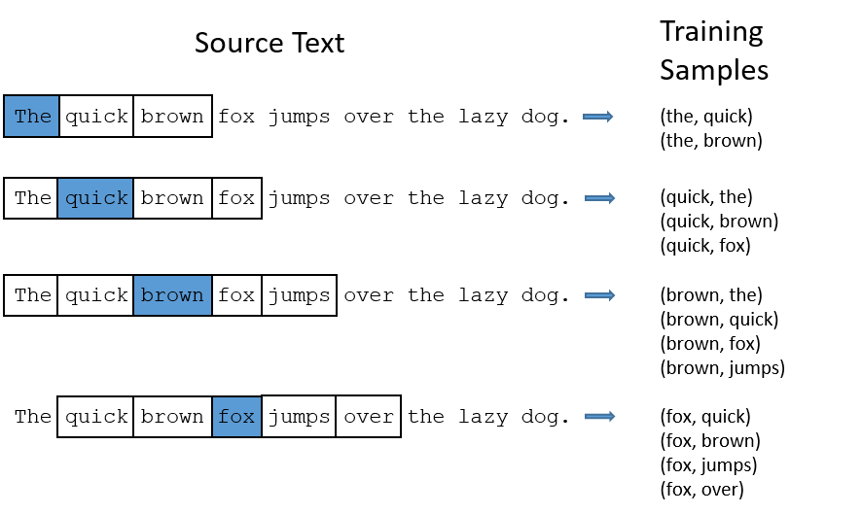
Skip-gram model
A text document is given:
A set of sentences
Input data to give into neural network
Context window
Context window size ⍵

Slide 10
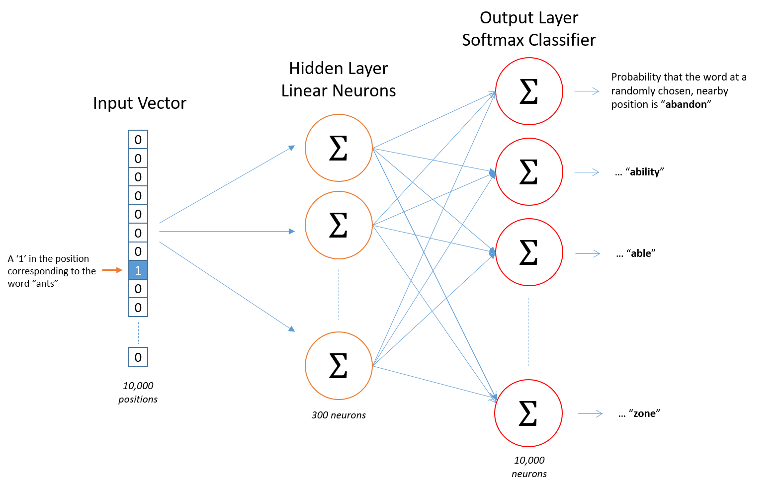
Skip-gram model, Cont.
Let’s say we have V words in our vocabulary
Use one-hot encoding to train the network
One hidden layer
No activation function
Stochastic gradient descent
Example:
V = 10000 (size of vocabulary)
300 neurons in hidden layer
Word “ants” as input to network
Add things like, when everything is learned, freeze all the weights, give in all the 1hot vectors => this is equal to weight matrix

Slide 11
Node Embedding
In 2014, DeepWalk: Online Learning of Social Representations
Each graph as a document
Random walks will be the sentences in this document
Random Walk In graph G(V,E):
  A sequences of nodes <v1, v2, …, vk>, such that each (vi, vi+1) is an edge in E

Slide 12
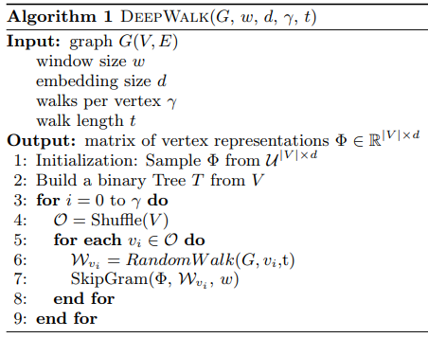
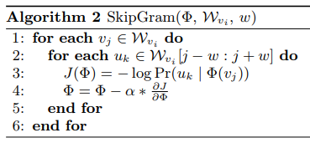
General method for node embedding

Slide 13


Classic Search Strategies
The problem of sampling neighborhoods of a source node can be viewed as a form of local search.
There are two extreme sampling strategies for generating neighborhood sets:
  Breadth-first Sampling (BFS)
  Depth-first Sampling (DFS)

Slide 14


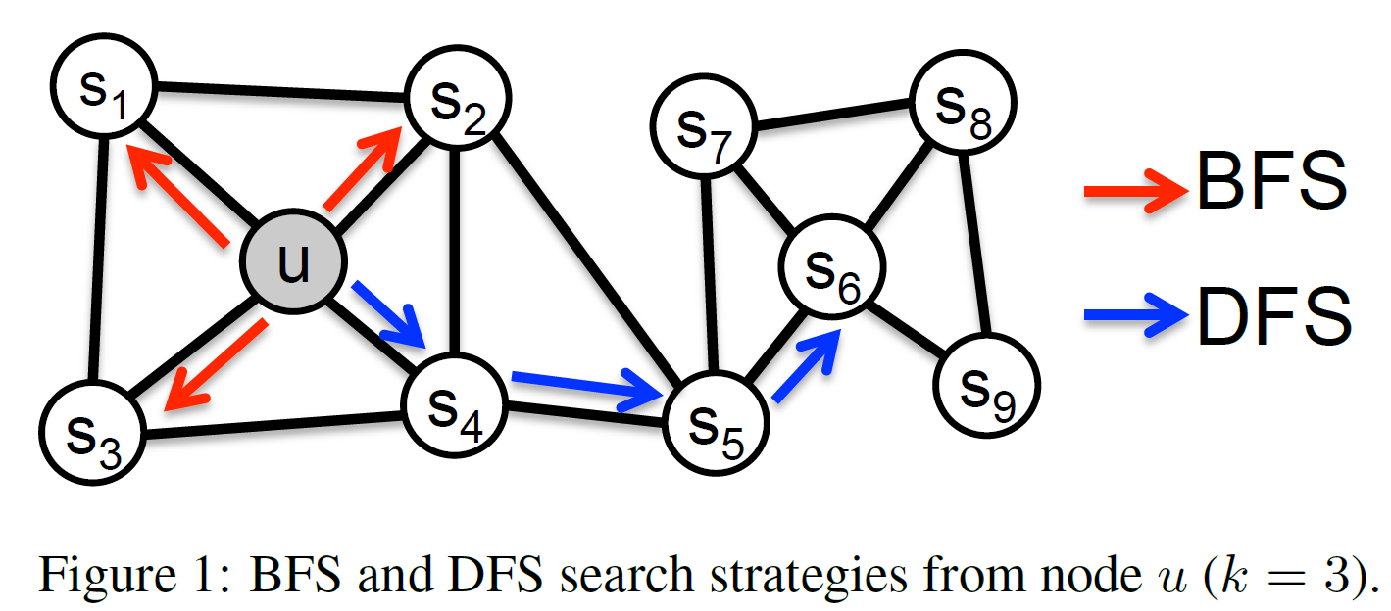
Breadth-first Sampling (BFS)
Neighborhood is restricted to nodes which are immediate neighbors of the source .
For a neighborhood of size BFS samples nodes
. .

Slide 15

BFS Structural Equivalence
Nodes that have similar structural roles in networks should be embedded closely together.
  E.g., nodes and in fig
Restricting search to nearby nodes,
BFS gives microscopic view.
Network roles such as bridges and
hubs can be inferred using BFS.

Slide 16

Depth-first Sampling (DFS)
Neighborhood consists of nodes sequentially sampled at increasing distances from the source node .
For a neighborhood of size DFS samples nodes
.

Slide 17

DFS Homophily
Nodes that are highly interconnected and belong to similar network communities should be embedded closely together.
  E.g., nodes and in fig
DFS sampled nodes reflect a
macro-view of nodes neighborhood.

Slide 18
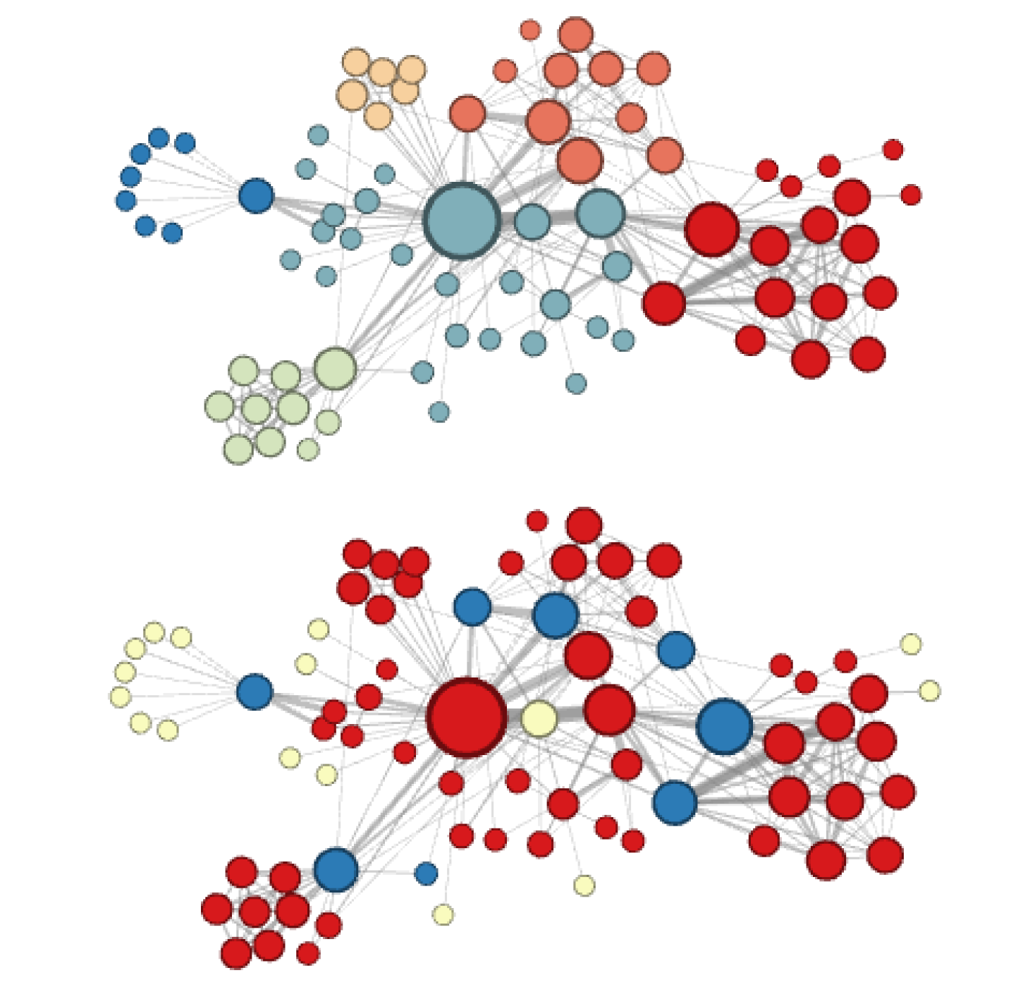
Visualization of Les Miserables Network
Generated by node2vec
Label colors reflecting:
  Homophily (top)
  Structural Equivalence (bottom)

Slide 19
Flexible notion of neighborhood
Authors design a flexible neighborhood sampling strategy which allows them to smoothly interpolate between BFS and DFS
The above sampling strategy is achieved by a flexible biased random walk that explores neighborhoods in a BFS as well as DFS fashion.

Slide 20
Drawbacks of DeepWalk and LINE
DeepWalk: learns d-dimensional feature representations by simulating uniform random walks. Can be observed as a special case of node2vec with parameters p = 1 & q = 1.
LINE: learns d-dimensional feature representations in two steps:
  d / 2 dimensions by BFS-style
  d / 2 dimensions by sampling nodes at 2-hop distance
Networks represent a mixture of homophily and structural equivalence, which are not effectively covered by the above two methods.

Slide 21

How Node2vec take random walks
Default Setup: Parameters Just the same as DeepWalk
Dimensionality (D) : 128
Number of walks starting from each node (r) : 10
Walk Length (l) : 80
Context Size (k) : 10
Each random walk:
Step 1: initial node
Step 2: look at the neighbors, select one as the next node
Step 3: repeat step 2 until the length of random walk is equal l
Say that each node has degree at least one

Slide 22
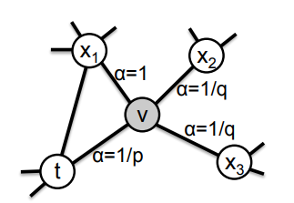

Where node2vec really comes in
Biasing the selection of next node
Last edge in random walk : t → v
Currently at node v
How to select next node from v neighbors ?
How much do you like to go back to t ?
⟶ parameter “p”
How much do you like to go far from t ?
⟶ parameter “q”

Slide 23
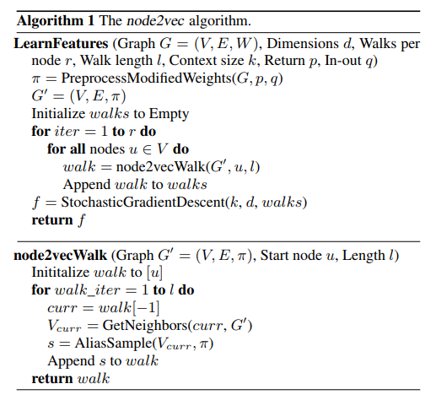
Overview of node2vec algorithm

Slide 24
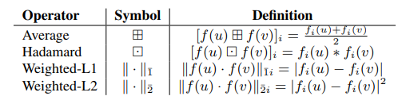
Edge Embedding
Link prediction deals with pairs of nodes
We need to find embeddings of edges
Embedding of edge (u,v) done by a binary operator g(u, v) : V × V ⟶ R^{d}

Slide 25
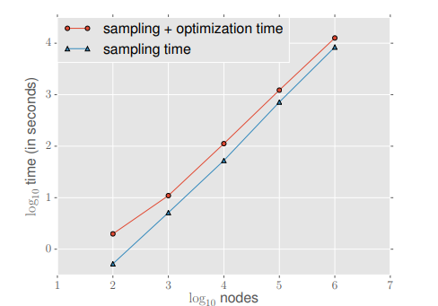
Node2vec Scalability
Process time is linear in number of nodes ⟶ O( a |V| )
a is constant relying on R (numWalks) and L (walkLength)
For Optimization (SGD) use negative sampling
Example: Erdos-Renyi graphs with an average
degree of 10

Slide 26

Results: Multi-label Classification
Every node is assigned labels from a finite set .
Training of algorithms on a fraction of nodes.
Task is to predict remaining nodes.
Datasets used:
  BlogCatalog: network of social relationships of bloggers
  Protein-Protein Interactions (PPI): subgraph of PPI network for Homo Sapiens
  Wikipedia: co-occurrence network of words

Slide 27
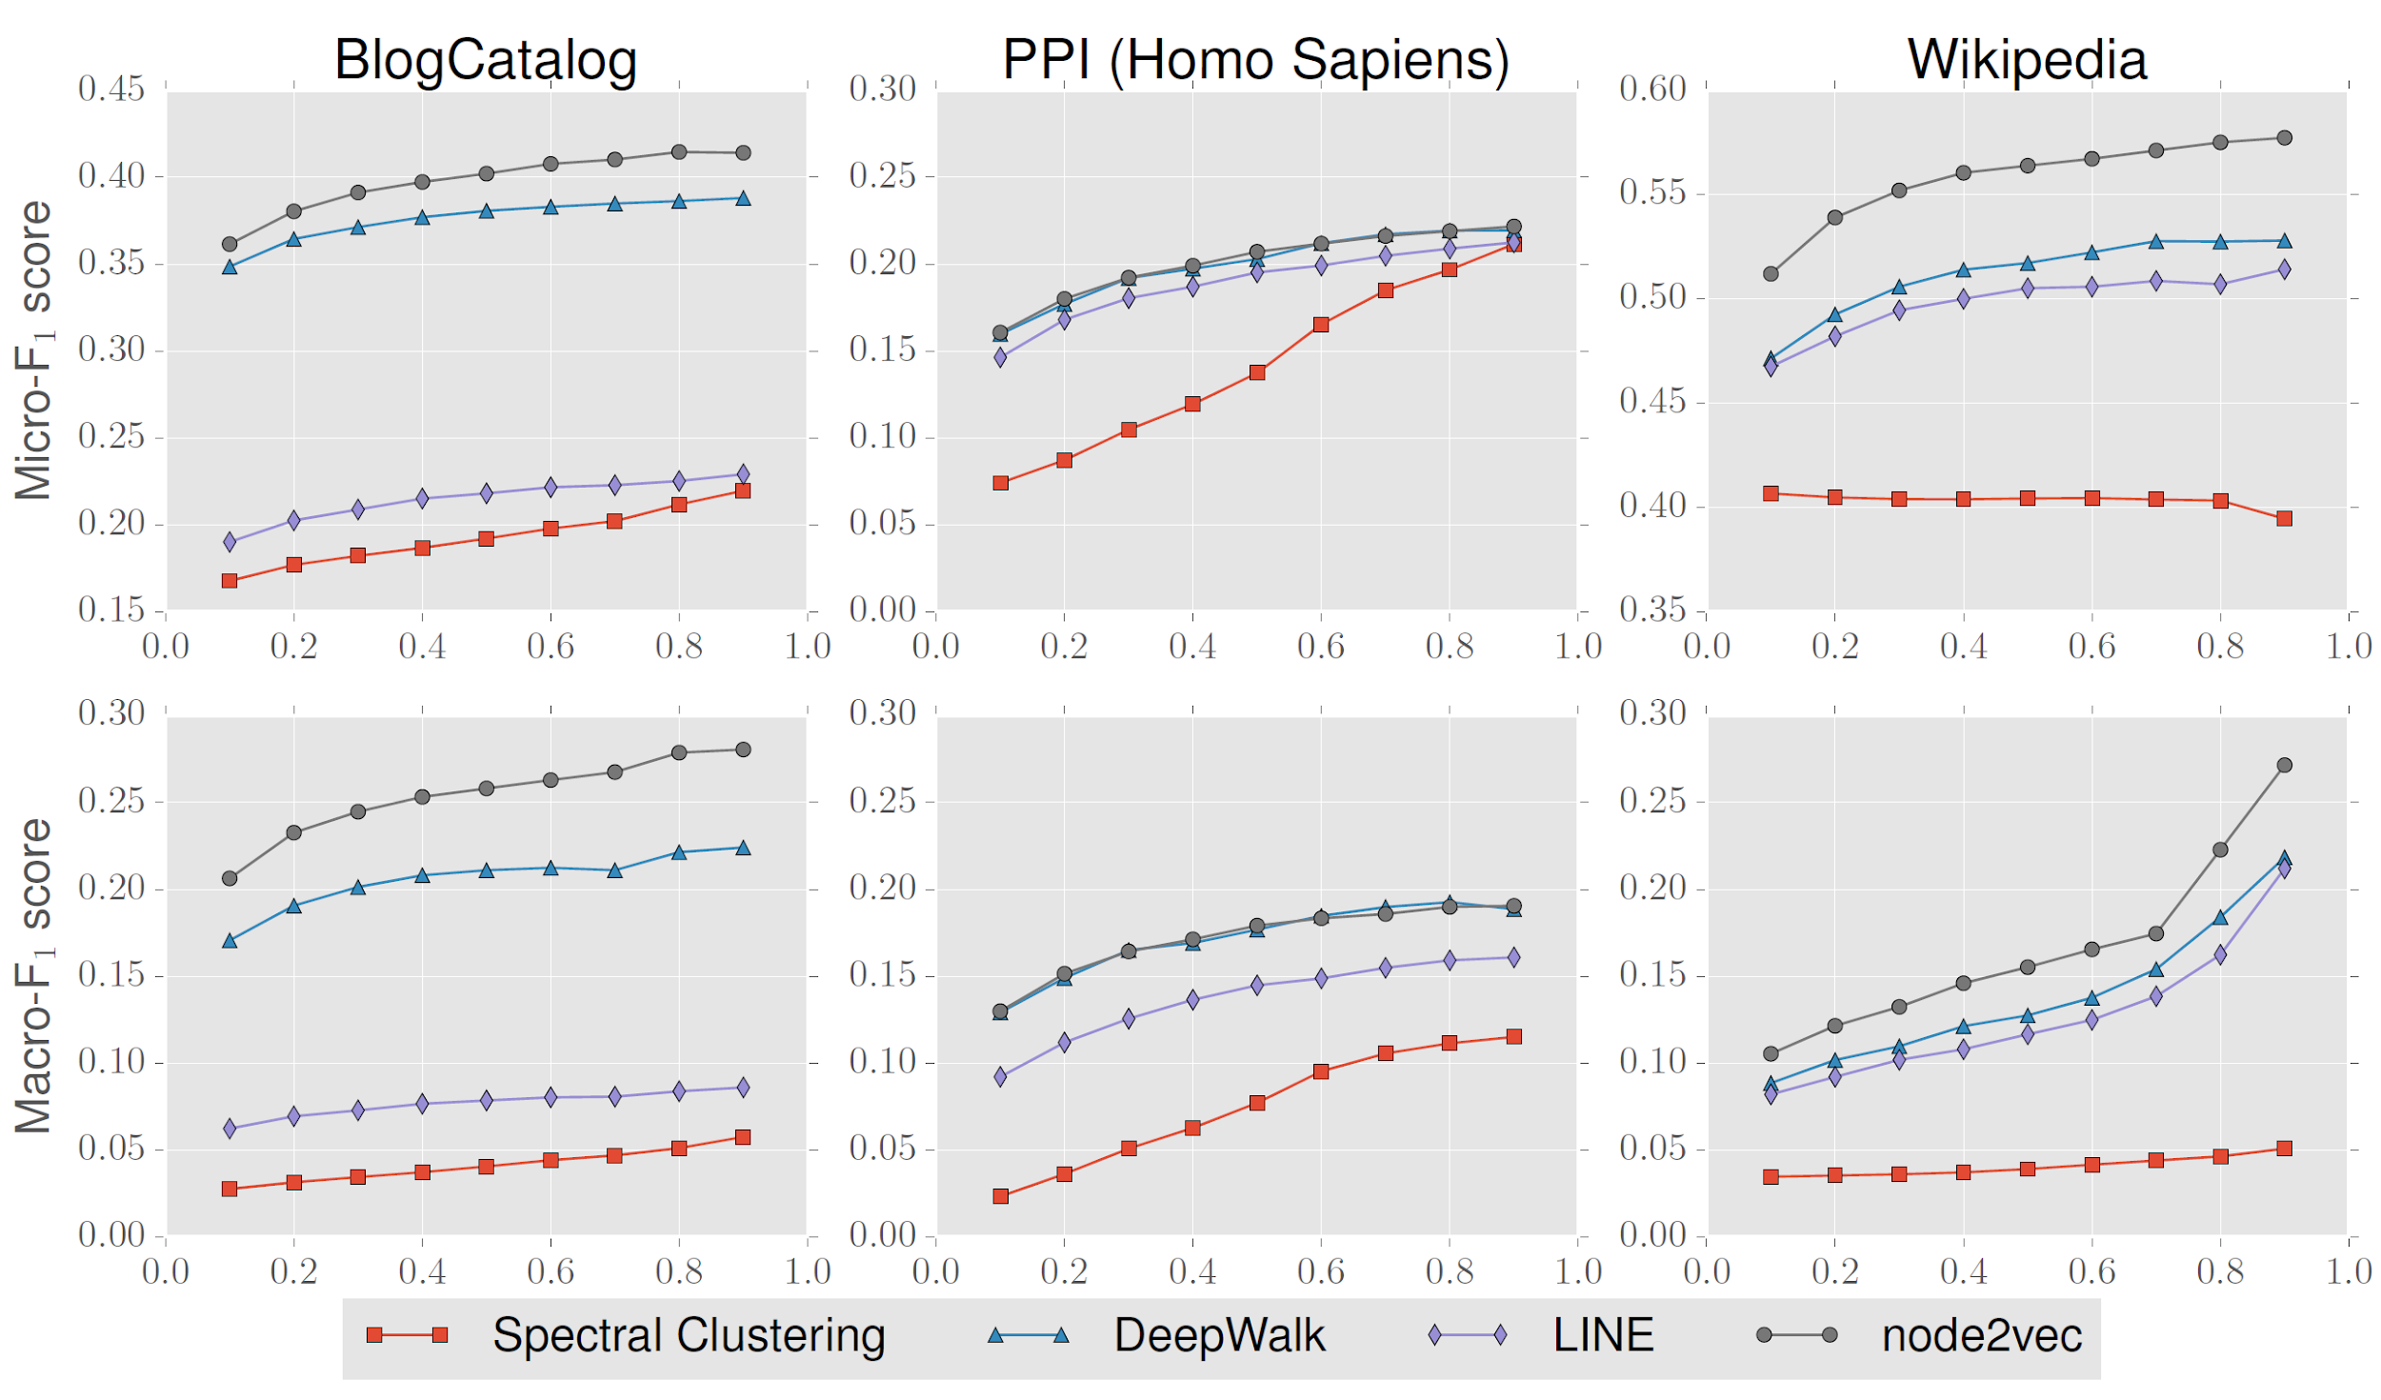
Graphs
x-axis shows fraction of labeled data

Slide 28
Results: Link Prediction
Given a network with certain fraction of edges removed, we would like to predict the missing edges.
Datasets used:
  Facebook: nodes and edges represents friendships & relationships between them.
  PPI: node represents a protein, and an edge indicates a biological interaction between a pair of proteins.
  arXiv: nodes represent scientists, and an edge indicates collaboration between them

Slide 29
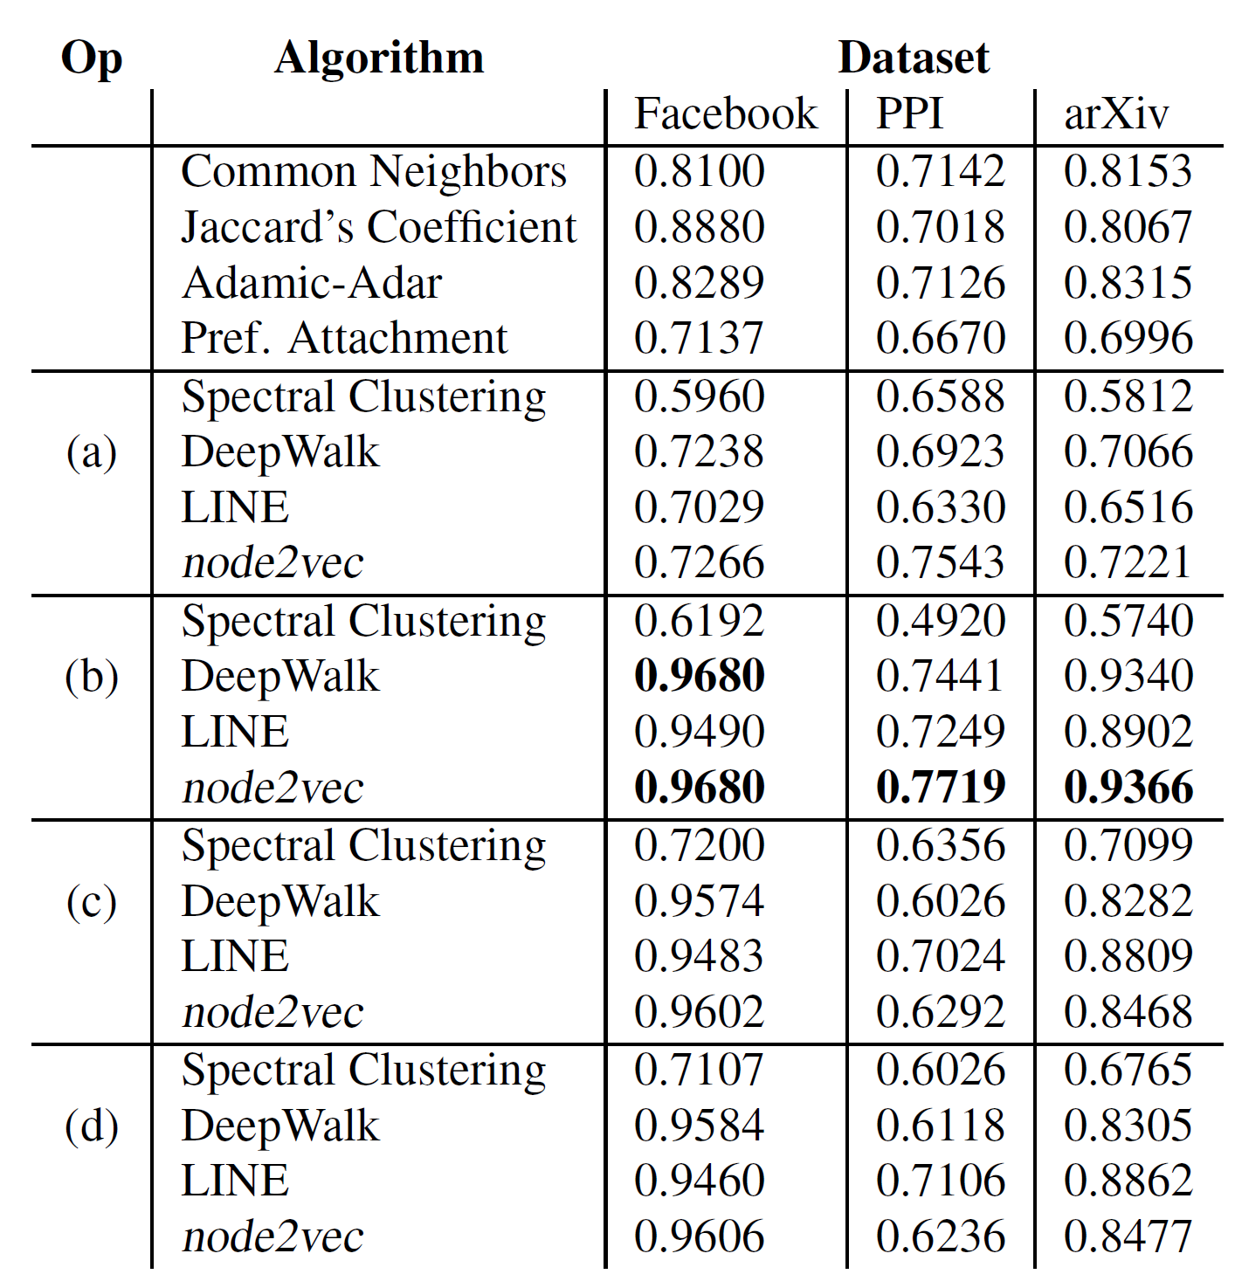
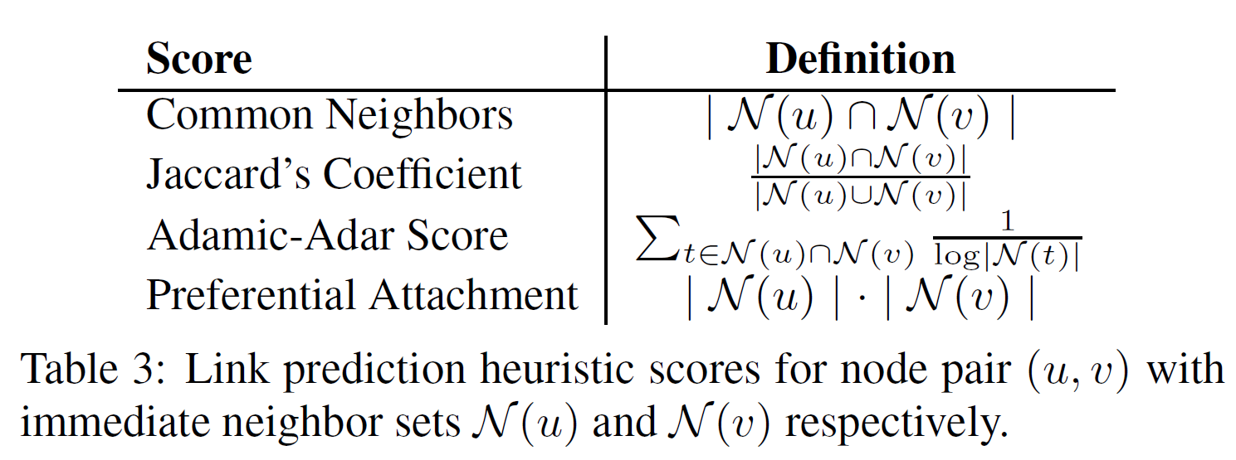
Table
None of feature learning algorithms have been previously used for link prediction, they additionally evaluate node2vec against heuristic scores
Area Under Curve (AUC) scores for link prediction

Slide 30
Thank You

