Slide 1
iClicker Reef Student Registration York University

Slide 2
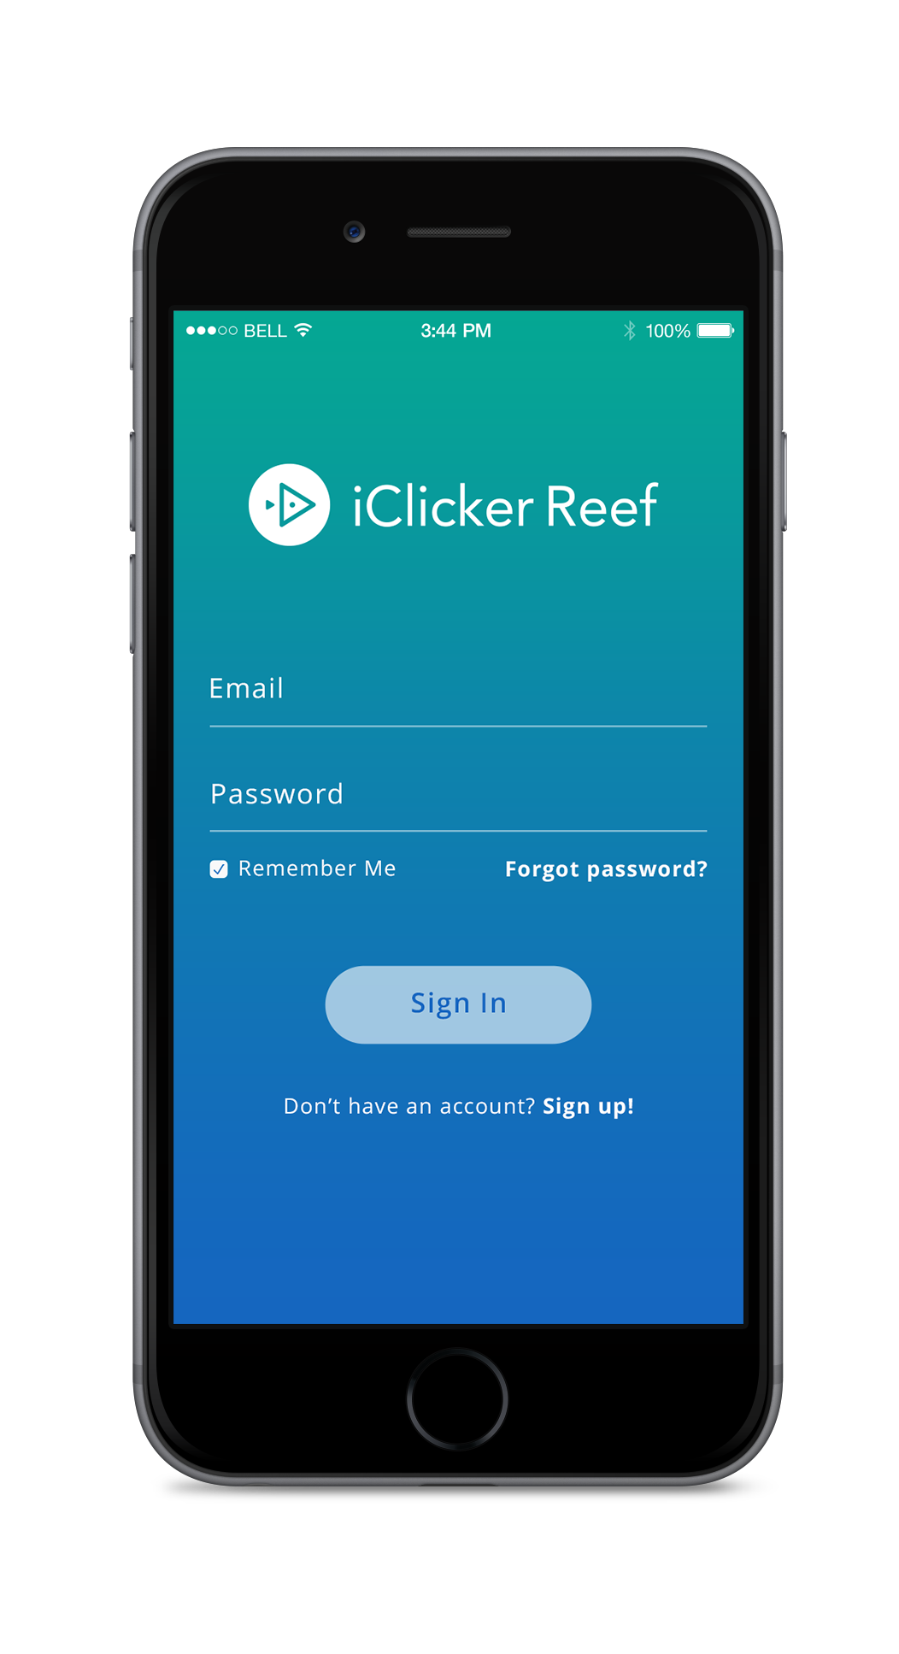
Devices Allowed in Class
You are required to bring a smartphone, tablet or laptop to participate in class polling sessions through iClicker Reef.

Slide 3
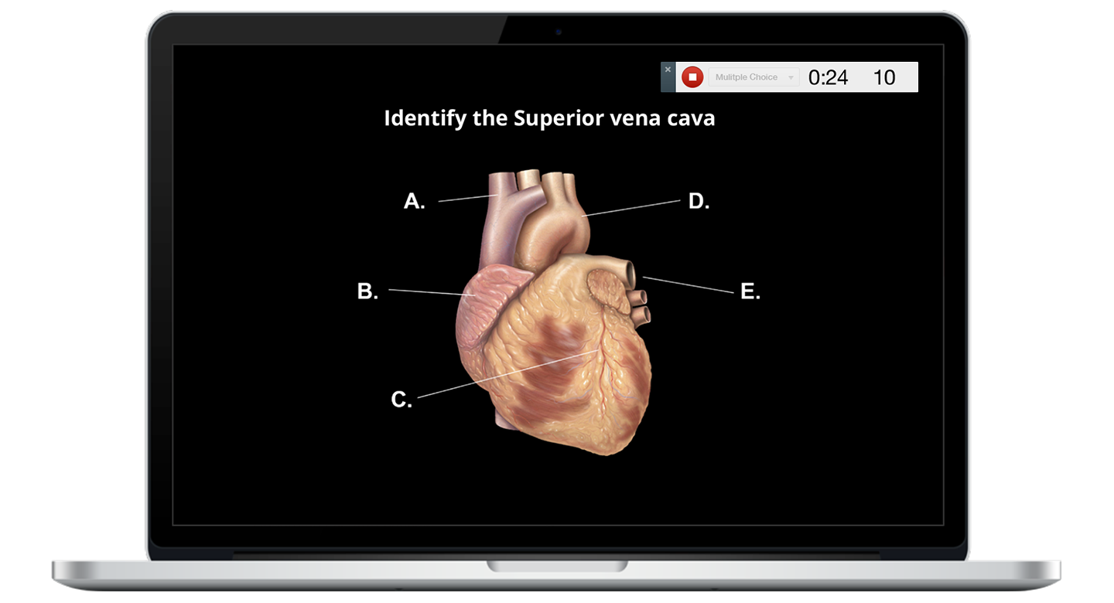
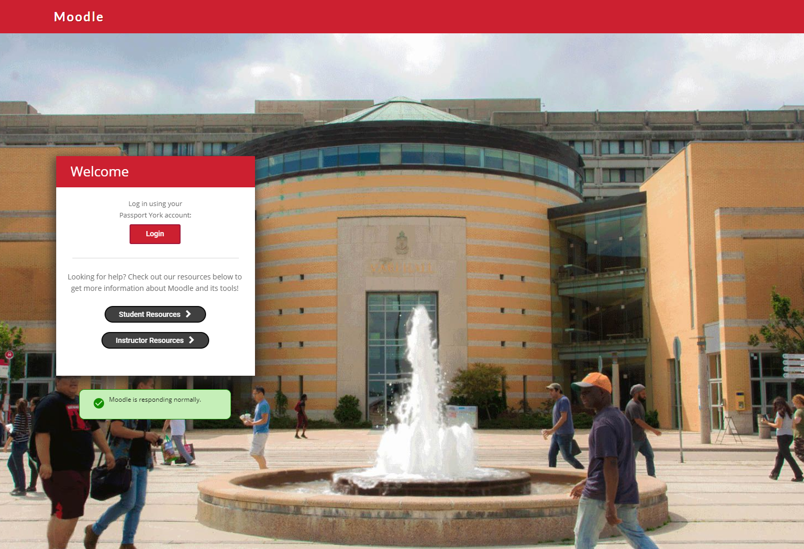
Register through Moodle
Delete this slide if not integrating with Moodle
Navigate to the iClicker Reef registration link in our Moodle course and click the link.
This will bring you to the iClicker Reef sign-in page.

Slide 4
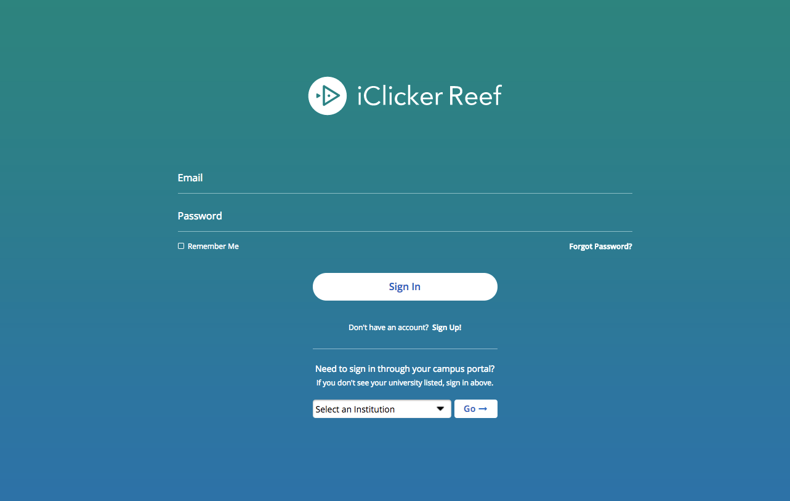
Create an iClicker Reef Account
You must create an iClicker Reef account to ensure your grades are counted, even if you use a physical remote.
Click Sign Up! to create your account.
If you already have a Reef account, sign in here! Do not create and use more than one Reef account as you will only receive credit from a single account.

Slide 5
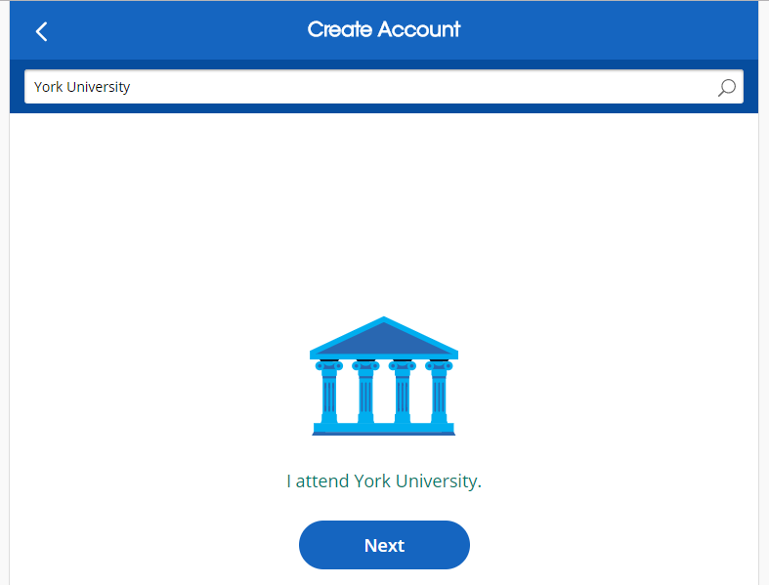
Select Default Institution
Enter York University as your institution.
Click Next.

Slide 6
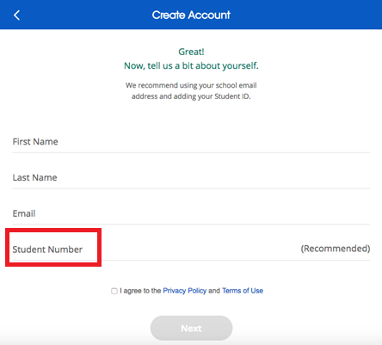
Complete your iClicker Reef profile
On the Create Account form, fill out your…
*First and Last Names
*York University Email
*Student Number (strongly encouraged)
Click Next.

Slide 7
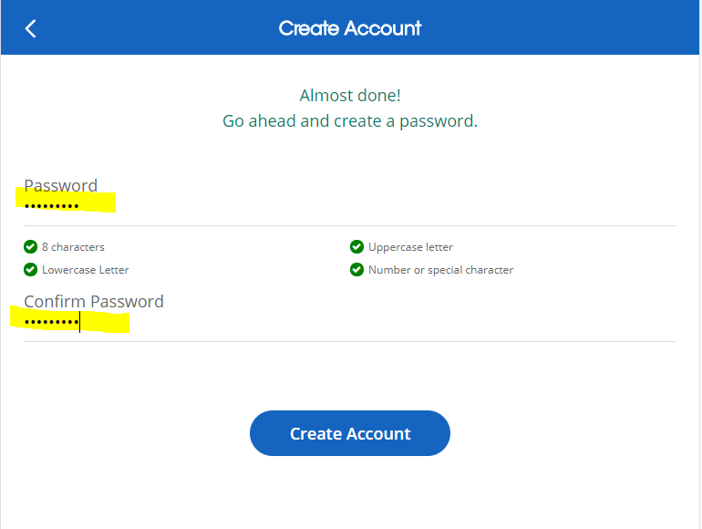
Create a password
Create and confirm your password in the two boxes on the next page.
Click Create Account.

Slide 8
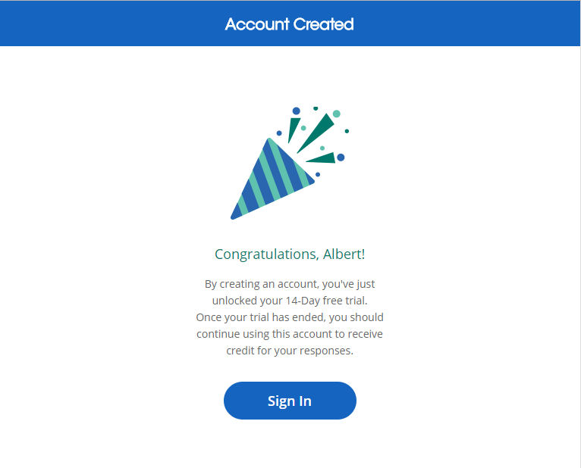
Free Trial Message – Please Ignore!
When you first create your iClicker Reef account, you will see a message about a free trial period.
Please ignore this message! As a York University student, you do NOT have to pay for a subscription or access code to use iClicker Reef.
**If you accidentally purchase anything for iClicker Reef, please contact iClicker Support immediately. Let them know you are a York University student and they will issue you a refund. They will need the following info:
-First and last name registered with iClicker
-Email used in iClicker account
-Cardholder’s name
-Last four digits of credit or debit card
-Purchase or order number (e.g., RFRP…., GPA….)
-Date of purchase

Slide 9
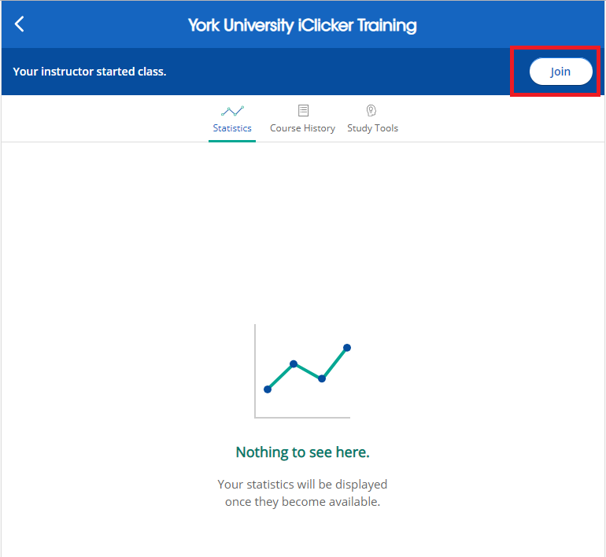
Check Your Courses List in Reef
After clicking the iClicker link from Moodle and creating or signing into your Reef account, check your course list in Reef to ensure that this course has been added to your account.
During each class, select the course in Reef and wait for me to start a session.

Slide 10
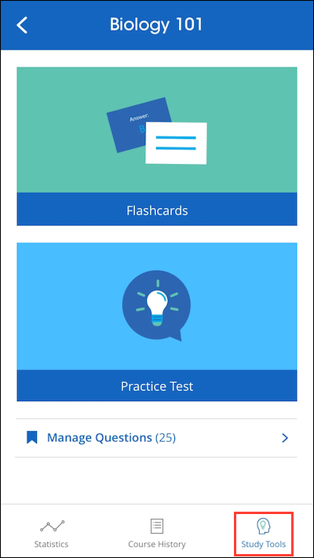
Course Statistics, Course History, Study Tools
The main screen of Reef shows your Course Statistics. Here you can access a detailed overview of your course performance for clicker sessions.
The Course History provides a detailed view of your individual session results, by date. Select an individual session to view results and images of polling questions.
Bookmark a question to use it as a flashcard or in a practice test in the Study Tools section.

Slide 11
Questions or Trouble Registering? Contact iClicker Support: https://macmillan.force.com/iclicker/s/contactsupport 9am-11pm EST Monday-Thursday 9am-9pm EST Fridays

