Slide 1
Computational Thinking through Mechatronics
EECS1011
Notes:
login 5065

Slide 2
Who Am I?
Dr. Burton Ma
office
Lassonde 2046
office hours : Wed 2:00–4:00PM
email
burton@cse.yorku.ca

Slide 3
Course Website
everything you need to know is on the course website on Moodle@York
https://moodle.yorku.ca/moodle/course/view.php?id=140036
the course is supposed to be automatically added to your "My Courses" when you enroll in the course

Slide 4
Lectures
there are 2 lecture hours per week
Mon & Wed 10:30-11:30 LAS A
lectures make use of iClicker
http://lts.info.yorku.ca/polling-student/

Slide 5
Labs
William Small Centre Room 106
seats 48 students
there are 490 students enrolled!
you must attend the lab section that you are enrolled in
I cannot change your lab sections because I do not have the administrative authority to do so
you need to see the Undergraduate Assistant in LAS 1012M for assistance

Slide 6
Labs
the labs use specialized hardware for sensing and control of simple electronic and mechanical devices
the hardware interfaces with a computer on which you will create a program to interact with the devices
you must complete the lab work during the lab time

Slide 7
Programming environment
the labs require Matlab

Slide 8
Assessment
times are tentative
Weight | Assessment item | Date
18% (9 x 2%) | Labs | see Calendar on Moodle
20% | Lab test 1 | week of Oct 15
25% | Lab test 2 | week of Nov 12
32.5% | Exam | scheduled by Registrar
4.5% (18 x 0.25%) | In-class iClicker participation | every lecture except today

Slide 9
What is MATLAB?
a numerical computing environment that has its own programming language
interactive: the user can enter commands and "stuff" happens
visualization: rich set of plotting functionality
programmable: the user can create programs that can be run within the MATLAB environment

Slide 10
A Quick Tour of MATLAB
the equation of a non-vertical line in 2D is:
plot the line on the domain -1 <= x <= 5

Slide 11
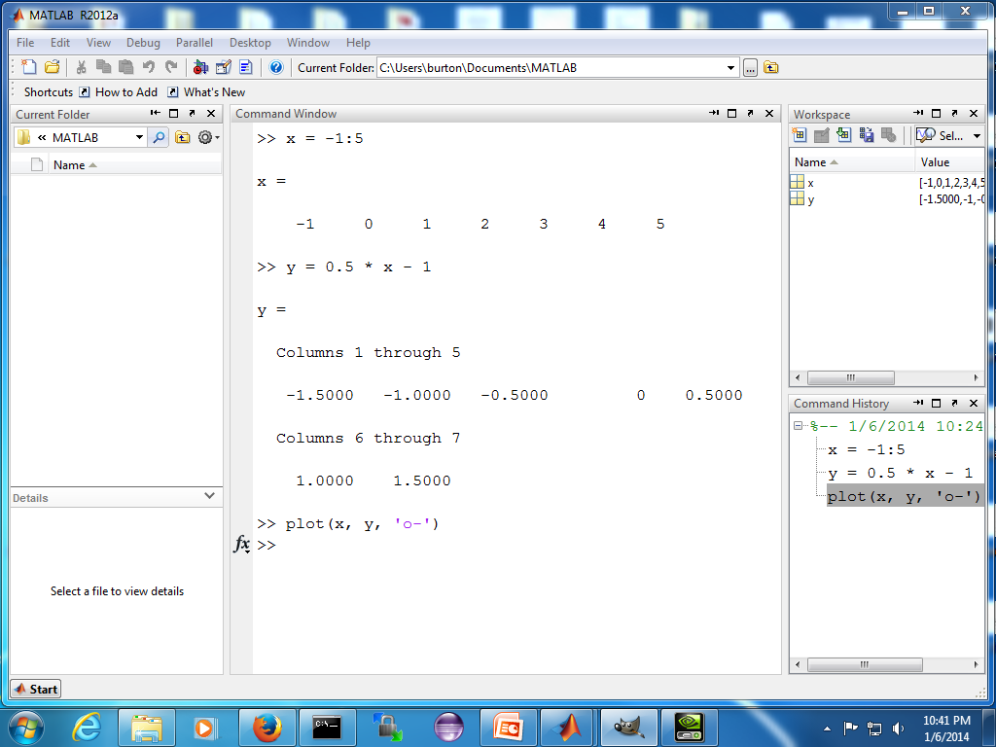

Slide 12
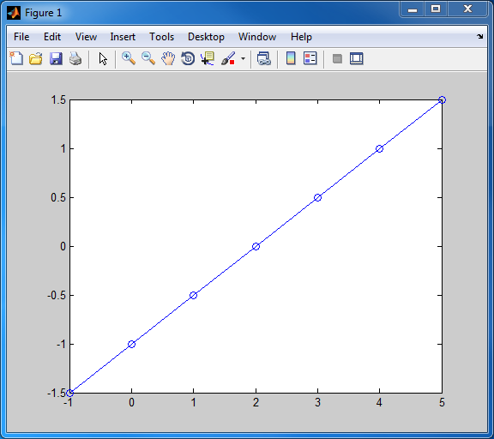

Slide 13
A Quick Tour of Matlab
find the intersection of the two lines:

Slide 14
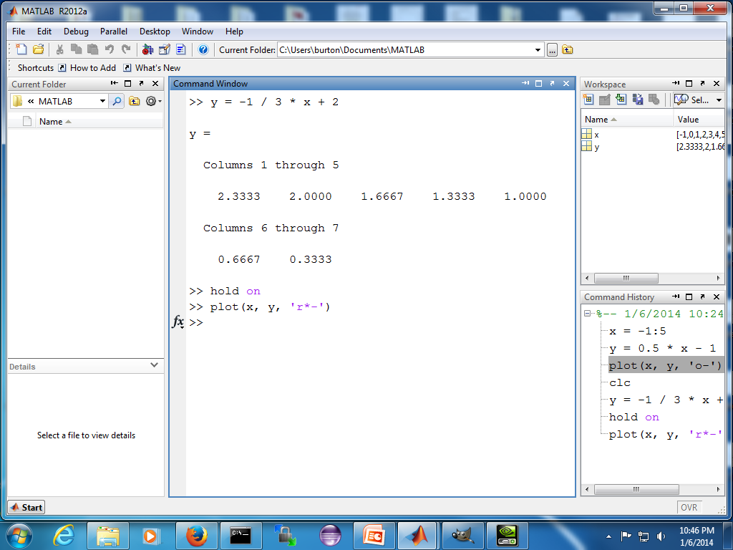

Slide 15
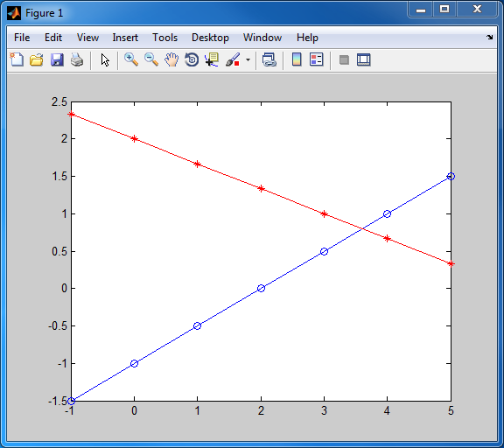

Slide 16
A Quick Tour of Matlab
it looks like the intersection point is somewhere around
can we find the exact intersection point?

Slide 17
A Quick Tour of Matlab
rewrite the equations of the lines as:
this system of two equations can be written in matrix form as:

Slide 18
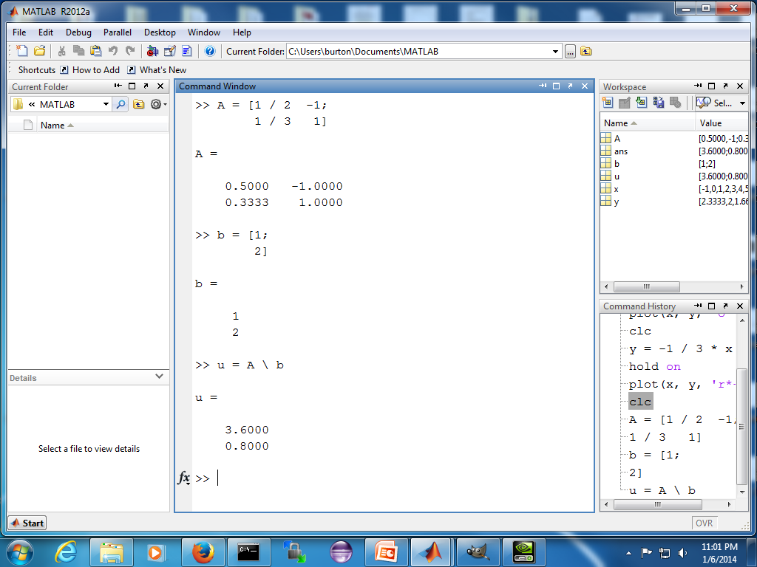

Slide 19
A Quick Tour of Matlab
elite basketball players seemingly defy gravity by hanging in the air
in his prime, Michael Jordan's (MJ) vertical leap was approximately 1.2 m. Assuming g = 9.8 m/s², MJ would have to jump vertically with an initial velocity v₀ = 4.8497 m/s to achieve a maximum height of 1.2m
explain why elite jumpers appear to hang in midair

Slide 20
A Quick Tour of Matlab
from the equations of projectile motion, we know that the vertical displacement of the jumper is given by:
let's plot y(t) for 0 <= t <= 1

Slide 21
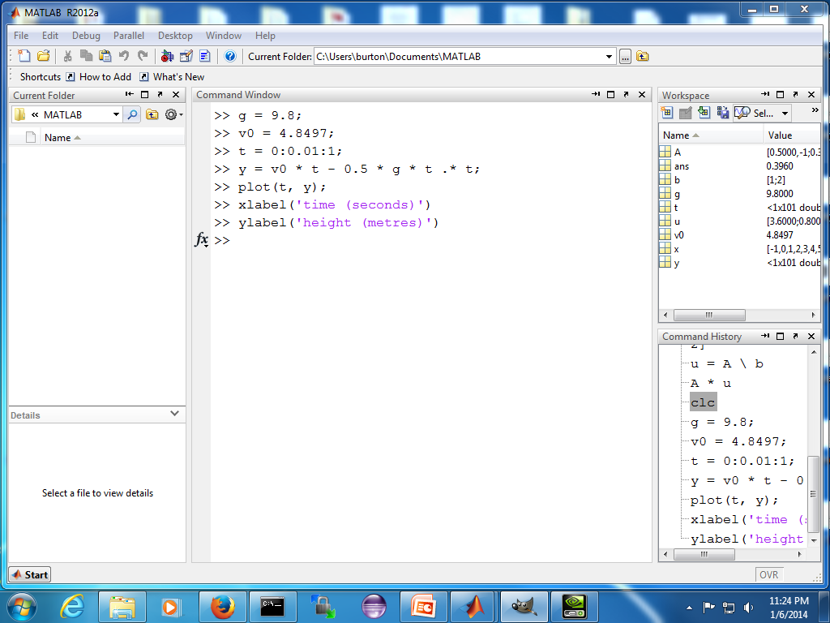

Slide 22
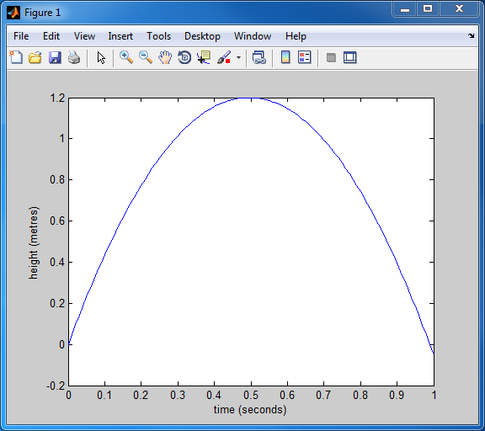

Slide 23
A Quick Tour of Matlab
this still doesn't really explain why the jumper seems to hang mid-air
what fraction of the total time spent in the air is the jumper at a height of 1m or more?
we could solve this exactly using the quadratic equation
we could estimate this by counting the number of values of y where y >= 1

Slide 24
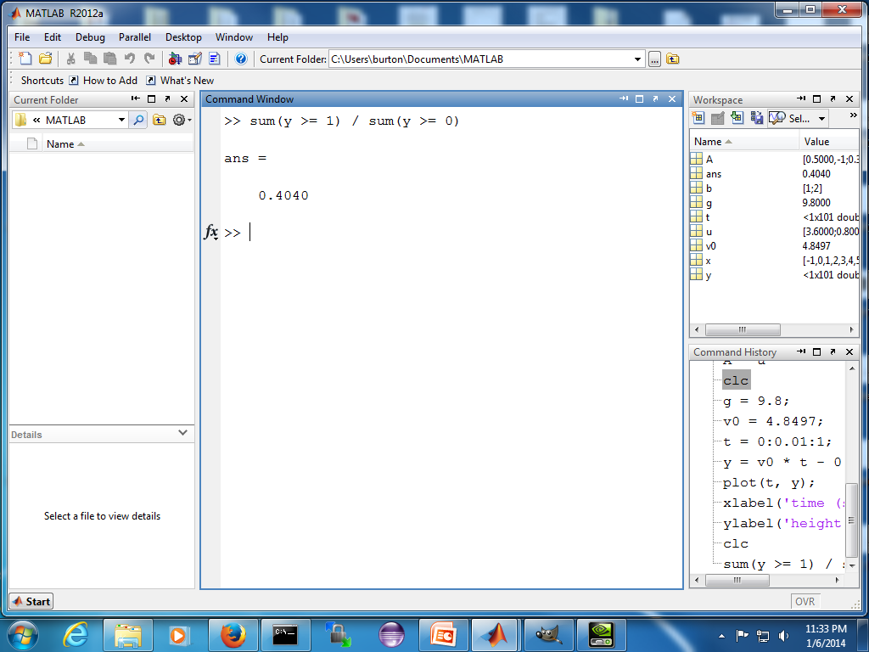

Slide 25
A Quick Tour of Matlab
the field of machine learning has seen very impressive results in recent years particularly in the area of deep learning
in class demo of “Deep Learning with MATLAB: Deep Learning in 11 Lines of MATLAB Code”
available online at:
https://www.mathworks.com/videos/deep-learning-in-11-lines-of-matlab-code-1481229977318.html

Slide 26
Matlab as a calculator

Slide 27
Real numbers
most Matlab applications deal with real numbers (as opposed to integer numbers)
if you type a plain number into Matlab then Matlab will interpret that number to be a real number of type double
short for "double-precision floating-point"

Slide 28
Real numbers in MATLAB
any plain number that you type into MATLAB is treated as a double; e.g.,
1 -1 +2 0.001 532.03857173
you can also use the letter e or E for scientific notation
scientific notation | meaning | value
1e2 | 1 × 10² | 100
1e-2 | 1 × 10⁻² | 0.01
53e+4 | 53 × 10⁴ | 530000
73.22e-3 | 73.22 × 10⁻³ | 0.07322
1e2.2 | error

Slide 29
Arithmetic operators
for numbers you can use the following arithmetic operators:
operation | operator | example | result
addition | + | 1.1 + 2 | 3.1
subtraction | - | 7 – 5.3 | 1.7
multiplication | * | 9.1 * 4 | 36.4
division | / | pi / 2 | 1.5707963267949
exponentiation | ^ | 5 ^ 2 | 25

Slide 30
Operator precedence
all operators in MATLAB follow a set of precedence rules ("order of operations") consistent with mathematics
operator | name | precedence
( ) | parentheses | highest
^ | exponentiation
- | negation
*, /, \ | multiplication and division
+, - | addition and subtraction | lowest

Slide 31
To do
make sure you have access to the Moodle course site
you need a Passport York account before you can use the Moodle site
https://moodle.yorku.ca/
complete LAB A
includes instructions for obtaining iClicker and MATLAB
must complete WHMIS 1 training

