Slide 1
Simultaneous Localization and Mapping

Slide 2
SLAM
simultaneous localization and mapping
  one of the most fundamental problems in mobile robotics
a robot is exploring an unknown static environment
  robot is given sensor measurements and control inputs
    does not have a map
    does not know its pose

Slide 3
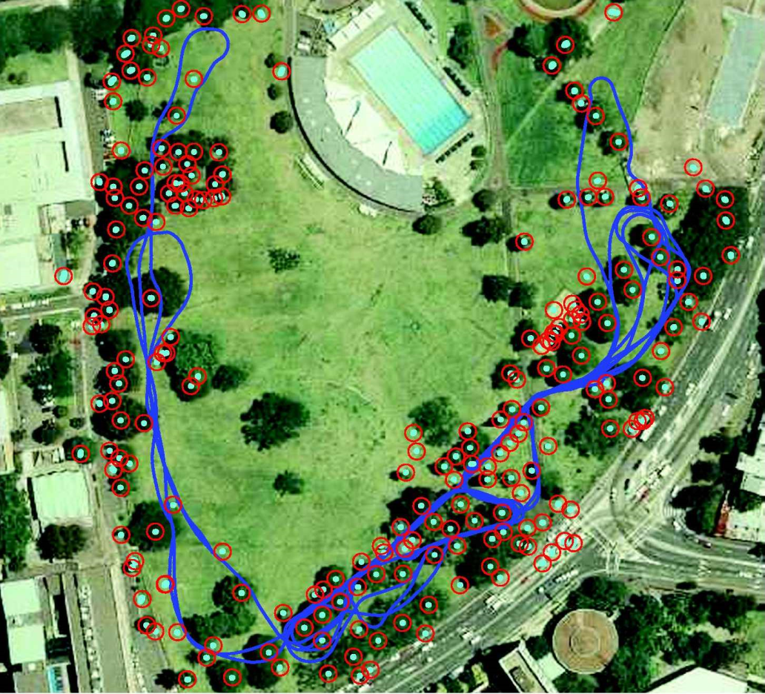
SLAM
robot must acquire a map while simultaneously localizing itself relative to the map
  harder than just localizing
    has no map
  harder than just mapping
    does not know its pose

Slide 4
Online SLAM
in the online SLAM problem, we wish to estimate
  the current pose of the robot x_{t} and
  the map variables m
we are given
  the sensor measurements z_{1:t} = {z₁, z₂, …, z_{t}} and
  the control inputs u_{1:t} = {u₁, u₂, …, u_{t}}

Slide 5
Online SLAM
the online SLAM problem is often expressed in a probabilistic framework
  compute the posterior probability
  what is the probability density function of the robot's current pose and the map given the history of sensor measurements and control inputs?

Slide 6
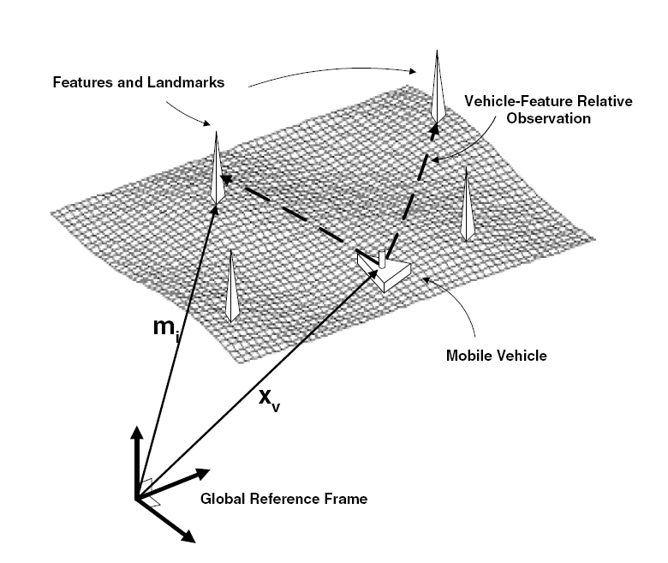
Landmark-Based SLAM

Slide 7
A Simple Landmark-Based SLAM Problem
given
  a directionless robot (i.e., don't care about orientation) that moves in controlled but noisy steps
  n fixed landmarks
  the robot can measure all of the landmarks all of the time in a controlled order
  the robot measures the relative offset from its position to each landmark

Slide 8
Plant Model
state; dimension 2n + 2
robot location
landmark 1 location
landmark 2 location
landmark n location

Slide 9
Plant Model
control input; dimension 2n + 2
robot step
*all zeros because no control is applied to landmarks

Slide 10
Plant Model
plant noise; dimension 2n + 2
noise in the control input (*additive)
*all zeros because landmarks are static

Slide 11
Plant Model

Slide 12
Measurement Model
the robot can measure all of the landmarks all of the time in a controlled order
the robot measures the relative offset from its position to each landmark
robot
landmark n
…
landmark 1
landmark 2

Slide 13
Measurement Model
dimension 2n
robot offset to landmark 1
robot offset to landmark 2
robot offset to landmark n

Slide 14
Measurement Model
dimension 2n

Slide 15
Measurement Model
measurement noise; dimension 2n
measurement noise for landmark 1 (*additive)
measurement noise for landmark 2 (*additive)
measurement noise for landmark n (*additive)

Slide 16
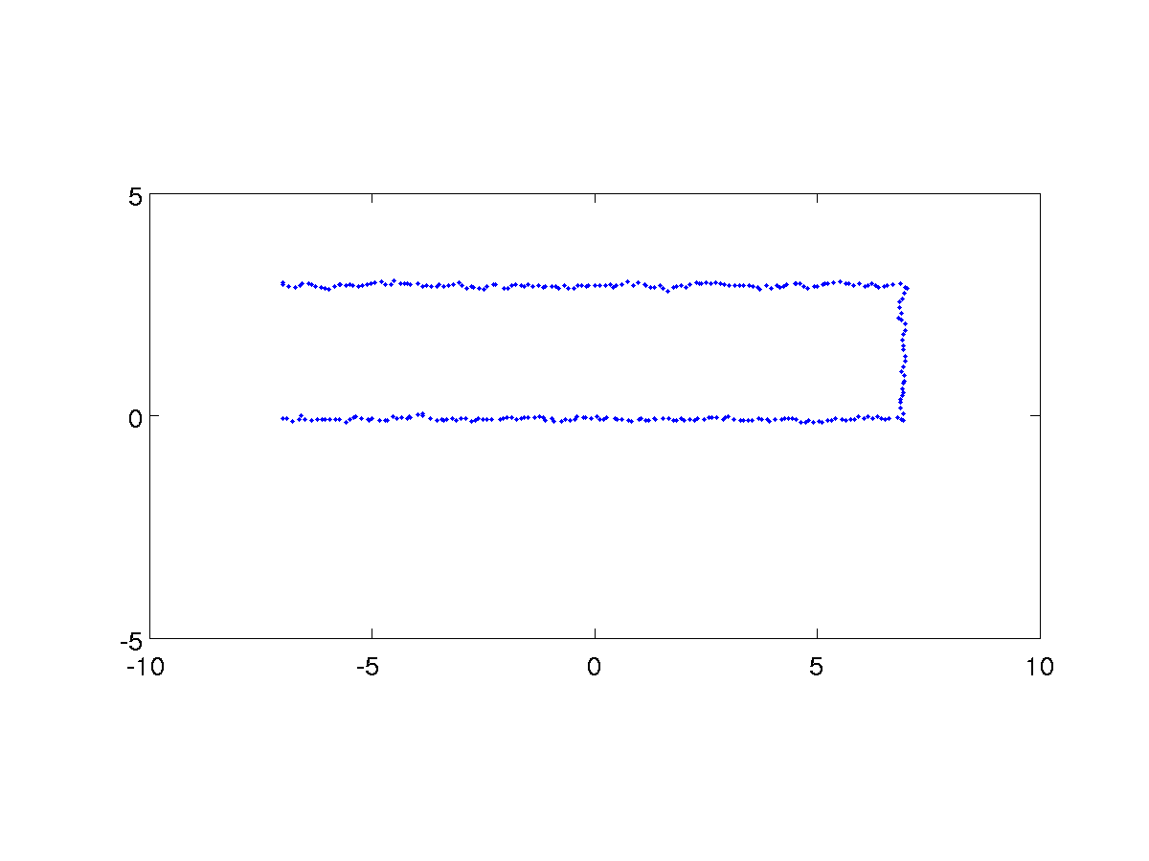
Example 1
estimated path

Slide 17
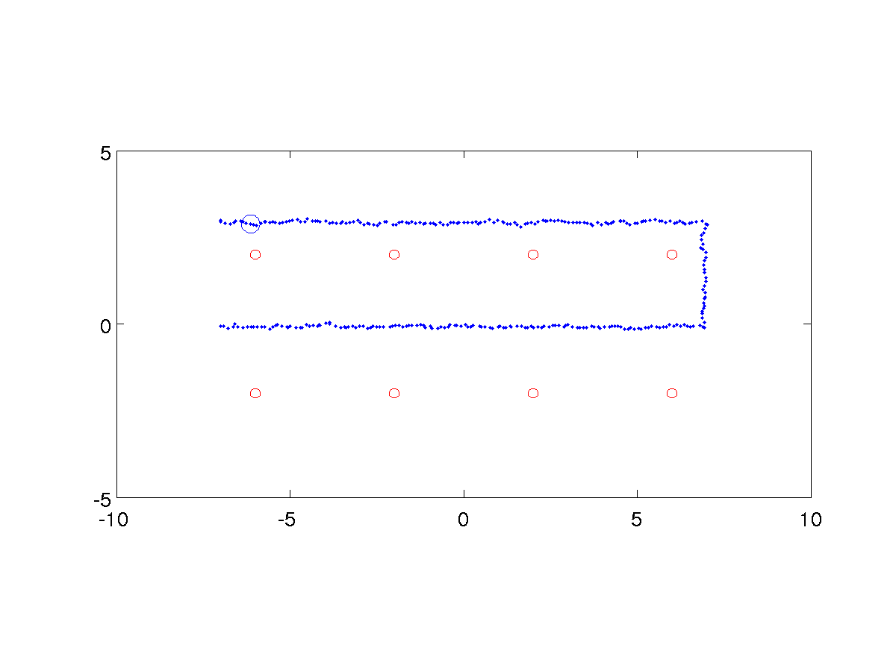
Example 1
robot position covariance
landmark position covariance
  robot position covariance is small near the start point because the robot has not travelled far enough for the control input noise to accumulate

Slide 18
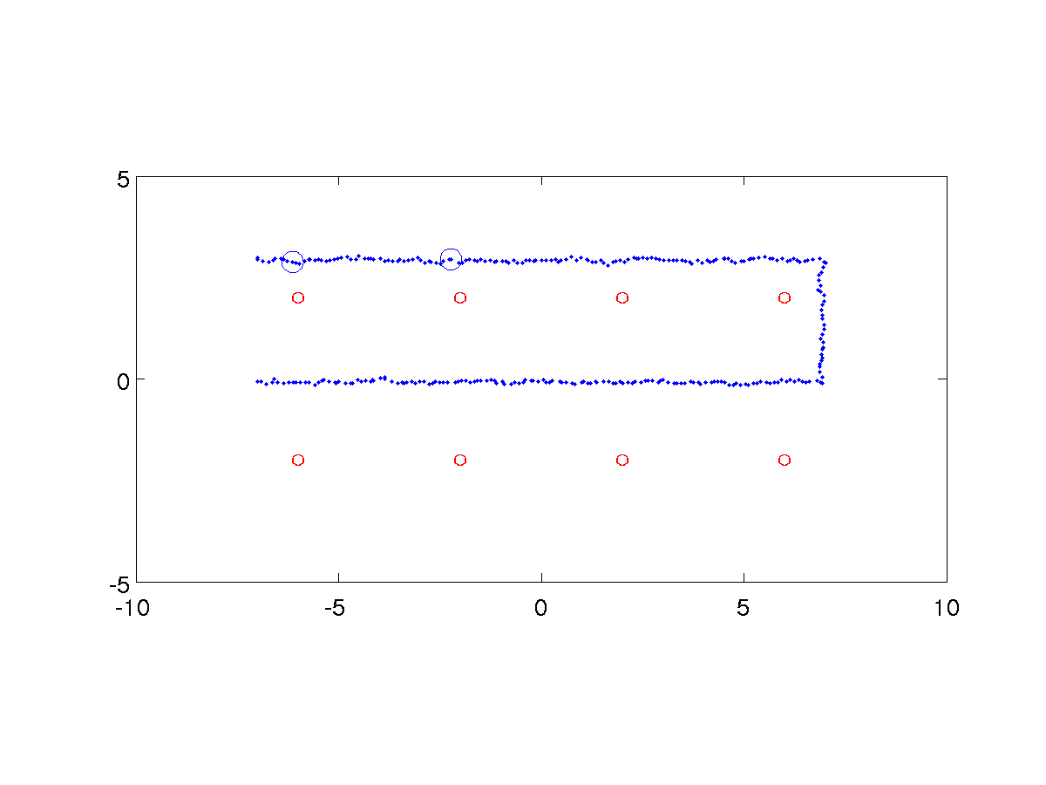
Example 1
robot position covariance
landmark position covariance

Slide 19
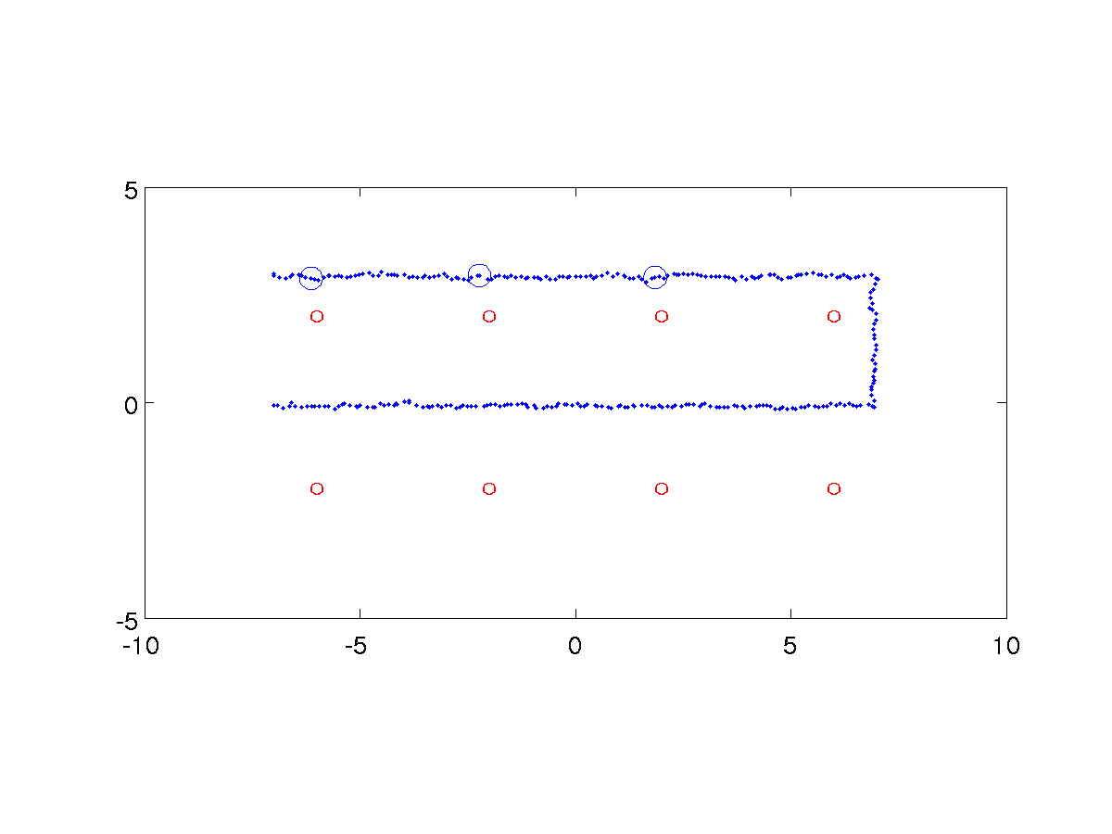
Example 1
robot position covariance
landmark position covariance

Slide 20
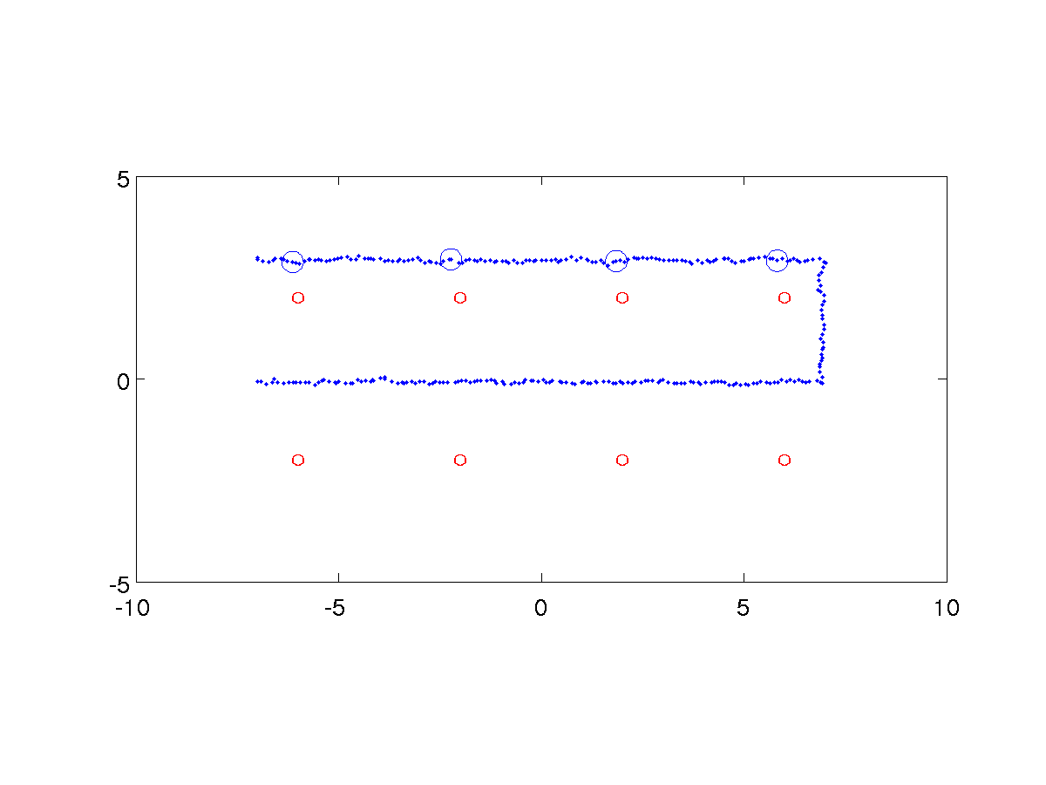
Example 1
robot position covariance
landmark position covariance

Slide 21

Example 1
robot position covariance
landmark position covariance

Slide 22

Example 1
robot position covariance
landmark position covariance

Slide 23
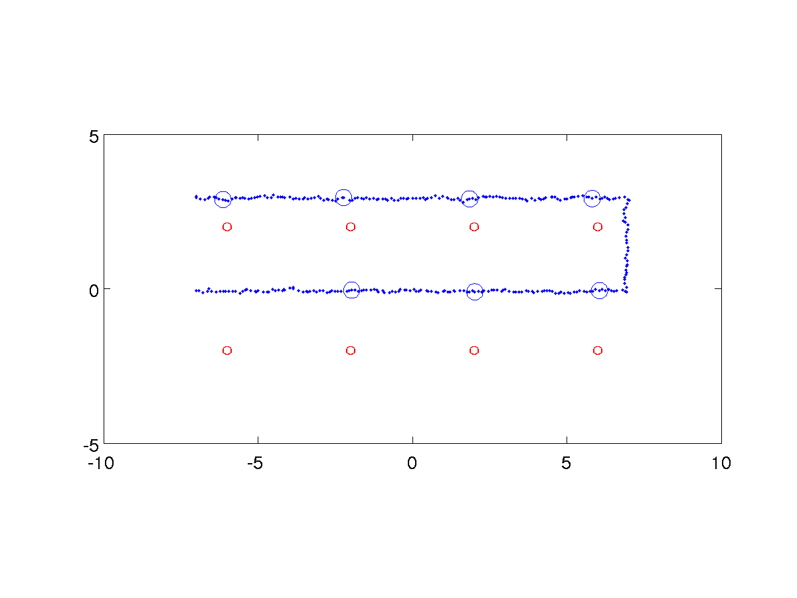
Example 1
robot position covariance
landmark position covariance

Slide 24

Example 1
robot position covariance
landmark position covariance

Slide 25
Example 2
the assumption that the robot can measure all of the landmarks all of the time is unrealistic for many kinds of sensors
  what do we need to change if the robot can only sense a subset of the landmarks at any given time?
    not the plant model

Slide 26
Measurement Model
the robot can measure all of the landmarks within a fixed radius around the robot
the robot measures the relative offset from its position to each landmark
robot
landmark n
…
landmark 1
landmark 2

Slide 27
Measurement Model
the robot might see multiple landmarks along sections of its path
landmark n
…
landmark 1
landmark 2

Slide 28
Measurement Model
the robot may not be able to measure any landmarks along sections of its path
landmark n
…
landmark 1
landmark 2

Slide 29
Measurement Model
the robot might revisit previously seen landmarks
landmark n
…
landmark 1
landmark 2

Slide 30
Measurement Model
assume that the actual sensor measurement for a landmark outside of the sensor range is [0 0]^{T}
  then we need to change the measurement model so that we can “zero out” measurements to landmarks that are outside of the sensor range
    this is easily done by manipulating C

Slide 31
Measurement Model
suppose that landmark 2 is outside of sensor range
  zero out the rows corresponding to the measurement for landmark 2
    C is now a function, C_{t} , of time

Slide 32
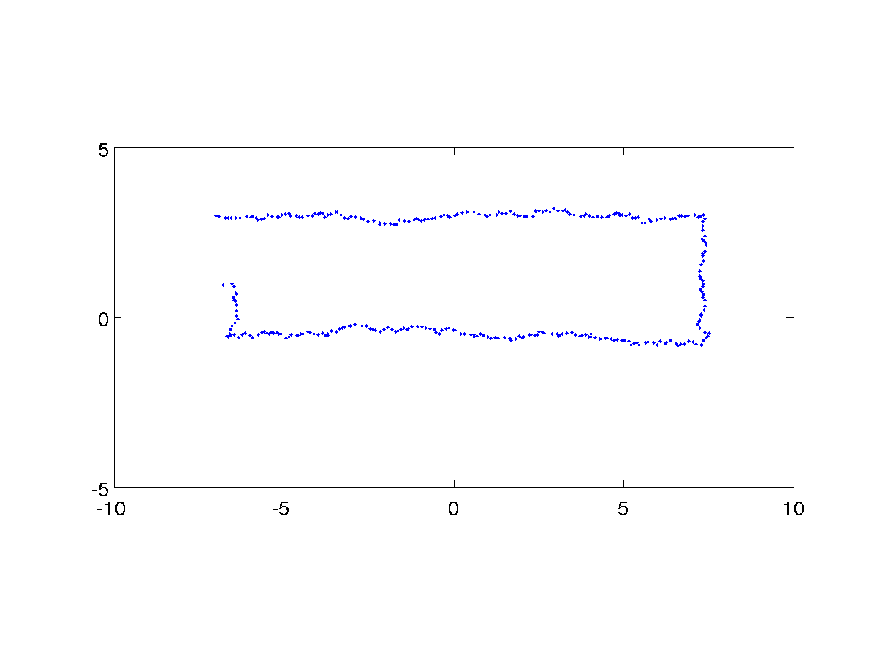
Example 2
estimated path

Slide 33
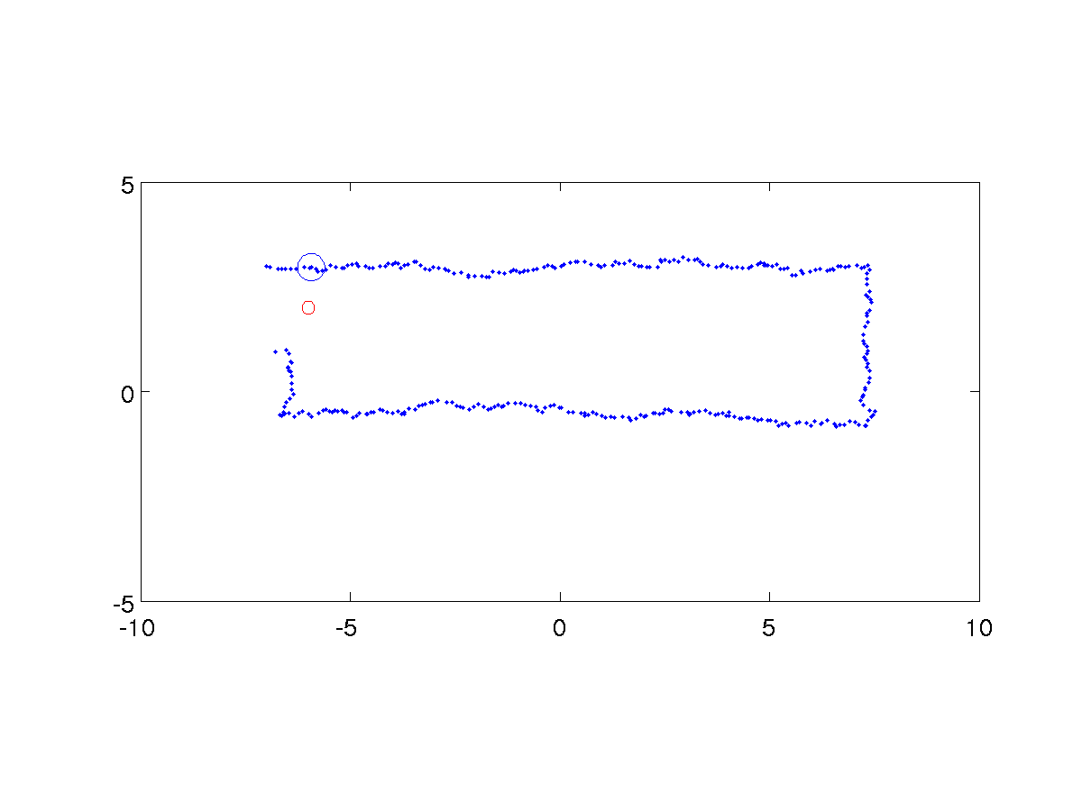
Example 2
robot position covariance
landmark position covariance

Slide 34
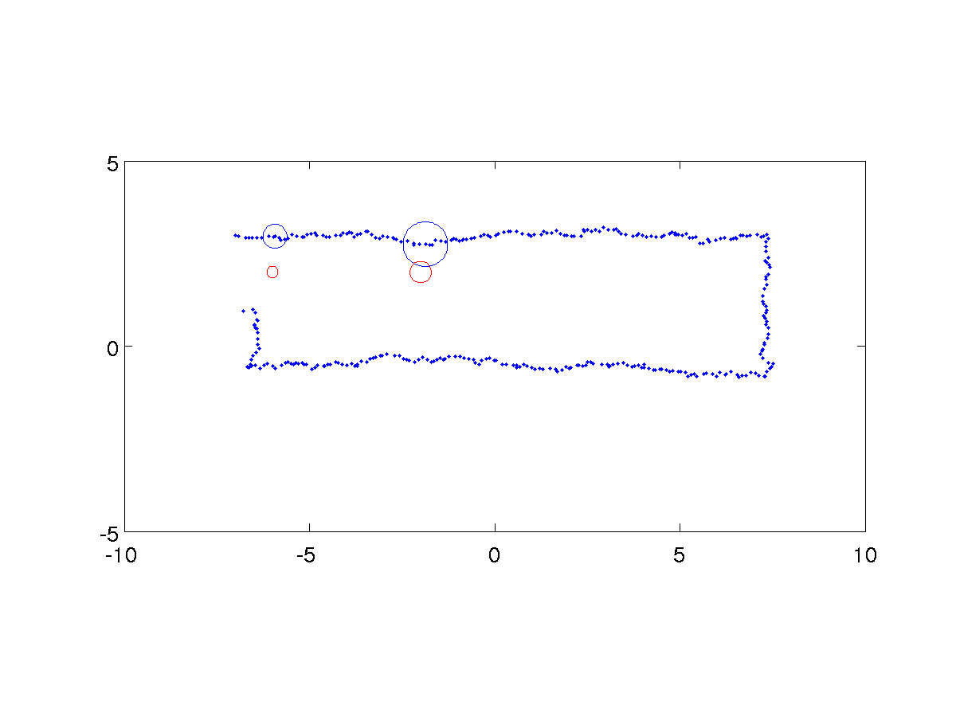
Example 2
robot position covariance
landmark position covariance
  robot position covariance grows as control input noise accumulates (and cannot be completely corrected by observing one landmark at a time)

Slide 35
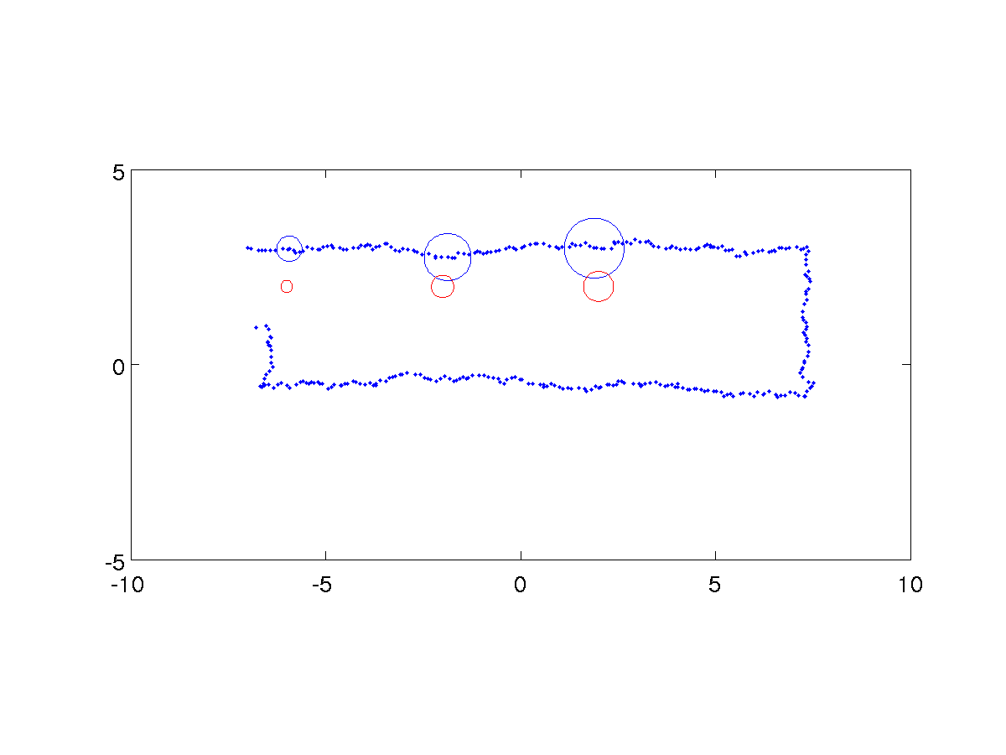
Example 2
robot position covariance
landmark position covariance
  each subsequent landmark position covariance grows because the landmark position estimate is correlated with the robot’s position

Slide 36
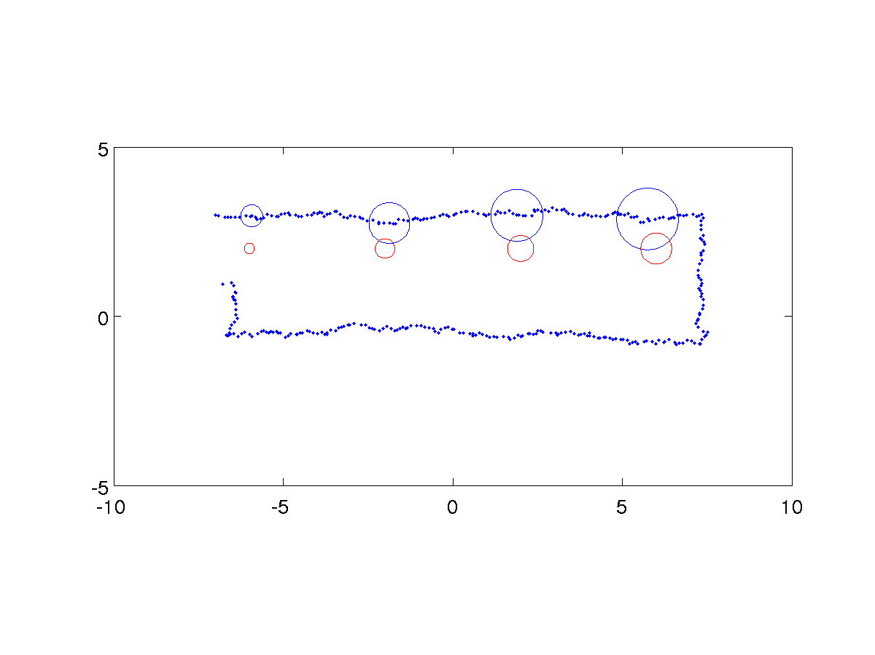
Example 2
robot position covariance
landmark position covariance

Slide 37
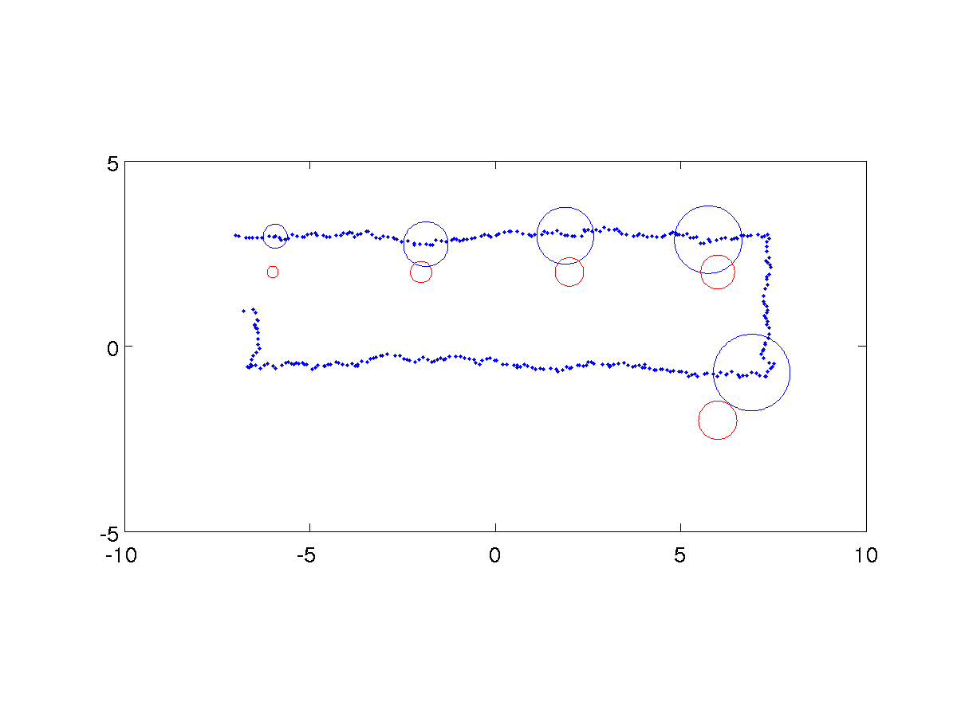
Example 2
robot position covariance
landmark position covariance

Slide 38
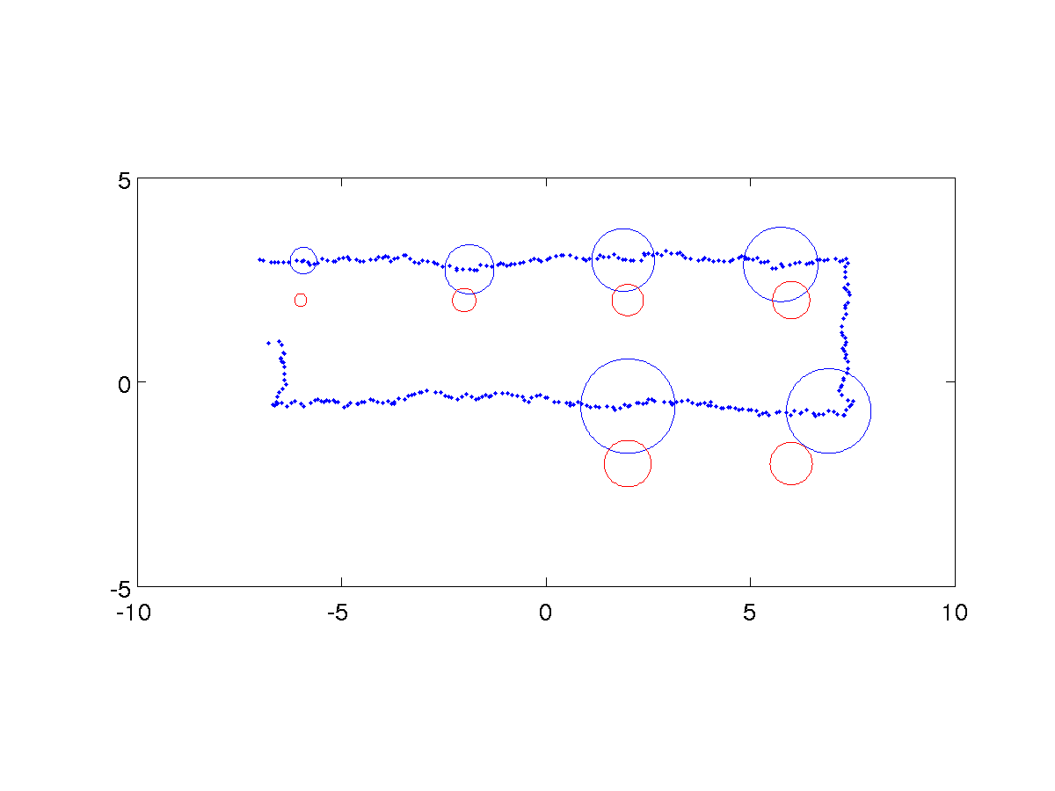
Example 2
robot position covariance
landmark position covariance

Slide 39
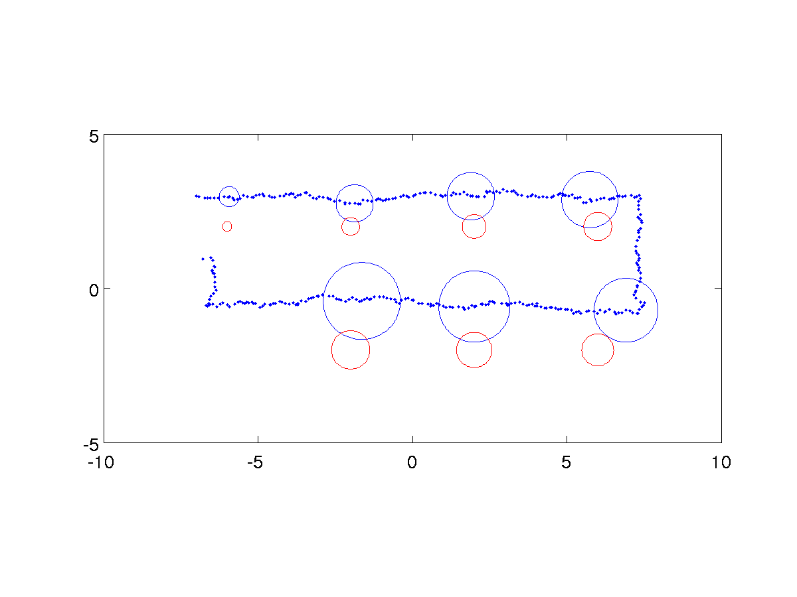
Example 2
robot position covariance
landmark position covariance

Slide 40
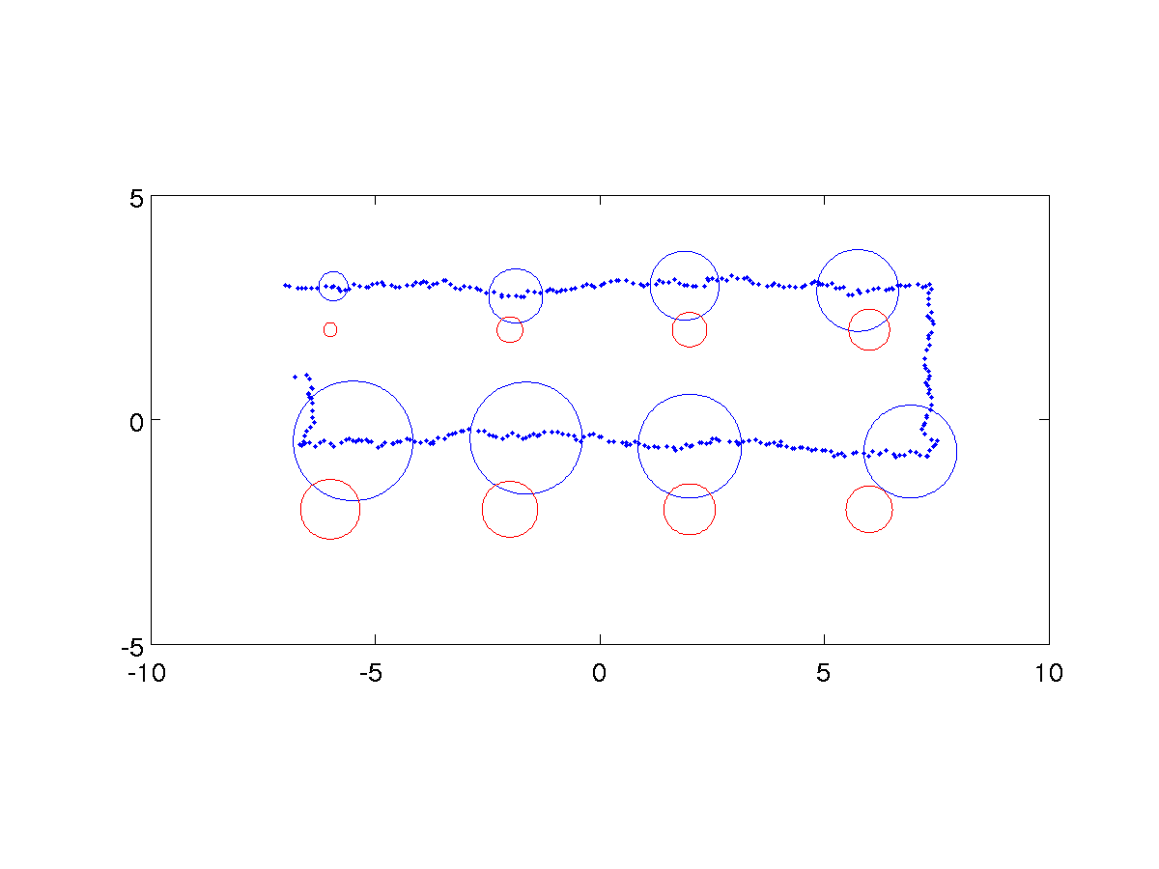
Example 2
robot position covariance
landmark position covariance

Slide 41
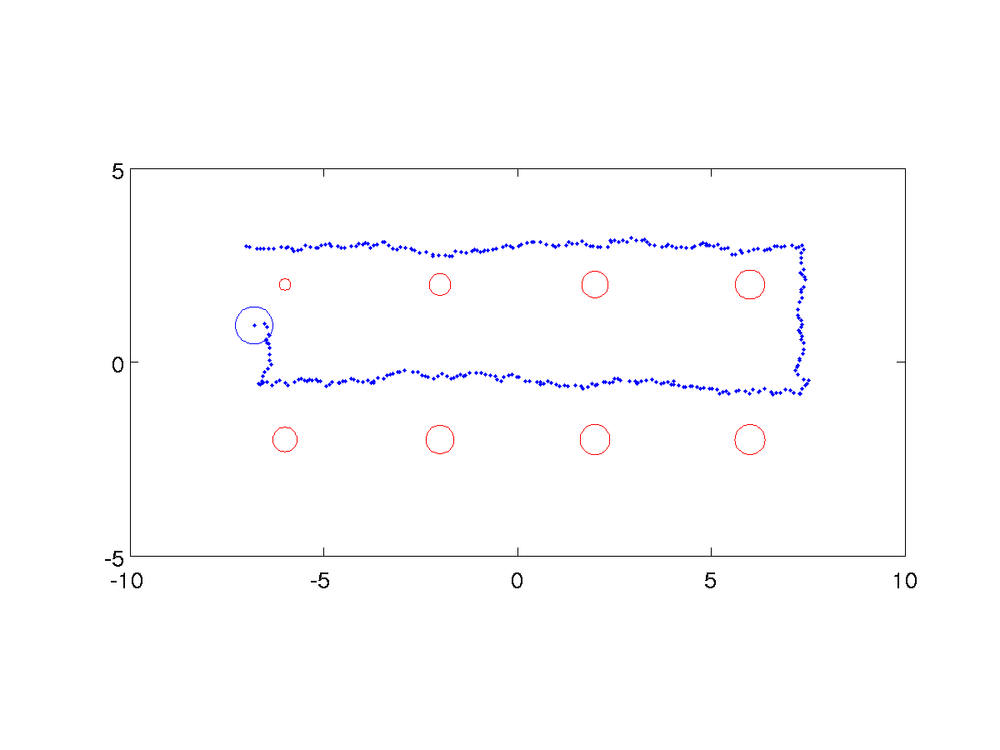
Example 2
robot position covariance
landmark position covariance
  when the robot sees the first landmark for a second time all of the covariances decrease!

Slide 42
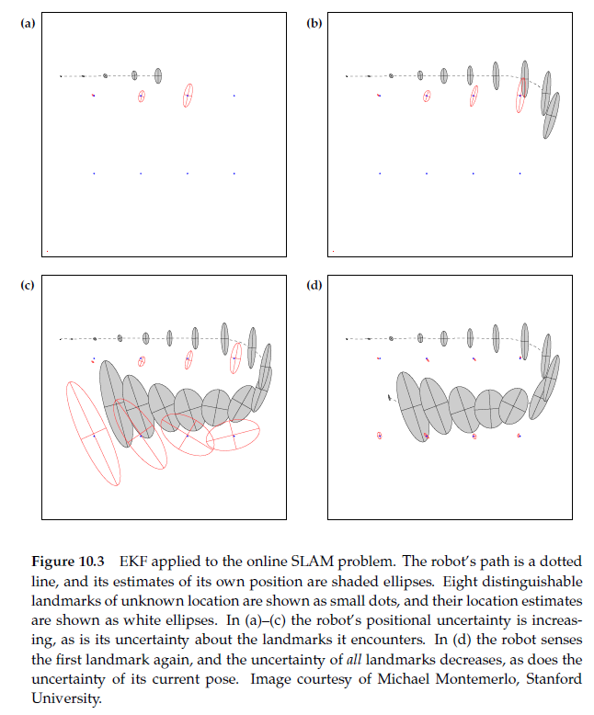
EKF Slam Example 3

Slide 43
Loop Closure
the phenomenon illustrated on the previous slide is called “closing the loop”
  occurs when a robot moving through unknown terrain encounters a landmark not seen for a “long” time
KF and EKF SLAM intrinsically perform loop closure (with high computational cost)
  online demo http://rogerstuckey.com/simulation/javascript/slam-html5/
  not every SLAM algorithm is capable of loop closure without an explicit loop closure process

Slide 44
Loop Closure in KF SLAM
it is not immediately obvious how KF SLAM performs loop closure until you look at the estimated state covariance matrix

Slide 45
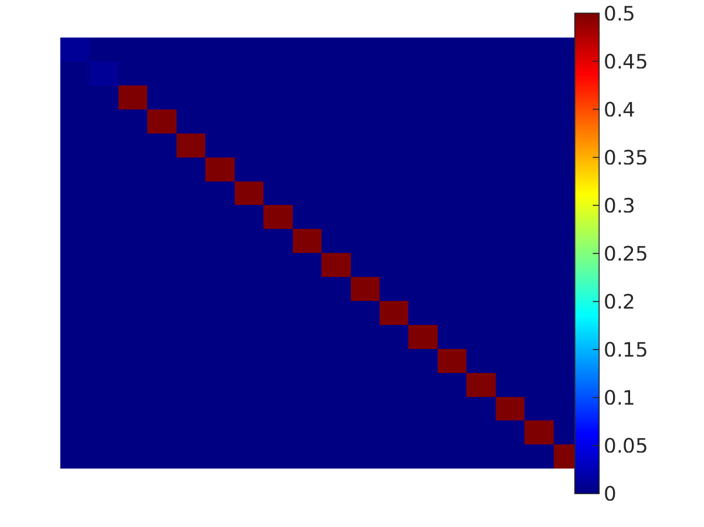
Loop Closure in KF SLAM
at the start of the path the robot’s position is assumed known and the landmark positions are assumed to be uknown
  following images show state covariance matrix
  black = 0 and white > 0.08
robot position
landmark positions

Slide 46
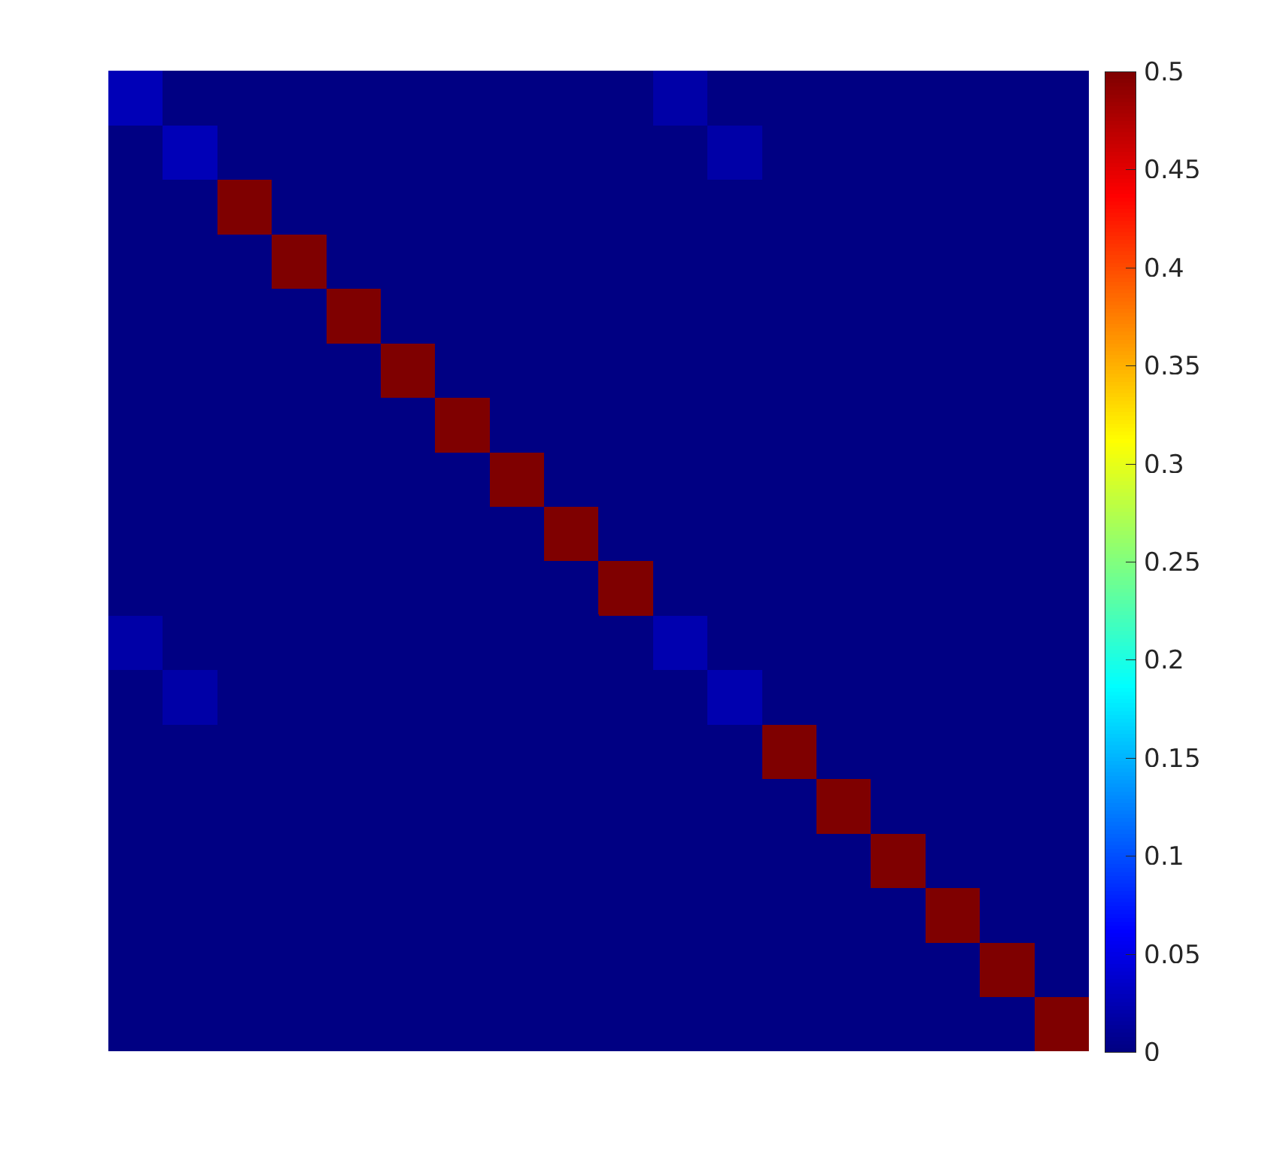
Loop Closure in KF SLAM
the covariance of the first measured landmark is related to the covariance of the estimated position of the robot
robot position
first measured landmark

Slide 47
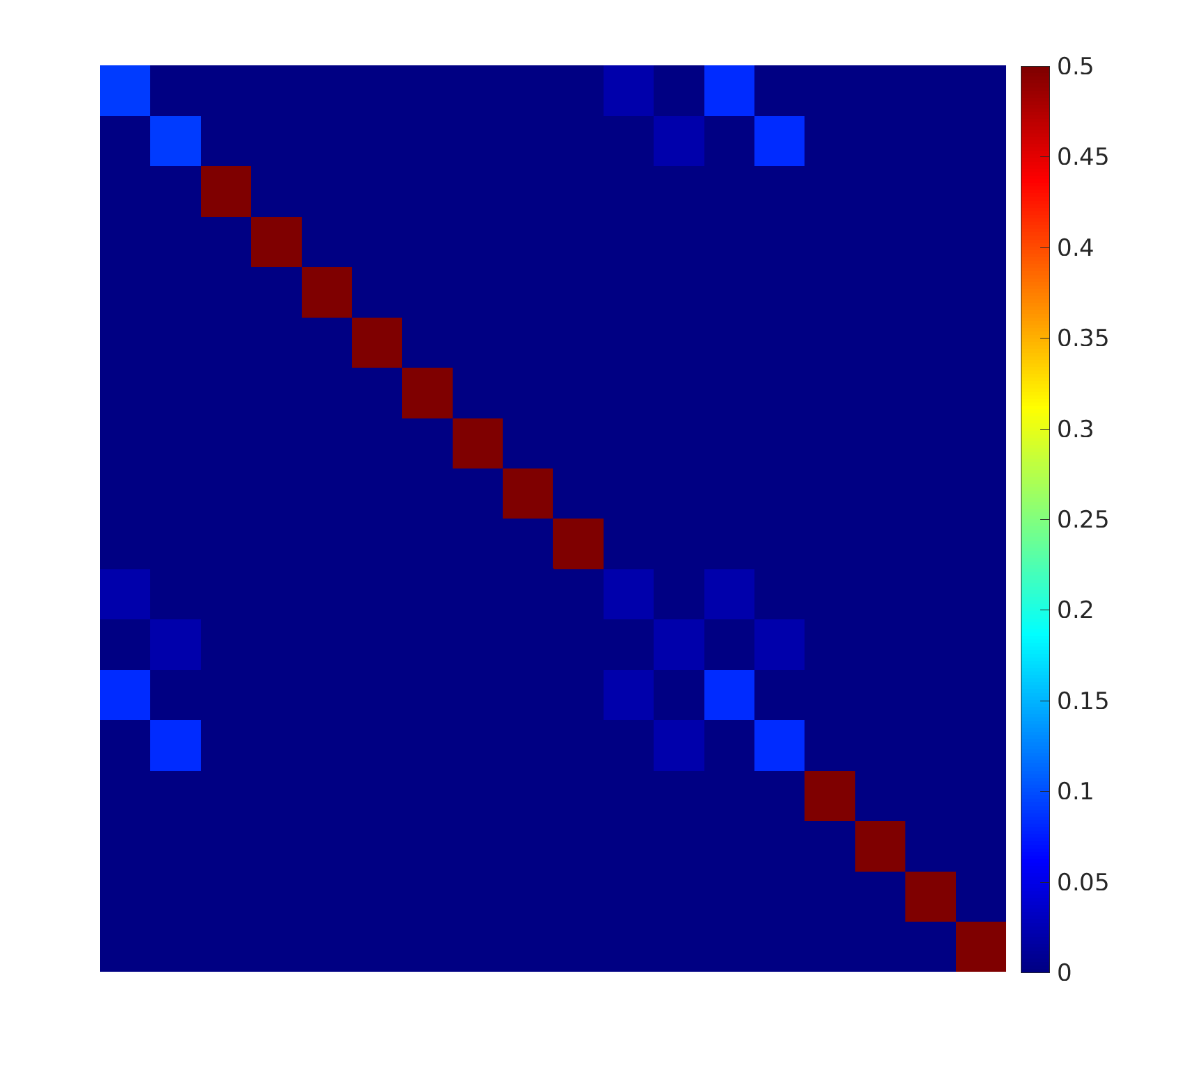
Loop Closure in KF SLAM
the covariance of the second measured landmark is related to the covariance of the estimated position of the robot, and less so to the covariance of the first measured landmark
robot position
second measured landmark

Slide 48
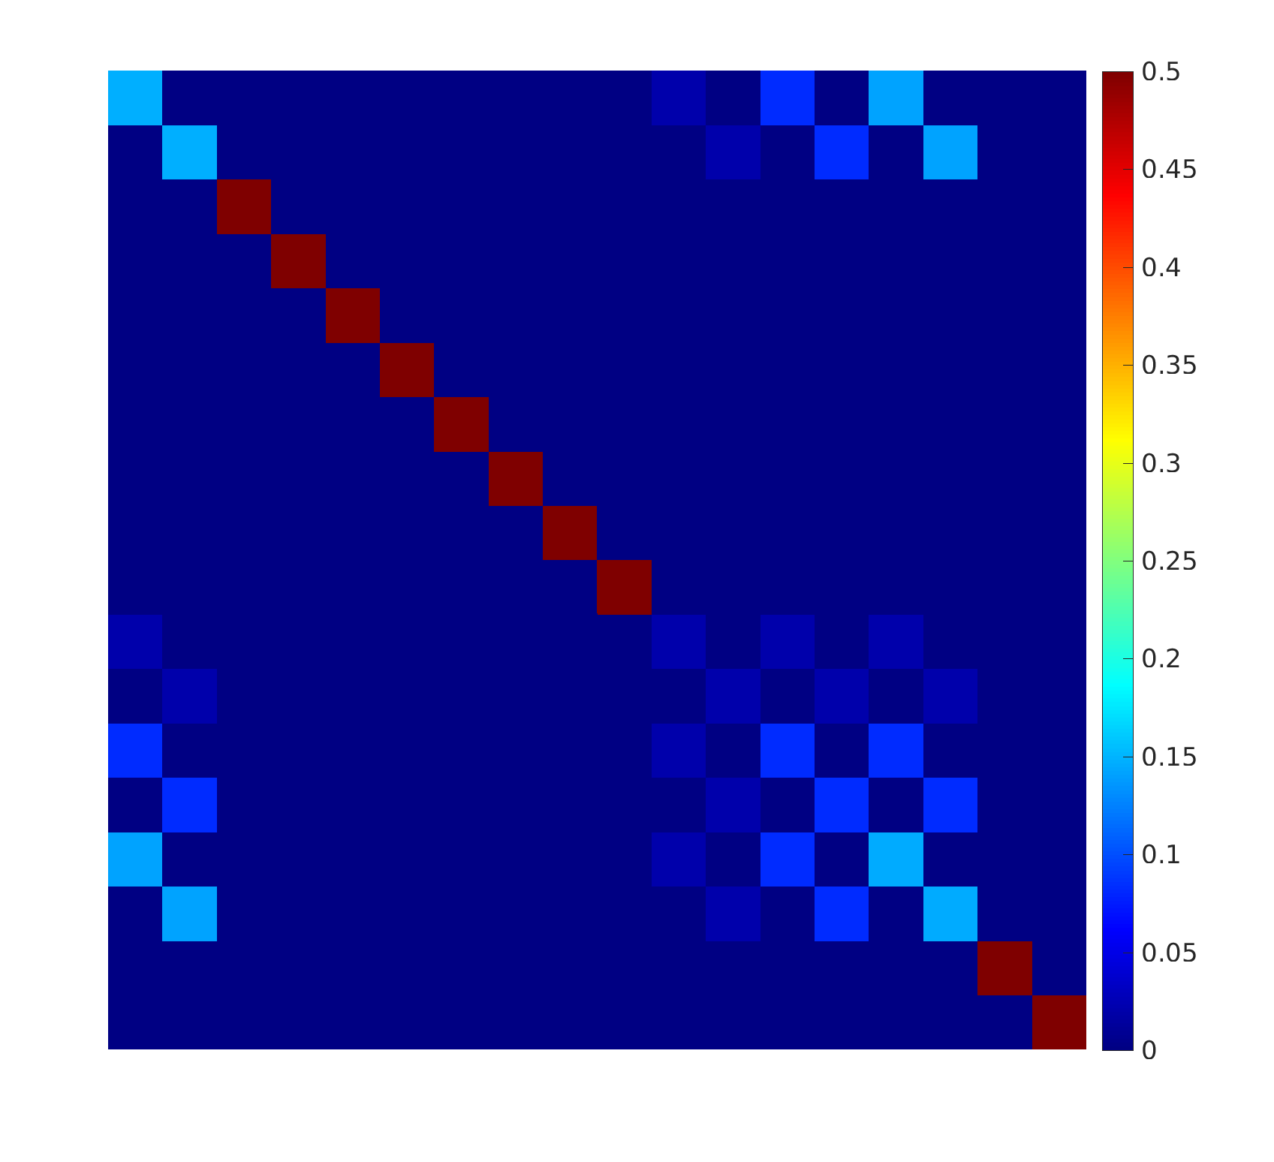
Loop Closure in KF SLAM
the covariance of the third measured landmark is related to the covariance of the estimated position of the robot, and less so the covariances of the first and second landmarks
robot position
third measured landmark

Slide 49
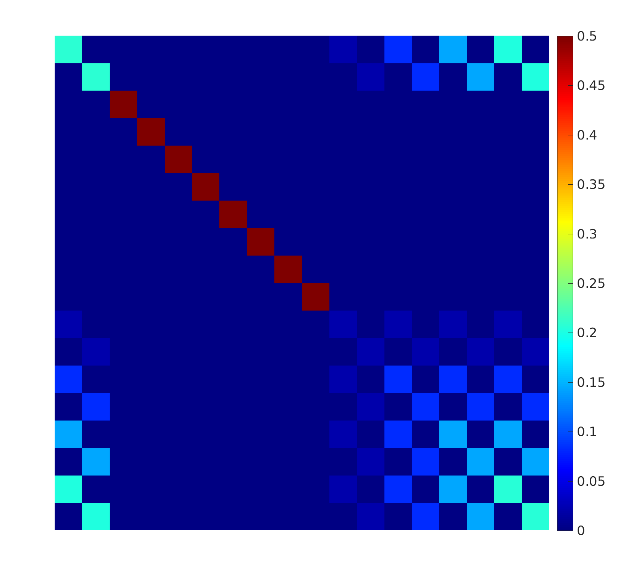
Loop Closure in KF SLAM
the covariance of the fourth measured landmark is related to the covariance of the estimated position of the robot, and less so the covariances of the previous landmarks
robot position
fourth measured landmark

Slide 50
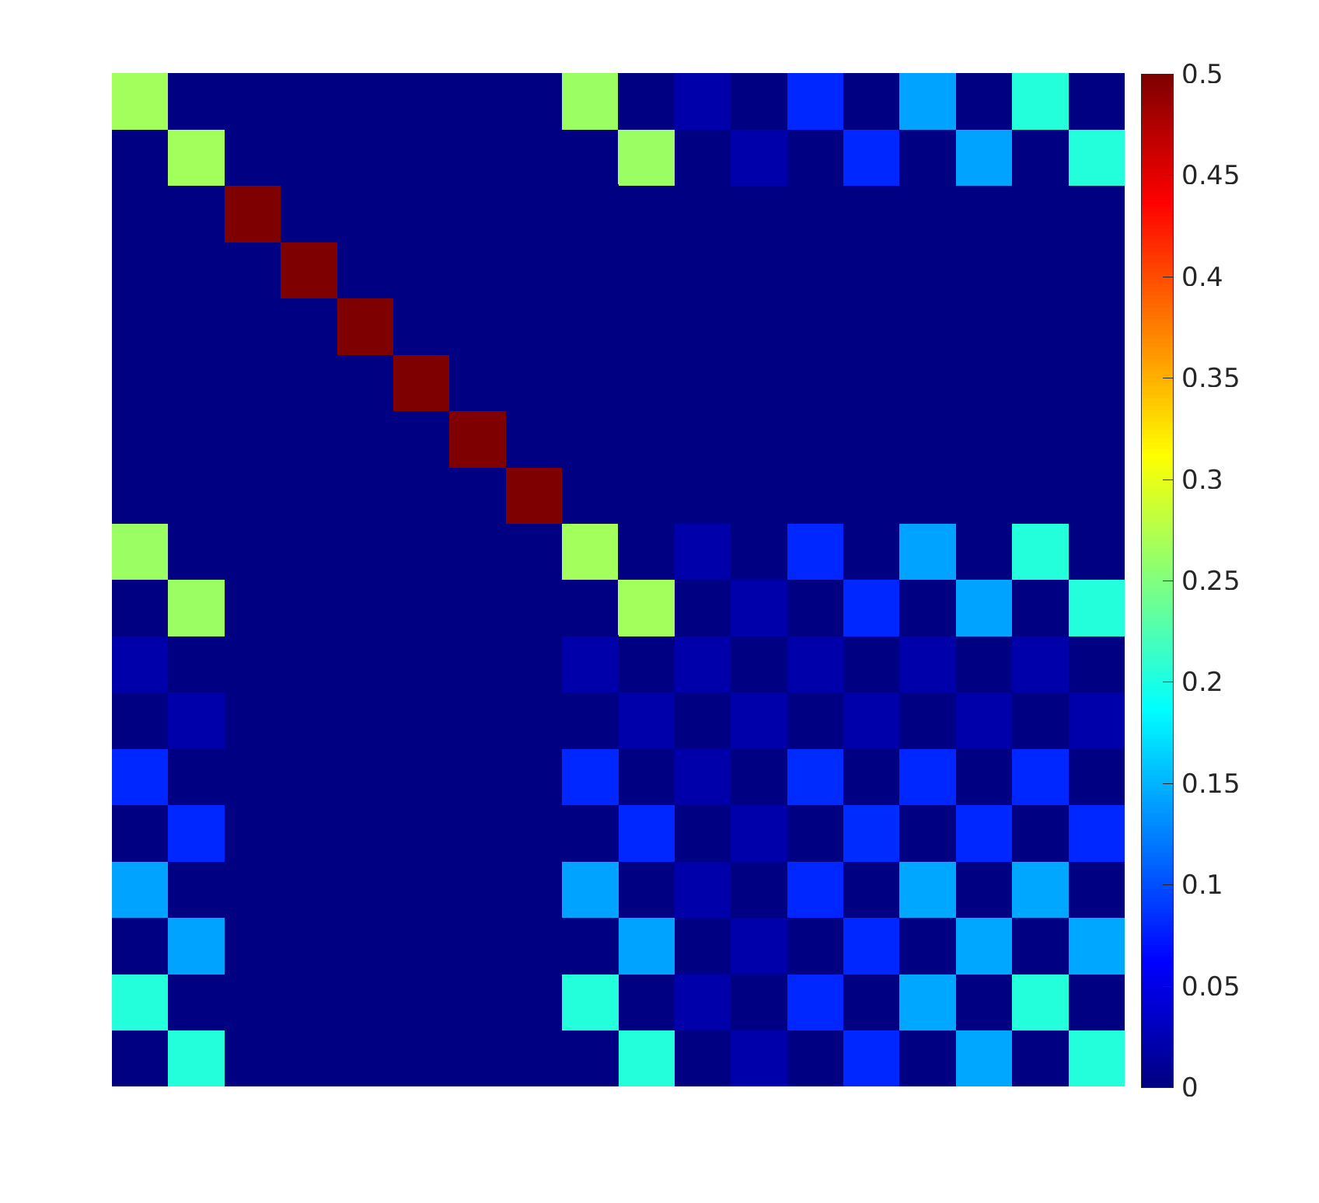
Loop Closure in KF SLAM
the covariance of the fifth measured landmark is related to the covariance of the estimated position of the robot, and less so the covariances of the previous landmarks
robot position
fifth measured landmark

Slide 51
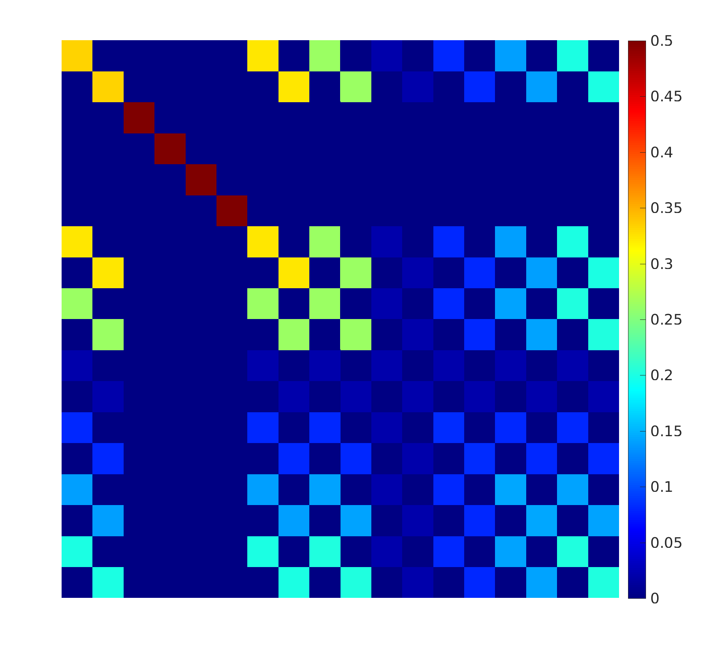
Loop Closure in KF SLAM
the covariance of the sixth measured landmark is related to the covariance of the estimated position of the robot, and less so the covariances of the previous landmarks
robot position
sixth measured landmark

Slide 52
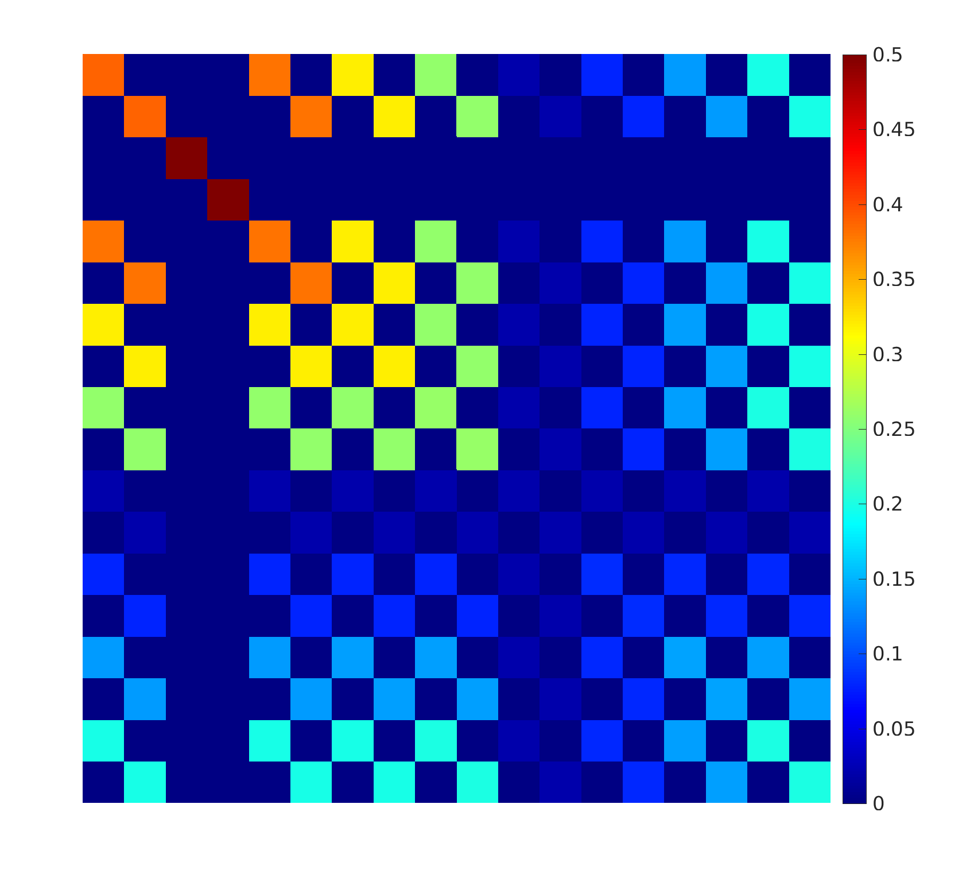
Loop Closure in KF SLAM
the covariance of the seventh measured landmark is related to the covariance of the estimated position of the robot, and less so the covariances of the previous landmarks
robot position
seventh measured
landmark

Slide 53
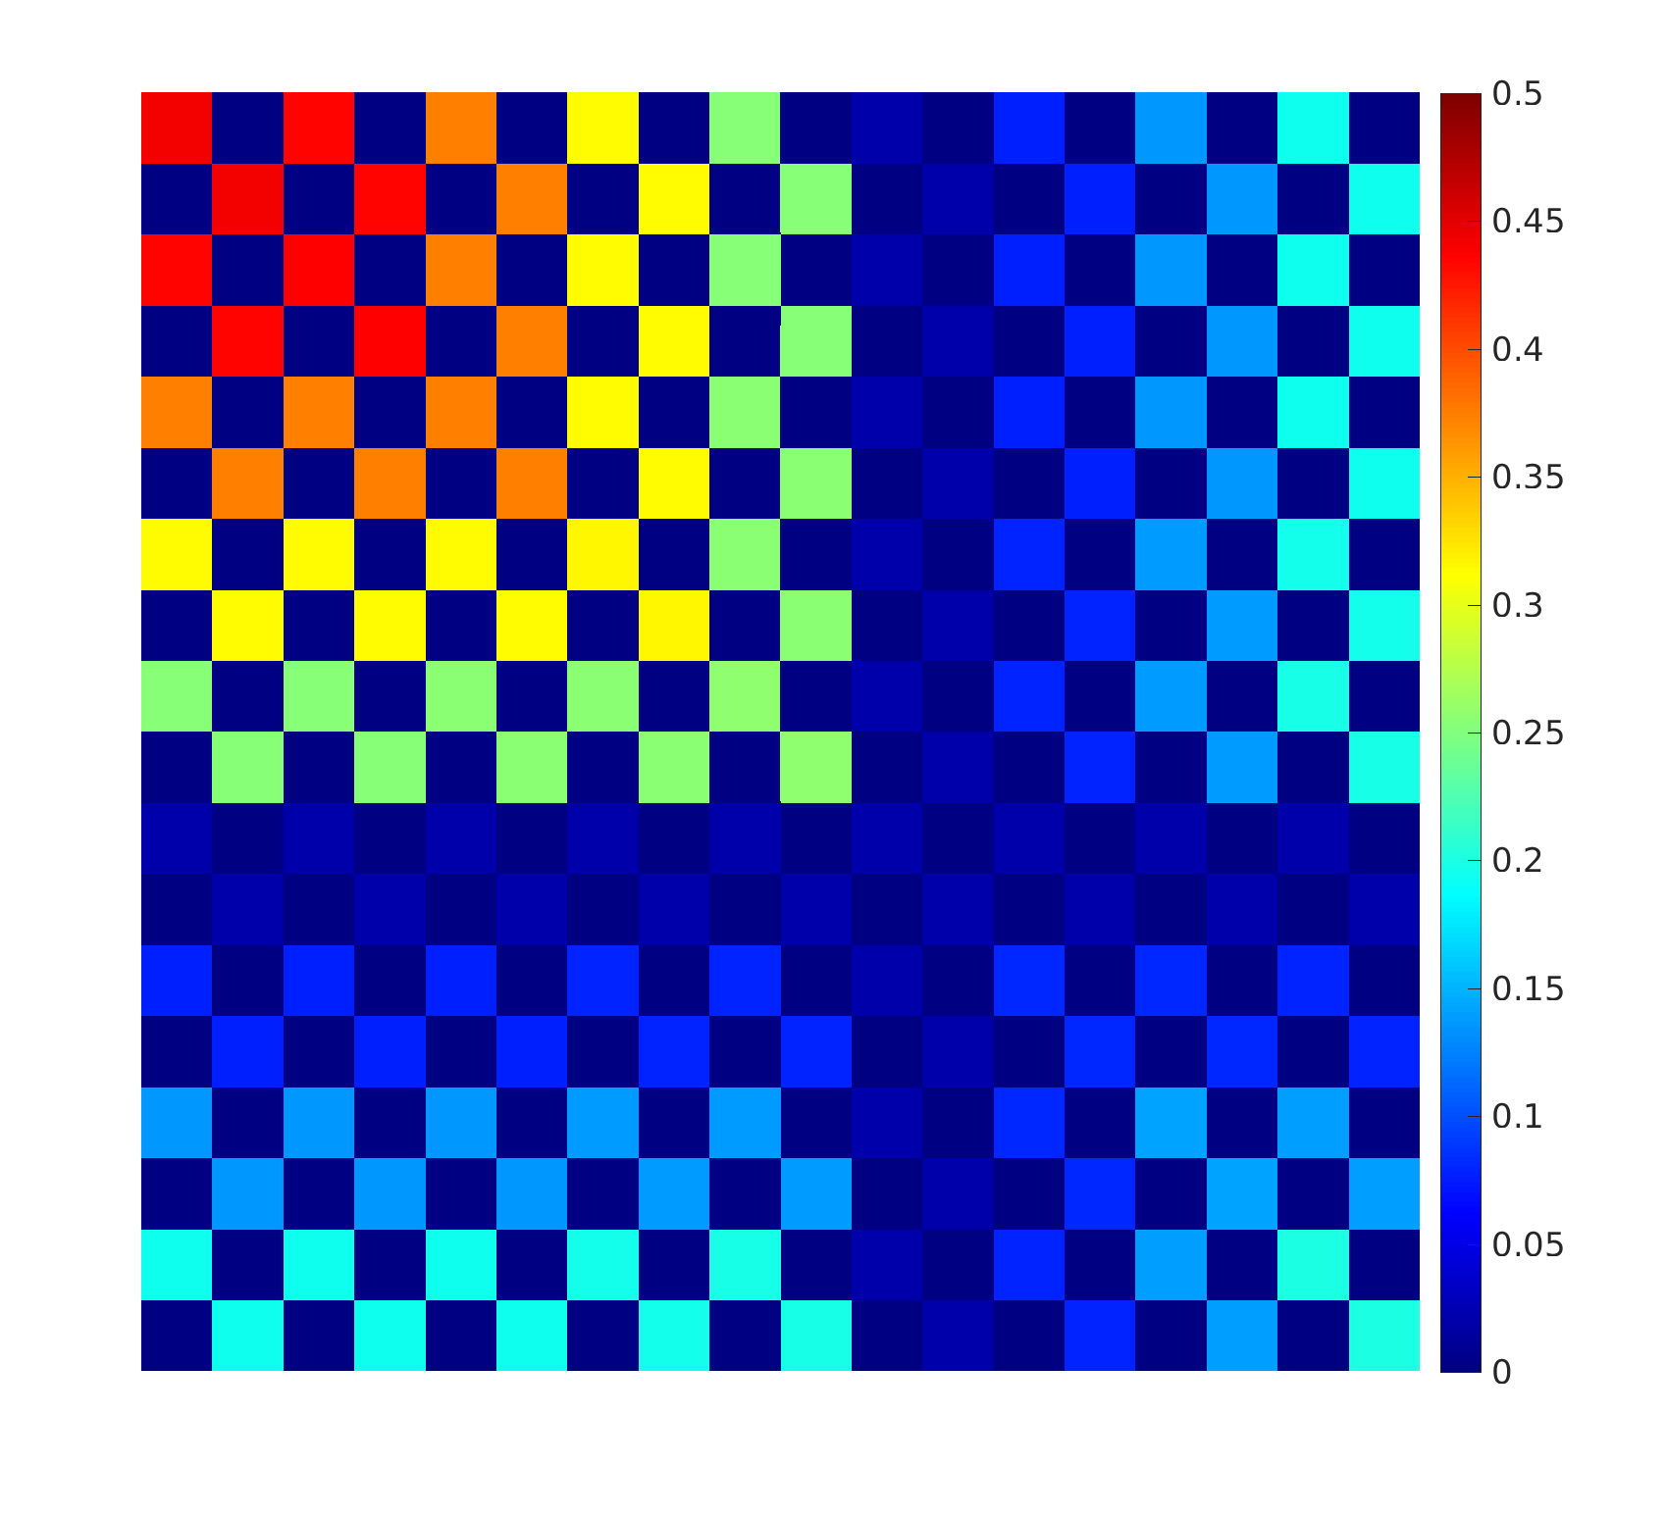
Loop Closure in KF SLAM
the covariance of the eighth measured landmark is related to the covariance of the estimated position of the robot, and less so the covariances of the previous landmarks
robot position
eighth measured
landmark

Slide 54
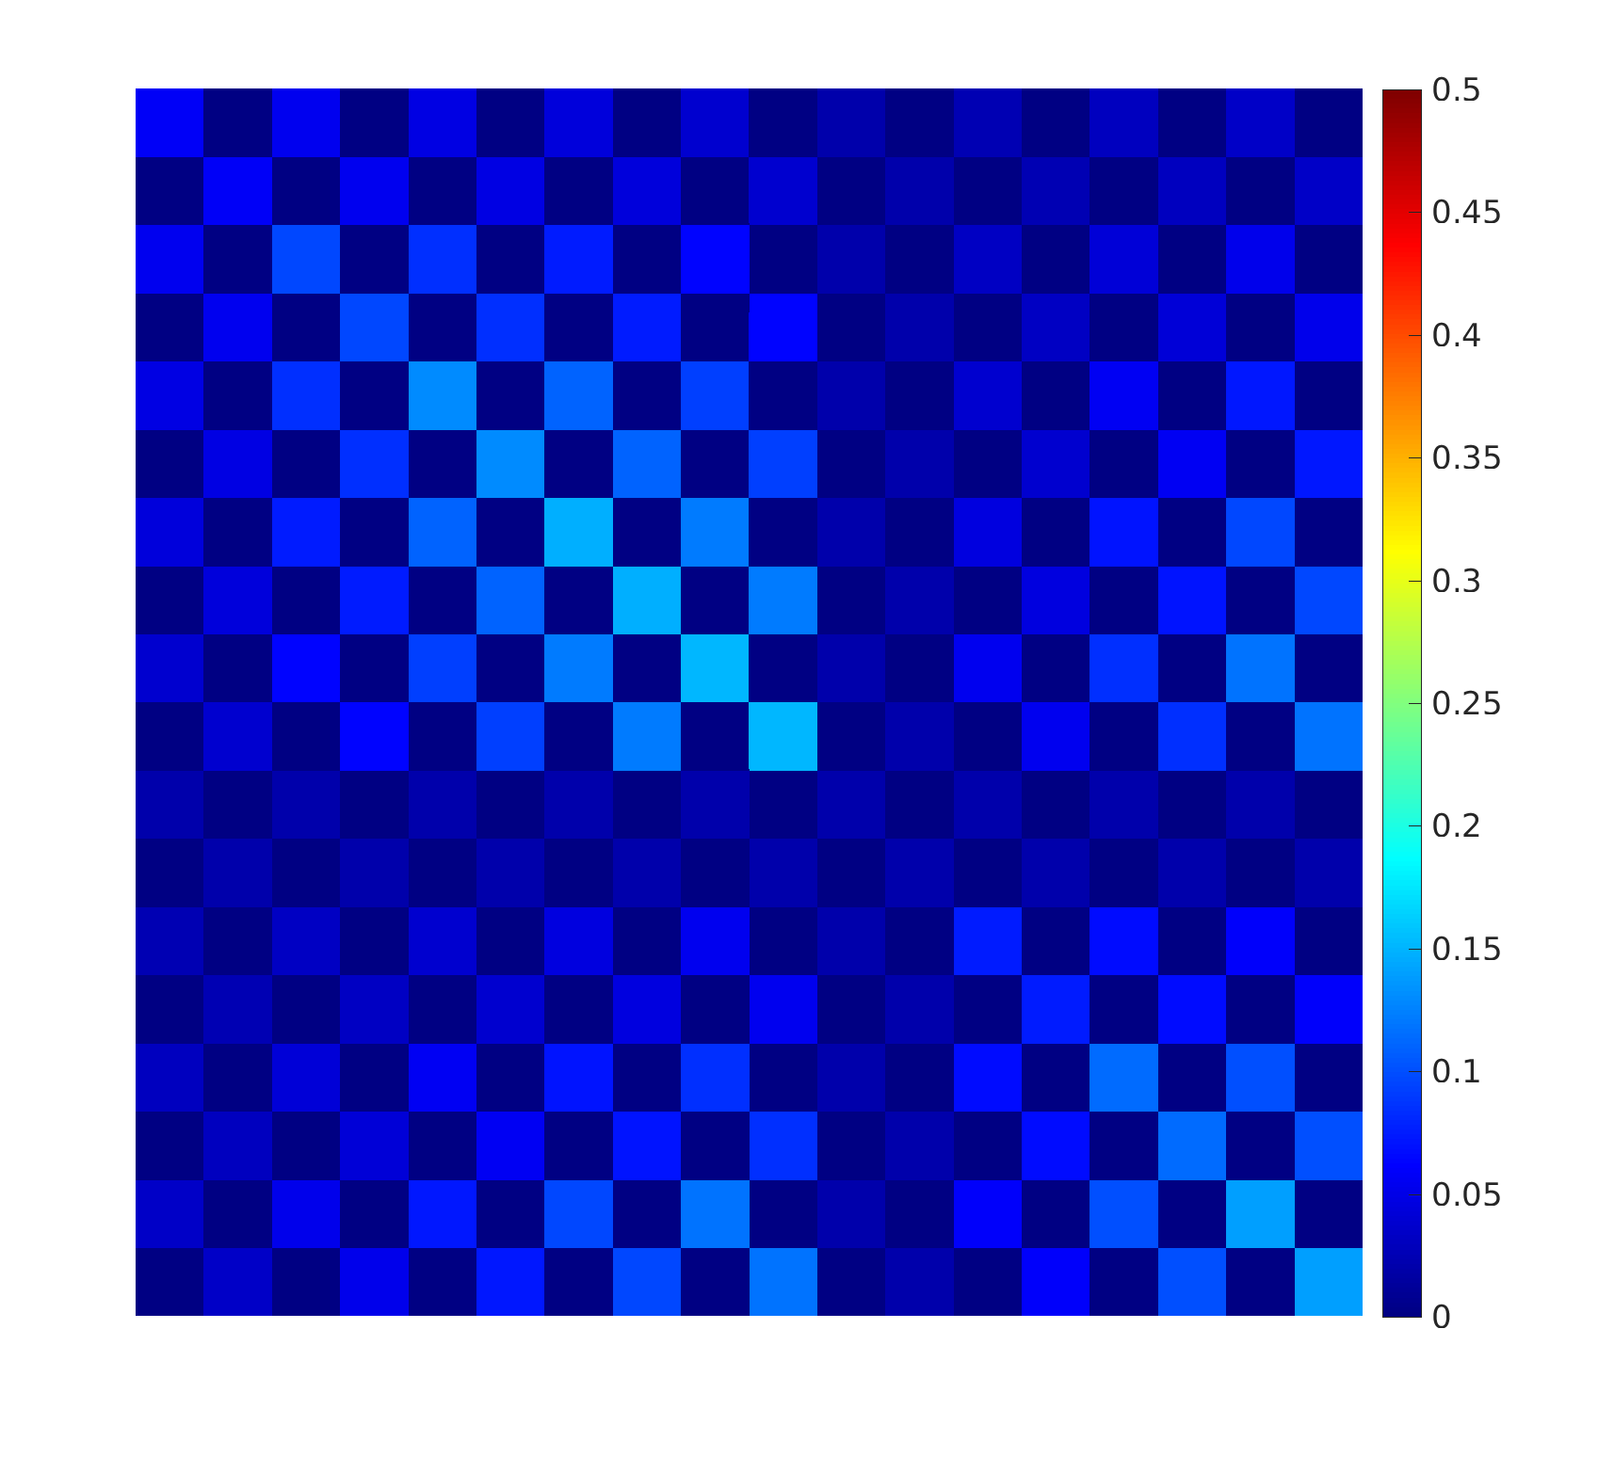
Loop Closure in KF SLAM
the covariance of the first measured landmark is related to the covariance of the estimated position of the robot and all of the other landmarks
robot position
first measured landmark

Slide 55
Loop Closure in KF SLAM
loop closure in KF SLAM comes with a high computational and storage cost
  state covariance matrix size is O(N ²) for N landmarks
  direct implementation of KF equations require matrix multiplication and inversion
    theoretical complexity O(N ^{2.376}), O(N ³) in practice
    if the robot only observes a small number of landmarks then it is possible to perform an update in O(N ²)

Slide 56
KF SLAM in Practice
most Kalman filter approaches are actually EKF SLAM
  non-linear plant and measurement models
many other issues not described in class
  dealing with gross errors in sensor data
  feature extraction from sensor data
  landmark correspondences (called the data association problem)
  3D instead of 2D motion
  landmark management
    choice of landmarks
    provisional landmarks
    landmark existence probability
    addition of new landmarks
    removal of false landmarks

Slide 57
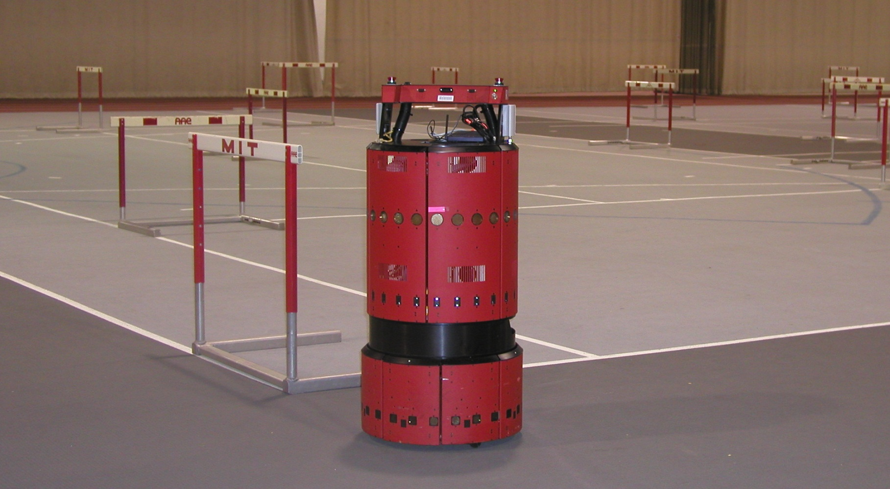
EKF SLAM Application
www.probabilistic-robotics.org
[MIT B21, courtesy by John Leonard]

Slide 58
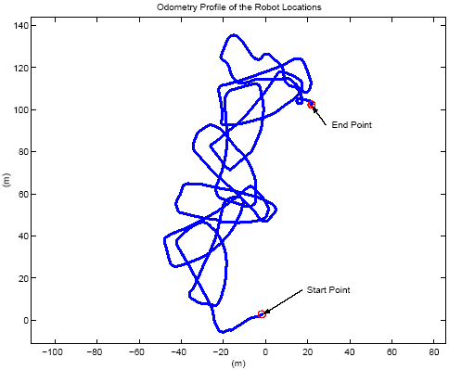
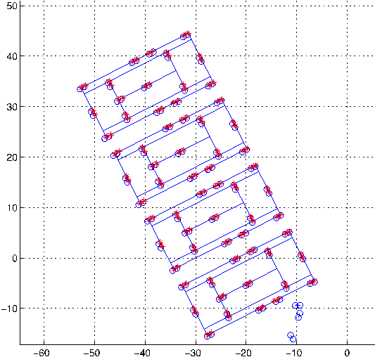
EKF SLAM Application
raw odometry
estimated trajectory
www.probabilistic-robotics.org
[courtesy by John Leonard]

Slide 59
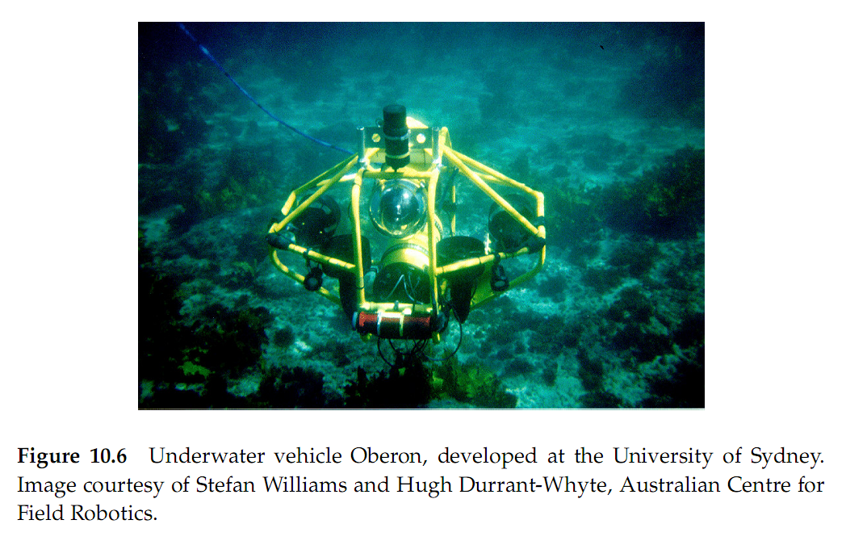
EKF SLAM Application

Slide 60
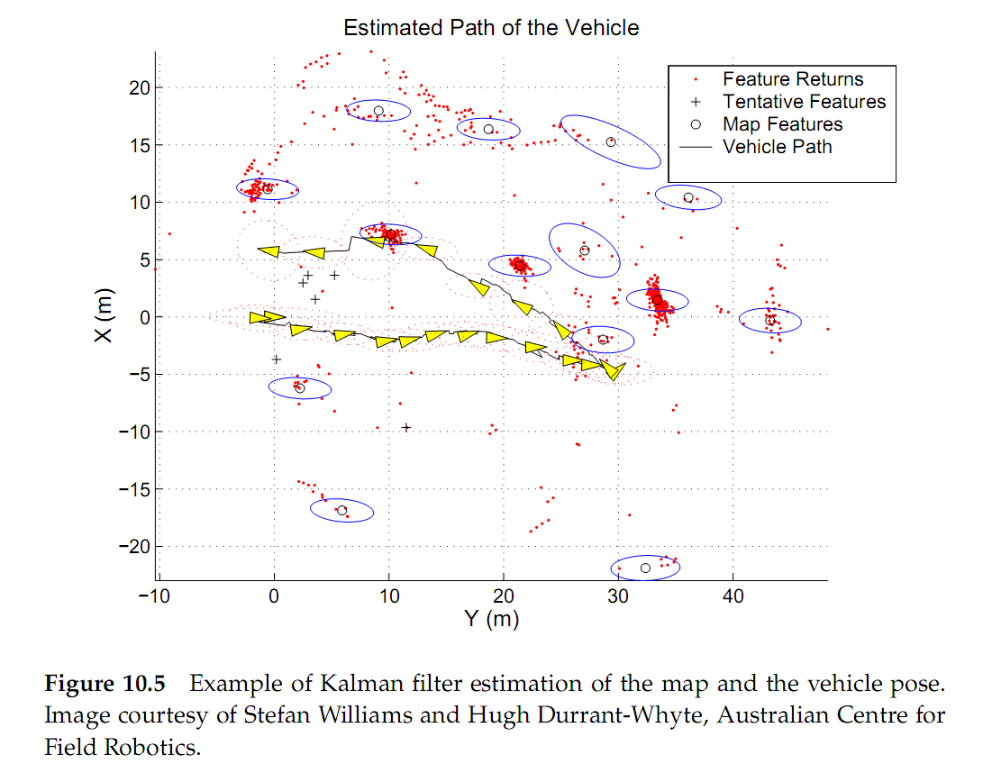
EKF SLAM Application

Slide 61
Bearing Only SLAM
in the KF SLAM problem we assumed a robot with sensors that could measure the vector from the robot to a landmark
  similar to, but not exactly the same as, a robot with sensors that can measure distance and bearing
suppose that a robot has a sensor that can only measure the bearing of a landmark (or multiple landmarks)
  perhaps using a monocular camera
  what is a possible measurement model?
    is it linear?

Slide 62
Bearing Only SLAM
assuming that the landmarks are uniquely identifiable explain
  how to use an EKF to solve the bearing only SLAM problem
  how to use a PF to solve the bearing only SLAM problem

