Slide 1
Probability Review

Slide 2
Why Probabilistic Robotics?
autonomous mobile robots need to accommodate the uncertainty that exists in the physical world
sources of uncertainty
  environment
  sensors
  actuation
  software
  algorithmic
probabilistic robotics attempts to represent uncertainty using the calculus of probability theory

Slide 3
Axioms of Probability Theory
Pr(A) denotes probability that proposition A is true.

Slide 4
A Closer Look at Axiom 3

Slide 5
Using the Axioms

Slide 6
Discrete Random Variables
X denotes a random variable.
X can take on a countable number of values in {x₁, x₂, …, x_{n}}.
P(X=x_{i} ), or P(x_{i} ), is the probability that the random variable X takes on value x_{i}.
P( ∙ ) is called probability mass function.

Slide 7
Discrete Random Variables
fair coin
fair dice
P(X=heads) = P(X=tails) = 1/2
P(X=1) = P(X=2) = P(X=3) = P(X=4) = P(X=5) = P(X=6) = 1/6

Slide 8
Discrete Random Variables
sum of two fair dice
P(X=2) | (1,1) | 1/36
P(X=3) | (1,2), (2,3) | 2/36
P(X=4) | (1,3), (2,2), (3,1) | 3/36
P(X=5) | (1,4), (2,3), (3,2), (4,1) | 4/36
P(X=6) | (1,5), (2,4), (3,3), (4,2), (5,1) | 5/36
P(X=7) | (1,6), (2,5), (3,4), (4,3), (5,2), (6, 1) | 6/36
P(X=8) | (2, 6), (3, 5), (4,4), (5,3), (6, 2) | 5/36
P(X=9) | (3, 6), (4, 5), (5, 4), (6, 3) | 4/36
P(X=10) | (4, 6), (5, 5), (6, 4) | 3/36
P(X=11) | (5, 6), (6, 5) | 2/36
P(X=12) | (6, 6) | 1/36

Slide 9
Discrete Random Variables
plotting the frequency of each possible value yields the histogram
6
5
4
frequency
3
2
1
2
3
4
5
6
7
8
9
10
11
12

Slide 10
Continuous Random Variables
X takes on values in the continuum.
p(X=x), or p(x), is a probability density function.
E.g.
p(x)
x

Slide 11

Continuous Random Variables
unlike probabilities and probability mass functions, a probability density function can take on values greater than 1
  e.g., uniform distribution over the range [0, 0.1]
however, it is the case that
$$\int_{−∞}^{∞}{p\left(x\right)dx=1}$$

Slide 12
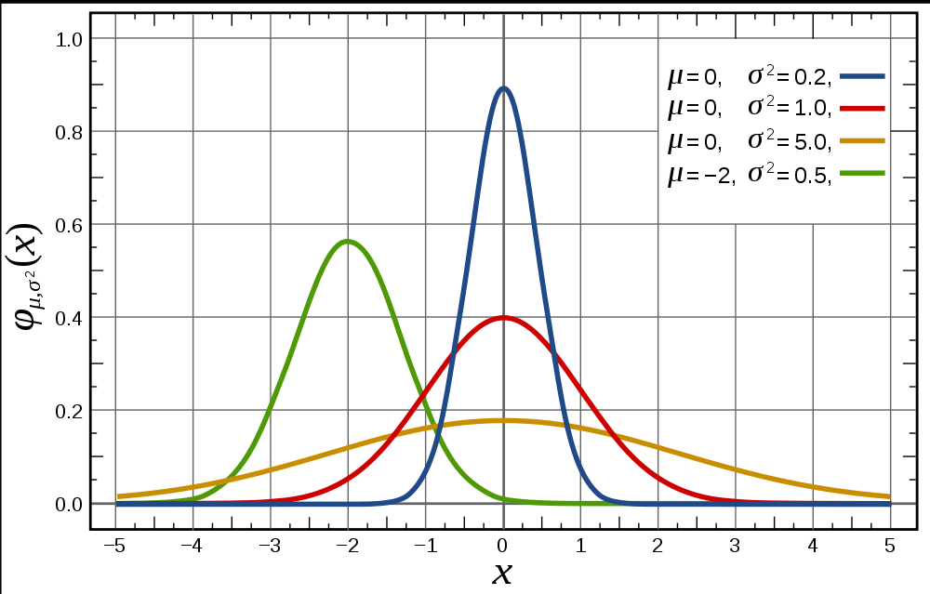
Continuous Random Variables
normal or Gaussian distribution in 1D

Slide 13

Continuous Random Variables
1D normal, or Gaussian, distribution
  mean
  standard deviation
  variance

Slide 14
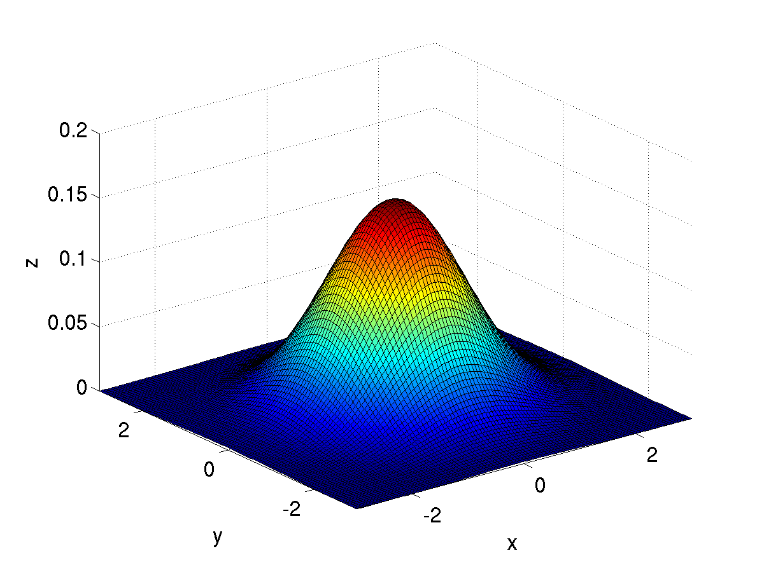
Continuous Random Variables
2D normal, or Gaussian, distribution
  mean
  covariance matrix

Slide 15
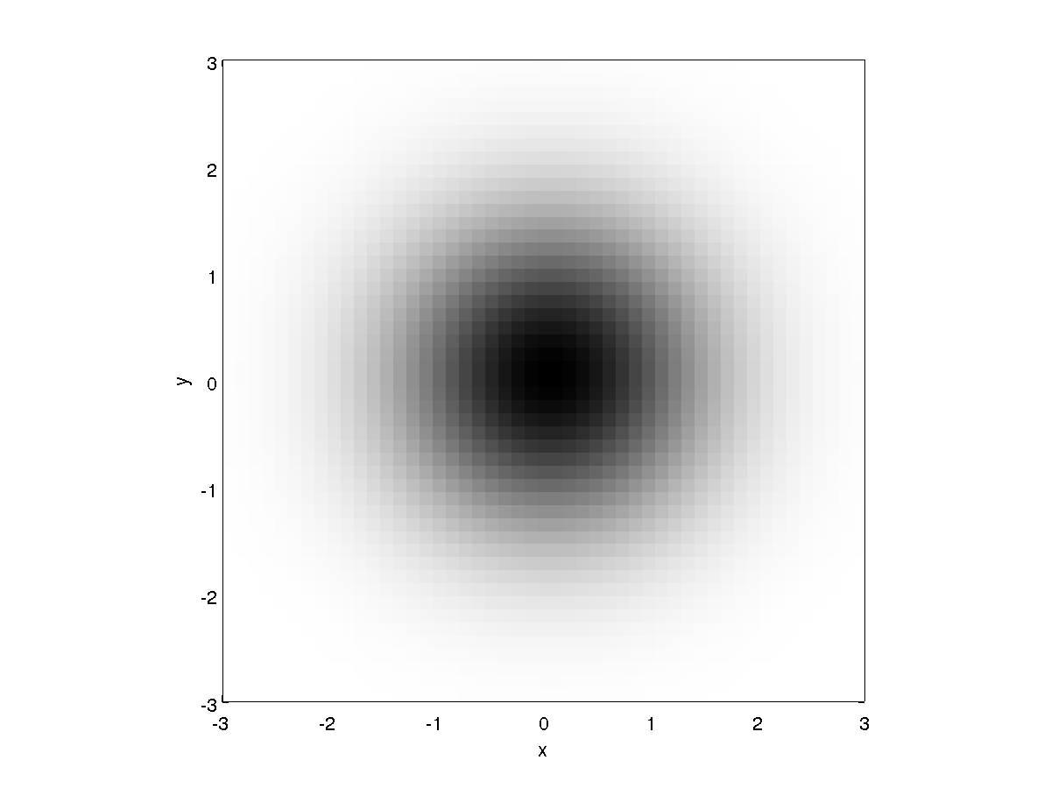
Continuous Random Variables
in 2D
  isotropic

Slide 16
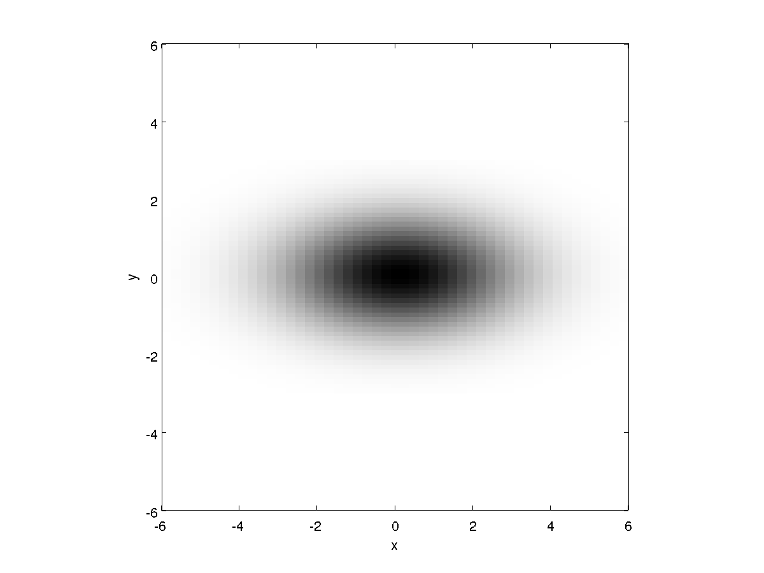
Continuous Random Variables
in 2D
  anisotropic

Slide 17
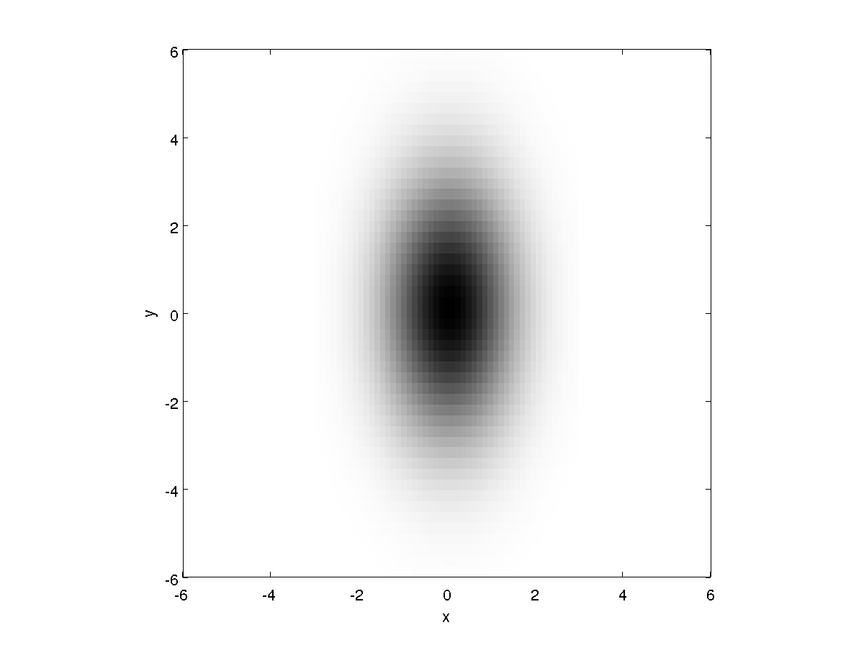
Continuous Random Variables
in 2D
  anisotropic

Slide 18
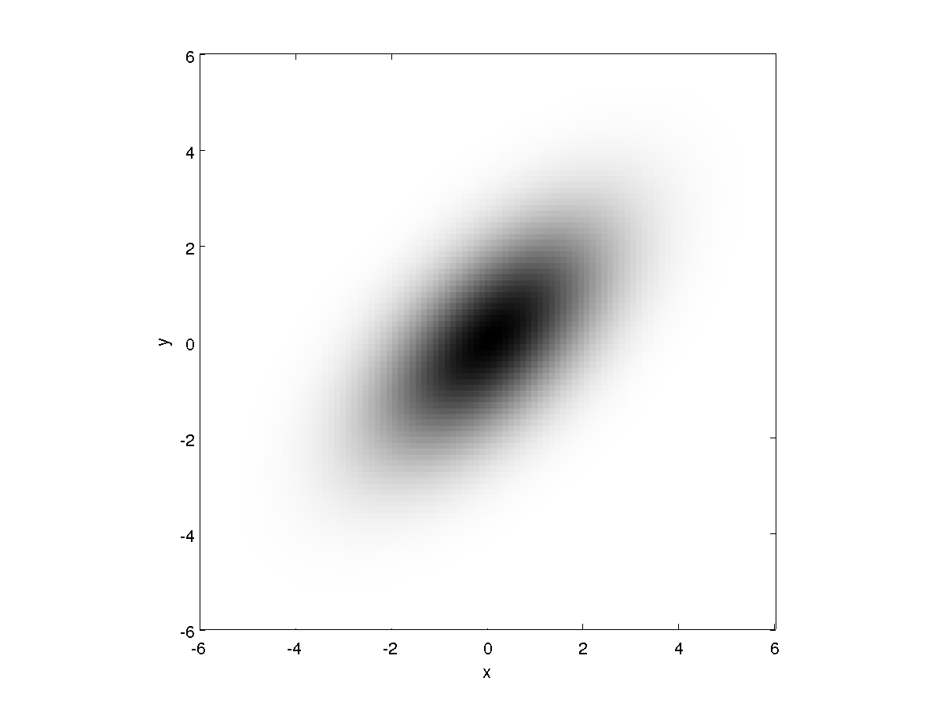
Continuous Random Variables
in 2D
  anisotropic

Slide 19
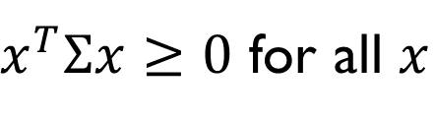
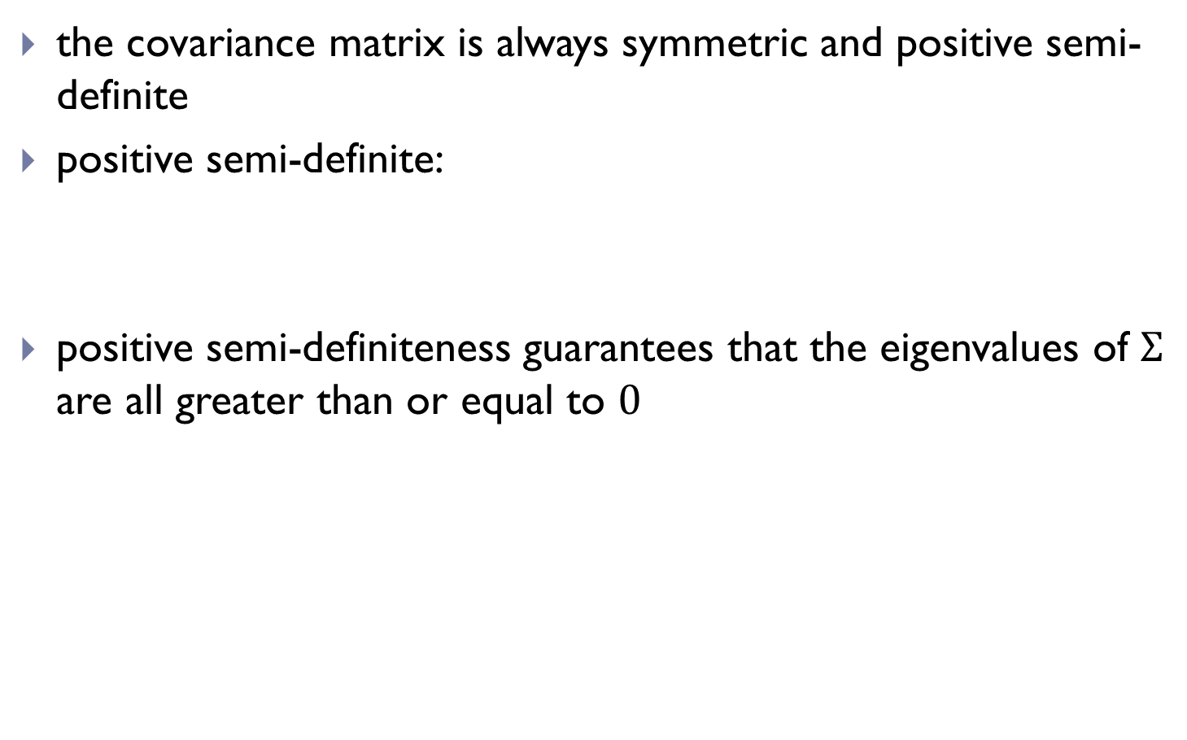
Covariance matrices
the covariance matrix is always symmetric and positive semi-definite
positive semi-definite:
positive semi-definiteness guarantees that the eigenvalues of $Σ$ are all greater than or equal to 0
$x^{T}Σx≥0$ for all $x$

Slide 20
>> [v, d] = eig([1 0; 0 4])
v =
1 0
0 1
d =
1 0
0 4

Slide 21
>> [v, d] = eig([2.5 1.5; 1.5 2.5])
v =
-0.7071 0.7071
0.7071 0.7071
d =
1 0
0 4

Slide 22
Joint Probability
the joint probability distribution of two random variables
P(X=x and Y=y) = P(x,y)
describes the probability of the event that X has the value x and Y has the value y
If X and Y are independent then
P(x,y) = P(x) P(y)

Slide 23
Joint Probability
the joint probability distribution of two random variables
P(X=x and Y=y) = P(x,y)
describes the probability of the event that X has the value x and Y has the value y
example: two fair dice
P(X=even and Y=even) = 9/36
P(X=1 and Y=not 1) = 5/36

Slide 24
Joint Probability
example: insurance policy deductibles
y
 | $0 | $100 | $200
$100 | 0.20 | 0.10 | 0.20
$250 | 0.05 | 0.15 | 0.30
home
x
automobile

Slide 25
Joint Probability and Independence
X and Y are said to be independent if
P(x,y) = P(x) P(y)
for all possible values of x and y
example: two fair dice
P(X=even and Y=even) = (1/2) (1/2)
P(X=1 and Y=not 1) = (1/6) (5/6)
are X and Y independent in the insurance deductible example?

Slide 26
Marginal Probabilities
the marginal probability distribution of X
describes the probability of the event that X has the value x
similarly, the marginal probability distribution of Y
describes the probability of the event that Y has the value y

Slide 27
Joint Probability
example: insurance policy deductibles
y
 | $0 | $100 | $200
$100 | 0.20 | 0.10 | 0.20
$250 | 0.05 | 0.15 | 0.30
home
x
automobile

Slide 28
Conditional Probability
the conditional probability P(x | y) = P(X=x | Y=y) is the probability of P(X=x) if Y=y is known to be true
  “conditional probability of x given y”

Slide 29
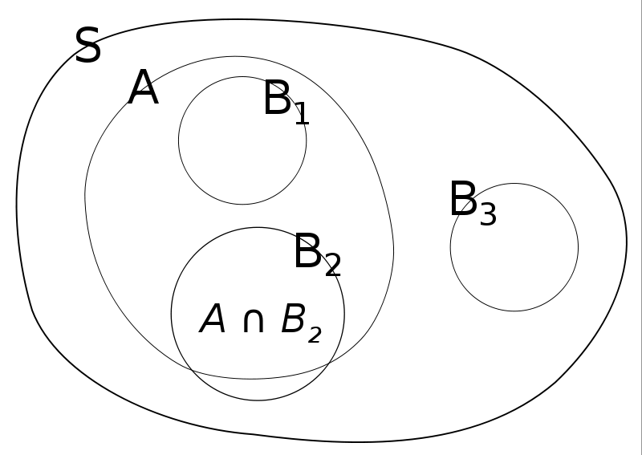
Conditional Probability

Slide 30
Conditional Probability
“information changes probabilities”
example:
  roll a fair die; what is the probability that the number is a 3?
  what is the probability that the number is a 3 if someone tells you that the number is odd? is even?

Slide 31
Conditional Probability
“information changes probabilities”
example:
  pick a playing card from a standard deck; what is the probability that it is the ace of hearts?
  what is the probability that it is the ace of hearts if someone tells you that it is an ace? that is a heart? that it is a king?

Slide 32
Conditional Probability
if X and Y are independent then

Slide 33
Bayes Formula
posterior

Slide 34
Bayes Rule with Background Knowledge

Slide 35
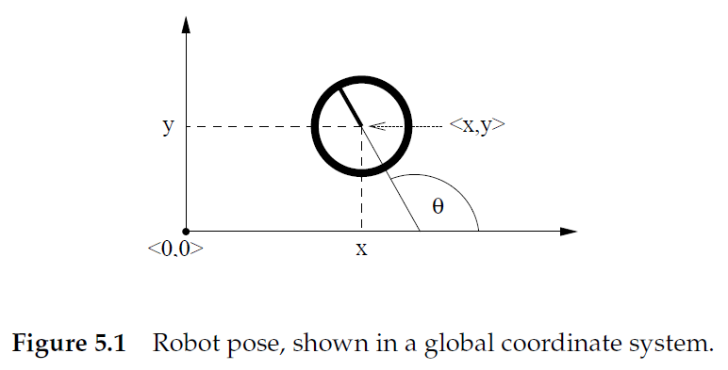
Back to Kinematics
location (in world frame)
pose vector or state
bearing or heading

Slide 36
Probabilistic Robotics
we seek the conditional density
what is the density of the state
given the motion command
performed at

Slide 37
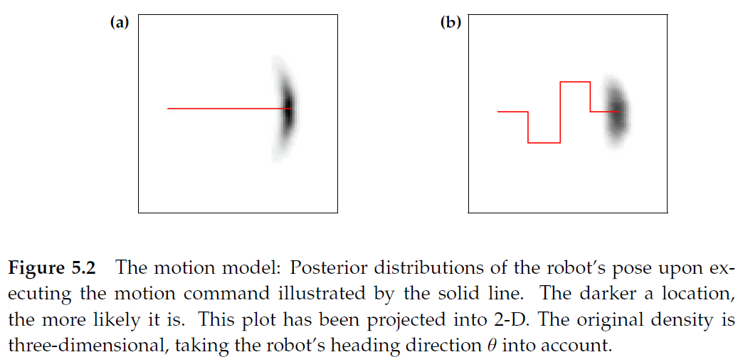
Probabilistic Robotics

Slide 38
Velocity Motion Model
assumes the robot can be controlled through two velocities
  translational velocity
  rotational velocity
our motion command, or control vector, is
positive values correspond to forward translation and counterclockwise rotation

Slide 39
Velocity Motion Model

Slide 40
Velocity Motion Model
center of circle
where

Slide 41
Velocity Motion Model

