Slide 1
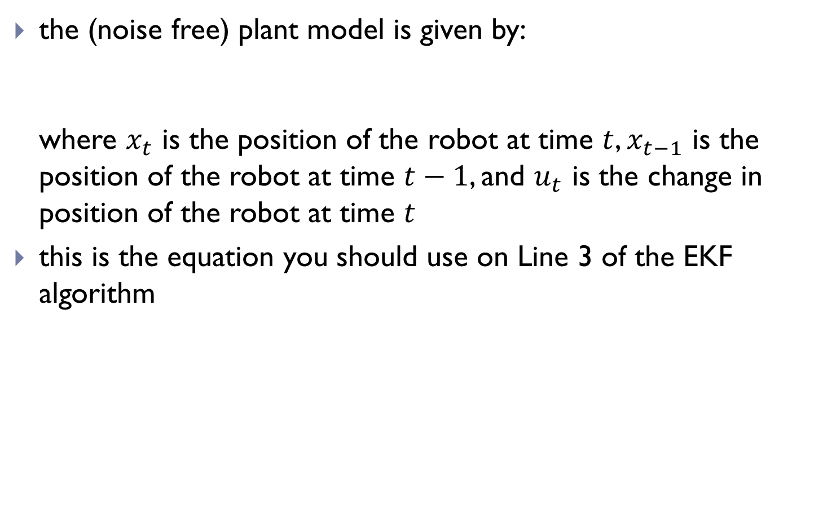

Plant model and Jacobian
the (noise free) plant model is given by:
where $x_{t}$ is the position of the robot at time $t$, $x_{t−1}$ is the position of the robot at time $t−1$, and $u_{t}$ is the change in position of the robot at time $t$
this is the equation you should use on Line 3 of the EKF algorithm
$$x_{t}=x_{t−1}+u_{t}=g(x_{t−1},u_{t})$$

Slide 2
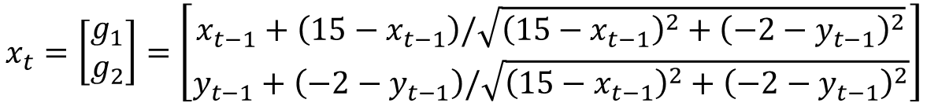
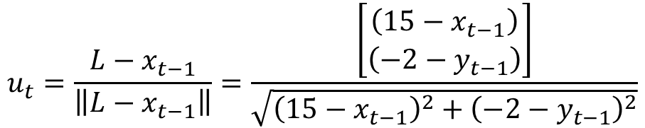

Plant model and Jacobian
the compute the Jacobian of the plant model, you need to express how the robot computes its control:
$$u_{t}=\frac{{L−x}_{t−1}}{\left\|{L−x}_{t−1}\right\|}=\frac{\left[\begin{matrix}\left(15−x_{t−1}\right) \\ \left(−2−y_{t−1}\right)\end{matrix}\right]}{\sqrt{{\left(15−x_{t−1}\right)}^{2}+{\left(−2−y_{t−1}\right)}^{2}}}$$
$$x_{t}=\left[\begin{matrix}g_{1} \\ g_{2}\end{matrix}\right]=\left[\begin{matrix}x_{t−1}+\left(15−x_{t−1}\right)/\sqrt{{\left(15−x_{t−1}\right)}^{2}+{\left(−2−y_{t−1}\right)}^{2}} \\ y_{t−1}+\left(−2−y_{t−1}\right)/\sqrt{{\left(15−x_{t−1}\right)}^{2}+{\left(−2−y_{t−1}\right)}^{2}}\end{matrix}\right]$$
$$G=\left[\begin{matrix}\frac{∂g_{1}}{∂x_{t−1}} & \frac{∂g_{1}}{∂y_{t−1}} \\ \frac{∂g_{2}}{∂x_{t−1}} & \frac{∂g_{2}}{∂y_{t−1}}\end{matrix}\right]$$

Slide 3


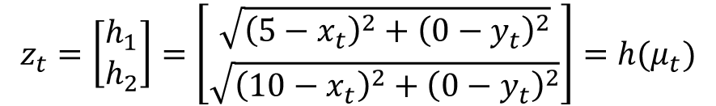
Measurement model and Jacobian
the measurement model is given by:
where $μ_{t}=\left[\begin{matrix}x_{t} \\ y_{t}\end{matrix}\right]$ is the predicted location of the robot at time $t$
the Jacobian of the measurement model is:
$$z_{t}=\left[\begin{matrix}h_{1} \\ h_{2}\end{matrix}\right]=\left[\begin{matrix}\sqrt{{\left(5−x_{t}\right)}^{2}+{\left({0−y}_{t}\right)}^{2}} \\ \sqrt{{\left(10−x_{t}\right)}^{2}+{\left({0−y}_{t}\right)}^{2}}\end{matrix}\right]=h(μ_{t})$$
$$H=\left[\begin{matrix}\frac{∂h_{1}}{∂x_{t}} & \frac{∂h_{1}}{∂y_{t}} \\ \frac{∂h_{2}}{∂x_{t}} & \frac{∂h_{2}}{∂y_{t}}\end{matrix}\right]$$

