Slide 1
Opportunistic Mobile Social Networks
Farzana Yasmeen
Dept. of Computer Science and Engineering
York University, Toronto, Canada
Date: Nov. 2, 2017

Slide 2
Overview
Introduction to Opportunistic/Delay-Tolerant Networks (DTN)
Problem domain: Routing in Opportunistic Networks
Overlay – Social Properties
Highlights of the Solution Space
SimBet Routing

Slide 3
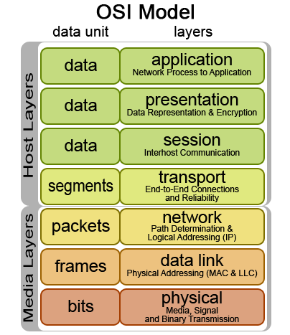
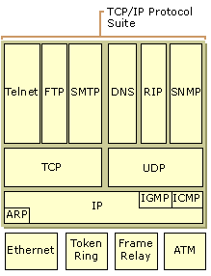
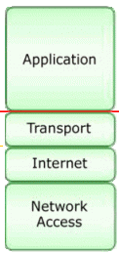
All People Seem to Need Data Processing
TCP/IP Model
Application Layer
Data Flow Layer
http://www.tech-faq.com/osi-model.html

Slide 4
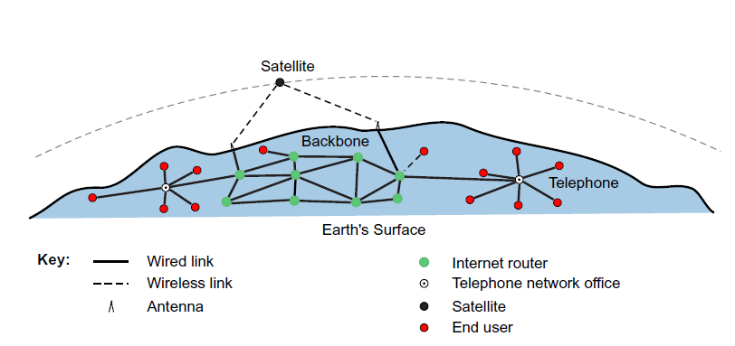
Some Communication Networks
Wireless Networks
Sensor Networks
Satellite Networks
Mobile Ad hoc networks (MANETs)
Voice Over IP (VoIP)
Internet of Things (IoT)
Delay-tolerant Networks
Online Social Networks

Slide 5
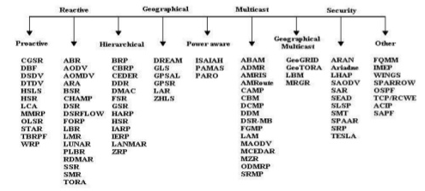
MANET Routing Protocols

Slide 6
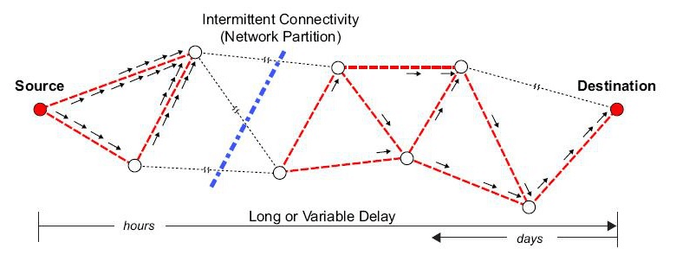
Delay-Tolerant Networks

Slide 7
Intermittent Connectivity
Intermittent connectivity:
mobility, geography, infrastructure, energy conservation
- high error rates, long delays in transmission, low throughput
C
A
B
D
E
F

Slide 8
A virtually connected network
Store-Carry-Forward:
Hop-by-hop instead of end-to-end
Persistent storage
Custody transfer mechanism
Rely on opportunity
C
A
B
M
D
S
D
detect next hop
forward
detect next hop
M
M
E
F
i
forward
i
detect next hop
wait for link to come up
forward

Slide 9
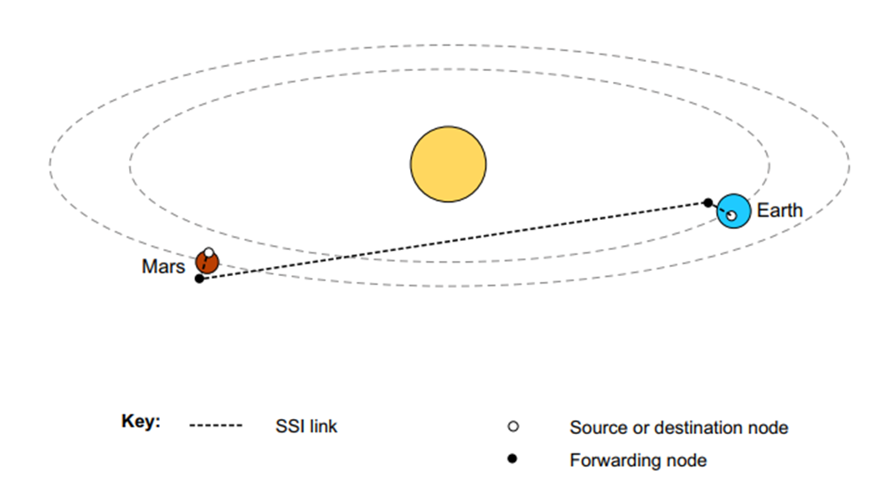
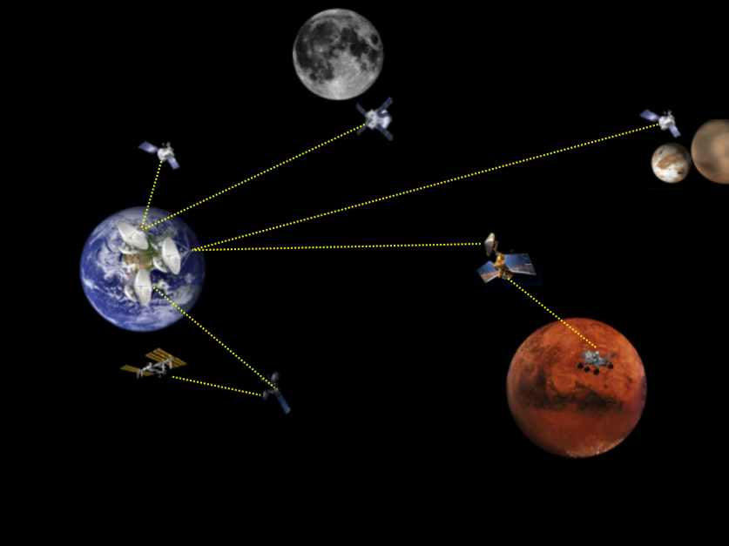
DTN – Interplanetary Networks
The world's national space agencies are constructing a DTN called the Solar System Internetwork (http://public.ccsds.org/publications/archive/730x1g1.pdf)
that uses the ipn scheme name.
http://ipnsig.org/wp-content/uploads/2015/09/DTN_Tutorial_v3.2.pdf

Slide 10
DTN – Vehicular Networks

Slide 11
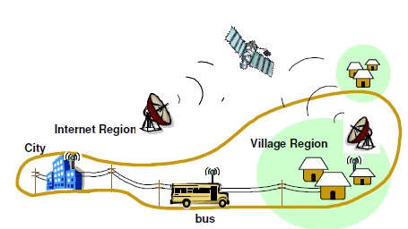
DTN – Rural Area Communication

Slide 12
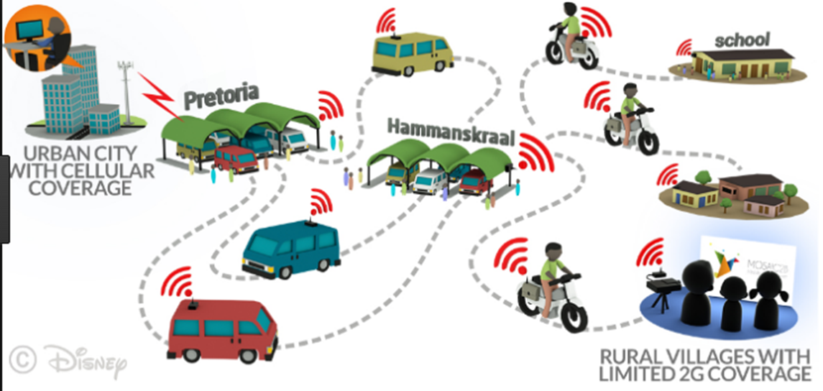
Combine across protocol stack

Slide 13
DTN – Mobile Social Network (MSN)

Slide 14
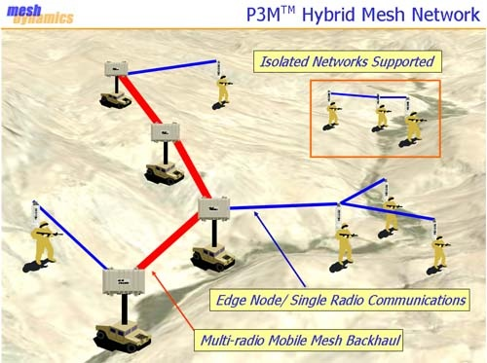
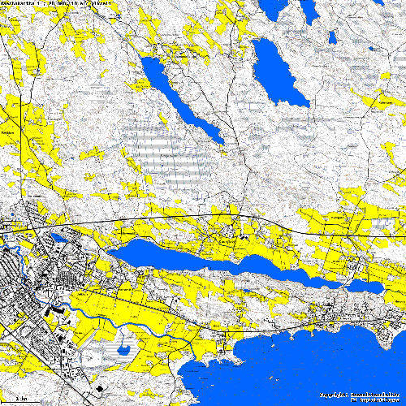
DTN vs MANET
Multihop ad hoc network
Delay-tolerant network
A
End-to-end delivery from A to C ≈ 1 min
A
End-to-end delivery from A to C ≈ 1 hour
frwrd msg to link
B
frwrd msg to link
B
link estb.
M
link estb.
frwrd msg to link
C
C
t
t
Route search among multiple hops
M
Route search among multiple hops
Delivery from source to destination
Delivery from source to destination
Store – Carry – Forward
http://www.meshdynamics.com/military-mesh-networks.html

Slide 15
Disruption-Tolerant Networks
https://www.youtube.com/watch?v=nWtRTzXJvtI

Slide 16
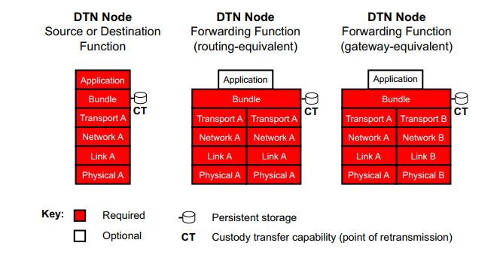
Overlay Approach

Slide 17
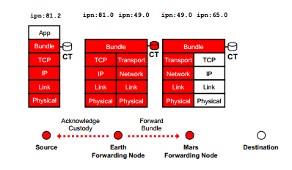
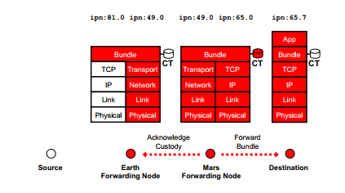
DTN in Action

Slide 18
Motivation
Motivation for Routing:
Motivation for DTN:
Store-n-forward overlay hides lower-layer disparity from the application
Longer delay is tolerable than no communication at all, as there is no infrastructure
Legacy applications: File Transfer, Email, Cached Web
Communication possible when devices are within communication range of each other
Physical proximity is important
Opportunistic contacts are called encounters
Sparse Wireless Network
D
E
B
C
A
F

Slide 19
Routing Objectives: Improve the capacity of the Network
Minimize end-end delay for messages
Maximize network delivery ratio
Routing Decision to B
and check transmitter availability
send last bit of msg. to B
msg. generated at A
start transmit to B
t₃
t₄
t₅
A
(sender)
t₁
t₂
can be very large in DTN
B receives msg.
Check receiver availability
B
encounter delay = E.D.
queuing delay = Q.D.
transmission delay = T.D.
propagation delay = P.D.
T.D.
A, B meet
A, B can be apart
contact duration
inter-contact time
C receives msg.
C
(receiver)
E.D.
Q.D.
P.D.
t₅
t₇
t₈
t₉
B, C meet

Slide 20
DTN Metrics (1)
Average message delivery ratio: The message delivery ratio of a destination d is the ratio of the number of unique messages for d generated by its source(s) and successfully received by d to the total number of unique messages created. The average message delivery ratio is the average of the delivery ratios of all the destinations in the network.
Average end-to-end delay: The end-to-end delay of every message successfully received at every destination is recorded. Once the copy of a particular message is received at the final destination, subsequent copies are disregarded. The average over all the messages received is then computed.

Slide 21
DTN Metrics (2)
Average buffer time: The buffer time for a message m is the interval between the time the message is saved in the buffer of a node to the time it is removed from the buffer of that node. Essentially, it is the time the message was queued in the node’s buffer. The average buffer time is the average taken over all messages stored at every node in the network.
Average buffer time significantly impacts a DTNs performance as:
(a) it is an indicator of how fast messages are being forwarded at nodes, and thus are propagating through the network, as longer buffer time leads to longer end-to-end delays; and
(b) the longer messages are stored in buffers the more buffer overflows will occur, leading to higher loss rates.

Slide 22
DTN Metrics (3)
Average overhead ratio:
where H is the number of hops a message m and all copies of m traverse in the network before a copy is successfully delivered to the intended recipient, and h_{d} is the number of hops the delivered message (or its copy) had traversed before reaching the final destination.
It represents the quantity of excessive relays required to deliver the message and quantifies the bandwidth and energy consumption of the routing protocol
Average number of contact opportunities per hour: We define a ‘contact opportunity’ as two nodes coming within the wireless transmission range of each other, presenting an opportunity to transfer messages.

Slide 23
DTN Routing Protocols
Epidemic Routing
[paper] http://issg.cs.duke.edu/epidemic/epidemic.pdf
[title] Epidemic Routing for Partially-Connected Ad Hoc Networks
PRoPHET
[paper] http://citeseerx.ist.psu.edu/viewdoc/download?doi=10.1.1.59.6027&rep=rep1&type=pdf
[title] Probabilistic routing in intermittently connected networks
Spray-n-Wait
[paper] https://dl.acm.org/citation.cfm?id=1080143
[title] Spray and wait: An efficient routing scheme for intermittently connected mobile networks.

Slide 24
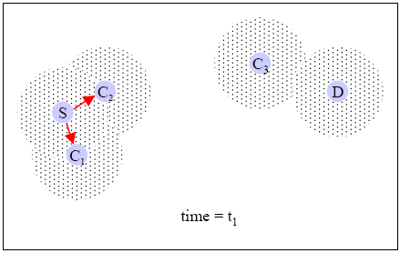
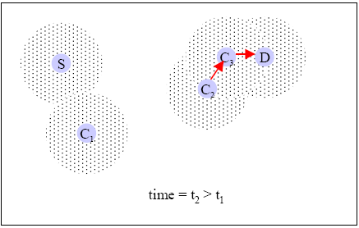
Epidemic Protocol – Random forwarding
Forward to any encountered node

Slide 25
Epidemic Routing
Message Duplication
Transmission overhead
M
M
M
M
M
M
S
M
M
D
M
M

Slide 26
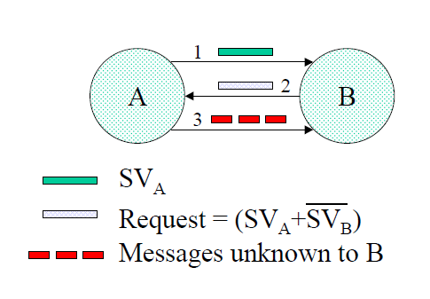
Summary Vector Exchange

Slide 27
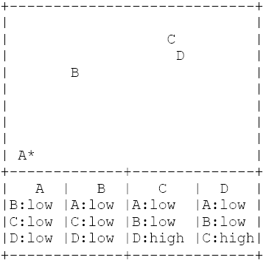
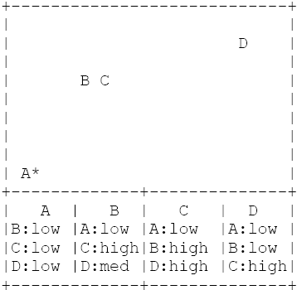
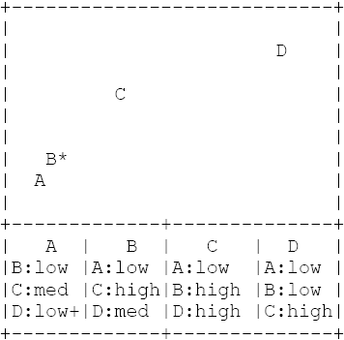
PRoPHET Protocol– Probabilistic forwarding
probabilistic metric -> delivery predictability : 0 <= P(a,b) <= 1
The delivery predictability metric, P(a,b) has three properties, based on which it is (re)calculated:
update,
aging, and
transitivity.

Slide 28
PRoPHET Routing
Transmission overhead
P_{(F,A),} P_{(F,D)}
P_{(C,G)}, P_{(C,D)}
M
F
C
P_{(F,D),} >P_{(A,D)}
P_{(I,D)}
I
P_{(A,B)}, P_{(A,D)} P_{(A,F)}, P_{(A,H)}
M
P_{(G,B)}, P_{(G,C)}
M
P_{(S,D),} >P_{(A,D)}
A
P_{(S,D),} P_{(S,H)}
G
M
P_{(E,B)}, P_{(E,D)}
P_{(D,A)}, P_{(D,C)} P_{(D,F)}, P_{(D,I)}
S
E
D
P_{(B,A)}, P_{(B,E)} P_{(B,G)}
P_{(H,A),} P_{(H,S)}
B
H

Slide 29
Spray-n-Wait
Spray and Wait (SnW) protocol is an n-copy routing protocol. This routing algorithm consists of two phases:
Spray phase: for every message M originating at a source node, K copies of the message are initially spread (forwarded by the source and possibly other nodes receiving a copy) to “K” distinct relays (i.e. intermediate nodes).
Wait phase: if the destination is not found in the spraying phase, each of the K nodes carrying a message copy performs direct transmission (i.e. will forward the message only to its destination).

Slide 30
Simulations (with contention, waypoint model)
Simulated schemes
Epidemic routing
Randomized flooding (p = 0.03)
Utility-based flooding (U_{th} = 0.02)
Constrained utility-based flooding
Source Spray and Wait (L = 10)
Optimal Spray and Wait (L = 10)
Seek and Focus
Oracle-based optimal algorithm
Same collision avoidance MAC protocol and utility function as before

Slide 31
Scenario A (low traffic)
500x500, M = 50 nodes, K = 20
Spray and Wait
Low delay (twice that of the optimal), small # of transmissions (even less than seek and focus)
achieves a lower delay than utility-based schemes

Slide 32
Scenario B (high traffic)
500x500, M = 50, K = 20 (6% coverage), 40 (25% coverage)
Spray and Wait achieves up to an order of magnitude reduction in number of transmission compared to flooding and utility-based schemes
and a delivery delay lower than all other schemes

Slide 33
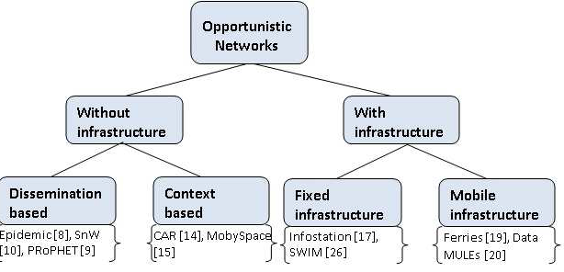
Opportunistic Mobile Networks
inherent (random) movement of nodes
flooding, multi-copy
probabilistic contacts
controlled movement of auxiliary nodes
deterministic contacts
Optimal MF design

Slide 34
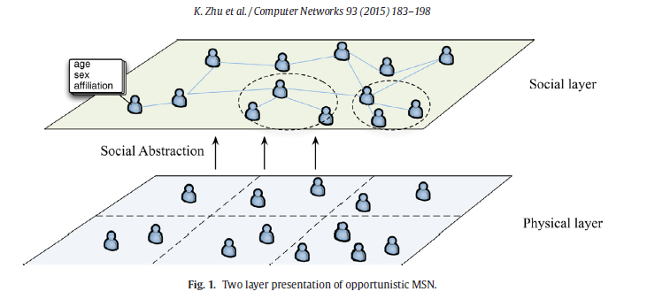
Opportunistic Mobile Social Networks (OMNS)
Characteristics of mobile nodes in opportunistic MSNs are:
Opportunistic contacts
Mobility
Social Features
Social Relationships A social graph G=(V,E,W)

Slide 35
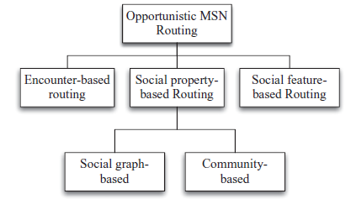
OMNS Routing

Slide 36
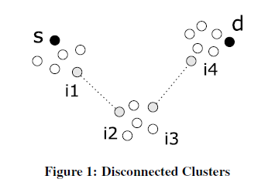
SimBet – It’s a small world
[paper] https://dl.acm.org/citation.cfm?id=1288113
[title] Social Network Analysis for Routing in Disconnected Delay-Tolerant MANETs

Slide 37
Centrality
Centrality in graph theory and network analysis is a quantification of the relative importance of a vertex within the graph (e.g., how important a person is within a social network).
The centrality of a node in a network is a measure of the structural importance of the node.
A central node, typically, has a stronger capability of connecting other network members.
There are several ways to measure centrality. The three most widely used centrality measures are Freeman’s degree, closeness, and betweenness measures

Slide 38
Degree centrality
A node with high degree centrality maintains contacts with numerous other network nodes. Such nodes can be seen as popular nodes with large numbers of links to others.
As such, a central node occupies a structural position (network location) that may act as a conduit for information exchange.

Slide 39
Closeness Centrality

Slide 40
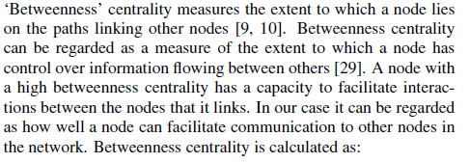
Betweenness Centrality

Slide 41
Socio vs Ego Networks

Slide 42
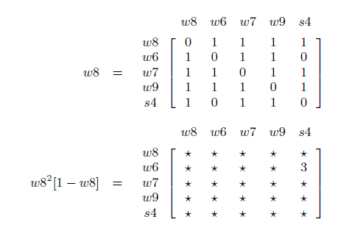
Betweenness Calculation
The betweenness of the ego node is the sum of the reciprocals of the entries of
A2 [1 − A]i,j

Slide 43
Similarity Calculation

Slide 44
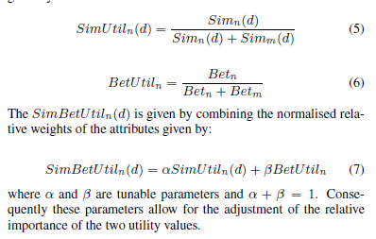
SimBet Utility Metrics

Slide 45
SimBet Algorithm

Slide 46
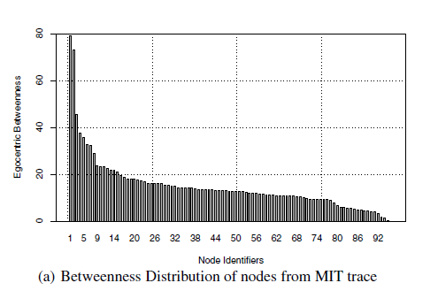
Betweenness Distribution

Slide 47
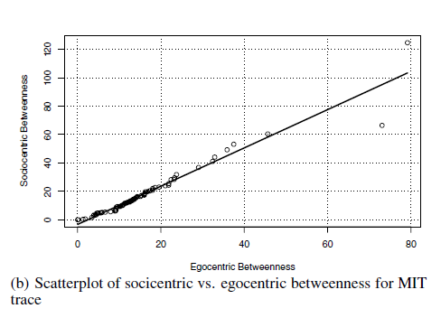
Betweenness Distribution

Slide 48
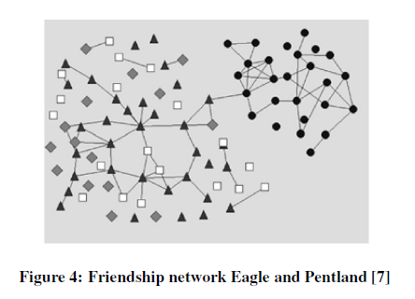
Friendship network Eagle and Pentland

Slide 49
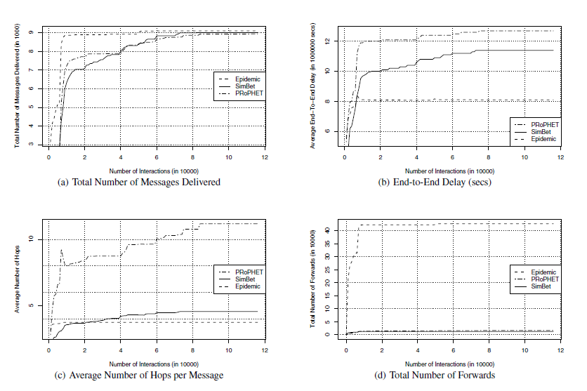
Simulation Results: Each node sending a message to each other node in the network

Slide 50
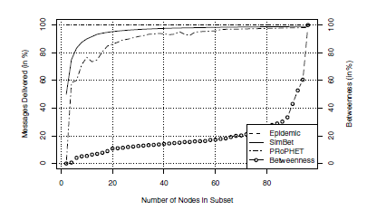
Percentage of message delivered between a subset of nodes increasing based on increased Betweenness

Slide 51
Conclusions
These forwarding metrics may prove useful in other distributed systems where global topology information is unavailable, especially where the underlying networks exhibit small-world characteristics.

Slide 52
Thank You

