Slide 1
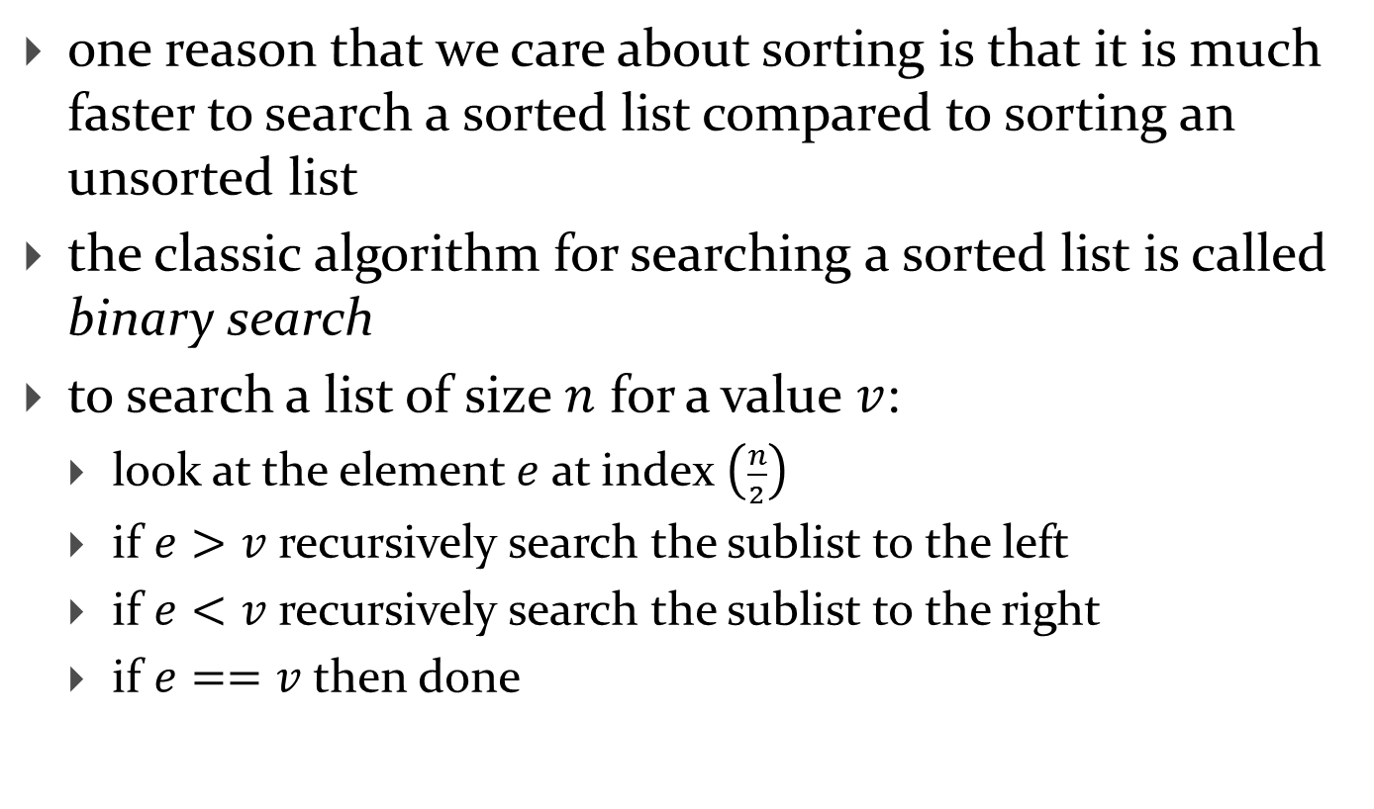
Binary Search
one reason that we care about sorting is that it is much faster to search a sorted list compared to sorting an unsorted list
the classic algorithm for searching a sorted list is called binary search
to search a list of size $n$ for a value $v$:
  look at the element $e$ at index $\left(\frac{n}{2}\right)$
  if $e>v$ recursively search the sublist to the left
  if $e<v$ recursively search the sublist to the right
  if $e==v$ then done

Slide 2

Binary Search
consider the sorted list of size $n=9$
 | 1 | 3 | 4 | 5 | 6 | 7 | 8 | 9 | 10
sublistindex | 0 | 1 | 2 | 3 | 4 | 5 | 6 | 7 | 8

Slide 3




Binary Search
search for $v=3$
 | 1 | 3 | 4 | 5 | 6 | 7 | 8 | 9 | 10
index | 0 | 1 | 2 | 3 | 4 | 5 | 6 | 7 | 8
$$mid=\frac{9}{2}=4$$
$$e=6$$
$v<e,$ recursively search the left sublist

Slide 4



Binary Search
search for $v=3$
no longer considered
 | 1 | 3 | 4 | 5 | 6 | 7 | 8 | 9 | 10
sublistindex | 0 | 1 | 2 | 3
$$mid=\frac{4}{2}=2$$
$$e=4$$
$v<e,$ recursively search the left sublist

Slide 5



Binary Search
search for $v=3$
no longer considered
 | 1 | 3 | 4 | 5 | 6 | 7 | 8 | 9 | 10
sublistindex | 0 | 1
$$mid=\frac{2}{2}=1$$
$$e=3$$
$v==e,$ done

Slide 6

Binary Search
search for $v=2$
 | 1 | 3 | 4 | 5 | 6 | 7 | 8 | 9 | 10
sublistindex | 0 | 1 | 2 | 3 | 4 | 5 | 6 | 7 | 8
$$mid=\frac{9}{2}=4$$
$$e=6$$
$v<e,$ recursively search the left sublist

Slide 7
Binary Search
search for $v=2$
no longer considered
 | 1 | 3 | 4 | 5 | 6 | 7 | 8 | 9 | 10
sublistindex | 0 | 1 | 2 | 3
$$mid=\frac{4}{2}=2$$
$$e=4$$
$v<e,$ recursively search the left sublist

Slide 8

Binary Search
search for $v=2$
no longer considered
 | 1 | 3 | 4 | 5 | 6 | 7 | 8 | 9 | 10
sublistindex | 0 | 1
$$mid=\frac{2}{2}=1$$
$$e=3$$
$v<e,$ recursively search the left sublist

Slide 9


Binary Search
search for $v=2$
no longer considered
 | 1 | 3 | 4 | 5 | 6 | 7 | 8 | 9 | 10
sublistindex | 0
$$mid=\frac{1}{2}=0$$
$$e=1$$
$v>e,$ recursively search the right sublist; right sublist is empty, done

Slide 10


Binary Search
search for $v=$9
 | 1 | 3 | 4 | 5 | 6 | 7 | 8 | 9 | 10
sublistindex | 0 | 1 | 2 | 3 | 4 | 5 | 6 | 7 | 8
$$mid=\frac{9}{2}=4$$
$$e=6$$
$v>e,$ recursively search the right sublist

Slide 11



Binary Search
search for $v=$9
 | 1 | 3 | 4 | 5 | 6 | 7 | 8 | 9 | 10
sublistindex |  |  |  |  |  | 0 | 1 | 2 | 3
$$mid=\frac{4}{2}=2$$
$$e=9$$
$v==e,$ done

Slide 12
/**
* Searches a sorted list of integers for a given value using binary search.
*
* @param v the value to search for
* @param t the list to search
* @return true if v is in t, false otherwise
*/
public static boolean contains(int v, List<Integer> t) {
if (t.isEmpty()) {
return false;
}
int mid = t.size() / 2;
int e = t.get(mid);
if (e == v) {
return true;
}
else if (v < e) {
return Recursion.contains(v, t.subList(0, mid));
}
else {
return Recursion.contains(v, t.subList(mid + 1, t.size()));
}
}

Slide 13
Binary Search
what is the recurrence relation?
what is the big-O complexity?

Slide 14
Revisiting Linked List

Slide 15
Recursive Objects
an object that holds a reference to its own type is a recursive object
  linked lists and trees are classic examples in computer science of objects that can be implemented recursively

Slide 16
Singly Linked List
a data structure made up of a sequence of nodes
each node has
  some data
  a field that contains a reference (a link) to the next node in the sequence
suppose we have a linked list that holds characters; a picture of our linked list would be:
node
'a'
'x'
'r'
'a'
's'
data
null
link

Slide 17
Singly Linked List
the first node of the list is called the head node
head node
'a'
'x'
'r'
'a'
null
data
link

Slide 18
Linked List
each node can be thought of as the head of a smaller list
'a'
'x'
'r'
'a'
head of
['a', 'x', 'r', 'a']

Slide 19
Linked List
each node can be thought of as the head of a smaller list
'a'
'x'
'r'
'a'
head of
['x', 'r', 'a']

Slide 20
Linked List
each node can be thought of as the head of a smaller list
'a'
'x'
'r'
'a'
head of
['r', 'a']

Slide 21
Linked List
each node can be thought of as the head of a smaller list
'a'
'x'
'r'
'a'
head of
['a']

Slide 22
Linked List
the recursive structure of the linked list suggests that algorithms that operate on a linked list can be implemented recursively
  e.g., getNode(int index) from Lab 5

Slide 23
/**
* Returns the node at the given index.
*
* <p>
* NOTE: This method is extremely useful for implementing many of the methods
* of this class, but students should try to use this method only once in each
* method.
*
* <p>
* NOTE: This method causes a privacy leak and would not normally be
* part of the public API; however, it is useful for testing purposes.
*
* @param index
* the index of the node
* @return the node at the given index
* @throws IndexOutOfBoundsException
* if index is less than 0 or greater than or equal the size of this
* list
*/
public Node getNode(int index) {
this.checkIndex(index);
return LinkedIntList.getNodeImpl(this.head, index); // private static method
}

Slide 24
/**
* Returns the node located at the specified index in the
* list with specified head node.
*
* @param head the head node of a linked list
* @param index the index of the element
* @return the node located index elements from the specified node
*/
private static Node getNodeImpl(Node head, int index) {
if (index == 0) {
return head;
}
return LinkedIntList.getNodeImpl(head.getNext(), index - 1);
}
base case(s)?
recursive case?
precondition(s)?

Slide 25
/**
* Returns the node located at the specified index in the
* list with specified head node.
*
* @param head the head node of a linked list
* @param index the index of the element
* @return the node located index elements from the specified node
*/
private static Node getNodeImpl(Node head, int index) {
if (index == 0) {
return head;
}
return LinkedIntList.getNodeImpl(head.getNext(), index - 1);
}

Slide 26
Linked List
recursive version of contains

Slide 27
/**
* Returns true if this list contains the specified element,
* and false otherwise.
*
* @param elem the element to search for
* @return true if this list contains the specified element,
* and false otherwise
*/
public boolean contains(int elem) {
if (this.size == 0) {
return false;
}
return LinkedIntList.contains(this.head, elem);
}

Slide 28
/**
* Returns true if the linked list with the specified head node contains
* the specified element, and false otherwise.
*
* @param head the head node
* @param elem the element to search for
* @return true if the linked list with the specified head node contains
* the specified element, and false otherwise
*/
private static boolean contains(Node head, int elem) {
if (head.getData() == elem) {
return true;
}
if (head.getNext() == null) {
return false;
}
return LinkedIntList.contains(head.getNext(), elem);
}
base case(s)?
recursive case?
precondition(s)?

Slide 29
/**
* Returns true if the linked list with the specified head node contains
* the specified element, and false otherwise.
*
* @param head the head node
* @param elem the element to search for
* @return true if the linked list with the specified head node contains
* the specified element, and false otherwise
*/
private static boolean contains(Node head, int elem) {
if (head.getData() == elem) {
return true;
}
if (head.getNext() == null) {
return false;
}
return LinkedIntList.contains(head.getNext(), elem);
}

