Slide 1
Recursion
notes Chapter 8

Slide 2
Tower of Hanoi
  move the stack of n disks from A to C
    can move one disk at a time from the top of one stack onto another stack
    cannot move a larger disk onto a smaller disk
A
B
C

Slide 3
Tower of Hanoi
legend says that the world will end when a 64 disk version of the puzzle is solved
several appearances in pop culture
  Doctor Who
  Rise of the Planet of the Apes
  Survior: South Pacific

Slide 4
Tower of Hanoi
n = 1
move disk from A to C
A
B
C

Slide 5
Tower of Hanoi
n = 1
A
B
C

Slide 6
Tower of Hanoi
n = 2
move disk from A to B
A
B
C

Slide 7
Tower of Hanoi
n = 2
move disk from A to C
A
B
C

Slide 8
Tower of Hanoi
n = 2
move disk from B to C
A
B
C

Slide 9
Tower of Hanoi
n = 2
A
B
C

Slide 10
Tower of Hanoi
n = 3
move disk from A to C
A
B
C

Slide 11
Tower of Hanoi
n = 3
move disk from A to B
A
B
C

Slide 12
Tower of Hanoi
n = 3
move disk from C to B
A
B
C

Slide 13
Tower of Hanoi
n = 3
move disk from A to C
A
B
C

Slide 14
Tower of Hanoi
n = 3
move disk from B to A
A
B
C

Slide 15
Tower of Hanoi
n = 3
move disk from B to C
A
B
C

Slide 16
Tower of Hanoi
n = 3
move disk from A to C
A
B
C

Slide 17
Tower of Hanoi
n = 3
A
B
C

Slide 18
Tower of Hanoi
write a loop-based method to solve the Tower of Hanoi problem
  discuss amongst yourselves now...

Slide 19
Tower of Hanoi
imagine that you had the following method (see next slide)
  how would you use the method to solve the Tower of Hanoi problem?
    discuss amongst yourselves now...

Slide 20
Tower of Hanoi
/**
* Prints the sequence of moves required to move n disks from the
* starting pole (from) to the goal pole (to) using a third pole
* (using).
*
* @param n
* the number of disks to move
* @param from
* the starting pole
* @param to
* the goal pole
* @param using
* a third pole
* @pre. n is greater than 0
*/
public static void move(int n, String from, String to, String using)

Slide 21
Tower of Hanoi
n = 4
you eventually end up at (see next slide)...
A
B
C

Slide 22
Tower of Hanoi
n = 4
move disk from A to C
A
B
C

Slide 23
Tower of Hanoi
n = 4
move (n – 1) disks from B to C using A
A
B
C

Slide 24
Tower of Hanoi
n = 4
A
B
C

Slide 25
Tower of Hanoi
notice that to solve the n = 4 size problem, you have to solve a variation of the n = 3 size problem twice and a variation of the n = 1 size problem once
we can use the move method to solve these 3 sub-problems

Slide 26
Tower of Hanoi
the basic solution can be described as follows:
  move (n – 1) disks from A to B
  move 1 disk from A to C
  move (n – 1) disks from B to C
furthermore:
  if exactly n == 1 disk is moved, print out the starting pole and the goal pole for the move

Slide 27
Tower of Hanoi
public static void move(int n, String from, String to, String using) {
if (n == 1) {
System.out.println("move disk from " + from + " to " + to);
}
else {
move(n - 1, from, using, to);
move(1, from, to, using);
move(n - 1, using, to, from);
}
}

Slide 28
Printing n of Something
suppose you want to implement a method that prints out n copies of a string
public static void printIt(String s, int n) {
for(int i = 0; i < n; i++) {
System.out.print(s);
}
}

Slide 29
A Different Solution
alternatively we can use the following algorithm:
  if n == 0 done, otherwise
    print the string once
    print the string (n – 1) more times
public static void printItToo(String s, int n) {
if (n == 0) {
return;
}
else {
System.out.print(s);
printItToo(s, n - 1); // method invokes itself
}
}

Slide 30
Recursion
a method that calls itself is called a recursive method
a recursive method solves a problem by repeatedly reducing the problem so that a base case can be reached
printItToo("*", 5)
*printItToo ("*", 4)
**printItToo ("*", 3)
***printItToo ("*", 2)
****printItToo ("*", 1)
*****printItToo ("*", 0) base case
*****
Notice that the number of times
the string is printed decreases
after each recursive call to printIt
Notice that the base case is
eventually reached.

Slide 31
Infinite Recursion
if the base case(s) is missing, or never reached, a recursive method will run forever (or until the computer runs out of resources)
public static void printItForever(String s, int n) {
// missing base case; infinite recursion
System.out.print(s);
printItForever(s, n - 1);
}
printItForever("*", 1)
* printItForever("*", 0)
** printItForever("*", -1)
*** printItForever("*", -2) ...........

Slide 32
Climbing a Flight of n Stairs
not Java
/**
* method to climb n stairs
*/
climb(n) :
if n == 0
done
else
step up 1 stair
climb(n – 1);
end

Slide 33
Rabbits
Month 0: 1 pair
0 additional pairs
Month 1: first pair
makes another pair
1 additional pair
Month 2: each pair
makes another pair;
oldest pair dies
1 additional pair
2 additional pairs
Month 3: each pair
makes another pair;
oldest pair dies

Slide 34
Fibonacci Numbers
the sequence of additional pairs
  0, 1, 1, 2, 3, 5, 8, 13, ...
are called Fibonacci numbers
base cases
  F(0) = 0
  F(1) = 1
recursive definition
  F(n) = F(n – 1) + F(n – 2)

Slide 35
Recursive Methods & Return Values
a recursive method can return a value
example: compute the nth Fibonacci number
public static int fibonacci(int n) {
if (n == 0) {
return 0;
}
else if (n == 1) {
return 1;
}
else {
int f = fibonacci(n - 1) + fibonacci(n - 2);
return f;
}
}

Slide 36
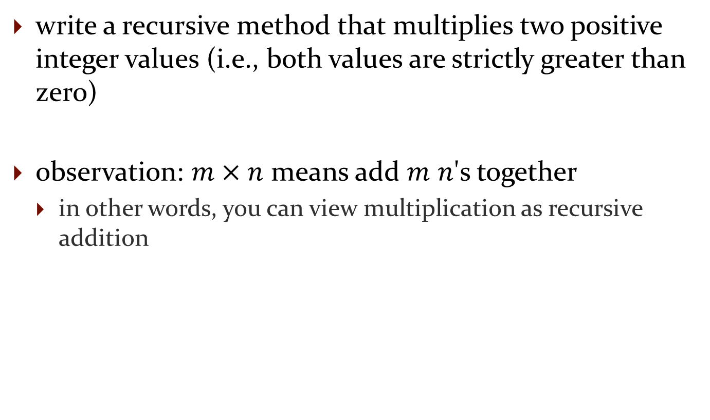
Recursive Methods & Return Values
write a recursive method that multiplies two positive integer values (i.e., both values are strictly greater than zero)
observation: $m×n$ means add $m$ $n$'s together
  in other words, you can view multiplication as recursive addition

Slide 37
Recursive Methods & Return Values
not Java:
/**
* Computes m * n
*/
multiply(m, n) :
if m == 1
return n
else
return n + multiply(m - 1, n)

Slide 38
public static int multiply(int m, int n) {
if (m == 1) {
return n;
}
return n + multiply(m - 1, n);
}

Slide 39
Recursive Methods & Return Values
example: write a recursive method countZeros that counts the number of zeros in an integer number n
  10305060700002L has 8 zeros
trick: examine the following sequence of numbers
  10305060700002
  1030506070000
  103050607000
  10305060700
  103050607
  1030506 ...

Slide 40
Recursive Methods & Return Values
not Java:
/**
* Counts the number of zeros in an integer n
*/
countZeros(n) :
if the last digit in n is a zero
return 1 + countZeros(n / 10)
else
return countZeros(n / 10)

Slide 41
don't forget to establish the base case(s)
  when should the recursion stop? when you reach a single digit (not zero digits; you never reach zero digits!)
    base case #1 : n == 0
      return 1
    base case #2 : n != 0 && n < 10
      return 0

Slide 42
public static int countZeros(long n) {
if(n == 0L) { // base case 1
return 1;
}
else if(n < 10L) { // base case 2
return 0;
}
boolean lastDigitIsZero = (n % 10L == 0);
final long m = n / 10L;
if(lastDigitIsZero) {
return 1 + countZeros(m);
}
else {
return countZeros(m);
}
}

Slide 43
countZeros Call Stack
callZeros( 800410L )
last in
first out
callZeros( 8L )
0
callZeros( 80L )
1 + 0
callZeros( 800L )
1 + 1 + 0
callZeros( 8004L )
0 + 1 + 1 + 0
callZeros( 80041L )
0 + 0 + 1 + 1 + 0
callZeros( 800410L )
1 + 0 + 0 + 1 + 1 + 0
= 3

Slide 44
Fibonacci Call Tree
F(5)
F(4)
F(3)
F(3)
F(2)
F(2)
F(1)
1
F(2)
F(1)
1
F(1)
1
F(0)
0
F(1)
1
F(0)
0
F(1)
1
F(0)
0

Slide 45
Compute Powers of 10
write a recursive method that computes 10^{n} for any integer value n
recall:
  10⁰ = 1
  10^{n} = 10 * 10^{n-1}
  10^{-n} = 1 / 10^{n}

Slide 46
public static double powerOf10(int n) {
if (n == 0) {
// base case
return 1.0;
}
else if (n > 0) {
// recursive call for positive n
return 10.0 * powerOf10(n - 1);
}
else {
// recursive call for negative n
return 1.0 / powerOf10(-n);
}
}

Slide 47
Fibonacci Numbers
the sequence of additional pairs
  0, 1, 1, 2, 3, 5, 8, 13, ...
are called Fibonacci numbers
base cases
  F(0) = 0
  F(1) = 1
recursive definition
  F(n) = F(n – 1) + F(n – 2)

Slide 48
Recursive Methods & Return Values
a recursive method can return a value
example: compute the nth Fibonacci number
public static int fibonacci(int n) {
if (n == 0) {
return 0;
}
else if (n == 1) {
return 1;
}
else {
int f = fibonacci(n - 1) + fibonacci(n - 2);
return f;
}
}

Slide 49
Fibonacci Call Tree
F(5)
F(4)
F(3)
F(3)
F(2)
F(2)
F(1)
1
F(2)
F(1)
1
F(1)
1
F(0)
0
F(1)
1
F(0)
0
F(1)
1
F(0)
0

Slide 50
A Better Recursive Fibonacci
public class Fibonacci {
private static Map<Integer, Long> values = new HashMap<Integer, Long>();
static {
Fibonacci.values.put(0, (long) 0);
Fibonacci.values.put(1, (long) 1);
}
public static long getValue(int n) {
Long value = Fibonacci.values.get(n);
if (value != null) {
return value;
}
value = Fibonacci.getValue(n - 1) + Fibonacci.getValue(n - 2);
Fibonacci.values.put(n, value);
return value;
}
}

Slide 51
Better Fibonacci Call Tree
F(5)
F(4)
F(3)
2
F(3)
F(2)
1
F(2)
F(1)
1
values in blue are already stored
in the map
F(1)
1
F(0)
0

Slide 52
A Better Recursive Fibonacci
because the map is static subsequent calls to Fibonacci.getValue(int) can use the values already computed and stored in the map

Slide 53
Better Fibonacci Call Tree
assuming the client has already invoked Fibonacci.getValue(5)
F(6)
F(5)
5
F(4)
3
values in blue are already stored
in the map

Slide 54
Compute Powers of 10
write a recursive method that computes 10^{n} for any integer value n
recall:
  10^{n} = 1 / 10^{-n} if n < 0
  10⁰ = 1
  10^{n} = 10 * 10^{n-1}

Slide 55
public static double powerOf10(int n) {
if (n < 0) {
return 1.0 / powerOf10(-n);
}
else if (n == 0) {
return 1.0;
}
return n * powerOf10(n - 1);
}

Slide 56
A Better Powers of 10
recall:
  10^{n} = 1 / 10^{-n} if n < 0
  10⁰ = 1
  10^{n} = 10 * 10^{n-1} if n is odd
  10^{n} = 10^{n/2} * 10^{n/2} if n is even

Slide 57
public static double powerOf10(int n) {
if (n < 0) {
return 1.0 / powerOf10(-n);
}
else if (n == 0) {
return 1.0;
}
else if (n % 2 == 1) {
return 10 * powerOf10(n - 1);
}
double value = powerOf10(n / 2);
return value * value;
}

Slide 58
What happens during recursion

Slide 59
What Happens During Recursion
a simplified model of what happens during a recursive method invocation is the following:
  whenever a method is invoked that method runs in a new block of memory
    when a method recursively invokes itself, a new block of memory is allocated for the newly invoked method to run in
consider a slightly modified version of the powerOf10 method

Slide 60
public static double powerOf10(int n) {
double result;
if (n < 0) {
result = 1.0 / powerOf10(-n);
}
else if (n == 0) {
result = 1.0;
}
else {
result = 10 * powerOf10(n - 1);
}
return result;
}

Slide 61
double x = Recursion.powerOf10(3);
 | 100 | main method
x |  | powerOf10(3)

Slide 62
double x = Recursion.powerOf10(3);
 | 600 | powerOf10 method
n |  | 3
result
 | 100 | main method
x |  | powerOf10(3)
a stack frame
methods occupy space in a region of memory called the call stack
information regarding the state of the method is stored in a stack frame
the stack frame includes information such as the method parameters, local variables of the method, where the return value of the method should be copied to, where control should flow to after the method completes, ...
stack memory can be allocated and deallocated very quickly, but this speed is obtained by restricting the total amount of stack memory
if you try to solve a large problem using recursion you can exceed the available amount of stack memory which causes your program to crash

Slide 63
double x = Recursion.powerOf10(3);
 | 600 | powerOf10 method
n |  | 3
result |  | 10 * powerOf10(2)
 | 100 | main method
x |  | powerOf10(3)

Slide 64
double x = Recursion.powerOf10(3);
 | 600 | powerOf10 method
n |  | 3
result |  | 10 * powerOf10(2)
 | 100 | main method
x |  | powerOf10(3)
 | 750 | powerOf10 method
n |  | 2
result

Slide 65
double x = Recursion.powerOf10(3);
 | 600 | powerOf10 method
n |  | 3
result |  | 10 * powerOf10(2)
 | 100 | main method
x |  | powerOf10(3)
 | 750 | powerOf10 method
n |  | 2
result |  | 10 * powerOf10(1)

Slide 66
double x = Recursion.powerOf10(3);
 | 600 | powerOf10 method
n |  | 3
result |  | 10 * powerOf10(2)
 | 100 | main method
x |  | powerOf10(3)
 | 750 | powerOf10 method
n |  | 2
result |  | 10 * powerOf10(1)
 | 800 | powerOf10 method
n |  | 1
result |  | 10 * powerOf10(0)

Slide 67
double x = Recursion.powerOf10(3);
 | 600 | powerOf10 method
n |  | 3
result |  | 10 * powerOf10(2)
 | 100 | main method
x |  | powerOf10(3)
 | 750 | powerOf10 method
n |  | 2
result |  | 10 * powerOf10(1)
 | 800 | powerOf10 method
n |  | 1
result |  | 10 * powerOf10(0)
 | 950 | powerOf10 method
n |  | 0
result

Slide 68
double x = Recursion.powerOf10(3);
 | 600 | powerOf10 method
n |  | 3
result |  | 10 * powerOf10(2)
 | 100 | main method
x |  | powerOf10(3)
 | 750 | powerOf10 method
n |  | 2
result |  | 10 * powerOf10(1)
 | 800 | powerOf10 method
n |  | 1
result |  | 10 * powerOf10(0)
 | 950 | powerOf10 method
n |  | 0
result |  | 1

Slide 69
double x = Recursion.powerOf10(3);
 | 600 | powerOf10 method
n |  | 3
result |  | 10 * powerOf10(2)
 | 100 | main method
x |  | powerOf10(3)
 | 750 | powerOf10 method
n |  | 2
result |  | 10 * powerOf10(1)
 | 800 | powerOf10 method
n |  | 1
result |  | 10 * 1
 | 950 | powerOf10 method
n |  | 0
result |  | 1

Slide 70
double x = Recursion.powerOf10(3);
 | 600 | powerOf10 method
n |  | 3
result |  | 10 * powerOf10(2)
 | 100 | main method
x |  | powerOf10(3)
 | 750 | powerOf10 method
n |  | 2
result |  | 10 * powerOf10(1)
 | 800 | powerOf10 method
n |  | 1
result |  | 10

Slide 71
double x = Recursion.powerOf10(3);
 | 600 | powerOf10 method
n |  | 3
result |  | 10 * powerOf10(2)
 | 100 | main method
x |  | powerOf10(3)
 | 750 | powerOf10 method
n |  | 2
result |  | 10 * 10
 | 800 | powerOf10 method
n |  | 1
result |  | 10

Slide 72
double x = Recursion.powerOf10(3);
 | 600 | powerOf10 method
n |  | 3
result |  | 10 * powerOf10(2)
 | 100 | main method
x |  | powerOf10(3)
 | 750 | powerOf10 method
n |  | 2
result |  | 100

Slide 73
double x = Recursion.powerOf10(3);
 | 600 | powerOf10 method
n |  | 3
result |  | 10 * 100
 | 100 | main method
x |  | powerOf10(3)
 | 750 | powerOf10 method
n |  | 2
result |  | 100

Slide 74
double x = Recursion.powerOf10(3);
 | 600 | powerOf10 method
n |  | 3
result |  | 1000
 | 100 | main method
x |  | powerOf10(3)

Slide 75
double x = Recursion.powerOf10(3);
 | 600 | powerOf10 method
n |  | 3
result |  | 1000
 | 100 | main method
x |  | 1000

Slide 76
double x = Recursion.powerOf10(3);
 | 100 | main method
x |  | 1000

