Slide 1
Advanced Object Oriented Programming
EECS2030E
Notes:
login 5065

Slide 2
Academic Support Programs: Bethune
having trouble with your FSC and LSE courses?
  consider using the Academic Support Programs at Bethune College
  PASS
    free, informal, structured, facilitated study groups: http://bethune.yorku.ca/pass/
  peer tutoring
    free, one-on-one, drop-in tutoring: http://bethune.yorku.ca/tutoring/

Slide 3
Who Am I?
Dr. Burton Ma
office
  Lassonde 2046
  hours : to be updated on the syllabus page
email
  burton@cse.yorku.ca

Slide 4
Course Format
everything you need to know is on Moodle
  http://learn.lassonde.yorku.ca/

Slide 5
Labs
in Prism computing labs (LAS1006)
Lab Zero starts in Week 1
  self-guided, can be done anytime before the start of Week 2
  using the Prism lab environment
  using eclipse
Labs 1-7 consist of a different set of programming problems for each lab
it is expected that you know how to use the lab computing environment

Slide 6
Labs
group lab work is allowed and strongly encouraged for Labs 1-7 (not Lab 0)
  groups of up to size 3
  see Academic Honesty section of syllabus
    TLDR Do not submit work that is not wholly your own

Slide 7
Labs
tips for effective group work
  alternate who is doing the typing (the driver) every few minutes
    don’t allow the stronger programmer to do everything
    if you are the stronger programmer then try explaining your thought processes to your group partners
  if you aren’t typing then you are a navigator
    you should be:
      watching what the driver is doing to catch mistakes
      planning what the group should do next
      developing test cases to test the code that is being written

Slide 8
Tests
all testing occurs during your regularly scheduled lab using the EECS labtest environment
miss a test for an acceptable reason?
  see Evaluation: Missed tests section of syllabus
Test | Weight
Test 1 | 15%
Test 2 | 15%
Test 3 | 15%
Test 4 | 15%
Exam | 30%

Slide 9
Textbook
a set of freely available electronic notes is available from the Moodle site
if you want a textbook the recommended text is Absolute Java, 5th Edition or newer by Savitch
  but any new-ish Java textbook will do
if you want a very concise reference to the language consider Java 8 Pocket Guide by Liguori and Liguori

Slide 10
Organization of a Java Program
Packages, classes, fields, and methods

Slide 11
Organization of a Typical Java Program
one or more files

Slide 12
Organization of a Typical Java Program
one or more files
zero or one package name

Slide 13
Organization of a Typical Java Program
one or more files
zero or one package name
zero or more import statements

Slide 14
Organization of a Typical Java Program
one or more files
zero or one package name
zero or more import statements
one class

Slide 15
Organization of a Typical Java Program
one or more files
zero or one package name
zero or more import statements
one class
one or more fields (class variables)

Slide 16
Organization of a Typical Java Program
one or more files
zero or one package name
zero or more import statements
one class
zero or more fields (class variables)
zero or more more constructors

Slide 17
Organization of a Typical Java Program
one or more files
zero or one package name
zero or more import statements
one class
zero or more fields (class variables)
zero or more more constructors
zero or more methods

Slide 18
Worksheet
Question 1

Slide 19
Organization of a Typical Java Program
it's actually more complicated than this
  static initialization blocks
  non-static initialization blocks
  classes inside of classes (inside of classes ...)
  classes inside of methods
  anonymous classes
  lambda expressions (in Java 8)
see http://docs.oracle.com/javase/tutorial/java/javaOO/index.html

Slide 20
Methods
Basics

Slide 21
Methods
a method performs some sort of computation
a method is reusable
  anyone who has access to the method can use the method without copying the contents of the method
  anyone who has access to the method can use the method without knowing the contents of the method
methods are described by their API (application program interface)

Slide 22
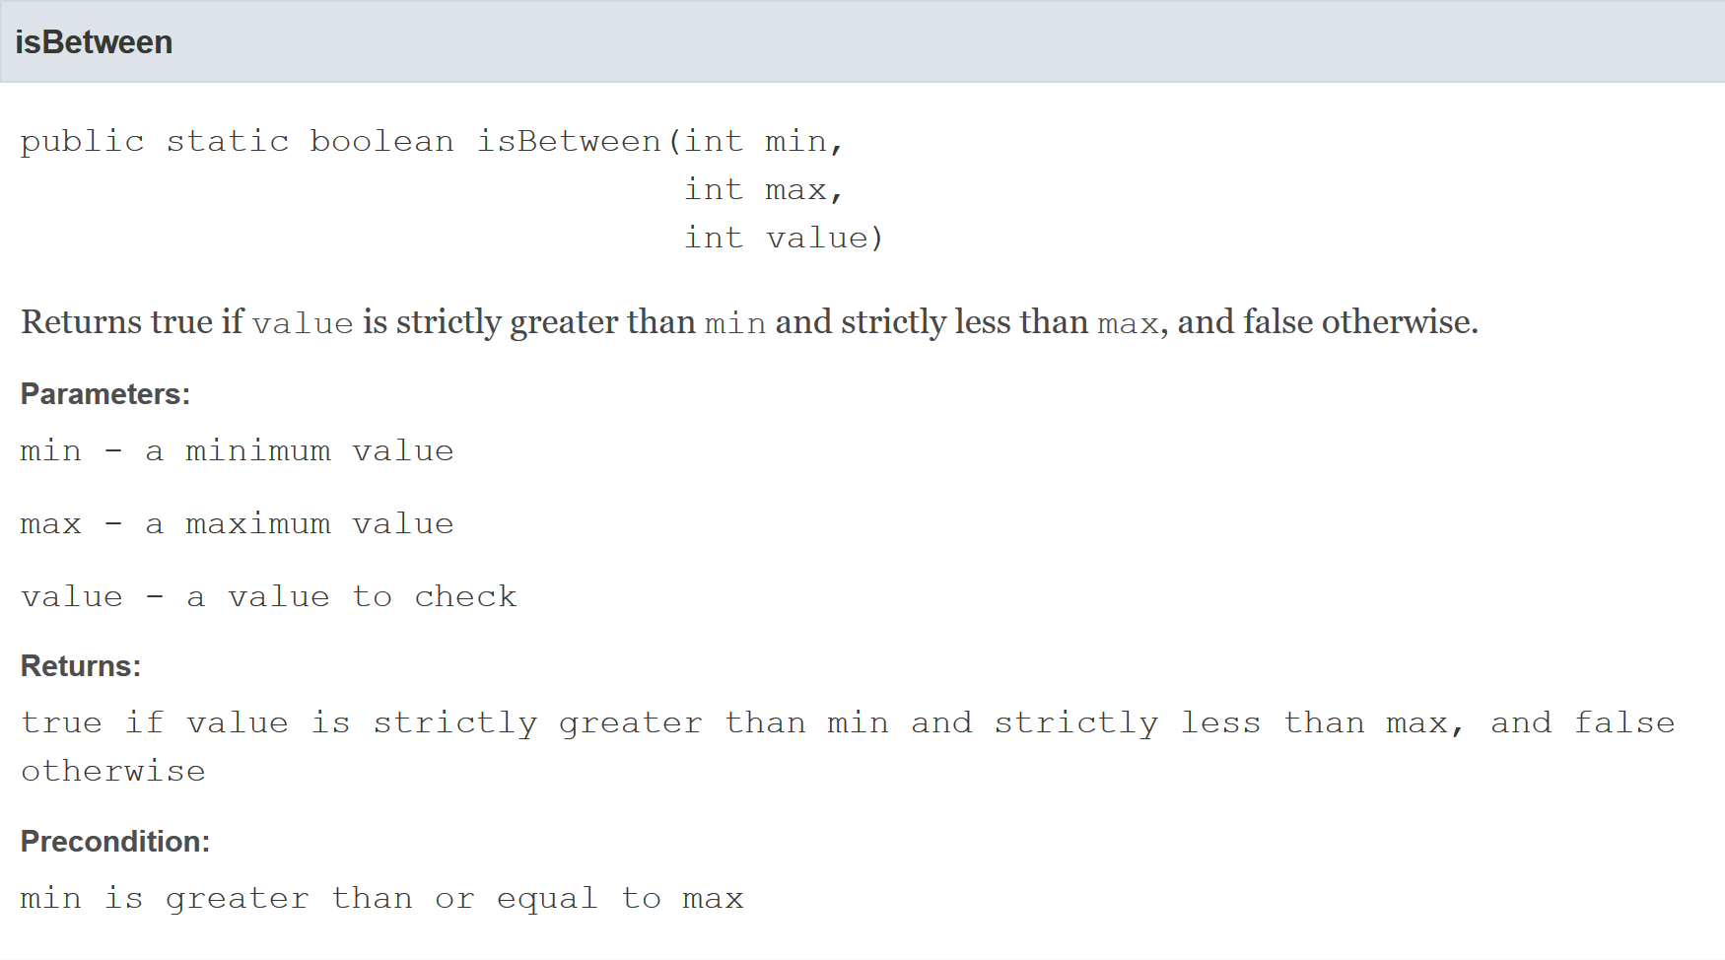
Example API method entry
less

Slide 23
Method header
the first line of a method declaration is sometimes called the method header
public static boolean isBetween(int min,
int max,
int value)
modifiers
return type
name
parameter list

Slide 24
Method parameter list
the parameter list is the list of types and names that appear inside of the parentheses
public static boolean
isBetween(int min, int max, int value)
the names in the parameter list must be unique
  i.e., duplicate parameter names are not allowed
parameter list

Slide 25
Method signature
every method has a signature
  the signature consists of the method name and the types in the parameter list
public static boolean isBetween(int min,
int max,
int value)
has the following signature
isBetween(int, int, int)
name
number and types of parameters
signature

Slide 26
Method signature
other examples from java.lang.String
  headers
    String toUpperCase()
    char charAt(int index)
    int indexOf(String str, int fromIndex)
    void getChars(int srcBegin, int srcEnd, char[] dst, int dstBegin)
  signatures
    toUpperCase()
    charAt(int)
    indexOf(String, int)
    getChars(int, int, char[], int)

Slide 27
Method signature
method signatures in a class must be unique
we can introduce a second method in the same class:
public static boolean
isBetween(double min, double max, double value)
but not this one:
public static boolean
isBetween(int value, int lo, int hi)

Slide 28
Method return types
all Java methods return nothing (void) or a single type of value
our method
public static boolean
isBetween(double min, double max, double value)
has the return type boolean

Slide 29
Worksheet
Question 2

Slide 30
Methods
Preconditions and postconditions

Slide 31
Preconditions and postconditions
recall the meaning of method pre- and postconditions
precondition
  a condition that the client must ensure is true immediately before a method is invoked
postcondition
  a condition that the method must ensure is true immediately after the method is invoked

Slide 32
Preconditions
recall that a method precondition is a condition that the client must ensure is true immediately before invoking a method
  if the precondition is not true, then the client has no guarantees of what the method will do
for static methods, preconditions are conditions on the values of the arguments passed to the method
  you need to carefully read the API to discover the preconditions

Slide 33
less
precondition

Slide 34
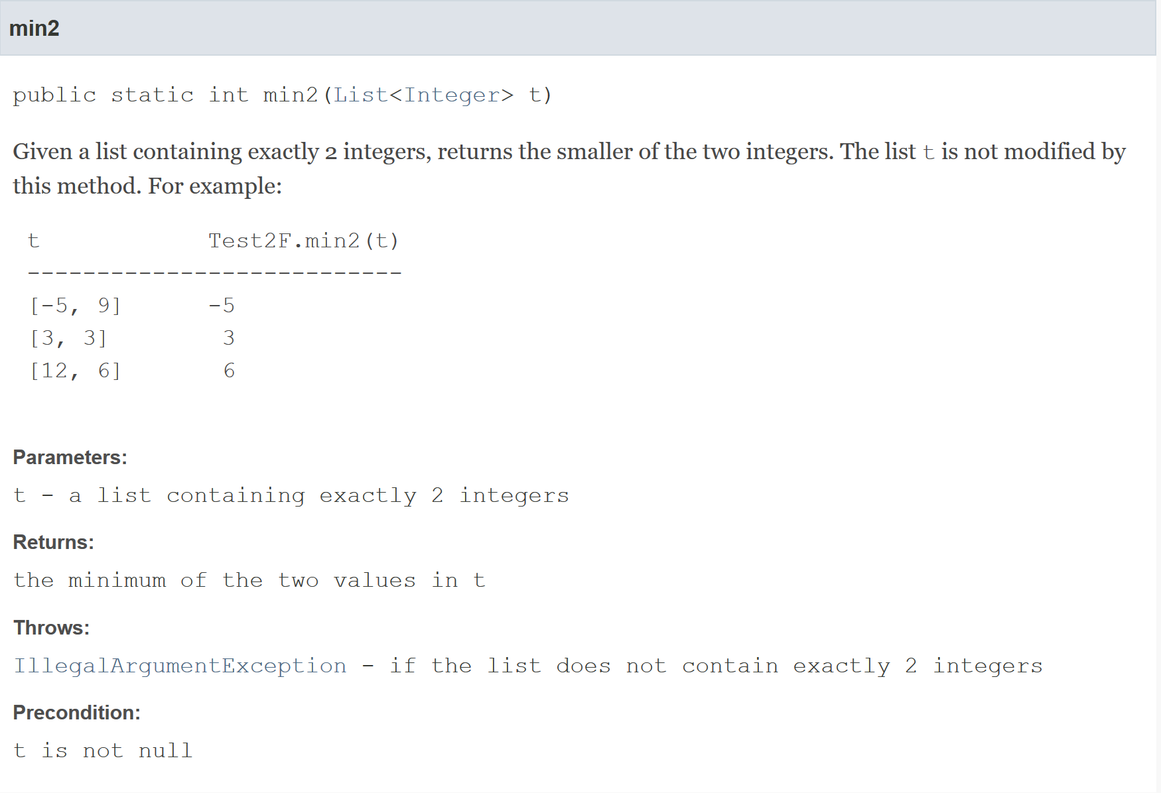
precondition
precondition

Slide 35
Preconditions
if a method has a parameter that has reference type then it is almost always assumed that a precondition for that parameter is that it is not equal to null
reminders:
  reference type means “not primitive type”
  null means “refers to no object”
    primitive types are never equal to null

Slide 36
Postconditions
  recall that a method postcondition is a condition that the method must ensure is true immediately after the method is invoked
  if the postcondition is not true, then there is something wrong with the implementation of the method
for static methods, postconditions are:
  conditions on the arguments after the method finishes
  conditions on the return value

Slide 37
postcondition
less

Slide 38
postcondition
postcondition

Slide 39
Worksheet
Question 3

Slide 40
Methods
Implementation

Slide 41
less

Slide 42
Methods and classes
in Java every method must be defined inside of a class
we will try to implement our method so that it matches its API:
  the method is inside the class named Test2F
  the class Test2F is inside the package eecs2030.test2
eclipse demonstration here

Slide 43
package eecs2030.test2;
public class Test2F {
}

Slide 44
Method body
a method implementation consists of:
  the method header
  a method body
    the body is a sequence of Java statements inside of a pair of braces { }

Slide 45
package eecs2030.test2;
public class Test2F {
public static boolean isBetween(int min, int max, int value) {
}
}

Slide 46
Methods with parameters
if a method has parameters, then you can use the parameter names as variables inside your method
  you cannot create new variables inside the method that have the same name as a parameter
  you cannot use the parameters outside of the method
    we say that the scope of the parameters is the method body
you may create additional variables inside your method if you wish
  we will create a variable to store the return value of the method

Slide 47
package eecs2030.test2;
public class Test2F {
public static boolean isBetween(int min, int max, int value) {
boolean result = true;
}
}

Slide 48
package eecs2030.test2;
public class Test2F {
public static boolean isBetween(int min, int max, int value) {
boolean result = true;
if (value <= min) {
result = false;
}
if (value >= max) {
result = false;
}
}
}

Slide 49
Methods with return values
if the method header says that a type is returned, then the method must return a value having the advertised type back to the client
you use the keyword return to return the value back to the client

Slide 50
package eecs2030.test2;
public class Test2F {
public static boolean isBetween(int min, int max, int value) {
boolean result = true;
if (value <= min) {
result = false;
}
if (value >= max) {
result = false;
}
return result;
}
}

Slide 51
Method return values
a method stops running immediately if a return statement is run
  this means that you are not allowed to have additional code if a return statement is reached
  however, you can have multiple return statements

Slide 52
package eecs2030.test2;
public class Test2F {
public static boolean isBetween(int min, int max, int value) {
if (value <= min) {
return false;
// code not allowed here
}
if (value >= max) {
return false;
// code not allowed here
}
return true;
// code not allowed here
}
}

Slide 53
Alternative implementations
there are many ways to implement this particular method

Slide 54
package eecs2030.test2;
public class Test2F {
public static boolean isBetween(int min, int max, int value) {
if (value <= min || value >= max) {
return false;
}
return true;
}
}

Slide 55
package eecs2030.test2;
public class Test2F {
public static boolean isBetween(int min, int max, int value) {
if (value > min && value < max) {
return true;
}
return false;
}
}

Slide 56
package eecs2030.test2;
public class Test2F {
public static boolean isBetween(int min, int max, int value) {
boolean result = value > min && value < max;
return result;
}
}

Slide 57
package eecs2030.test2;
public class Test2F {
public static boolean isBetween(int min, int max, int value) {
return value > min && value < max;
}
}

Slide 59
package eecs2030.test2;
import java.util.List;
public class Test2F {
// implementation of isBetween not shown
public static int min2(List<Integer> t) {
}
}

Slide 60
package eecs2030.test2;
import java.util.List;
public class Test2F {
// implementation not shown
public static int min2(List<Integer> t) {
if (t.size() != 2) {
throw new IllegalArgumentException("list size != 2");
}
int first = t.get(0);
int second = t.get(1);
}
}

Slide 61
package eecs2030.test2;
import java.util.List;
public class Test2F {
// implementation not shown
public static int min2(List<Integer> t) {
if (t.size() != 2) {
throw new IllegalArgumentException("list size != 2");
}
int first = t.get(0);
int second = t.get(1);
if (first < second) {
return first;
}
return second;
}
}

Slide 62
Worksheet
Question 4

Slide 63
Invoking methods
Pass-by-value

Slide 64
static Methods
a method that is static is a per-class member
  client does not need an object reference to invoke the method
  client uses the class name to access the method
  boolean isBetween = Test2F.isBetween(0, 5, 2);
  static methods are also called class methods
[notes 1.2.4]

Slide 65
Invoking methods
a client invokes a method by passing arguments to the method
  the types of the arguments must be compatible with the types of parameters in the method signature
  the values of the arguments must satisfy the preconditions of the method contract
List<Integer> t = new ArrayList<Integer>();
t.add(100);
t.add(-99);
int min = Test2F.min2(t);
argument

Slide 66
Pass-by-value
Java uses pass-by-value to:
  transfer the value of the arguments to the method
  transfer the return value back to the client
consider the following utility class and its client…

Slide 67
import type.lib.Fraction;
public class Doubler {
private Doubler() {
}
// tries to double x
public static void twice(int x) {
x = 2 * x;
}
// tries to double f
public static void twice(Fraction f) {
long numerator = f.getNumerator();
f.setNumerator( 2 * numerator );
}
}
assume that a Fraction
represents a fraction (i.e., has an integer numerator and denominator)

Slide 68
import type.lib.Fraction;
public class TestDoubler {
public static void main(String[] args) {
int a = 1;
Doubler.twice(a);
Fraction b = new Fraction(1, 2);
Doubler.twice(b);
System.out.println(a);
System.out.println(b);
}
}

Slide 69
Pass-by-value
what is the output of the client program?
  try it and see
an invoked method runs in its own area of memory that contains storage for its parameters
each parameter is initialized with the value of its corresponding argument

Slide 70
Pass-by-value with reference types
Fraction b =
new Fraction(1, 2);
 | 64 | client
b
500a
the object at address 500
this is an address
because b is a
reference variable
(refer to objects)
 | 500 | Fraction object
numer |  | 1
denom |  | 2

Slide 71
Pass-by-value with reference types
Fraction b =
new Fraction(1, 2);
 | 64 | client
b
value of b is not the
Fraction 1/2
500a
value of b is a reference to the new
Fraction object
 | 500 | Fraction object
numer |  | 1
denom |  | 2

Slide 72
Pass-by-value with reference types
Fraction b =
new Fraction(1, 2);
Doubler.twice(b);
 | 64 | client
b
the value of b
is passed to the
method Doubler.twice
500a
 | 500 | Fraction object
numer |  | 1
denom |  | 2
 | 600 | Doubler.twice
f
parameter f
is an independent copy of the value
of argument b
(a reference)
500a

Slide 73
Pass-by-value with reference types
Fraction b =
new Fraction(1, 2);
Doubler.twice(b);
 | 64 | client
b
500a
 | 500 | Fraction object
numer |  | 1 2
denom |  | 2
Doubler.twice
multiplies the
numerator of the Fraction object by 2
 | 600 | Doubler.twice
f
500a

Slide 74
Pass-by-value with primitive types
int a = 1;
 | 64 | client
a
1
value of a is the
integer value that we stored
this is the numeric
value because a is
a primitive variable

Slide 75
Pass-by-value with primitive types
int a = 1;
Doubler.twice(a);
 | 64 | client
a
the value of a
is passed to the
method Doubler.twice
1
this is a different Doubler.twice method than the previous example (now resides at address 800)
 | 800 | Doubler.twice
x |  | 1
parameter x
is an independent copy of the value
of argument a
(a primitive)

Slide 76
Pass-by-value with primitive types
int a = 1;
Doubler.twice(a);
 | 64 | client
a
1
 | 800 | Doubler.twice
x
Doubler.twice
multiplies the value of x by 2;
that's it, nothing else happens
1 2

Slide 77
Pass-by-value
Java uses pass-by-value for all types (primitive and reference)
  an argument of primitive type cannot be changed by a method
  an argument of reference type can have its state changed by a method
pass-by-value is used to return a value from a method back to the client

Slide 78
Worksheet
Question 5

Slide 79
Documenting a method
Javadoc

Slide 80
Documenting
documenting code was not a new idea when Java was invented
  however, Java was the first major language to embed documentation in the code and extract the documentation into readable electronic APIs
the tool that generates API documents from comments embedded in the code is called Javadoc

Slide 81
Documenting
Javadoc processes doc comments that immediately precede a class, attribute, constructor or method declaration
  doc comments delimited by /** and */
  doc comment written in HTML and made up of two parts
    a description
      first sentence of description gets copied to the summary section
      only one description block; can use <p> to create separate paragraphs
    block tags
      begin with @ (@param, @return, @throws and many others)
      @pre. is a non-standard (custom tag used in EECS1030) for documenting preconditions

Slide 82
Method documentation example
Eclipse will generate an empty Javadoc comment for you if you right-click on the method header and choose Source→Generate Element Comment
/**
* @param min
* @param max
* @param value
* @return
*/
public static boolean isBetween(int min, int max, int value) {
// implementation not shown
}

Slide 83
Method documentation example
The first sentence of the documentation should be short summary of the method; this sentence appears in the method summary section.
/**
* Returns true if value is strictly greater than min and strictly
* less than max, and false otherwise.
*
* @param min
* @param max
* @param value
* @return
*/
public static boolean isBetween(int min, int max, int value) {
// implementation not shown
}

Slide 84
Method documentation example
You should provide a brief description of each parameter.
/**
* Returns true if value is strictly greater than min and strictly
* less than max, and false otherwise.
*
* @param min a minimum value
* @param max a maximum value
* @param value a value to check
* @return
*/
public static boolean isBetween(int min, int max, int value) {
// implementation not shown
}

Slide 85
Method documentation example
Provide a brief description of the return value if the return type is not void. This description often describes a postcondition of the method.
/**
* Returns true if value is strictly greater than min and strictly
* less than max, and false otherwise.
*
* @param min a minimum value
* @param max a maximum value
* @param value a value to check
* @return true if value is strictly greater than min and strictly
* less than max, and false otherwise
*/
public static boolean isBetween(int min, int max, int value) {
// implementation not shown
}

Slide 86
Method documentation example
if a method has one or more preconditions, you should use the EECS2030 specific @pre. tag to document them

Slide 87
Method documentation example
Describe any preconditions using the EECS2030 specific @pre. tag. You have to manually do this.
/**
* Returns true if value is strictly greater than min and strictly
* less than max, and false otherwise.
*
* @param min a minimum value
* @param max a maximum value
* @param value a value to check
* @return true if value is strictly greater than min and strictly
* less than max, and false otherwise
* @pre min is greater than or equal to max
*/
public static boolean isBetween(int min, int max, int value) {
// implementation not shown
}

Slide 88
Method documentation example
if a method throws an exception then you should use the @throws tag to document the exception

Slide 89
/**
* Given a list containing exactly 2 integers, returns the smaller of the
* two integers. The list <code>t</code> is not modified by this method.
* For example:
*
* <pre>
* t Test2F.min2(t)
* ---------------------------
* [-5, 9] -5
* [3, 3] 3
* [12, 6] 6
* </pre>
*
* @pre t is not null
* @param t a list containing exactly 2 integers
* @return the minimum of the two values in t
* @throws IllegalArgumentException if the list does not contain exactly 2
* integers
*/
public static int min2(List<Integer> t) {
}
HTML markup is also allowed

Slide 90
Worksheet
Question 6

Slide 91
Utility classes

Slide 92
Review: Java Class
a class is a model of a thing or concept
in Java, a class is usually a blueprint for creating objects
  fields (or attributes)
    the structure of an object; its components and the information (data) contained by the object
  methods
    the behaviour of an object; what an object can do

Slide 93
Utility classes
sometimes, it is useful to create a class called a utility class that is not used to create objects
  such classes have no constructors for a client to use to create objects
in a utility class, all features are marked as being static
  you use the class name to access these features
examples of utility classes:
  java.lang.Math
  java.util.Arrays
  java.util.Collections

Slide 94
Utility classes
the purpose of a utility class is to group together related fields and methods where creating an object is not necessary
java.lang.Math
  groups mathematical constants and functions
  do not need a Math object to compute the cosine of a number
java.util.Collections
  groups methods that operate on Java collections
  do not need a Collections object to sort an existing List

Slide 95
Class versus utility class
a class is used to create instances of objects where each instance has its own state
for example:
  the class java.awt.Point is used to create instances that represent a location (x, y) where x and y are integers
  each instance occupies a separate location in memory which we can illustrate in a memory diagram
  public static void main(String[] args) {
  Point p = new Point(0, 0); // point (0, 0)
  Point q = new Point(17, 100); // point (17, 100)
  Point r = new Point(-1, -5); // point (-1, -5)
  }

Slide 96
Name | Address
 | 100 | Point class
x
y
 | 200 | Point instance
x |  | 0
y |  | 0
 | 300 | Point instance
x |  | 17
y |  | 100
 | 400 | Point instance
x |  | -1
y |  | -5
Point class is loaded
into memory
Point instance with
state (0, 0)
Point instance with
state (17, 100)
Point instance with
state (-1, -5)
continued on next slide

Slide 97
Name | Address
 | 500 | main method
p |  | 200a
q |  | 300a
r |  | 400a
the main method
the variables
created in the
main method
the object at address 200
the object at address 300
the object at address 400
these are addresses
because p, q, and r
are reference variables
(refer to objects)

Slide 98
Class versus utility class
a utility class is never used to create objects
when you use a utility class only the class itself occupies any memory
  public static void main(String[] args) {
  double x = Math.cos(Math.PI / 3.0);
  double y = Math.sin(Math.PI / 3.0);
  // notice that we never created a Math object
  }

Slide 99
Name | Address
 | 100 | Math class
PI |  | 3.1415....
E |  | 2.7182....
 | 200 | main method
x |  | 0.8660....
y |  | 0.5
Math class is loaded
into memory but there
are no Math instances
the value cos(π/3)
the value sin(π/3)
these are values (not
addresses) because
x and y are primitive
variables (double)

Slide 100
A simple utility class
implement a utility class that helps you calculate Einstein's famous mass-energy equivalence equation
E = mc² where
  m is mass (in kilograms)
  c is the speed of light (in metres per second)
  E is energy (in joules)

Slide 101
Start by creating a package, giving the class a name, and creating the class body block.
package ca.yorku.eecs.eecs2030;
public class Relativity {
public static final double C = 299792458;
public static double massEnergy(double mass) {
return mass * Relativity.C * Relativity.C;
}
}

Slide 102
Add a field that represents the speed of light.
package ca.yorku.eecs.eecs2030;
public class Relativity {
public static final double C = 299792458;
public static double massEnergy(double mass) {
return mass * Relativity.C * Relativity.C;
}
}

Slide 103
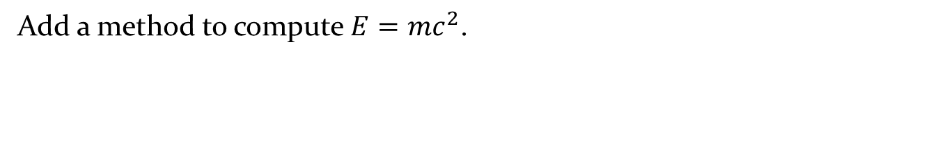
Add a method to compute $E=mc^{2}$.
package ca.yorku.eecs.eecs2030;
public class Relativity {
public static final double C = 299792458;
public static double massEnergy(double mass) {
double energy = mass * Relativity.C * Relativity.C;
return energy;
}
}

Slide 104
Add a method to compute $E=mc^{2}$.
package ca.yorku.eecs.eecs2030;
public class Relativity {
public static final double C = 299792458;
public static double massEnergy(double mass) {
double energy = mass * Relativity.C * Relativity.C;
return energy;
}
}

Slide 105
Here's a program that uses (a client) the Relativity utility class.
package ca.yorku.eecs.eecs2030;
public class OneGram {
public static void main(String[] args) {
double mass = 0.001;
double energy = Relativity.massEnergy(mass);
System.out.println("1 gram = " + energy + " Joules");
}
}

Slide 106
Worksheet
Question 7

Slide 107
Fields
a field is a member that holds data
a constant field is usually declared by specifying
  modifiers
    access modifier public
    static modifier static
    final modifier final
  type double
  name C
  value 299792458
public static final double C = 299792458;

Slide 108
Fields
field names must be unique in a class
the scope of a field is the entire class
[notes] use the term “field” only for public fields

Slide 109
public Fields
a public field is visible to all clients
// client of Relativity
int speedOfLight = Relativity.C;

Slide 110
static Fields
a field that is static is a per-class member
  only one copy of the field, and the field is associated with the class
    every object created from a class declaring a static field shares the same copy of the field
  textbook uses the term static variable
  also commonly called class variable

Slide 111
static Fields
 | 64 | client invocation
y
Relativity y = new Relativity();
Relativity z = new Relativity();
1000a
z
1100a
 | 500 | Relativity class
C |  | 299792458
belongs to class
 | 1000 | Relativity object
???
no copy of
C
 | 1100 | Relativity object
???

Slide 112
static Field Client Access
a client should access a public static field without using an object reference
  use the class name followed by a period followed by the attribute name
public static void main(String[] args) {
double sunDistance = 149.6 * 1e9;
double seconds = sunDistance / Relativity.C;
System.out.println(
"time for light to travel from sun to earth " +
seconds + " seconds");
}
time for light to travel from sun to earth 499.01188641643546 seconds

Slide 113
static Attribute Client Access
it is legal, but considered bad form, to access a public static attribute using an object
public static void main(String[] args) {
double sunDistance = 149.6 * 1e9;
Relativity y = new Relativity();
double seconds = sunDistance / y.C;
System.out.println(
"time for light to travel from sun to earth " +
seconds + " seconds");
}
time for light to travel from sun to earth 499.01188641643546 seconds

Slide 114
final Fields
a field that is final can only be assigned to once
  public static final fields are typically assigned when they are declared
  public static final double C = 299792458;
  public static final fields are intended to be constant values that are a meaningful part of the abstraction provided by the class

Slide 115
final Fields of Primitive Types
final fields of primitive types are constant
public class Relativity {
public static final double C = 299792458;
}
// client of Relativity
public static void main(String[] args) {
Relativity.C = 100; // will not compile;
// field C
// is final and
// previously assigned
}

Slide 116
final Fields of Immutable Types
final fields of immutable types are constant
String is immutable
  it has no methods to change its contents
public class NothingToHide {
public static final String X = "peek-a-boo";
}
// client of NothingToHide
public static void main(String[] args) {
NothingToHide.X = "i-see-you";
// will not compile;
// field X is final and
// previously assigned
}

Slide 117
final Fields of Mutable Types
final fields of mutable types are not logically constant; their state can be changed
public class ReallyNothingToHide {
public static final Fraction HALF =
new Fraction(1, 2);
}
// client of ReallyNothingToHide
public static void main(String[] args) {
ReallyNothingToHide.HALF.setDenominator(3);
// works!!
// HALF is now 1/3
}

Slide 118
final Fields of Mutable Types
 |  |  | ReallyNothingToHide class
final | HALF | 192 | 700a
 |  |  | :
 |  | 700 | Fraction obj
 |  |  | :
not final! | numer |  | 1
not final! | denom |  | 2
3
ReallyNothingToHide.HALF.setDenominator(3);

Slide 119
final fields
avoid using mutable types as public constants
  they are not logically constant

Slide 120
new Relativity objects
our Relativity class does not expose a constructor
  but
        Relativity y = new Relativity();
  is legal
if you do not define any constructors, Java will generate a default no-argument constructor for you
  e.g., we get the public constructor
  public Relativity() { }
  even though we did not implement it

Slide 121
Preventing instantiation
in a utility class you can prevent a client from making new instances of your class by declaring a private constructor
a private field, constructor, or method can only be used inside the class that it is declared in

Slide 122
package ca.yorku.eecs.eecs2030;
public class Relativity {
public static final double C = 299792458;
private Relativity() {
// private and empty by design
}
public static double massEnergy(double mass) {
double energy = mass * Relativity.C * Relativity.C;
return energy;
}
}

Slide 123
Introduction to Testing

Slide 124
Testing
testing code is a vital part of the development process
the goal of testing is to find defects in your code
  Program testing can be a very effective way to show the presence of bugs, but it is hopelessly inadequate for showing their absence.
  —Edsger W. Dijkstra

Slide 125
Testing with a main method
if I had asked you to test your worksheet 1 methods you probably would have written a main method

Slide 126
public static void main(String[] args) {
// avg
int a = 1;
int b = 1;
int c = 1;
System.out.println(
String.format("average of %d, %d, and %d : ", a, b, c) +
Test2E.avg(a, b, c));
// swap2
List<Integer> t = new ArrayList<Integer>();
t.add(3);
t.add(5);
String s = t.toString();
Test2E.swap2(t);
System.out.println(
String.format("swap2(%s) : %s", s, t.toString()));

Slide 127
// allGreaterThan
t.clear();
t.add(4);
t.add(5);
t.add(6);
t.add(7);
t.add(8);
System.out.println(
String.format("allGreaterThan(%s, %s) : %s",
t.toString(), 5, Test2E.allGreaterThan(t, 5)));
// toInt
t.clear();
t.add(1);
t.add(2);
t.add(3);
System.out.println(
String.format("toInt(%s) : %d",
t.toString(), Test2E.toInt(t)));
}

Slide 128
Testing with a main method
running the main method results in the following output:
average of 1, 1, and 1 : 1.0
swap2([3, 5]) : [5, 3]
allGreaterThan([4, 5, 6, 7, 8], 5) : [6, 7, 8]
toInt([1, 2, 3]) : 123

Slide 129
Testing with a main method
testing using a single main method has some disadvantages:
  someone has to examine the output to determine if the tests have passed or failed
  all of the tests are in one method
    we can’t run tests independently from one another
    there is no easy way to pick which tests we want to run

Slide 130
JUnit
JUnit is a unit test framework
“A framework is a semi-complete application. A framework provides a reusable, common structure to share among applications.”
  from the book JUnit in Action

Slide 131
JUnit
“A unit test examines the behavior of a distinct unit of work. Within a Java application, the “distinct unit of work” is often (but not always) a single method. … A unit of work is a task that isn't directly dependent on the completion of any other task.”
  from the book JUnit in Action

Slide 132
A JUnit test example
let’s write a test for the worksheet 1 method avg
we need a class to write the test in
we need to import the JUnit library
we need to write a method that implements the test
happily, eclipse helps you do all of this
  in the Package Explorer, right click on the class that you want to test and select New > JUnit Test Case

Slide 133
package eecs2030.test2;
import static org.junit.Assert.*;
import org.junit.Test;
public class Test2ETest {
@Test
public void test_avg() {
int a = -99;
int b = 100;
int c = -11;
double expected = -10.0 / 3;
double actual = Test2E.avg(a, b, c);
double delta = 1e-9;
assertEquals(expected, actual, delta);
}
static import: allows you to use
static methods from the class
org.junit.Assert without specifying
the class name
Avoid the widespread use of static
imports. Although it is convenient
being able to not include the class
name in front of the method name,
it makes it difficult to tell which
class the method comes from*.
*https://docs.oracle.com/javase/8/docs/technotes/guides/language/static-import.html

Slide 134
package eecs2030.test2;
import static org.junit.Assert.*;
import org.junit.Test;
public class Test2ETest {
@Test
public void test_avg() {
int a = -99;
int b = 100;
int c = -11;
double expected = -10.0 / 3;
double actual = Test2E.avg(a, b, c);
double delta = 1e-9;
assertEquals(expected, actual, delta);
}
An annotation; JUnit uses the @Test
annotation to determine which
methods are unit tests.

Slide 135
package eecs2030.test2;
import static org.junit.Assert.*;
import org.junit.Test;
public class Test2ETest {
@Test
public void test_avg() {
int a = -99;
int b = 100;
int c = -11;
double expected = -10.0 / 3;
double actual = Test2E.avg(a, b, c);
double delta = 1e-9;
assertEquals(expected, actual, delta);
}
A JUnit method that throws an exception if expected and actual differ
by more than delta. JUnit handles the exception and reports the test
failure to the user.

Slide 136
A JUnit test example
consider testing swap2 (a method which does not return a value)

Slide 137
@Test
public void test_swap2() {
List<Integer> actual = new ArrayList<Integer>();
actual.add(-99);
actual.add(88);
List<Integer> expected = new ArrayList<Integer>();
expected.add(88);
expected.add(-99);
Test2E.swap2(actual);
assertEquals(expected, actual);
}
A JUnit method that throws an exception if expected and actual are
not equal. JUnit handles the exception and reports the test
failure to the user.

Slide 138
Creating tests
based on the previous example, when you write a test in you need to determine:
  what arguments to pass to the method
  what the expected return value is when you call the method with your chosen arguments
    if the method does not return a value then you need to determine what the expected results are of calling the method with your chosen arguments

Slide 139
Creating tests
for now, we will define a test case to be:
  a specific set of arguments to pass to the method
  the expected return value (if any) and the expected results when the method is called with the specified arguments

Slide 140
Creating tests
to write a test for a static method in a utility class you need to consider:
  the preconditions of the method
  the postconditions of the method
  what exceptions the method might throw

Slide 141
Creating tests: Preconditions
recall that method preconditions often place restrictions on the values that a client can use for arguments to the method

Slide 142
less
precondition

Slide 143
precondition
precondition

Slide 144
Creating tests: Preconditions
the arguments you choose for the test should satisfy the preconditions of the method
  but see the slides on testing exceptions!
it doesn’t make sense to use arguments that violate the preconditions because the postconditions are not guaranteed if you violate the preconditions

Slide 145
Creating tests: Postconditions
recall that a postcondition is what the method promises will be true after the method completes running
a test should confirm that the postconditions are true
many postconditions require more than one test to verify

Slide 146
postcondition
less
requires one test to verify a return value of true and a second test to verify a return value for false

Slide 147
postcondition
postcondition

Slide 148
Creating tests: Exceptions
some methods having preconditions throw an exception if a precondition is violated
if the API for the method states that an exception is thrown under certain circumstances then you should test those circumstances
  even if writing such a test requires violating a precondition

Slide 149
@Test(expected = IllegalArgumentException.class)
public void test_swap2_throws() {
List<Integer> t = new ArrayList<Integer>();
Test2E.swap2(t);
}
@Test(expected = IllegalArgumentException.class)
public void test_swap2_throws2() {
List<Integer> t = new ArrayList<Integer>();
t.add(10000);
Test2E.swap2(t);
}
A JUnit test that is expected to result
in an IllegalArgumentException
being thrown. The test fails if an
IllegalArgumentException
is not thrown.

Slide 150
@Test(expected = IllegalArgumentException.class)
public void test_swap2_throws() {
List<Integer> t = new ArrayList<Integer>();
Test2E.swap2(t);
}
@Test(expected = IllegalArgumentException.class)
public void test_swap2_throws2() {
List<Integer> t = new ArrayList<Integer>();
t.add(10000);
Test2E.swap2(t);
}
swap2 should throw an exception
because t is empty.

Slide 151
@Test(expected = IllegalArgumentException.class)
public void test_swap2_throws() {
List<Integer> t = new ArrayList<Integer>();
Test2E.swap2(t);
}
@Test(expected = IllegalArgumentException.class)
public void test_swap2_throws2() {
List<Integer> t = new ArrayList<Integer>();
t.add(10000);
Test2E.swap2(t);
}
swap2 should throw an exception
because t has only one element.

Slide 152
Choosing test cases
typically, you use several test cases to test a method
  the course notes uses the term test vector to refer to a collection of test cases
it is usually impossible or impractical to test all possible sets of arguments
  how many possible arguments does the worksheet 1 method avg have?

Slide 153
Choosing test cases
when choosing tests cases, you should consider using
  arguments that have typical (not unusual) values, and
  arguments that test boundary cases
    argument value around the minimum or maximum value allowed by the preconditions
    argument value around a value where the behavior of the method changes

Slide 154
Example of a boundary case
consider testing the worksheet 1 method avg
the method has no preconditions
the boundary values of the arguments a, b, and c are Integer.MAX_VALUE and Integer.MIN_VALUE

Slide 155
@Test
public void test_avg_boundary() {
int a = Integer.MAX_VALUE;
int b = Integer.MAX_VALUE;
int c = Integer.MAX_VALUE;
double expected = Integer.MAX_VALUE;
double actual = Test2E.avg(a, b, c);
double delta = 1e-9;
assertEquals(expected, actual, delta);
}

Slide 156
Example of a boundary case
consider testing the method isBetween
the method has a precondition that min <= max
less

Slide 157
Example of a boundary case
boundary cases:
  value == min + 1
    expected return value: true
  value == min
    expected return value: false
  value == max
    expected return value: false
  value == max - 1
    expected return value: true
  min == max
    expected result: no exception thrown
  min == max - 1
    expected result: IllegalArgumentException thrown

