Slide 1
Inheritance (cont)
Abstract Classes

Slide 2
Polymorphism
inheritance allows you to define a base class that has fields and methods
  classes derived from the base class can use the public and protected base class fields and methods
polymorphism allows the implementer to change the behaviour of the derived class methods

Slide 3
// client code
public void print(Dog d) {
System.out.println( d.toString() );
}
// later on...
Dog fido = new Dog();
CockerSpaniel lady = new CockerSpaniel();
Mix mutt = new Mix();
this.print(fido);
this.print(lady);
this.print(mutt);
Dog toString
CockerSpaniel toString
Mix toString

Slide 4
notice that fido, lady, and mutt were declared as Dog, CockerSpaniel, and Mutt
what if we change the declared type of fido, lady, and mutt ?

Slide 5
// client code
public void print(Dog d) {
System.out.println( d.toString() );
}
// later on...
Dog fido = new Dog();
Dog lady = new CockerSpaniel();
Dog mutt = new Mix();
this.print(fido);
this.print(lady);
this.print(mutt);
Dog toString
CockerSpaniel toString
Mix toString

Slide 6
what if we change the print method parameter type to Object ?

Slide 7
// client code
public void print(Object obj) {
System.out.println( obj.toString() );
}
// later on...
Dog fido = new Dog();
Dog lady = new CockerSpaniel();
Dog mutt = new Mix();
this.print(fido);
this.print(lady);
this.print(mutt);
this.print(new Date());
Dog toString
CockerSpaniel toString
Mix toString
Date toString

Slide 8
Late Binding
polymorphism requires late binding of the method name to the method definition
  late binding means that the method definition is determined at run-time
non-static method
obj.toString()
run-time type of
the instance obj

Slide 9
Declared vs Run-time type
Dog lady = new CockerSpaniel();
declared
type
run-time or actual
type

Slide 10
the declared type of an instance determines what methods can be used
  the name lady can only be used to call methods in Dog
  lady.someCockerSpanielMethod() won't compile
Dog lady = new CockerSpaniel();

Slide 11
Dynamic dispatch
the actual type of the instance determines what definition is used when the method is called
  lady.toString() uses the CockerSpaniel definition of toString
selecting which version of a polymorphic method to use at run-time is called dynamic dispatch
Dog lady = new CockerSpaniel();

Slide 12
Abstract classes

Slide 13
Abstract Classes
sometimes you will find that you want the API for a base class to have a method that the base class cannot define
  e.g. you might want to know what a Dog's bark sounds like but the sound of the bark depends on the breed of the dog
    you want to add the method bark to Dog but only the subclasses of Dog can implement bark

Slide 14
Abstract Classes
sometimes you will find that you want the API for a base class to have a method that the base class cannot define
  e.g. you might want to know the breed of a Dog but only the subclasses have information about the breed
    you want to add the method getBreed to Dog but only the subclasses of Dog can implement getBreed

Slide 15
if the base class has methods that only subclasses can define and the base class has fields common to all subclasses then the base class should be abstract
  if you have a base class that just has methods that it cannot implement then you probably want an interface
abstract :
    (dictionary definition) existing only in the mind
in Java an abstract class is a class that you cannot make instances of
  e.g. http://docs.oracle.com/javase/7/docs/api/java/util/AbstractList.html

Slide 16
an abstract class provides a partial definition of a class
  the "partial definition" contains everything that is common to all of the subclasses
  the subclasses complete the definition
an abstract class can define fields and methods
  subclasses inherit these
an abstract class can define constructors
  subclasses must call these
an abstract class can declare abstract methods
  subclasses must define these (unless the subclass is also abstract)

Slide 17
Abstract Methods
an abstract base class can declare, but not define, zero or more abstract methods
the base class is saying "all Dogs can provide a String describing the breed, but only the subclasses know enough to implement the method"
public abstract class Dog
{
// fields, ctors, regular methods
public abstract String getBreed();
}

Slide 18
Abstract Methods
the non-abstract subclasses must provide definitions for all abstract methods
  consider getBreed in Mix

Slide 19
public class Mix extends Dog
{ // stuff from before...
@Override
public String getBreed() {
if(this.breeds.isEmpty()) {
return "mix of unknown breeds";
}
StringBuffer b = new StringBuffer();
b.append("mix of");
for(String breed : this.breeds) {
b.append(" " + breed);
}
return b.toString();
}

Slide 20
PureBreed
a purebreed dog is a dog with a single breed
  one String field to store the breed
note that the breed is determined by the subclasses
  the class PureBreed cannot give the breed field a value
  but it can implement the method getBreed
the class PureBreed defines an field common to all subclasses and it needs the subclass to inform it of the actual breed
  PureBreed is also an abstract class

Slide 21
public abstract class PureBreed extends Dog
{
private String breed;
public PureBreed(String breed) {
super();
this.breed = breed;
}
public PureBreed(String breed, int size, int energy) {
super(size, energy);
this.breed = breed;
}

Slide 22
@Override public String getBreed()
{
return this.breed;
}
}

Slide 23
Subclasses of PureBreed
the subclasses of PureBreed are responsible for setting the breed
  consider Komondor

Slide 24
Komondor
public class Komondor extends PureBreed
{
private final String BREED = "komondor";
public Komondor() {
super(BREED);
}
public Komondor(int size, int energy) {
super(BREED, size, energy);
}
// other Komondor methods...
}

Slide 25
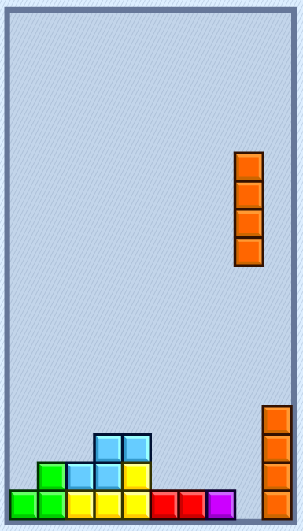
Another example: Tetris
played with 7 standard blocks called tetriminoes
blocks drop from the top
player can move blocks left, right, and down
player can spin blocks left and right

Slide 26
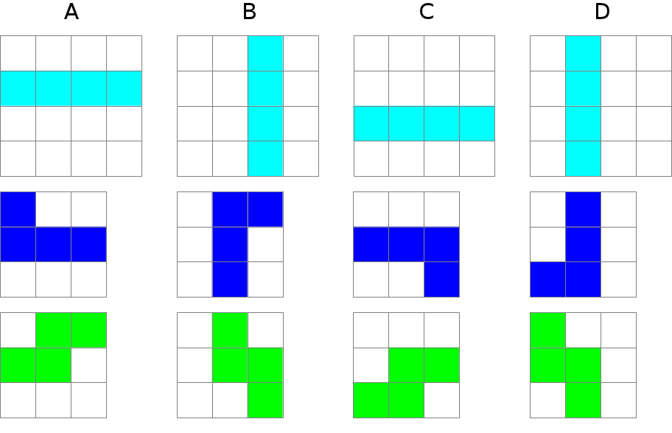
Tetriminoes
spinning the I, J, and S blocks

Slide 27
Tetriminoes
features common to all tetriminoes
  has-a color
  has-a shape
  has-a position
  draw
  move left, right, and down
features unique to each kind of tetrimino
  the actual shape
  spin left and right

Slide 28
class name in italics for abstract classes
a 2D point
a grid object that stores the shape
protected constructor
Block
- color : Color
- position : Point2
- grid : BlockGrid
# Block(int, Point2, Color)
+ draw()
+ moveDown()
+ moveLeft()
+ moveRight()
...
Block is abstract because we can't define the shape of a generic block
IBlock
+ IBlock(Point2, Color)
+ spinLeft()
+ spinRight()
constructor defines the shape
methods modify the shape to produce the rotated version of the block
http://www.eecs.yorku.ca/course_archive/2016-17/F/2030/labs/lab4/lab4.html

Slide 29
Inheritance (cont)
Static Features

Slide 30
Static Fields and Inheritance
static fields behave the same as non-static fields in inheritance
  public and protected static fields are inherited by subclasses, and subclasses can access them directly by name
  private static fields are not inherited and cannot be accessed directly by name
    but they can be accessed/modified using public and protected methods

Slide 31
Static Fields and Inheritance
the important thing to remember about static fields and inheritance
  there is only one copy of the static field shared among the declaring class and all subclasses
consider trying to count the number of Dog objects created by using a static counter

Slide 32
// the wrong way to count the number of Dogs created
public abstract class Dog {
// other fields...
static protected int numCreated = 0;
Dog() {
// ...
Dog.numCreated++;
}
public static int getNumberCreated() {
return Dog.numCreated;
}
// other contructors, methods...
}
protected, not private, so that subclasses can modify it directly

Slide 33
// the wrong way to count the number of Dogs created
public class Mix extends Dog
{
// fields...
Mix()
{
super();
Mix.numCreated++;
}
// other contructors, methods...
}

Slide 34
// too many dogs!
public class TooManyDogs
{
public static void main(String[] args)
{
Mix mutt = new Mix();
System.out.println( Mix.getNumberCreated() );
}
}
prints 2

Slide 35
What Went Wrong?
there is only one copy of the static field shared among the declaring class and all subclasses
  Dog declared the static field
  Dog increments the counter every time its constructor is called
  Mix inherits and shares the single copy of the field
  Mix constructor correctly calls the superclass constructor
    which causes numCreated to be incremented by Dog
  Mix constructor then incorrectly increments the counter

Slide 36
Counting Dogs and Mixes
suppose you want to count the number of Dog instances and the number of Mix instances
  Mix must also declare a static field to hold the count
    somewhat confusingly, Mix can give the counter the same name as the counter declared by Dog

Slide 37
public class Mix extends Dog
{
// other fields...
private static int numCreated = 0; // bad style; hides Dog.numCreated
public Mix()
{
super(); // will increment Dog.numCreated
// other Mix stuff...
numCreated++; // will increment Mix.numCreated
}
// ...

Slide 38
Hiding Fields
note that the Mix field numCreated has the same name as an field declared in a superclass
  whenever numCreated is used in Mix, it is the Mix version of the field that is used
if a subclass declares an field with the same name as a superclass field, we say that the subclass field hides the superclass field
  considered bad style because it can make code hard to read and understand
    should change numCreated to numMixCreated in Mix

Slide 39
Static Methods and Inheritance
there is a significant difference between calling a static method and calling a non-static method when dealing with inheritance
there is no dynamic dispatch on static methods
  therefore, you cannot override a static method

Slide 40
public abstract class Dog {
private static int numCreated = 0;
public static int getNumCreated() {
return Dog.numCreated;
}
}
public class Mix {
private static int numMixCreated = 0;
public static int getNumCreated() {
return Mix.numMixCreated;
}
}
public class Komondor {
private static int numKomondorCreated = 0;
public static int getNumCreated() {
return Komondor.numKomondorCreated;
}
}
notice no @Override
notice no @Override

Slide 41
public class WrongCount {
public static void main(String[] args) {
Dog mutt = new Mix();
Dog shaggy = new Komondor();
System.out.println( mutt.getNumCreated() );
System.out.println( shaggy.getNumCreated() );
System.out.println( Mix.getNumCreated() );
System.out.println( Komondor.getNumCreated() );
}
}
prints 2
2
1
1
Dog version
Dog version
Mix version
Komondor
version

Slide 42
What's Going On?
there is no dynamic dispatch on static methods
because the declared type of mutt is Dog, it is the Dog version of getNumCreated that is called
because the declared type of shaggy is Dog, it is the Dog version of getNumCreated that is called

Slide 43
Hiding Methods
notice that Mix.getNumCreated and Komondor.getNumCreated work as expected
if a subclass declares a static method with the same name as a superclass static method, we say that the subclass static method hides the superclass static method
  you cannot override a static method, you can only hide it
  hiding static methods is considered bad form because it makes code hard to read and understand

Slide 44
the client code in WrongCount illustrates two cases of bad style, one by the client and one by the implementer of the Dog hierarchy
  the client should not have used an instance to call a static method
  the implementer should not have hidden the static method in Dog

Slide 45
Using superclass methods

Slide 46
Other Methods
methods in a subclass will often need or want to call methods in the immediate superclass
  a new method in the subclass can call any public or protected method in the superclass without using any special syntax
a subclass can override a public or protected method in the superclass by declaring a method that has the same signature as the one in the superclass
  a subclass method that overrides a superclass method can call the overridden superclass method using the super keyword

Slide 47
Dog equals
we will assume that two Dogs are equal if their size and energy are the same
@Override public boolean equals(Object obj)
{
boolean eq = false;
if(obj != null && this.getClass() == obj.getClass())
{
Dog other = (Dog) obj;
eq = this.getSize() == other.getSize() &&
this.getEnergy() == other.getEnergy();
}
return eq;
}

Slide 48
Mix equals (version 1)
two Mix instances are equal if their Dog subobjects are equal and they have the same breeds
@Override public boolean equals(Object obj)
{ // the hard way
boolean eq = false;
if(obj != null && this.getClass() == obj.getClass()) {
Mix other = (Mix) obj;
eq = this.getSize() == other.getSize() &&
this.getEnergy() == other.getEnergy() &&
this.breeds.size() == other.breeds.size() &&
this.breeds.containsAll(other.breeds);
}
return eq;
}
subclass can call
public method of
the superclass

Slide 49
Mix equals (version 2)
two Mix instances are equal if their Dog subobjects are equal and they have the same breeds
  Dog equals already tests if two Dog instances are equal
  Mix equals can call Dog equals to test if the Dog subobjects are equal, and then test if the breeds are equal
also notice that Dog equals already checks that the Object argument is not null and that the classes are the same
  Mix equals does not have to do these checks again

Slide 50
@Override public boolean equals(Object obj)
{
boolean eq = false;
if (super.equals(obj))
{ // the Dog subobjects are equal
Mix other = (Mix) obj;
eq = this.breeds.size() == other.breeds.size() &&
this.breeds.containsAll(other.breeds);
}
return eq;
}
subclass method that overrides a superclass
method can call the original superclass method

Slide 51
Dog toString
@Override public String toString()
{
String s = "size " + this.getSize() +
"energy " + this.getEnergy();
return s;
}

Slide 52
Mix toString
@Override public String toString()
{
StringBuffer b = new StringBuffer();
b.append(super.toString());
for(String s : this.breeds)
b.append(" " + s);
b.append(" mix");
return b.toString();
}
size and energy of the dog
breeds of the mix

Slide 53
Dog hashCode
// similar to code generated by Eclipse
@Override public int hashCode()
{
final int prime = 31;
int result = 1;
result = prime * result + this.getEnergy();
result = prime * result + this.getSize();
return result;
}
use this.energy and
this.size to compute
the hash code

Slide 54
Mix hashCode
// similar to code generated by Eclipse
@Override public int hashCode()
{
final int prime = 31;
int result = super.hashCode();
result = prime * result + this.breeds.hashCode();
return result;
}
use this.energy,
this.size, and this.breeds
to compute the hash code

Slide 55
Graphical User Interfaces
notes Chap 7

Slide 56
Java Swing
Swing is a Java toolkit for building graphical user interfaces (GUIs)
  http://docs.oracle.com/javase/tutorial/uiswing/TOC.html
old version of the Java tutorial had a visual guide of Swing components
  http://web.mit.edu/6.005/www/sp14/psets/ps4/java-6-tutorial/components.html

Slide 57
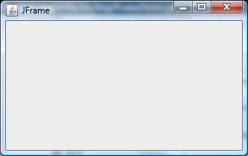
Simple Applications
simple applications often consist of just a single window (containing some controls)
JFrame
window with border, title, buttons

Slide 58
Simple Applications
simple applications can be implemented as a subclass of a JFrame
  hundreds of inherited methods but only a dozen or so are commonly called by the implementer (see URL below)
Object
Component
user interface item
Container
holds other components
Window
plain window
Frame
window with title and
border
JFrame
View
https://docs.oracle.com/javase/tutorial/uiswing/components/frame.html

Slide 59
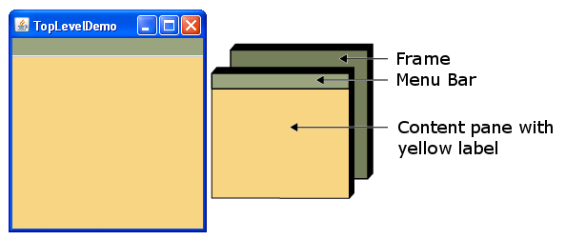
Simple Applications
a simple application made up of a:
  JFrame
    has-a JMenuBar
    has-a Container (called the content pane)
      has-a JLabel

Slide 60

Simple Applications
a simple application made up of a:
  JFrame
    has-a JMenuBar
    has-a Container (called the content pane)
      has-a JLabel

Slide 61
Creating JFrames
Create the frame
Choose what happens when the frame closes
Create components and put them in the frame
Size the frame
Show it

Slide 62
public class ImageViewer extends JFrame implements ActionListener {
// a unique identifier to associate with the Open command
public static final String OPEN_COMMAND = "Open";
// a label to show the image
private JLabel img;
public ImageViewer() {
// 1. Create the frame
super("Image Viewer");
// 2. Choose what happens when the frame closes
this.setDefaultCloseOperation(JFrame.EXIT_ON_CLOSE);
// 3. Create components and put them in the frame
this.makeMenu();
this.makeLabel();
this.setLayout(new FlowLayout());
// 4. Size the frame
this.setMinimumSize(new Dimension(600, 400));
this.pack();
// 5. Show it
this.setVisible(true);
}

Slide 63
public class ImageViewer extends JFrame implements ActionListener {
// a unique identifier to associate with the Open command
public static final String OPEN_COMMAND = "Open";
// a label to show the image
private JLabel img;
public ImageViewer() {
// 1. Create the frame
super("Image Viewer");
// 2. Choose what happens when the frame closes
this.setDefaultCloseOperation(JFrame.EXIT_ON_CLOSE);
// 3. Create components and put them in the frame
this.makeMenu();
this.makeLabel();
this.setLayout(new FlowLayout());
// 4. Size the frame
this.setMinimumSize(new Dimension(600, 400));
this.pack();
// 5. Show it
this.setVisible(true);
}

Slide 64
public class ImageViewer extends JFrame implements ActionListener {
// a unique identifier to associate with the Open command
public static final String OPEN_COMMAND = "Open";
// a label to show the image
private JLabel img;
public ImageViewer() {
// 1. Create the frame
super("Image Viewer");
// 2. Choose what happens when the frame closes
this.setDefaultCloseOperation(JFrame.EXIT_ON_CLOSE);
// 3. Create components and put them in the frame
this.makeMenu();
this.makeLabel();
this.setLayout(new FlowLayout());
// 4. Size the frame
this.setMinimumSize(new Dimension(600, 400));
this.pack();
// 5. Show it
this.setVisible(true);
}

Slide 65
public class ImageViewer extends JFrame implements ActionListener {
// a unique identifier to associate with the Open command
public static final String OPEN_COMMAND = "Open";
// a label to show the image
private JLabel img;
public ImageViewer() {
// 1. Create the frame
super("Image Viewer");
// 2. Choose what happens when the frame closes
this.setDefaultCloseOperation(JFrame.EXIT_ON_CLOSE);
// 3. Create components and put them in the frame
this.makeMenu();
this.makeLabel();
this.setLayout(new FlowLayout());
// 4. Size the frame
this.setMinimumSize(new Dimension(600, 400));
this.pack();
// 5. Show it
this.setVisible(true);
}
to respond to the user
selecting the Open
command from the menu
controls how the components
re-size and re-position when the
JFrame changes size

Slide 66
public class ImageViewer extends JFrame implements ActionListener {
// a unique identifier to associate with the Open command
public static final String OPEN_COMMAND = "Open";
// a label to show the image
private JLabel img;
public ImageViewer() {
// 1. Create the frame
super("Image Viewer");
// 2. Choose what happens when the frame closes
this.setDefaultCloseOperation(JFrame.EXIT_ON_CLOSE);
// 3. Create components and put them in the frame
this.makeMenu();
this.makeLabel();
this.setLayout(new FlowLayout());
// 4. Size the frame
this.setMinimumSize(new Dimension(600, 400));
this.pack();
// 5. Show it
this.setVisible(true);
}
sizes the JFrame so that all components
have their preferred size; uses the layout
manager to help adjust component sizes

Slide 67
public class ImageViewer extends JFrame implements ActionListener {
// a unique identifier to associate with the Open command
public static final String OPEN_COMMAND = "Open";
// a label to show the image
private JLabel img;
public ImageViewer() {
// 1. Create the frame
super("Image Viewer");
// 2. Choose what happens when the frame closes
this.setDefaultCloseOperation(JFrame.EXIT_ON_CLOSE);
// 3. Create components and put them in the frame
this.makeMenu();
this.makeLabel();
this.setLayout(new FlowLayout());
// 4. Size the frame
this.setMinimumSize(new Dimension(600, 400));
this.pack();
// 5. Show it
this.setVisible(true);
}

Slide 68

Labels
a label displays unselectable text and images
label
JLabel
label
JLabel
http://docs.oracle.com/javase/tutorial/uiswing/components/label.html

Slide 69
private void makeLabel() {
this.img = new JLabel("");
this.getContentPane().add(this.img);
}

Slide 70
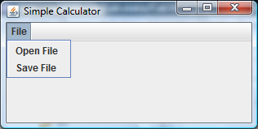
Menus
a menu appears in a menu bar (or a popup menu)
each item in the menu is a menu item
menu
JMenu
menu bar
JMenuBar
menu item
JMenuItem
JMenuBar
+ add(JMenu)
*
JMenu
+ add(JMenuItem)
*
JMenuItem
http://docs.oracle.com/javase/tutorial/uiswing/components/menu.html

Slide 71
Menus
to create a menu
  create a JMenuBar
  create one or more JMenu objects
    add the JMenu objects to the JMenuBar
  create one or more JMenuItem objectes
    add the JMenuItem objects to the JMenu

Slide 72
private void makeMenu() {
JMenuBar menuBar = new JMenuBar();
JMenu fileMenu = new JMenu("File");
menuBar.add(fileMenu);
JMenuItem openMenuItem = new JMenuItem("Open...");
openMenuItem.setActionCommand(ImageViewer.OPEN_COMMAND);
openMenuItem.addActionListener(this);
fileMenu.add(openMenuItem);
this.setJMenuBar(menuBar);
}

Slide 73
private void makeMenu() {
JMenuBar menuBar = new JMenuBar();
JMenu fileMenu = new JMenu("File");
menuBar.add(fileMenu);
JMenuItem openMenuItem = new JMenuItem("Open...");
openMenuItem.setActionCommand(ImageViewer.OPEN_COMMAND);
openMenuItem.addActionListener(this);
fileMenu.add(openMenuItem);
this.setJMenuBar(menuBar);
}

Slide 74
private void makeMenu() {
JMenuBar menuBar = new JMenuBar();
JMenu fileMenu = new JMenu("File");
menuBar.add(fileMenu);
JMenuItem openMenuItem = new JMenuItem("Open...");
openMenuItem.setActionCommand(ImageViewer.OPEN_COMMAND);
openMenuItem.addActionListener(this);
fileMenu.add(openMenuItem);
this.setJMenuBar(menuBar);
}
to respond to the user
selecting the Open
command from the menu

Slide 75
private void makeMenu() {
JMenuBar menuBar = new JMenuBar();
JMenu fileMenu = new JMenu("File");
menuBar.add(fileMenu);
JMenuItem openMenuItem = new JMenuItem("Open...");
openMenuItem.setActionCommand(ImageViewer.OPEN_COMMAND);
openMenuItem.addActionListener(this);
fileMenu.add(openMenuItem);
this.setJMenuBar(menuBar);
}

Slide 76
Event Driven Programming
so far we have a frame with some UI elements (menu, menu item, label)
  now we need to implement the actions
each UI element is a source of events
  button pressed, slider moved, text changed, etc.
when the user interacts with a UI element an event is triggered
  this causes an event object to be sent to every object listening for that particular event
    the event object carries information about the event
the event listeners respond to the event

Slide 77
Not a UML Diagram
event
listener A
event
listener B
event
source 1
event object 1
event
listener C
event
source 2
event object 2
event
listener D

Slide 78
Implementation
each JMenuItem has two inherited methods from AbstractButton
public void addActionListener(ActionListener l)
public void setActionCommand(String actionCommand)
for the JMenuItem
  call addActionListener with the listener as the argument
  call setActionCommand with a string describing what event has occurred

Slide 79
Implementation
our application has one event thiat is fired by a button (JMenuItem)
  a button fires an ActionEvent event whenever it is clicked
ImageViewer listens for fired ActionEvents
  how? by implementing the ActionListener interface
  public interface ActionListener
  {
  void actionPerformed(ActionEvent e);
  }

Slide 80
@Override
public void actionPerformed(ActionEvent e) {
String command = e.getActionCommand();
if (command.equals(ImageViewer.OPEN_COMMAND)) {
JFileChooser chooser = new JFileChooser();
int result = chooser.showOpenDialog(this);
if (result == JFileChooser.APPROVE_OPTION) {
String fileName =
chooser.getSelectedFile().getAbsolutePath();
ImageIcon icon = new ImageIcon(fileName);
if (icon.getImageLoadStatus() ==
MediaTracker.COMPLETE) {
this.img.setIcon(icon);
this.pack();
}
}
}
}

Slide 81
@Override
public void actionPerformed(ActionEvent e) {
String command = e.getActionCommand();
if (command.equals(ImageViewer.OPEN_COMMAND)) {
JFileChooser chooser = new JFileChooser();
int result = chooser.showOpenDialog(this);
if (result == JFileChooser.APPROVE_OPTION) {
String fileName =
chooser.getSelectedFile().getAbsolutePath();
ImageIcon icon = new ImageIcon(fileName);
if (icon.getImageLoadStatus() ==
MediaTracker.COMPLETE) {
this.img.setIcon(icon);
this.pack();
}
}
}
}
to respond to the user
selecting the Open
command from the menu

Slide 82
@Override
public void actionPerformed(ActionEvent e) {
String command = e.getActionCommand();
if (command.equals(ImageViewer.OPEN_COMMAND)) {
JFileChooser chooser = new JFileChooser();
int result = chooser.showOpenDialog(this);
if (result == JFileChooser.APPROVE_OPTION) {
String fileName =
chooser.getSelectedFile().getAbsolutePath();
ImageIcon icon = new ImageIcon(fileName);
if (icon.getImageLoadStatus() ==
MediaTracker.COMPLETE) {
this.img.setIcon(icon);
this.pack();
}
}
}
}
used to pick the file
to open

Slide 83
@Override
public void actionPerformed(ActionEvent e) {
String command = e.getActionCommand();
if (command.equals(ImageViewer.OPEN_COMMAND)) {
JFileChooser chooser = new JFileChooser();
int result = chooser.showOpenDialog(this);
if (result == JFileChooser.APPROVE_OPTION) {
String fileName =
chooser.getSelectedFile().getAbsolutePath();
ImageIcon icon = new ImageIcon(fileName);
if (icon.getImageLoadStatus() ==
MediaTracker.COMPLETE) {
this.img.setIcon(icon);
this.pack();
}
}
}
}
show the file chooser and
get the user result (ok or
cancel)

Slide 84
@Override
public void actionPerformed(ActionEvent e) {
String command = e.getActionCommand();
if (command.equals(ImageViewer.OPEN_COMMAND)) {
JFileChooser chooser = new JFileChooser();
int result = chooser.showOpenDialog(this);
if (result == JFileChooser.APPROVE_OPTION) {
String fileName =
chooser.getSelectedFile().getAbsolutePath();
ImageIcon icon = new ImageIcon(fileName);
if (icon.getImageLoadStatus() ==
MediaTracker.COMPLETE) {
this.img.setIcon(icon);
this.pack();
}
}
}
}
user picked a file and
pressed ok

Slide 85
@Override
public void actionPerformed(ActionEvent e) {
String command = e.getActionCommand();
if (command.equals(ImageViewer.OPEN_COMMAND)) {
JFileChooser chooser = new JFileChooser();
int result = chooser.showOpenDialog(this);
if (result == JFileChooser.APPROVE_OPTION) {
String fileName =
chooser.getSelectedFile().getAbsolutePath();
ImageIcon icon = new ImageIcon(fileName);
if (icon.getImageLoadStatus() ==
MediaTracker.COMPLETE) {
this.img.setIcon(icon);
this.pack();
}
}
}
}
get the file name and
directory path that the
user picked

Slide 86
@Override
public void actionPerformed(ActionEvent e) {
String command = e.getActionCommand();
if (command.equals(ImageViewer.OPEN_COMMAND)) {
JFileChooser chooser = new JFileChooser();
int result = chooser.showOpenDialog(this);
if (result == JFileChooser.APPROVE_OPTION) {
String fileName =
chooser.getSelectedFile().getAbsolutePath();
ImageIcon icon = new ImageIcon(fileName);
if (icon.getImageLoadStatus() ==
MediaTracker.COMPLETE) {
this.img.setIcon(icon);
this.pack();
}
}
}
}
try to read the image

Slide 87
@Override
public void actionPerformed(ActionEvent e) {
String command = e.getActionCommand();
if (command.equals(ImageViewer.OPEN_COMMAND)) {
JFileChooser chooser = new JFileChooser();
int result = chooser.showOpenDialog(this);
if (result == JFileChooser.APPROVE_OPTION) {
String fileName =
chooser.getSelectedFile().getAbsolutePath();
ImageIcon icon = new ImageIcon(fileName);
if (icon.getImageLoadStatus() ==
MediaTracker.COMPLETE) {
this.img.setIcon(icon);
this.pack();
}
}
}
}
if the image was
successfully read from disk

Slide 88
@Override
public void actionPerformed(ActionEvent e) {
String command = e.getActionCommand();
if (command.equals(ImageViewer.OPEN_COMMAND)) {
JFileChooser chooser = new JFileChooser();
int result = chooser.showOpenDialog(this);
if (result == JFileChooser.APPROVE_OPTION) {
String fileName =
chooser.getSelectedFile().getAbsolutePath();
ImageIcon icon = new ImageIcon(fileName);
if (icon.getImageLoadStatus() ==
MediaTracker.COMPLETE) {
this.img.setIcon(icon);
this.pack();
}
}
}
}
set the label image and
re-size the frame

Slide 89
public static void main(String[] args) {
// make an ImageViewer instance
new ImageViewer();
}
}

