Slide 1
Interfaces

Slide 2
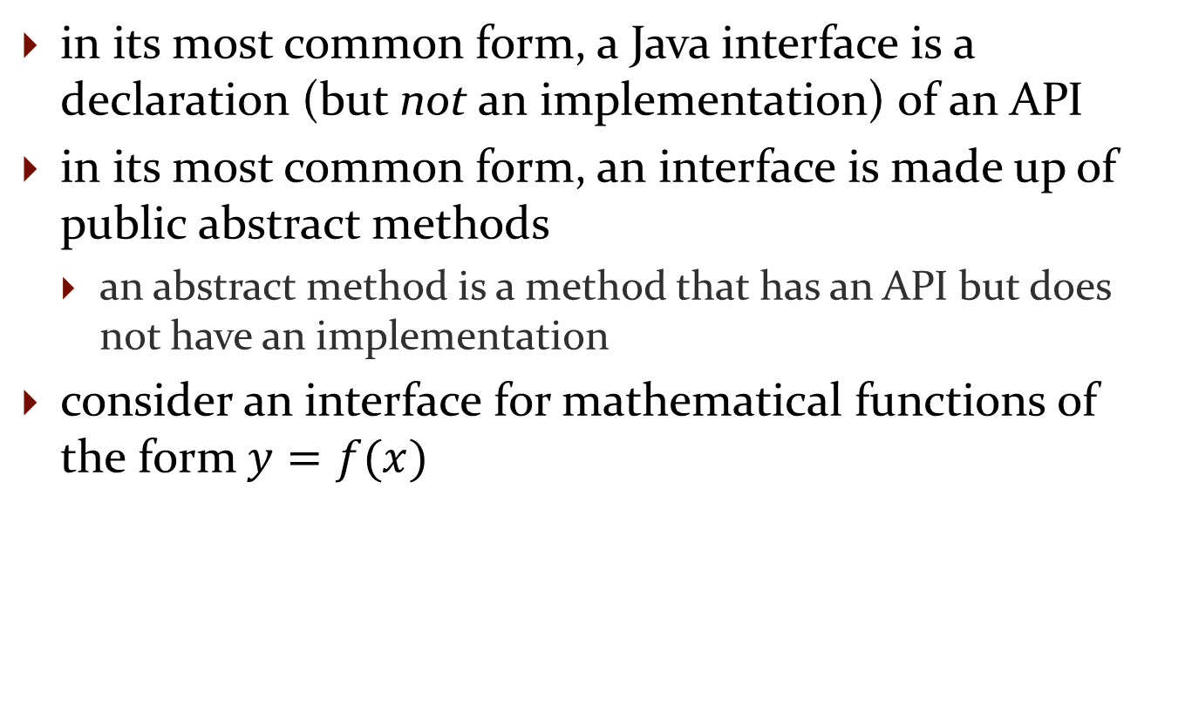
Interfaces
in its most common form, a Java interface is a declaration (but not an implementation) of an API
in its most common form, an interface is made up of public abstract methods
  an abstract method is a method that has an API but does not have an implementation
consider an interface for mathematical functions of the form $y=f(x)$

Slide 3
import java.util.List;
public interface Function {
/**
* Evaluate the function at x.
*
* @param x the value at which to evaluate the function
* @return the value of the function evaluated at x
*/
public double eval(double x);
/**
* Evaluate the function at each value of x in the given list.
*
* @param x a list of values at which to evaluate the function
* @return the list of values of the function evaluated at the given
* values of x
*/
public List<Double> eval(List<Double> x);
}
semicolon, and no method body
semicolon, and no method body

Slide 4
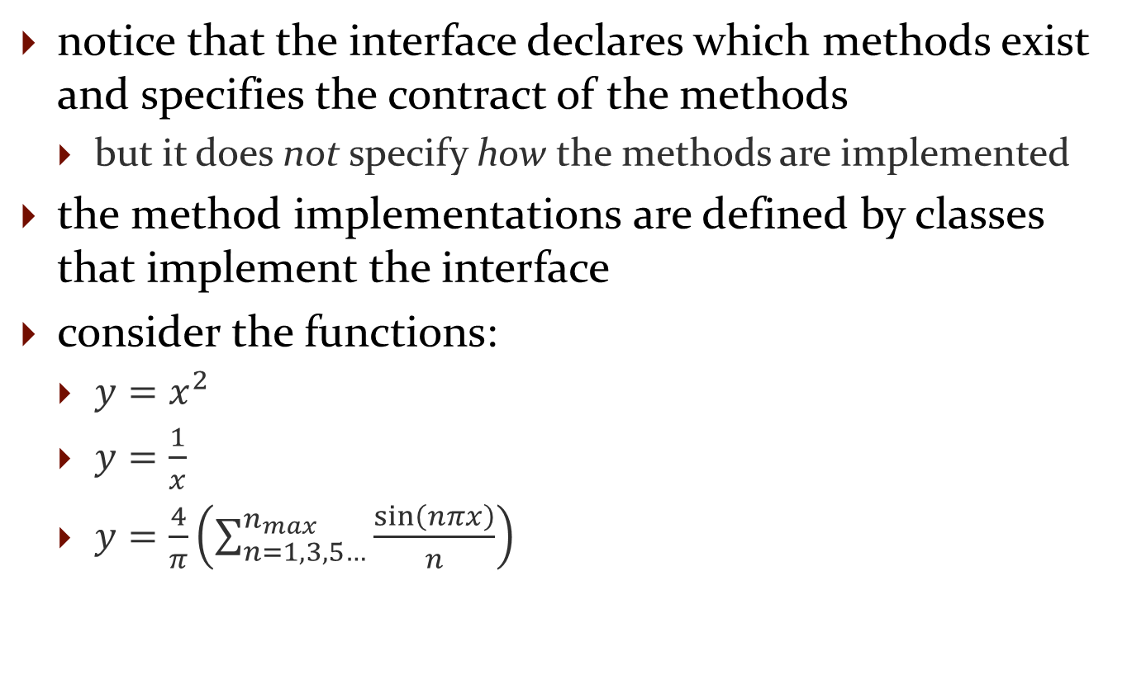
Interfaces
notice that the interface declares which methods exist and specifies the contract of the methods
  but it does not specify how the methods are implemented
the method implementations are defined by classes that implement the interface
consider the functions:
  $y=x^{2}$
  $y=\frac{1}{x}$
  $y=\frac{4}{π}\left(\sum_{n=1,3,5…}^{n_{max}}{\frac{\sin\left(nπx\right)}{n}}\right)$

Slide 5
Square implements the Function
interface
public class Square implements Function {
@Override
public double eval(double x) {
return x * x;
}
@Override
public List<Double> eval(List<Double> x) {
List<Double> result = new ArrayList<>();
for (Double val : x) {
result.add(this.eval(val));
}
return result;
}
// no constructors because Square has no fields
}
Square must provide an
implementation of eval(double)
Square must provide an
implementation of
eval(List<Double>)

Slide 6
Reciprocal implements the
Function interface
public class Reciprocal implements Function {
@Override
public double eval(double x) {
return 1.0 / x;
}
@Override
public List<Double> eval(List<Double> x) {
List<Double> result = new ArrayList<>();
for (Double val : x) {
result.add(this.eval(val));
}
return result;
}
// no constructors because Reciprocal has no fields
}
Reciprocal must provide an
implementation of eval(double)
Reciprocal must provide
an implementation of
eval(List<Double>)

Slide 7
SquareWave implements the
Function interface
public class SquareWave implements Function {
private int nmax;
public SquareWave(int nmax) {
if (nmax < 1) {
throw new IllegalArgumentException();
}
this.nmax = nmax;
}
@Override
public double eval(double x) {
double result = 0;
for (int n = 1; n < this.nmax; n += 2) {
result += Math.sin(n * Math.PI * x) / n;
}
return 4 / Math.PI * result;
}
SquareWave must provide an
implementation of eval(double)

Slide 8
@Override
public List<Double> eval(List<Double> x) {
List<Double> result = new ArrayList<>();
for (Double val : x) {
result.add(this.eval(val));
}
return result;
}
SquareWave must provide
an implementation of
eval(List<Double>)

Slide 9
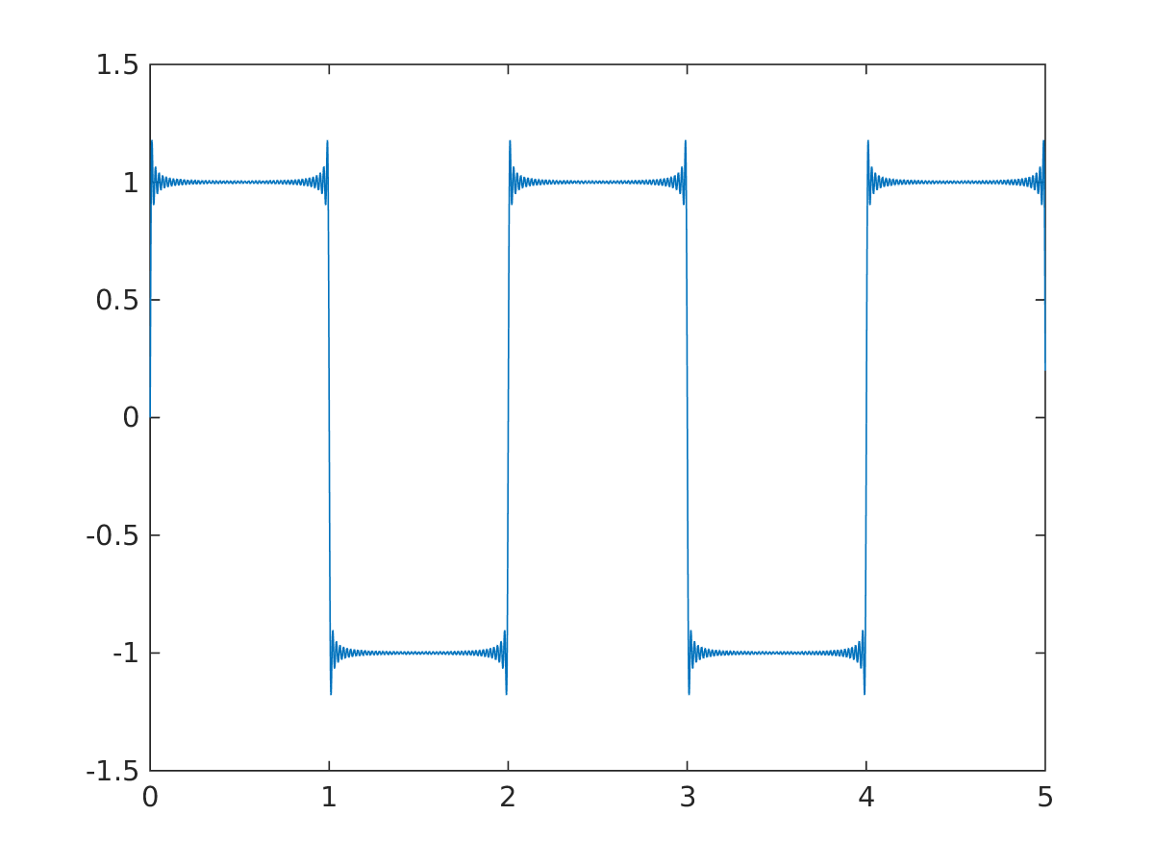
SquareWave
SquareWave implements the Fourier series for a square wave
  results for nmax = 101

Slide 10
Interfaces in the Java library
interfaces are widely used in the Java library
  Collection, List, Set, Map
  Iterable, Iterator
  CharSequence , Appendable
  Comparable
  …

Slide 11
Interfaces are types
an interface is a reference data type
  if you define a reference variable whose type is an interface, any object you assign to it must be an instance of a class that implements the interface (https://docs.oracle.com/javase/tutorial/java/IandI/interfaceAsType.html)
List<String> t = new ArrayList<String>();
interface
implements the interface

Slide 12
Interfaces are types
an interface is a reference data type
  if you define a reference variable whose type is an interface, any object you assign to it must be an instance of a class that implements the interface (https://docs.oracle.com/javase/tutorial/java/IandI/interfaceAsType.html)
Function f = new SquareWave(101);
interface
implements the interface

Slide 13
Inheritance
Notes Chapter 6

Slide 14

Inheritance
you know a lot about an object by knowing its class
  for example what is a Komondor?
http://en.wikipedia.org/wiki/File:Komondor_delvin.jpg

Slide 15
Object
Dog
Dog is-a Object
PureBreed is-a Dog
PureBreed is-a Object
PureBreed
Mix
BloodHound
Komondor
...
Komondor is-a PureBreed
Komondor is-a Dog
Komondor is-a Object

Slide 16
superclass of Dog
(and all other classes)
Object
superclass ==
base class
parent class
subclass ==
derived class
extended class
child class
subclass of Object
superclass of PureBreed
Dog
subclass of Dog
superclass of Komondor
PureBreed
Mix
BloodHound
Komondor
...

Slide 17
Object
Dog
Dog extends Object
PureBreed
Mix
PureBreed extends Dog
BloodHound
Komondor
...
Komondor extends
PureBreed

Slide 18
Some Definitions
we say that a subclass is derived from its superclass
with the exception of Object, every class in Java has one and only one superclass
  Java only supports single inheritance
a class X can be derived from a class that is derived from a class, and so on, all the way back to Object
  X is said to be descended from all of the classes in the inheritance chain going back to Object
  all of the classes X is derived from are called ancestors of X

Slide 19
Why Inheritance?
a subclass inherits all of the non-private members (fields and methods but not constructors) from its superclass
  if there is an existing class that provides some of the functionality you need you can derive a new class from the existing class
  the new class has direct access to the public and protected attributes and methods without having to re-declare or re-implement them
  the new class can introduce new fields and methods
  the new class can re-define (override) its superclass methods

Slide 20
Is-A
inheritance models the is-a relationship between classes
  is-a means is-substitutable-for

Slide 21
Is-A
from a Java point of view, is-a means you can use a derived class instance in place of an ancestor class instance
public SomeClass {
public someMethod(Dog dog) {
// does something with dog
}
}
// client code of someMethod
Komondor shaggy = new Komondor();
SomeClass.someMethod( shaggy ); // OK, Komondor is-a dog
Mix mutt = new Mix ();
SomeClass.someMethod( mutt ); // OK, Mix is-a dog

Slide 22

Is-A Pitfalls
is-a has nothing to do with the real world
is-a has everything to do with how the implementer has modelled the inheritance hierarchy
the classic example:
  Circle is-a Ellipse?
Ellipse
Circle

Slide 23
Circle is-a Ellipse?
mathematically a circle is a kind of ellipse
but if Ellipse can do something that Circle cannot, then Circle is-a Ellipse is false for the purposes of inheritance
  remember: is-a means you can substitute a derived class instance for one of its ancestor instances
    if Circle cannot do something that Ellipse can do then you cannot (safely) substitute a Circle instance for an Ellipse instance

Slide 24
// method in Ellipse
/*
* Change the width and height of the ellipse.
* @param width the desired width.
* @param height the desired height.
* @pre. width > 0 && height > 0
*/
public void setSize(double width, double height) {
this.width = width;
this.height = height;
}

Slide 25
there is no good way for Circle to support setSize (assuming that the fields width and height are always the same for a Circle) because clients expect setSize to set both the width and height
can't Circle override setSize so that it throws an exception if width != height?
  no; this will surprise clients because Ellipse.setSize does not throw an exception if width != height
can't Circle override setSize so that it sets
width == height?
  no; this will surprise clients because Ellipse.setSize says that the width and height can be different

Slide 26
what if there is no setSize method?
  if a Circle can do everything an Ellipse can do then Circle can extend Ellipse

Slide 27
A Naïve Inheritance Example
a stack is an important data structure in computer science
  data structure: an organization of information for better algorithm efficiency or conceptual unity
    e.g., list, set, map, array
widely used in computer science and computer engineering
  e.g., undo/redo can be implemented using two stacks

Slide 28


Stack
examples of stacks

Slide 29
Top of Stack
top of the stack

Slide 30
Stack Operations
classically, stacks only support two operations
  push
    add to the top of the stack
  pop
    remove from the top of the stack
there is no way to access elements of the stack except at the top of the stack

Slide 31
Push
st.push("A")
st.push("B")
st.push("C")
st.push("D")
st.push("E")
top
"E"
top
"D"
top
"C"
top
"B"
top
"A"

Slide 32
Pop
String s = st.pop()
s = st.pop()
s = st.pop()
s = st.pop()
s = st.pop()
top
"E"
top
"D"
top
"C"
top
"B"
top
"A"

Slide 33
Implementing stack using inheritance
a stack looks a lot like a list
  pushing an element onto the top of the stack looks like adding an element to the end of a list
  popping an element from the top of a stack looks like removing an element from the end of the list
if we have stack inherit from list, our stack class inherits the add and remove methods from list
  we don't have to implement them ourselves
let's try making a stack of integers by inheriting from ArrayList<Integer>

Slide 34
Implementing stack using inheritance
import java.util.ArrayList;
public class BadStack extends ArrayList<Integer> {
}
use the keyword extends
followed by the name of
the class that you want
to extend

Slide 35
Implementing stack using inheritance
import java.util.ArrayList;
public class BadStack extends ArrayList<Integer> {
public void push(int value) {
this.add(value);
}
public int pop() {
int last = this.remove(this.size() - 1);
return last;
}
}
push = add to end of this list
pop = remove from end of this list

Slide 36
Implementing stack using inheritance
that's it, we’re done!
public static void main(String[] args) {
BadStack t = new BadStack();
t.push(0);
t.push(1);
t.push(2);
System.out.println(t);
System.out.println("pop: " + t.pop());
System.out.println("pop: " + t.pop());
System.out.println("pop: " + t.pop());
}
[0, 1, 2]
pop: 2
pop: 1
pop: 0

Slide 37
Implementing stack using inheritance
why is this a poor implementation?
by having BadStack inherit from ArrayList<Integer> we are saying that a stack is a list
  anything a list can do, a stack can also do, such as:
    get a element from the middle of the stack (instead of only from the top of the stack)
    set an element in the middle of the stack
    iterate over the elements of the stack

Slide 38
Implementing stack using inheritance
public static void main(String[] args) {
BadStack t = new BadStack();
t.push(100);
t.push(200);
t.push(300);
System.out.println("get(1)?: " + t.get(1));
t.set(1, -1000);
System.out.println("set(1, -1000)?: " + t);
}
[100, 200, 300]
get(1)?: 200
set(1, -1000)?: [100, -1000, 300]

Slide 39
Implementing stack using inheritance
using inheritance to implement a stack is an example of an incorrect usage of inheritance
inheritance should only be used when an is-a relationship exists
  a stack is not a list, therefore, we should not use inheritance to implement a stack
even experts sometimes get this wrong
  early versions of the Java class library provided a stack class that inherited from a list-like class
    java.util.Stack

Slide 40
Other ways to implement stack
use composition
Stack has-a List
the end of the list is the top of the stack
  push adds an element to the end of the list
  pop removes the element at the end of the list

Slide 41
Inheritance (Part 2)
Notes Chapter 6

Slide 42
Object
Dog
Dog extends Object
PureBreed
Mix
PureBreed extends Dog
BloodHound
Komondor
...
Komondor extends
PureBreed

Slide 43
Implementing Inheritance
suppose you want to implement an inheritance hierarchy that represents breeds of dogs for the purpose of helping people decide what kind of dog would be appropriate for them
many possible fields:
  appearance, size, energy, grooming requirements, amount of exercise needed, protectiveness, compatibility with children, etc.
  we will assume two fields measured on a 10 point scale
    size from 1 (small) to 10 (giant)
    energy from 1 (lazy) to 10 (high energy)

Slide 44
Dog
public class Dog extends Object
{
private int size;
private int energy;
// creates an "average" dog
Dog()
{ this(5, 5); }
Dog(int size, int energy)
{ this.setSize(size); this.setEnergy(energy); }

Slide 45
public int getSize()
{ return this.size; }
public int getEnergy()
{ return this.energy; }
public final void setSize(int size)
{ this.size = size; }
public final void setEnergy(int energy)
{ this.energy = energy; }
}
why final? stay tuned…

Slide 46
What is a Subclass?
a subclass looks like a new class that has the same API as its superclass with perhaps some additional methods and fields
  the new class has direct access to the public and protected* fields and methods without having to re-declare or re-implement them
  the new class can introduce new fields and methods
  the new class can re-define (override) its superclass methods
* the notes does not discuss protected access

Slide 47
Mix UML Diagram
a mixed breed dog is a dog whose ancestry is unknown or includes more than one pure breed
Dog
1
Mix
ArrayList<String>
breeds

Slide 48
Dog
- size : int
- energy : int
+ setSize()
+ setEnergy()
+ equals(Object) : boolean
+ hashCode() : int
+ toString() : String
...
Mix
- breeds : ArrayList<String>
+ getBreeds() : List<String>
+ equals(Object) : boolean
+ hashCode() : int
+ toString() : String
...
subclass can add new fields
subclass can add new methods
subclass can change the implementation of inherited methods

Slide 49
What is a Subclass?
a subclass looks like a new class that has the same API as its superclass with perhaps some additional methods and fields
inheritance does more than copy the API of the superclass
  the derived class contains a subobject of the parent class
  the superclass subobject needs to be constructed (just like a regular object)
    the mechanism to perform the construction of the superclass subobject is to call the superclass constructor

Slide 50
What is a Subclass?
another model of inheritance is to imagine that the subclass contains all of the fields of the parent class (including the private fields), but cannot directly use the private fields

Slide 51
Mix Memory Diagram
500 | Mix object
size | 1
energy | 10
breeds | 1000a
size and energy belong to
the superclass
private in superclass
not accessible by name to Mix

Slide 52
Constructors of Subclasses
the purpose of a constructor is to set the values of the fields of this object
how can a constructor set the value of a field that belongs to the superclass and is private?
  by calling the superclass constructor and passing this as an implicit argument

Slide 53
Constructors of Subclasses
the first line in the body of every constructor must be a call to another constructor
  if it is not then Java will insert a call to the superclass default constructor
    if the superclass default constructor does not exist or is private then a compilation error occurs
a call to another constructor can only occur on the first line in the body of a constructor
the superclass constructor must be called during construction of the derived class

Slide 54
Mix (version 1)
public final class Mix extends Dog {
// no declaration of size or energy; part of Dog
private ArrayList<String> breeds;
public Mix () {
// call to a Dog constructor
super();
this.breeds = new ArrayList<String>();
}
public Mix(int size, int energy) {
// call to a Dog constructor
super(size, energy);
this.breeds = new ArrayList<String>();
}

Slide 55
public Mix(int size, int energy,
ArrayList<String> breeds) {
// call to a Dog constructor
super(size, energy);
this.breeds = new ArrayList<String>(breeds);
}

Slide 56
Mix (version 2 using chaining)
public final class Mix extends Dog {
// no declaration of size or energy; part of Dog
private ArrayList<String> breeds;
public Mix () {
// call to a Mix constructor
this(5, 5);
}
public Mix(int size, int energy) {
// call to a Mix constructor
this(size, energy, new ArrayList<String>());
}

Slide 57
public Mix(int size, int energy,
ArrayList<String> breeds) {
// call to a Dog constructor
super(size, energy);
this.breeds = new ArrayList<String>(breeds);
}

Slide 58
why is the constructor call to the superclass needed?
  because Mix is-a Dog and the Dog part of Mix needs to be constructed

Slide 59
Mix mutt = new Mix(1, 10);
Mix object
Dog object
Mix constructor starts running
creates new Dog subobject by invoking
the Dog constructor
    Dog constructor starts running
    creates new Object subobject
    by (silently) invoking the
    Object constructor
        Object constructor runs
        and finishes
    sets size and energy
    and finishes
creates a new empty ArrayList and
assigns it to breeds
and finishes
Object object
size | 1
energy | 10
breeds | 1000

Slide 60
Mix Memory Diagram
500 | Mix object
size | 1
energy | 10
breeds | 1000a
1000 | ArrayList<String> object
 | ...

Slide 61
Invoking the Superclass Ctor
why is the constructor call to the superclass needed?
  because Mix is-a Dog and the Dog part of Mix needs to be constructed
    similarly, the Object part of Dog needs to be constructed

Slide 62
Invoking the Superclass Ctor
a derived class can only call its own constructors or the constructors of its immediate superclass
  Mix can call Mix constructors or Dog constructors
  Mix cannot call the Object constructor
    Object is not the immediate superclass of Mix
  Mix cannot call PureBreed constructors
    cannot call constructors across the inheritance hierarchy
  PureBreed cannot call Komondor constructors
    cannot call subclass constructors

Slide 63
Constructors & Overridable Methods
if a class is intended to be extended then its constructor must not call an overridable method
  Java does not enforce this guideline
why?
  recall that a derived class object has inside of it an object of the superclass
  the superclass object is always constructed first, then the subclass constructor completes construction of the subclass object
  the superclass constructor will call the overridden version of the method (the subclass version) even though the subclass object has not yet been constructed

Slide 64
Superclass Ctor & Overridable Method
public class SuperDuper {
public SuperDuper() {
// call to an over-ridable method; bad
this.overrideMe();
}
public void overrideMe() {
System.out.println("SuperDuper overrideMe");
}
}

Slide 65
Subclass Overrides Method
public class SubbyDubby extends SuperDuper {
private final Date date;
public SubbyDubby() {
super();
this.date = new Date();
}
@Override
public void overrideMe() {
System.out.println("SubbyDubby overrideMe : " + this.date);
}
public static void main(String[] args) {
SubbyDubby sub = new SubbyDubby();
sub.overrideMe();
}
}

Slide 66
the programmer's intent was probably to have the program print:
    SuperDuper overrideMe
    SubbyDubby overrideMe : <the date>
  or, if the call to the overridden method was intentional
    SubbyDubby overrideMe : <the date>
    SubbyDubby overrideMe : <the date>
but the program prints:
    SubbyDubby overrideMe : null
    SubbyDubby overrideMe : <the date>
final attribute in
two different states!

Slide 67
What's Going On?
new SubbyDubby() calls the SubbyDubby constructor
the SubbyDubby constructor calls the SuperDuper constructor
the SuperDuper constructor calls the method overrideMe which is overridden by SubbyDubby
the SubbyDubby version of overrideMe prints the SubbyDubby date field which has not yet been assigned to by the SubbyDubby constructor (so date is null)
the SubbyDubby constructor assigns date
SubbyDubby overrideMe is called by the client

Slide 68
remember to make sure that your base class constructors only call final methods or private methods
  if a base class constructor calls an overridden method, the method will run in an unconstructed derived class

Slide 69
Preconditions and Inheritance
precondition
  what the method assumes to be true about the arguments passed to it
inheritance (is-a)
  a subclass is supposed to be able to do everything its superclasses can do
how do they interact?

Slide 70
Preconditions and Inheritance
a subclass can change a precondition on a method but whatever argument values the superclass method accepts must also be accepted by the subclass method

Slide 71
Strength of a Precondition
to strengthen a precondition means to make the precondition more restrictive
// Dog setEnergy
// 1. no precondition
// 2. 1 <= energy
// 3. 1 <= energy <= 10
// 4. energy == 5
public void setEnergy(int energy)
{ ... }
weakest precondition
strongest precondition

Slide 72
Preconditions on Overridden Methods
a subclass can change a precondition on a method but it must not strengthen the precondition
  a subclass that strengthens a precondition is saying that it cannot do everything its superclass can do
// Dog setEnergy
// assume non-final
// @pre. none
public
void setEnergy(int nrg)
{ // ... }
// Mix setEnergy
// bad : strengthen precond.
// @pre. 1 <= nrg <= 10
public
void setEnergy(int nrg)
{
if (nrg < 1 || nrg > 10)
{ // throws exception }
// ...
}

Slide 73
client code written for Dogs now fails when given a Mix
remember: a subclass must be able to do everything its ancestor classes can do; otherwise, clients will be (unpleasantly) surprised
// client code that sets a Dog's energy to zero
public void walk(Dog d)
{
d.setEnergy(0);
}

Slide 74
Postconditions and Inheritance
postcondition
  what the method promises to be true when it returns
    the method might promise something about its return value
      "returns size where size is between 1 and 10 inclusive"
    the method might promise something about the state of the object used to call the method
      "sets the size of the dog to the specified size"
    the method might promise something about one of its parameters
how do postconditions and inheritance interact?

Slide 75
Postconditions and Inheritance
a subclass can change a postcondition on a method but whatever the superclass method promises will be true when it returns must also be true when the subclass method returns

Slide 76
Strength of a Postcondition
to strengthen a postcondition means to make the postcondition more restrictive
// Dog getSize
// 1. no postcondition
// 2. return value >= 1
// 3. return value
// between 1 and 10
// 4. return 5
public int getSize()
{ ... }
weakest postcondition
strongest postcondition

Slide 77
Postconditions on Overridden Methods
a subclass can change a postcondition on a method but it must not weaken the postcondition
  a subclass that weakens a postcondition is saying that it cannot do everything its superclass can do
// Dog getSize
//
// @post. 1 <= size <= 10
public
int getSize()
{ // ... }
// Dogzilla getSize
// bad : weaken postcond.
// @post. 1 <= size
public
int getSize()
{ // ... }
Dogzilla: a made-up breed of dog
that has no upper limit on its size

Slide 78
client code written for Dogs can now fail when given a Dogzilla
remember: a subclass must be able to do everything its ancestor classes can do; otherwise, clients will be (unpleasantly) surprised
// client code that assumes Dog size <= 10
public String sizeToString(Dog d)
{
int sz = d.getSize();
String result = "";
if (sz < 4) result = "small";
else if (sz < 7) result = "medium";
else if (sz <= 10) result = "large";
return result;
}

Slide 79
Exceptions
all exceptions are objects that are subclasses of java.lang.Throwable
Throwable
Exception
RuntimeException
...
...
and many, many more
IllegalArgumentException
...
...
and many more
AJ chapter 9

Slide 80
User Defined Exceptions
you can define your own exception hierarchy
  often, you will subclass Exception
Exception
public
class DogException extends Exception
DogException
BadSizeException
NoFoodException
BadDogException

Slide 81
Exceptions and Inheritance
a method that claims to throw a checked exception of type X is allowed to throw any checked exception type that is a subclass of X
  this makes sense because exceptions are objects and subclass objects are substitutable for ancestor classes
  // in Dog
  public void someDogMethod() throws DogException
  {
  // can throw a DogException, BadSizeException,
  // NoFoodException, or BadDogException
  }

Slide 82
a method that overrides a superclass method that claims to throw a checked exception of type X can also claim to throw a checked exception of type X or a subclass of X
  remember: a subclass is substitutable for the parent type
  // in Mix
  @Override
  public void someDogMethod() throws DogException
  {
  // ...
  }

