Slide 1
Strategy Design Pattern
EECS 6431- Software Re-engineering
Nasim Razavi

Slide 2
Table of Content
Strategy pattern
Motivation
Intent
Applicability
Structure
Participants
Implementation
Sequence diagram
Consequences
References

Slide 3
Strategy pattern
Strategy pattern (known as policy) is a behavioral software design pattern that enables a behavior (an algorithm) to be selected at runtime.
A Strategy defines a set of algorithms that can be used interchangeably.

Slide 4
Motivation
A superclass or an interface may offer features that are not applicable for all subclass. In this case, for instance, we have to overwrite those features for some subclasses.
Having optional features in the supper classes that are only relevant to some subclasses causes many duplicate codes and long lists of conditionals.
A class have different behaviors. Multiple algorithms can be implemented for a specific task.

Slide 5
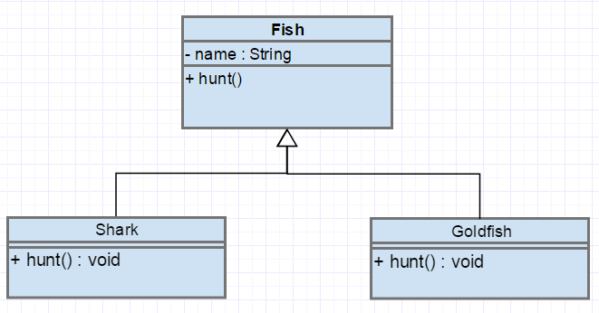
Motivation
Example

Slide 6
Intent
The behavior of a class to be independent from the clients that use it.
By encapsulating each algorithm and make them interchangeable.
Put the abstraction in an interface, push implementation details down to derived classes.
The behavior can change in subclasses without side effects.

Slide 7
Applicability
Use the Strategy pattern when
Many related classes differ only in their behavior.
To avoid complex code.
We have multiple algorithms for a specific task and we want the client decides what strategy to be used at runtime.

Slide 8
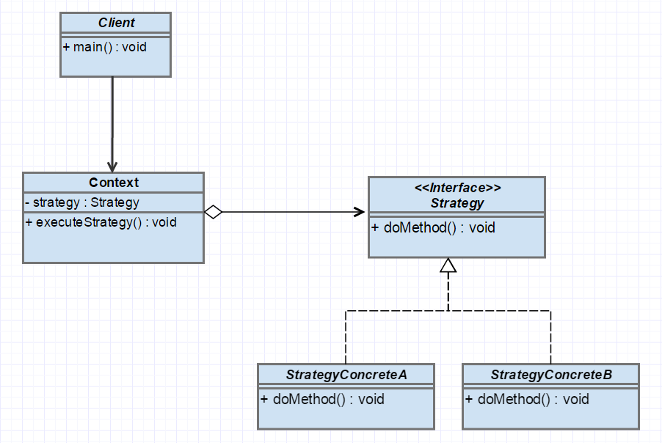
Structure

Slide 9
Participants
Strategy
Declares an interface common to all supported algorithms.
Different behaviors can be selected by swapping between ConcreteStrategys without any side effect in Context.
ConcreteStrategy
Defines an algorithm by implementing the Strategy interface.
Context
Is composed of a strategy. It is a class that requires changing behaviors.
Client
Defines what behavior the context uses.

Slide 10
Implementation
Define the Strategy and Context. Make Strategy objects of related algorithms.
The strategies can be defined as a hierarchy of classes offering the ability to extend and customize the existing algorithms.
The context object can have a default algorithm. In runtime, if it does not contain a strategy object, it will execute the default algorithm.

Slide 11
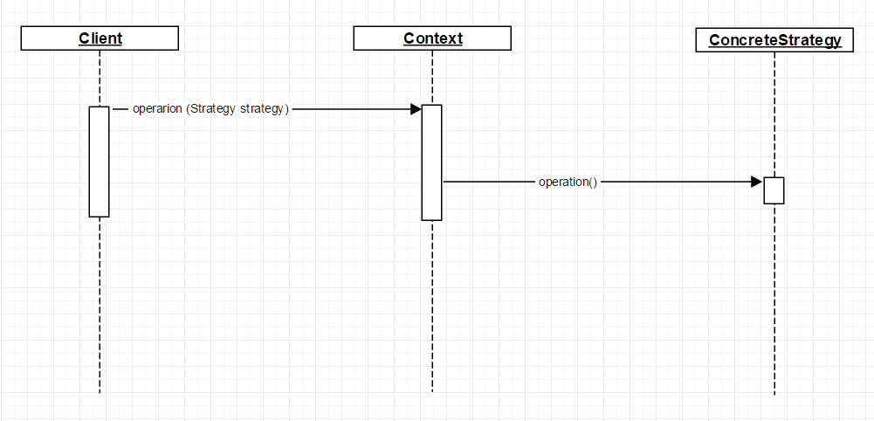
Sequence Diagram

Slide 12
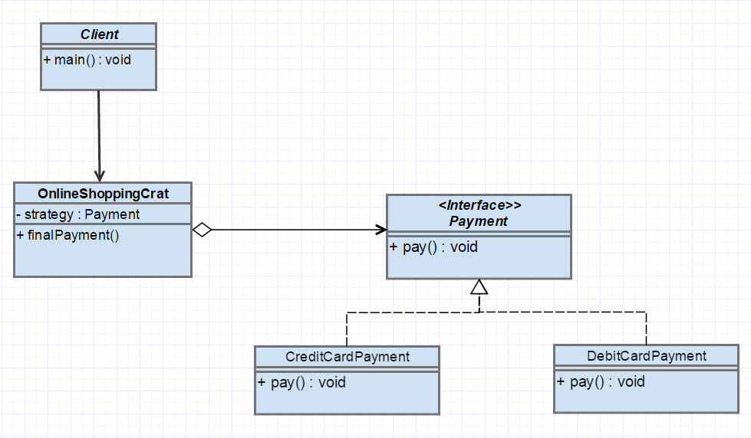
Example

Slide 13
Consequences
Benefits
Encapsulates families of related algorithms into Strategy classes.
Keeps class changes from forcing other class changes.
Implements algorithms independent from the Context class.
Simplifies switching, understanding, and extending the algorithms.
Avoids duplicate codes.
Eliminates conditional statements.
Is flexible. The client can choose among different strategies.

Slide 14
Consequences
Drawbacks
Communication overhead between Strategy and Context.
The increased number of objects.
The client has to be aware of strategies and their difference.

Slide 15
Refrences
Vlissides, John, et al. "Design patterns: Elements of reusable object-oriented software." Reading: Addison-Wesley 49.120 (1995): 11.

